Slide 1


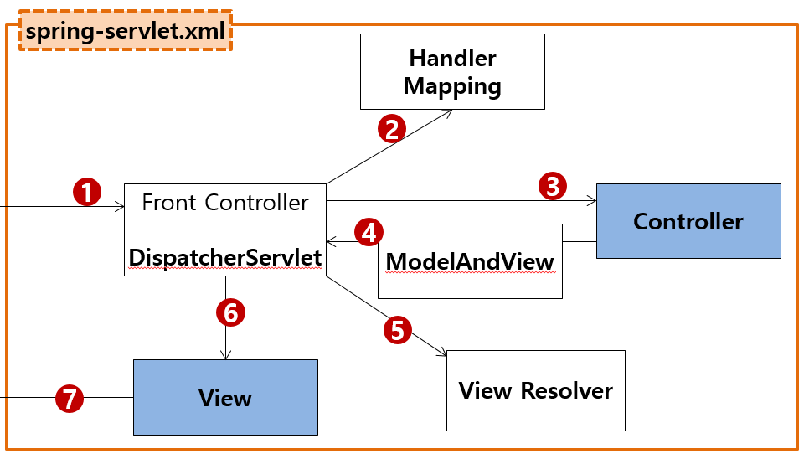
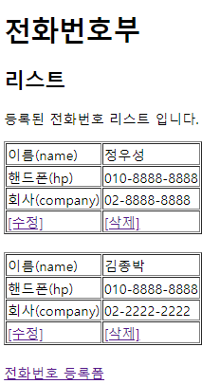
HM
/list →PhoneController.list() GET, POST
/writeForm →PhoneController.writeForm() GET, POST
/write →PhoneController.write() GET, POST
rquest
파라미터
name=정우성
hp=010-111-111
company=02-222-2222
어튜리뷰트
클라이언트
정우성(미국)
서버
(천호동)
http://localhost:8000/phonebook4/write?
name=정우성&hp=010-111-111&company=02-222-2222
Rqeust(요청)
tomcat-9.0
MainController
/main
MainController
/main
Request header
파라미터:
name=정우성&hp=010-111-111&company=02-222-2222
Request body
8000
phonebook4
MainContoller(servlet)객체
@Controller
PhoneController
/writeForm
pblic String write(){
}
GuestbookController
/gbc/addList
/gbc/deleteForm
/gbc/delete
GuestbookController
/gbc?action=addList
/gbc?action=deleteForm
/gbc?action=delete
/main
Response(응답)
*포워드
response
UserController
/user/joinForm
/user/join
/user/joinOk
/user/loginForm
/user/login
/user/updateForm
/user/update
UserController
/user?action=joinForm
/user?action=join
/user?action=joinOk
/user?action=loginForm
/user?action=login
/user?action=updateForm
/user?action=update
Response header
Response body (html)
writeForm.jsp
객체
BoardController
/board/list
/board/writeForm
/board/write
/board/delete
/board/read
/board/updateForm
/board/update
BoardController
/board?action=list
/board?action=writeForm
/board?action=write
/board?action=delete
/board?action=read
/board?action=updateForm
/board?action=update
maven (다운로드관리)
pom.xml
<!-- spring container(core) -->
<!-- Spring Web -->
<!-- Spring MVC -->
<!-- Oracle JDBC -->
<!-- jstl -->
web.xml
sping-servlet.xml세팅
DS 등록
한글처리
spring-servlet.xml
controller등록관련 설정(HM)
com.javaex.contorller
Model And View
model "personList" 0x999
return "/WEB-INF/list.jsp"

Slide 2
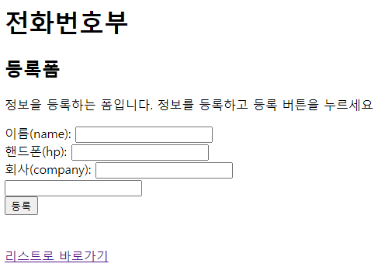
HM
/list →PhoneController.list() GET, POST
/writeForm →PhoneController.writeForm() GET, POST
클라이언트
정우성(미국)
서버
(천호동)
http://localhost:8000/phonebook4/writeForm
Rqeust(요청)
tomcat-9.0
Request header
파라미터: action=???
Request body
8000
phonebook4
MainContoller(servlet)객체
@Controller
PhoneController
/writeForm
pblic String writeForm(){
}
/main
Response(응답)
*포워드
Response header
Response body (html)
rquest
writeForm.jsp
객체
response
Model And View
return "/WEB-INF/write.jsp"
maven (다운로드관리)
pom.xml
<!-- spring container(core) -->
<!-- Spring Web -->
<!-- Spring MVC -->
<!-- Oracle JDBC -->
<!-- jstl -->
web.xml
sping-servlet.xml세팅
DS 등록
한글처리
spring-servlet.xml
controller등록관련 설정(HM)
com.javaex.contorller

Slide 3
HM
/list →PhoneController.list() GET, POST
특정인터넷주소(요청) 일때 작동할메소드 리스트
클라이언트
정우성(미국)
서버
(천호동)
http://localhost:8000/phonebook4/list
Rqeust(요청)
tomcat-9.0
MainController
/main
MainController
/main
Request header
파라미터: action=???
Request body
8000
phonebook4
MainContoller(servlet)객체
@Controller
PhoneController
public void list(Model model) {
}
등록폼
등록
삭제
수정폼
수정
GuestbookController
/gbc/addList
/gbc/deleteForm
/gbc/delete
GuestbookController
/gbc?action=addList
/gbc?action=deleteForm
/gbc?action=delete
/main
Response(응답)
*포워드
UserController
/user/joinForm
/user/join
/user/joinOk
/user/loginForm
/user/login
/user/updateForm
/user/update
UserController
/user?action=joinForm
/user?action=join
/user?action=joinOk
/user?action=loginForm
/user?action=login
/user?action=updateForm
/user?action=update
Response header
Response body (html)
rquest
listjsp
객체
response
Model And View
model "personList" 0x999
return "/WEB-INF/list.jsp"
BoardController
/board/list
/board/writeForm
/board/write
/board/delete
/board/read
/board/updateForm
/board/update
BoardController
/board?action=list
/board?action=writeForm
/board?action=write
/board?action=delete
/board?action=read
/board?action=updateForm
/board?action=update
spring-servlet.xml
controller등록관련 설정(HM)
com.javaex.contorller
maven (다운로드관리)
pom.xml
<!-- spring container(core) -->
<!-- Spring Web -->
<!-- Spring MVC -->
web.xml
sping-servlet.xml세팅
DS 등록
한글처리

Slide 4
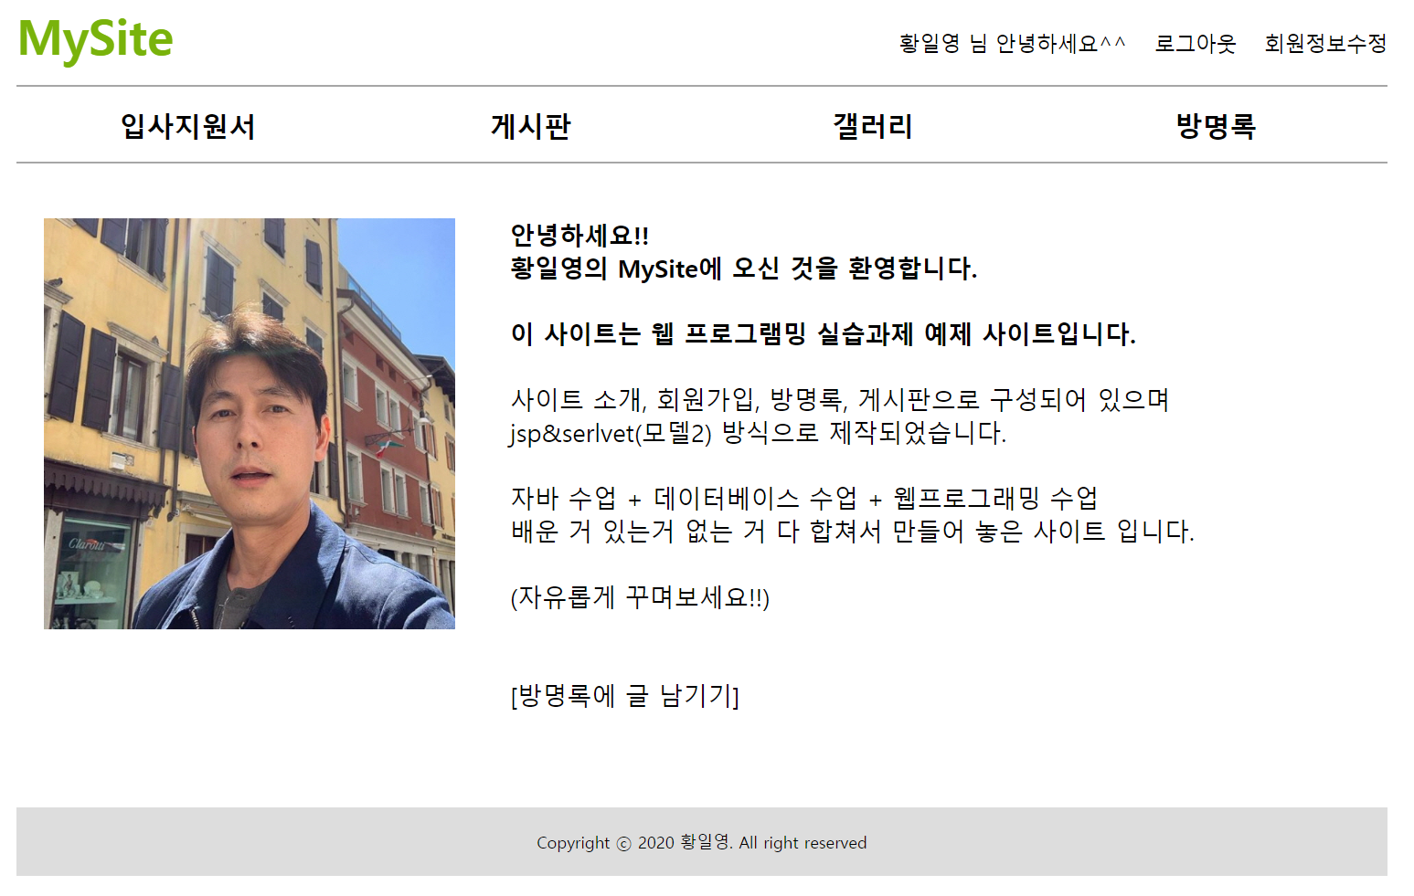
클라이언트
정우성(미국)
서버
(천호동)
web.xml
http://localhost:8000/mysite/main
Rqeust(요청)
tomcat-9.0
Request header
파라미터: action=???
Request body
8000
phonebook4
MainContoller(servlet)객체
/main
Response(응답)
*포워드
Response header
Response body (html)
rquest
index.jsp
객체
response

