Slide 1
Big Data:
NoSQL Data Models
A comprehensive comparison
Laura Beaudoin
Reetesh Dooleea
Ming Xiao Yuan
Mohsen Rahmati

Slide 2
What is Big Data?
Volume
Variety
Velocity
Value
Big Data is everywhere.
BIG DATA

Slide 3
SQL vs NoSQL: Handling Big Data
SQL
NoSQL
Big Data
Vertical Scaling:
Single server
Hard accessing
Horizontal Scaling:
Multiple servers
Easier accessing
Voluminous
Not good with accessing to big volumes
Good with accessing to big volumes

Slide 4
SQL vs NoSQL: Handling Big Data
SQL
NoSQL
Big Data
Data modelling:
Done in advance
Takes a lot of time
Data modelling:
Flexible
Changing continuously
Not good with changing
Good with changing

Slide 5
Table of Contents
01
02
03
NoSQL Data Models
Benchmarking
Results
Methodology
Interpretation
3 examples

Slide 6
Table of Contents
01
02
03
NoSQL Data Models
Benchmarking
Results
Methodology
Interpretation
3 examples

Slide 7



NoSQL Data Models
DOCUMENT
GRAPH
KEY-VALUE
[1]
[2]
[3]
Documents with various structure
Graph with nodes and edges
Unique keys with values
Flexible, adaptable, scalable, easy requests
Flexible, performant, simple queries, visualization of data
Flexible, simple implementation

Slide 8
Table of contents
01
02
03
NoSQL Data Models
Benchmarking
Results
Methodology
Interpretation
3 examples

Slide 9
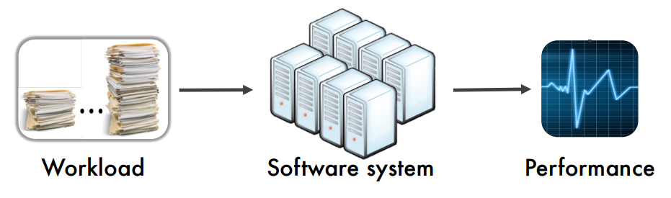
Benchmarking: YCSB
Measuring Software
performance
CRUD
operations
Data loading &
Workload execution
[4]

Slide 10

Environment Configurations
Amazon EC2 instance
Type : t2.large
vCPU : 2
Ubuntu 22.04.1
Linux packages & librairies
[5]

Slide 11
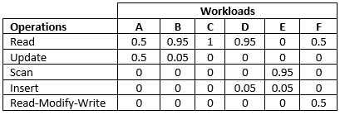
YCSB Workloads and Databases Specifications
Workload A (Read, Update)
Workload B (Read, Update)
YCSB Workloads overview
Targeted databases

Slide 12
Methodology
Load & execute Workload
Bash Script
02
04
01
03
docker & docker-compose
Save, clean and repeat
Record count:
1 000
6 nodes
3x

Slide 13
Table of Contents
01
02
03
NoSQL Data Models
Benchmarking
Results
Methodology
Interpretation
3 examples

Slide 14
Results
WORKLOAD A
Throughput
(ops/s)
Latency
(us)
(50% read, 50% update)
1599
10 335
Read
Update
155
1395
249
301
MongoDB
Redis
MongoDB
Redis

Slide 15
Results
WORKLOAD B
Throughput
(ops/s)
Latency
(us)
(95% read, 5% update)
1781
12 448
Read
Update
413
1105
218
367
MongoDB
Redis
MongoDB
Redis

Slide 16
Summary
MongoDB
NoSQL
Data
Models
Redis
OrientDB
Better at Reading than Writing
4x to 10x more performant in Read and Update than MongoDB
To be benchmarked

Slide 17
References
[1] https://commons.wikimedia.org/wiki/File:MongoDB_Logo.svg
[2] https://commons.wikimedia.org/wiki/File:OrientDB_Logo_2014_280x177.jpg
[3] https://commons.wikimedia.org/wiki/File:Logo-redis.svg
[4] LOG8371E (Software Quality Engineering), Week 11: Autoscaling
[5] https://medium.com/javarevisited/7-best-aws-ec2-amazon-elastic-compute-
cloud-online-courses-for-beginners-in-2021-f7a1a55ea719

