Slide 1
HELLO!
I am Tan Zhong Ming
You can find me at sf_tanzhongming@qiup.edu.my

Slide 2
It’s supposed to be automatic, but actually you have to push this button.
–John Brunner

Slide 3
1.
Problem
Let’s start with the first set of slides

Slide 4

Problem
Remove stuttered speech manually
Time consuming
High learning curve
Expansive hire editor
Improve the accuracy of speech recognition
Audio Pre-process
Deep Speech

Slide 5
Scope
Perform pre-processing techniques to audio data set for better sound quality
Build and train an Artificial Neural Network (ANN) for the stuttered speech classification model.
Build and train an End-to-end deep learning model - Deep Speech
Develop an application and algorithm for Android to automatically remove the stuttered speech.
Implement audio pre-processing technique to improve the accuracy of speech recognition.
Develop an improved version of auto subtitle generator.

Slide 6
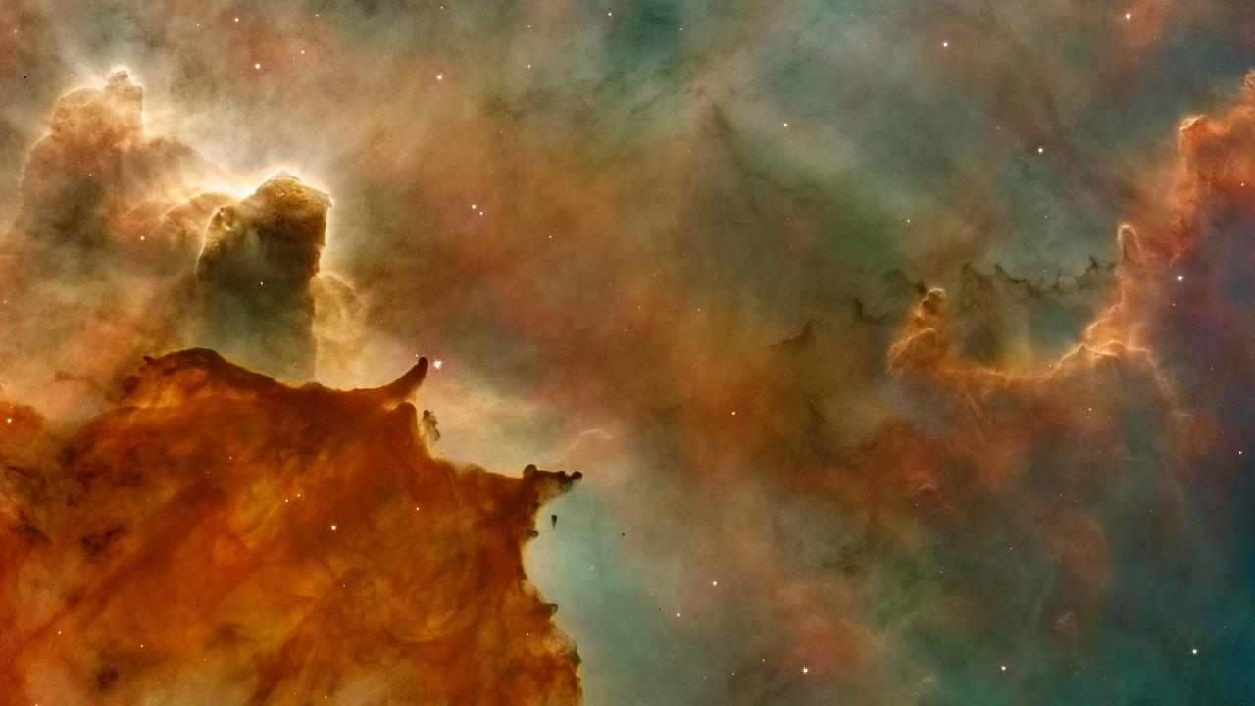
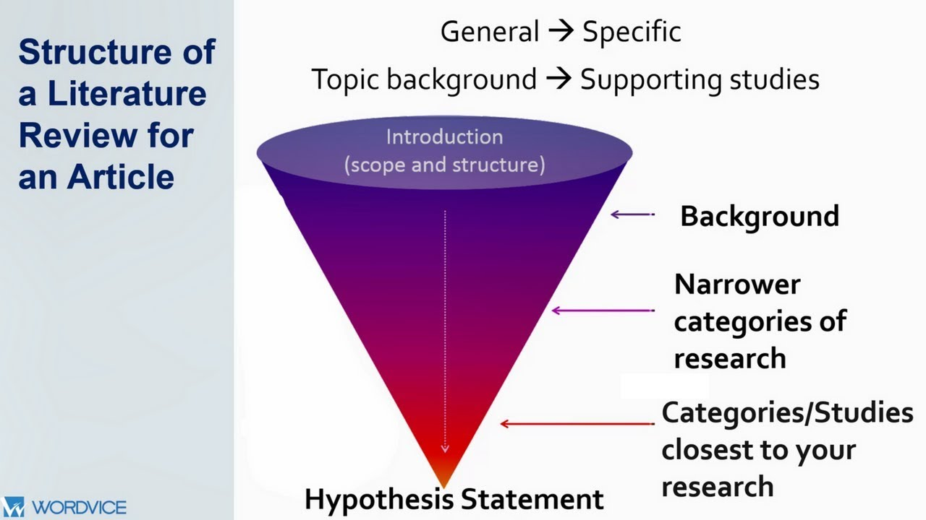
Data
NLP? Signal? Value?

Slide 7
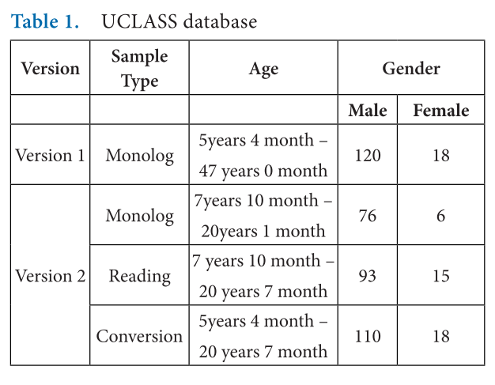
UCLASS
UCLASS
Indian Regional Language
Polish Language
German Language
Swapnil D. Waghmare1*, Ratnadeep R. Deshmukh1, Pukhraj P. Shrishrimal1, Vishal B. Waghmare2 Ganesh B. Janvale3
and Babasaheb Sonawane4 1

Slide 8
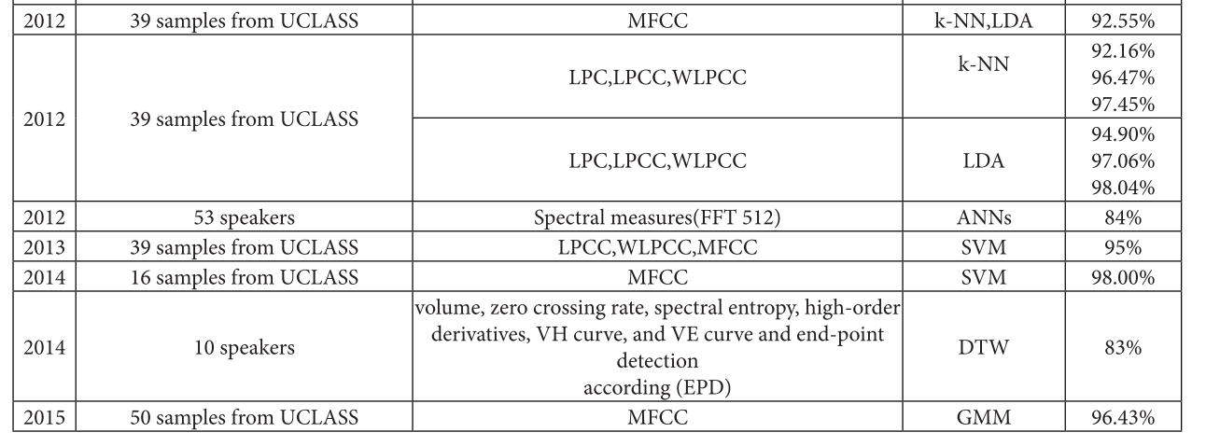
History
WHY MFCC

Slide 9
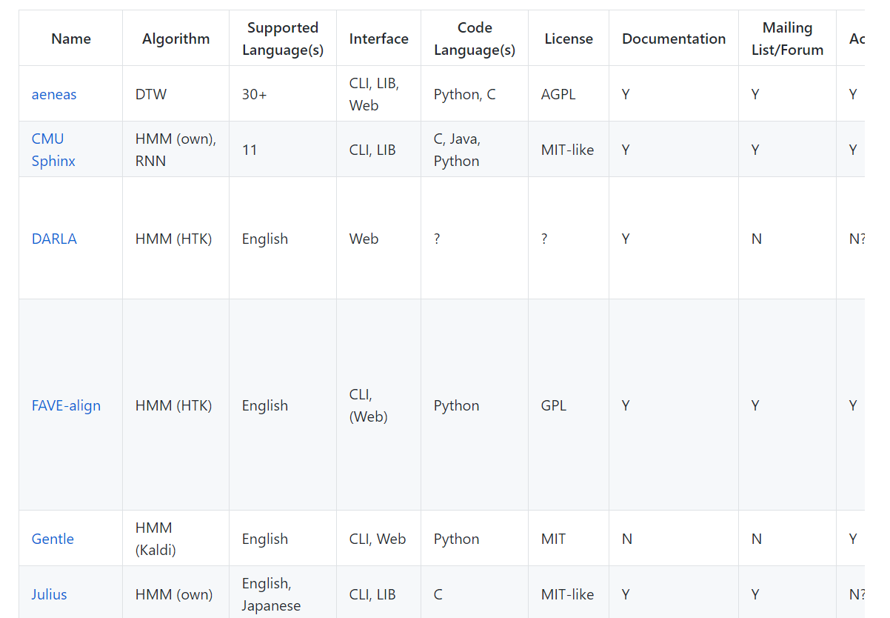
Forced Alignment Tools
Aeneas
Montreal Forces Aligner
Gentle
https://github.com/pettarin/forced-alignment-tools

Slide 10
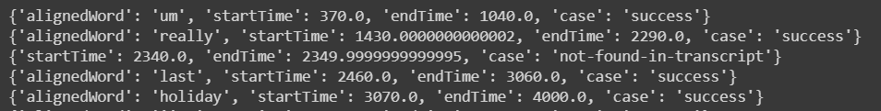
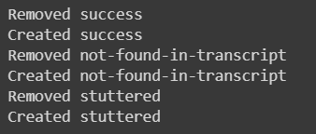
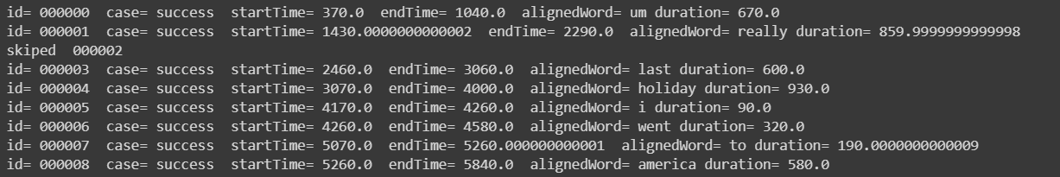
Gentle
Docker
REST API
No need standardize
Send audio with script
Append to list

Slide 11
Feature Extraction
MFCC

Slide 12
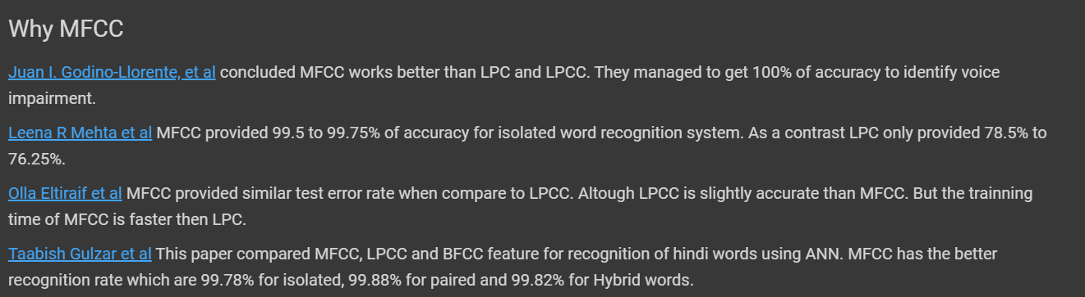
Why again
Multiple language in 1 model
Replace existing ASR
Current ASR overcomplicated
Solve multiple issues in current ASR

Slide 13
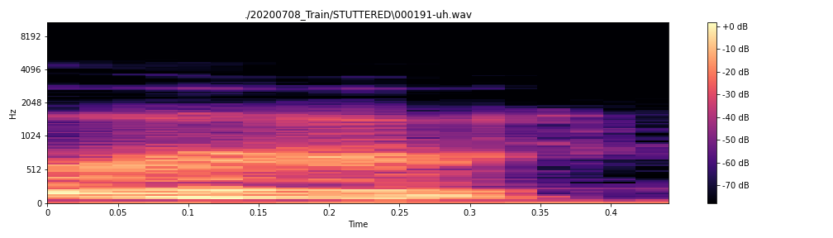
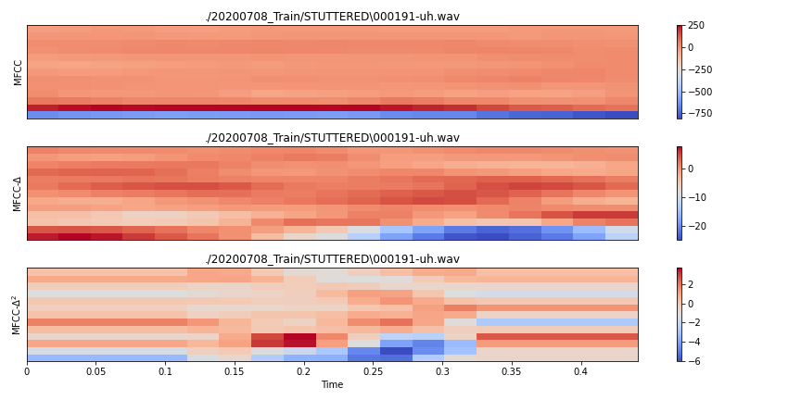
How?
Convert amplitude to db (logarithmic unit used to measure sound level)
Use librosa to calculate mfcc
Delta, Delta^2
13Mfcc * 3 = 39
+ 1 RMSE
Feature vector = 80

Slide 14
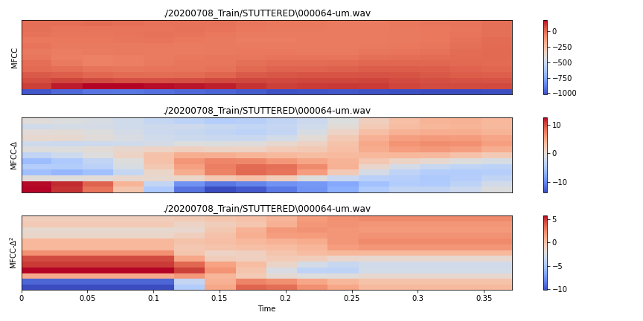

Slide 15
Remove module
Amplitude

Slide 16
Algorithm
Extract the audio into desired format
Read the audio and store into array
Calculate the average maximum amplitude
Normalize the amplitude in array by dividing maximum amplitude
Only include the frame higher than silent threshold
Calculate the timecode by using frames as an input
Produce a temporary file include the input file, inpoint, outpoint - chunks.txt
Use ffmpeg select and concat the chunk of video together

Slide 17
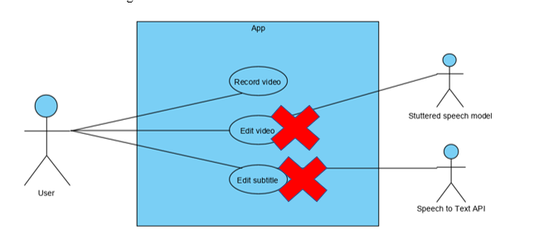
Use Case
Subtitle?

Slide 18
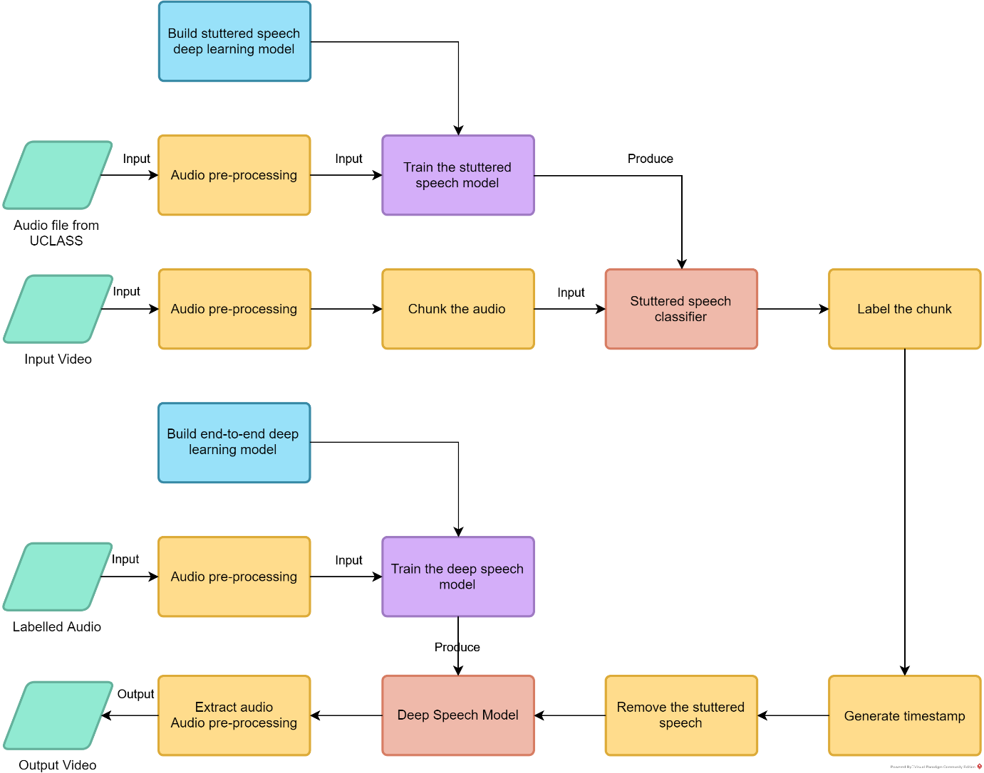
IBM

Slide 19
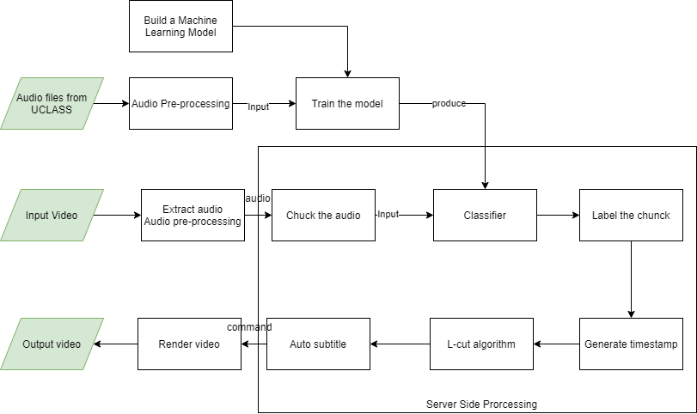
IBM

Slide 20
Feature Extraction
MFCC

Slide 22
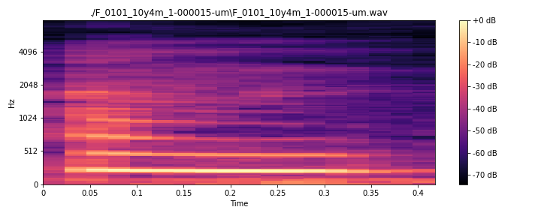

Slide 23
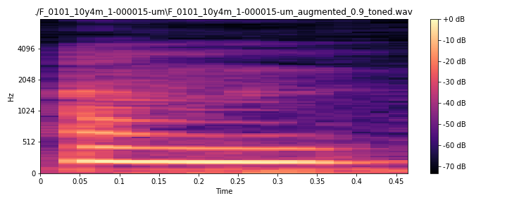

Slide 24
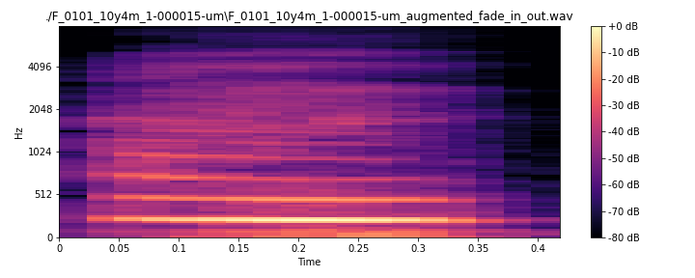

Slide 25
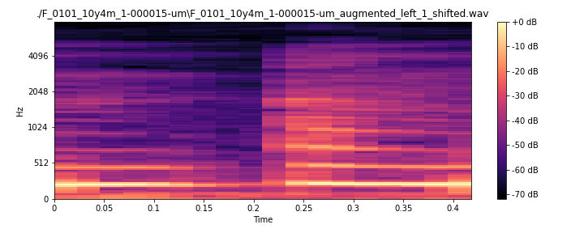

Slide 26
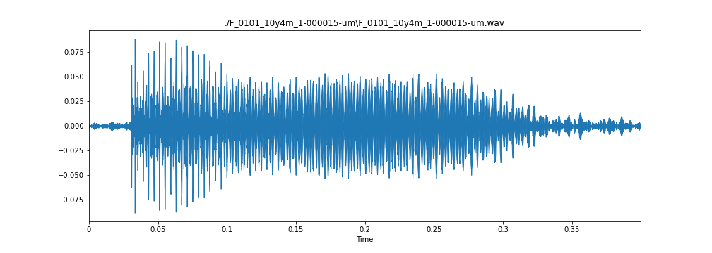

Slide 27
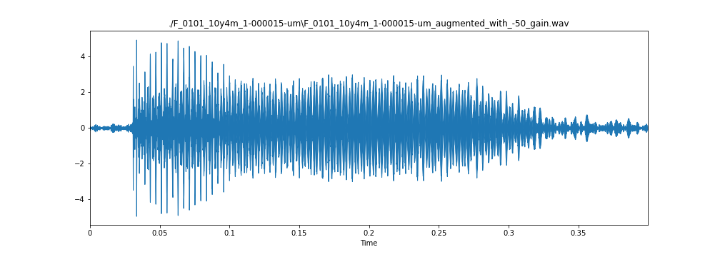

Slide 28
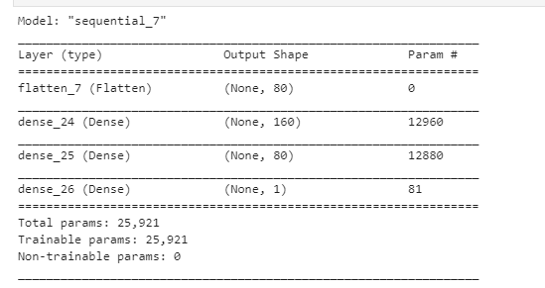
MLP 1

Slide 29
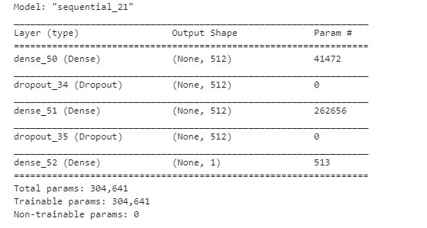
MLP 2

Slide 30
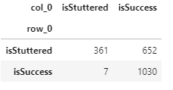
SVM

Slide 31
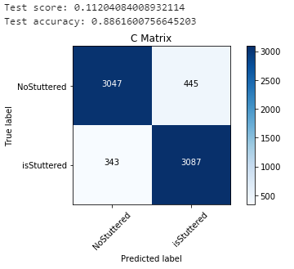
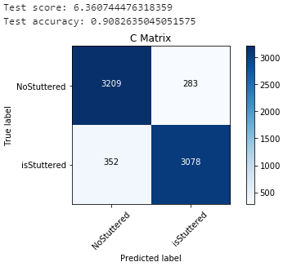
MLP 1 VS MLP2

Slide 32
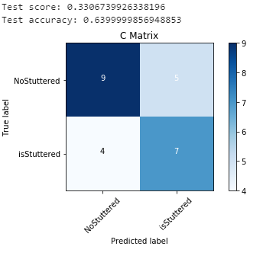
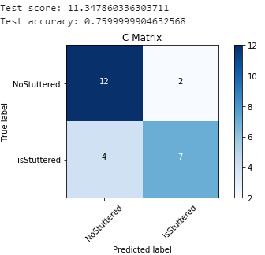
MLP 1 VS MLP2

Slide 33

THANKS!
Any questions?
You can find me at
sf_tanzhongming@quip.edu.my

