Slide 1
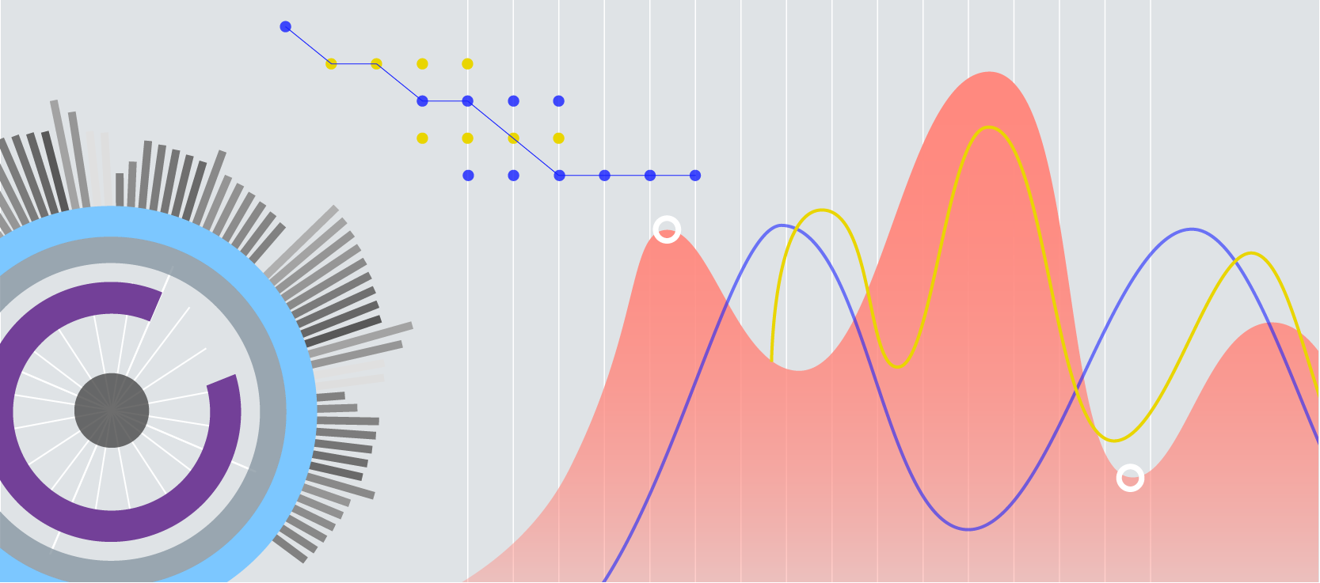
Blog Feedback prediction
Term Project for CSE 583
Rajal Nivargi - rfn5089
Notes:
Hello, my name is Rajal Nivargi and my term project topic is Blog Feedback prediction.

Slide 2
Project description
Problem statement
Automatic analysis of blog posts posted in the last 72 hours by predicting the number of comments on blogs in the next 24 hours
Motivation
Exploring possible insights from the predictions for social media marketing using blog posts
Method
Used linear regression and ensemble learning models to predict the number of comments and compare their performance on the basis of mean squared error and R2 score
Baseline
Feedback Prediction for Blogs by Krisztián Buza – Performed data and feature extraction from 37 279 documents collected from Hungarian blogs and found the WEKA classifiers (REP tree and M5P tree) to have best performance on the basis of evaluation metrics : HIT@10 and AUC@10
Notes:
HIT@10: out of the 10 documents predicted to be the most relevant, how many belong to the most relevant 10 documents
Predicted values match the current values
AUC@10: calculate AUC of the predictions for the 10 most relevant documents according to the ground truth

Slide 3
Dataset description
BlogFeedbackData
Basic features
Number of links and feedbacks
Textual features
Bag of words
Weekday features
Binary indicators to which day of the week
Parent features
Number of parents, min, max and average feedback the parent received
Number of instances | 60021
Number of attributes | 281
Attribute characteristics | Integer real
Buza, K. (2014). Feedback Prediction for Blogs. In Data Analysis, Machine Learning and Knowledge Discovery (pp. 145-152). Springer International Publishing.
UCI machine learning repository: https://archive.ics.uci.edu/ml/datasets/BlogFeedback
Notes:
Multivariate dataset of 281 features from the 60 thousand blog posts and the target number of comments.
There are 4 types of features which includes the number of comments on the post before recoding the data, feedback on the sources of the blog post, presence of 200 significant words and binary indication of the day of publication.

Slide 4
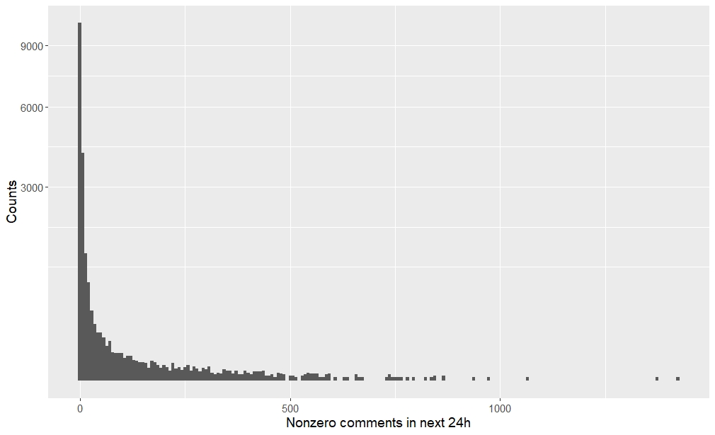
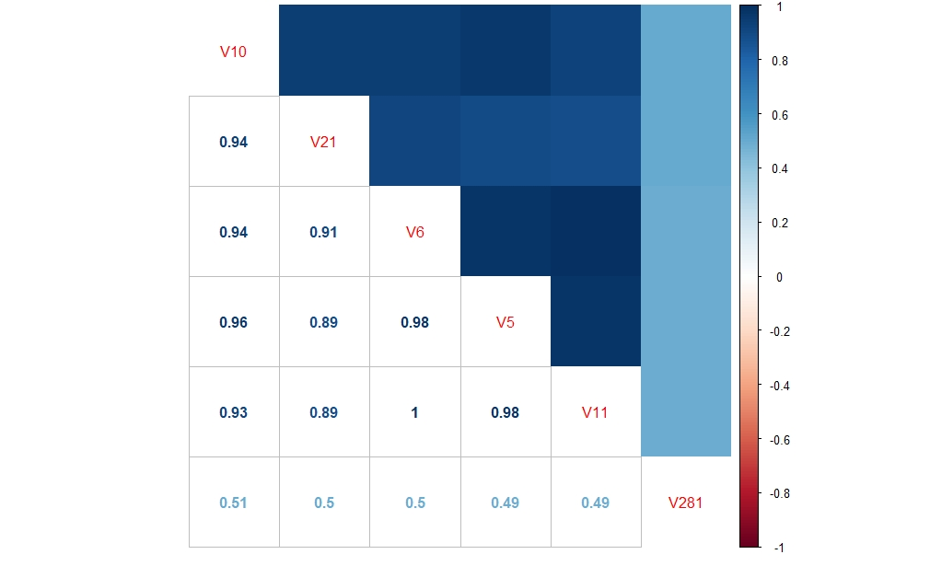
Initial analysis of train data
DataExplore: https://github.com/hncpr1992/BlogFeedBackProject
Notes:
These are two key data inferences from initial data analytics.
1) Skewed dependent variable : 64% of the dependent variables in train data are zero, and among the non-zero ones, about 75% of them are less than 10, however, the dependent variable can also be as high as 1424.
2) Correlation of the dependent variable is high with some columns as compared to others. The independent features have the highest correlation with the target values are mostly medians or averages of the comments from the source in different time periods. However, many of the rest features are highly correlated with each other as well.

Slide 5
Approach
Regression models:
Linear regression
Random forests
Gradient boosting
ADA boost
Evaluation criteria:
Mean absolute error
Median absolute error
Mean squared error
Max Error
R2 score
Notes:
The first approach I took in this project had 4 regression models. The linear regression is a base model along with three ensemble learning methods.
The evaluation criteria I used was 4 different error values and R2 score.

Slide 6
Average of values over 10 observations
Notes:
The 10 observations are generated by using 5 different test sets that are chosen at the interval of 15 days spread over two months. These were computed with train data as it is and another attempt with randomly permuted columns in the train data. The default scikit learn regressor functions were used to predict the number of comments. The metrics show that the error is lowest when the random forests regressor is used. I also tried increasing the number of estimators in these models. However, a significant improvement was not observed.

Slide 7
Inference
Random forests and gradient boosting perform better overall
Majority of features have most zero values, hence, feature selection is important
Notes:
R2 score represents the proportion of variance (of y) that has been explained by the independent variables in the model. Best possible score is 1.0 and it can be negative (because the model can be arbitrarily worse). Disregarding the input features, would get a R^2 score of 0.0.
The highest value observed in this case was 0.7
Since most of the features in the data are binary indicators such as bag of words and day of week indicator, feature selection will be my second approach to the problem.

Slide 8
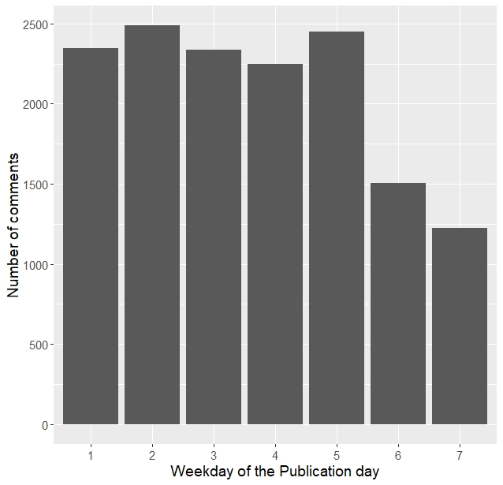
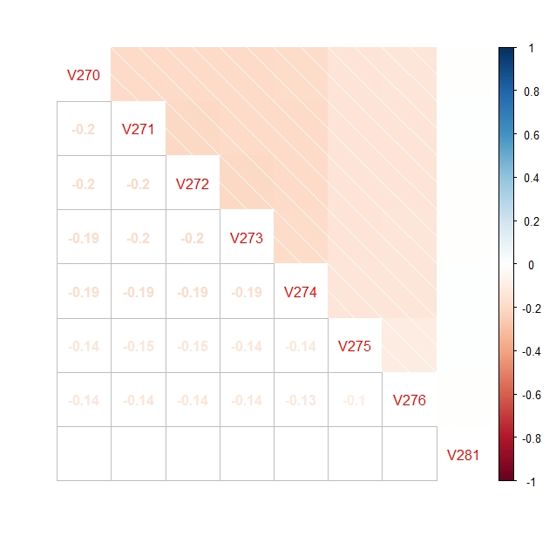
Next step: Feature selection
Weekday features
Notes:
Since my motivation for studying this project was to understand the social media aspect of the blog post, I tired to understand the effect of independent feature sets on the number of comments. First I considered Weekday features.
It is said that the best day to publish a blog is Monday and Thursday. As seen from the frequency chart of our data. It can be verified that weekdays such as Tuesday and Thursday indeed have a higher number of comments. However, the correlation between the number of comments and the weekday binary features is very low. Thus, they would not give good results when used for regression models as input for prediction.

Slide 9
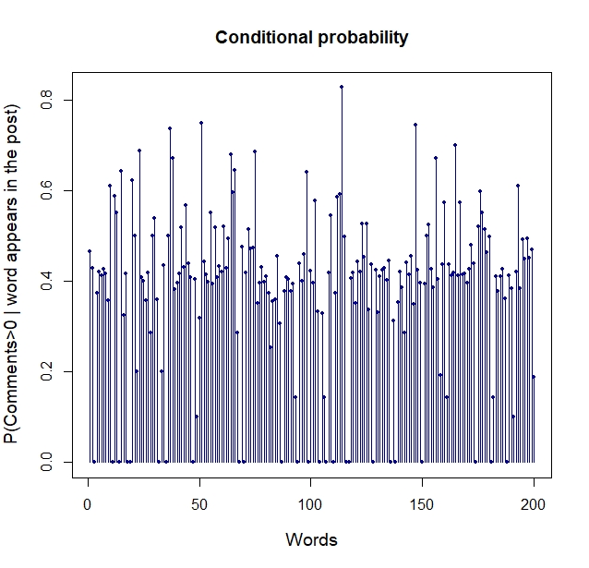
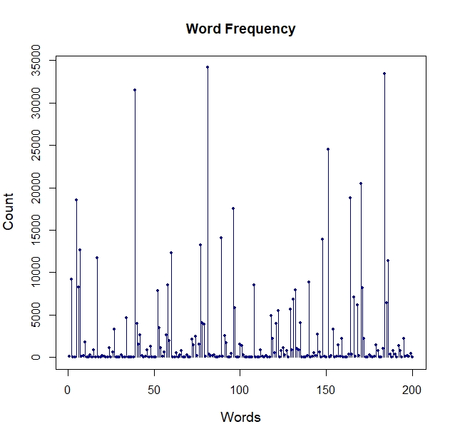
Next step: Feature selection
Bag of words features
Notes:
The next feature set was the bag of significant words. As seen in the frequency chart, there are some words that stand out. These maybe stop words in sentence which explains their high frequency. However, The conditional probability of the comments being higher than 0 when a given word appears is around 0.4 distributed over the data. Hence, this may again not be the feature we can use for regression.

Slide 10
Feature selection
Filter method
Top 10% features based on correlation with the target variable
Wrapper method
Recursive Feature Elimination with cross-validation
Obtained features from the basic features and parent feature sets
Notes:
I considered the traditional filter and wrapper method for feature selection. Using correlation between the feature and the target values, I chose the top 1% of the features which are not highly correlated with each other.
I continued the feature selection through the wrapper method of Recursive Feature elimination with 5-fold cross validation using random forests, our best performing model as the learning estimator. I was down to 9 features from this step which includes features from the basic and parent feature sets which is the average, min, max feedback on source blogs and past number of comments on the post before recording the data.

Slide 11
Results
Notes:
I made a chart explaining the outputs from the different models and methods I tried.This data is recorded for one test data set as opposed to my earlier approach where I considered 5. As seen above, the mean squared errors takes a dip for all the models after the filer method was implemented. The gradient boost model in green and Adaboost model in red usually performs better when the number of estimators are increased. However, the Random forests is seen to perform the best with low error values over different methods.

Slide 12
Results
Notes:
I made a similar chart for R2 score and could observe an increase in the score when the feature selection is applied. The observations are similar to the one in the earlier chart with Random forests performing the best. If observed, linear regression has a uniform output in this and the previous chart as well.

Slide 13
Conclusion
Data analysis of features in a given dataset
Importance of feature selection when various feature sets are available
Ensemble models
Future work
Neural networks for prediction
Notes:
Besides the experience of dealing with real world skewed data, my takeaway would be understanding how to use correlation between the features and the dependent variables to determine further steps to improve the performance of the models. The importance of feature selection when you have various feature sets are available.
Ensemble models and their relative performance
Since simpler ensembles models worked well of this data, a neural network may also be a good avenue to explore in the future. This was also suggested by the parent paper in which they tired using a multi-layer perceptron.

