Slide 1

Informed Non-convex Robust Principal Component Analysis with Features
Niannan Xue, Jiankang Deng, Yannis Panagakis, Stefanos Zafeiriou
Speaker: Jiankang Deng
Notes:
Hello, everyone!
My name is Jiankang Deng from Imperial College.
I feel very honored to present our work here.
The tittle of our work is…
This work is co-authored with …

Slide 2
Outline
Background
Motivation
Related Works
Proposed Approach
Convergence Guarantee
Experimental Results
Notes:
This is the outline of my presentation.
First, I will introduce background work: Robust PCA
Then, I will give some motivations of using side information, especially the features.
After illustrating some related works, I will introduce our method and give the convergence guarantee.
Finally, I will show some promising experiment results.

Slide 3
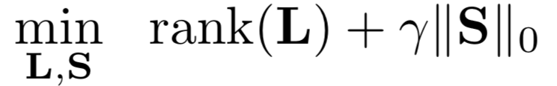


Background
Robust PCA
Given a known data matrix M = L + S, where L and S are unknown but L is low-rank and S is sparse, we want to recover L.
Rigorously,
is a Lagrange multiplier
gives the number of non-zero elements in S
NP-hard problem!

Slide 4
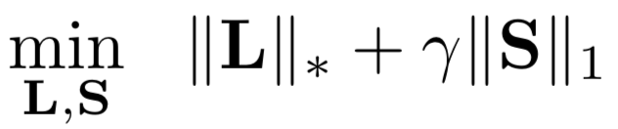
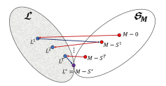
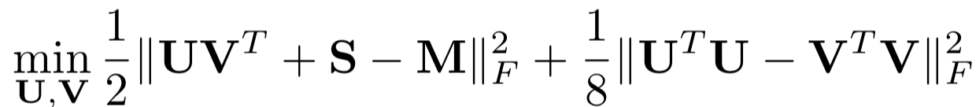
Background
Provable approaches to solve Robust PCA
Principal Component Pursuit (Candes et al & Venkat et al)
Convex problem, ADMM
AltProj (Netrapalli et al)
condition: given rank r
solution: hard-thresholding and alternating non-convex projections
merit: fast convergence
Fast RPCA (Yi et al)
condition: given rank r and sparsity α.
solution: gradient descent (one step), projection (U V S) ...iteratively
merit: faster convergence
Notes:
AltProj, the search consists of alternating non-convex projections. That is, duringeach cycle, hard-thresholding takes place first to remove large entries and pro-jection of appropriate residuals onto the set of low-rank matrices with increasingranks is carried out next.

Slide 5
Motivation
Side information (features)
Collaborative filtering: apart from ratings of an item by other users, the profile of the user and the description of the item can also be exploited in making recommendations.
Relationship prediction: user behaviors and message exchanges can assist in finding missing links on social media networks.
Person-specific facial deformable model fitting: an orthonormal subspace learnt from manually annotated data captured in-the-wild, when fed into an image congealing procedure, can help produce more correct fittings
Notes:
After introducing the background work: Robust PCA, I give some motivations of side information, especially features.
Side information is widely used in a lot of research area, such as…

Slide 6

Related Works
Side information (features)
Principal component pursuit with features (Chiang et al)
M=XHY^{T}+S, convex, ADMM, better convergence
sometimes be slower
Inductive Robust PCA via Iterative Hard Thresholding (Niranjan et al)
solution: Entry-wise hard thresholding and spectral hard thresholding,
More complexity, inferior convergence
Can we do better?

Slide 7
Proposed Approach
Setup
Let the data matrix be M∈R^{n×n}
Let the rank of L be r.
Let us be informed of the proportion of non-zero entries per row and column, denoted by α.
Assume that there are also available features X∈R^{n×d} and Y∈R^{n×d} such that they are feasible.

Slide 8
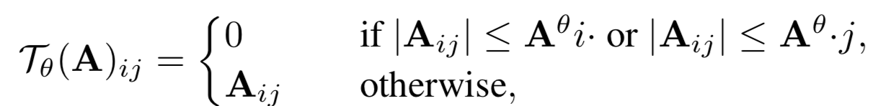
Proposed Approach
Hard-thresholding
where A^{θ} i · and A^{θ} ·j are the (n₂×θ)^{th} and (n₁×θ)^{th} largest element in absolute value in row i and column j, respectively.
(We only keep the θ-largest elements in its row and column.)
Initialization
S = T_{α}(M)
L = M -S
UΣV^{T}=L (r-truncated SVD)
P = X^{T}UΣ^{0.5}, Q = Y^{T}VΣ^{0.5}
Notes:
We first introduce the sparse estimator via hard-thresholding.
we form new matrices P and Q.

Slide 9
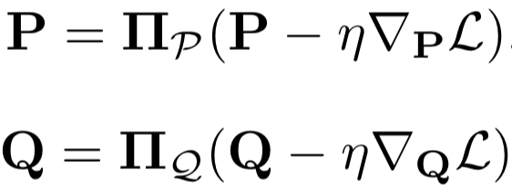

Proposed Approach
Objective function
Gradient descent
Hard-thresholding
Notes:
we define the following objective function.
in each step, we calculate new P and Q by gradient descent.
We calculate S by hard-thresholding.

Slide 10
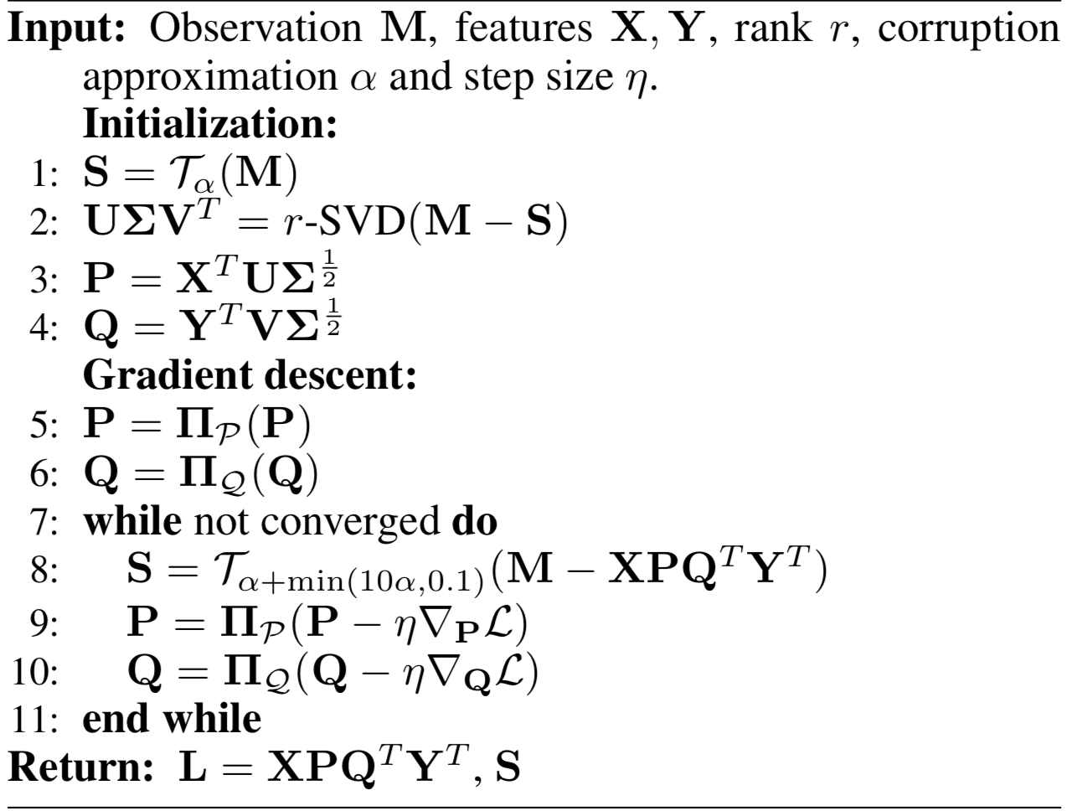
Proposed Approach
Algorithm
Notes:
ita

Slide 11


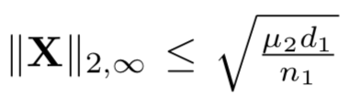

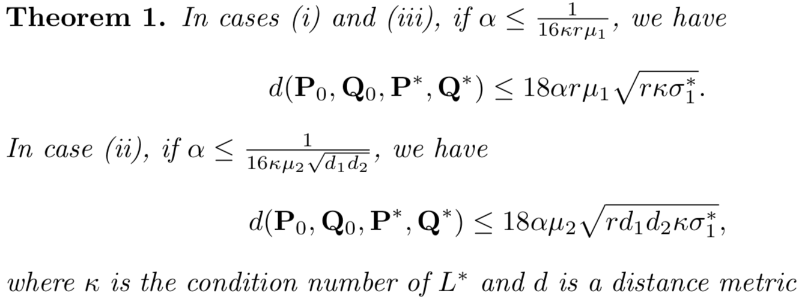
Convergence Guarantee
Incoherence conditions:
case: (i)
case: (ii)
case: (iii) both (i) and (ii)
Notes:
We consider three incoherence conditions:
(i) incoherence on the low-rank matrix
(ii) on the features
(iii) on both
After the initialization stage,
When alpha satisfies this condition, we have the following upper bound on the distance metric.

Slide 12
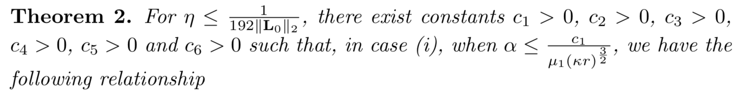
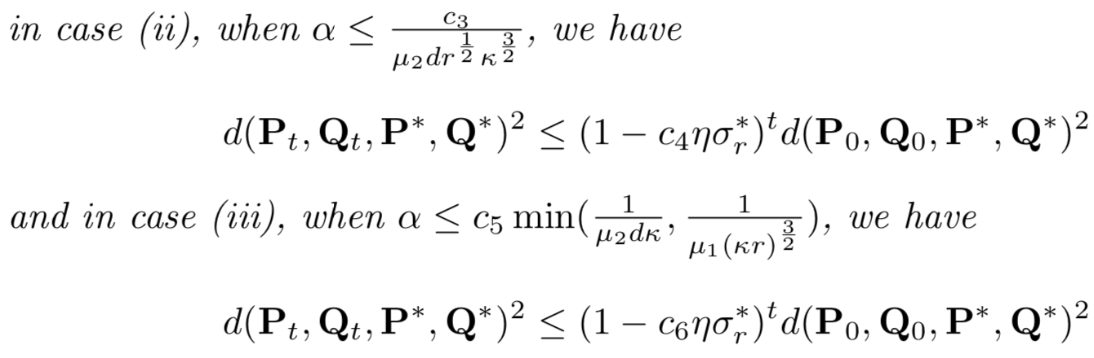
Convergence Guarantee
Distance metric decreases exponentially.
Notes:
After T steps of iteration, when ita satisfied
Distance metric decreases exponentially.

Slide 13
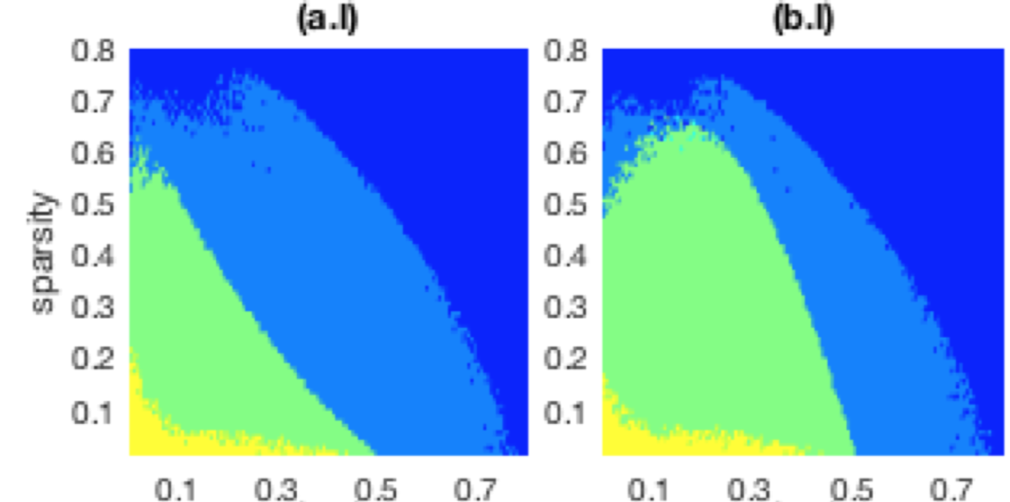
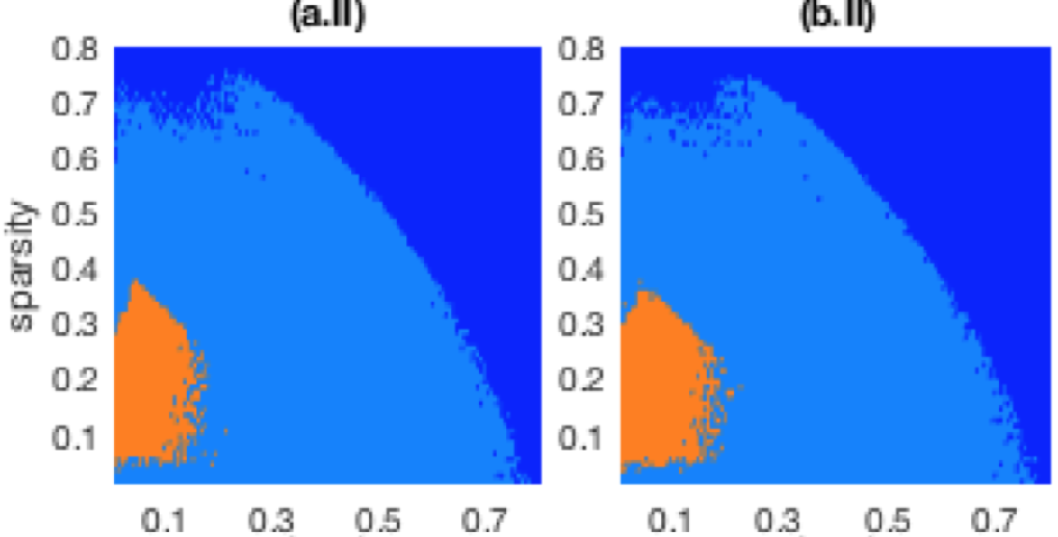
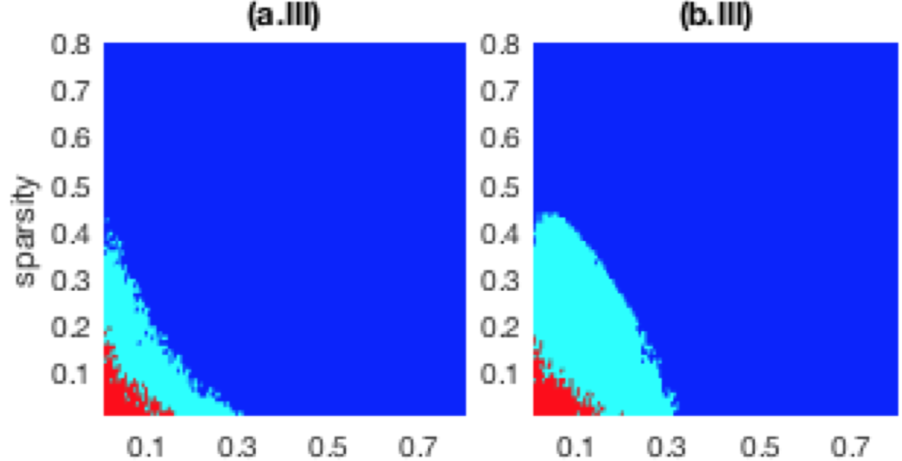
Experimental Results
Phase transition
random sign model and coherent sign model
Notes:
left: random signs right coherent signs
plot results from algorithms incorporating features.
our algorithm contrasts with fast RPCA
Other feature-free algorithms are investigated
Figures a illustrate the random sign model and Figures b for the coherent sign model.
All previous non-convex attempts fail to outperform their convex equivalents.
IRPCA-IHT is unable to deal with even moderate levels of corruption.
The frontier of recoverability that has been advanced by our algorithm over PCPF is phenomenal, massively ameliorating fast RPCA.
The anomalous asymmetry in the two sign models is no longer observed in non-convex algorithms.

Slide 14
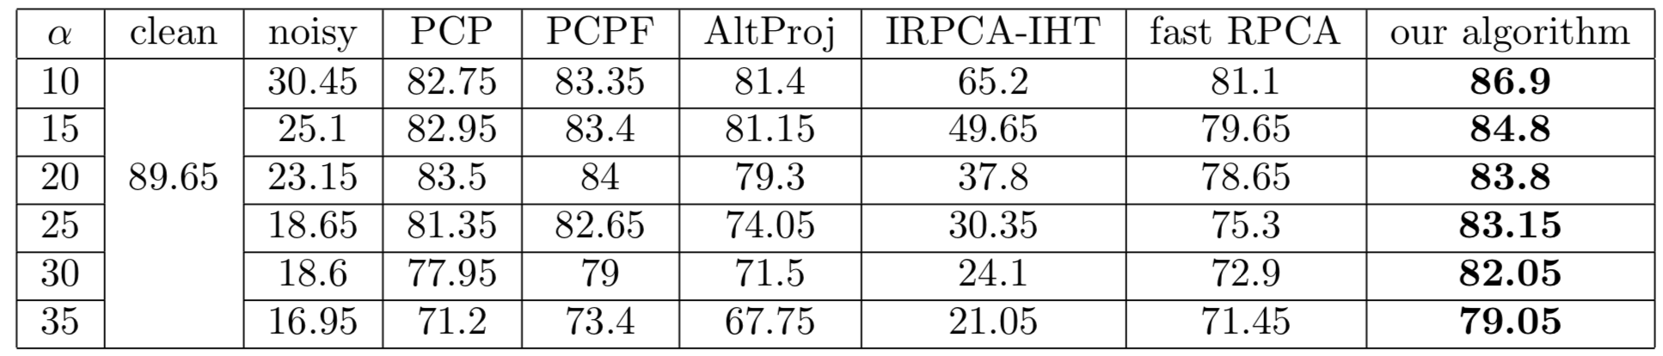
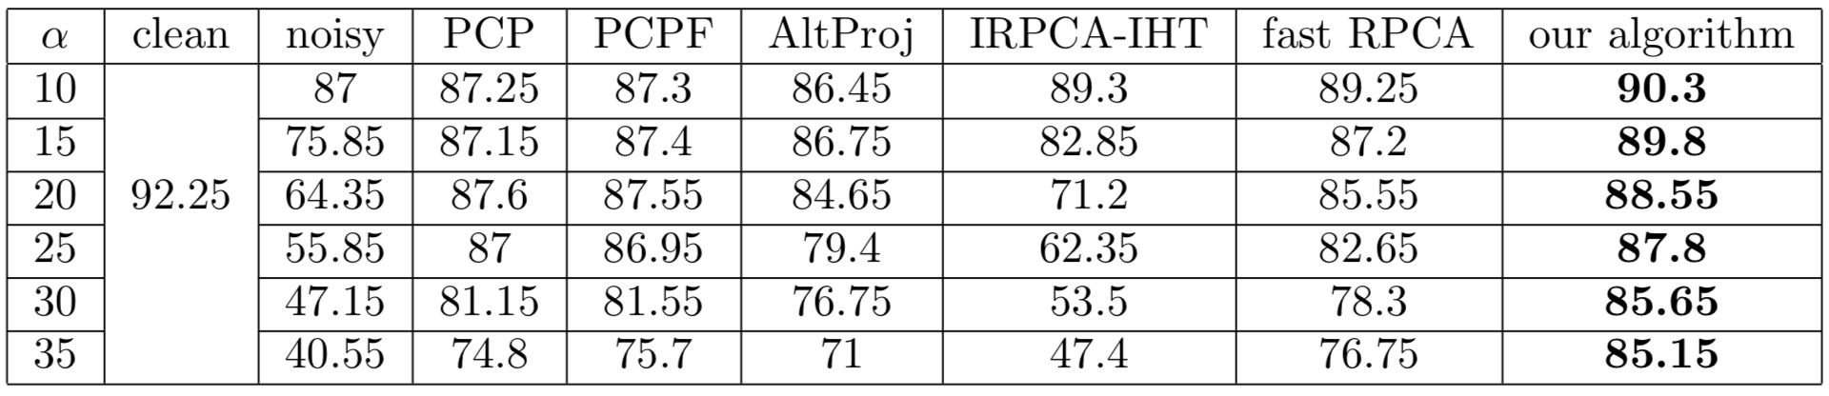
Experimental Results
Image classification
Linear SVM
Kernel SVM
Notes:
Mnist
Alpha is the noise level.

Slide 15
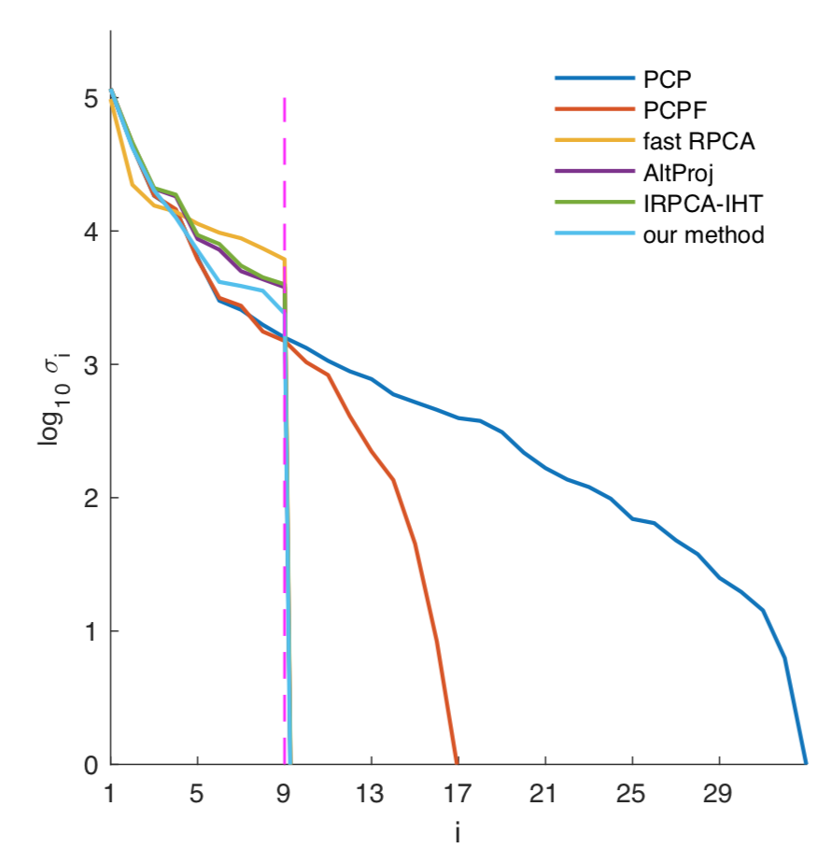
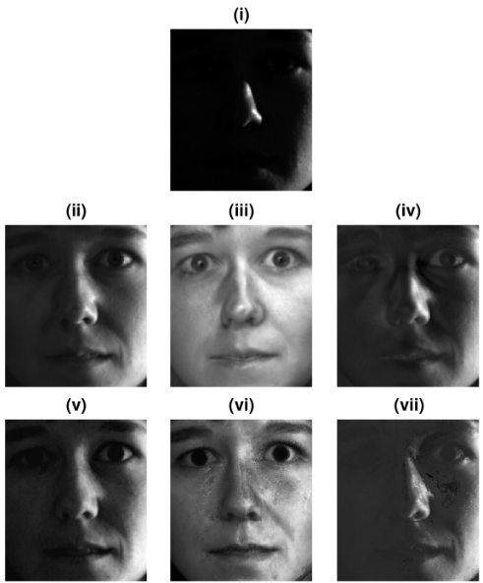
Experimental Results
Face denoising
(i) original
(ii) PCPF
(iii) our algorithm
(iv) IRPCA-IHT
(v) PCP
(vi) fast RPCA
(vii) AltProjç
Log-scale singular values
of the denoised matrices
Notes:
The proposed method has the most rapid decay.

Slide 16
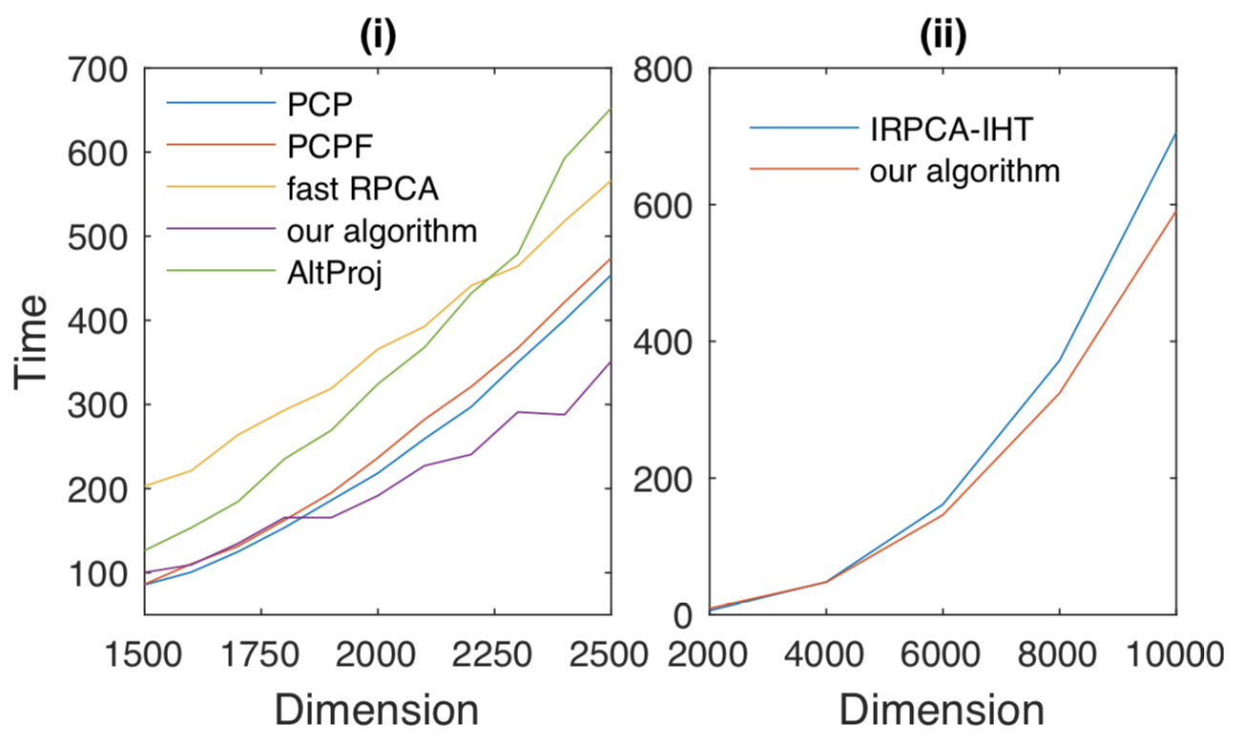
Experimental Results
Running Time
Running times for observation matrices of increasing dimensions

Slide 17

Email: jiankangdeng@gmail.com
Notes:
Thanks for your attention.
If you have any question, please send to my email. I will reply with the related details as soon as possible.

