Slide 1



Applying Patterns & Frameworks to Concurrent & Networked Software
Douglas C. Schmidt
d.schmidt@vanderbilt.edu
www.dre.vanderbilt.edu/~schmidt
Professor of Computer Science
Institute for Software Integrated Systems Vanderbilt University Nashville, Tennessee, USA

Slide 2
Topics Covered in this Section of Modules
Summarize the case study used throughout this module
HTTP Client
GET /index.html HTTP/1.0
HTTP Server
www.dre.vanderbilt.edu
<H1>DOC Group page</H1>...
HTML Parser
File Cache
Protocol Handlers
GUI
Requestor
Event Dispatcher
Transport Protocol (TCP)
OS Kernel
OS Kernel
IP Network

Slide 3
Topics Covered in this Section of Modules
Performance
Simplicity
Wrapper Facade
Predictability
Proactor
Reactor
Leader/Followers
ACT
Acceptor-Connector
Simplicity
Strategized Locking
Scalability
Half-Sync/Half-Async
Scoped Locking
Active Object
Monitor Object
Thread-Safe Interface
Flexibility
File Cache
Protocol Handlers
Component Configurator
Activator
Event Dispatcher

Slide 4
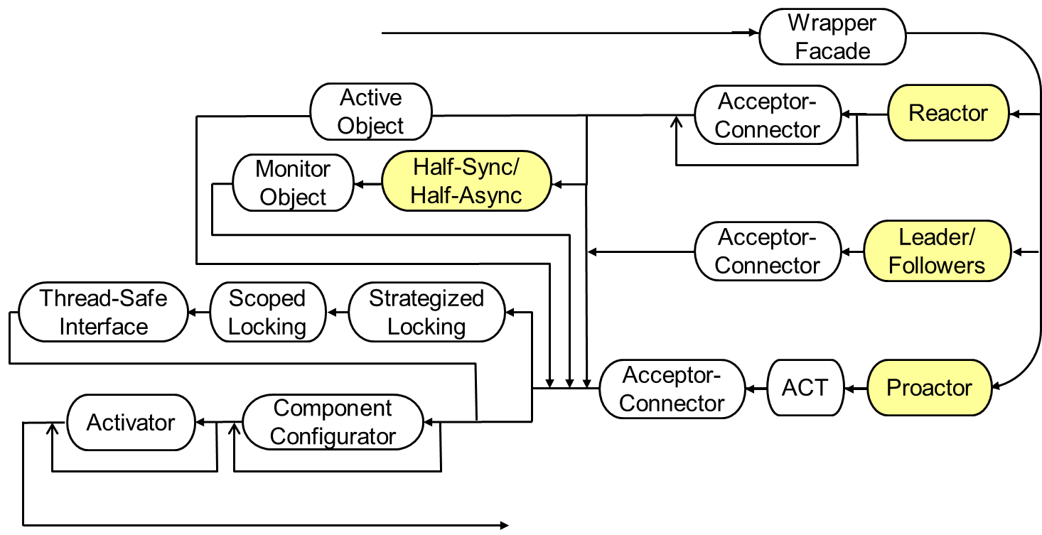
Topics Covered in this Section of Modules

Slide 5
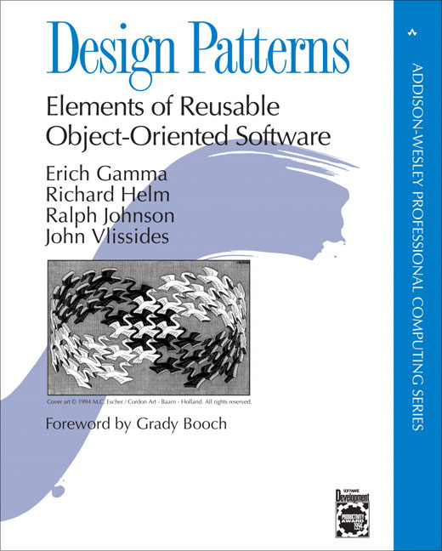

Topics Covered in this Section of Modules
Summarize the case study used throughout this module
This case study focuses on applying patterns

Slide 6

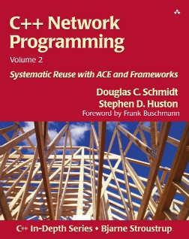
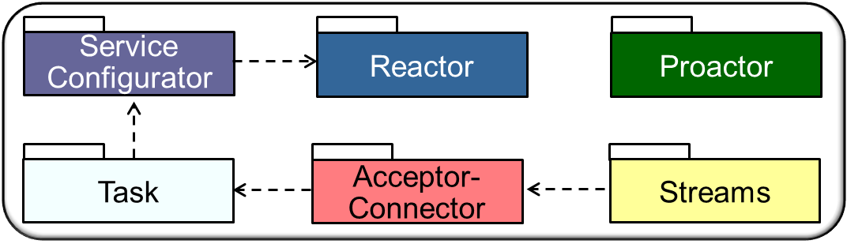
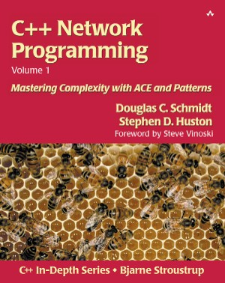
Topics Covered in this Section of Modules
Summarize the case study used throughout this module
This case study focuses on applying patterns & frameworks

Slide 7
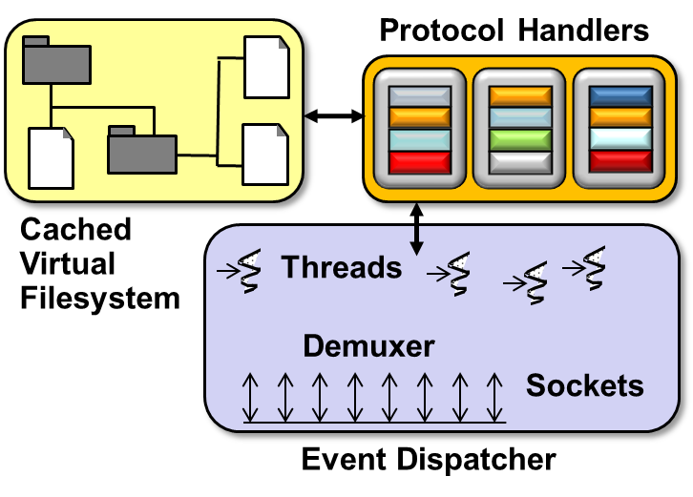
Topics Covered in this Section of Modules
Summarize the case study used throughout this module
This case study focuses on applying patterns & frameworks to the JAWS web server
JAWS is available in open-source ACE release at download.dre.vanderbilt.edu

Slide 8
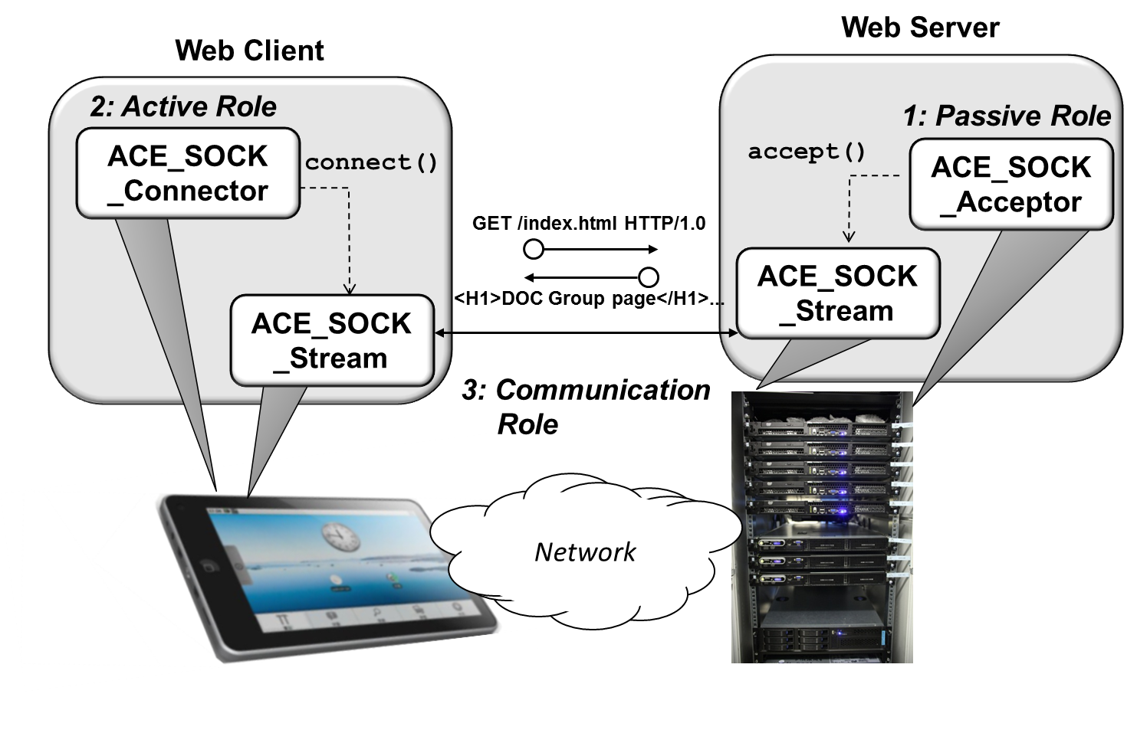
Topics Covered in this Section of Modules
Summarize the case study used throughout the module
Apply patterns & frameworks to JAWS in the following areas
Service access & communication
Wrapper Facade

Slide 9
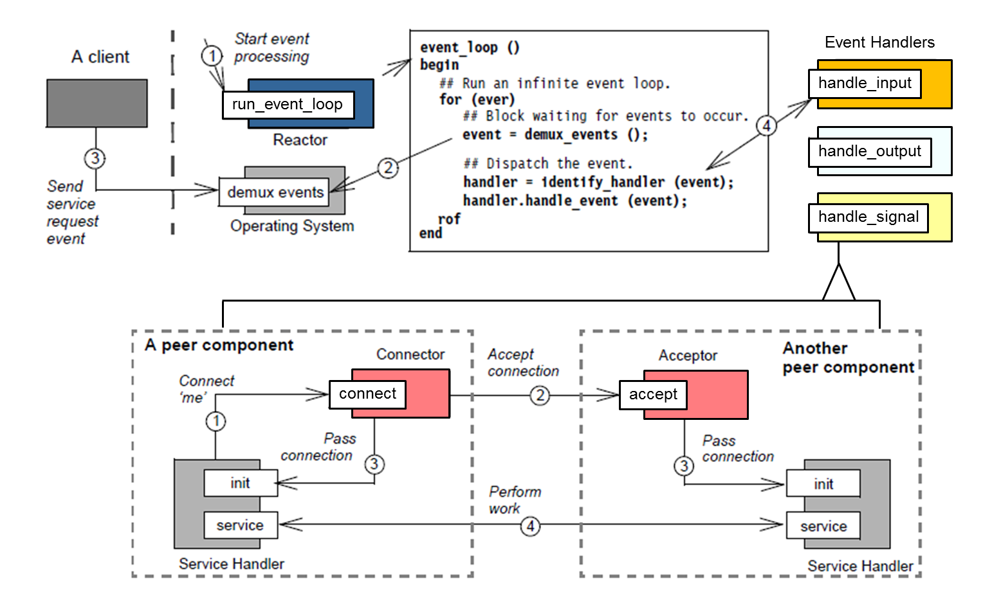
Topics Covered in this Section of Modules
Summarize the case study used throughout the module
Apply patterns & frameworks to JAWS in the following areas
Synchronous event handling, connections, & service initialization
Acceptor- Connector
Reactor

Slide 10
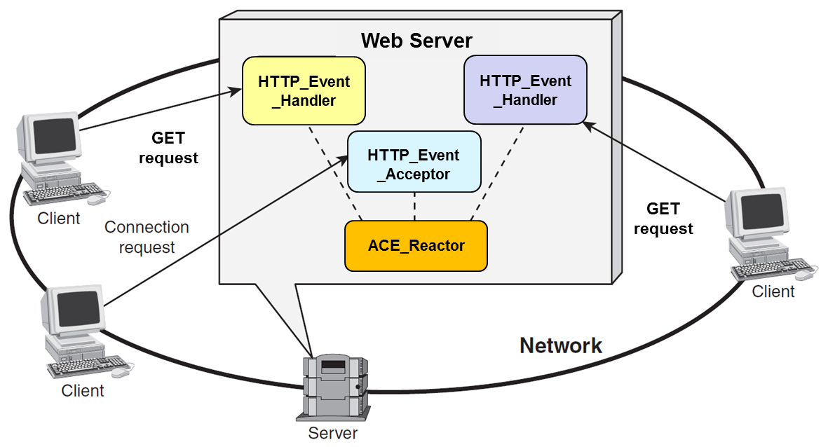



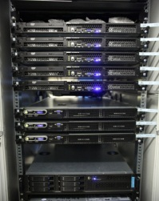
Topics Covered in this Section of Modules
Summarize the case study used throughout the module
Apply patterns & frameworks to JAWS in the following areas
Synchronous event handling, connections, & service initialization
HTTP_Svc _Handler
Logging
Event
Handler
HTTP_Svc Handler
HTTP_Event_ Handler
HTTP_Svc _Acceptor
Server
Acceptor- Connector
Reactor

Slide 11
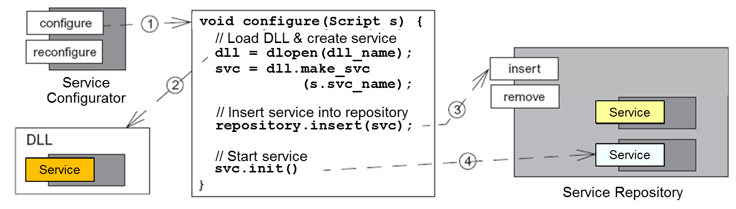
Topics Covered in this Section of Modules
Summarize the case study used throughout the module
Apply patterns & frameworks to JAWS in the following areas
Service configuration & activation
Activator
Component Configurator

Slide 12
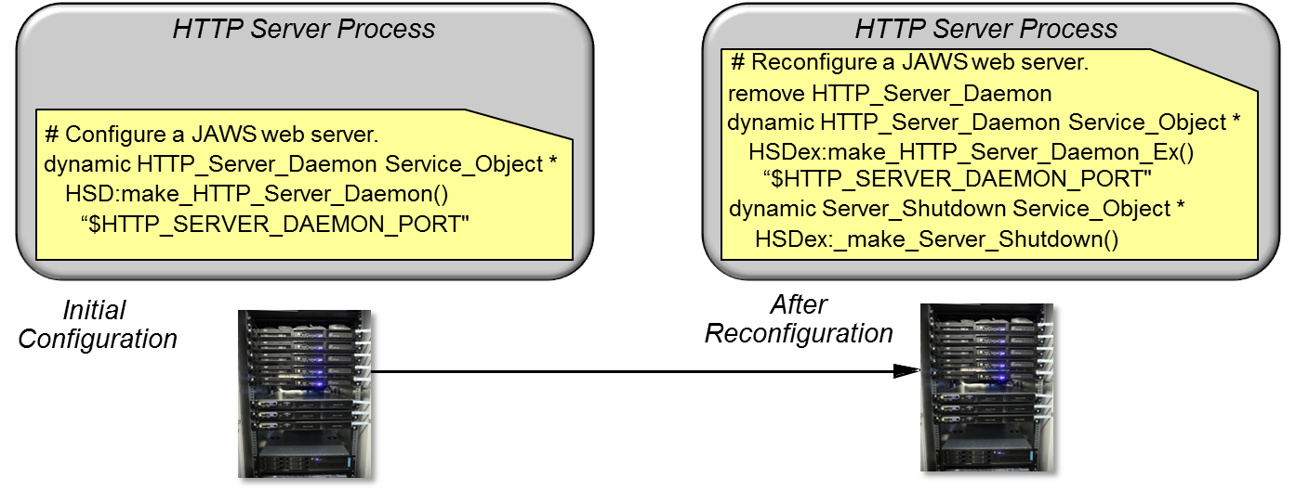
Topics Covered in this Section of Modules
Summarize the case study used throughout the module
Apply patterns & frameworks to JAWS in the following areas
Service configuration & activation
Service Configurator
Acceptor- Connector
Reactor

Slide 13
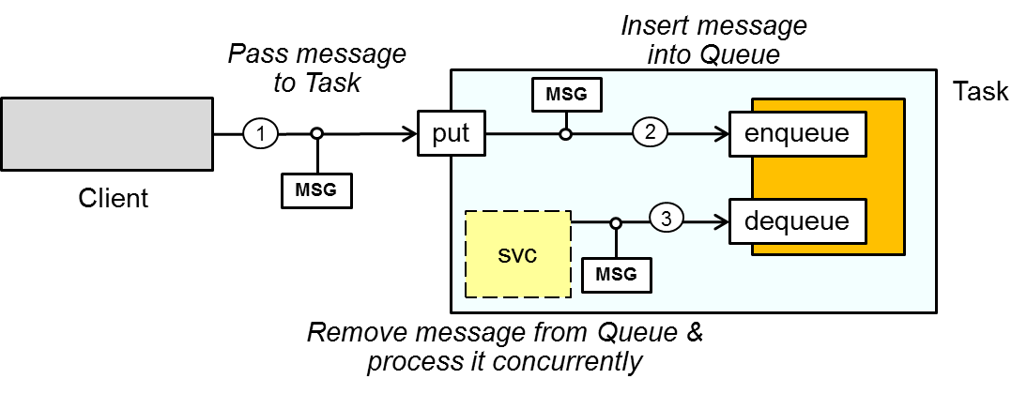
Topics Covered in this Section of Modules
Summarize the case study used throughout the module
Apply patterns & frameworks to JAWS in the following areas
Concurrency & synchronization
svc
Active Object
Half-Sync/ Half-Async
Monitor Object
Reactor
Leader/ Followers
Thread-Safe Interface
Scoped Locking
Strategized Locking
Double-Checked Locking Optimization

Slide 14
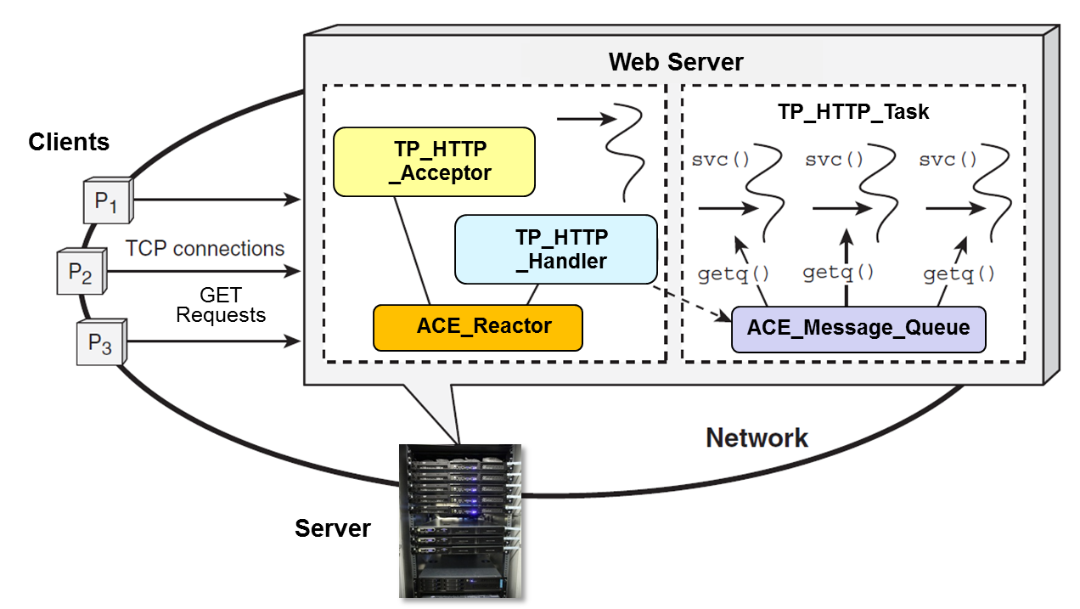
Topics Covered in this Section of Modules
Summarize the case study used throughout the module
Apply patterns & frameworks to JAWS in the following areas
Concurrency & synchronization
Acceptor- Connector
Reactor
Task

Slide 15
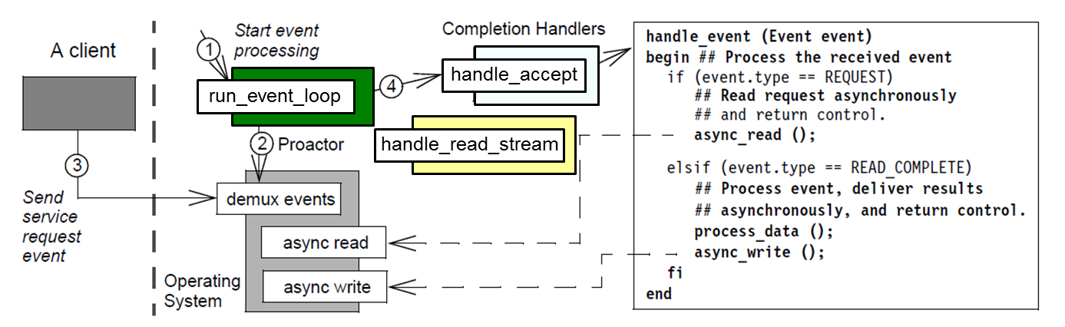
Topics Covered in this Section of Modules
Summarize the case study used throughout the module
Apply patterns & frameworks to JAWS in the following areas
Asynchronous event handling
Asynchronous Completion Token
Proactor

Slide 16
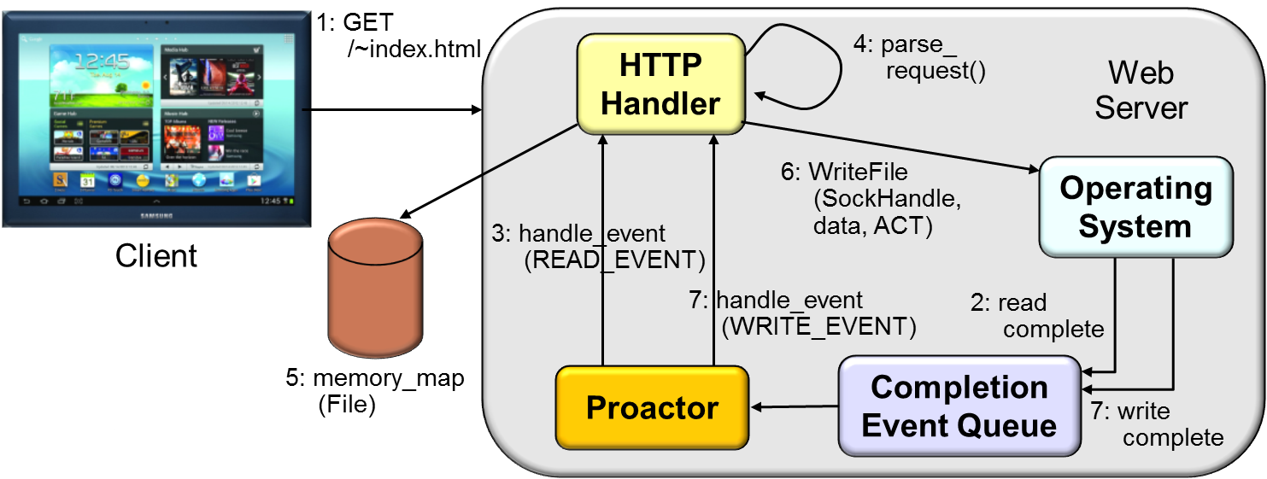
Topics Covered in this Section of Modules
Summarize the case study used throughout the module
Apply patterns & frameworks to JAWS in the following areas
Asynchronous event handling
Proactor

Slide 17

Topics Covered in this Section of Modules
Summarize the case study used throughout the module
Apply patterns & frameworks to JAWS in the following areas
Service access & communication
Synchronous event handling, connections, & service initialization
Service configuration & activation
Concurrency & synchronization
Asynchronous event handling
Evaluate benefits & limitations of applying patterns & frameworks to concurrent & networked software
Complexity vs. productivity
Extensibility vs. performance
Buy vs. build
Debugging & testing
We’ll cover many code examples written in C++ & Java

