Slide 1



Introduction to Patterns & Frameworks
(with Emphasis on Concurrent & Networked Software)
Douglas C. Schmidt
d.schmidt@vanderbilt.edu
www.dre.vanderbilt.edu/~schmidt
Professor of Computer Science
Institute for Software Integrated Systems Vanderbilt University Nashville, Tennessee, USA

Slide 2
Topics Covered in this Section of Modules
Summarize key pattern concepts
Enable Systematic Design Reuse
Convey Architectural Knowledge
Identify & Name Recurring Structures & Behaviors
Codify Design Expertise
Map Design Problems to Proven Solutions
…
Pattern Concepts

Slide 3
Topics Covered in this Section of Modules
Summarize key pattern concepts
Enable Systematic Design Reuse
Convey Architectural Knowledge
Identify & Name Recurring Structures & Behaviors
Codify Design Expertise
Map Design Problems to Proven Solutions
…
Pattern Concepts

Slide 4
Topics Covered in this Section of Modules
Summarize key pattern concepts
Enable Systematic Design Reuse
Convey Architectural Knowledge
Identify & Name Recurring Structures & Behaviors
Codify Design Expertise
Map Design Problems to Proven Solutions
…
Pattern Concepts

Slide 5
Topics Covered in this Section of Modules
Summarize key pattern concepts
Enable Systematic Design Reuse
Convey Architectural Knowledge
Identify & Name Recurring Structures & Behaviors
Codify Design Expertise
Map Design Problems to Proven Solutions
…
Pattern Concepts

Slide 6
Topics Covered in this Section of Modules
Summarize key pattern concepts
Convey Architectural Knowledge
Identify & Name Recurring Structures & Behaviors
Codify Design Expertise
Map Design Problems to Proven Solutions
…
Enable Systematic Design Reuse
Pattern Concepts

Slide 7
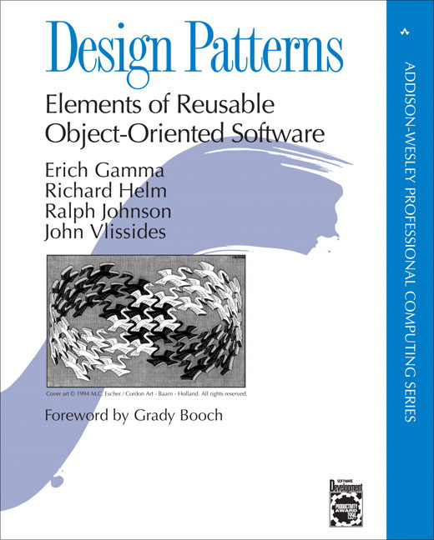
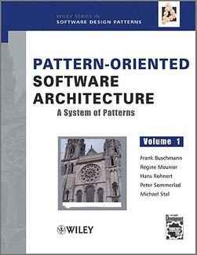
Topics Covered in this Section of Modules
Summarize key pattern concepts
Give examples of common patterns related to concurrent & networked software
“Gang of Four” (GoF) book
“POSA1” book

Slide 8
Topics Covered in this Section of Modules
Summarize key pattern concepts
Give examples of common patterns related to concurrent & networked software
“Gang of Four” (GoF) book
“POSA1” book

Slide 9
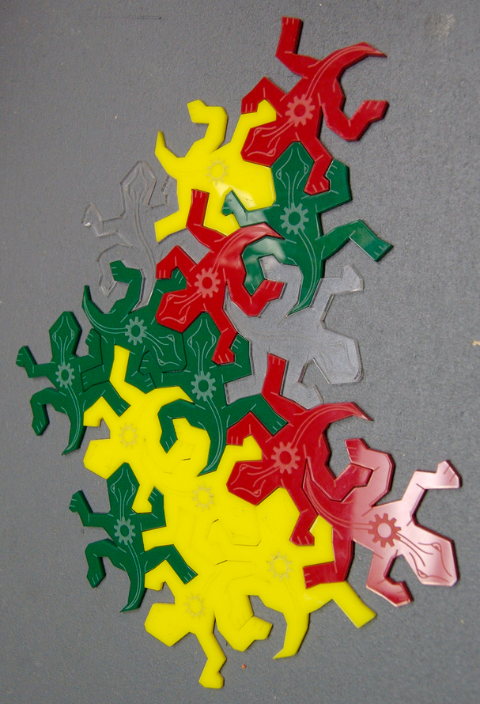
Topics Covered in this Section of Modules
Summarize key pattern concepts
Give examples of common patterns related to concurrent & networked software
Explore relationships between patterns
Notes:
http://www.flickr.com/photos/82439748@N00/1155311612/,

Slide 10

Topics Covered in this Section of Modules
Summarize key pattern concepts
Give examples of common patterns related to concurrent & networked software
Explore relationships between patterns
Notes:
http://www.flickr.com/photos/82439748@N00/1155311612/,

Slide 11
Topics Covered in this Section of Modules
Summarize key pattern concepts
Give examples of common patterns related to concurrent & networked software
Explore relationships between patterns
Notes:
http://www.flickr.com/photos/82439748@N00/1155311612/,

Slide 12

Topics Covered in this Section of Modules
Summarize key pattern concepts
Give examples of common patterns related to concurrent & networked software
Explore relationships between patterns
Notes:
http://www.flickr.com/photos/82439748@N00/1155311612/,

Slide 13
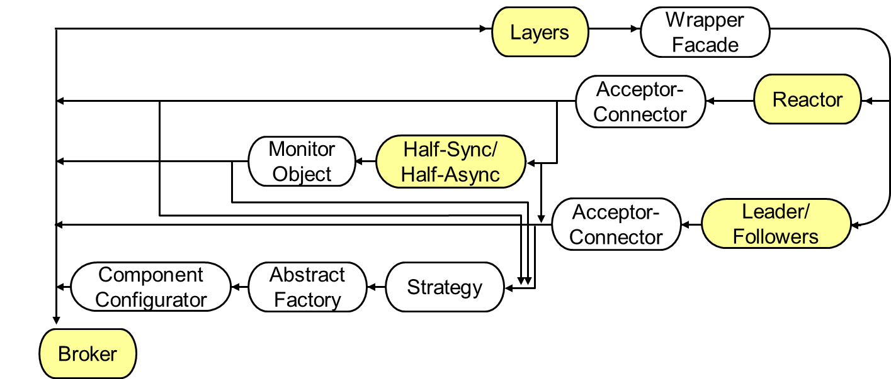
Topics Covered in this Section of Modules
Summarize key pattern concepts
Give examples of common patterns related to concurrent & networked software
Explore relationships between patterns
Notes:
http://www.flickr.com/photos/82439748@N00/1155311612/,

Slide 14
Topics Covered in this Section of Modules
Summarize key pattern concepts
Give examples of common patterns related to concurrent & networked software
Explore relationships between patterns
Summarize key framework concepts & their relations to patterns
Extensible Design & Code
Inversion of Control
Implement Pattern Languages
Reusable “Semi-Complete” Applications
Domain-Specific Functionality & Structure
…
Framework Concepts

Slide 15
Topics Covered in this Section of Modules
Summarize key pattern concepts
Give examples of common patterns related to concurrent & networked software
Explore relationships between patterns
Summarize key framework concepts & their relations to patterns
Extensible Design & Code
Inversion of Control
Implement Pattern Languages
Reusable “Semi-Complete” Applications
Domain-Specific Functionality & Structure
…
Framework Concepts

Slide 16
Topics Covered in this Section of Modules
Summarize key pattern concepts
Give examples of common patterns related to concurrent & networked software
Explore relationships between patterns
Summarize key framework concepts & their relations to patterns
Extensible Design & Code
Inversion of Control
Implement Pattern Languages
Reusable “Semi-Complete” Applications
Domain-Specific Functionality & Structure
…
Framework Concepts

Slide 17
Topics Covered in this Section of Modules
Summarize key pattern concepts
Give examples of common patterns related to concurrent & networked software
Explore relationships between patterns
Summarize key framework concepts & their relations to patterns
Extensible Design & Code
Inversion of Control
Implement Pattern Languages
Reusable “Semi-Complete” Applications
Domain-Specific Functionality & Structure
…
Framework Concepts

Slide 18
Topics Covered in this Section of Modules
Summarize key pattern concepts
Give examples of common patterns related to concurrent & networked software
Explore relationships between patterns
Summarize key framework concepts & their relations to patterns
Extensible Design & Code
Inversion of Control
Implement Pattern Languages
Reusable “Semi-Complete” Applications
Domain-Specific Functionality & Structure
…
Framework Concepts

Slide 19
Topics Covered in this Section of Modules
Summarize key pattern concepts
Give examples of common patterns related to concurrent & networked software
Explore relationships between patterns
Summarize key framework concepts & their relations to patterns
Extensible Design & Code
Inversion of Control
Implement Pattern Languages
Reusable “Semi-Complete” Applications
Domain-Specific Functionality & Structure
…
Framework Concepts

Slide 20
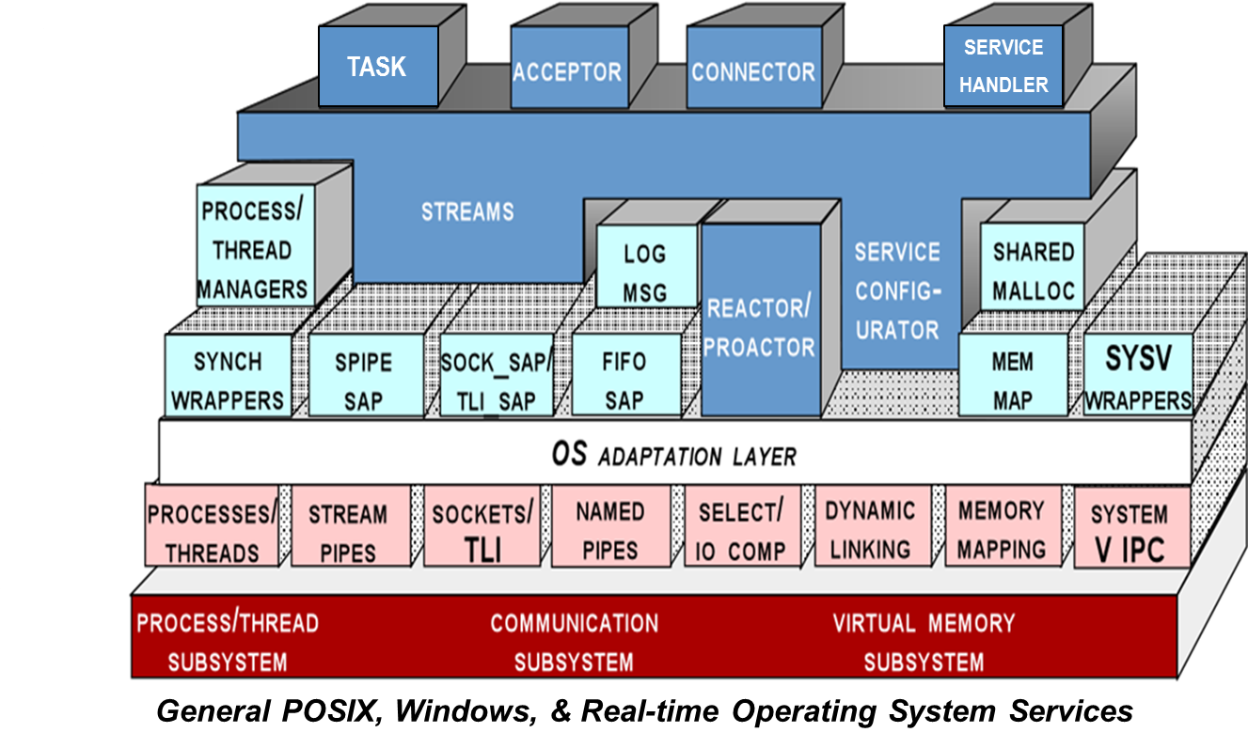
Topics Covered in this Section of Modules
Summarize key pattern concepts
Give examples of common patterns related to concurrent & networked software
Explore relationships between patterns
Summarize key framework concepts & their relations to patterns
Give examples of frameworks related to concurrent & networked software
ACE (C++) www.dre.vanderbilt.edu/ACE
Notes:
http://developer.android.com/images/system-architecture.jpg

Slide 21
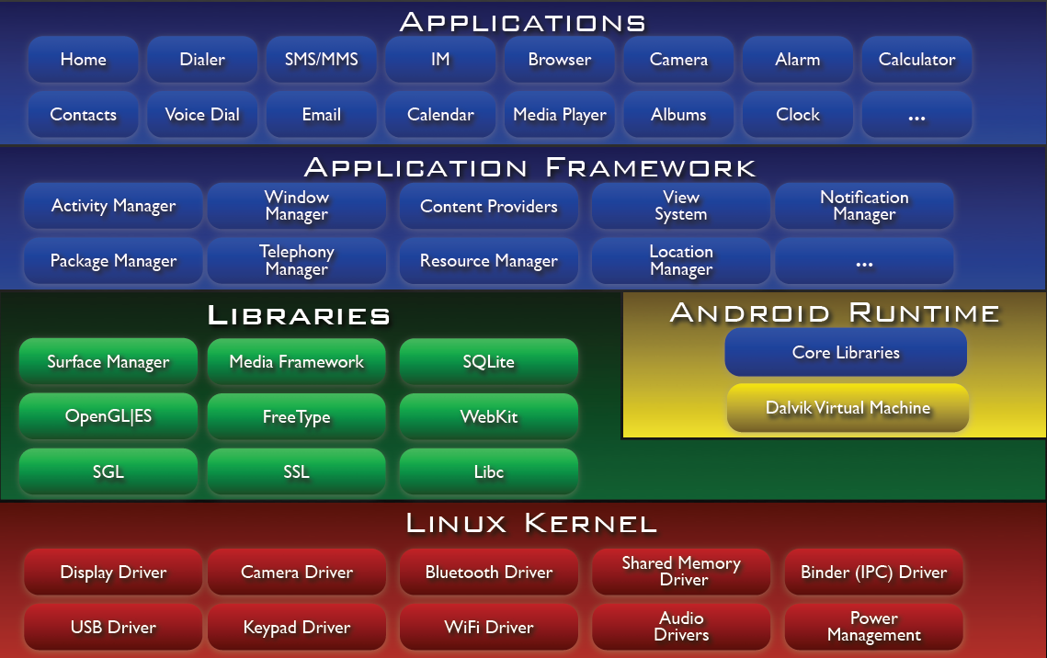
Topics Covered in this Section of Modules
Summarize key pattern concepts
Give examples of common patterns related to concurrent & networked software
Explore relationships between patterns
Summarize key framework concepts & their relations to patterns
Give examples of frameworks related to concurrent & networked software
ACE (C++) www.dre.vanderbilt.edu/ACE
Android (Java) developer.android.com
ACE & Android pattern-oriented frameworks are available in open-source form
Notes:
http://developer.android.com/images/system-architecture.jpg

Slide 22

Topics Covered in this Section of Modules
Summarize key pattern concepts
Give examples of common patterns related to concurrent & networked software
Explore relationships between patterns
Summarize key framework concepts & their relations to patterns
Give examples of frameworks related to concurrent & networked software
Summarize benefits & limitations of patterns & frameworks
Notes:
http://upload.wikimedia.org/wikiversity/en/c/c7/Mask.gif

Slide 23


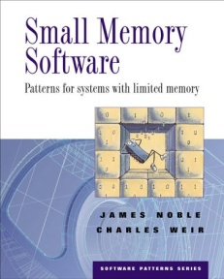

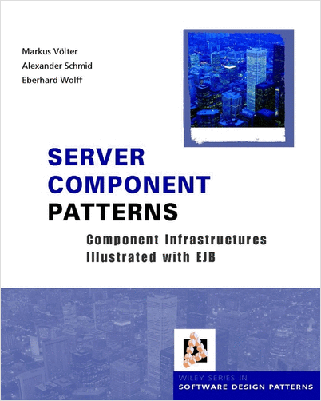
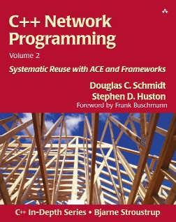
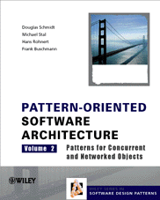
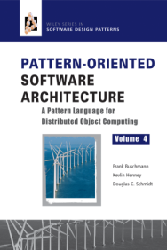
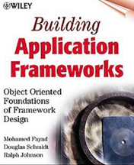
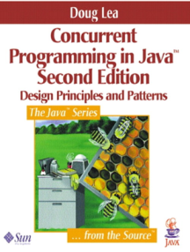
Topics Covered in this Section of Modules
Summarize key pattern concepts
Give examples of common patterns related to concurrent & networked software
Explore relationships between patterns
Summarize key framework concepts & their relations to patterns
Give examples of frameworks related to concurrent & networked software
Summarize benefits & limitations of patterns & frameworks
Reference additional info about patterns & frameworks
blog.sei.cmu.edu/archives.cfm/category/reflections-on-software-architecture

Slide 24
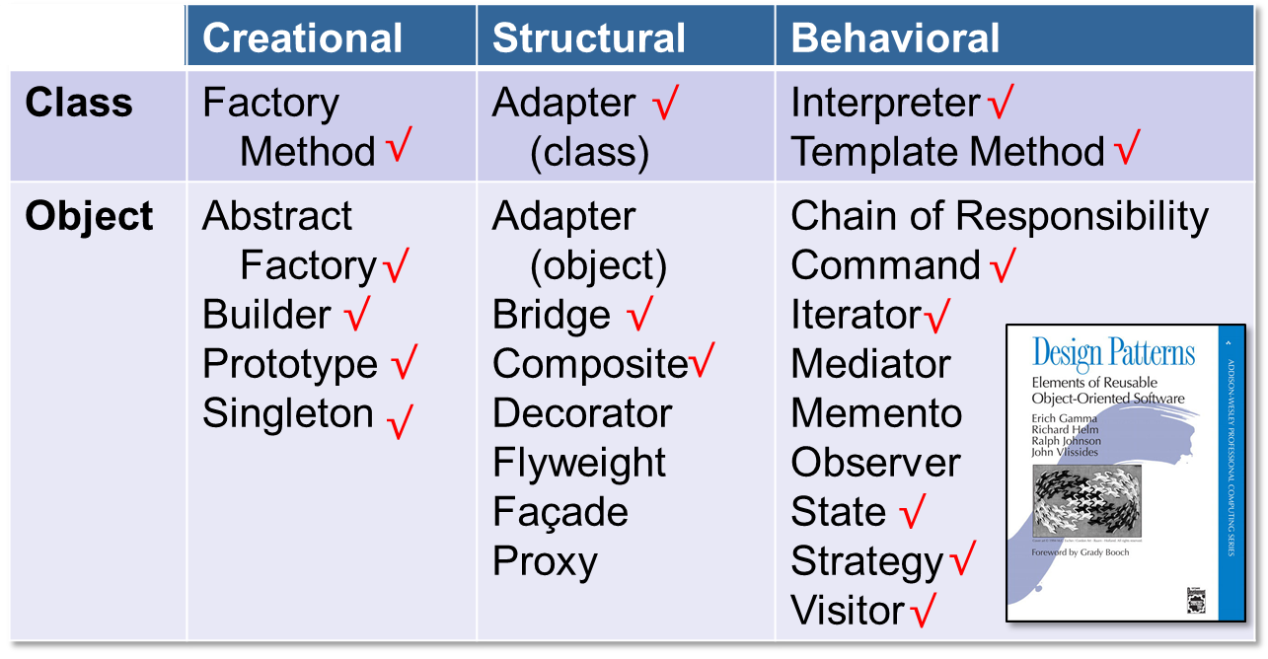
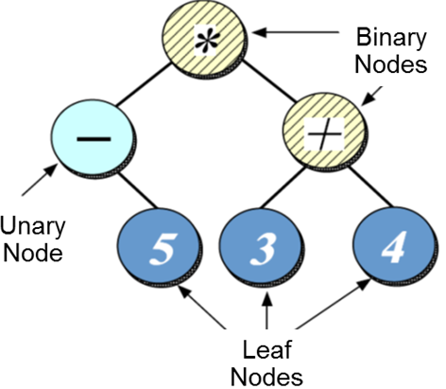
Topics Covered in this Section of Modules
Summarize key pattern concepts
Give examples of common patterns related to concurrent & networked software
Explore relationships between patterns
Summarize key framework concepts & their relations to patterns
Give examples of frameworks related to concurrent & networked software
Summarize benefits & limitations of patterns & frameworks
Reference additional info about patterns & frameworks
See Appendix for a case study of “Gang of Four” (GoF) patterns

