Slide 1



Overview of JAWS Web Server Case Study: Part 1
Douglas C. Schmidt
d.schmidt@vanderbilt.edu
www.dre.vanderbilt.edu/~schmidt
Professor of Computer Science
Institute for Software Integrated Systems Vanderbilt University Nashville, Tennessee, USA

Slide 2
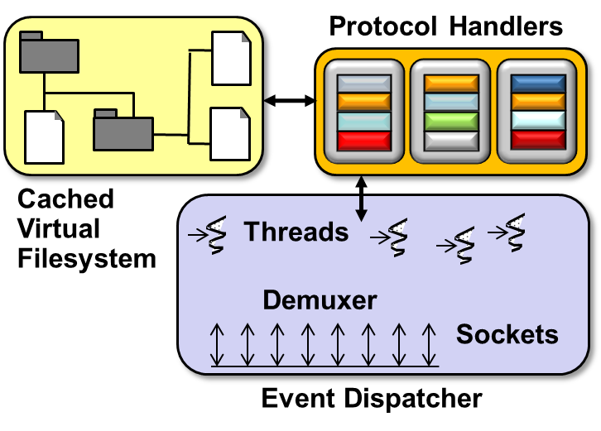
Topics Covered in this Part of the Module
Describe the pattern-oriented JAWS web server case study

Slide 3
Web Server Overview
Goal: Download web content scalably, efficiently, & robustly
HTTP Client
GET /index.html HTTP/1.0
HTTP Server
www.dre.vanderbilt.edu
<H1>DOC Group page</H1>...
HTML Parser
File Cache
Protocol Handlers
GUI
Requestor
Event Dispatcher
Transport Protocol (TCP)
OS Kernel
OS Kernel
IP Network

Slide 4
Web Server Overview
Goal: Download web content scalably, efficiently, & robustly
Key Requirements
Portable to multiple operating systems & protocols
e.g., Windows, UNIX, real-time operating systems, etc.
HTTP Client
GET /index.html HTTP/1.0
HTTP Server
www.dre.vanderbilt.edu
<H1>DOC Group page</H1>...
HTML Parser
File Cache
Protocol Handlers
GUI
Requestor
Event Dispatcher
Transport Protocol (TCP)
OS Kernel
OS Kernel
IP Network

Slide 5
Web Server Overview
Goal: Download web content scalably, efficiently, & robustly
Key Requirements
Portable to multiple operating systems & protocols
Support many web server design alternatives
e.g., concurrency models, event demuxing models, file caching models, etc.
HTTP Client
GET /index.html HTTP/1.0
HTTP Server
www.dre.vanderbilt.edu
<H1>DOC Group page</H1>...
HTML Parser
File Cache
Protocol Handlers
GUI
Requestor
Event Dispatcher
Transport Protocol (TCP)
OS Kernel
OS Kernel
IP Network

Slide 6
Web Server Overview
Goal: Download web content scalably, efficiently, & robustly
Key Requirements
Portable to multiple operating systems & protocols
Support many web server design alternatives
Leverage advances in multi-processor hardware/software
e.g., multi-core, async I/O, etc.
HTTP Client
GET /index.html HTTP/1.0
HTTP Server
www.dre.vanderbilt.edu
<H1>DOC Group page</H1>...
HTML Parser
File Cache
Protocol Handlers
GUI
Requestor
Event Dispatcher
Transport Protocol (TCP)
OS Kernel
OS Kernel
IP Network

Slide 7
Web Server Overview
Goal: Download web content scalably, efficiently, & robustly
Key Requirements
Portable to multiple operating systems & protocols
Support many web server design alternatives
Leverage advances in multi-processor hardware/software
Operate effectively in various settings
e.g., even in the face of erroneous or malicious clients
HTTP Client
GET /index.html HTTP/1.0
HTTP Server
www.dre.vanderbilt.edu
<H1>DOC Group page</H1>...
HTML Parser
File Cache
Protocol Handlers
GUI
Requestor
Event Dispatcher
Transport Protocol (TCP)
OS Kernel
OS Kernel
IP Network

Slide 8
JAWS Web Server Architecture
JAWS is a pattern-oriented web server implemented using ACE frameworks
Performs parsing & protocol processing of HTTP requests
Improves web server performance by reducing the overhead of file system accesses when processing HTTP GET requests
Transport Protocol
Accepts client connection request events, receives HTTP GET requests, & performs event demultiplexing & concurrency strategies
OS Kernel
JAWS is available in open-source ACE release at download.dre.vanderbilt.edu

Slide 9
Key Sources of Variability in JAWS
File caching models, e.g., LRU, LFU, etc.
Transfer protocols, e.g., HTTP 1.0, 1.1, etc.
Concurrency models, e.g., thread-per-connection, various thread pools, etc.
Event demuxing models, e.g., sync, async, etc.
Transport Protocol
Operating system & transport protocol APIs, e.g., Windows, UNIX, RTOS, etc.
OS Kernel
Patterns & frameworks support a variation-oriented design process

Slide 10
A Variation-oriented Design Process
Pattern & Framework Knowledge
Trade-off Analysis
Design & Implementation Decisions
Implement & Integrate w/ Patterns & Frameworks

Slide 11
Summary
JAWS is a pattern-oriented open-source web server that’s been optimized for high performance, e.g.:
Uses lightweight concurrency models
Minimizes locking
Applies file caching & memory mapping
Uses “gather-write” I/O mechanisms
Minimizes logging
Pre-computes HTTP responses
Avoids excessive time() calls
Optimizes the transport interface

Slide 12
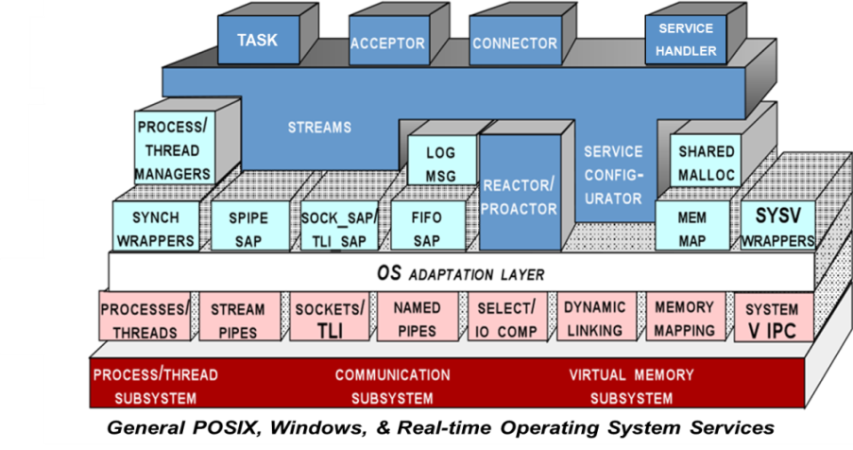
Summary
JAWS is a pattern-oriented open-source web server that’s been optimized for high performance, e.g.:
Uses lightweight concurrency models
Minimizes locking
Applies file caching & memory mapping
Uses "gather-write" I/O mechanisms
Minimizes logging
Pre-computes HTTP responses
Avoids excessive time() calls
Optimizes the transport interface
There are multiple versions of JAWS in ACE
ACE_ROOT/apps/{JAWS,JAW2,JAW3}
See www.dre.vanderbilt.edu/JAWS for more info & papers on JAWS

Slide 13
Overview of JAWS Web Server Case Study: Part 2
Douglas C. Schmidt
d.schmidt@vanderbilt.edu
www.dre.vanderbilt.edu/~schmidt
Professor of Computer Science
Institute for Software Integrated Systems Vanderbilt University Nashville, Tennessee, USA

Slide 14
Topics Covered in this Part of the Module
Describe the pattern-oriented JAWS web server case study
Summarize the patterns in the JAWS web server design
Design Problem | Pattern(s)
Encapsulating low-level OS APIs | Wrapper Facade
Decoupling event demuxing & connection management from protocol processing | Reactor & Acceptor-Connector
Scaling up performance via multi-threading | Half-Sync/Half-Async & Active Object
Synchronized request queue | Monitor Object
Minimizing multi-threading overhead | Leader/Followers
Using asynchronous I/O effectively | Proactor
Efficiently demuxing asynchronous operations & completions | Asynchronous Completion Token
Enhancing server (re)configurability | Component Configurator
Minimizing unused server resources | Activator
Transparently parameterizing synchronization into components | Strategized Locking
Ensuring locks are released properly | Scoped Locking
Minimizing unnecessary locking | Thread-Safe Interface

Slide 15

Outline of the Design Space for POSA2 Patterns
Effectively design & configure app access to interfaces & implementations of evolving services & components
Service Access & Configuration Patterns | Event Handling Patterns | Concurrency Patterns | Synchronization Patterns
Wrapper Facade | Reactor | Active Object | Strategized Locking
Component Configurator | Proactor | Half-Sync/Half-Async | Scoped Locking
Interceptor | Acceptor-Connector | Leader/Followers | Thread-Safe Interface
Extension Interface | Asynchronous Completion Token | Monitor Object | Double-Checked Locking Optimization
 |  | Thread-Specific Storage

Slide 16
Outline of the Design Space for POSA2 Patterns
Simplify development of flexible & efficient event-driven apps
Service Access & Configuration Patterns | Event Handling Patterns | Concurrency Patterns | Synchronization Patterns
Wrapper Facade | Reactor | Active Object | Strategized Locking
Component Configurator | Proactor | Half-Sync/Half-Async | Scoped Locking
Interceptor | Acceptor-Connector | Leader/Followers | Thread-Safe Interface
Extension Interface | Asynchronous Completion Token | Monitor Object | Double-Checked Locking Optimization
 |  | Thread-Specific Storage

Slide 17
Outline of the Design Space for POSA2 Patterns
Enhance design & performance of multi-threaded concurrent & networked software
Service Access & Configuration Patterns | Event Handling Patterns | Concurrency Patterns | Synchronization Patterns
Wrapper Facade | Reactor | Active Object | Strategized Locking
Component Configurator | Proactor | Half-Sync/Half-Async | Scoped Locking
Interceptor | Acceptor-Connector | Leader/Followers | Thread-Safe Interface
Extension Interface | Asynchronous Completion Token | Monitor Object | Double-Checked Locking Optimization
 |  | Thread-Specific Storage

Slide 18
Outline of the Design Space for POSA2 Patterns
Provide flexible solutions to common problems related to synchronizing concurrent objects
Service Access & Configuration Patterns | Event Handling Patterns | Concurrency Patterns | Synchronization Patterns
Wrapper Facade | Reactor | Active Object | Strategized Locking
Component Configurator | Proactor | Half-Sync/Half-Async | Scoped Locking
Interceptor | Acceptor-Connector | Leader/Followers | Thread-Safe Interface
Extension Interface | Asynchronous Completion Token | Monitor Object | Double-Checked Locking Optimization
 |  | Thread-Specific Storage

Slide 19
Outline of the Design Space for POSA2 Patterns
Service Access & Configuration Patterns | Event Handling Patterns | Concurrency Patterns | Synchronization Patterns
Wrapper Facade | Reactor | Active Object | Strategized Locking
Component Configurator | Proactor | Half-Sync/Half-Async | Scoped Locking
Interceptor | Acceptor-Connector | Leader/Followers | Thread-Safe Interface
Extension Interface | Asynchronous Completion Token | Monitor Object | Double-Checked Locking Optimization
 |  | Thread-Specific Storage
√
√
√
√
√
√
√
√
√
√
√
√
√
√
www.dre.vanderbilt.edu/POSA has info on POSA2 book

Slide 20
Design Problems & Pattern-Oriented Solutions
Many design problems faced developing JAWS can be resolved via POSA2 (& GoF) patterns
Design Problem | Pattern(s)
Encapsulating low-level OS APIs | Wrapper Facade
Decoupling event demuxing & connection management from protocol processing | Reactor & Acceptor-Connector
Scaling up performance via multi-threading | Half-Sync/Half-Async & Active Object
Synchronized request queue | Monitor Object
Minimizing multi-threading overhead | Leader/Followers
Using asynchronous I/O effectively | Proactor
Efficiently demuxing asynchronous operations & completions | Asynchronous Completion Token
Enhancing server (re)configurability | Component Configurator
Minimizing unused server resources | Activator
Transparently parameterizing synchronization into components | Strategized Locking
Ensuring locks are released properly | Scoped Locking
Minimizing unnecessary locking | Thread-Safe Interface

Slide 21
Design Problems & Pattern-Oriented Solutions
Many design problems faced developing JAWS can be resolved via POSA2 (& GoF) patterns
Design Problem | Pattern(s)
Encapsulating low-level OS APIs | Wrapper Facade
Decoupling event demuxing & connection management from protocol processing | Reactor & Acceptor-Connector
Scaling up performance via multi-threading | Half-Sync/Half-Async & Active Object
Synchronized request queue | Monitor Object
Minimizing multi-threading overhead | Leader/Followers
Using asynchronous I/O effectively | Proactor
Efficiently demuxing asynchronous operations & completions | Asynchronous Completion Token
Enhancing server (re)configurability | Component Configurator
Minimizing unused server resources | Activator
Transparently parameterizing synchronization into components | Strategized Locking
Ensuring locks are released properly | Scoped Locking
Minimizing unnecessary locking | Thread-Safe Interface

Slide 22
Design Problems & Pattern-Oriented Solutions
Many design problems faced developing JAWS can be resolved via POSA2 (& GoF) patterns
Design Problem | Pattern(s)
Encapsulating low-level OS APIs | Wrapper Facade
Decoupling event demuxing & connection management from protocol processing | Reactor & Acceptor-Connector
Scaling up performance via multi-threading | Half-Sync/Half-Async & Active Object
Synchronized request queue | Monitor Object
Minimizing multi-threading overhead | Leader/Followers
Using asynchronous I/O effectively | Proactor
Efficiently demuxing asynchronous operations & completions | Asynchronous Completion Token
Enhancing server (re)configurability | Component Configurator
Minimizing unused server resources | Activator
Transparently parameterizing synchronization into components | Strategized Locking
Ensuring locks are released properly | Scoped Locking
Minimizing unnecessary locking | Thread-Safe Interface

Slide 23
Design Problems & Pattern-Oriented Solutions
Many design problems faced developing JAWS can be resolved via POSA2 (& GoF) patterns
Design Problem | Pattern(s)
Encapsulating low-level OS APIs | Wrapper Facade
Decoupling event demuxing & connection management from protocol processing | Reactor & Acceptor-Connector
Scaling up performance via multi-threading | Half-Sync/Half-Async & Active Object
Synchronized request queue | Monitor Object
Minimizing multi-threading overhead | Leader/Followers
Using asynchronous I/O effectively | Proactor
Efficiently demuxing asynchronous operations & completions | Asynchronous Completion Token
Enhancing server (re)configurability | Component Configurator
Minimizing unused server resources | Activator
Transparently parameterizing synchronization into components | Strategized Locking
Ensuring locks are released properly | Scoped Locking
Minimizing unnecessary locking | Thread-Safe Interface

Slide 24
Design Problems & Pattern-Oriented Solutions
Many design problems faced developing JAWS can be resolved via POSA2 (& GoF) patterns
Design Problem | Pattern(s)
Encapsulating low-level OS APIs | Wrapper Facade
Decoupling event demuxing & connection management from protocol processing | Reactor & Acceptor-Connector
Scaling up performance via multi-threading | Half-Sync/Half-Async & Active Object
Synchronized request queue | Monitor Object
Minimizing multi-threading overhead | Leader/Followers
Using asynchronous I/O effectively | Proactor
Efficiently demuxing asynchronous operations & completions | Asynchronous Completion Token
Enhancing server (re)configurability | Component Configurator
Minimizing unused server resources | Activator
Transparently parameterizing synchronization into components | Strategized Locking
Ensuring locks are released properly | Scoped Locking
Minimizing unnecessary locking | Thread-Safe Interface

Slide 25
Design Problems & Pattern-Oriented Solutions
Many design problems faced developing JAWS can be resolved via POSA2 (& GoF) patterns
Design Problem | Pattern(s)
Encapsulating low-level OS APIs | Wrapper Facade
Decoupling event demuxing & connection management from protocol processing | Reactor & Acceptor-Connector
Scaling up performance via multi-threading | Half-Sync/Half-Async & Active Object
Synchronized request queue | Monitor Object
Minimizing multi-threading overhead | Leader/Followers
Using asynchronous I/O effectively | Proactor
Efficiently demuxing asynchronous operations & completions | Asynchronous Completion Token
Enhancing server (re)configurability | Component Configurator
Minimizing unused server resources | Activator
Transparently parameterizing synchronization into components | Strategized Locking
Ensuring locks are released properly | Scoped Locking
Minimizing unnecessary locking | Thread-Safe Interface

Slide 26
Design Problems & Pattern-Oriented Solutions
Many design problems faced developing JAWS can be resolved via POSA2 (& GoF) patterns
Design Problem | Pattern(s)
Encapsulating low-level OS APIs | Wrapper Facade
Decoupling event demuxing & connection management from protocol processing | Reactor & Acceptor-Connector
Scaling up performance via multi-threading | Half-Sync/Half-Async & Active Object
Synchronized request queue | Monitor Object
Minimizing multi-threading overhead | Leader/Followers
Using asynchronous I/O effectively | Proactor
Efficiently demuxing asynchronous operations & completions | Asynchronous Completion Token
Enhancing server (re)configurability | Component Configurator
Minimizing unused server resources | Activator
Transparently parameterizing synchronization into components | Strategized Locking
Ensuring locks are released properly | Scoped Locking
Minimizing unnecessary locking | Thread-Safe Interface

Slide 27
Design Problems & Pattern-Oriented Solutions
Many design problems faced developing JAWS can be resolved via POSA2 (& GoF) patterns
Design Problem | Pattern(s)
Encapsulating low-level OS APIs | Wrapper Facade
Decoupling event demuxing & connection management from protocol processing | Reactor & Acceptor-Connector
Scaling up performance via multi-threading | Half-Sync/Half-Async & Active Object
Synchronized request queue | Monitor Object
Minimizing multi-threading overhead | Leader/Followers
Using asynchronous I/O effectively | Proactor
Efficiently demuxing asynchronous operations & completions | Asynchronous Completion Token
Enhancing server (re)configurability | Component Configurator
Minimizing unused server resources | Activator
Transparently parameterizing synchronization into components | Strategized Locking
Ensuring locks are released properly | Scoped Locking
Minimizing unnecessary locking | Thread-Safe Interface

Slide 28

Design Problems & Pattern-Oriented Solutions
Many design problems faced developing JAWS can be resolved via POSA2 (& GoF) patterns
Design Problem | Pattern(s)
Encapsulating low-level OS APIs | Wrapper Facade
Decoupling event demuxing & connection management from protocol processing | Reactor & Acceptor-Connector
Scaling up performance via multi-threading | Half-Sync/Half-Async & Active Object
Synchronized request queue | Monitor Object
Minimizing multi-threading overhead | Leader/Followers
Using asynchronous I/O effectively | Proactor
Efficiently demuxing asynchronous operations & completions | Asynchronous Completion Token
Enhancing server (re)configurability | Component Configurator
Minimizing unused server resources | Activator
Transparently parameterizing synchronization into components | Strategized Locking
Ensuring locks are released properly | Scoped Locking
Minimizing unnecessary locking | Thread-Safe Interface

Slide 29
Design Problems & Pattern-Oriented Solutions
Many design problems faced developing JAWS can be resolved via POSA2 (& GoF) patterns
Design Problem | Pattern(s)
Encapsulating low-level OS APIs | Wrapper Facade
Decoupling event demuxing & connection management from protocol processing | Reactor & Acceptor-Connector
Scaling up performance via multi-threading | Half-Sync/Half-Async & Active Object
Synchronized request queue | Monitor Object
Minimizing multi-threading overhead | Leader/Followers
Using asynchronous I/O effectively | Proactor
Efficiently demuxing asynchronous operations & completions | Asynchronous Completion Token
Enhancing server (re)configurability | Component Configurator
Minimizing unused server resources | Activator
Transparently parameterizing synchronization into components | Strategized Locking
Ensuring locks are released properly | Scoped Locking
Minimizing unnecessary locking | Thread-Safe Interface

Slide 30
Design Problems & Pattern-Oriented Solutions
Many design problems faced developing JAWS can be resolved via POSA2 (& GoF) patterns
Design Problem | Pattern(s)
Encapsulating low-level OS APIs | Wrapper Facade
Decoupling event demuxing & connection management from protocol processing | Reactor & Acceptor-Connector
Scaling up performance via multi-threading | Half-Sync/Half-Async & Active Object
Synchronized request queue | Monitor Object
Minimizing multi-threading overhead | Leader/Followers
Using asynchronous I/O effectively | Proactor
Efficiently demuxing asynchronous operations & completions | Asynchronous Completion Token
Enhancing server (re)configurability | Component Configurator
Minimizing unused server resources | Activator
Transparently parameterizing synchronization into components | Strategized Locking
Ensuring locks are released properly | Scoped Locking
Minimizing unnecessary locking | Thread-Safe Interface

Slide 31
Design Problems & Pattern-Oriented Solutions
Many design problems faced developing JAWS can be resolved via POSA2 (& GoF) patterns
Design Problem | Pattern(s)
Encapsulating low-level OS APIs | Wrapper Facade
Decoupling event demuxing & connection management from protocol processing | Reactor & Acceptor-Connector
Scaling up performance via multi-threading | Half-Sync/Half-Async & Active Object
Synchronized request queue | Monitor Object
Minimizing multi-threading overhead | Leader/Followers
Using asynchronous I/O effectively | Proactor
Efficiently demuxing asynchronous operations & completions | Asynchronous Completion Token
Enhancing server (re)configurability | Component Configurator
Minimizing unused server resources | Activator
Transparently parameterizing synchronization into components | Strategized Locking
Ensuring locks are released properly | Scoped Locking
Minimizing unnecessary locking | Thread-Safe Interface

Slide 32
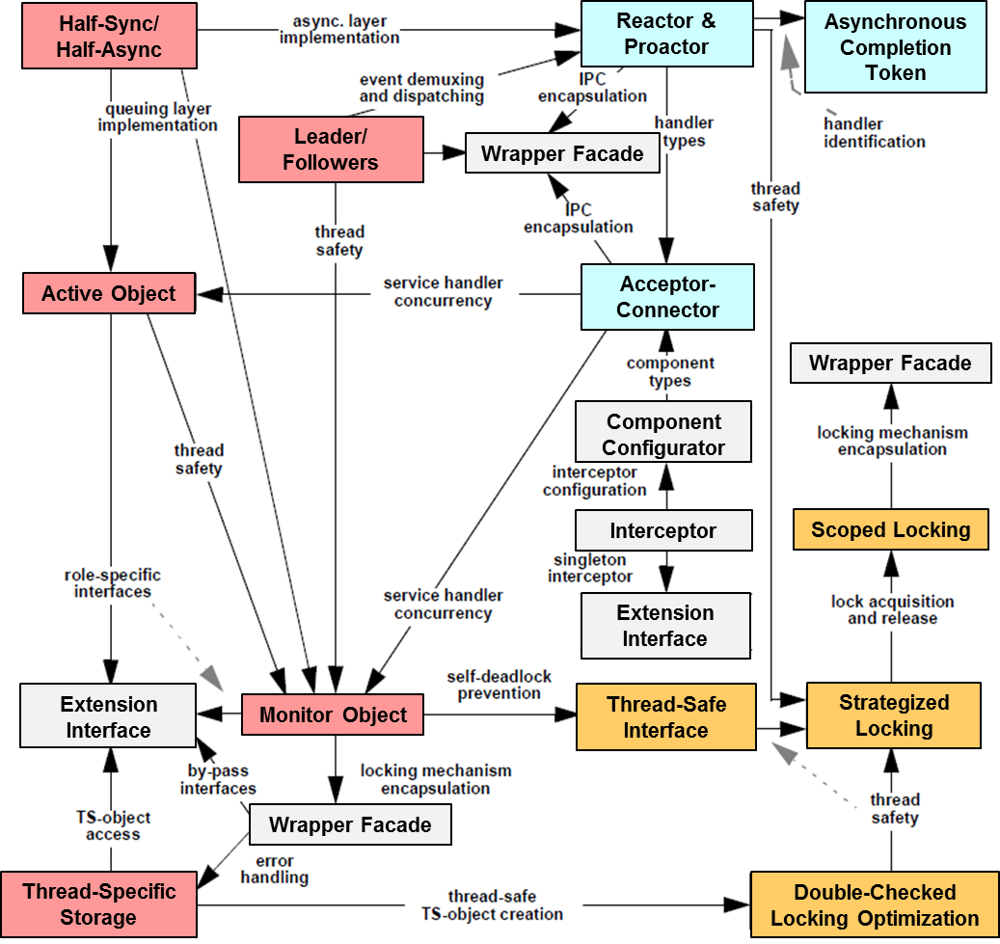
Summary
POSA2 patterns direct developers towards strategic elements of concurrent & networked software
The impact of many accidental & inherent complexities can be alleviated if strategic elements are properly addressed
Naturally, these patterns aren’t limited just to web servers!!

Slide 33


Summary
POSA2 patterns direct developers towards strategic elements of concurrent & networked software
The impact of many accidental & inherent complexities can be alleviated if strategic elements are properly addressed
POSA2 patterns also redirect developers from preoccupation with low-level OS & networking protocols & mechanisms
While having a solid grasp of these topics is important, they are tactical in scope
Notes:
http://www.flickr.com/photos/48380660@N04/4670622965/

Slide 34




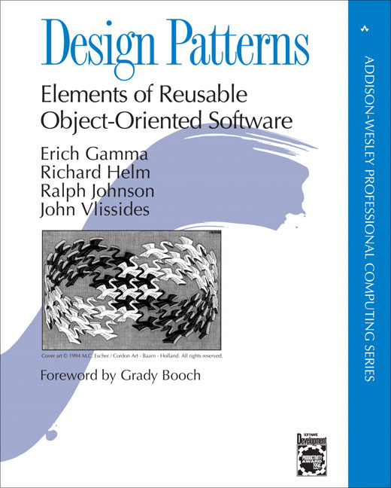


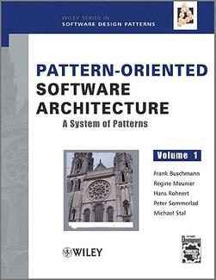
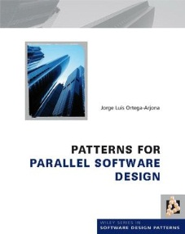
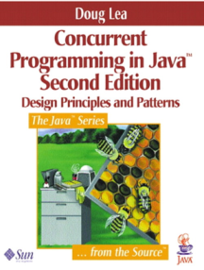
Summary
POSA2 patterns direct developers towards strategic elements of concurrent & networked software
The impact of many accidental & inherent complexities can be alleviated if strategic elements are properly addressed
POSA2 patterns also redirect developers from preoccupation with low-level OS & networking protocols & mechanisms
While having a solid grasp of these topics is important, they are tactical in scope
Combining POSA2 patterns with patterns from GoF & other sources helps create more powerful & comprehensive pattern languages
Notes:
http://www.flickr.com/photos/48380660@N04/4670622965/

Slide 35
Overview of JAWS Web Server Case Study: Part 3
Douglas C. Schmidt
d.schmidt@vanderbilt.edu
www.dre.vanderbilt.edu/~schmidt
Professor of Computer Science
Institute for Software Integrated Systems Vanderbilt University Nashville, Tennessee, USA

Slide 36
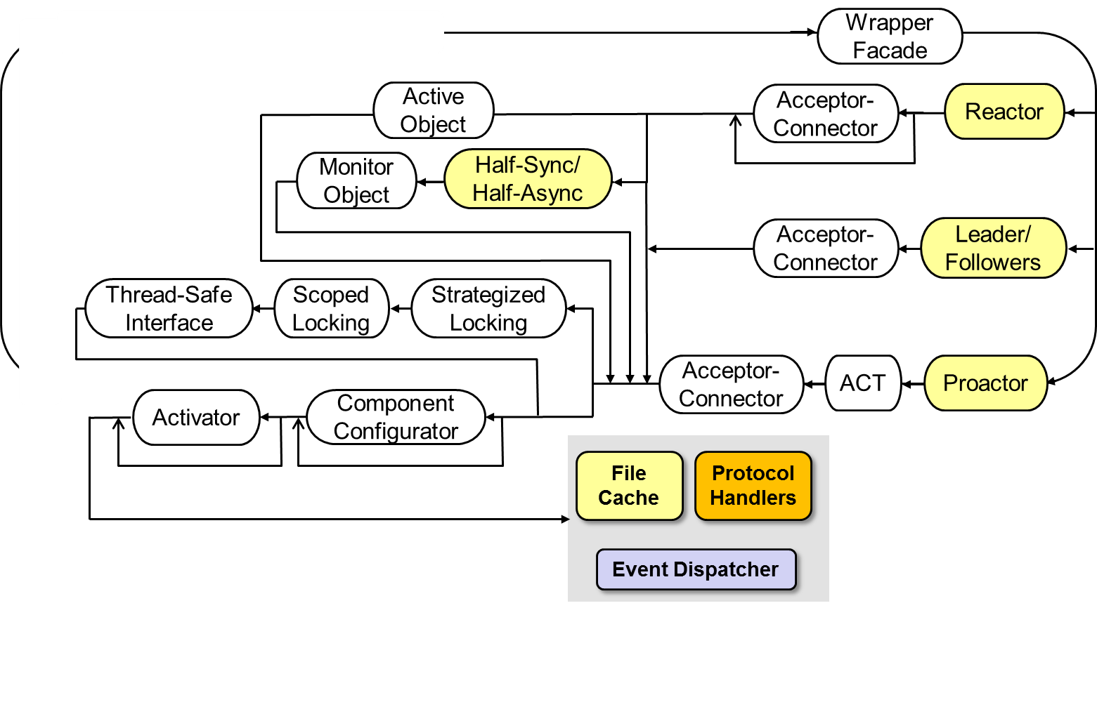
Topics Covered in this Part of the Module
Describe the pattern-oriented JAWS web server case study
Summarize the patterns in the JAWS web server design
Present a pattern language for the JAWS web server

Slide 37
Recap of Pattern Languages
Pattern languages are groups of related patterns that define a vocabulary & process for the orderly resolution of development problems in particular domains
en.wikipedia.org/wiki/Pattern_language has broader pattern language usages

Slide 38
Recap of Pattern Languages
Pattern languages are groups of related patterns that define a vocabulary & process for the orderly resolution of development problems in particular domains
The patterns in a pattern language build on each other to help generate a system by documenting a successive progression of design decisions, transformations, & alternatives
Design Problem | Pattern(s)
Encapsulating low-level OS APIs | Wrapper Facade
Decoupling event demuxing & connection management from protocol processing | Reactor & Acceptor-Connector
Scaling up performance via multi-threading | Half-Sync/Half-Async & Active Object
Synchronized request queue | Monitor Object
Minimizing multi-threading overhead | Leader/Followers
Using asynchronous I/O effectively | Proactor
Efficiently demuxing asynchronous operations & completions | Asynchronous Completion Token
Enhancing server (re)configurability | Component Configurator
Minimizing unused server resources | Activator
Transparently parameterizing synchronization into components | Strategized Locking
Ensuring locks are released properly | Scoped Locking
Minimizing unnecessary locking | Thread-Safe Interface

Slide 39
A Pattern Language for the JAWS Web Server
Wrapper Facade
Active Object
Acceptor- Connector
Reactor
Monitor Object
Half-Sync/ Half-Async
Acceptor- Connector
Leader/ Followers
Thread-Safe Interface
Scoped Locking
Strategized Locking
Acceptor- Connector
ACT
Proactor
Activator
Component Configurator
File Cache
Protocol Handlers
Event Dispatcher
This pattern language for the JAWS web server is not comprehensive

Slide 40
A Pattern Language for the JAWS Web Server
Wrapper Facade
Active Object
Acceptor- Connector
Reactor
Monitor Object
Half-Sync/ Half-Async
Acceptor- Connector
Leader/ Followers
Thread-Safe Interface
Scoped Locking
Strategized Locking
Acceptor- Connector
ACT
Proactor
Activator
Component Configurator
File Cache
Protocol Handlers
Event Dispatcher
Simple, reactive, but non-scalable

Slide 41
A Pattern Language for the JAWS Web Server
Wrapper Facade
Active Object
Acceptor- Connector
Reactor
Monitor Object
Half-Sync/ Half-Async
Acceptor- Connector
Leader/ Followers
Thread-Safe Interface
Scoped Locking
Strategized Locking
Acceptor- Connector
ACT
Proactor
Activator
Component Configurator
File Cache
Protocol Handlers
Event Dispatcher
Simple, reactive, flexible, & more (coarse-grained) scalable

Slide 42
A Pattern Language for the JAWS Web Server
Wrapper Facade
Active Object
Acceptor- Connector
Reactor
Monitor Object
Half-Sync/ Half-Async
Acceptor- Connector
Leader/ Followers
Thread-Safe Interface
Scoped Locking
Strategized Locking
Acceptor- Connector
ACT
Proactor
Activator
Component Configurator
File Cache
Protocol Handlers
Event Dispatcher
Simple, concurrent, & more (fine-grained) scalable

Slide 43
A Pattern Language for the JAWS Web Server
Wrapper Facade
Active Object
Acceptor- Connector
Reactor
Monitor Object
Half-Sync/ Half-Async
Acceptor- Connector
Leader/ Followers
Thread-Safe Interface
Scoped Locking
Strategized Locking
Acceptor- Connector
ACT
Proactor
Activator
Component Configurator
File Cache
Protocol Handlers
Event Dispatcher
Concurrent & scalable, but may be less predictable

Slide 44
A Pattern Language for the JAWS Web Server
Wrapper Facade
Active Object
Acceptor- Connector
Reactor
Monitor Object
Half-Sync/ Half-Async
Acceptor- Connector
Leader/ Followers
Thread-Safe Interface
Scoped Locking
Strategized Locking
Acceptor- Connector
ACT
Proactor
Activator
Component Configurator
File Cache
Protocol Handlers
Event Dispatcher
Concurrent, predictable, but may be less scalable

Slide 45
A Pattern Language for the JAWS Web Server
Wrapper Facade
Active Object
Acceptor- Connector
Reactor
Monitor Object
Half-Sync/ Half-Async
Acceptor- Connector
Leader/ Followers
Thread-Safe Interface
Scoped Locking
Strategized Locking
Acceptor- Connector
ACT
Proactor
Activator
Component Configurator
File Cache
Protocol Handlers
Event Dispatcher
Asynchronous, concurrent, scalable, but limited portability

Slide 46
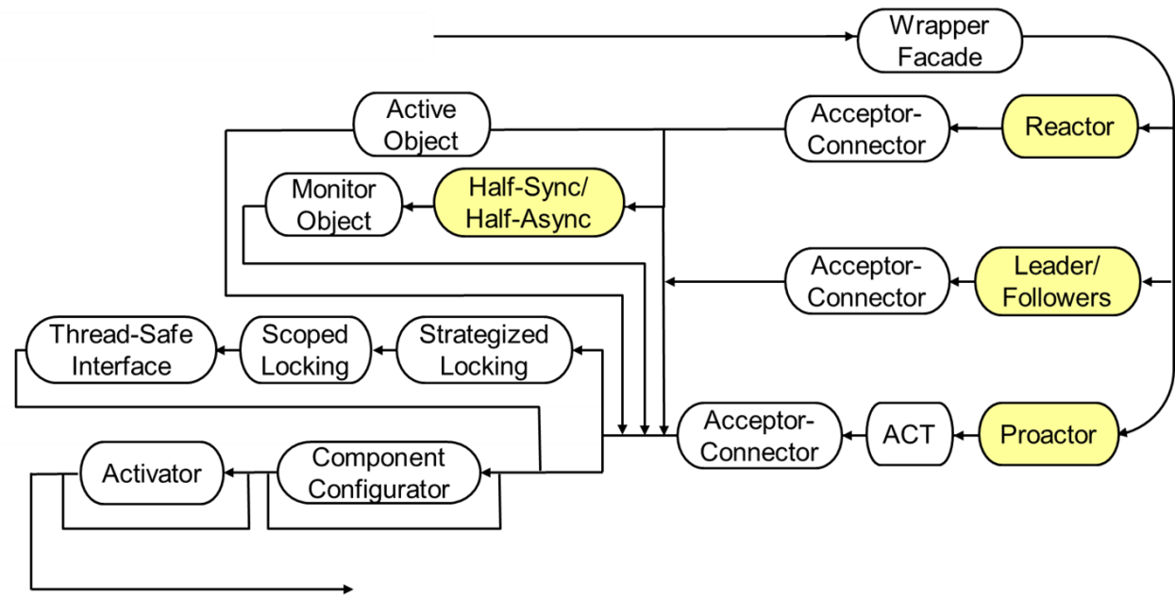
Summary
The pattern language applied to JAWS helps to systematically document & evaluate alternative paths through the design space

Slide 47

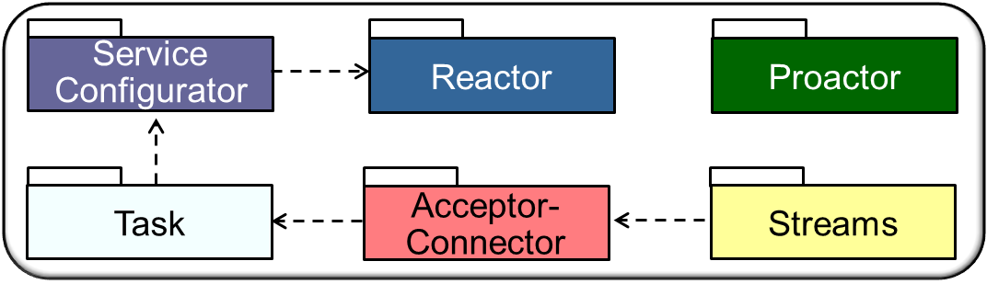
Summary
The pattern language applied to JAWS helps to systematically document & evaluate alternative paths through the design space
Wrapper facades & frameworks provided by ACE middleware can implement this pattern language
See www.dre.vanderbilt.edu/ACE for more info on ACE

