Slide 1


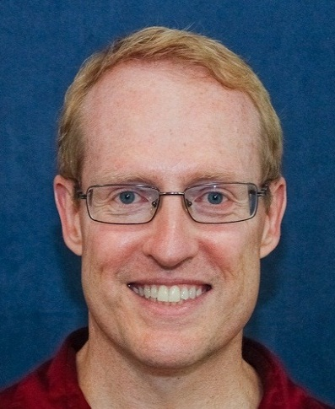
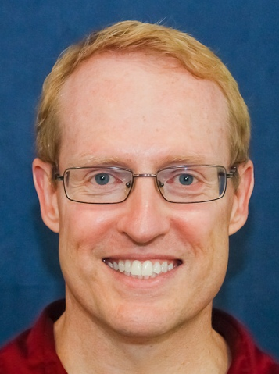

More Info on Patterns & Frameworks
Douglas C. Schmidt
d.schmidt@vanderbilt.edu
www.dre.vanderbilt.edu/~schmidt
Professor of Computer Science
Institute for Software Integrated Systems Vanderbilt University Nashville, Tennessee, USA

Slide 2
Topics Covered in this Module
Twenty years ago there wasn’t much info available on software patterns
e.g., some early papers on software patterns include
P. Coad, “Object-Oriented Patterns,” Communications of the ACM, 9/92
R. Johnson, “Documenting Frameworks using Patterns,” OOPSLA ’92
Gamma, Helm, Johnson, Vlissides, “Design Patterns: Abstraction & Reuse of Object-Oriented Design,” ECOOP ’93

Slide 3
Topics Covered in this Module
Twenty years ago there wasn’t much info available on software patterns
e.g., some early papers on software patterns include
P. Coad, “Object-Oriented Patterns,” Communications of the ACM, 9/92
R. Johnson, “Documenting Frameworks using Patterns,” OOPSLA ’92
Gamma, Helm, Johnson, Vlissides, “Design Patterns: Abstraction & Reuse of Object-Oriented Design,” ECOOP ’93
Coverage of software frameworks starts even further
e.g., some early papers on software frameworks include
R. Johnson & B. Foote, “Designing Reusable Classes”, Journal of Object-Oriented Programming, ’88
G. Andert, “Object Frameworks in the Taligent OS,” IEEE Compcon, ’94

Slide 4
Topics Covered in this Module
Twenty years ago there wasn’t much info available on software patterns
e.g., some early papers on software patterns include
P. Coad, “Object-Oriented Patterns,” Communications of the ACM, 9/92
R. Johnson, “Documenting Frameworks using Patterns,” OOPSLA ’92
Gamma, Helm, Johnson, Vlissides, “Design Patterns: Abstraction & Reuse of Object-Oriented Design,” ECOOP ’93
Coverage of software frameworks starts even early
e.g., some early papers on software frameworks include
R. Johnson & B. Foote, “Designing Reusable Classes”, Journal of Object-Oriented Programming, ’88
G. Andert, “Object Frameworks in the Taligent OS,” IEEE Compcon, ’94
This module provides pointers to some of the ever growing literature on these topics that have emerged over the past several decades

Slide 5
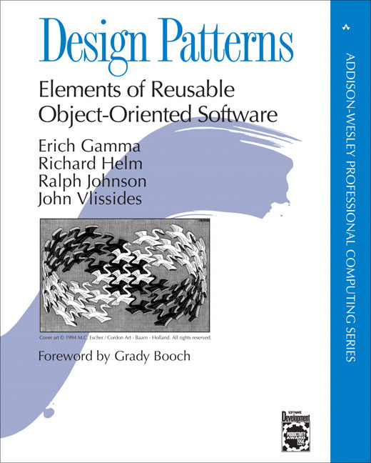
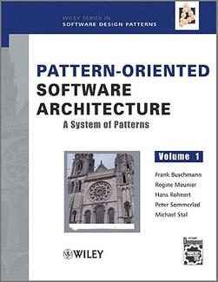
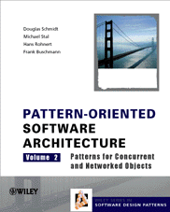

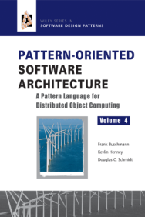

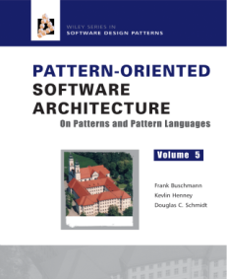
Some Software Pattern Books
Design Patterns: Elements of Reusable Object-Oriented Software, Gamma, et al., 0-201- 63361-2
Pattern-Oriented Software Architecture, Vol. 1, Buschmann, et al., 0-471-95869-7
Pattern-Oriented Software Architecture, Vol. 2, Schmidt, et al., 0-471-60695-2
Pattern-Oriented Software Architecture, Vol. 3, Jain & Kircher, 0-470-84525-2
Pattern-Oriented Software Architecture, Vol. 4, Buschmann, et al., 0-470-05902-8
Pattern-Oriented Software Architecture, Vol. 5, Buschmann, et al., 0-471-48648-5
Software Architecture: Perspectives on an Emerging Discipline, Shaw, et al., 0-131-82957-2

Slide 6


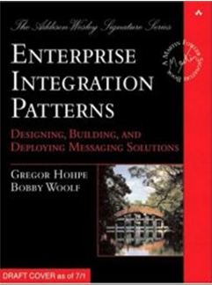
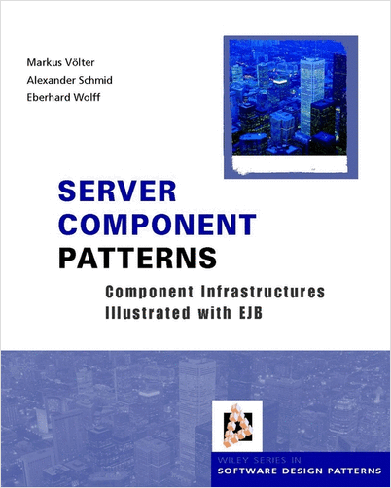
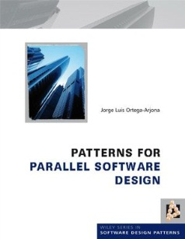


Some Software Pattern Books (cont’d)
Pattern Hatching, Vlissides, 0-201-43293-5
Core J2EE Patterns, Alur, et al., 0-131-42246-4
Enterprise Integration Patterns, Hohpe & Wolfe, 0-321-20068-3
Server Component Patterns, Voelter, et al., 0-470-84319-5
Patterns for Parallel Software Design, Ortega-Arjona, 0-470-69734-2
Patterns for Fault Tolerant Software, Hanmer, et al., 0-470-31979-8
Security Patterns, Schumacher, et al., 0-470-85884-2

Slide 7

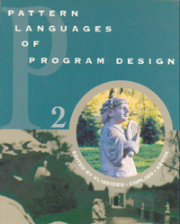
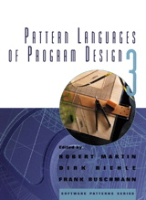
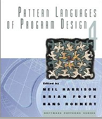
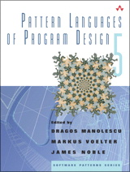
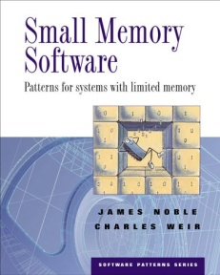
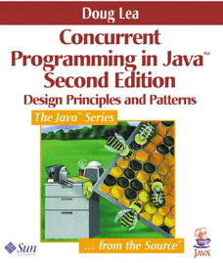
Some Software Pattern Books (cont’d)
Pattern Languages of Program Design
Vol. 1, Coplien, et al., eds., 0-201- 60734-4
Vol. 2, Vlissides, et al., eds., 0-201-89527-7
Vol. 3, Martin, et al., eds., 0-201- 31011-2
Vol. 4, Harrison, et al., eds., 0-201-43304-4
Vol. 5, Manolescu, et al., eds., 0-321-32194-4
Small Memory Software, Noble & Weir, 0-201-59607-5
Concurrent Programming in Java, 2nd ed., Lea, 0-201-31009-0
See www.hillside.net/patterns/books for more pattern books

Slide 8


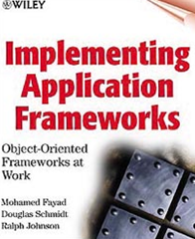
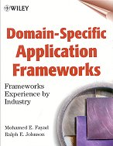
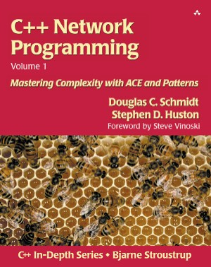
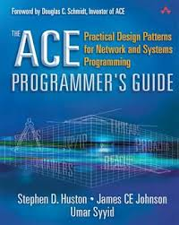
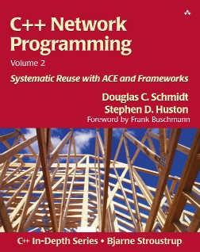
Some Software Framework Books
Inside Taligent Technology, Cotter, et al., 0-201-40970-4
Building Application Frameworks, Fayad, et al., 0-471-24875-4
Implementing Application Frameworks, Fayad, et al., 0-471-25201-8
Domain-Specific Application Frameworks, Fayad, et al., 0-471-33280-1
C++ Network Programming Vol 1., Schmidt, et al., 0-201-60464-7
C++ Network Programming Vol 2., Schmidt, et al., 0-201-79525-6
The ACE Programmer's Guide, Huston, et al., 0-201-69971-0

Slide 9

Pattern Conferences
The Hillside Group Sponsors many different conferences
e.g., PLoP, EuroPLoP, AsianPLoP, ScrumPLoP, VikingPLoP, SugarLoafPLoP, UP, & ChiliPLoP,
These conferences focus on writers workshops to better improve patterns through group exposure
See www.dre.vanderbilt.edu/~schmidt/writersworkshop.html for more information on writers workshops
Each conference offers advanced topics for more adept pattern writers
Participants have the opportunity to refine & extend their patterns with help from knowledgeable patterns enthusiasts
See hillside.net/conferences/ for more info on pattern conferences

Slide 10
Pattern Mailing Lists
patterns@cs.uiuc.edu: present & refine patterns
patterns-discussion@cs.uiuc.edu: general discussion
gang-of-4-patterns@cs.uiuc.edu: discussion on Design Patterns
siemens-patterns@cs.uiuc.edu: discussion on Pattern-Oriented Software Architecture
ui-patterns@cs.uiuc.edu: discussion on user interface patterns
business-patterns@cs.uiuc.edu: discussion on patterns for business processes
ipc-patterns@cs.uiuc.edu: discussion on patterns for distributed systems
See hillside.net/patterns/mailing-lists for patterns mailing lists

Slide 11
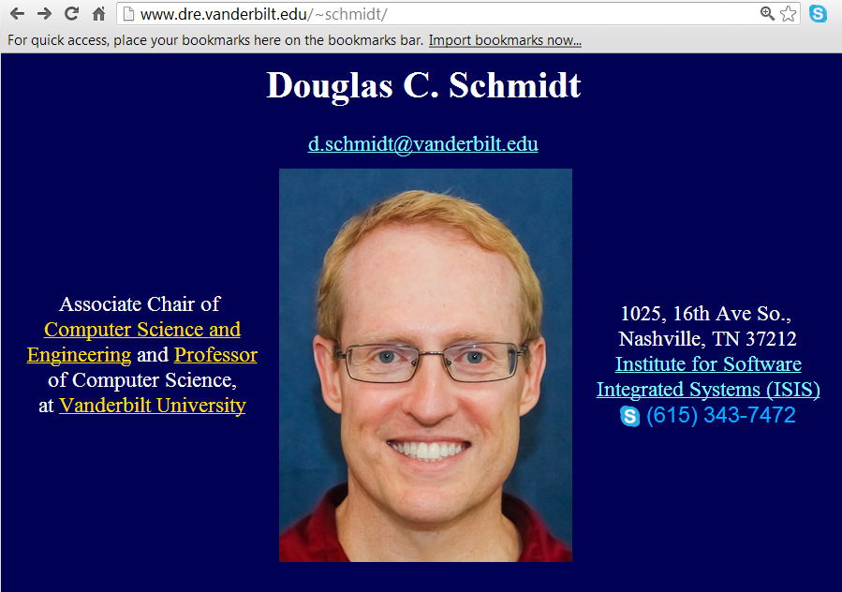
Summary
Other material I’ve created on patterns & frameworks
www.dre.vanderbilt.edu/~schmidt/ patterns-frameworks.html
My pattern & framework courses
www.dre.vanderbilt.edu/ ~schmidt/courses.html
My pattern & framework books
www.dre.vanderbilt.edu/ ~schmidt/POSA
www.dre.vanderbilt.edu/ ~schmidt/ACE
Presentations I’ve given on patterns & frameworks
www.dre.vanderbilt.edu/ ~schmidt/multimedia.html
Open-source software I’ve built based on patterns & frameworks
www.dre.vanderbilt.edu/ACE
www.dre.vanderbilt.edu/TAO

