Slide 1



Patterns & Frameworks for Service Configuration & Activation: Part 1
Douglas C. Schmidt
d.schmidt@vanderbilt.edu
www.dre.vanderbilt.edu/~schmidt
Professor of Computer Science
Institute for Software Integrated Systems Vanderbilt University Nashville, Tennessee, USA

Slide 2
Topics Covered in this Part of the Module
Describe the Component Configurator pattern
Component
Component
Repository
*
init()
fini()
suspend()
resume()
info()
components
Reactor_ HTTP_Server
<<contains>>
Component
Configurator
TPC_HTTP _Server
TP_HTTP _Server
TP_Reactor_ HTTP_Server

Slide 3
Enhancing Server (Re)Configurability
Context | Problem
Some implementations of web server components depend on static or dynamic factors e.g., # of cores, version of the OS, system workload, etc. | Prematurely committing to a web server configuration is inflexible/inefficient since some decisions can’t be made at design-time & apps incur overhead for unused or unneeded components
Protocol Handlers
Cached Virtual Filesystem
Threads
Demuxer
Sockets
Event Dispatcher

Slide 4
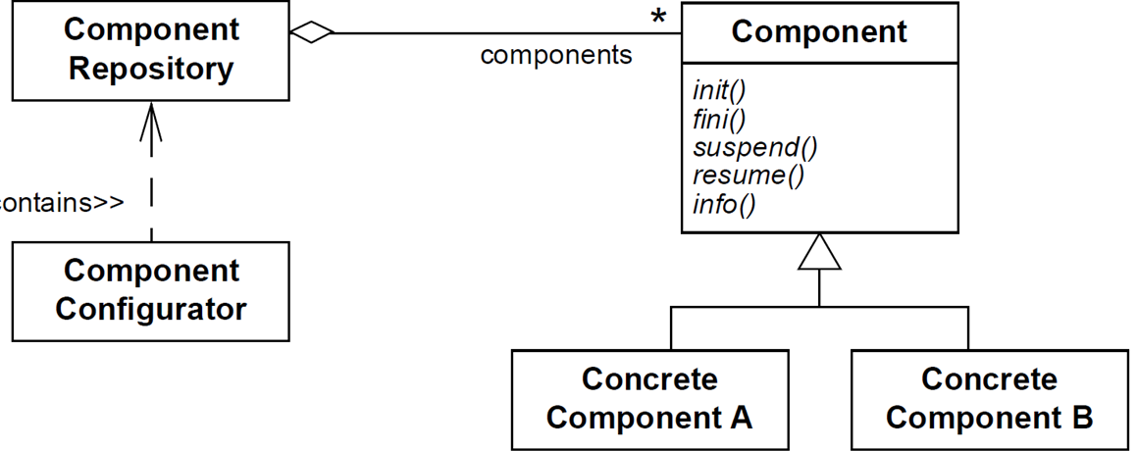
Enhancing Server (Re)Configurability
Context | Problem | Solution
Some implementations of web server components depend on static or dynamic factors e.g., # of cores, version of the OS, system workload, etc. | Prematurely committing to a web server configuration is inflexible/inefficient since some decisions can’t be made at design-time & apps incur overhead for unused or unneeded components | Apply the Component Configurator pattern to assemble desired web server components dynamically e.g., at installation-time or at runtime
Component Configurator decouples component interfaces from their implementations & can (re)configure components without having to shutdown & restart running apps
<<contains>>
Structure

Slide 5
Enhancing Server (Re)Configurability
Context | Problem | Solution
Some implementations of web server components depend on static or dynamic factors e.g., # of cores, version of the OS, system workload, etc. | Prematurely committing to a web server configuration is inflexible/inefficient since some decisions can’t be made at design-time & apps incur overhead for unused or unneeded components | Apply the Component Configurator pattern to assemble desired web server components dynamically e.g., at installation-time or at runtime
Component Configurator decouples component interfaces from their implementations & can (re)configure components without having to shutdown & restart running apps
<<contains>>
Structure

Slide 6
Enhancing Server (Re)Configurability
Context | Problem | Solution
Some implementations of web server components depend on static or dynamic factors e.g., # of cores, version of the OS, system workload, etc. | Prematurely committing to a web server configuration is inflexible/inefficient since some decisions can’t be made at design-time & apps incur overhead for unused or unneeded components | Apply the Component Configurator pattern to assemble desired web server components dynamically e.g., at installation-time or at runtime
Component Configurator decouples component interfaces from their implementations & can (re)configure components without having to shutdown & restart running apps
<<contains>>
Structure

Slide 7
Enhancing Server (Re)Configurability
Context | Problem | Solution
Some implementations of web server components depend on static or dynamic factors e.g., # of cores, version of the OS, system workload, etc. | Prematurely committing to a web server configuration is inflexible/inefficient since some decisions can’t be made at design-time & apps incur overhead for unused or unneeded components | Apply the Component Configurator pattern to assemble desired web server components dynamically e.g., at installation-time or at runtime
Component Configurator decouples component interfaces from their implementations & can (re)configure components without having to shutdown & restart running apps
<<contains>>
Structure
See www.dre.vanderbilt.edu/~schmidt/PDF/Svc-Conf.pdf for more info

Slide 8
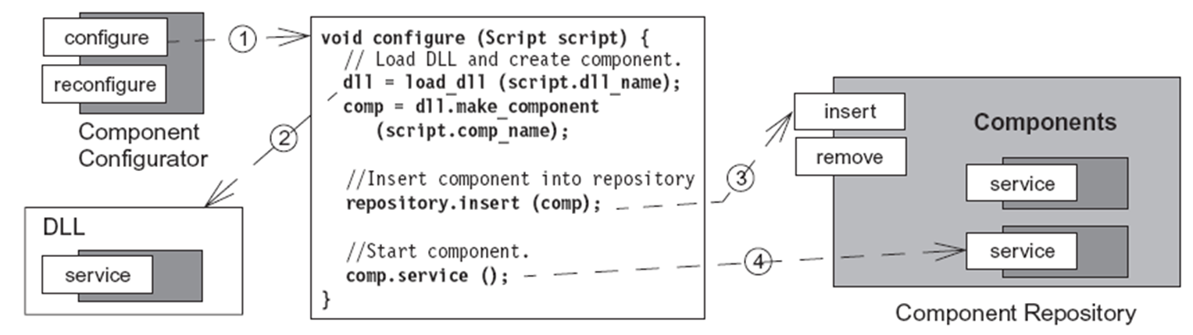
Enhancing Server (Re)Configurability
Context | Problem | Solution
Some implementations of web server components depend on static or dynamic factors e.g., # of cores, version of the OS, system workload, etc. | Prematurely committing to a web server configuration is inflexible/inefficient since some decisions can’t be made at design-time & apps incur overhead for unused or unneeded components | Apply the Component Configurator pattern to assemble desired web server components dynamically e.g., at installation-time or at runtime
Dynamics

Slide 9
Enhancing Server (Re)Configurability
Context | Problem | Solution
Some implementations of web server components depend on static or dynamic factors e.g., # of cores, version of the OS, system workload, etc. | Prematurely committing to a web server configuration is inflexible/inefficient since some decisions can’t be made at design-time & apps incur overhead for unused or unneeded components | Apply the Component Configurator pattern to assemble desired web server components dynamically e.g., at installation-time or at runtime
Dynamics

Slide 10
Enhancing Server (Re)Configurability
Context | Problem | Solution
Some implementations of web server components depend on static or dynamic factors e.g., # of cores, version of the OS, system workload, etc. | Prematurely committing to a web server configuration is inflexible/inefficient since some decisions can’t be made at design-time & apps incur overhead for unused or unneeded components | Apply the Component Configurator pattern to assemble desired web server components dynamically e.g., at installation-time or at runtime
Dynamics

Slide 11
Enhancing Server (Re)Configurability
Context | Problem | Solution
Some implementations of web server components depend on static or dynamic factors e.g., # of cores, version of the OS, system workload, etc. | Prematurely committing to a web server configuration is inflexible/inefficient since some decisions can’t be made at design-time & apps incur overhead for unused or unneeded components | Apply the Component Configurator pattern to assemble desired web server components dynamically e.g., at installation-time or at runtime
Dynamics
Examples include loadable device drivers, Java applets, & app servers

Slide 12
Applying Component Configurator to JAWS
JAWS can apply the Component Configurator pattern to dynamically assemble various configurations
e.g., different threading models, different termination schemes, etc.
Component
Component
Repository
*
init()
fini()
suspend()
resume()
info()
components
<<contains>>
Component
Configurator
Reactor_ HTTP_Server
TP_Reactor_ HTTP_Server
TPC_HTTP _Server
TP_HTTP _Server

Slide 13
Applying Component Configurator to JAWS
JAWS can apply the Component Configurator pattern to dynamically assemble various configurations
e.g., different threading models, different termination schemes, etc.
Concrete components can be packaged into a suitable unit of configuration
e.g., as a dynamically linked library (DLL) or shared library
Component
Component
Repository
*
init()
fini()
suspend()
resume()
info()
components
<<contains>>
Component
Configurator
Reactor_ HTTP_Server
TP_Reactor_ HTTP_Server
TPC_HTTP _Server
TP_HTTP _Server

Slide 14
Applying Component Configurator to JAWS
JAWS can apply the Component Configurator pattern to dynamically assemble various configurations
e.g., different threading models, different termination schemes, etc.
Concrete components can be packaged into a suitable unit of configuration
e.g., as a dynamically linked library (DLL) or shared library
Only components that are currently in use are configured into a JAWS web server process
Reduces memory footprint
Component
Component
Repository
*
init()
fini()
suspend()
resume()
info()
components
<<contains>>
Component
Configurator
TP_Reactor_ HTTP_Server
Reactor_ HTTP_Server
TPC_HTTP _Server
TP_HTTP _Server

Slide 15
Benefits of Component Configurator
Parsimony
Only incur memory overhead for components that are actually used
Component
Component
Repository
*
init()
fini()
suspend()
resume()
info()
components
<<contains>>
Component
Configurator
TP_Reactor_ HTTP_Server
Reactor_ HTTP_Server
TPC_HTTP _Server
TP_HTTP _Server

Slide 16
Benefits of Component Configurator
Parsimony
Only incur memory overhead for components that are actually used
Centralized administration
Centralizes uniform initialization & termination activities
Component
Component
Repository
*
init()
fini()
suspend()
resume()
info()
components
<<contains>>
Component
Configurator
TP_Reactor_ HTTP_Server
Reactor_ HTTP_Server
TPC_HTTP _Server
TP_HTTP _Server

Slide 17
Benefits of Component Configurator
Parsimony
Only incur memory overhead for components that are actually used
Centralized administration
Centralizes uniform initialization & termination activities
Modularity & testability
Decouples components from manner in which they are configured into processes
Component
Component
Repository
*
init()
fini()
suspend()
resume()
info()
components
<<contains>>
Component
Configurator
TP_Reactor_ HTTP_Server
Reactor_ HTTP_Server
TPC_HTTP _Server
TP_HTTP _Server

Slide 18
Benefits of Component Configurator
Parsimony
Only incur memory overhead for components that are actually used
Centralized administration
Centralizes uniform initialization & termination activities
Modularity & testability
Decouples components from manner in which they are configured into processes
Configuration dynamism & control
Can reconfigure components without modifying, recompiling, statically relinking existing code & without restarting the component or other collocated components
Component
Component
Repository
*
init()
fini()
suspend()
resume()
info()
components
<<contains>>
Component
Configurator
TP_Reactor_ HTTP_Server
Reactor_ HTTP_Server
TPC_HTTP _Server
TP_HTTP _Server

Slide 19
Limitations of Component Configurator
Lack of determinism & ordering dependencies
Hard to determine/analyze behavior of app until its components are configured at run-time
Component
Component
Repository
*
init()
fini()
suspend()
resume()
info()
components
<<contains>>
Component
Configurator
TP_Reactor_ HTTP_Server
Reactor_ HTTP_Server
TPC_HTTP _Server
TP_HTTP _Server

Slide 20
Limitations of Component Configurator
Lack of determinism & ordering dependencies
Hard to determine/analyze behavior of app until its components are configured at run-time
Reduced security or reliability
An app that uses this pattern may be less secure or reliable than an equivalent statically-configured app
Component
Component
Repository
*
init()
fini()
suspend()
resume()
info()
components
<<contains>>
Component
Configurator
TP_Reactor_ HTTP_Server
Reactor_ HTTP_Server
TPC_HTTP _Server
TP_HTTP _Server

Slide 21
Limitations of Component Configurator
Lack of determinism & ordering dependencies
Hard to determine/analyze behavior of app until its components are configured at run-time
Reduced security or reliability
An app that uses this pattern may be less secure or reliable than an equivalent statically-configured app
Increased run-time overhead & infrastructure complexity
Additional abstraction & indirection when executing components
Component
Component
Repository
*
init()
fini()
suspend()
resume()
info()
components
<<contains>>
Component
Configurator
TP_Reactor_ HTTP_Server
Reactor_ HTTP_Server
TPC_HTTP _Server
TP_HTTP _Server

Slide 22
Limitations of Component Configurator
Lack of determinism & ordering dependencies
Hard to determine/analyze behavior of app until its components are configured at run-time
Reduced security or reliability
An app that uses this pattern may be less secure or reliable than an equivalent statically-configured app
Increased run-time overhead & infrastructure complexity
Additional abstraction & indirection when executing components
Overly narrow common interfaces
Component initialization/termination may be too complicated or tightly coupled to perform uniformly
Component
Component
Repository
*
init()
fini()
suspend()
resume()
info()
components
<<contains>>
Component
Configurator
TP_Reactor_ HTTP_Server
Reactor_ HTTP_Server
TPC_HTTP _Server
TP_HTTP _Server

Slide 23
Patterns & Frameworks for Service Configuration & Activation: Part 2
Douglas C. Schmidt
d.schmidt@vanderbilt.edu
www.dre.vanderbilt.edu/~schmidt
Professor of Computer Science
Institute for Software Integrated Systems Vanderbilt University Nashville, Tennessee, USA

Slide 24
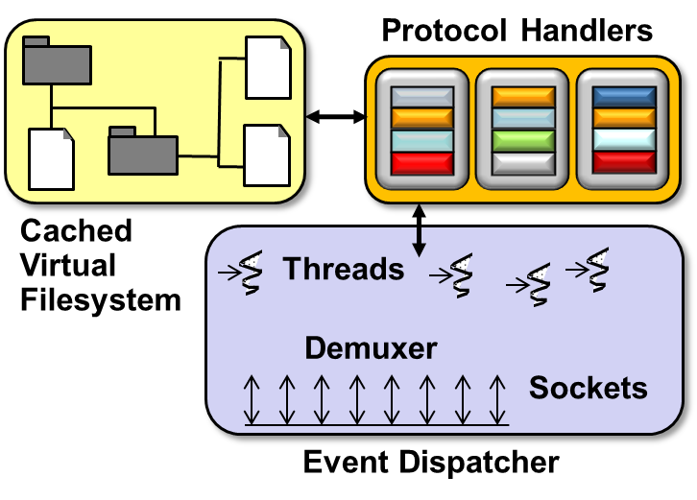
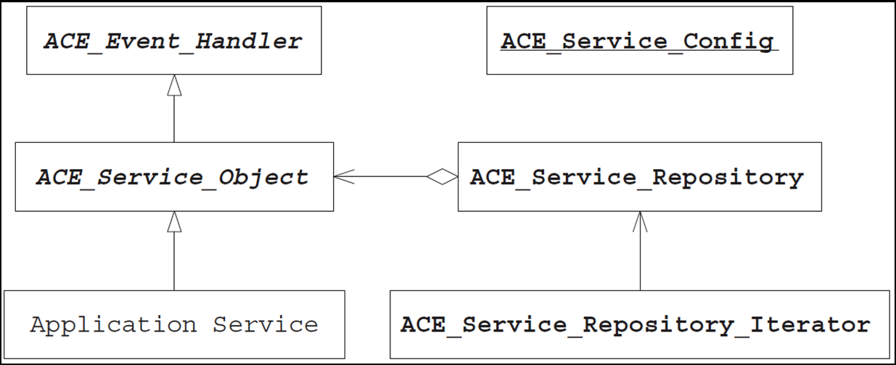
Topics Covered in this Part of the Module
Describe the Component Configurator pattern
Describe the ACE Service Configurator framework

Slide 25
Motivation for the ACE Service Configurator Framework
Configuring & managing service life cycles involves the following aspects:
Initialization
IDLE
CONFIGURE/ init()
RECONFIGURE/ init()
EXECUTE/ run_event_loop()
RUNNING
TERMINATE/ fini()
SUSPEND/ suspend()
RESUME/ resume()
SUSPENDED
TERMINATE/ fini()

Slide 26
Motivation for the ACE Service Configurator Framework
Configuring & managing service life cycles involves the following aspects:
Initialization
Execution control
IDLE
CONFIGURE/ init()
RECONFIGURE/ init()
EXECUTE/ run_event_loop()
RUNNING
TERMINATE/ fini()
SUSPEND/ suspend()
RESUME/ resume()
SUSPENDED
TERMINATE/ fini()

Slide 27
Motivation for the ACE Service Configurator Framework
Configuring & managing service life cycles involves the following aspects:
Initialization
Execution control
Termination
IDLE
CONFIGURE/ init()
RECONFIGURE/ init()
EXECUTE/ run_event_loop()
RUNNING
TERMINATE/ fini()
SUSPEND/ suspend()
RESUME/ resume()
SUSPENDED
TERMINATE/ fini()

Slide 28

Motivation for the ACE Service Configurator Framework
Configuring & managing service life cycles involves the following aspects:
Initialization
Execution control
Termination
Developing these capabilities in an ad hoc manner can produce tightly coupled data structures & classes

Slide 29
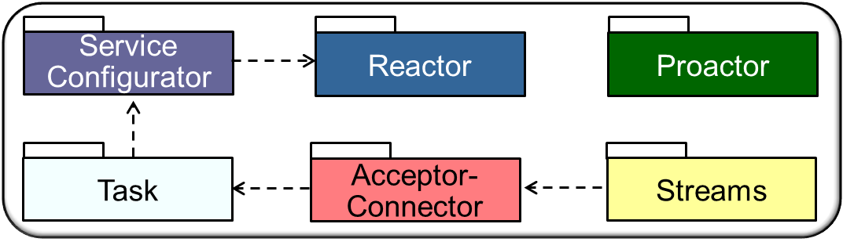

Overview of ACE Service Configurator Framework
Classes in this framework allow apps to defer configuration & implementation decisions about their services until late in the design cycle
During installation-time or even at runtime
Inherit from base class ACE_Service_Object
void configure(Script s) {
// Load DLL & create service
dll = dlopen(dll_name); svc = dll.make_svc (s.svc_name);
ACE_Service _Configurator
TCP_HTTP _Server
// Insert service into repository
repository.insert(svc);
Reactor_ HTTP_Server
TP_HTTP Server
// Start service
svc.init()
ACE_Service_Repository

Slide 30
Overview of ACE Service Configurator Framework
Classes in this framework allow apps to defer configuration & implementation decisions about their services until late in the design cycle
During installation-time or even at runtime
Apps/services inherit from ACE_Service_Object & override its hook methods, which the ACE Service Configurator framework then dispatches to configure & control lifecycle of apps/service
Classes are designed in accordance with the Component Configurator pattern

Slide 31
Overview of ACE Service Configurator Framework
Classes in this framework allow apps to defer configuration & implementation decisions about their services until late in the design cycle
During installation-time or even at runtime
Apps/services inherit from ACE_Service_Object & override its hook methods, which the ACE Service Configurator framework then dispatches to configure & control lifecycle of apps/service
Key classes in the ACE Service Configurator framework include
ACE Class | Description
ACE_Service_ Object | Defines a uniform interface that ACE Service Configurator framework uses to configure & control a service implementation’s lifecycle, including initializing, suspending, resuming, & terminating a service
ACE_Service_ Repository | A central repository for all services managed by the ACE Service Configurator framework that provides methods for locating, reporting on, & controlling all app configured services
ACE_Service_ Config | Provides an interpreter that parses & executes scripts specifying which services to (re)configure into an application (e.g., by linking & unlinking DLLs) & which services to suspend & resume

Slide 32
Overview of ACE Service Configurator Framework
Classes in this framework allow apps to defer configuration & implementation decisions about their services until late in the design cycle
During installation-time or even at runtime
Apps/services inherit from ACE_Service_Object & override its hook methods, which the ACE Service Configurator framework then dispatches to configure & control lifecycle of apps/service
Key classes in the ACE Service Configurator framework include
ACE Class | Description
ACE_Service_ Object | Defines a uniform interface that ACE Service Configurator framework uses to configure & control a service implementation’s lifecycle, including initializing, suspending, resuming, & terminating a service
ACE_Service_ Repository | A central repository for all services managed by the ACE Service Configurator framework that provides methods for locating, reporting on, & controlling all app configured services
ACE_Service_ Config | Provides an interpreter that parses & executes scripts specifying which services to (re)configure into an application (e.g., by linking & unlinking DLLs) & which services to suspend & resume

Slide 33
Overview of ACE Service Configurator Framework
Classes in this framework allow apps to defer configuration & implementation decisions about their services until late in the design cycle
During installation-time or even at runtime
Apps/services inherit from ACE_Service_Object & override its hook methods, which the ACE Service Configurator framework then dispatches to configure & control lifecycle of apps/service
Key classes in the ACE Service Configurator framework include
ACE Class | Description
ACE_Service_ Object | Defines a uniform interface that ACE Service Configurator framework uses to configure & control a service implementation’s lifecycle, including initializing, suspending, resuming, & terminating a service
ACE_Service_ Repository | A central repository for all services managed by the ACE Service Configurator framework that provides methods for locating, reporting on, & controlling all app configured services
ACE_Service_ Config | Provides an interpreter that parses & executes scripts specifying which services to (re)configure into an application (e.g., by linking & unlinking DLLs) & which services to suspend & resume
See www.dre.vanderbilt.edu/~schmidt/PDF/Svc-Conf.pdf for more info

Slide 34
The ACE_Service_Object Class
The base class that the ACE Service Configurator framework uses to configure & manage service implementations via the following hook methods:
Initialize & finalize a service
ACE_Event_Handler
ACE_Service_Object
init()
fini()
suspend()
resume()
info()
…

Slide 35
The ACE_Service_Object Class
The base class that the ACE Service Configurator framework uses to configure & manage service implementations via the following hook methods:
Initialize & finalize a service
Suspend service execution temporarily & resume execution of a suspended service
ACE_Event_Handler
ACE_Service_Object
init()
fini()
suspend()
resume()
info()
…

Slide 36
The ACE_Service_Object Class
The base class that the ACE Service Configurator framework uses to configure & manage service implementations via the following hook methods:
Initialize & finalize a service
Suspend service execution temporarily & resume execution of a suspended service
Report key service information
e.g., its purpose, current status, port number where it listens for client connections, etc.
ACE_Event_Handler
ACE_Service_Object
init()
fini()
suspend()
resume()
info()
…

Slide 37
The ACE_Service_Object Class
The base class that the ACE Service Configurator framework uses to configure & manage service implementations via the following hook methods:
Initialize & finalize a service
Suspend service execution temporarily & resume execution of a suspended service
Report key service information
e.g., its purpose, current status, port number where it listens for client connections, etc.
ACE_Event_Handler
ACE_Service_Object
init()
fini()
suspend()
resume()
info()
…
By inheriting from ACE_Event_Handler an ACE_Service_Object can also be registered with ACE Reactor framework
Handles variability of service-specific lifecycle behavior via a common API

Slide 38
The ACE_Service_Config Class
Implements the Façade pattern to integrate other Service Configurator classes & provide following capabilities:
Interprets a scripting language that provides directives to
Locate & initialize a service implementation at run time
ACE_Service_Config
ACE_Service_Config()
open()
close()
process_directive()
process_directives()
suspend()
resume()
reconfigure()
...

Slide 39
The ACE_Service_Config Class
Implements the Façade pattern to integrate other Service Configurator classes & provide following capabilities:
Interprets a scripting language that provides directives to
Locate & initialize a service implementation at run time
Suspend, resume, reinitialize, & shutdown a service after it's been initialized
ACE_Service_Config
ACE_Service_Config()
open()
close()
process_directive()
process_directives()
suspend()
resume()
reconfigure()
...

Slide 40
The ACE_Service_Config Class
Implements the Façade pattern to integrate other Service Configurator classes & provide following capabilities:
Interprets a scripting language that provides directives to
Locate & initialize a service implementation at run time
Suspend, resume, reinitialize, & shutdown a service after it's been initialized
It allows service reconfiguration at runtime
ACE_Service_Config
ACE_Service_Config()
open()
close()
process_directive()
process_directives()
suspend()
resume()
reconfigure()
...

Slide 41
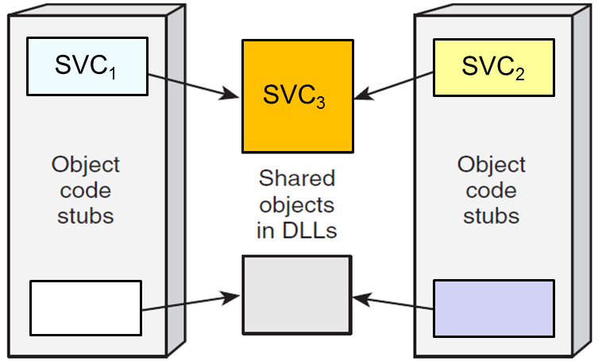
The ACE_Service_Config Class
Implements the Façade pattern to integrate other Service Configurator classes & provide following capabilities:
Interprets a scripting language that provides directives to
Locate & initialize a service implementation at run time
Suspend, resume, reinitialize, & shutdown a service after it's been initialized
It allows service reconfiguration at runtime
It supports management of
Static services − Linked into an app
Dynamic services − Linked dynamically from shared libraries (DLLs)
ACE_Service_Config
SVC₃
Handles the variability of static & dynamic configuration via a common API

Slide 42
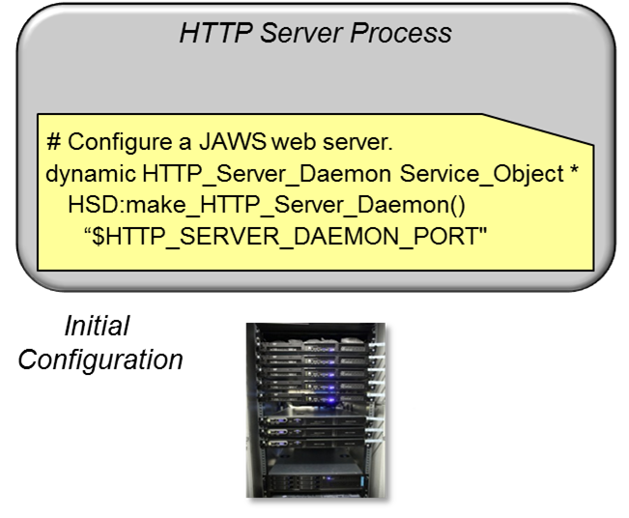
Service Configuration Directives
Directives are commands that can be passed to the ACE Service Configurator framework to designate its behavior
Dynamically configure an implementation of JAWS into the server process

Slide 43
Service Configuration Directives
Directives are commands that can be passed to the ACE Service Configurator framework to designate its behavior
The following directives are supported:
Directive | Description
dynamic | Dynamically link a service and initialize it by calling its init() hook method
static | Call the init() hook method to initialize a service that was linked statically
remove | Remove a service completely by calling its fini() hook method & unlinking it from the app process when it’s no longer used
suspend | Call a service’s suspend() hook method to pause it without removing it
resume | Call a service’s resume() hook method to continue processing a service that was suspended earlier
stream | Initialize an ordered list of hierarchically related modules

Slide 44
Service Configuration Directives
Directives are commands that can be passed to the ACE Service Configurator framework to designate its behavior
The following directives are supported:
Directives can be specified to ACE_Service_Config by either:
Using configuration files (named svc.conf by default) that contain one or more directives
By passing individual directives as strings to the ACE_Service_Config ::process_directive() method
Directive | Description
dynamic | Dynamically link a service and initialize it by calling its init() hook method
static | Call the init() hook method to initialize a service that was linked statically
remove | Remove a service completely by calling its fini() hook method & unlinking it from the app process when it’s no longer used
suspend | Call a service’s suspend() hook method to pause it without removing it
resume | Call a service’s resume() hook method to continue processing a service that was suspended earlier
stream | Initialize an ordered list of hierarchically related modules

Slide 45
Summary
ACE Service Configurator framework improves JAWS extensibility by deferring implementation choices until late in the lifecycle
Inherit from base class ACE_Service_Object
void configure(Script s) {
// Load DLL & create service
dll = dlopen(dll_name); svc = dll.make_svc (s.svc_name);
ACE_Service _Configurator
TCP_HTTP _Server
// Insert service into repository
repository.insert(svc);
Reactor_ HTTP_Server
TP_HTTP Server
// Start service
svc.init()
ACE_Service_Repository

Slide 46
Summary
ACE Service Configurator framework improves JAWS extensibility by deferring implementation choices until late in the lifecycle
This late binding yields the following benefits:
Apps are composed of multiple services that can be developed independently
ACE_Service _Object
ACE_Service
_Repository
*
services
init()
fini()
suspend()
resume()
info()
<<contains>>
ACE_Service
_Config
TP_Reactor_ HTTP_Server
Reactor_ HTTP_Server
TPC_HTTP _Server
TP_HTTP _Server

Slide 47
Summary
ACE Service Configurator framework improves JAWS extensibility by deferring implementation choices until late in the lifecycle
This late binding yields the following benefits:
Apps are composed of multiple services that can be developed independently
Developers can concentrate on a functionality & other key design dimensions without committing prematurely to a particular configuration
ACE_Service _Object
ACE_Service
_Repository
*
services
init()
fini()
suspend()
resume()
info()
<<contains>>
ACE_Service
_Config
TPC_HTTP _Server
Reactor_ HTTP_Server
TP_Reactor_ HTTP_Server
TP_HTTP _Server

Slide 48
Summary
ACE Service Configurator framework improves JAWS extensibility by deferring implementation choices until late in the lifecycle
This late binding yields the following benefits:
Apps are composed of multiple services that can be developed independently
Developers can concentrate on a functionality & other key design dimensions without committing prematurely to a particular configuration
Apps can be (re)configured at installation-time or runtime
IDLE
CONFIGURE/ init()
RECONFIGURE/ init()
RUNNING
EXECUTE/ run_event_loop()
TERMINATE/ fini()
SUSPEND/ suspend()
RESUME/ resume()
SUSPENDED
TERMINATE/ fini()

Slide 49
Patterns & Frameworks for Service Configuration & Activation: Part 3
Douglas C. Schmidt
d.schmidt@vanderbilt.edu
www.dre.vanderbilt.edu/~schmidt
Professor of Computer Science
Institute for Software Integrated Systems Vanderbilt University Nashville, Tennessee, USA

Slide 50
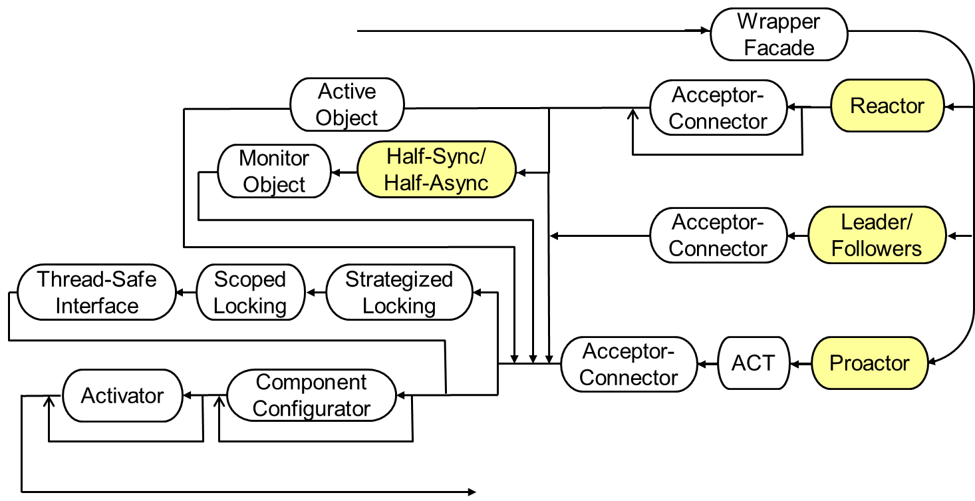
Topics Covered in this Part of the Module
Describe the Component Configurator pattern
Describe the ACE Service Configurator framework
Apply ACE Service Configurator to JAWS
Dynamic configuration path thru the JAWS pattern language

Slide 51
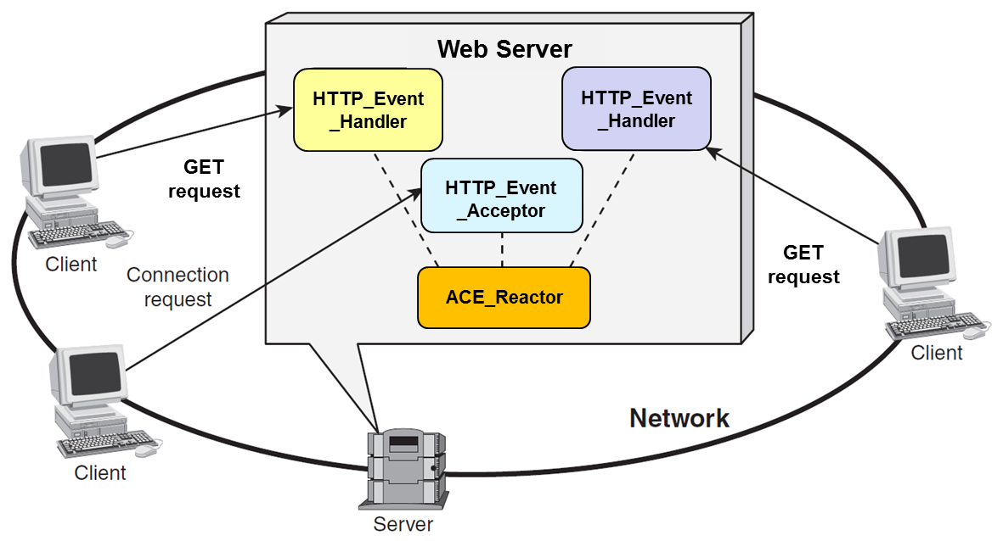



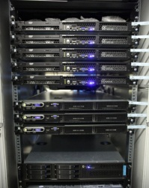
Using ACE_Service_Object with JAWS
To showcase ACE_Service_Object, we’ll reimplement the reactive JAWS web server from the Acceptor-Connector example
HTTP_Svc _Handler
HTTP_Svc _Handler
Logging
Event
Handler
HTTP_Event_ Handler
Reactor_HTTP_Server_Adapter
Server
Components in this web server are linked dynamically at installation & runtime

Slide 52
Using ACE_Service_Object with JAWS
To showcase ACE_Service_Object, we’ll reimplement the reactive JAWS web server from the Acceptor-Connector example
template <typename ACCEPTOR>
class Reactor_HTTP_Server_Adapter : public ACE_Service_Object {
public:
virtual int init
(int argc, char *argv[]);
virtual int fini ();
virtual int info (char **, size_t) const;
virtual int suspend ();
virtual int resume ();
private:
Reactor_HTTP_Server<ACCEPTOR> *server_;
};
Hook methods inherited from ACE_Service_Object
Reuse Reactor_HTTP_Server from earlier examples
Note the use of the GoF Adapter pattern!

Slide 53
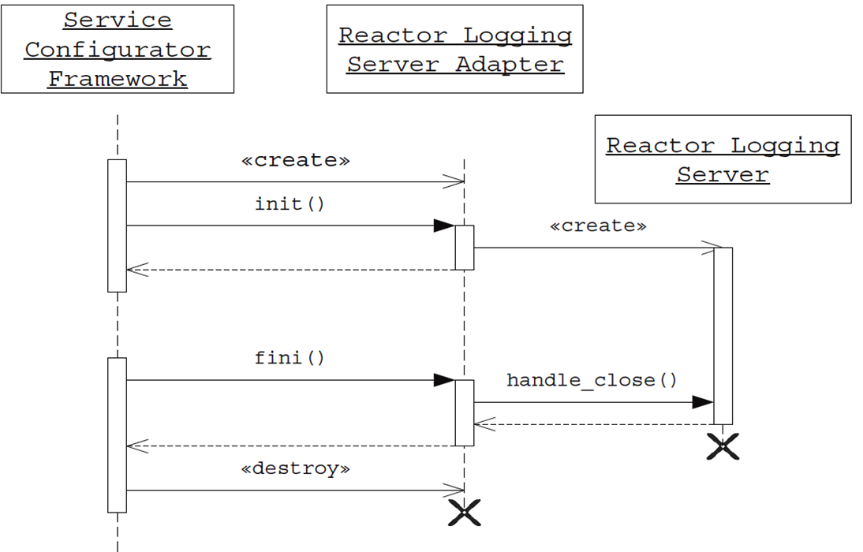
Using ACE_Service_Object with JAWS
To showcase ACE_Service_Object, we’ll reimplement the reactive JAWS web server from the Acceptor-Connector example
Reactor HTTP
Server Adapter
Reactor HTTP
Server
Rather than being configured statically, this revision is configured dynamically by the ACE Service Configurator framework

Slide 54
Using ACE_Service_Object with JAWS
To showcase ACE_Service_Object, we’ll reimplement the reactive JAWS web server from the Acceptor-Connector example
Reactor HTTP
Server Adapter
Reactor HTTP
Server
This object is linked dynamically

Slide 55
Using ACE_Service_Object with JAWS
To showcase ACE_Service_Object, we’ll reimplement the reactive JAWS web server from the Acceptor-Connector example
Reactor HTTP
Server Adapter
Reactor HTTP
Server
It can also be unlinked when it’s no longer needed

Slide 56
Using ACE_Service_Object with JAWS
Hook method called back by ACE Service Configurator framework to initialize the service
1 template <typename ACCEPTOR> int
2 Reactor_HTTP_Server_Adapter<ACCEPTOR>::init
3 (int argc, char *argv[])
4 {
5 server_ = new (nothrow)
6 Reactor_HTTP_Server<ACCEPTOR>
7 (argc, argv,
8 ACE_Reactor::instance ()));
9 return server_ == 0 ? -1 : 0;
10 }
Allocate & initialize the Reactor_HTTP_Server
Returning -1 causes this service object to be destroyed

Slide 57
Using ACE_Service_Object with JAWS
template <typename ACCEPTOR> int
Reactor_HTTP_Server_Adapter<ACCEPTOR>::fini () {
server_->handle_close (); server_ = 0; return 0;
}
This hook method is called by framework to terminate the service
template <typename ACCEPTOR> int
Reactor_HTTP_Server_Adapter<ACCEPTOR>::suspend ()
{
return server_->reactor ()->suspend_handler (server_);
}
template <typename ACCEPTOR> int
Reactor_HTTP_Server_Adapter<ACCEPTOR>::resume ()
{
return server_->reactor ()->resume_handler (server_);
}
These hook methods are called by framework to suspend/resume a service

Slide 58
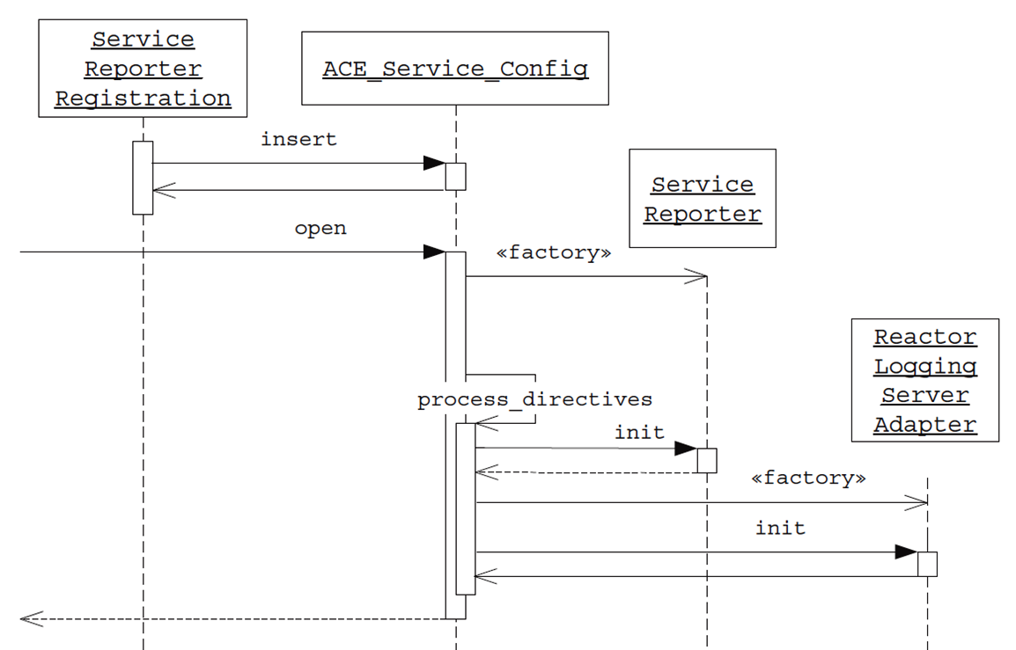
Using ACE_Service_Config with JAWS
Apply the ACE Service Configurator framework to create a server whose initial configuration behaves as follows:
It dynamically links & configures the Reactor_HTTP_ Server_Adapter into the server's address space
Statically configures a Service_Reporter that returns info about statically/dynamically configured services
Reactor HTTP
Server Adapter
Shortly we’ll show how to dynamically reconfigure another reactive web service

Slide 59
Using ACE_Service_Config with JAWS
Here’s a generic main() program that is useful for many apps & services
1 #include "ace/OS.h"
2 #include "ace/Service_Config.h"
3 #include "ace/Reactor.h"
4 int main (int argc, char *argv[]) {
5 ACE_STATIC_SVC_REGISTER (Reporter);
6 ACE_Service_Config::open
7 (argc, argv, ACE_DEFAULT_LOGGER_KEY, 0);
8
9 ACE_Reactor::instance ()->run_reactor_event_loop ();
10 return 0;
11 }
Uses svc.conf file to configure the Service_ Reporter & Reactor_ HTTP_Server_Adapter into app process
Run the reactor's event loop

Slide 60
Using ACE_Service_Config with JAWS
#include "Reactor_HTTP_Server_Adapter.h"
#include "HTTP_Svc_Acceptor.h"
#include "HTTP_Server_Daemon_export.h"
typedef Reactor_HTTP_Server_Adapter<HTTP_Svc_Acceptor>
HTTP_Server_Daemon;
ACE_FACTORY_DEFINE (HSD, HTTP_Server_Daemon)
Instantiate the adapter using the HTTP_Svc_Acceptor from our previous example
This macro ensures the HTTP_Server_Daemon type can be linked dynamically

Slide 61
Using ACE_Service_Config with JAWS
#include "Reactor_HTTP_Server_Adapter.h"
#include "HTTP_Svc_Acceptor.h"
#include "HTTP_Server_Daemon_export.h"
typedef Reactor_HTTP_Server_Adapter<HTTP_Svc_Acceptor>
HTTP_Server_Daemon;
ACE_FACTORY_DEFINE (HSD, HTTP_Server_Daemon)
This svc.conf file is used to configure the main program
1 static Service_Reporter "-p $SERVICE_REPORTER_PORT"
2 dynamic HTTP_Server_Daemon Service_Object *
3 HSD:_make_HTTP_Server_Daemon()
4 "$HTTP_SERVER_DAEMON_PORT"
Dynamically configure the web server
Statically configure Service_Reporter

Slide 62
Using ACE_Service_Config with JAWS
#include "Reactor_HTTP_Server_Adapter.h"
#include "HTTP_Svc_Acceptor.h"
#include "HTTP_Server_Daemon_export.h"
typedef Reactor_HTTP_Server_Adapter<HTTP_Svc_Acceptor>
HTTP_Server_Daemon;
ACE_FACTORY_DEFINE (HSD, HTTP_Server_Daemon)
1 static Service_Reporter "-p $SERVICE_REPORTER_PORT"
2 dynamic HTTP_Server_Daemon Service_Object *
3 HSD:_make_HTTP_Server_Daemon()
4 "$HTTP_SERVER_DAEMON_PORT"
The ACE_Service_Config interpreter expands these environment variables

Slide 63
Using ACE Service Configurator Reconfiguration
The previous JAWS web server configuration has the limitation that the ACE_Reactor::run_reactor_event_loop() can’t be shut down on the reactor singleton
1 #include "ace/OS.h"
2 #include "ace/Service_Config.h"
3 #include "ace/Reactor.h"
4 int main (int argc, char *argv[]) {
5 ACE_STATIC_SVC_REGISTER (Reporter);
6 ACE_Service_Config::open
7 (argc, argv, ACE_DEFAULT_LOGGER_KEY, 0);
8 ACE_Reactor::instance ()->run_reactor_event_loop ();
9 return 0;
10 }
Doesn’t terminate gracefully!

Slide 64
Using ACE Service Configurator Reconfiguration
The previous JAWS web server configuration has the following limitation:
The ACE_Reactor::run_reactor_event_loop() can’t be shut down on the reactor singleton
We can add these capabilities without affecting existing code or the Service_Reporter service by defining a new svc.conf file & instructing the server to reconfigure itself
Shutdown the existing web server
1 remove HTTP_Server_Daemon
2 dynamic HTTP_Server_Daemon Service_Object *
3 HSDex:_make_HTTP_Server_Daemon()
4 "$SERVER_SERVER_DAEMON_PORT"
5 dynamic Server_Shutdown Service_Object *
6 HSDex:_make_Server_Shutdown()
Restart the web server
Dynamically link new shutdown service

Slide 65
Using ACE Service Configurator Reconfiguration
class Server_Shutdown : public ACE_Service_Object {
public:
virtual int init (int, char *[]) {
reactor_ = ACE_Reactor::instance ();
return ACE_Thread_Manager::instance ()->spawn (controller, reactor_);
}
virtual int fini () {
Quit_Handler *quit_handler = new Quit_Handler (reactor_);
return reactor_->notify (quit_handler);
}
// ... Other method omitted ...
private:
ACE_Reactor *reactor_;
};
ACE_FACTORY_DEFINE (HSDex, Server_Shutdown)
Spawn a thread to run the reactor
Notify the reactor to shut itself down
This macro ensures the Server_Shutdown type can be linked dynamically

Slide 66
Using ACE Service Configurator Reconfiguration
Runs in a separate thread of control
1 static void *controller (void *arg) {
2 ACE_Reactor *reactor = static_cast<ACE_Reactor *> (arg);
3 Quit_Handler *quit_handler = new Quit_Handler (reactor);
4 for (;;) {
5 std::string user_input;
6 std::getline (cin, user_input, '\n');
7 if (user_input == "quit") {
8 reactor->notify (quit_handler);
9 break;
10 }
11 }
12 return 0;
13 }
Use the Reactor’s notify pipe to wakeup the reactor & inform it to shut down by calling handle_exception()

Slide 67
Using ACE Service Configurator Reconfiguration
class Quit_Handler : public ACE_Event_Handler {
public:
Quit_Handler (ACE_Reactor *r): ACE_Event_Handler (r) {}
virtual int handle_exception (ACE_HANDLE) {
reactor ()->end_reactor_event_loop ();
return -1;
}
virtual int handle_close (ACE_HANDLE, ACE_Reactor_Mask) {
delete this;
return 0;
}
private:
virtual ~Quit_Handler () {}
};
Shutdown the reactor event loop & trigger call to handle_close() method
It’s ok to “delete this” in this context
Private destructor ensures dynamic allocation

Slide 68
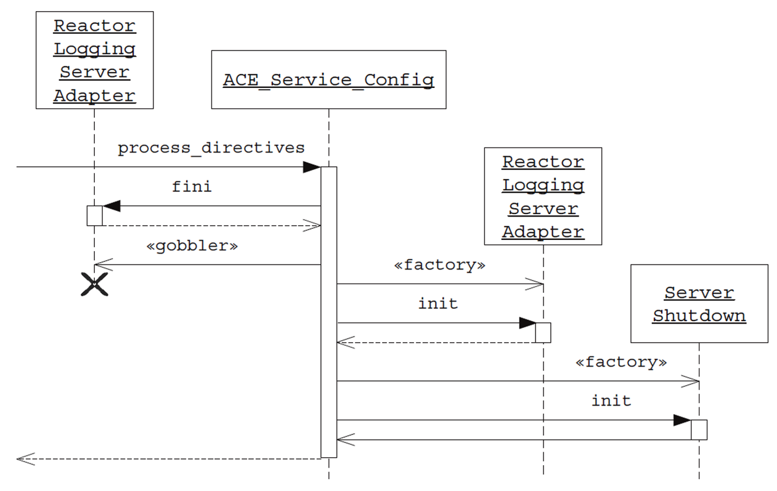
Using ACE Service Configurator Reconfiguration
Reactor HTTP
Server Adapter
Out with the old
In with the new
Reactor HTTP
Server Adapter
Sequence diagram for ACE Service Configurator reconfiguration

Slide 69
Using ACE Service Configurator Reconfiguration
The reconfigured server has a separate thread to control shutdowns gracefully
HTTP_Svc _Handler
HTTP_Svc _Handler
Logging
Event
Handler
HTTP_Event_ Handler
Reactor_HTTP_Server_Adapter
controller()
notify()
Controller thread notifies reactor to shutdown
Server

Slide 70
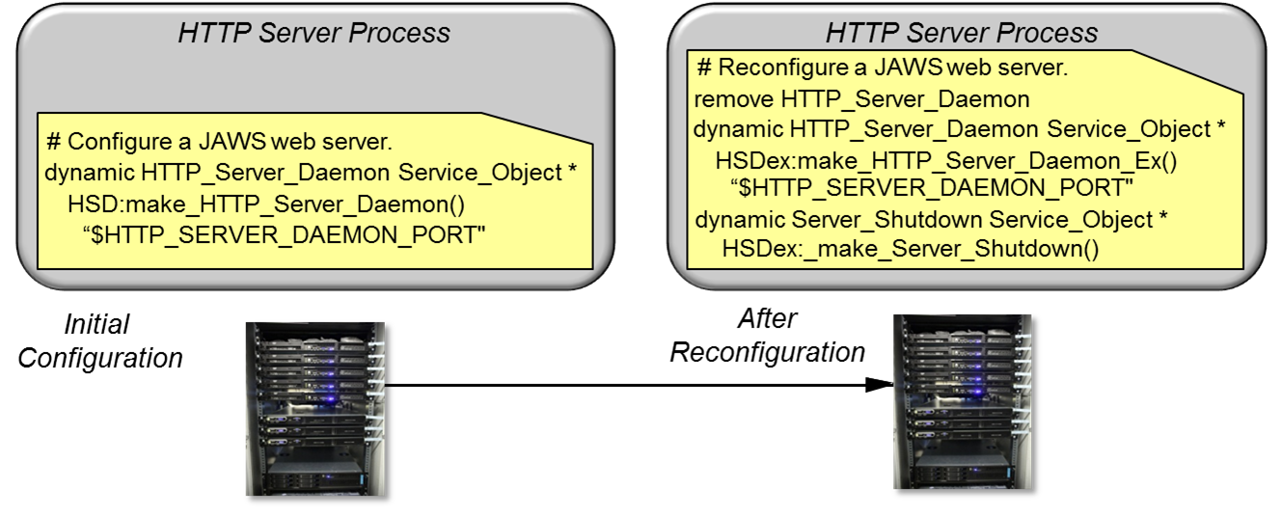
Summary
The ACE Service Configurator can support the (re)configuration new services & new service implementations during installation or even at runtime

Slide 71
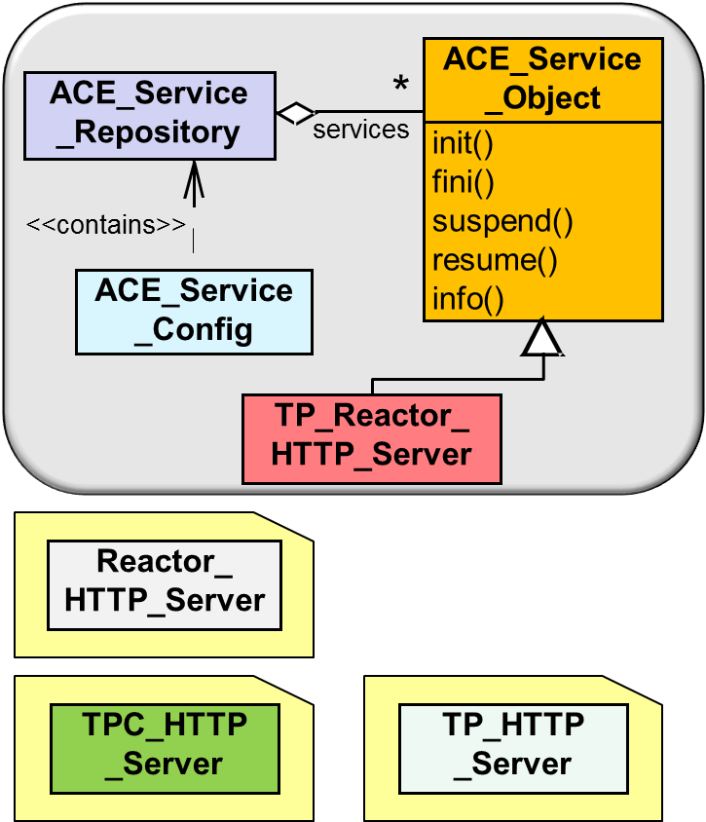
Summary
The ACE Service Configurator can support the (re)configuration new services & new service implementations during installation or even at runtime
We used these capabilities to separate parts of previous web servers implementations into independently linkable & configurable services

Slide 72
Summary
The ACE Service Configurator can support the (re)configuration new services & new service implementations during installation or even at runtime
We used these capabilities to separate parts of previous web servers implementations into independently linkable & configurable services
The result was a web server framework that can be configured & deployed in various ways

Slide 73
Summary
The ACE Service Configurator can support the (re)configuration new services & new service implementations during installation or even at runtime
We used these capabilities to separate parts of previous web servers implementations into independently linkable & configurable services
The result was a web server framework that can be configured & deployed in various ways
The ACE Service Configurator framework allows administrators to select features & alternative strategies that make the most sense in a particular context

Slide 74
Patterns & Frameworks for Service Configuration & Activation: Part 4
Douglas C. Schmidt
d.schmidt@vanderbilt.edu
www.dre.vanderbilt.edu/~schmidt
Professor of Computer Science
Institute for Software Integrated Systems Vanderbilt University Nashville, Tennessee, USA

Slide 75
Topics Covered in this Part of the Module
Describe the Component Configurator pattern
Describe the ACE Service Configurator framework
Apply ACE Service Configurator to JAWS
Apply the Activator pattern to JAWS via the Inetd framework
Add activator to the dynamic configuration path thru the JAWS pattern language

Slide 76
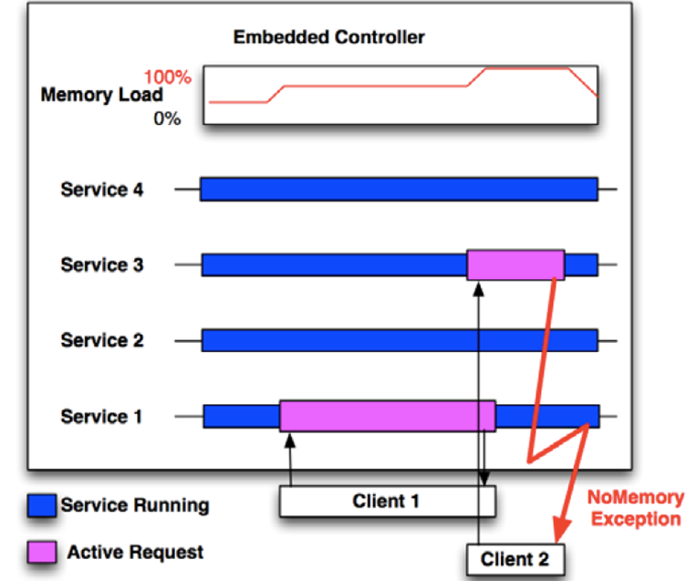
Minimizing Resource Utilization
Context | Problem
Resource constrained & highly dynamic environments | It may not feasible to have all application server implementations running all the time since this ties up end-system resources unnecessarily
Small Memory Device

Slide 77
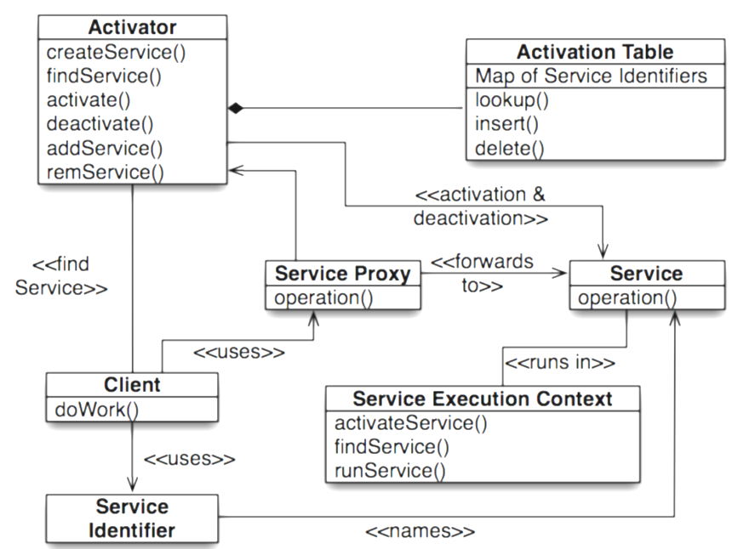
Minimizing Resource Utilization
Context | Problem | Solution
Resource constrained & highly dynamic environments | It may not feasible to have all application server implementations running all the time since this ties up end-system resources unnecessarily | Apply the Activator pattern to activate & deactivate JAWS web server automatically
Structure
Activator automates scalable on-demand activation & deactivation of service execution contexts to run services accessed by many clients without consuming excessive resources
See www.dre.vanderbilt.edu/~schmidt/PDF/Activator.pdf for info on Activator

Slide 78
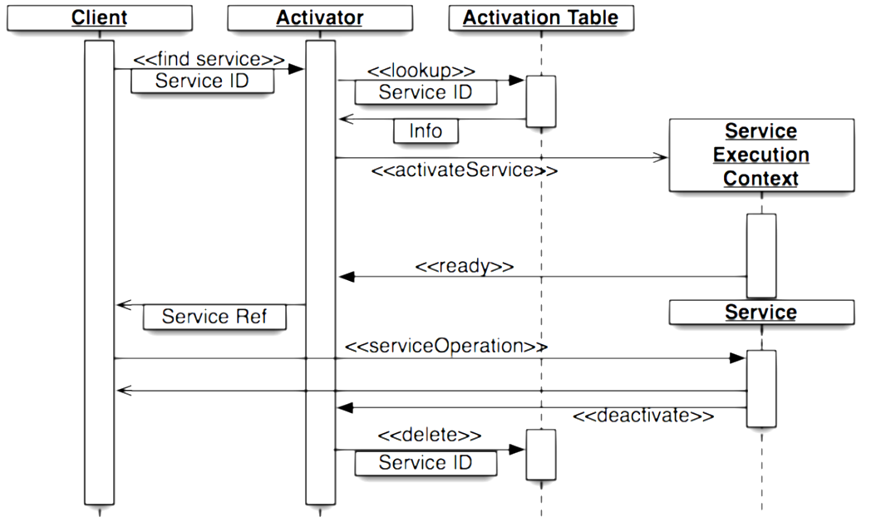
Minimizing Resource Utilization
Context | Problem | Solution
Resource constrained & highly dynamic environments | It may not feasible to have all application server implementations running all the time since this ties up end-system resources unnecessarily | Apply the Activator pattern to activate & deactivate JAWS web server automatically
Dynamics
An Activator can activate & passivate a service running in a server after each method call, each transaction, etc

Slide 79
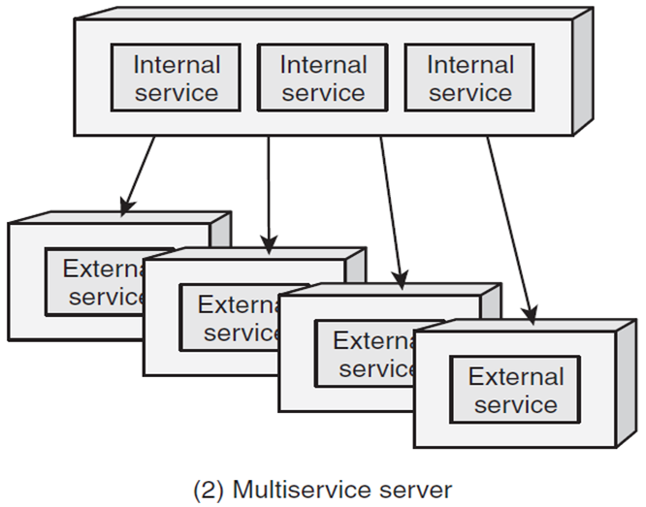
Applying Activator to JAWS
Activator is supported the UNIX Inetd “superserver”
Inetd Superserver

Slide 80
Applying Activator to JAWS
Activator is supported the UNIX Inetd “superserver”
Internal services are fixed at static link time
e.g., ECHO & DAYTIME
Internal service
Internal service
Internal service

Slide 81
Applying Activator to JAWS
Activator is supported the UNIX Inetd “superserver”
Internal services are fixed at static link time
e.g., ECHO & DAYTIME
External services can be dynamically reconfigured via sending a SIGHUP signal to Inetd, which then performs the socket()/bind()/listen() calls on all services listed in the inetd.conf file
e.g., FTP, TELNET, & HTTP
Internal service
Internal service
Internal service
See en.wikipedia.org/wiki/Inetd for more on Inetd

Slide 82
Applying Activator to JAWS
Clients can use the Inetd-based Activator pattern to launch a JAWS-based web server on-demand
Inetd (www.dre.vanderbilt.edu)
Client
…
…
…
…
…
…

Slide 83
Applying Activator to JAWS
Clients can use the Inetd-based Activator pattern to launch a JAWS-based web server on-demand
Put following line in the /etc/inetd.conf file:
Inetd (www.dre.vanderbilt.edu)
Client
http
/usr/etc/httpd
port:80
…
…
…
http stream tcp nowait root /usr/etc/httpd httpd

Slide 84
Applying Activator to JAWS
Clients can use the Inetd-based Activator pattern to launch a JAWS-based web server on-demand
Put following line in the /etc/inetd.conf file:
When a TCP connection arrives on port 80, Inetd launches the JAWS-based server program
Inetd (www.dre.vanderbilt.edu)
Client
1. connect()
http
/usr/etc/httpd
port:80
…
…
…
2. fork/exec
http stream tcp nowait root /usr/etc/httpd httpd
JAWS server (www.dre.vanderbilt.edu:80)

Slide 85
Applying Activator to JAWS
Clients can use the Inetd-based Activator pattern to launch a JAWS-based web server on-demand
Put following line in the /etc/inetd.conf file:
When a TCP connection arrives on port 80, Inetd launches the JAWS-based server program
This server then handles the client request(s)
Inetd (www.dre.vanderbilt.edu)
Client
1. connect()
http
/usr/etc/httpd
port:80
…
…
…
2. fork/exec
http stream tcp nowait root /usr/etc/httpd httpd
3. GET /~index
JAWS server (www.dre.vanderbilt.edu:80)
4. <H1>DOC Group …</H1>

Slide 86
Applying Activator to JAWS
Clients can use the Inetd-based Activator pattern to launch a JAWS-based web server on-demand
Put following line in the /etc/inetd.conf file:
When a TCP connection arrives on port 80, Inetd launches the JAWS-based server program
This server then handles the client request(s)
Inetd (www.dre.vanderbilt.edu)
Client
1. connect()
http
/usr/etc/httpd
port:80
…
…
…
2. fork/exec
http stream tcp nowait root /usr/etc/httpd httpd
3. GET /~index
JAWS server (www.dre.vanderbilt.edu:80)
4. <H1>DOC Group …</H1>
This design uses memory more efficiently since the server runs only when needed
Appropriate for a web server that isn’t expected to run with high loads

Slide 87
Benefits of the Activator Pattern
More effective resource utilization
Servers can be spawned “on-demand,” thereby minimizing resource utilization until clients actually require them
Inetd (www.dre.vanderbilt.edu)
Client
1. connect()
http
/usr/etc/httpd
port:80
…
…
…
2. fork/exec
3. GET /~index
JAWS server (www.dre.vanderbilt.edu:80)
4. <H1>DOC Group …</H1>

Slide 88
Benefits of the Activator Pattern
More effective resource utilization
Servers can be spawned “on-demand,” thereby minimizing resource utilization until clients actually require them
Coarse-grained concurrency
By spawning server processes to run on multi-core/CPU computers
Inetd (www.dre.vanderbilt.edu)
Client
1. connect()
http
/usr/etc/httpd
port:80
…
…
…
2. fork/exec
3. GET /~index
JAWS server (www.dre.vanderbilt.edu:80)
4. <H1>DOC Group …</H1>

Slide 89
Benefits of the Activator Pattern
More effective resource utilization
Servers can be spawned “on-demand,” thereby minimizing resource utilization until clients actually require them
Coarse-grained concurrency
By spawning server processes to run on multi-core/CPU computers
Modularity, testability, & reusability
Application modularity & reusability is improved by decoupling server implementations from the manner in which the servers are activated
Inetd (www.dre.vanderbilt.edu)
Client
1. connect()
http
/usr/etc/httpd
port:80
…
…
…
2. fork/exec
3. GET /~index
JAWS server (www.dre.vanderbilt.edu:80)
4. <H1>DOC Group …</H1>

Slide 90
Limitations of the Activator Pattern
Lack of determinism & ordering dependencies
Hard to determine or analyze the behavior of an app until its components are activated at runtime
Inetd (www.dre.vanderbilt.edu)
Client
1. connect()
http
/usr/etc/httpd
port:80
…
…
…
2. fork/exec
3. GET /~index
JAWS server (www.dre.vanderbilt.edu:80)
4. <H1>DOC Group …</H1>

Slide 91
Limitations of the Activator Pattern
Lack of determinism & ordering dependencies
Hard to determine or analyze the behavior of an app until its components are activated at runtime
Reduced security or reliability
An application that uses Activator may be less secure or reliable than an equivalent statically-configured application
Inetd (www.dre.vanderbilt.edu)
Client
1. connect()
http
/usr/etc/httpd
port:80
…
…
…
2. fork/exec
3. GET /~index
JAWS server (www.dre.vanderbilt.edu:80)
4. <H1>DOC Group …</H1>

Slide 92
Limitations of the Activator Pattern
Lack of determinism & ordering dependencies
Hard to determine or analyze the behavior of an app until its components are activated at runtime
Reduced security or reliability
An application that uses Activator may be less secure or reliable than an equivalent statically-configured application
Increased run-time overhead & infrastructure complexity
By adding levels of abstraction & indirection when activating & executing components
Inetd (www.dre.vanderbilt.edu)
Client
1. connect()
http
/usr/etc/httpd
port:80
…
…
…
2. fork/exec
3. GET /~index
JAWS server (www.dre.vanderbilt.edu:80)
4. <H1>DOC Group …</H1>

