Slide 1



Patterns & Frameworks for Asynchronous Event Handling: Part 1
Douglas C. Schmidt
d.schmidt@vanderbilt.edu
www.dre.vanderbilt.edu/~schmidt
Professor of Computer Science
Institute for Software Integrated Systems Vanderbilt University Nashville, Tennessee, USA

Slide 2
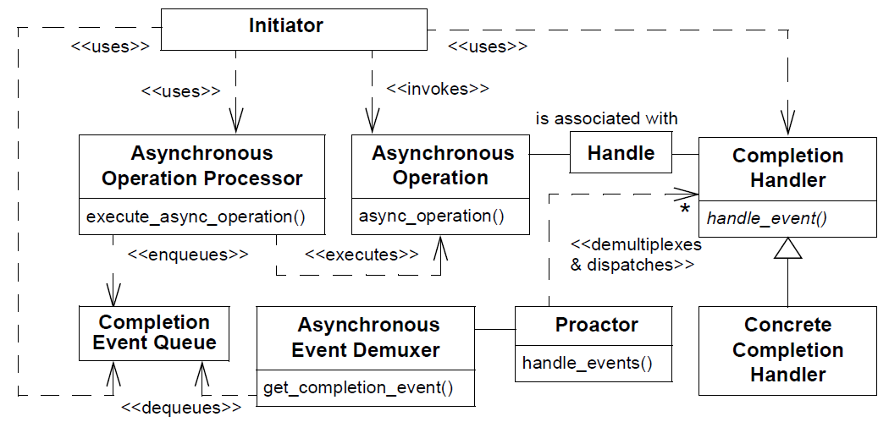
Topics Covered in this Part of the Module
Describe the Proactor pattern

Slide 3
Using Asynchronous I/O Effectively
Context | Problem
Synchronous event handling & multi-threading may not achieve most scalable web server when OS supports async I/O | Leveraging efficiency & scalability of async I/O is hard due to time/space separation of async operation invocations & their subsequent completion events
GetQueued
CompletionStatus()
GetQueued
CompletionStatus()
GetQueued
CompletionStatus()
AcceptEx()
AcceptEx()
AcceptEx()
Passive-mode Socket handle
I/O Completion
Port
COMPLETION EVENTS
See en.wikipedia.org/wiki/Input/output_completion_port for more info

Slide 4
Using Asynchronous I/O Effectively
Context | Problem | Solution
Synchronous event handling & multi-threading may not achieve most scalable web server when OS supports async I/O | Leveraging efficiency & scalability of async I/O is hard due to time/space separation of async operation invocations & their subsequent completion events | Apply the Proactor pattern to efficiently demux async I/O operations
Structure
Proactor uses async I/O to allow event-driven apps to gain benefits of concurrency performance without incurring its liabilities

Slide 5
Using Asynchronous I/O Effectively
Context | Problem | Solution
Synchronous event handling & multi-threading may not achieve most scalable web server when OS supports async I/O | Leveraging efficiency & scalability of async I/O is hard due to time/space separation of async operation invocations & their subsequent completion events | Apply the Proactor pattern to efficiently demux async I/O operations
Structure
Proactor uses async I/O to allow event-driven apps to gain benefits of concurrency performance without incurring its liabilities

Slide 6
Using Asynchronous I/O Effectively
Context | Problem | Solution
Synchronous event handling & multi-threading may not achieve most scalable web server when OS supports async I/O | Leveraging efficiency & scalability of async I/O is hard due to time/space separation of async operation invocations & their subsequent completion events | Apply the Proactor pattern to efficiently demux async I/O operations
Structure
Proactor uses async I/O to allow event-driven apps to gain benefits of concurrency performance without incurring its liabilities

Slide 7
Using Asynchronous I/O Effectively
Context | Problem | Solution
Synchronous event handling & multi-threading may not achieve most scalable web server when OS supports async I/O | Leveraging efficiency & scalability of async I/O is hard due to time/space separation of async operation invocations & their subsequent completion events | Apply the Proactor pattern to efficiently demux async I/O operations
Structure
Proactor uses async I/O to allow event-driven apps to gain benefits of concurrency performance without incurring its liabilities

Slide 8
Using Asynchronous I/O Effectively
Context | Problem | Solution
Synchronous event handling & multi-threading may not achieve most scalable web server when OS supports async I/O | Leveraging efficiency & scalability of async I/O is hard due to time/space separation of async operation invocations & their subsequent completion events | Apply the Proactor pattern to efficiently demux async I/O operations
Structure
Proactor uses async I/O to allow event-driven apps to gain benefits of concurrency performance without incurring its liabilities
See www.dre.vanderbilt.edu/~schmidt/PDF/proactor.pdf for more info

Slide 9
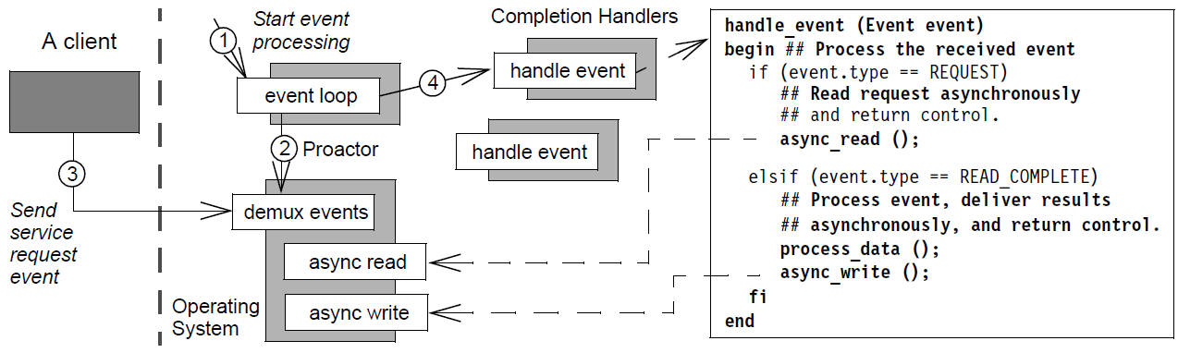
Using Asynchronous I/O Effectively
Context | Problem | Solution
Synchronous event handling & multi-threading may not achieve most scalable web server when OS supports async I/O | Leveraging efficiency & scalability of async I/O is hard due to time/space separation of async operation invocations & their subsequent completion events | Apply the Proactor pattern to efficiently demux async I/O operations
Dynamics

Slide 10
Using Asynchronous I/O Effectively
Context | Problem | Solution
Synchronous event handling & multi-threading may not achieve most scalable web server when OS supports async I/O | Leveraging efficiency & scalability of async I/O is hard due to time/space separation of async operation invocations & their subsequent completion events | Apply the Proactor pattern to efficiently demux async I/O operations
Dynamics

Slide 11
Using Asynchronous I/O Effectively
Context | Problem | Solution
Synchronous event handling & multi-threading may not achieve most scalable web server when OS supports async I/O | Leveraging efficiency & scalability of async I/O is hard due to time/space separation of async operation invocations & their subsequent completion events | Apply the Proactor pattern to efficiently demux async I/O operations
Dynamics

Slide 12
Using Asynchronous I/O Effectively
Context | Problem | Solution
Synchronous event handling & multi-threading may not achieve most scalable web server when OS supports async I/O | Leveraging efficiency & scalability of async I/O is hard due to time/space separation of async operation invocations & their subsequent completion events | Apply the Proactor pattern to efficiently demux async I/O operations
Dynamics

Slide 13
Using Asynchronous I/O Effectively
Context | Problem | Solution
Synchronous event handling & multi-threading may not achieve most scalable web server when OS supports async I/O | Leveraging efficiency & scalability of async I/O is hard due to time/space separation of async operation invocations & their subsequent completion events | Apply the Proactor pattern to efficiently demux async I/O operations
Dynamics
Note similarities & differences with the Reactor pattern

Slide 14

Applying the Proactor Pattern to JAWS
4: connect()
1: accept()
HTTP Handler
Web Server
7: create()
HTTP Acceptor
8: ReadFile
(SockHandle, data, ACT)
2: AcceptEx (AcceptHandle, ACT)
6: handle_event (ACCEPT_EVENT)
Operating System
Connection establishment & service initialization phase
Proactor
Completion Event Queue
3,9: handle_events()
5: accept complete
1: GET /~index.html
4: parse_ request()
Web Server
HTTP Handler
6: WriteFile (SockHandle, data, ACT)
Operating System
3: handle_event (READ_EVENT)
8: handle_event (WRITE_EVENT)
2: read complete
Data transfer phase
5: memory_map (File)
Completion Event Queue
Proactor
7: write complete

Slide 15
Benefits of Proactor Pattern
Separation of concerns & portability
Decouples app-independent & app-specific async operations
Web Server
1: accept()
HTTP Handler
7: create()
HTTP Acceptor
2: AcceptEx (AcceptHandle, ACT)
6: handle_event (ACCEPT_EVENT)
8: ReadFile
(SockHandle, data, ACT)
Proactor
3,9: handle_events()
Operating System
Completion Event Queue
5: accept complete

Slide 16
Benefits of Proactor Pattern
Separation of concerns & portability
Decouples app-independent & app-specific async operations
Decoupling of threading from concurrency
Async operation processor executes long-duration operations so apps can spawn fewer threads
Web Server
1: accept()
HTTP Handler
7: create()
HTTP Acceptor
2: AcceptEx (AcceptHandle, ACT)
6: handle_event (ACCEPT_EVENT)
8: ReadFile
(SockHandle, data, ACT)
Proactor
3,9: handle_events()
Operating System
Completion Event Queue
5: accept complete

Slide 17
Benefits of Proactor Pattern
Separation of concerns & portability
Decouples app-independent & app-specific async operations
Decoupling of threading from concurrency
Async operation processor executes long-duration operations so apps can spawn fewer threads
Performance
Avoids context switching costs by activating only those threads that have events to process
Web Server
1: accept()
HTTP Handler
7: create()
HTTP Acceptor
2: AcceptEx (AcceptHandle, ACT)
6: handle_event (ACCEPT_EVENT)
8: ReadFile
(SockHandle, data, ACT)
Proactor
3,9: handle_events()
Operating System
Completion Event Queue
5: accept complete

Slide 18
Benefits of Proactor Pattern
Separation of concerns & portability
Decouples app-independent & app-specific async operations
Decoupling of threading from concurrency
Async operation processor executes long-duration operations so apps can spawn fewer threads
Performance
Avoids context switching costs by activating only those threads that have events to process
Simplification of app synchronization
If completion handlers spawn no threads, apps can be written without synchronization concerns
Web Server
1: accept()
HTTP Handler
7: create()
HTTP Acceptor
2: AcceptEx (AcceptHandle, ACT)
6: handle_event (ACCEPT_EVENT)
8: ReadFile
(SockHandle, data, ACT)
Proactor
3,9: handle_events()
Operating System
Completion Event Queue
5: accept complete

Slide 19
Limitations of Proactor Pattern
Restricted applicability
Requires native OS support for asynchronous operations
Web Server
1: accept()
HTTP Handler
7: create()
HTTP Acceptor
2: AcceptEx (AcceptHandle, ACT)
6: handle_event (ACCEPT_EVENT)
8: ReadFile
(SockHandle, data, ACT)
Proactor
3,9: handle_events()
Operating System
Completion Event Queue
5: accept complete

Slide 20
Limitations of Proactor Pattern
Restricted applicability
Requires native OS support for asynchronous operations
Complexity of programming, debugging, & testing
It is hard to program apps & services using asynchrony due to separation in time & space between operation invocation & completion
Web Server
1: accept()
HTTP Handler
7: create()
HTTP Acceptor
2: AcceptEx (AcceptHandle, ACT)
6: handle_event (ACCEPT_EVENT)
8: ReadFile
(SockHandle, data, ACT)
Proactor
3,9: handle_events()
Operating System
Completion Event Queue
5: accept complete

Slide 21
Limitations of Proactor Pattern
Restricted applicability
Requires native OS support for asynchronous operations
Complexity of programming, debugging, & testing
It is hard to program apps & services using asynchrony due to separation in time & space between operation invocation & completion
Scheduling, controlling, & canceling asynchronously running operations
Initiators may not be able to control order in which asynchronous operations are executed by asynchronous operation processor
May also not be able to cancel operations
Web Server
1: accept()
HTTP Handler
7: create()
HTTP Acceptor
2: AcceptEx (AcceptHandle, ACT)
6: handle_event (ACCEPT_EVENT)
8: ReadFile
(SockHandle, data, ACT)
Proactor
3,9: handle_events()
Operating System
Completion Event Queue
5: accept complete

Slide 22
Patterns & Frameworks for Asynchronous Event Handling: Part 2
Douglas C. Schmidt
d.schmidt@vanderbilt.edu
www.dre.vanderbilt.edu/~schmidt
Professor of Computer Science
Institute for Software Integrated Systems Vanderbilt University Nashville, Tennessee, USA

Slide 23
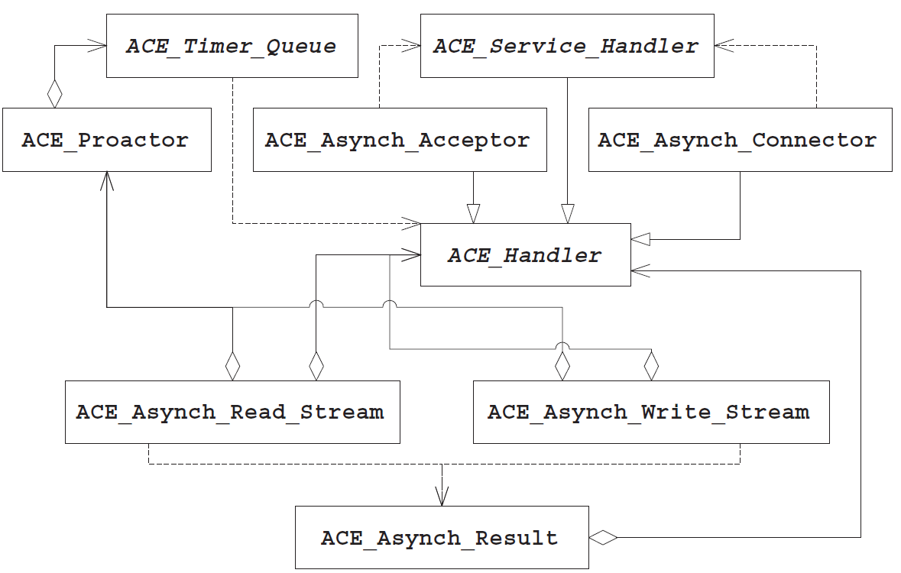
Topics Covered in this Part of the Module
Describe the Proactor pattern
Describe the ACE Proactor framework
The Proactor is the most complicated ACE framework

Slide 24
Motivation for the ACE Proactor Framework
OS support for asynchronous operations has several limitations
Tedious & error-prone to program
Non-portable and/or inefficient
GetQueued
CompletionStatus()
GetQueued
CompletionStatus()
GetQueued
CompletionStatus()
I/O Completion
Port
COMPLETION EVENTS
Passive-mode Socket handle
AcceptEx()
AcceptEx()
AcceptEx()

Slide 25
Motivation for the ACE Proactor Framework
OS support for asynchronous operations has several limitations
Tedious & error-prone to program
Non-portable and/or inefficient
Modern Windows platforms support both overlapped I/O & I/O completion ports
These mechanisms are effcient, but tricky to program
GetQueued
CompletionStatus()
GetQueued
CompletionStatus()
GetQueued
CompletionStatus()
I/O Completion
Port
COMPLETION EVENTS
Passive-mode Socket handle
AcceptEx()
AcceptEx()
AcceptEx()

Slide 26
Motivation for the ACE Proactor Framework
OS support for asynchronous operations has several limitations
Tedious & error-prone to program
Non-portable and/or inefficient
Modern Windows platforms support both overlapped I/O & I/O completion ports
These mechanisms are efficient, but tricky to program
Some operating systems implement the POSIX.4 AIO specification
The spec focuses on disk I/O & implementations are often buggy & inefficient
GetQueued
CompletionStatus()
GetQueued
CompletionStatus()
GetQueued
CompletionStatus()
I/O Completion
Port
COMPLETION EVENTS
Passive-mode Socket handle
AcceptEx()
AcceptEx()
AcceptEx()

Slide 27
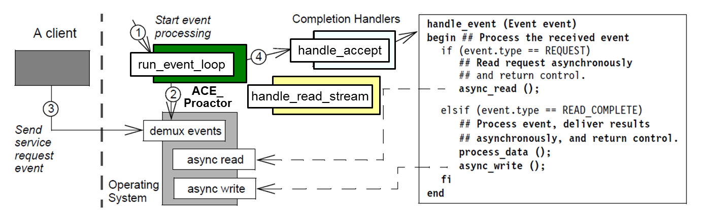
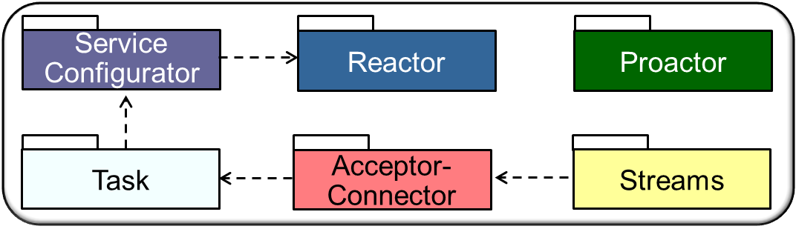

Overview of the ACE Proactor Framework
Classes in this framework allow event-driven apps to process completion events for operations invoked asynchronously

Slide 28
Overview of the ACE Proactor Framework
Classes in this framework allow event-driven apps to process completion events for operations invoked asynchronously
Apps inherit from ACE_Service_Handler & override its hook methods, which ACE Proactor framework then dispatches to process completion events
These classes are designed in accordance with the Proactor pattern

Slide 29
Overview of the ACE Proactor Framework
Classes in this framework allow event-driven apps to process completion events for operations invoked asynchronously
Apps inherit from ACE_Service_Handler & override its hook methods, which ACE Proactor framework then dispatches to process completion events
Key classes in the ACE Proactor framework include
ACE Class | Description
ACE_Handler ACE_Asynch_Read_Stream ACE_Asynch_Write_Stream | Initiate asynchronous read & write operations on an I/O stream & associate each with an ACE_Handler object that will receive the results of those operations
ACE_Asynch_Acceptor ACE_Asynch_Connector | Implementation of Acceptor-Connector pattern that establishes new TCP/IP connections asynchronously
ACE_Service_Handler | Defines the target of the ACE_Asynch_Acceptor & ACE_Asynch_Connector connection factories & provides the hook methods to initialize a TCP/IP connected service
ACE_Proactor | Manages timers & asynchronous I/O completion event demultiplexing

Slide 30
Overview of the ACE Proactor Framework
Classes in this framework allow event-driven apps to process completion events for operations invoked asynchronously
Apps inherit from ACE_Service_Handler & override its hook methods, which ACE Proactor framework then dispatches to process completion events
Key classes in the ACE Proactor framework include
ACE Class | Description
ACE_Handler ACE_Asynch_Read_Stream ACE_Asynch_Write_Stream | Initiate asynchronous read & write operations on an I/O stream & associate each with an ACE_Handler object that will receive the results of those operations
ACE_Asynch_Acceptor ACE_Asynch_Connector | Implementation of Acceptor-Connector pattern that establishes new TCP/IP connections asynchronously
ACE_Service_Handler | Defines the target of the ACE_Asynch_Acceptor & ACE_Asynch_Connector connection factories & provides the hook methods to initialize a TCP/IP connected service
ACE_Proactor | Manages timers & asynchronous I/O completion event demultiplexing

Slide 31
Overview of the ACE Proactor Framework
Classes in this framework allow event-driven apps to process completion events for operations invoked asynchronously
Apps inherit from ACE_Service_Handler & override its hook methods, which ACE Proactor framework then dispatches to process completion events
Key classes in the ACE Proactor framework include
ACE Class | Description
ACE_Handler ACE_Asynch_Read_Stream ACE_Asynch_Write_Stream | Initiate asynchronous read & write operations on an I/O stream & associate each with an ACE_Handler object that will receive the results of those operations
ACE_Asynch_Acceptor ACE_Asynch_Connector | Implementation of Acceptor-Connector pattern that establishes new TCP/IP connections asynchronously
ACE_Service_Handler | Defines the target of the ACE_Asynch_Acceptor & ACE_Asynch_Connector connection factories & provides the hook methods to initialize a TCP/IP connected service
ACE_Proactor | Manages timers & asynchronous I/O completion event demultiplexing

Slide 32
Overview of the ACE Proactor Framework
Classes in this framework allow event-driven apps to process completion events for operations invoked asynchronously
Apps inherit from ACE_Service_Handler & override its hook methods, which ACE Proactor framework then dispatches to process completion events
Key classes in the ACE Proactor framework include
ACE Class | Description
ACE_Handler ACE_Asynch_Read_Stream ACE_Asynch_Write_Stream | Initiate asynchronous read & write operations on an I/O stream & associate each with an ACE_Handler object that will receive the results of those operations
ACE_Asynch_Acceptor ACE_Asynch_Connector | Implementation of Acceptor-Connector pattern that establishes new TCP/IP connections asynchronously
ACE_Service_Handler | Defines the target of the ACE_Asynch_Acceptor & ACE_Asynch_Connector connection factories & provides the hook methods to initialize a TCP/IP connected service
ACE_Proactor | Manages timers & asynchronous I/O completion event demultiplexing

Slide 33
Overview of the ACE Proactor Framework
Classes in this framework allow event-driven apps to process completion events for operations invoked asynchronously
Apps inherit from ACE_Service_Handler & override its hook methods, which ACE Proactor framework then dispatches to process completion events
Key classes in the ACE Proactor framework include
ACE Class | Description
ACE_Handler ACE_Asynch_Read_Stream ACE_Asynch_Write_Stream | Initiate asynchronous read & write operations on an I/O stream & associate each with an ACE_Handler object that will receive the results of those operations
ACE_Asynch_Acceptor ACE_Asynch_Connector | Implementation of Acceptor-Connector pattern that establishes new TCP/IP connections asynchronously
ACE_Service_Handler | Defines the target of the ACE_Asynch_Acceptor & ACE_Asynch_Connector connection factories & provides the hook methods to initialize a TCP/IP connected service
ACE_Proactor | Manages timers & asynchronous I/O completion event demultiplexing
See www.dre.vanderbilt.edu/~schmidt/PDF/proactor.pdf for more

Slide 34
The ACE_Asynch_[Read|Write]_Stream Classes
These factory classes enable applications to initiate portable asynchronous read() & write() operations that provide the following capabilities:
They can initiate asynchronous I/O operations on a stream-oriented IPC mechanism, such as a TCP socket
ACE_Asynch_Operation
open()
cancel()
ACE_Asynch_Read_Stream
read()
ACE_Asynch_Write_Stream
write()

Slide 35
The ACE_Asynch_[Read|Write]_Stream Classes
These factory classes enable applications to initiate portable asynchronous read() & write() operations that provide the following capabilities:
They can initiate asynchronous I/O operations on a stream-oriented IPC mechanism, such as a TCP socket
They bind an I/O handle, an ACE_Handler object, & a ACE_Proactor to process I/O completion events efficiently
ACE_Asynch_Operation
open()
cancel()
ACE_Asynch_Read_Stream
read()
ACE_Asynch_Write_Stream
write()

Slide 36
The ACE_Asynch_[Read|Write]_Stream Classes
These factory classes enable applications to initiate portable asynchronous read() & write() operations that provide the following capabilities:
They can initiate asynchronous I/O operations on a stream-oriented IPC mechanism, such as a TCP socket
They bind an I/O handle, an ACE_Handler object, & a ACE_Proactor to process I/O completion events efficiently
They create an object that carries an operation's parameters through the ACE Proactor framework to its completion handler
ACE_Asynch_Operation
open()
cancel()
ACE_Asynch_Read_Stream
read()
ACE_Asynch_Write_Stream
write()
Result
bytes_to_read()
message_block()
handle()

Slide 37
The ACE_Asynch_[Read|Write]_Stream Classes
These factory classes enable applications to initiate portable asynchronous read() & write() operations that provide the following capabilities:
They can initiate asynchronous I/O operations on a stream-oriented IPC mechanism, such as a TCP socket
They bind an I/O handle, an ACE_Handler object, & a ACE_Proactor to process I/O completion events efficiently
They create an object that carries an operation's parameters through the ACE Proactor framework to its completion handler
ACE_Asynch_Operation
open()
cancel()
ACE_Asynch_Read_Stream
read()
ACE_Asynch_Write_Stream
write()
They derive from ACE_Asynch_Operation, which provides the interface to initialize the object & cancel outstanding I/O operations
Handles variability of asynchronous I/O operations via a common API

Slide 38
The ACE_Handler Class
The base class of all asynchronous completion handlers in the ACE Proactor framework
It provides hook methods to handle completion of all asynchronous I/O operations defined in ACE
Including connection establishment & I/O operations on files & IPC streams
ACE_Handler
handle_accept()
handle_connect()
handle_read_stream
handle_write_stream()
handle_transmit_file()
handle_read_file()
handle_write_file()
handle_time_out()
…

Slide 39
The ACE_Handler Class
The base class of all asynchronous completion handlers in the ACE Proactor framework
It provides hook methods to handle completion of all asynchronous I/O operations defined in ACE
Including connection establishment & I/O operations on files & IPC streams
It provides a hook method to handle timer expiration
ACE_Handler
handle_accept()
handle_connect()
handle_read_stream
handle_write_stream()
handle_transmit_file()
handle_read_file()
handle_write_file()
handle_time_out()
…

Slide 40
The ACE_Handler Class
The base class of all asynchronous completion handlers in the ACE Proactor framework
It provides hook methods to handle completion of all asynchronous I/O operations defined in ACE
Including connection establishment & I/O operations on files & IPC streams
It provides a hook method to handle timer expiration
ACE_Handler
handle_accept()
handle_connect()
handle_read_stream
handle_write_stream()
handle_transmit_file()
handle_read_file()
handle_write_file()
handle_time_out()
…
Handles variability of asynchronous event completion via a common API

Slide 41
The ACE_Service_Handler Class
This class defines the interface for the ACE_Asynch_Acceptor & ACE_Asynch_Connector to activate when a new TCP connection is accepted
It provides the basis for initializing & implementing a networked app service
Acts as the target of ACE_Asynch_Connector & ACE_Asynch_Acceptor connection factories
ACE_Handler
ACE_Service_Handler
open()
addresses()
act()
…

Slide 42
The ACE_Service_Handler Class
This class defines the interface for the ACE_Asynch_Acceptor & ACE_Asynch_Connector to activate when a new TCP connection is accepted
It provides the basis for initializing & implementing a networked app service
Acts as the target of ACE_Asynch_Connector & ACE_Asynch_Acceptor connection factories
It receives the connected peer’s address
ACE_Handler
ACE_Service_Handler
open()
addresses()
act()
…

Slide 43
The ACE_Service_Handler Class
This class defines the interface for the ACE_Asynch_Acceptor & ACE_Asynch_Connector to activate when a new TCP connection is accepted
It provides the basis for initializing & implementing a networked app service
Acts as the target of ACE_Asynch_Connector & ACE_Asynch_Acceptor connection factories
It receives the connected peer’s address
ACE_Handler
ACE_Service_Handler
open()
addresses()
act()
…
It inherits the ability to handle asynchronous I/O completion events since it derives from ACE_Handler
Handles variability of asynchronous network I/O via a common API

Slide 44
The ACE_Asynch_Acceptor Class
This class provides an implementation of asynchronous Acceptor capability in the Acceptor-Connector pattern:
It initiates asynchronous passive connection establishment
ACE_Handler
SERVICE_HANDLER
ACE_Asynch_Acceptor
open()
accept()
cancel()
validate_connections()
…

Slide 45
The ACE_Asynch_Acceptor Class
This class provides an implementation of asynchronous Acceptor capability in the Acceptor-Connector pattern:
It initiates asynchronous passive connection establishment
It acts as a factory, creating a new ACE_Service_Handler for each accepted connection
ACE_Handler
SERVICE_HANDLER
ACE_Asynch_Acceptor
open()
accept()
cancel()
validate_connections()
…

Slide 46
The ACE_Asynch_Acceptor Class
This class provides an implementation of asynchronous Acceptor capability in the Acceptor-Connector pattern:
It initiates asynchronous passive connection establishment
It acts as a factory, creating a new ACE_Service_Handler for each accepted connection
It can cancel a previously initiated asynchronous accept() operation
ACE_Handler
SERVICE_HANDLER
ACE_Asynch_Acceptor
open()
accept()
cancel()
validate_connections()
…

Slide 47
The ACE_Asynch_Acceptor Class
This class provides an implementation of asynchronous Acceptor capability in the Acceptor-Connector pattern:
It initiates asynchronous passive connection establishment
It acts as a factory, creating a new ACE_Service_Handler for each accepted connection
It can cancel a previously initiated asynchronous accept() operation
It provides a hook method to validate the peer before initializing a new ACE_Service_Handler
ACE_Handler
SERVICE_HANDLER
ACE_Asynch_Acceptor
open()
accept()
cancel()
validate_connections()
…

Slide 48
The ACE_Asynch_Acceptor Class
This class provides an implementation of asynchronous Acceptor capability in the Acceptor-Connector pattern:
It initiates asynchronous passive connection establishment
It acts as a factory, creating a new ACE_Service_Handler for each accepted connection
It can cancel a previously initiated asynchronous accept() operation
It provides a hook method to validate the peer before initializing a new ACE_Service_Handler
ACE_Handler
SERVICE_HANDLER
ACE_Asynch_Acceptor
open()
accept()
cancel()
validate_connections()
…
Inherits from ACE_Handler to handle asynchronous accept completion events
Handles variability of async passive connections via a common API

Slide 49
The ACE_Proactor Class
Defines an interface for ACE Proactor framework capabilities:
Centralize event loop processing
ACE_Proactor
*
ACE_Handler
run_event_loop()
dispatches
handle_accept()
handle_read_stream()
handle_write_stream()
handle_time_out()
owns
<<uses>>
Handle
*
notifies
Completion Event Queue
GetCompletion Status()
Concrete Completion Handler A
handle_accept()
Concrete Completion Handler B
handle_read_stream()
handle_writer_stream()

Slide 50
The ACE_Proactor Class
Defines an interface for ACE Proactor framework capabilities:
Centralize event loop processing
Demuxes completion events to completion handlers & dispatches hook methods on completion handlers
ACE_Proactor
*
ACE_Handler
run_event_loop()
dispatches
handle_accept()
handle_read_stream()
handle_write_stream()
handle_time_out()
owns
<<uses>>
Handle
*
notifies
Completion Event Queue
GetCompletion Status()
Concrete Completion Handler A
handle_accept()
Concrete Completion Handler B
handle_read_stream()
handle_writer_stream()
handle_time_out()

Slide 51
The ACE_Proactor Class
Defines an interface for ACE Proactor framework capabilities:
Centralize event loop processing
Demuxes completion events to completion handlers & dispatches hook methods on completion handlers
Dispatch timer expirations to their associated ACE_Handle objects
ACE_Proactor
*
ACE_Handler
run_event_loop()
dispatches
handle_accept()
handle_read_stream()
handle_write_stream()
handle_time_out()
owns
<<uses>>
Handle
*
notifies
Completion Event Queue
GetCompletion Status()
Concrete Completion Handler A
handle_accept()
Concrete Completion Handler B
handle_read_stream()
handle_writer_stream()
handle_time_out()

Slide 52
The ACE_Proactor Class
Defines an interface for ACE Proactor framework capabilities:
Centralize event loop processing
Demuxes completion events to completion handlers & dispatches hook methods on completion handlers
Dispatch timer expirations to their associated ACE_Handle objects
ACE_Proactor
*
ACE_Handler
run_event_loop()
dispatches
handle_accept()
handle_read_stream()
handle_write_stream()
handle_time_out()
owns
<<uses>>
Handle
*
notifies
Completion Event Queue
GetCompletion Status()
Concrete Completion Handler A
handle_accept()
Concrete Completion Handler B
handle_read_stream()
handle_writer_stream()
handle_time_out()
Handles variability of asynchronous event handling via a common API

Slide 53
Summary
A proactive I/O model is harder to program than reactive & synchronous I/O models for several reasons
There’s a time/space separation between asynchronous invocation & completion handling that requires tricky state management
e.g., bookkeeping details & data fragments must be managed explicitly, rather than handled implicitly on the run-time stack
Web Server
1: accept()
HTTP_ Asynch_ Handler
7: create()
HTTP_ Asynch_ Acceptor
2: AcceptEx (AcceptHandle, ACT)
6: handle_event (ACCEPT_EVENT)
8: ReadFile
(SockHandle, data, ACT)
ACE_Proactor
3,9: handle_events()
Windows
Completion Event Queue
5: accept complete

Slide 54
Summary
A proactive I/O model is harder to program than reactive & synchronous I/O models for several reasons
There’s a time/space separation between asynchronous invocation & completion handling that requires tricky state management
e.g., bookkeeping details & data fragments must be managed explicitly, rather than handled implicitly on the run-time stack
There are also significant accidental complexities associated with the quality of asynchronous I/O on many OS platforms
Web Server
1: accept()
HTTP_ Asynch_ Handler
7: create()
HTTP_ Asynch_ Acceptor
2: AcceptEx (AcceptHandle, ACT)
6: handle_event (ACCEPT_EVENT)
8: ReadFile
(SockHandle, data, ACT)
ACE_Proactor
3,9: handle_events()
Windows
Completion Event Queue
5: accept complete

Slide 55
Summary
A proactive I/O model is harder to program than reactive & synchronous I/O models for several reasons
There’s a time/space separation between asynchronous invocation & completion handling that requires tricky state management
e.g., bookkeeping details & data fragments must be managed explicitly, rather than handled implicitly on the run-time stack
There are also significant accidental complexities associated with the quality of asynchronous I/O on many OS platforms
The ACE Proactor framework helps to alleviate many of these complexities
Web Server
1: accept()
HTTP_ Asynch_ Handler
7: create()
HTTP_ Asynch_ Acceptor
2: AcceptEx (AcceptHandle, ACT)
6: handle_event (ACCEPT_EVENT)
8: ReadFile
(SockHandle, data, ACT)
ACE_Proactor
3,9: handle_events()
Windows
Completion Event Queue
5: accept complete

Slide 56
Patterns & Frameworks for Asynchronous Event Handling: Part 3
Douglas C. Schmidt
d.schmidt@vanderbilt.edu
www.dre.vanderbilt.edu/~schmidt
Professor of Computer Science
Institute for Software Integrated Systems Vanderbilt University Nashville, Tennessee, USA

Slide 57
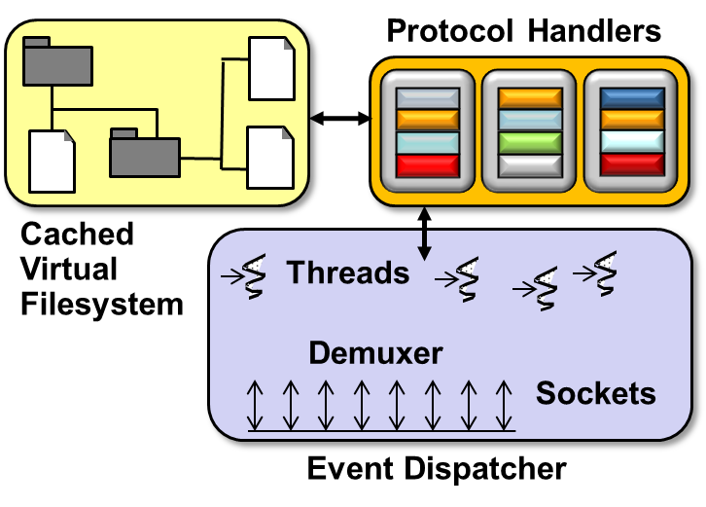
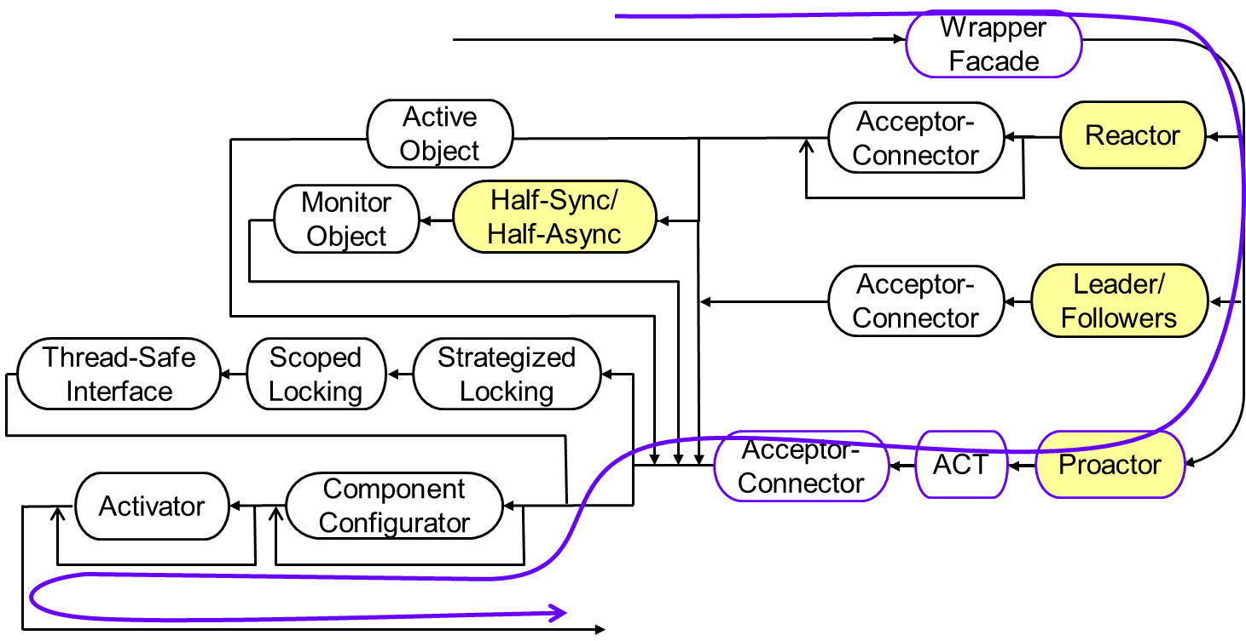
Topics Covered in this Part of the Module
Describe the Proactor pattern
Describe the ACE Proactor framework
Apply the ACE Proactor framework to JAWS
Asynchronous path thru the JAWS pattern language

Slide 58
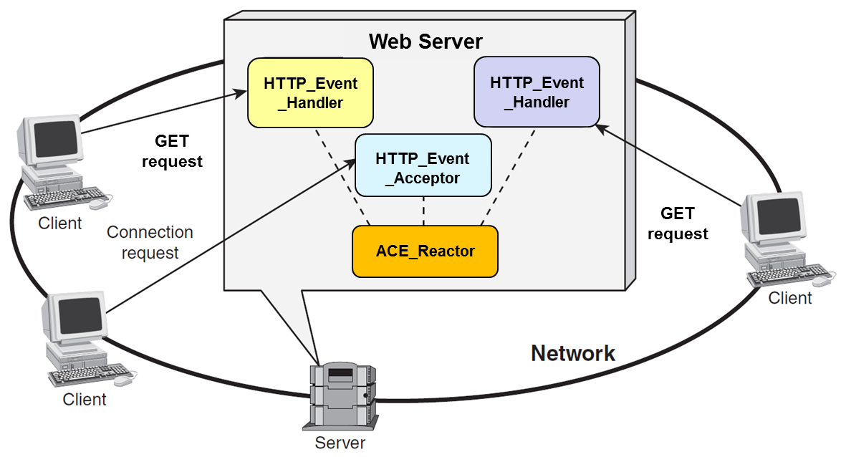


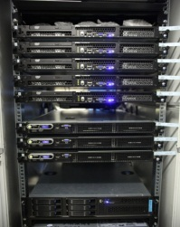
Proactive Processing w/ACE Proactor Framework
Use ACE_Service_Handler & ACE_Asynch_Acceptor to implement a JAWS web server based on the Proactor pattern
HTTP_ Asynch_ Handler
HTTP_ Asynch_ Handler
Logging
Event
Handler
HTTP_Event_ Handler
HTTP_Asynch _Acceptor
ACE_Proactor
Server
This implementation only uses a single thread, but is still scalable on Windows

Slide 59
Proactive Processing with ACE_Service_Handler
Implements HTTP using asynchronous operations
class HTTP_Asynch_Handler : public ACE_Service_Handler {
private:
ACE_Proactor *proactor_; // Cached Proactor.
ACE_Mem_Map file_; // Memory-mapped file
ACE_HANDLE handle_; // Socket endpoint
HTTP_Request request_;
ACE_Asynch_Read_Stream read_stream_;
ACE_Asynch_Write_Stream write_stream_;
public:
HTTP_Asynch_Handler (ACE_Proactor *proactor) : proactor_ (proactor) {}
// ... Continued below
Hold HTTP request while it’s being processed
Read/write asynchronous socket I/O

Slide 60
Proactive Processing with ACE_Service_Handler
Hook method invoked by HTTP_Asynch_Acceptor
virtual void open (ACE_HANDLE new_handle,
ACE_Message_Block &mb) {
request_.state_ = INCOMPLETE; // Initialize state for request
io_handle_ = new_handle; // Store handle to the open socket
read_stream_.open
(*this,
io_handle_,
0, proactor_);
read_stream_.read
(request_.message (), request_.size ());
}
Initialize ACE_Async_Read_Stream, with *this as completion handler
Start asynchronous read operation on connected socket

Slide 61
Proactive Processing with ACE_Service_Handler
Completion event handling method dispatched by ACE Proactor framework
virtual void handle_read_stream (const ACE_Asynch_Read_Stream::Result &result) {
if (request_complete (result))
handle_request ();
else
read_stream_.read (request_.message (), request_.size ());
}
// ...
}
Got the entire read request, so handle it
Didn’t get entire request, so initiate a new asynchronous read() operation to try & get the remainder

Slide 62
Proactive Processing with ACE_Service_Handler
Handle processing of a completed request
void handle_request () {
switch (request_.command ()) {
case HTTP_Request::GET: // Request to download a file
file_.map (request_.filename ());
write_stream_.write (file_.addr (),
file_.size ());
break;
case HTTP_Request::PUT: // Request to upload a file
...
Switch on the HTTP command type
Memory map the requested content & invoke an asynchronous write operation to transmit it to the client
We could also use transmit_file() here

Slide 63
Proactive Processing with ACE_Asynch_Acceptor
Implements HTTP using asynchronous operations
class HTTP_Asynch_Acceptor
: public ACE_Asynch_Acceptor<HTTP_Asynch_Handler> {
public:
HTTP_Asynch_Acceptor (ACE_INET_Addr addr,
ACE_Proactor *proactor) {
open (addr, 0, false, ACE_DEFAULT_ASYNCH_BACKLOG, 1, proactor);
}
Starts multiple asynchronous accept requests on addr

Slide 64
Applying the ACE Proactor framework to JAWS
const u_short PORT = 80;
int main (int argc, char *argv[]) {
ACE_INET_Addr addr (argc == 1 ? PORT : atoi (argv[1]));
HTTP_Asynch_Acceptor acceptor (addr,
ACE_Proactor::instance ());
for (;;)
ACE_Proactor::instance ()->run_proactor_event_loop ();
...
Associate the HTTP_Asynch_Acceptor’s passive-mode socket handle with the ACE_Proactor singleton’s completion port & invoke multiple asynchronous accept operations to initiative proactive web serve processing
Event loop processes client connection requests & HTTP requests proactively

Slide 65
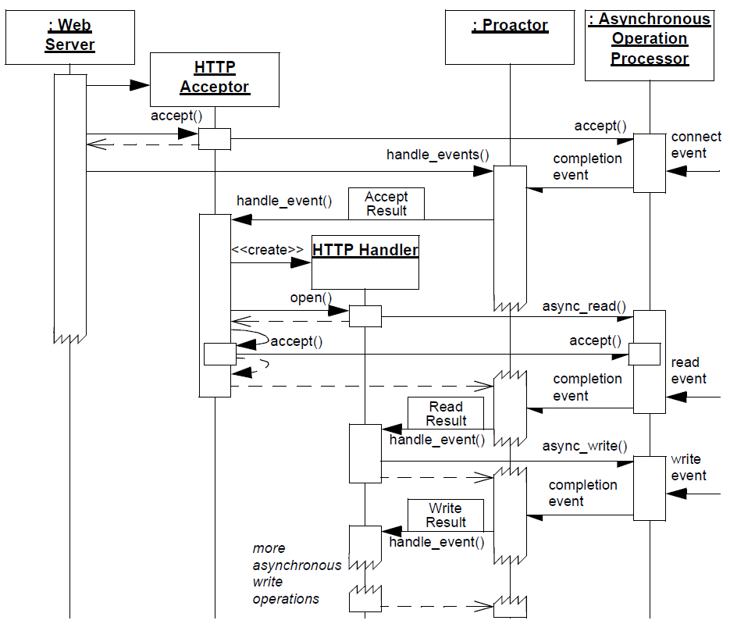
Sequence Diagram of ACE Proactor Web Server
: ACE_ Proactor
: HTTP_ Asynch_ Acceptor
run_event_loop()
Connection establishment & service initialization phase
handle_accept()
: HTTP_Asynch _Handler
handle_read _stream ()
Data transfer phase
handle_write _stream ()

Slide 66
Summary
The ACE Proactor framework alleviates reactive I/O bottlenecks without introducing the complexity & overhead of synchronous I/O & multi-threading

Slide 67
Summary
The ACE Proactor framework alleviates reactive I/O bottlenecks without introducing the complexity & overhead of synchronous I/O & multi-threading
This framework allows an app to execute I/O operations via two phases:
An app can initiate one or more asynchronous I/O operations on multiple I/O handles in parallel without having to wait until they complete
Web Server
<<uses>>
<<uses>>
<<invokes>>
is associated with
Windows
Operating System
Asynchronous
Operation
ACE_Handler
ACE_HANDLE
AcceptEx(), ReadFile()
WriteFile()
handle_accept()
handle_write_stream()
execute_async_op()

Slide 68
Summary
The ACE Proactor framework alleviates reactive I/O bottlenecks without introducing the complexity & overhead of synchronous I/O & multithreading
This framework allows an app to execute I/O operations via two phases:
An app can initiate one or more asynchronous I/O operations on multiple I/O handles in parallel without having to wait until they complete
As each operation completes, the OS notifies an app-defined completion handler that then processes the results from the completed I/O operation
<<uses>>
Web Server
<<uses>>
<<uses>>
<<invokes>>
is associated with
Windows
Operating System
Asynchronous
Operation
ACE_Handler
ACE_HANDLE
AcceptEx(), ReadFile()
WriteFile()
handle_accept()
handle_write_stream()
execute_async_op()
*
<<enqueues>>
<<executes>>
<<demultiplexes
& dispatches>>
I/O Completion
Port
Asynchronous
Event Demuxer
ACE_Proactor
HTTP_ Asynch_
Acceptor
HTTP_ Asynch_
Handler
handle_events()
GetQueuedCompletionStatus()
<<dequeues>>

Slide 69
Patterns & Frameworks for Asynchronous Event Handling: Part 4
Douglas C. Schmidt
d.schmidt@vanderbilt.edu
www.dre.vanderbilt.edu/~schmidt
Professor of Computer Science
Institute for Software Integrated Systems Vanderbilt University Nashville, Tennessee, USA

Slide 70
Topics Covered in this Part of the Module
Describe the Proactor pattern
Describe the ACE Proactor framework
Apply the ACE Proactor framework to JAWS
Describe the Asynchronous Completion Token pattern & apply it to JAWS
Asynchronous path thru the JAWS pattern language

Slide 71
Efficiently Demuxing Asynch Event Completions
Context | Problem
In a proactive web server async I/O operations will yield I/O completion event responses that must be processed efficiently | Need to minimize time/ space used to demux completion events to their associated completion handler

Slide 72
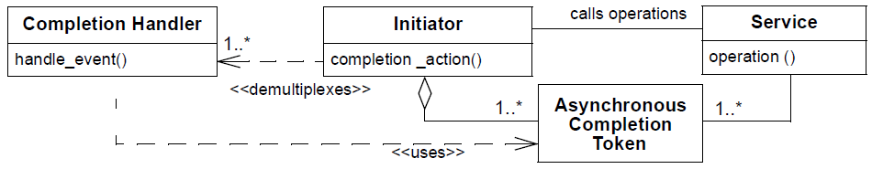
Efficiently Demuxing Asynch Event Completions
Context | Problem | Solution
In a proactive web server async I/O operations will yield I/O completion event responses that must be processed efficiently | Need to minimize time/ space used to demux completion events to their associated completion handler | Apply the Asynchronous Completion Token pattern to demux & process the responses of asynchronous operations efficiently
Asynchronous Completion Token allows an app to efficiently demux & process the responses of asynchronous operations it invokes on services
Structure

Slide 73
Efficiently Demuxing Asynch Event Completions
Context | Problem | Solution
In a proactive web server async I/O operations will yield I/O completion event responses that must be processed efficiently | Need to minimize time/ space used to demux completion events to their associated completion handler | Apply the Asynchronous Completion Token pattern to demux & process the responses of asynchronous operations efficiently
Asynchronous Completion Token allows an app to efficiently demux & process the responses of asynchronous operations it invokes on services
Structure

Slide 74
Efficiently Demuxing Asynch Event Completions
Context | Problem | Solution
In a proactive web server async I/O operations will yield I/O completion event responses that must be processed efficiently | Need to minimize time/ space used to demux completion events to their associated completion handler | Apply the Asynchronous Completion Token pattern to demux & process the responses of asynchronous operations efficiently
Asynchronous Completion Token allows an app to efficiently demux & process the responses of asynchronous operations it invokes on services
Structure

Slide 75
Efficiently Demuxing Asynch Event Completions
Context | Problem | Solution
In a proactive web server async I/O operations will yield I/O completion event responses that must be processed efficiently | Need to minimize time/ space used to demux completion events to their associated completion handler | Apply the Asynchronous Completion Token pattern to demux & process the responses of asynchronous operations efficiently
Asynchronous Completion Token allows an app to efficiently demux & process the responses of asynchronous operations it invokes on services
Structure

Slide 76
Efficiently Demuxing Asynch Event Completions
Context | Problem | Solution
In a proactive web server async I/O operations will yield I/O completion event responses that must be processed efficiently | Need to minimize time/ space used to demux completion events to their associated completion handler | Apply the Asynchronous Completion Token pattern to demux & process the responses of asynchronous operations efficiently
Asynchronous Completion Token allows an app to efficiently demux & process the responses of asynchronous operations it invokes on services
Structure

Slide 77
Efficiently Demuxing Asynch Event Completions
Context | Problem | Solution
In a proactive web server async I/O operations will yield I/O completion event responses that must be processed efficiently | Need to minimize time/ space used to demux completion events to their associated completion handler | Apply the Asynchronous Completion Token pattern to demux & process the responses of asynchronous operations efficiently
Asynchronous Completion Token allows an app to efficiently demux & process the responses of asynchronous operations it invokes on services
Structure
See www.dre.vanderbilt.edu/~schmidt/PDF/ACT.pdf for more info

Slide 78
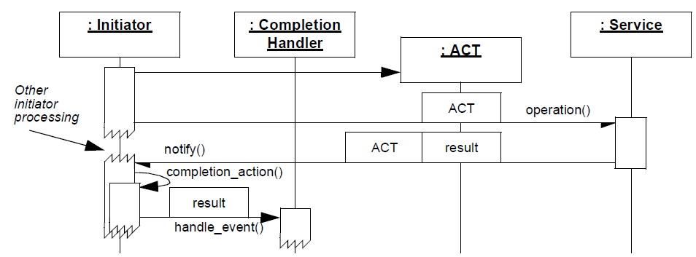
Efficiently Demuxing Asynch Event Completions
Context | Problem | Solution
In a proactive web server async I/O operations will yield I/O completion event responses that must be processed efficiently | Need to minimize time/ space used to demux completion events to their associated completion handler | Apply the Asynchronous Completion Token pattern to demux & process the responses of asynchronous operations efficiently
Transmit info that identifies how the initiator should process the service’s response
Dynamics

Slide 79
Efficiently Demuxing Asynch Event Completions
Context | Problem | Solution
In a proactive web server async I/O operations will yield I/O completion event responses that must be processed efficiently | Need to minimize time/ space used to demux completion events to their associated completion handler | Apply the Asynchronous Completion Token pattern to demux & process the responses of asynchronous operations efficiently
Dynamics
Return this info to initiator when operation finishes, so it can be used to demux the response efficiently

Slide 80
Applying the Asynchronous Completion Token Pattern in JAWS
class HTTP_Asynch_Handler :
public ACE_Service_Handler {
virtual void open (.....) {
...
read_stream_.open
(*this,
io_handle_,
0, proactor_);
...
Asynchronous completion tokens (ACTs) are passed to all asynchronous operations to efficiently indicate completion handlers
Pass this as ACT
1: accept()
HTTP_ Asynch_ Handler
Web Server
7: create()
HTTP_ Asynch_ Acceptor
8: ReadFile
(SockHandle, data, ACT)
2: AcceptEx (AcceptHandle, ACT)
6: handle_accept()
4: connect()
Windows
ACE_Proactor
Completion Event Queue
3,9: handle_events()
5: accept complete

Slide 81
Applying the Asynchronous Completion Token Pattern in JAWS
class HTTP_Asynch_Handler :
public ACE_Service_Handler {
virtual void handle_read_stream (.....) {
...
}
...
Asynchronous completion tokens (ACTs) are passed to all asynchronous operations to efficiently indicate completion handlers
Completion event handling method dispatched by ACE Proactor framework
1: accept()
HTTP_ Asynch_ Handler
Web Server
7: create()
HTTP_ Asynch_ Acceptor
8: ReadFile
(SockHandle, data, ACT)
2: AcceptEx (AcceptHandle, ACT)
6: handle_accept()
4: connect()
Windows
ACE_Proactor
Completion Event Queue
3,9: handle_events()
5: accept complete

Slide 82
Benefits of Asynchronous Completion Token
Simplified initiator data structures
Initiators need not maintain complex data structures to associate responses with completion handlers
Web Server
1: accept()
HTTP_ Asynch_ Handler
7: create()
HTTP_ Asynch_ Acceptor
2: AcceptEx (AcceptHandle, ACT)
6: handle_accept()
8: ReadFile
(SockHandle, data, ACT)
ACE_Proactor
3,9: handle_events()
Windows
Completion Event Queue
5: accept complete

Slide 83
Benefits of Asynchronous Completion Token
Simplified initiator data structures
Initiators need not maintain complex data structures to associate responses with completion handlers
Efficient state acquisition
ACTs are time efficient because they need not require complex parsing of data returned with service response
Web Server
1: accept()
HTTP_ Asynch_ Handler
7: create()
HTTP_ Asynch_ Acceptor
2: AcceptEx (AcceptHandle, ACT)
6: handle_accept()
8: ReadFile
(SockHandle, data, ACT)
ACE_Proactor
3,9: handle_events()
Windows
Completion Event Queue
5: accept complete

Slide 84
Benefits of Asynchronous Completion Token
Simplified initiator data structures
Initiators need not maintain complex data structures to associate responses with completion handlers
Efficient state acquisition
ACTs are time efficient because they need not require complex parsing of data returned with service response
Space efficiency
ACTs can consume minimal space
Web Server
1: accept()
HTTP_ Asynch_ Handler
7: create()
HTTP_ Asynch_ Acceptor
2: AcceptEx (AcceptHandle, ACT)
6: handle_accept()
8: ReadFile
(SockHandle, data, ACT)
ACE_Proactor
3,9: handle_events()
Windows
Completion Event Queue
5: accept complete

Slide 85
Benefits of Asynchronous Completion Token
Simplified initiator data structures
Initiators need not maintain complex data structures to associate responses with completion handlers
Efficient state acquisition
ACTs are time efficient because they need not require complex parsing of data returned with service response
Space efficiency
ACTs can consume minimal space
Flexibility
User-defined ACTs are not forced to inherit from an interface to use the service’s ACTs
Web Server
1: accept()
HTTP_ Asynch_ Handler
7: create()
HTTP_ Asynch_ Acceptor
2: AcceptEx (AcceptHandle, ACT)
6: handle_accept()
8: ReadFile
(SockHandle, data, ACT)
ACE_Proactor
3,9: handle_events()
Windows
Completion Event Queue
5: accept complete

Slide 86
Limitations of Asynchronous Completion Token
Memory leaks
Memory leaks can result if initiators use ACTs as pointers to dynamically allocated memory & services fail to return the ACTs
Web Server
1: accept()
HTTP_ Asynch_ Handler
7: create()
HTTP_ Asynch_ Acceptor
2: AcceptEx (AcceptHandle, ACT)
6: handle_accept()
8: ReadFile
(SockHandle, data, ACT)
ACE_Proactor
3,9: handle_events()
Windows
Completion Event Queue
5: accept complete

Slide 87
Limitations of Asynchronous Completion Token
Memory leaks
Memory leaks can result if initiators use ACTs as pointers to dynamically allocated memory & services fail to return the ACTs
Authentication
When an ACT is returned to an initiator on completion of an asynch event, the initiator may need to authenticate the ACT before using it
Web Server
1: accept()
HTTP_ Asynch_ Handler
7: create()
HTTP_ Asynch_ Acceptor
2: AcceptEx (AcceptHandle, ACT)
6: handle_accept()
8: ReadFile
(SockHandle, data, ACT)
ACE_Proactor
3,9: handle_events()
Windows
Completion Event Queue
5: accept complete

Slide 88
Limitations of Asynchronous Completion Token
Memory leaks
Memory leaks can result if initiators use ACTs as pointers to dynamically allocated memory & services fail to return the ACTs
Authentication
When an ACT is returned to an initiator on completion of an asynch event, the initiator may need to authenticate the ACT before using it
Application re-mapping
If ACTs are used as direct pointers to memory, errors can occur if part of the application is re-mapped in virtual memory
Web Server
1: accept()
HTTP_ Asynch_ Handler
7: create()
HTTP_ Asynch_ Acceptor
2: AcceptEx (AcceptHandle, ACT)
6: handle_accept()
8: ReadFile
(SockHandle, data, ACT)
ACE_Proactor
3,9: handle_events()
Windows
Completion Event Queue
5: accept complete

