Slide 1





Evaluating Patterns & Frameworks for Concurrent & Networked Software
Douglas C. Schmidt
d.schmidt@vanderbilt.edu
www.dre.vanderbilt.edu/~schmidt
Professor of Computer Science
Institute for Software Integrated Systems Vanderbilt University Nashville, Tennessee, USA

Slide 2


Topics Covered in this Module
Summarize the benefits & limitations of patterns & frameworks for concurrent & networked software
Notes:
http://upload.wikimedia.org/wikiversity/en/c/c7/Mask.gif

Slide 3
Benefits of Patterns
Capture & abstract recurring software roles & relationships to facilitate systematic reuse of successful designs
Wrapper Facade
Active Object
Acceptor- Connector
Reactor
Monitor Object
Half-Sync/ Half-Async
Acceptor- Connector
Leader/ Followers
Thread-Safe Interface
Scoped Locking
Strategized Locking
Acceptor- Connector
ACT
Proactor
Activator
Component Configurator
File Cache
Protocol Handlers
Event Dispatcher
No patterns or paths thru the pattern language are specific to web servers
Notes:
Origins of the Reactor story.

Slide 4
Benefits of Patterns
Record engineering tradeoffs & design alternatives to enhance development & sustainment
Wrapper Facade
Active Object
Acceptor- Connector
Reactor
Monitor Object
Half-Sync/ Half-Async
Acceptor- Connector
Leader/ Followers
Thread-Safe Interface
Scoped Locking
Strategized Locking
Acceptor- Connector
ACT
Proactor
Activator
Component Configurator
File Cache
Protocol Handlers
Event Dispatcher
Simple, reactive, but non-scalable

Slide 5
Benefits of Patterns
Record engineering tradeoffs & design alternatives to enhance development & sustainment
Wrapper Facade
Active Object
Acceptor- Connector
Reactor
Monitor Object
Half-Sync/ Half-Async
Acceptor- Connector
Leader/ Followers
Thread-Safe Interface
Scoped Locking
Strategized Locking
Acceptor- Connector
ACT
Proactor
Activator
Component Configurator
File Cache
Protocol Handlers
Event Dispatcher
Concurrent & scalable, but may be less predictable

Slide 6
Benefits of Patterns
Record engineering tradeoffs & design alternatives to enhance development & sustainment
Wrapper Facade
Active Object
Acceptor- Connector
Reactor
Monitor Object
Half-Sync/ Half-Async
Acceptor- Connector
Leader/ Followers
Thread-Safe Interface
Scoped Locking
Strategized Locking
Acceptor- Connector
ACT
Proactor
Activator
Component Configurator
File Cache
Protocol Handlers
Event Dispatcher
Concurrent, predictable, but may be less scalable

Slide 7
Benefits of Patterns
Record engineering tradeoffs & design alternatives to enhance development & sustainment
Wrapper Facade
Active Object
Acceptor- Connector
Reactor
Monitor Object
Half-Sync/ Half-Async
Acceptor- Connector
Leader/ Followers
Thread-Safe Interface
Scoped Locking
Strategized Locking
Acceptor- Connector
ACT
Proactor
Activator
Component Configurator
File Cache
Protocol Handlers
Event Dispatcher
Asynchronous, concurrent, scalable, but limited portability

Slide 8
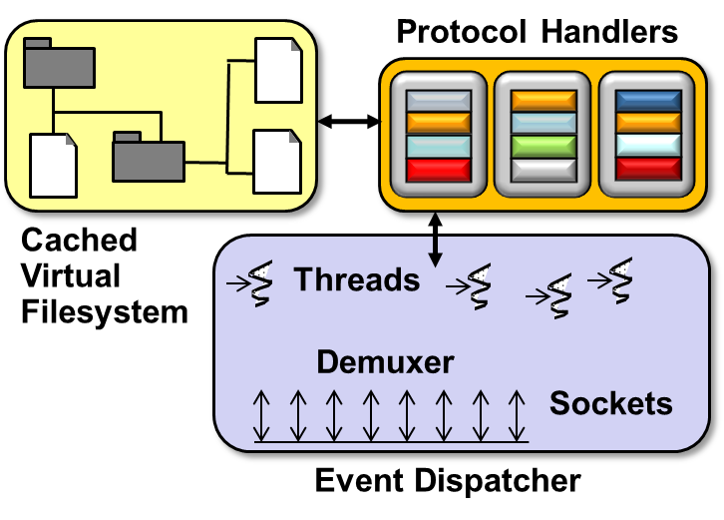
Benefits of Patterns
Enable a shared design vocabulary that enhances understanding, (re)engineering effort, & team communication
This vocabulary generalizes far beyond web servers!
Design Problem | Pattern(s)
Encapsulating low-level OS APIs | Wrapper Facade
Decoupling event demuxing & connection management from protocol processing | Reactor & Acceptor-Connector
Scaling up performance via multi-threading | Half-Sync/Half-Async & Active Object
Synchronized request queue | Monitor Object
Minimizing multi-threading overhead | Leader/Followers
Using asynchronous I/O effectively | Proactor
Efficiently demuxing asynchronous operations & completions | Asynchronous Completion Token
Enhancing server (re)configurability | Component Configurator
Minimizing unused server resources | Activator
Transparently parameterizing synchronization into components | Strategized Locking
Ensuring locks are released properly | Scoped Locking
Minimizing unnecessary locking | Thread-Safe Interface
See www.dre.vanderbilt.edu/JAWS for more info
Notes:
Tell Hardpack story

Slide 9


Benefits of Patterns
Transcend language-centric biases
Design Problem | Pattern(s)
Encapsulating low-level OS APIs | Wrapper Facade
Decoupling event demuxing & connection management from protocol processing | Reactor & Acceptor-Connector
Scaling up performance via multi-threading | Half-Sync/Half-Async & Active Object
Synchronized request queue | Monitor Object
Minimizing multi-threading overhead | Leader/Followers
Using asynchronous I/O effectively | Proactor
Efficiently demuxing asynchronous operations & completions | Asynchronous Completion Token
Enhancing server (re)configurability | Component Configurator
Minimizing unused server resources | Activator
Transparently parameterizing synchronization into components | Strategized Locking
Ensuring locks are released properly | Scoped Locking
Minimizing unnecessary locking | Thread-Safe Interface
Notes:
http://www.flickr.com/photos/55510802@N06/5422730118/

Slide 10
Benefits of Patterns
Abstract away from non-essential implementation details
e.g., during the design phase
Wrapper Facade
Active Object
Acceptor- Connector
Reactor
Monitor Object
Half-Sync/ Half-Async
Acceptor- Connector
Leader/ Followers
Thread-Safe Interface
Scoped Locking
Strategized Locking
Acceptor- Connector
ACT
Proactor
Activator
Component Configurator
File Cache
Protocol Handlers
Event Dispatcher
Notes:
http://www.flickr.com/photos/55510802@N06/5422730118/

Slide 11

Limitations of Patterns
May neglect essential details of implementations & optimization, e.g.
Edge-triggered vs. level- triggered event demuxers
WaitForMultipleObjects() vs. select()
Threading & synchronization semantics
Asynchronous I/O semantics on Windows vs. POSIX
Local & remote inter-process communication (IPC) mechanisms
Language-specific features
Reactor
*
Event Handler
handle_events()
register_handler()
remove_handler()
dispatches
handle_event ()
get_handle()
*
Handle
owns
*
notifies
<<uses>>
handle set
Synchronous
Event Demuxer
Concrete Event Handler A
select ()
handle_event ()
get_handle()
Concrete Event Handler B
handle_event ()
get_handle()
Some limitations from before don’t apply when combining patterns & frameworks
Notes:
http://www.flickr.com/photos/75001512@N00/4864207213/

Slide 12
Benefits of Frameworks
Design reuse
e.g., by guiding app developers thru steps needed to ensure successful creation & deployment of software
ACE_Event _Handler
ACE_Reactor
*
handle_events()
register_handler()
remove_handler()
dispatches
handle_input()
get_handle()
*
owns
Handle
*
notifies
<<uses>>
handle set
Synchronous
Event Demuxer
ACE_ Acceptor
ACE_Svc
_Handler
handle_input()
get_handle()
handle_input()
get_handle()
select()
HTTP_Svc
_Acceptor
HTTP_Svc
_Handler
handle_input()
get_handle()
handle_input()
get_handle()

Slide 13
Benefits of Frameworks
Design reuse
e.g., by guiding app developers thru steps needed to ensure successful creation & deployment of software
ACE_Event _Handler
ACE_Reactor
*
handle_events()
register_handler()
remove_handler()
dispatches
handle_input()
get_handle()
*
owns
Handle
*
notifies
<<uses>>
handle set
Synchronous
Event Demuxer
ACE_ Acceptor
ACE_Svc
_Handler
handle_input()
get_handle()
open()
svc()
select()
TPC_HTTP
_Acceptor
TPC_HTTP
_Handler
handle_input()
get_handle()
open()
svc()

Slide 14

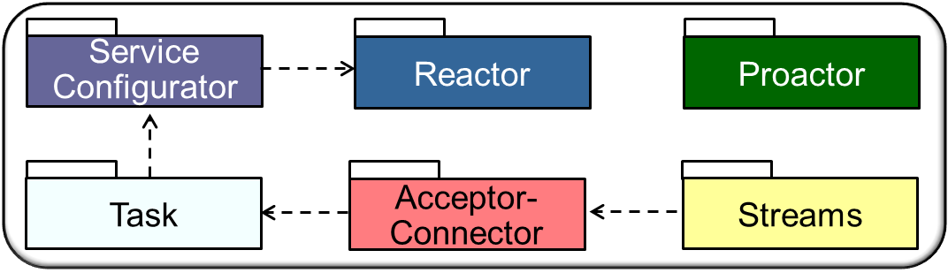
Benefits of Frameworks
Implementation reuse
e.g., by leveraging previous development & optimization efforts & amortizing software lifecycle costs

Slide 15
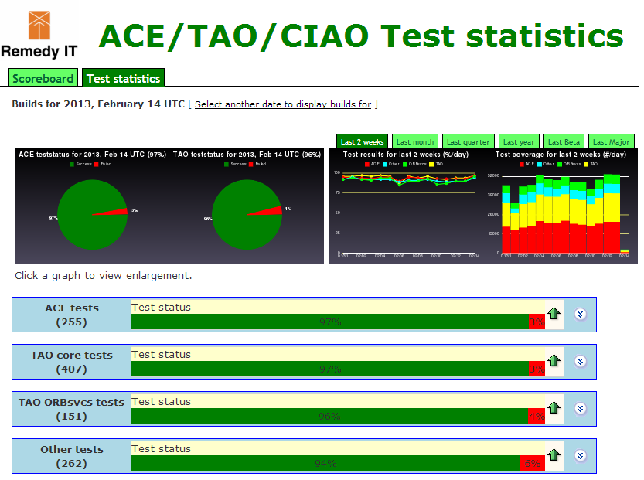
Benefits of Frameworks
Validation reuse
e.g., by amortizing the efforts of validating application- & platform-independent portions of software, thereby enhancing dependability & performance
scoreboard.theaceorb.nl/ test_stats

Slide 16
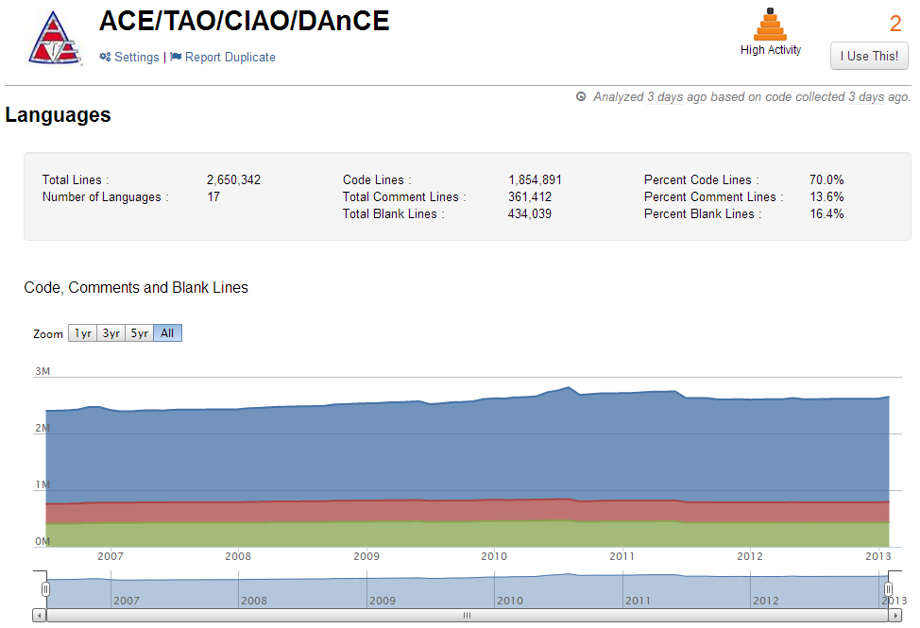
Limitations of Frameworks
Significant time may required to learn how to use frameworks effectively
www.ohloh.net/p/acetaociao
Notes:
http://www.flickr.com/photos/42042252@N02/4086095092/

Slide 17
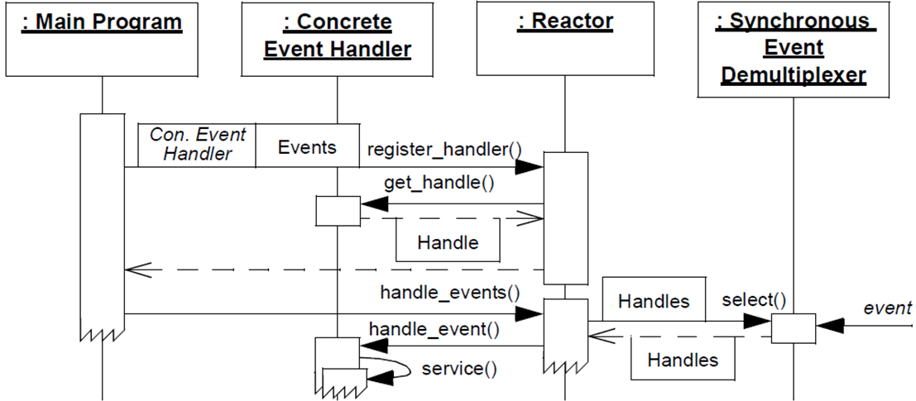
Limitations of Frameworks
Polymorphism, inversion of control, & concurrent (especially asynchronous) processing makes debugging tedious & challenging
Note inversion of control
Notes:
http://www.flickr.com/photos/76103695@N00/1703252007/

Slide 18
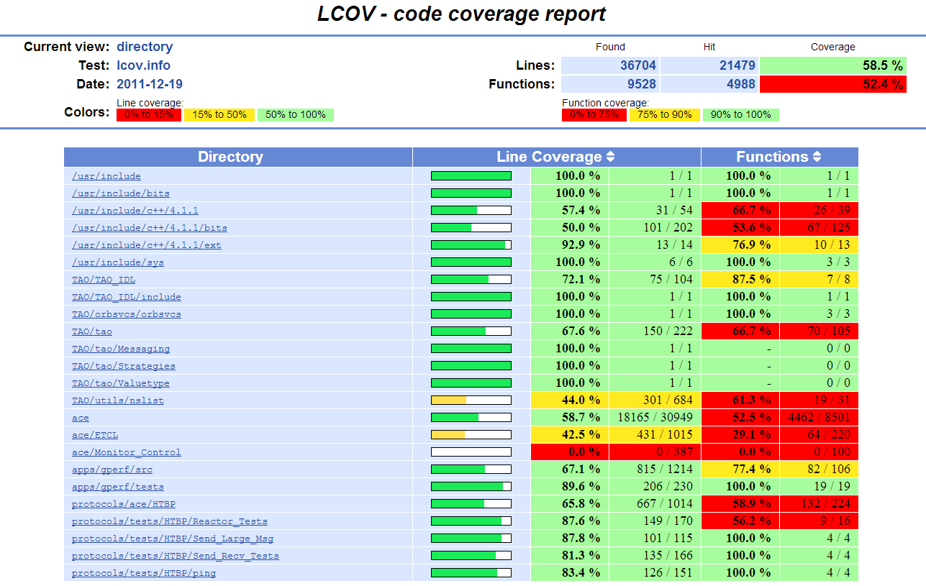
Limitations of Frameworks
Testing can be tricky due to “late binding”
www.dre.vanderbilt.edu/Coverage

Slide 19
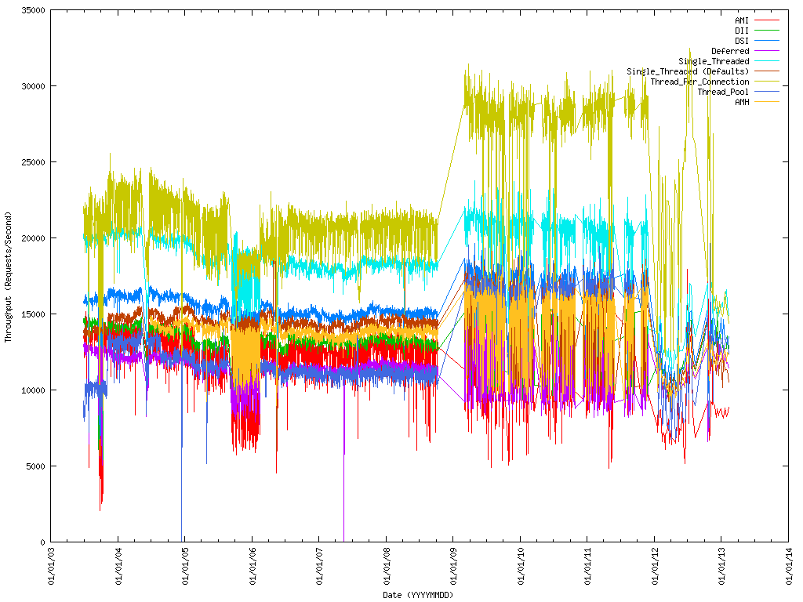
Limitations of Frameworks
Performance may degrade due to complex structures & levels of indirection
atcdstats.theaceorb.nl
Notes:
http://www.flickr.com/photos/87244355@N00/376781013/

Slide 20
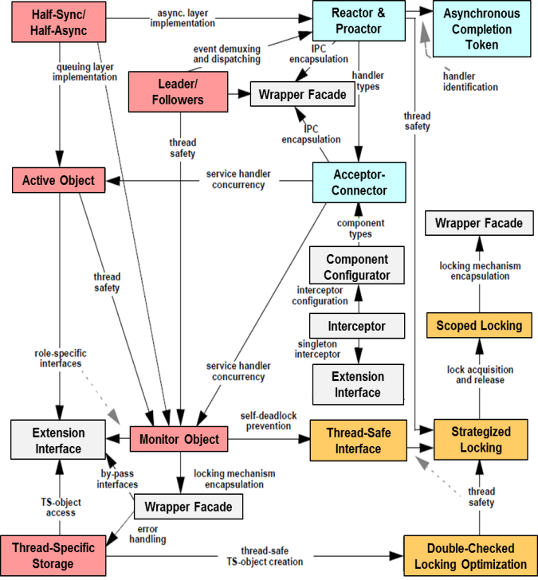
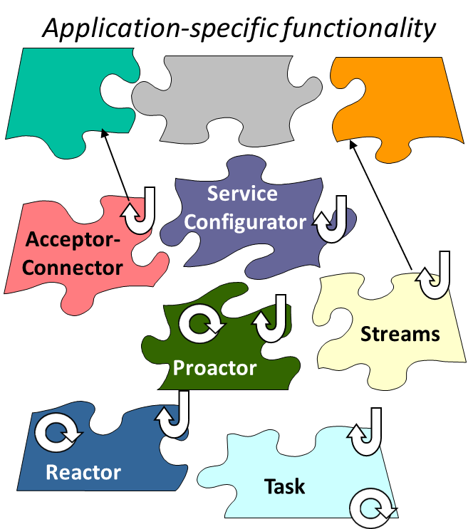
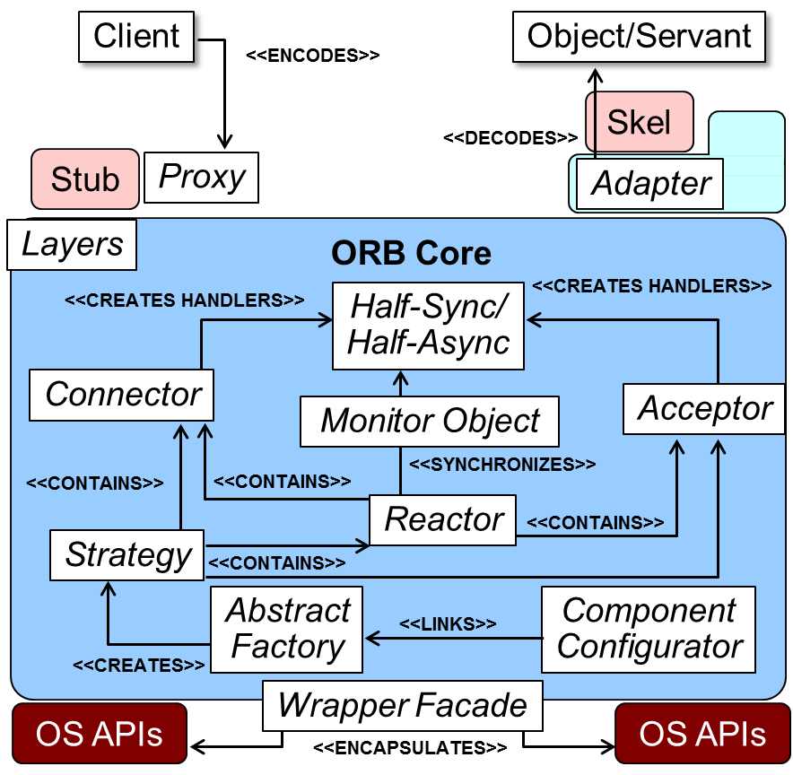
Summary
Patterns, frameworks, & middleware are synergistic
Patterns codify expertise via reusable architecture design themes & styles
Frameworks codify expertise via reuse of algorithms, extensible architectures, & components
Middleware codifies expertise via common components that provide a façade to framework capabilities
There are now powerful feedback loops advancing these technologies

Slide 21
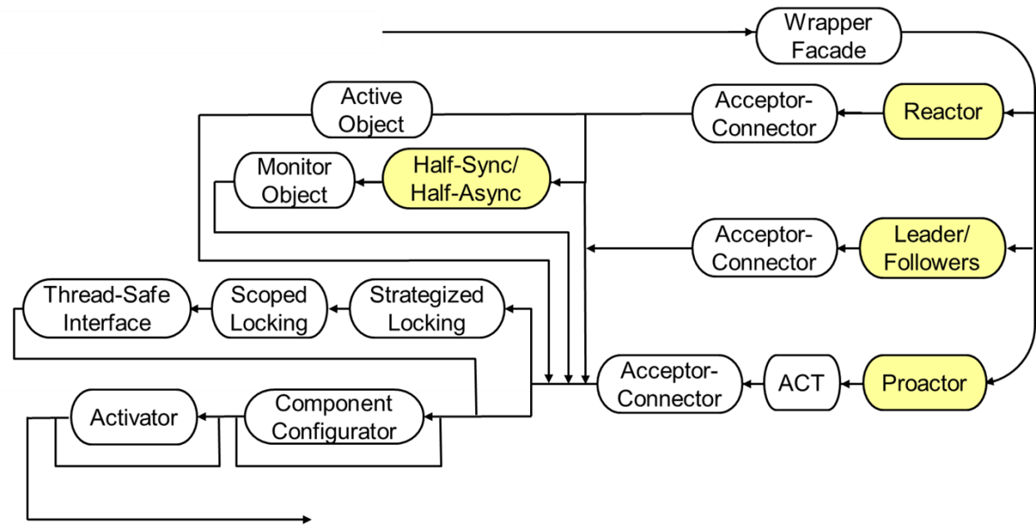
Summary
Understand patterns to learn how to better develop & apply frameworks & apps
Some of the most useful patterns are used to describe frameworks
Patterns also apply to non-framework technologies, as well
Notes:
3D Scales of Justice, http://www.flickr.com/photos/86530412@N02/7953227784/

