Slide 1



Introduction to Concurrent & Networked Software
Douglas C. Schmidt
d.schmidt@vanderbilt.edu
www.dre.vanderbilt.edu/~schmidt
Professor of Computer Science
Institute for Software Integrated Systems Vanderbilt University Nashville, Tennessee, USA

Slide 2
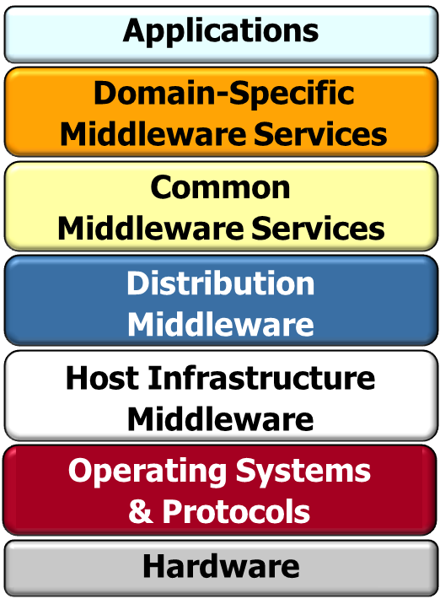
Topics Covered in this Section of Modules
Discuss key layers in concurrent & networked software

Slide 3
Topics Covered in this Section of Modules
Discuss key layers in concurrent & networked software

Slide 4
Topics Covered in this Section of Modules
Discuss key layers in concurrent & networked software

Slide 5
Topics Covered in this Section of Modules
Discuss key layers in concurrent & networked software

Slide 6
Topics Covered in this Section of Modules
Discuss key layers in concurrent & networked software

Slide 7
Topics Covered in this Section of Modules
Discuss key layers in concurrent & networked software

Slide 8
Topics Covered in this Section of Modules
Discuss key layers in concurrent & networked software

Slide 9
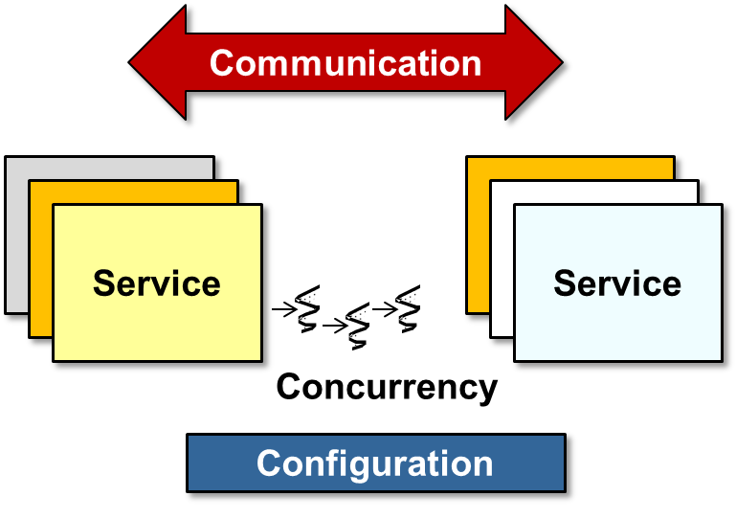
Topics Covered in this Section of Modules
Discuss key layers in concurrent & networked software
Explore key design dimensions of concurrent & networked software

Slide 10
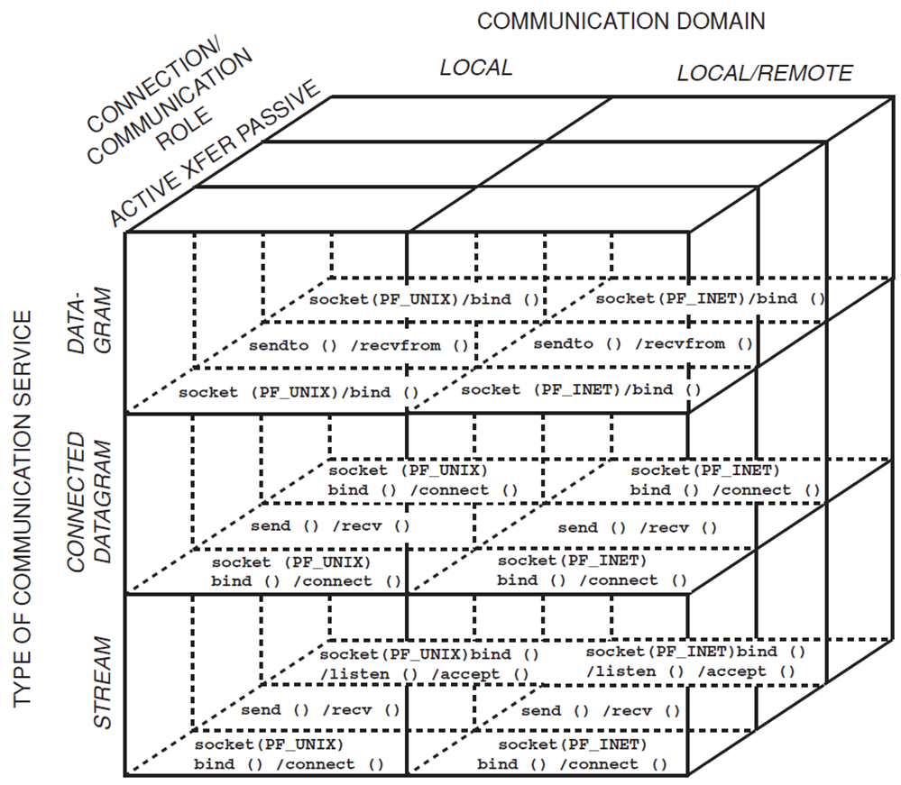
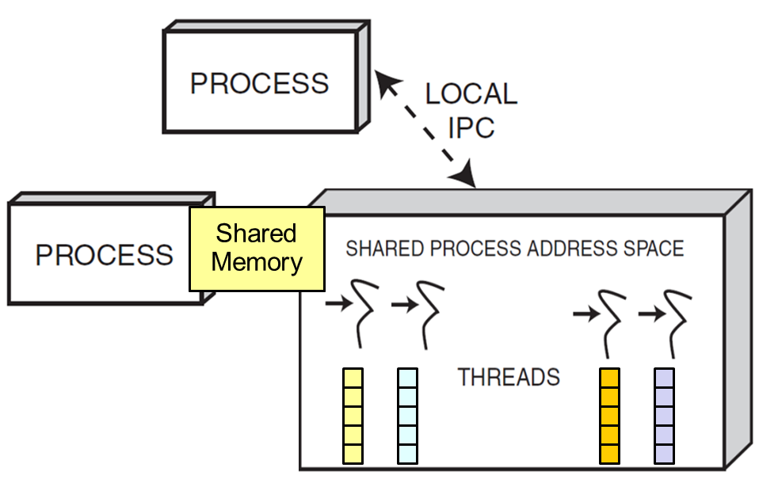
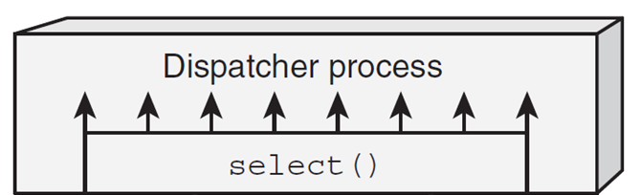
Topics Covered in this Section of Modules
Discuss key layers in concurrent & networked software
Explore key design dimensions of concurrent & networked software
Survey key operating system concurrent & networked software mechanisms & APIs
Written largely in C
select()

Slide 11

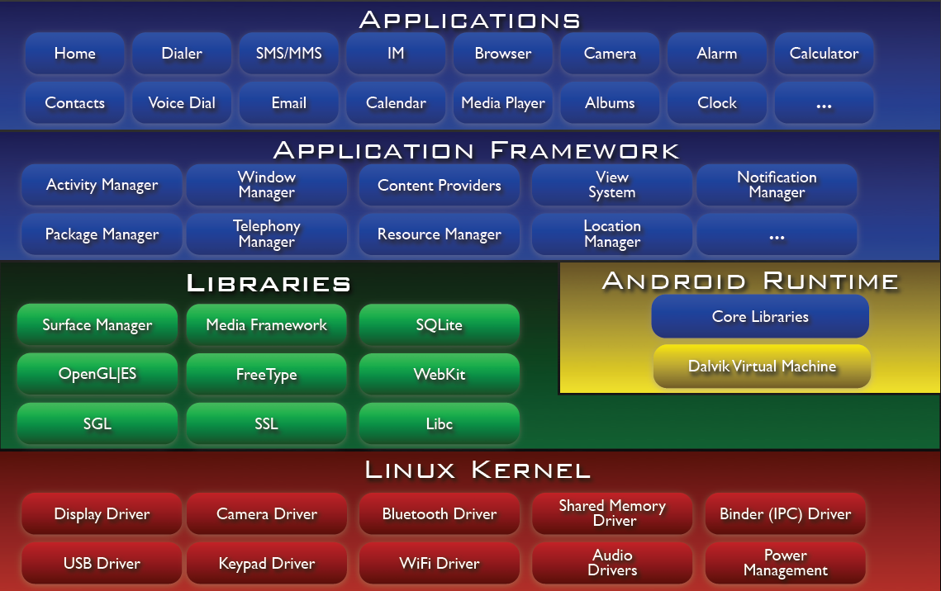
Topics Covered in this Section of Modules
Discuss key layers in concurrent & networked software
Explore key design dimensions of concurrent & networked software
Survey key operating system concurrent & networked software mechanisms & API
Describe key Android concurrent & networked software mechanisms & APIs
Written largely in Java
This section focuses primarily on concepts – there’s little/no patterns/code here

