Slide 1
MontaVista Linux
Professional Edition 4.0
Jump Start Training
MontaVista Software Inc.,
Taiwan Branch
Jesse Lien
Email: support_tw@mvista.com
TEL: 02-23784056

Slide 2
Agenda
10:10 ~ 11:00
  Preparing Development System
  Boot Configure and Download
  Development Tools (I)
    Applications and Libraries Development and Debug
    Kernel Development and Debug
11:10 ~ 12:00
  Development Tools (II)
    Platform Image
    System and Target Tools
13:10 ~ 14:20
  Kernel Modules
  Linux Device Driver Overview
14:40 ~ 15:50
  Pro 4.0 Real-time Technology
    Real-time kernel design
    Real-time device driver
    Real-time applications
16:00 ~ 16:30
  Final Thoughts
  Q & A

Slide 3
Preparing Development System
Supported Host Distributions
  MVL PE 3.1: MVL PE 4.0:
    Mandrake 8.1 8.1
    RedHat 7.3, 9.0, RHEL3.0 WS 9.0, RHEL WS/ES 3.0
    SuSE 7.3 9.2 Enterprise / Pro
    Yellow Dog 2.1 N/A
    Solaris 7 and 8 8 and 9
    Windows 2000/XP Windows 2000/XP
  VMware[tm] Workstation 3.1 (or above)
Host Configuration
  NFS, bootp/dhcpd, tftp, firewall, minicom, …
  $PATH: /opt/montavista/pro/bin:/opt/montavista/common/bin:
        /opt/montavista/common/eclipse:
        /opt/montavista/pro/devkit/arm/xscale_be/bin

Slide 4
Preparing Development System
MontaVista Software Package Installation
  Pro 4.0 is shipped on seven CD-ROMs
    Host Binaries, DevRocket, and Documentation CD-ROMs which applies to all installations
    Linux Support Package, Cross, and Target architecture CD-ROMs contains the target specific software for your target(s)
    A source CDROM which includes applications and tools sources
  MontaVista Zone provides fixes & updates
    http://support.mvista.com

Slide 5
Preparing Development System
MontaVista Source CD Installation
  Managed by Source RPM
  Use MontaVista’s “mvl-edition-rpm” and “mvl-edition-rpmbuild” instead of Redhat’s “rpm”
    Default working path: ~/montavista/rpm/
    5 stages of rpmbuild: prepare, compile, install, binary rpm, and source rpm
    e.g.: mvl-edition-rpmbuild –ba --target=arm_v5t_le-linux ucd-snmp.spec
    May skip pre-positioned stages by --short-circuit option.
      e.g., mvl-edition-rpmbuild –bc --short-circuit --target=arm_v5t_le-linux ucd-snmp.spec

Slide 6
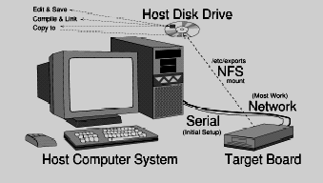
Development Environment

Slide 7

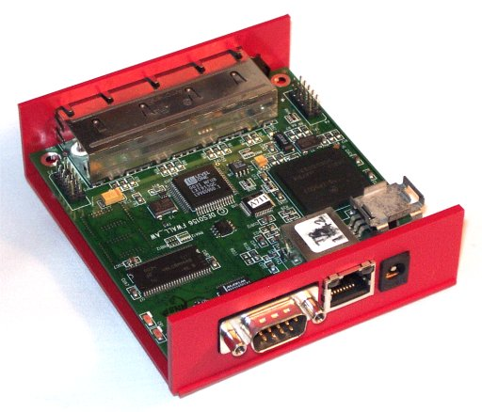
Boot Config. & Download

Slide 8
Boot Config. & Download
Assumptions for the Lab Equipment
  Using BOOTP and TFTP to transfer the booting operating system from the host system disk to the target system memory
  A portion of the host’s file system will be available to the target operating system by an NFS mount
The Steps
  Step B - Build the target binary (vmlinux)
  Step C - Configure the target & host network capabilities
  Step D - Download the binary to the target
  Step E - Execute program(s) on the target

Slide 9
Boot Config. & Download
Step B - Build the target binary (vmlinux)
  Linux uses the make utility extensively.
  Sources organized into subdirectories
  If compressed, it is then called vmlinuz
  Booter and optional RAM disk are then added and the composite is named zvmlinuz, zImage or bzImage
  Some boards need S-Records / other formats, then convert as needed
  See “MontaVista Linux PE 4.0 Kernel Developer’s Guide” for detail

Slide 10
Boot Config. & Download
Step C: Configure the target and host network capabilities
  BOOTP (uses DHCP)
  TFTP Daemon
  NFS Information
  Minicom
  Refer to the MontaVista Linux Professional Edition Quick Start Guide

Slide 11
Boot Config. & Download
Step D: Download the binary to the target
  Configure the target board
  Interconnect host and target
  Activate the target’s firmware to retrieve the previously built zImage binary file and transfer control into it
  The first part of zImage, the Linux Boot Loader, uncompresses Linux and places it at the appropriate memory address

Slide 12
Boot Config. & Download
Step D: Download the binary to the target (cont’d)
  The Linux Boot Loader also uncompresses the RAM disk image, if present, and places it in memory
  Finally, the Linux Boot Loader transfers control to the uncompressed Linux image
  (vmlinux) along with a command line describing the RAM disk image (if present)
  Linux initializes itself including the hardware Memory Management Unit (MMU) that translates logical (or virtual) addresses into physical (or real addresses.)

Slide 13
Boot Config. & Download
Step E: Execute program(s) on the target
  Linux mounts the initial file system from RAM Disk, or NFS Disk, or Local Disk.
  Linux, in init/main.c searches for the init first as /sbin/init, then as /etc/init, then /bin/init and finally /bin/sh (any of which could be a binary executable, a shell script, or any other file that Linux knows how to execute) and then executes it.
  Typically, it is the /sbin/init program that is executed at this point.
  /sbin/init processes the /etc/inittab file. See man init and man inittab for complete details on starting your own application programs via the init process.

Slide 14
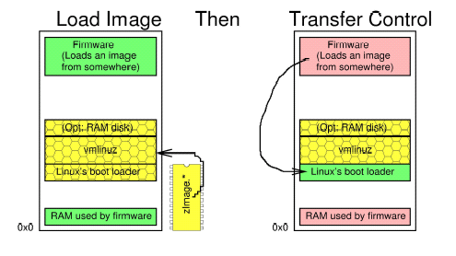
Loading: Image Loader

Slide 15
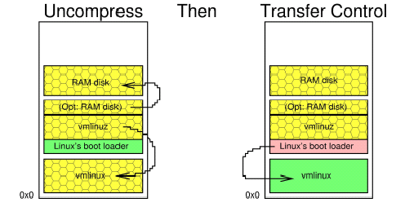
Loading: Linux Boot Loader

Slide 16
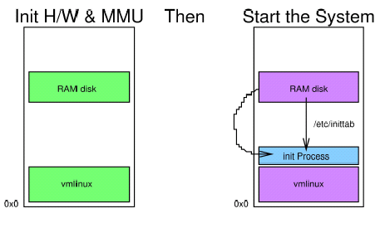
Loading: Linux Startup

Slide 17

Development Tools

Slide 18

Development Tools
DevRocket 2.0
  Integrated Development Environment (IDE)
  Based on Eclipse 3.0.1, CDT 2.1
  512MB+ DRAM is recommended on host PC
  Project Wizards
  Libraries footprint optimization
  GUI-based debugging
  The outline view useful for source/class browsing
  Supports C and C++

Slide 19
Development Tools
What’s new in DevRocket 2.0
  MontaVista target tools
    Target interaction and monitoring
  MontaVista system measurement tools
    Interrupt/preemption latency
  Kernel GDB (kgdb) integrated
  Linux Trace Toolkit (LTT) integrated
  Strace/ltrace integrated
  Performance improvement
  Allows users to pull in external RPMs for package selection
  Remote terminal console

Slide 20
Development Tools
Using command-line tools
  GNU C/C++ compiler
  gcc - C Compiler
  g++ - C++ Compiler
  A family of compilers for various target CPUs
  A front-end for the build process including preprocessor, compiler, assembler and linker
MontsVista provides both cross and native toolchain
  /opt/montavista/pro/devkit/arm/v5t_le/bin
  /opt/montavista/pro/devkit/arm/v5t_le/target/usr/bin

Slide 21
Development Tools
Binutils: a collection of binary tools
  ar - Manages object file archives
  nm - List symbols from object files
  objcopy - Copy and translate object files
  size - List text, data and bss sizes
  strip - Remove symbols
  addr2line - Convert addresses to file and line

Slide 22
Development Tools
make and Makefile
  Traditional Unix tool
  Almost anything you can do by hand (and then some) can be done through a Makefile
  Lots of good books from which to learn
  Notably "Managing Projects with Make" (Pub: O’Reilly)

Slide 23
Development Tools
A simple Makefile example
  # Makefile for ferret
  CC=arm_v5t_le-gcc
  TARGET=/opt/montavista/pro/devkit/arm/v5t_le/target
  all: install
  install: ferret
  cp ferret $(TARGET)
  ferret: ferret.c Makefile
  $(CC) -D_REENTRANT -O $< -o $@ -lpthread
  clean:
  - rm -f ferret.o ferret $(TARGET)/ferret

Slide 24

Application Development

Slide 25
Application Development
Choose your prefer development environment
  Self-host or Cross compilation
  Using DevRocket or Command-line to edit and compile your applications
Decide the threading library
  LinuxThreads
  NPTL
  Solaris Threads Library (ScTL)
Pushing applications to the target
  NFS or local file systems, for cxample, ramdisk
Testing and debugging on the target

Slide 26
Threading Libraries
By default all applications link to the LinuxThreads library. However, at runtime, applications dynamically link to NPTL.
You can link applications directly to NPTL
  Add -nptl to your application compilation options
You can also set LinuxThreads as default runtime library by LD_ASSUME_KERNEL environment variable
  If this variable is not set, or is set to a value greater than or equal to 2.6.1, the NPTL library is used.

Slide 27
Comparing Threading Libraries
NPTL
  Generally faster
  better signal handling
  Unlimited threads per process up to the maximum available system RAM
  More POSIX compliant
  Semaphore support
  Cross-process synchronization

Slide 28
Comparing Threading Libraries
LinuxThreads
  Much slower, but more predictable behavior
  Limited to 1022 threads per process
  Limited POSIX functionality
  Limited semaphore functionality
  Linuxthreads currently retains an advantage over NPTL in that process queuing on synchronization primitives follows scheduling policy and priority.

Slide 29
Multi-threaded Programming
Pthread Coding Requirements
  Include files
    unistd.h
    pthread.h
    semaphore.h
  Compiler flags
    -lpthread for LinuxThreads
    -nptl for NPTL
    -D_REENTRANT

Slide 30
Multi-threaded Programming
Pthread Functions Briefly
  pthread_create - Create a new thread
  pthread_exit - "Me" exit
  pthread_join - Wait for a given thread to pthread_exit
  pthread_cancel - Attempt to terminate a thread
  pthread_self - Who am I?
  pthread_detach - Save no resources if I pthread_exit later (can’t be joined)

Slide 31
Multi-threaded Programming
Pthread Attribute Preparation
  int pthread_attr_init(pthread_attr_t *attr);
  Setup pthread attribute object
  Usually setup before calling pthread_create
    Pthread_attr_setschedpolicy()
    Pthread_attr_setschedparam()
  Inheritsched attribute
  PTHREAD_INHERIT_SCHED vs. PTHREAD_EXPLICIT_SCHED
  pthread_attr_getinheritsched and pthread_attr_setinheritsched

Slide 32
Debugging Applications
Using native gdb or cross gdb
Using GDB with front-end GUI
  DDD
  DevRocket
Addition Tools for debugging
  LTT
  strace/ltrace
  mtrace

Slide 33
Debugging Applications
Source Debugging
  gdb (on host) with gdbserver (on target)
  Preparing the object files (compiling with -g and –ggdb option)
    No optimization makes it easier to follow execution but performance may change dramatically when recompiled with full optimization
    Full optimization may lead to surprising leaps and jumps when executing and "watching" with gdb
    Optimization is optional for user-level applications but in the kernel it is mandatory.

Slide 34
Debugging Applications
Source Debugging
  Starting the gdbserver on the target
    Receives requests from gdb on host
    Sends answers to gdb on host
    gdbserver is very small
    Symbol table and source files on host system
    Full (-g or -ggdb) contents needed only on host
    Only the executable binary is on the target
  Connecting gdb and gdbserver
  You can choose DevRocket or DDD to be GUI front-end for gdb

Slide 35
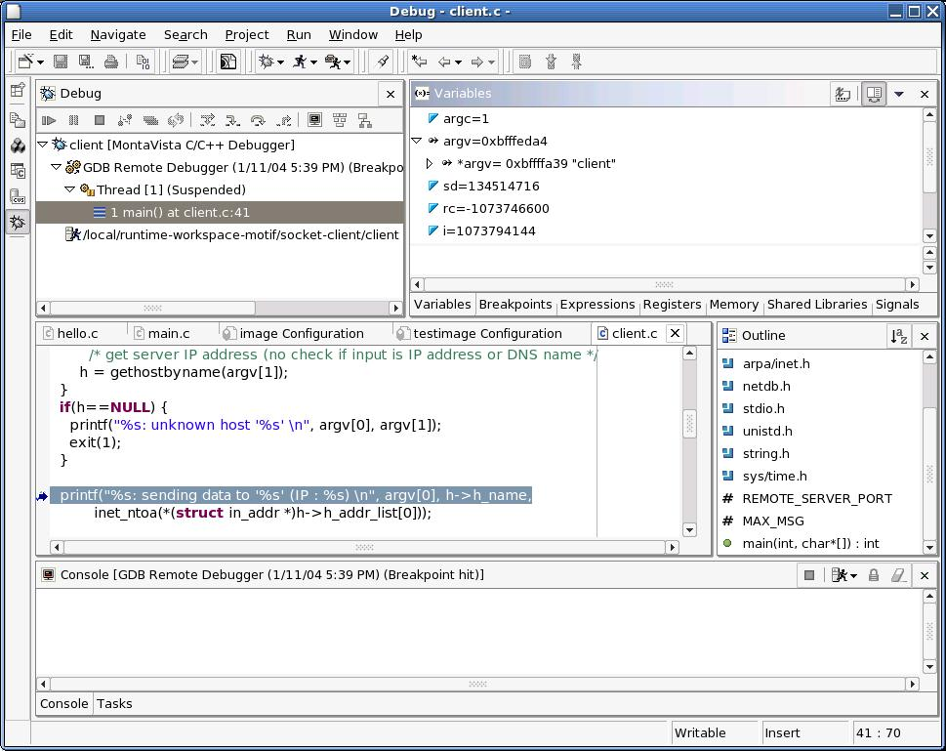
Debugging with DevRocket

Slide 36
Debugging Applications
Source Debugging
  You can have multiple gdbservers running simultaneously on the target for Multiple process debugging
  Multi-threaded application debugging is also supported
    “info threads” command
    “thread <tID>” command
    You can choose whether to set breakpoints on all threads, or on a particular thread: “break <line#> thread <tID>”
    Whenever your program stops under GDB for any reason, all threads of execution stop, not just the current thread. Conversely, whenever you restart the program, all threads start executing. This is true even when single-stepping with commands like step or next.

Slide 37
Debugging Applications
Learning more about gdb
  The GNU Web-Site, http://www.gnu.org/
  Books, see “Beginning Linux Programming”, Richard Stones and Neil Matthew , WROX Press, Ltd., 1-861002-97-1.
  Use the help command in gdb itself.

Slide 38
Debugging Applications
ltrace/strace
  Library call/system call tracers
  Intercepts and records
    Dynamic library calls
    Received signals
    System calls
  Allows you to see which routines your applications are actually calling
  Can help debug interaction dependent system problems
    Shows order of all system calls made even with multiple processes running

Slide 39
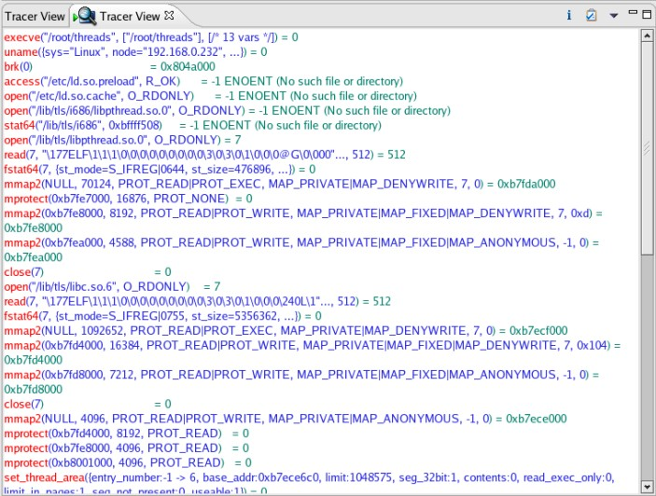
Remote System Call Trace

Slide 40
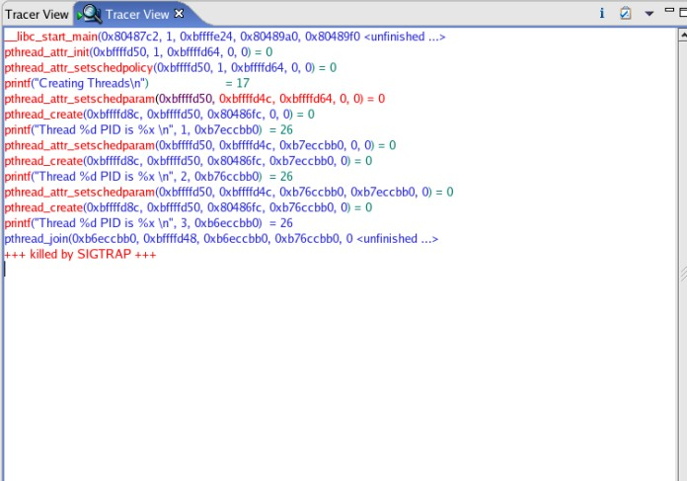
Remote Library Call Trace

Slide 41

Kernel Development

Slide 42
Kernel Development
Choose your prefer approach for development environment
  Self-host or Cross compilation
  Using DevRocket or Command line
Kernel configuration
  Determine what networking options you want to enable
  Decide what standard devices you want to enable
  Decide whether or not your applications require any of the real-time performance
  Select the file system types you want to use in your deployed embedded project
Convert the kernel image to a format that can be used by your target firmware

Slide 43
Configuring the Kernel
Copy a kernel source tree to your work directory from the installation location
/opt/montavista/<release>/devkit/lsp/<target>/linux-<version>
To configure a kernel, you can either do it by using command line or DevRocket™
make config or menuconfig or xconfig

Slide 44
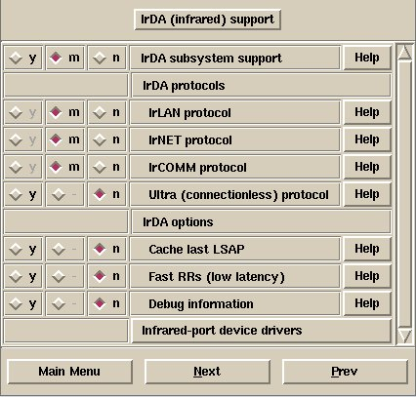
Setting Options
“y” means this function will be included statically in the kernel
“m” means to build this function as a dynamically-loaded module
“n” means this function is disabled and will not be built

Slide 45
Building the Kernel
Once the .config is constructed and the dependencies updated, we can build the kernel
  # make bzImage /* X86 */
  Or
  # make zImage /* PPC, etc. */
The compile will then take several minutes depending on your system
You can also do this using DevRocket™

Slide 46
Building Kernel Options
SMP
HRT
Hyper-Threading
Networking
Graphics
Standard Devices
See “MontaVista® Linux® Professional Edition 4.0 Kernel Developer’s Guide”

Slide 47
Kernel Debugging
printk
KGDB
KDB (only supported in CGE)
Ksymoops
LTT
JTAG emulator
  Abatron BDI2000
  EPI MAJIC
  Lauterbach Trace32

Slide 48
Kernel Debugging
Kernel GDB (KGDB)
  Source debugging of the Kernel
  Requirements:
    Enabling the CONFIG_KGDB entry in the Kernel Hacking section
    Configuring KGDB options
    Connect serial port
    KGDB over Ethernet (new in Pro4.0)
    Download and boot target
    Launch DDD and gdb to use the serial port
    Upon connection, set breakpoints and go
  NOT available for some LSPs
    In that case, BDI2000 is the tool that can help you
  Kernel Modules Debugging
    Need extra steps to do it, will be talked later

Slide 49
Kernel Debugging
If a driver encounters a non system fatal error such as an invalid memory access, we get an “oops” message
  The calling user process is terminated
A calling sequence and brief register dump is then displayed to help debug the problem
For a symbolic stack trace of the failed instruction
  Cut and paste the dump output to a file
  cd to your kernel directory and run the following
  # ksymoops –m System.map <oops-filename>
  P.S. 2.6 kernel has CONFIG_KALLSYMS can do this for you automatically

Slide 50
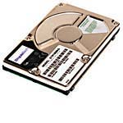

Platform Image Deployment
rootfs
kernel
Target

Slide 51
Deploying a Target File System
Creating the Target Filesystem
Configuration of User Space Environment
Testing the Environment
Filesystem Size Reduction
Getting Free of NFS

Slide 52
File Systems
Linux sees everything as part of a file system
  Devices, data files, video, etc.
The type of storage device you have will determine the size and type of your file system
For higher reliability, use a journaling file system on the target
  Automatic file system recovery in the event of failure
Pro supports the following journaling file systems:
  ReiserFS
  Journaling FLASH File System 2 (JFFS2)
  EXT3

Slide 53
File Systems
File Systems Supported (partial list)
  EXT2/3
  Yet Another Flash File System (YAFFS) (new!)
    Designed and optimized for NAND Flash chips
    Larger Flash sizes and faster erase and write processes
    Journaling support that automatically provides automatic wear-leveling and power failure recovery
  XFS
    Journaled, 64-bit file system from SGI; Supports up to 9 exabytes (10¹⁸)
    Up to 16TB per file
    Focus is on high bandwidth

Slide 54
File Systems
File Systems Supported (partial list)
  CramFS
    A compressed, read-only file system
    Useful for root file systems
      Applications and libraries do not change at run time
    Typically, better compression and faster performance than you see from JFFS2
  JFFS/JFFS2
    A journaling file system that places itself directly on flash chips with the disk emulation
    Automatically performs wear-leveling and garbage collection
    The file system is compressed allowing for more storage in the same amount of flash

Slide 55
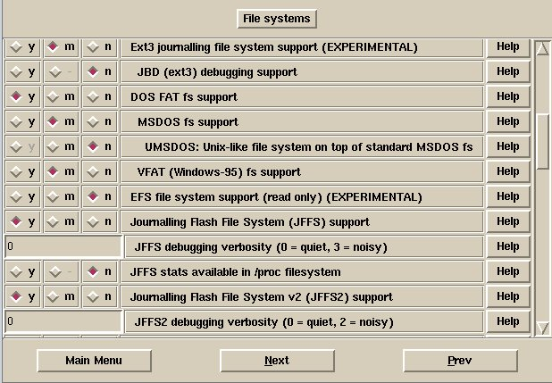
File Systems kernel configuration

Slide 56
Creating the Target Filesystem
Using DevRocket
  Create a Platform Image Project
  Select the packages you want
  Remove the unnecessary folders/files
  Set Platform Image options
  Determine File System Type
  Generate the Image
You can also manually copy all the needed stuff from the target directory

Slide 57
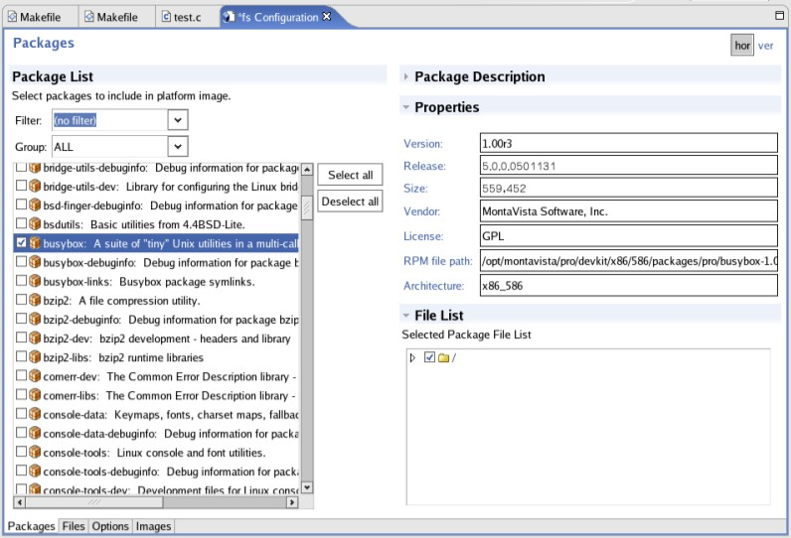
Platform Image Projects

Slide 58
Creating the Target Filesystem
Add your own applications
  Copy your applications to where you want them to reside in the target file system
  Better use cpio type to generate an archive format for placement, then use fstool to transform to real target file system type like ext2/ext3/cramfs/jffs2
    fstool -t <fs-type> [ -d <dir-name> | -f <file-name>] [Options]
  In Devrocket, you can also import your own or 3rd parties applications into platform image project

Slide 59
Configure User-Space Environment
Start-Up scripts
  To specify which processes should be run at boot time and during normal operation
  To specify how to configure and initialize physical devices
  To configure the system during runtime
  To start your application
  As a system developer, you decide which services and applications should be executed by changing these scripts

Slide 60
Testing the Environment
To verify the functionality by NFS first so that it can be later transferred to the target storage media
After NFS verification, you can transfer to target local file system for real test

Slide 61
Testing the Environment
How Do I Enable a Local Root File System?
A practice: Use ramdisk as root file system
  Kernel configuration:
    Edit kernel bootup command line option: “root=/dev/ram”
    Block devices: enable RAMDISK support, init ramdisk support, default ramdisk size 4096kB
    File Systems: Disable network file system as root option
    Networking Options: Disable IP auto configuration (option)

Slide 62
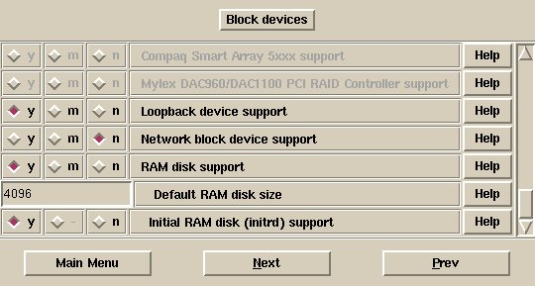
Testing the Environment
Kernel configuration for initrd support

Slide 63
Testing the Environment
Use ramdisk as root file system (cont’d):
  Use DevRocket or other ways you preferred to generate your root file system, convert to ext2 format and compress it.
  Download to the target and run
  <Redboot> load –r –v –b 0x01800000 ramdisk.gz
  <Redboot> load –r –v –b 0x01008000 kernel
  <Redboot> exec –r 0x01800000 0x01008000

Slide 64
Testing the Environment
Use cramfs or jffs2 as root file system
  You have to transform your target filesystem to cramfs or jffs2 format
    Use Devrocket or fstool in Host, otherwise,
    Use mkfs.jffs2 or mkfs.cramfs in Target
  Erase the flash before you write to
  Write the image to the flash partition
  Rebuild the kernel with "root=/dev/mtdblock? rw“
  Reboot the system with the new kernel and file system

Slide 65
Reducing File System Size
The simplest way to do this is to remove any unused files
You can strip binaries
Using Library Optimisation Tool to reduce the shared libraries size
Use a compressed file system

Slide 66
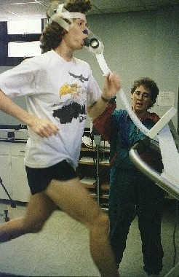
System and Target Tools

Slide 67
Kernel Profiling
Two places where we can instrument the kernel for performance analysis
  One focuses on interrupt latencies and preemption latencies
  The other is a generic kernel “event” logger
The event logger outputs to the Linux Trace Toolkit (LTT)

Slide 68
Kernel Profiling
Interrupt Latency
  The kernel has mechanism (CONFIG_ILATENCY) for collecting data on interrupt performance
  This mechanism displays its data via the /proc interface
    /proc/ilatcurve presents the raw data
    /proc/imaxoff presents the maximum “interrupt off” offenders
      The lines in the source file where the interrupts were turned off and on again are presented

Slide 69
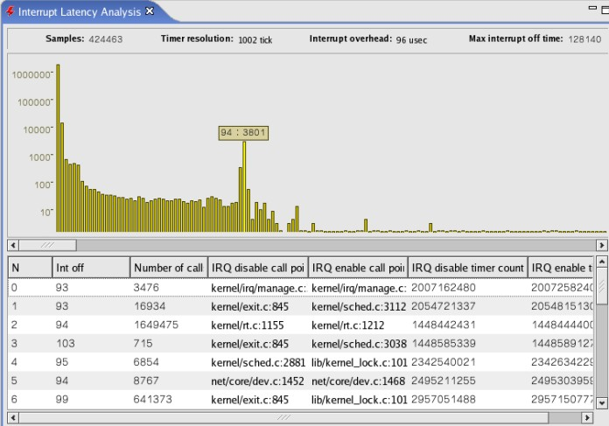
Interrupt Latency

Slide 70
Kernel Profiling
Preemption Latency
  This feature (CONFIG_PREEMPT_TIMES) instructs the kernel preemption code to measure periods of non-preemptibility and report the 20 worst in /proc/latencytimes
  /proc/latencytimes results are reset when read
  Collecting this data should not be done in production systems
    – Too much overhead

Slide 71
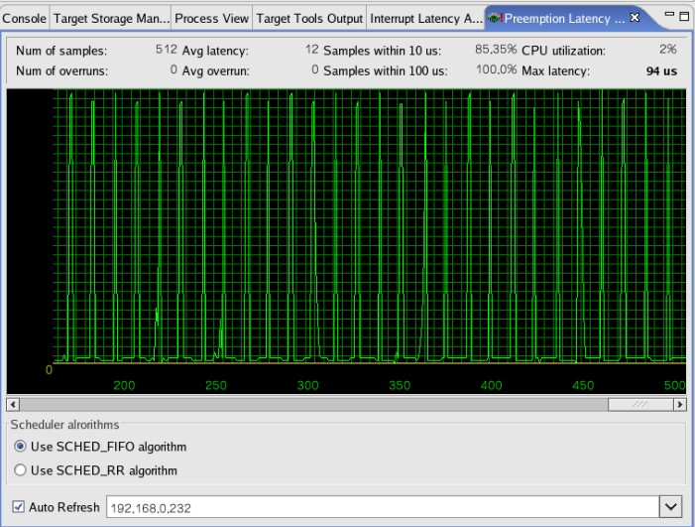
Preemption Latency

Slide 72
Application Profiling
Linux Trace Tool - Suite of software that allows developer to view, capture and analyzing system behavior
  Logs processor utilization and user and system events and processes
  Eases debugging of multi-process and multi-threaded code
Data collection is built into the kernel
  Periodically calls a logging daemon which will store the kernel events to a storage media

Slide 73
Linux Trace Toolkit
Linux Trace Toolkit (LTT)
  Fully-featured tracing system for the Linux kernel. It includes both the kernel components required for tracing and the user-level tools required to view the traces.
  Micro-second event time-stamps
  Performance overhead ~ 2.5 %.
  Multi-platform support
  Friendly GUI with event graph, system and per-process analysis, and raw event descriptions.

Slide 74
Linux Trace Toolkit
Linux Trace Toolkit (LTT) Usage Steps
  Enable Linux "Kernel Tracing" configuration
  To enable LTT tracing support, you must enable the RelayFS.
  Mount the relay file system:
    # mkdir /mnt/relay
    # mount -t relayfs relayfs /mnt/relay
  Start the trace daemon in target:
  tracedaemon –ts10 ./out.trace ./out.proc
  In the previous versions, you need to run "tracevisualizer" in host and load the above output files for analysis. Now it has been integrated into DevRocket 2.0.

Slide 75
Linux Trace Toolkit
Linux Trace Toolkit (LTT) Usage
  For more information, see the Linux Trace Toolkit online reference manual: http://www.opersys.com/LTT/documentation.html
  HOWTO instructions available on the www.linuxdoc.org Web Site

Slide 76
Remote System Management
Communicate with target
List / Modify processes
View / modify file system
Built-in consoles
Start / stop services
Target storage manager
Remote reboot
Please read “MontaVista Linux PE 4.0 Development Environment User’s Guide”

Slide 77
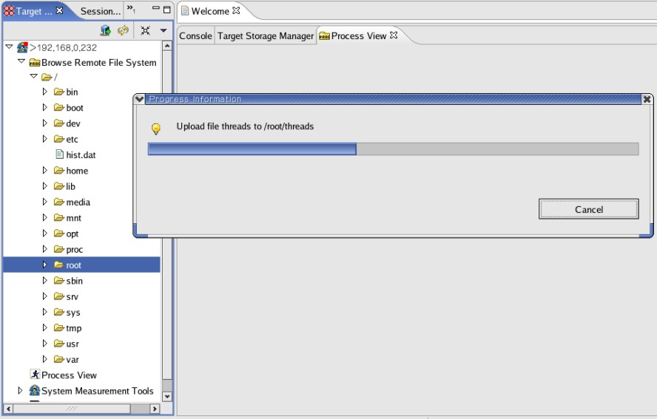
Target Tools

Slide 78
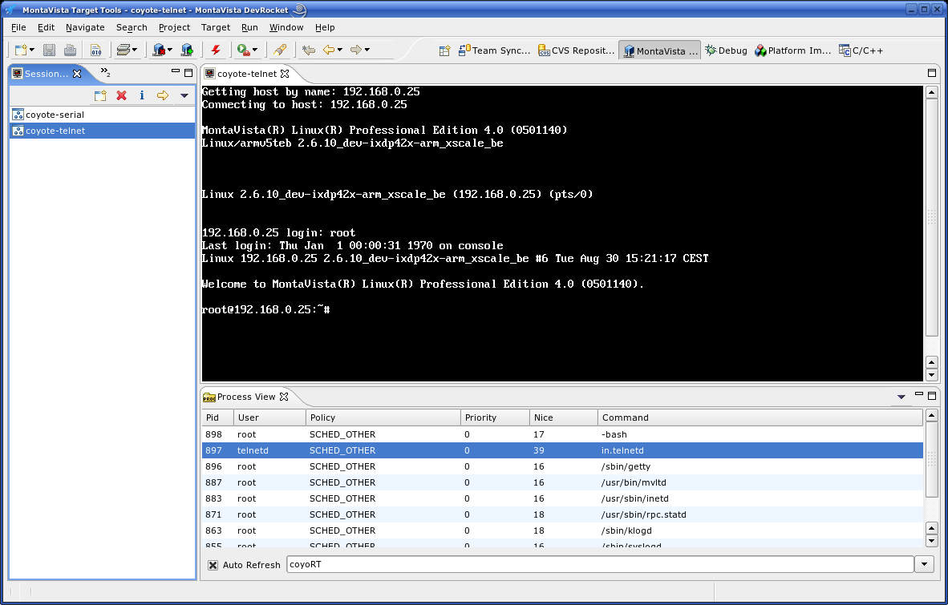
Target Console and process view

Slide 79

Kernel Module Development

Slide 80
Kernel Modules
An object file (e.g., myfile.o) that is dynamically loaded and added to the kernel at run-time
Often used to add/remove optional items to/from the system such as device drivers
Useful when kernel footprint or alternative drivers is an issue
May also be used with proprietary code to avoid licensing issues in GPL

Slide 81
Kernel Modules
Loading and Unloading Modules
  insmod - Install (load) a module
  rmmod - Remove (unload) a module
  lsmod - List installed modules
  depmod - Show dependencies of a module
  modprobe - Loads a module and its dependencies
  modinfo - Displays information about a module
Start-Up
  insmod may be used in /etc/init.d/* and /etc/rc*.d/*

Slide 82
Kernel Modules
A Simple Kernel Module
  #include <linux/module.h>
  #include <linux/init.h>
  #include <linux/kernel.h>
  static int __init my_init_module(void){
  printk("<1> Yup, I’m here!\n"); /* Logged to /dev/console */
  return 0;
  }
  static void __exit my_cleanup_module(void)
  {
  printk("<1> And now I’m leaving.\n"); /* Logged to /dev/console */
  }
  module_init(my_init_module);
  module_exit(my_cleanup_module);

Slide 83
Kernel Modules
Kernel Module Compiling
  Kernel modules need to be built using the kernel headers rather than the user-space headers
  Save the source file and edit the Makefile in the same kernel drivers directory.
    obj-m += mymodule.o
  make -C <path-to-kernel> SUBDIR=$PWD modules
  Compiling with version information is automatically done, you don’t have to take care the detail like previous versions
  To unload a module, you must now compile unloading support in kernel
    CONFIG_MODULE_UNLOAD

Slide 84
Kernel Modules
depmod - Module Dependencies Database
  Creates a database of module dependencies
  Scans modules in /lib/modules
  Generates /lib/modules/*/modules.dep
    * will be replaced by the kernel version and build number
  Update when adding new modules to the system that should be automatically inserted
  Modules that will be loaded manually do not need to be in the database

Slide 85
Kernel Modules
depmod Example
  # insmod lp
  ./lp.o: unresolved symbol parport_register_device_R9b846d61
  ./lp.o: unresolved symbol parport_release_R93e35225
  ./lp.o: unresolved symbol parport_claim_or_block_Rca62ba8c
  ./lp.o: unresolved symbol parport_unregister_device_Re6842bfb
  ./lp.o: unresolved symbol parport_enumerate_R6a5c148b
  # depmod -a
  /lib/modules/2.2.12-20b/modules.dep
  /lib/modules/2.2.12-20b/misc/lp.o: /lib/modules/2.2.12-20b/misc/parport.o

Slide 86
Kernel Modules
modprobe - Load Module and its Dependencies
  May be used instead of insmod
  Check dependency database
  Loads dependent modules in the correct order
  Checks /etc/conf.modules for parameters
  Can pass additional parameters

Slide 87
Kernel Modules
Often have a custom /proc interface built-in to the module
  Written by the kernel module programmer
  Can be written to provide both a read and a write interface
  Typically used initially to assist in kernel module debugging
  But the long-term use is typically to help the system administrator either by providing information about system configuration and operation, and allowing parameters in the kernel module to be modified as may be needed by the administrator

Slide 88
Kernel Modules
Passing Values to the Module
  modprobe parport_pc.o demo=1
  This works with insmod also
  In the module’s source
    /* parport_pc.c */
    #ifdef MODULE
    static int demo = 0;
    MODULE_PARM(demo, "i");
    MODULE_PARM_DESC(demo, "Demo variable, defaults to 0");
    #endif

Slide 89
Kernel Modules Debugging
Kernel Modules Source Level Debugging
  Instructs insmod to generate a load map for the module when it gets loaded into memory.
    [target linux] insmod –m module.o > module.map
    [target linux] grep “.text” module.map
    [gdb] add-symbol-file module.o XXXXXXXX
    XXXXXXXX = address of ‘.text’ section from grep command.
  precludes the ability to debug the module’s ‘init’method.

Slide 90

Linux Device Driver Overview

Slide 91
What is a Device Driver
Generally, a catch-all term used to refer to software used to access a device
Can be integrated into the kernel using the driver model
  Kernel modules
Can be a simple collection of library calls from userspace
  The so-called user-mode device driver

Slide 92
Driver Types in Linux
Three basic Linux driver models
  Character drivers
    Character oriented
    Byte at a time
    Serial, keyboard, video, USB, etc.
  Block drivers
    Multiple, fixed sized blocks of data
    Ramdom access possible
    Hard disk, MTDs, CDROM, etc.
  Network drivers
    Packet oriented,
    multiple, variable-sized blocks of data
    Ethernet, etc.

Slide 93
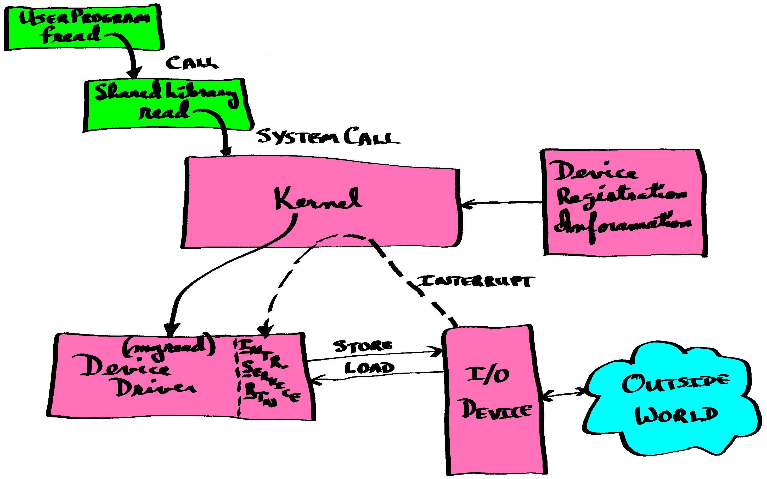
Driver Execution Model

Slide 94
Kernel Address Space
Linux memory is broken into two distinct regions
  Kernel address space
  User address space
Kernel space is a “flat” memory region
  Can address all physical RAM
  Still uses “logical” (aka “virtual”) addresses
  Macros provide translations from physical/bus addresses to logical addresses and back
  Kernel memory is never “swapped” to disk

Slide 95
User Address Space
Unlike kernel space, user space cannot directly access physical addresses
Each user process has its own virtual address map
User memory can be swapped to disk unless it is locked into memory via mlock()
All memory defaults to being private to the user process

Slide 96
Code Executing in Kernel Space
The kernel itself
Device drivers/Loadable Modules
  A loadable module is code that is not compiled into the kernel (that code could be a driver)
  Typically executes on behalf of a user process but in kernel space
Interrupt Service Routines
  Usually installed by a device driver
Exception handlers
Kernel threads
Tasklets/Bottom halves/Soft IRQs

Slide 97
Code Executing in User Space
User processes
  The programs you run
User threads
  Sub-tasks run within a process address space
Daemons/Servers
  portmap, nfs, xinetd, etc.
Shared Libraries
  A shared library contains functions that are used at run time, potentially by many programs
  Dynamically loaded/unloaded

Slide 98
Code Spaces
Kernel Space
User Space
Processes
Tasklets
Shared Libraries
Soft IRQs
Kernel Threads
Bottom halves
Daemons/Servers
Exceptions
ISRs
Device Drivers
Threads
The Kernel

Slide 99
Dealing with Logical Addresses
Physical devices are unaware of Linux’s use of physical <-> logical translation
  They only deal in physical addresses
Device driver writers need to translate the logical addresses to physical addresses so we can program the device
  The reverse is also true
Linux provides a series of macros/functions to handle the translation
  Virt_to_phys, phys_to_virt, virt_to_bus, bus_to_virt

Slide 100
Kernel Space Memory Allocation
Buddy allocator
  Used for large blocks of memory (<=2MBs)
  get_zeroed_page, __get_free_page, __get_free_pages
  free_page, free_pages
SLAB allocator
  Used for smaller allocations to avoid memory fragmentation (<=128KBs)
  Kmalloc()/kfree(), vmalloc()/vfree()
Boot allocator
  Establish RAM sizing and a preliminary memory map during boot, usually used for big allocation (e.g. > 2MB physically contiguous memory)
Notes:
Buddy allocator: paged size, contiguous
Slab allocator: smaller, non-paged size
kmalloc – contiguous ; vmalloc – non-contiguous

Slide 101
Processes in Kernel Space
When a process makes a driver call, it transitions into kernel space
Drivers typically operate on a user’s behalf
  User process requests service
Driver is called in the context of the user process
  We can tell which process is calling us
  The driver has visibility of the process’s VMA

Slide 102
User Space Buffers and Driver
Memory allocated in a user process can be accessed from the driver
  Buffer addresses passed in read/write calls are an example
  Probably not contiguous
All user space addresses passed to the driver need to be validated by access_ok()
copy_to_user()/put_user()
copy_from_user()/get_user()

Slide 103
The Linux Driver Model
Each of the different driver types, all follow the same basic flow
First, we register the device with the kernel
Next, we establish and implement the callbacks for the device
We use the device via the callbacks
Finally, we un-register the device to remove it from the kernel

Slide 104
Block Drivers
Block drivers provide the foundation for all Linux file systems
Notice that there are no read() or write() callbacks, the kernel has provided these
Linux already supports over 40 different file systems with varying types of underlying devices
Generally, we will rarely need to write a block driver from scratch

Slide 105
Character Drivers
Most of the drivers we will encounter or develop are character-oriented
  Serial, parallel, USB, IEEE-1394, etc. are all character devices
We will focus on character device drivers in this course

Slide 106
Driver Initialization
Typically called from init_module()
Executed when the module is loaded
Register device
Typically does as little as possible
Most work done at open() time

Slide 107
Driver Cleanup
Typically called from cleanup_module()
Executed when the module is unloaded
Un-register device
Typically does very little because most work done in release()

Slide 108
Driver Registration
One of the first things we have do with our device driver is to register it with kernel
To do this, we use the register_chrdev() call
Done only once on installation
Unregister_chrdev() is called when we remove our device driver

Slide 109
Device Nodes
Devices will have both a major and minor device number associated with them
  Kernel only uses the major number
  Your driver can use the minor number
Using macros for portability
Documentation/devices.txt
Dynamic request
Devfs and udev

Slide 110
File Operations Structure
Content varies with Linux version number
Each entry is a pointer to a function in your driver
  #include <linux/fs.h>
  static struct file_operations device_fops = {
  read: device_read, /* read */
  write: device_write, /* write */
  poll: device_poll, /* poll */
  ioctl: device_ioctl, /* ioctl */
  mmap: device_mmap, /* mmap */
  open: device_open, /* open */
  release: device_release,/* release */
  };

Slide 111
File Operations
Open
  Increments module usage count
  Allocate memory
  Initialize timers, variables, and other functions
Release
  A.k.a., close
  Decrements module usage count
  Frees memory
  Turns timers off, …etc.

Slide 112
File Operations
Read
  May implement non-blocking, and/or blocking I/O
  Typically calls “copy_to_user” to transfer data from kernel to user space
Write
  May implement non-blocking, and/or blocking I/O
  Typically calls “copy_from_user” to transfer data from user to kernel space

Slide 113
File Operations
Ioctl
  Device specific operations, such as:
    Serial port: transmit a break
    Tape drives: rewind
  Command numbers
    Should be unique across the system to prevent disasters caused by issuing the right command to the wrong devices.
    Documentation/ioctl-number.txt

Slide 114
Useful Attributes
IO_NONBLOCK
  Non-blocking I/O operations succeed immediately or fail
FASYNC – Asynchronous Signaling
  Driver sends a signal to the process after the I/O operation has been completed

Slide 115
Blocking vs. Non-Blocking I/O
By default, a read on an empty device or a write on a full device should cause the user process to pause execution until data or space becomes available.
  This is referred to as blocking
The process can tell the driver that he doesn’t want the default blocking behavior using an ioctl call
  Actions that would normally block return – EAGAIN
  To avoid context switch during I/O calls

Slide 116
Using Wait Queues
Whenever a process must wait for an event, such as data arrival, we should put the process to sleep.
  Releases CPU for the other work
  At some future point in time, another entity “wakes up” the sleeping process
Putting a process to sleep involves a wait queue
  wait_queue_head_t;
  init_waitqueue_head();
  wait_event is SMP safe and avoids the race condition found in older sleep implementations
Waking the process up
  wake_up()/wake_up_interruptible()

Slide 117
Poll/Select
Allow a process to sleep until any of several I/Os are done
Awaken when one or more I/Os have completed
Replaces manual polling
The epoll was added in 2.5.45 for larger scale support

Slide 118
Asynchronous I/O
Most I/O is synchronous.
  The program waits for the I/O to complete
In asynchronous I/O, a process queues a request for service and then the process moves on
  The driver will then asynchronously inform the process that the request is ready via a signal (SIGIO)

Slide 119
Asynchronous I/O
The process’ viewpoint
  A process would execute the following code to set up async notification on STDIN:
  signal(SIGIO, &input_handler); /* sig hndlr */
  fcntl(STDIN_FILENO, F_SETOWN, getpid());
  oflags = fcntl(STDIN_FILENO, F_GETFL);
  fcntl(STDIN_FILENO, F_SETFL, oflags | FASYNC);
The driver’s viewpoint
  fasync_helper()
  kill_fasync()

Slide 120
Interrupts and Bottom Halves
Execution Flow
Role of an ISR
Fast and Slow Interrupts
Registering ISRs
Masking / Controling Interrupts
Sharing Interrupts
Post-interrupt Processing

Slide 121
/proc/interrupts
Count of interrupts by IRQ level
Example:
CPU0
0: 2026528 XT-PIC timer
1: 22286 XT-PIC keyboard
2: 0 XT-PIC cascade
8: 2 XT-PIC rtc
9: 1289 XT-PIC acpi
10: 2674416 XT-PIC nvidia
11: 774811 XT-PIC Texas Instruments PCI1410 PC card Cardbus
Controller, Toshiba America Info Systems
ToPIC95, Toshiba America Info Systems
ToPIC95 (#2), usb-uhci, usb-uhci, usb-uhci,
ohci1394, orinoco_cs, eth0, Intel 82801CA-ICH3
12: 49 XT-PIC PS/2 Mouse
14: 111040 XT-PIC ide0
15: 17 XT-PIC ide1
NMI: 0
ERR: 0
Shared Interrupts

Slide 122
Determining the IRQ Number
For PCI devices, PCI discovery has done it already
Use kernel-assisted probing
Use “blind man’s bluff” probing
Try a shotgun approach
Compile-in a default value or have the user pass it on the command line
Check the schematic, sometimes it is just plain hardwired!
Once the device’s IRQ number is known, it’s time to install the interrupt handler

Slide 123
Installing a Handler (1 of 2)
#include <linux/sched.h>
int request_irq(unsigned int irq,
void(*handler)(int, void *, struct pt_regs *),
unsigned long irqflags, const char *devname,
void *dev_id);
void free_irq(unsigned int irq, void *dev_id);
  Return values for request_irq
    0 -> success
    neg -> error code
    -EBUSY -> interrupt in use and either the current flags or the caller’s flags do not include SA_SHIRQ
  unsigned int irq
    The interrupt number

Slide 124
Installing a Handler (2 of 2)
irqflags
  SA_INTERRUPT
    A “fast” handler, or if not, then a slow one
  SA_SHIRQ
    Interrupt sharing between devices
  SA_SAMPLE_RANDOM
    interrupts can contribute to the entropy pool used by /dev/random and /dev/urandom
      Devices that interrupt in a truly random manner can contribute to the system’s random number pool

Slide 125
Interrupt Sharing
Linux software support for interrupt sharing was developed for PCI devices but it also works with other busses that are level-triggered
If the IRQ is shared, we cannot determine from the PIC which device generated the interrupt, so we must run the ISRs for all devices
Installing a shared handler
  SA_SHIRQ bit must be specified

Slide 126
Kernel Knowledge
The kernel keeps track of all of the registered ISRs via the irqaction table
  dev_id differentiates between them
request_irq() succeeds if
  The interrupt line is free, or
  both of the following conditions are met:
    The previously registered handler specified SA_SHIRQ in the flags, and also
    Both the new handler and the old one are fast handlers, or both are slow.

Slide 127
Interrupt Sharing Misc. Issues
Kernel probing not available for shared handlers
  Use the shotgun approach
Remove by free_irq()
Interrupt state of the device is checked at ISR
  See if our device is causing this interrupt; if not, return and let next driver to handle
  Typically a simple check with minimal overhead
Note: A driver using a shared handler is no longer the exclusive owner of the IRQ
  It should avoid enable_irq() and disable_irq()

Slide 128
Fast and Slow Interrupts
Most devices use “slow” interrupts
  They are masked off at the PIC
    They can be interrupted by other interrupts
    Only the interrupt currently being handled is masked off – at the PIC
  Processing goes to the operating system to reschedule things after the interrupt
  Linux calls the corresponding ISR’s “Slow Handlers”
We can still use “fast” interrupts
  These are masked off at the CPU
    These will not be interrupted by other interrupts
    All interrupts masked off at the CPU
  Typically used for very short, deterministic data movements like that of a serial port
  The ISRs for these devices are called “Fast Handlers”

Slide 129
Fast and Slow Handlers
Fast (SA_INTERRUPT)
  Guaranteed atomic (un-interrupted) processing
  In practice, very commonly used -- for safety or because of uncertainty about re-entrancy
Slow
  Could be interrupted by other interrupts
All shared interrupts on the same level must be either fast or slow
  You cannot mix fast and slow ISRs on the same level

Slide 130
Reducing Interrupt Latency
During Linux’s development it was discovered that network-related ISRs were causing non-deterministic latency
  No “a priori” knowledge of the amount of data to be copied in the ISR
The approach to address this was to split the ISR into a top-half that reset the device and a bottom-half that performed the actual data movement
  The bottom-half ran with interrupts re-enabled

Slide 131
Bottom Halves
The original Linux DPC concept from which tasks, then tasklets, and now Soft IRQs are derived
Limited to older drivers
31 possible routines
They have to be “marked” to be run
These have been deprecated in favor of tasklets and soft IRQs but they’re still found in older drivers

Slide 132
Post-Interrupt Work
The bottom-half concept worked so well that everyone wanted to use them
Unfortunately, bottom-halves were limited to only 31 instances and were not very extensible
To create a general-purpose mechanism, the Linux developers created the concept of a “tasklet”
  They created a work-queue mechanism that would run any number of tasklets serially

Slide 133
Tasklets
Essentially, a function that is called after the ISR completes
Except, once executing on a processor, if the tasklet is re-scheduled (because of another interrupt), it will not begin running (again) until the first instance completes execution
Tasklets actually execute in the same context as a kernel thread

Slide 134
Soft IRQs
New in Linux 2.4
Very similar to Tasklets
Except,
  A given Soft IRQ can be executed concurrently on separate processors
    They must be written to be reentrant
  In a uni-processor system, this isn’t possible
    Unless we have a hyper-threaded CPU ☺
    In that case, Soft IRQs behave the same as Tasklets

Slide 135
So, What Are They Again?
Soft IRQs, Tasklets and Bottom Halves
  Not a process
  Not a thread
  Not an interrupt service routine
  Something the system will run before any process (at any priority) gets to run again
  Run in “software interrupt” context
What if we need process context?
  Answer: Work queues

Slide 136
Work Queues
Work queues are very similar to tasklets
  Function calls are placed on a queue to be executed at a later time
However, work queues are executed by a helper “kernel thread” in process context
  They can sleep
There is no limit to the number of helper threads
Priorities and preemption apply

Slide 137
Re-Structuring the ISR
Split the interrupt processing into two parts
  Interrupt Service Routine
    (Use Fast or Slow as you think appropriate)
    When an interrupt occurs, save data and status from the device, “schedule” the tasklet, and exit
    Keep this code as brief as possible
  Tasklets, Soft IRQs
    Runs with interrupts re-enabled
    Runs after all ISRs have been executed
    Tasklets execute in the context of the do_softirq() kernel thread

Slide 138
Making Them Run
Bottom Halves
  mark_bh(WHICHONE)
  See also: init_bh(), remove_bh()
Tasklets
  tasklet_schedule(WHICHONE)
  See also: tasklet_init(), tasklet_enable(), tasklet_disable(), tasklet_kill()
Soft IRQs
  raise_softirq(WHICHONE)
  See also: open_softirq()
Work queues
  schedule_work(WHICHONE)
  See also: schedule_delayed_work(), cancel_work()

Slide 139
Which One Should I Use?
Bottom Halves
  Reserved for older devices
  Avoid using these in new designs
Tasklets
  Use these whenever possible
Soft IRQs
  Reserved for very high throughput needs
  Full-reentrancy across SMP machines
  Avoid these unless absolutely necessary
Work queues
  If you need to do work that could sleep
  Can have higher latency than tasklets but can run for longer duration

Slide 140
Kernel Synchronization
Preventing Race Conditions
Semaphore
  Use only in thread context in the kernel
  May block (sleep) the thread
Lock variables
  Any kernel context (include ISR)
  They don’t put processes to sleep, they are “spin locks”
Atomics
Interrupt Masking

Slide 141
Preventing Race Conditions
Re-design the code
  Avoid sharing data
Disable interrupts
  Prevents re-use on same processor
  Ineffective in an SMP environment
Semaphores
  A.k.a. Mutex
  Use only in a thread/process context in the kernel
  May block (sleep) the thread/process
Lock variables
  Prevents re-use on other processors
  Prevents context switch to another process on this processor

Slide 142
The Options
Unfortunately, redesign of the code may not be practical
Disabling interrupts is an option that should be avoided if possible
Kernel semaphores are not compatible with ISRs
  These can put processes to sleep
Spin locks are the mechanism of choice if ISRs are involved

Slide 143
Migrating Drivers to 2.6 kernel
New Module Subsystem
Unified Device Model
USB
Wireless
Block devices
Multimedia
Networking

Slide 144
Migrating Drivers to 2.6 kernel
In the 2.4 kernel, information about devices is frequently located in /proc
  No unified approach, however
Linux 2.6 supplant devfs and procfs with sysfs
  This organizes subsystems by bus interface and provides a consistent interface

Slide 145
Migrating Drivers to 2.6 kernel
Kernel Building
  make modules no longer needed, modules built by the make command.
  make depends no longer exists

Slide 146
Migrating Drivers to 2.6 kernel
Module Writing
  No longer need the #define MODULE
  Different way of counting module instances, MOD_INC_USE_COUNT is deprecated
  Should be managed outside the module, otherwises, race condition risks.
  MODULE_PARAM no longer exists, use module_param(name, type, perm) instead
  Offers better type checking and worked for statically compiled modules too.
  Symbols are no longer exported by default, EXPORT_NO_SYMBOLS is redundant

Slide 147
Migrating Drivers to 2.6 kernel
For more information on the changes in driver code for the 2.6 Linux kernel, see:
  http://lwn.net/Articles/driver-porting/
  http://lwn.net/Articles/2.6-kernel-api/
  http://www-128.ibm.com/developerworks/linux/library/l-inside.html
  http://linuxdevices.com/articles/AT4389927951.html
  http://developer.osdl.org/dev/opendrivers/wiki/index.php/Documentation

Slide 148
Driver Debugging Techniques
printk()
Oops
/proc
Kdb / Kgdb
LTT
Get a Linux-aware JTAG box
Combine external hardware such as LED

Slide 149
Linux Device Driver Resources
The most useful way to learn is to trace device driver sources
  <kernel source tree>/drivers/
Books (O’Reilly stuff)
Linux Journal
Web sites
MontaVista Support

Slide 150

Real-time Technology

Slide 151
Linux and Real-Time: Evolution over Time
Gradual SMP-Oriented Linux Kernel Optimizations
Early Kernel 1.x | No Kernel preemption
SMP Kernel 2.x | No Kernel preemption, “BKL” SMP Lock
SMP Kernel 2.2 - 2.4 | No preemption, Spin-locked Critical Sections
“Preempt” Kernel 2.4 | Kernel Preemption outside Critical Sections Spin-locked Critical Sections
Current Kernel 2.6 | Kernel Preemption outside Critical Sections, Preemptible “BKL”
“RT-Preempt” Kernel | Kernel Critical sections Preemptible IRQ Subsystem Prioritized and Preemptible Mutex Locks with Priority Inheritance

Slide 152
What’s New in Pro 4.0
New real-time technology
  Fully preemptible real-time kernel
  Interrupt handler in thread context
  Fast real-time domain library (FRD)

Slide 153
Building a Real-Time Kernel
PREEMPT_RT
  New in the Pro 4.0 kernel
  Complete preemption, fast real-time response
  Low system performance
PREEMPT_DESKTOP
  Real-time solution provided in Pro 3.1
  Enabled by default in the Pro 4.0
  Slower real-time response
  Higher system performance
PREEMPT_NONE
  No real-time capabilities
  Maximum data output, highest system performance

Slide 154
PREEMPT_DESKTOP
Preemptible Kernel with the exceptions:
  while handling interrupts
  while doing “bottom half” processing
  while holding a spinlock, writelock, or readlock
  while the kernel is executing the scheduler itself
  At all other times, the MontaVista algorithm allows preemption. Also, whenever the system exits from one of the above states, it tests to see if preemption is called for. If so, the current task is preempted.

Slide 155
PREEMPT_DESKTOP
To enable the MontaVista Preemptible Kernel, complete the following steps:
  Start make menuconfig or make xconfig
  Select “Processor type and features”
  Select “Preemption Mode”
  Enable the Preemptible Kernel (Low-Latency Desktop) option (PREEMPT_DESKTOP)
  Save and Rebuild the kernel

Slide 156
PREEMPT_DESKTOP
This improves general responsibilities, but cannot yet deliver RTOS-level performance and guarantees because of the barriers,
  Priority Inversion → Critical tasks waiting on non-critical tasks
  Too many “Critical Regions” → Frequent, Long Latencies
  Interrupt not scheduled → Unable to fully prioritize system

Slide 157
PREEMPT_RT
MontaVista introduces Fully Preemptible Kernel by the following technologies,
  Priority-Inheriting Mutex replaces Spin-Locks and Big Kernel Lock (BKL)
    Solution to “Priority Inversion” and “Too many Critical Regions” barriers
  Interrupt Handlers in Thread Context
    Prioritized hardware interrupt handlers
  Debugging and performance tools
    Deadlock Detect identifies lock-ordering errors, cycles
    Interrupt and Preemption Latency Tracing

Slide 158
PREEMPT_RT
Priority-Inheriting Mutex replaces Spin-Locks and Big Kernel Lock (BKL)
  Priority inheritance eliminates priority inversion delays
  Preemptable alternative to spin-locked / non-preemptible regions
  Multiple concurrent tasks allowed into Independent critical sections
  PI Mutex protected BKL regions (BKL historically non-preemptable)
    Almost all kernel code becomes preemptible
    Dramatic reduction in preemption delays
Notes:
A brief summary of real-time implementation in the 2.6 kernel:
First, Spin Locks protecting the Critical Regions are replaced by Priority Mutex. This makes the kernel completely preemptible. Priority Inheritance Mutex provides protection of Priority Inversion and avoids dead locks. Low priority process which holds a resource requested by a higher priority process will be temporarily raised to the higher priority and release the resource as soon as possible.
Secondly, Interrupt Handlers are executed in thread context, and with priorities, which means lower priority interrupt handlers can be pre-empted by higher priority thread.
Thirdly, the Big Kernel Lock is converted to a Priority Inheritance Mutex, providing better preemptibility and better performance.

Slide 159
Real-Time Preemption with PI Mutexes
No
Preemption
Voluntary
Preemption
Preemptible
Kernel
Realtime
Preemption
Preemptible
Non-Preemptible

Slide 160
PREEMPT_RT
Interrupt Handlers in Thread Context
Legacy Linux IRQ Subsystem Shortcomings
  IRQ subsystem has unbounded latencies
  SoftIRQ subsystem activated after IRQ handler
  No Priorities for Interrupts
Solution: Interrupts in Thread Context
  Demote top- and bottom-halves to Priority Task-space
  Real-Time tasks at Higher Priority than IRQ handlers
  Interleaving of RT and IRQ tasks
  Vacated IRQ execution-space for RT IRQ functions
Notes:
A brief summary of real-time implementation in the 2.6 kernel:
First, Spin Locks protecting the Critical Regions are replaced by Priority Mutex. This makes the kernel completely preemptible. Priority Inheritance Mutex provides protection of Priority Inversion and avoids dead locks. Low priority process which holds a resource requested by a higher priority process will be temporarily raised to the higher priority and release the resource as soon as possible.
Secondly, Interrupt Handlers are executed in thread context, and with priorities, which means lower priority interrupt handlers can be pre-empted by higher priority thread.
Thirdly, the Big Kernel Lock is converted to a Priority Inheritance Mutex, providing better preemptibility and better performance.

Slide 161
PREEMPT_RT
To enable the MontaVista Fully Preemptible Kernel, complete the following steps:
  Start make menuconfig or make xconfig
  Select “Processor type and features”
  Select “Preemption Mode”
  Enable “Complete Preemption (Real-Time)”
  Save and Rebuild the kernel

Slide 162
Real-time Suboptions
If the Complete Preemption (Real-Time) mode is selected, then the following suboptions are on and cannot be turned off. If the No Forced Preemption (Server) or the Preemptible Kernel (Low-Latency Desktop) mode are selected then all suboptions should be off (even though they may be selectable). All other combinations are not supported.
  CONFIG_PREEMPT_SOFTIRQS
  CONFIG_PREEMPT_HARDIRQS
  CONFIG_PREEMPT_RCU
  CONFIG_SPINLOCK_BKL
Notes:
PREEMPT_SOFTIRQS
This option reduces the latency of the kernel by 'threading' soft interrupts. This means that all softirqs will execute in softirqd's context. While this helps latency, it can also reduce performance.
Default setting is N.
The threading of softirqs can also be controlled via /proc/sys/kernel/softirq_preemption runtime flag and the sofirq-preempt=0/1 boot-time option.
PREEMPT_HARDIRQS
This option reduces the latency of the kernel by 'threading' hardirqs. This means that all (or selected) hardirqs will run in their own kernel thread context. While this helps latency, this feature can also reduce performance.
Default setting is N.
The threading of hardirqs can also be controlled via the /proc/sys/kernel/hardirq_preemption runtime flag and the hardirq-preempt=0/1 boot-time option. Per-irq threading can be enabled/disable via the /proc/irq/<IRQ>/<handler>/threaded runtime flags.
SPINLOCK_BKL
This option increases the latency of the kernel by making the big kernel lock spinlock-based (which is bad for latency). However, enable this option if you see any problems to revert back to the traditional spinlock BKL design.
Default setting is N.
CONFIG_PREEMPT_RCU
This option reduces the latency of the kernel by "threading" RCU sections. Normally RCU (Read-Copy-Update) code is non-preemptible. If this option is selected then read-only RCU sections become preemptible. This helps latency, but may increase memory utilization.
Default setting is N.

Slide 163
Scheduler
MontaVista O(1) Scheduler
  O(1) scheduler is already enabled in MontaVista kernel, you don’t need to re-configure the kernel to support it.
  The time taken for selecting a new process will be fixed (constant time irrespective of number of tasks)
  CPU Affinity
    MontaVista builds extra functionality to support CPU affinity in multi-processor systems. Developers can specify on a thread-by-thread basis on which of several CPUs a given thread can execute.

Slide 164
Scheduling Policy
The Pro scheduler determine the order of task execution based on priority and policy. The following scheduler policies are available for real-time tasks:
  SCHED_RR
  SCHED_FIFO

Slide 165
Scheduling Policy
SCHED_FIFO
    Processes (threads) run “First In First Out”
    use the elevated priority numbers
    Most commonly used "real-time" scheme
    Used when process(es) are known to use relatively brief "bursts" of CPU time
    Permits the highest priority process (thread) to run "at will"
    Starvation of lower priorities can occur
    NOTE: Processes MUST wait -- busy spins are bad

Slide 166
Scheduling Policy
SCHED_RR (Round Robin)
    SCHED_RR is SCHED_FIFO with "quanta"
    A "Quanta" is a period of time after which the process (thread) is moved behind others of the same priority
    May be used when the process(es) are known to have long periods of intensive execution and more than one process uses this priority
    Also use the elevated priority numbers
    Processes run until they say they want to wait, or until their quanta is exhausted

Slide 167
Scheduling Policy
SCHED_NORMAL
    In Linux, it is implemented as the normal scheduling policy (let’s be fair and let everyone run)
    Only available at POSIX priority zero
    Lower priority than SCHED_FIFO and SCHED_RR
    Used for non-realtime activities

Slide 168
Fast Real-time Domain
Fast Real-time Domain (FRD)
  FRD is a real-time kernel module that simulates a real-time application.
  You can use FRD to measure the preemption latency of the kernel instead of writing your own real-time test application.
  FRD is composed of an interrupt service routine and several real-time tasks. You can choose how many threads to execute, the number of iterations to test, and thread priorities.
  FRD is not compatible with High Resolution Timers, you must configure the kernel with only one of these two options enabled.

Slide 169
Real-Time Kernel Driver
Code portability
  Developers are encouraged to utilize standard high-level locking APIs for all non-time-critical code such that proper transition to the real-time Mutex is guaranteed.
  The legacy non-preemptible lock has been renamed to raw_spin_lock and a new data type corresponding to it is raw_spinlock_t for non-preemptible critical sections
  Third-party drivers compile by default to be fully preemptible.

Slide 170
Real-Time Kernel Driver
Kernel process management
  List accesses are protected by Mutexes in Pro 4.0 real-time kernel
    wake_up, interruptible_sleep and related operations cannot be called with interrupts disabled (in IRQ context)
  Deadlock warning and detection (scheduling while atomic)
    Non-zero preempt count
    While interrupts are disabled
  No spinlock can be taken if a mutex is nested deeper

Slide 171
Example
Locking,
A deeper level than S1
locked
2
M1
1
Task
B
Task
A
S1
1
Task
C
3
locked
4
sleep
5
Spin,
waiting for sleeping task A
locking

Slide 172
Real-Time Kernel Driver
Lock sharing with common kernel code
Critical section management
For more detail, see “MontaVista Linux PE 4.0 Kernel Developer’s Guide” Appendix B

Slide 173
Real-Time Kernel Driver
In the real-time preemption model, except timer interrupt, a kernel thread is created and the interrupt function is assigned to this thread context
  Interrupt services can be prioritized and preemptible
  A new IRQ flag SA_NODELAY can be used to make your device’s interrupt run in legacy (IRQ context)
The primary restriction for SA_NODELAY interrupt functionality
  Wake_up cannot be called from a SA_NODELAY interrupt, wake_up_process must be used instead.
  It is impossible to lock a mutex from IRQ context, use non-preemptible raw_spinlock instead

Slide 174
Real-Time Applications
Engineers need to understand the following constraints for real-time applications development
  Memory use and allocation
  Timer and signal delivery
  Creating tasks/Setting policies

Slide 175
Building Real-Time Applications
The basic outline to build a program that runs using PREEMPT_RT
  1 Start program.
  2 Allocate any resources to be used by the application.
  3 Open any files and establish any communications.
  4 Set scheduling policy.
  5 Set scheduler priority.
  6 Start the real-time processing of the program.

Slide 176
Real-Time Applications
Making Yourself Realtime
  #include <sched.h>
  struct sched_param sched_params;
  /* Change our priority to as high as possible and use SCHED_FIFO */
  sched_params.sched_priority = sched_get_priority_max(SCHED_FIFO);
  if (0 != sched_setscheduler(getpid(), SCHED_FIFO, &sched_params)) {
  printf("sched_setscheduler failed (YOU MUST BE ROOT TO USE THIS)\n");
  exit(1);
  }

Slide 177

Final Thoughts

Slide 178
Final Thoughts
Memory leak in kernel space
Kernel footprints reduction
Linux security

