Slide 1
CytoSEE Document

Slide 2
1 Single-file analysis

Slide 3
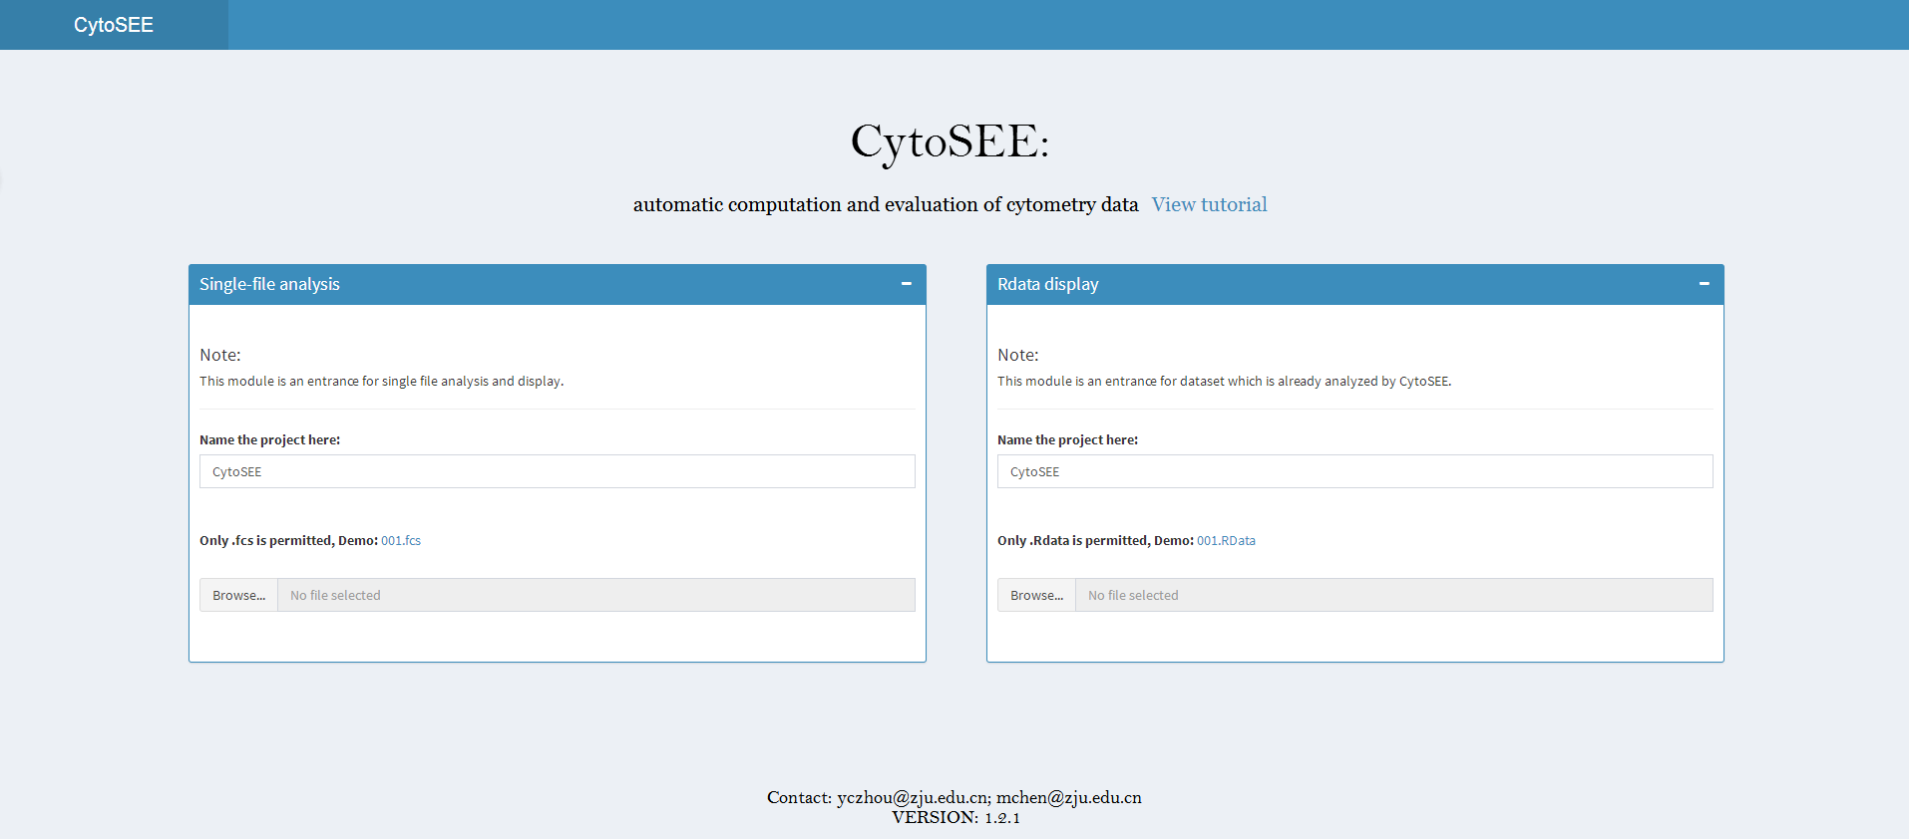
1
2
1
Name the project, default is CytoSEE
2
Upload the .fcs file

Slide 4
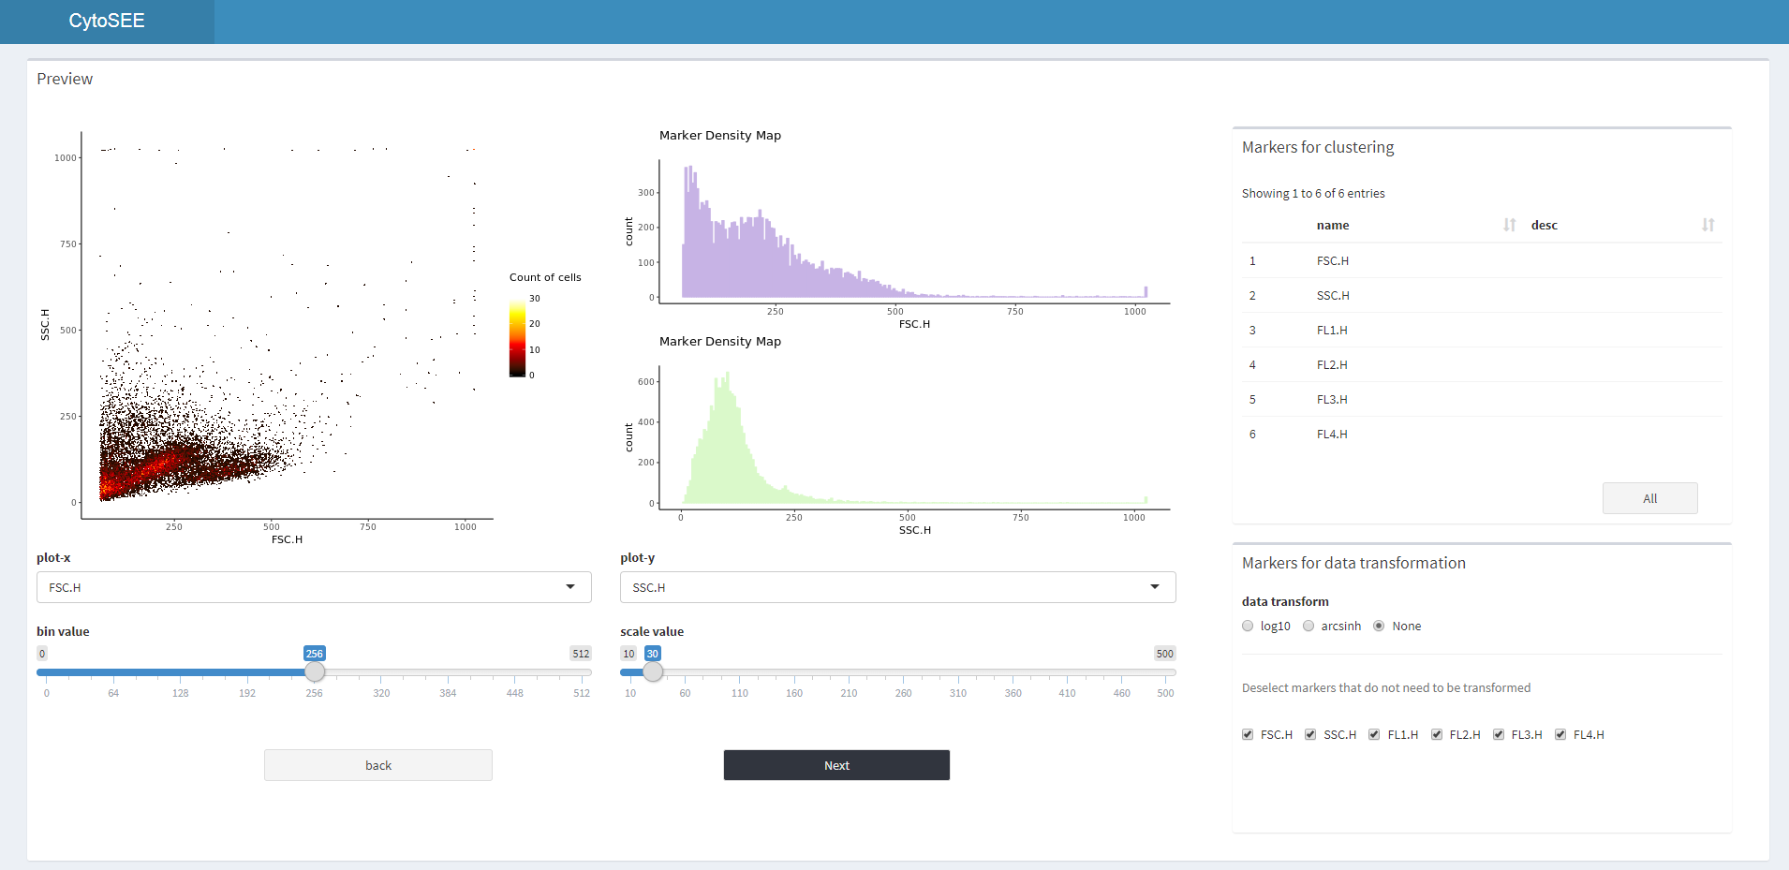
1
2
4
5
3
1
Correlation plot between two markers
Bin value, scale value bar
Data transform by log10, arcsinh or None
3
5
2
Density map of marker
Select markers for clustering
4

Slide 5
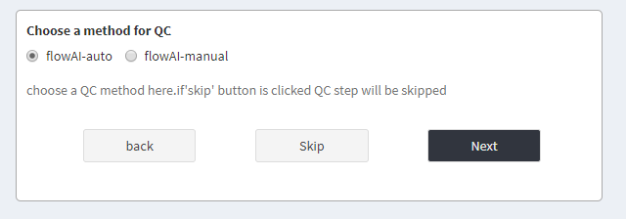
1
1
Choose method for quality control

Slide 6
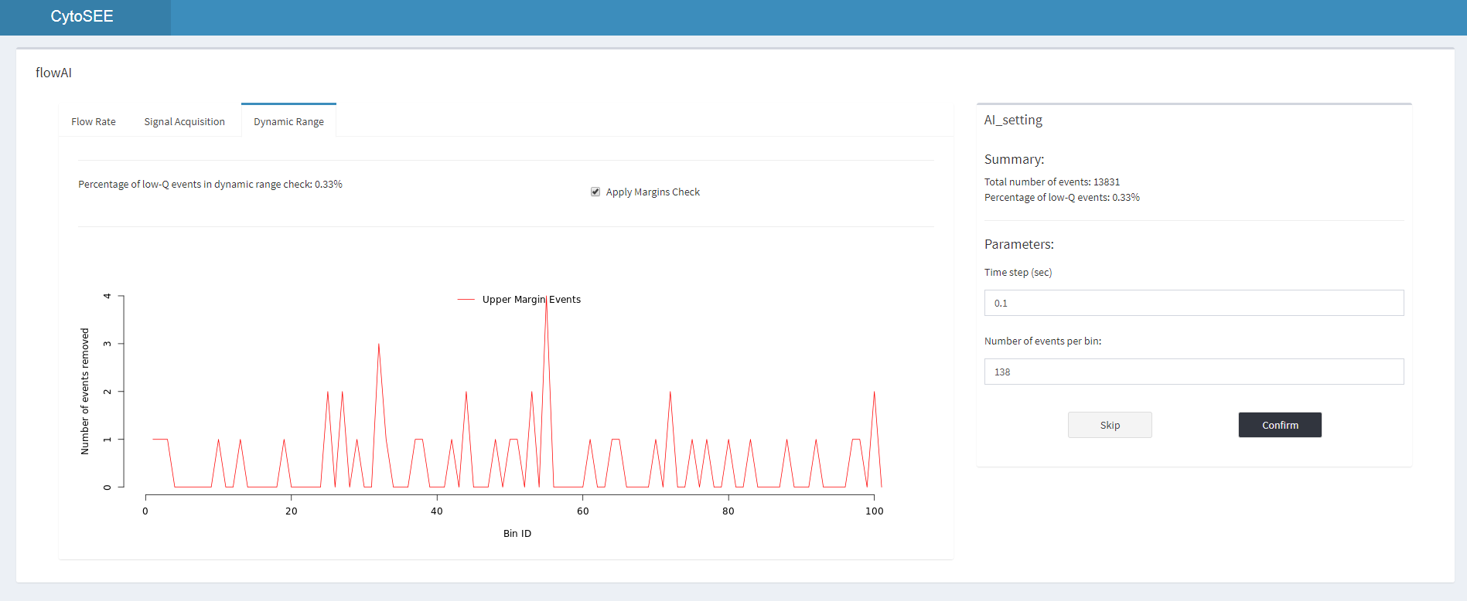
flowAI-manual
1
Dynamic range check
2
Manual setting panel

Slide 7
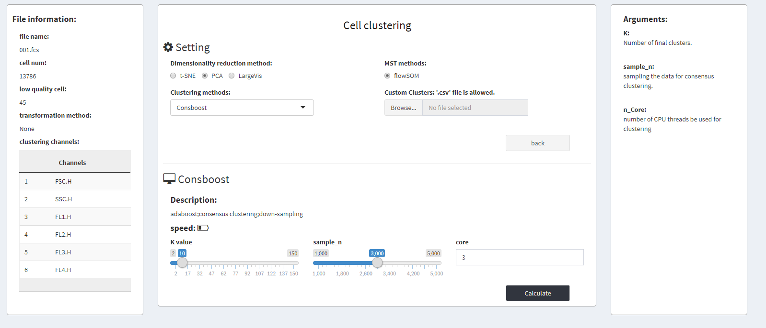
flowAI-auto
1
2
4
3
1
Basic file information
Clustering method parameters
3
2
Cell clustering setting
Arguments tips
4

Slide 8
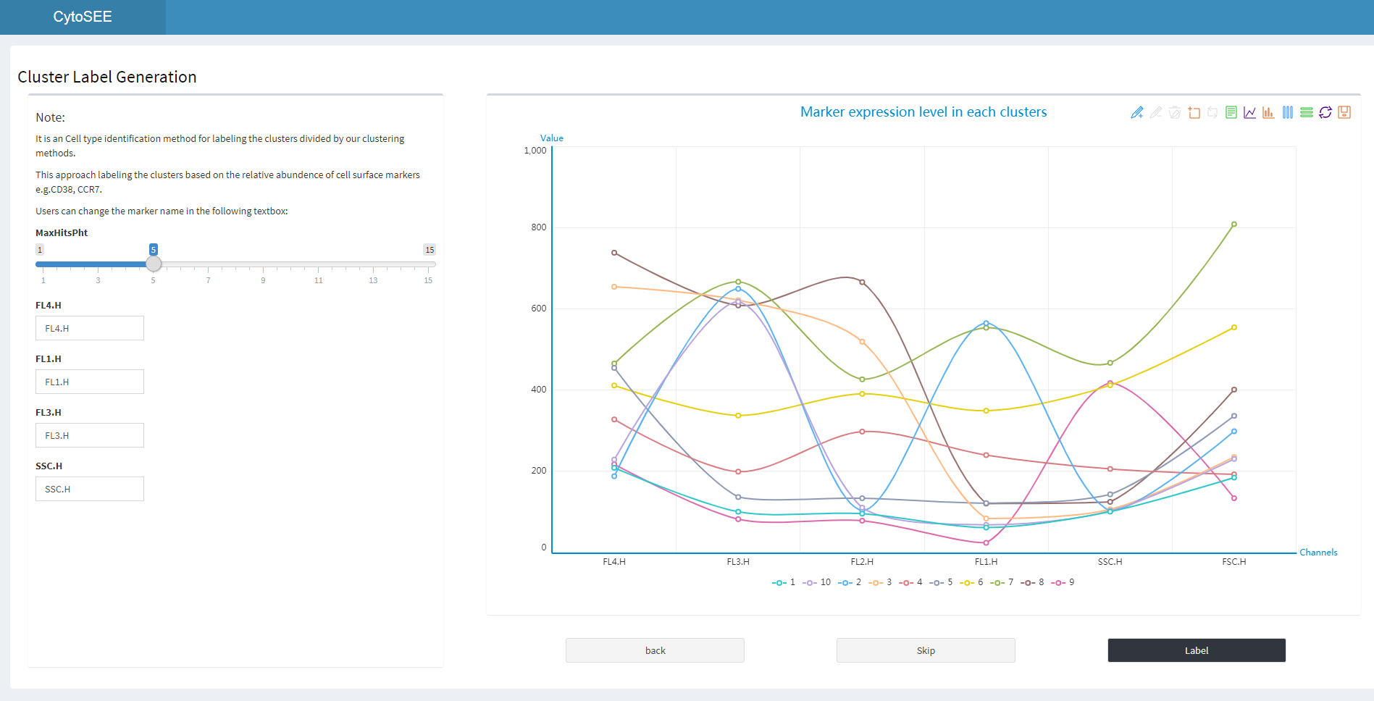
1
2
Enter the marker name here, e.g. CD40
1
Label the cluster
2
Maker expression level in each clusters

Slide 9
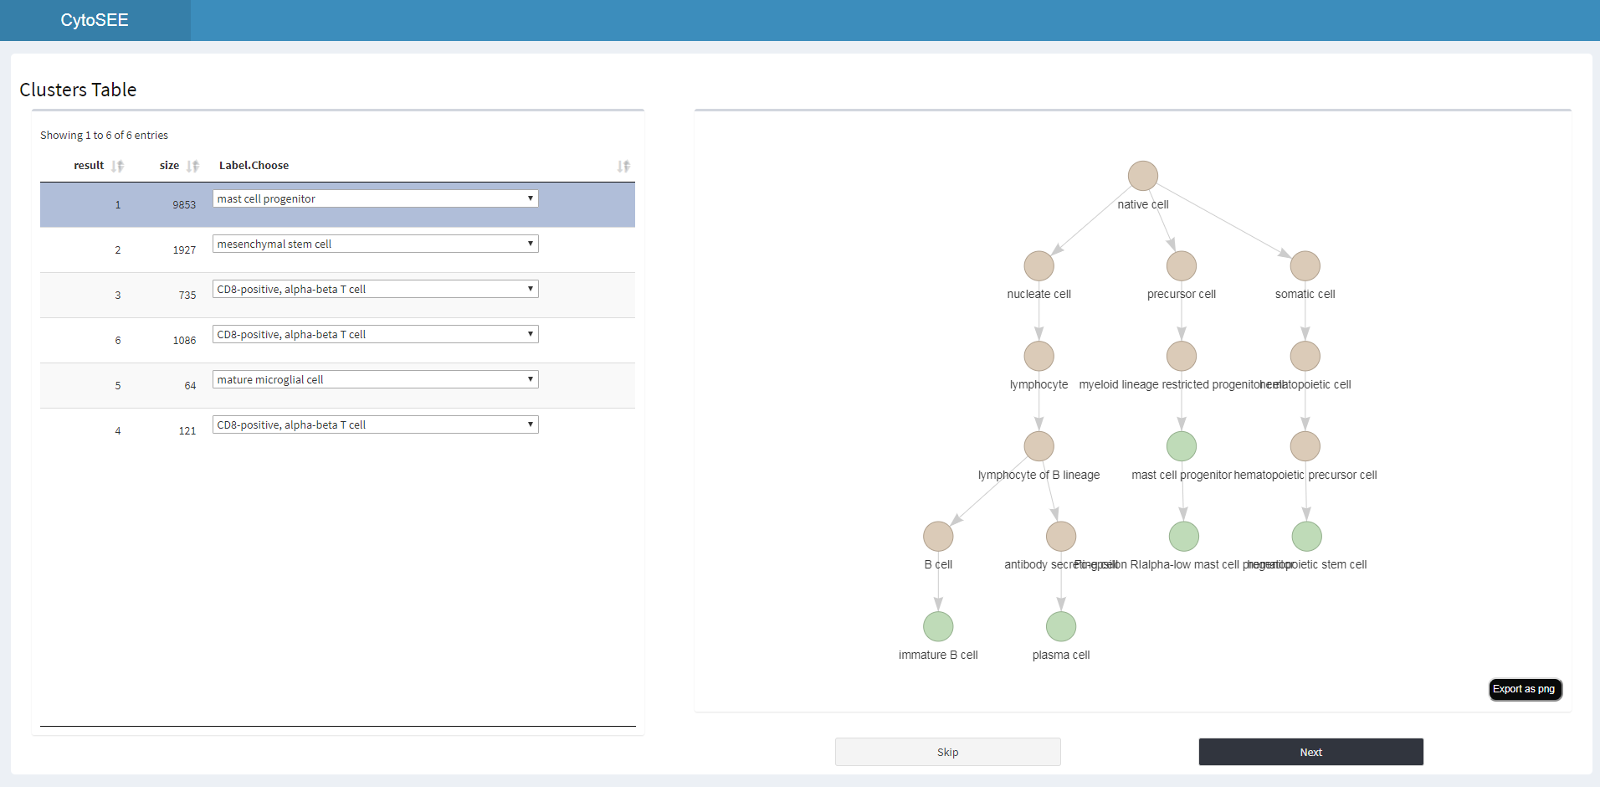
1
2
1
Cluster label tables
2
Divisive marker tree

Slide 10
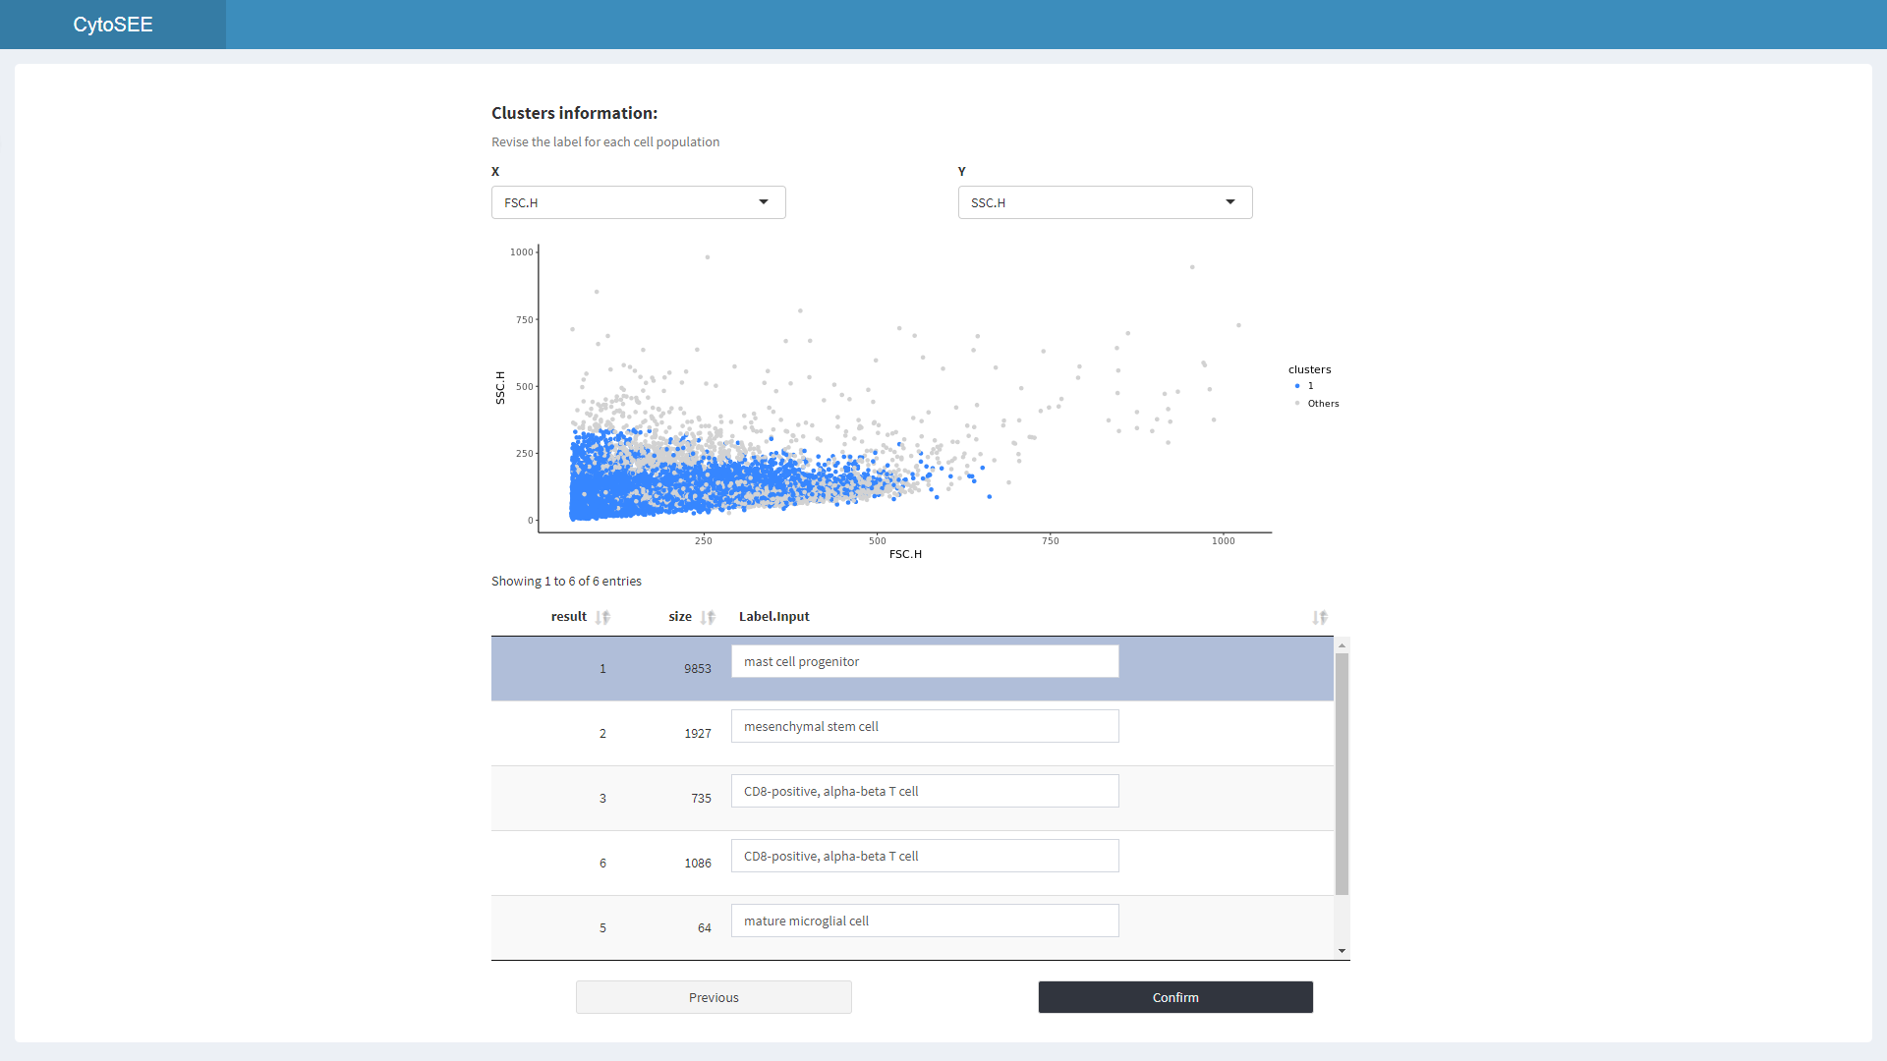
1
1
Clusters label information

Slide 11
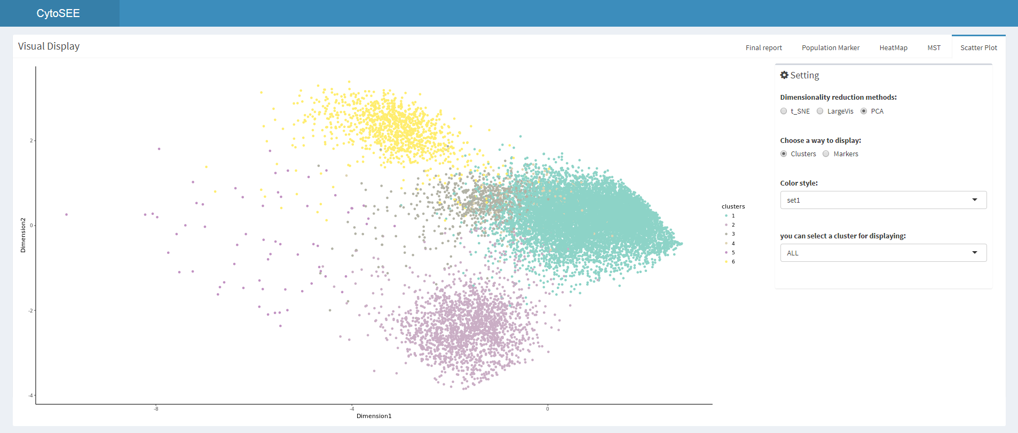
1
2
1
Dimensionality reduction visualization
2
Control panel – scatter plot

Slide 12
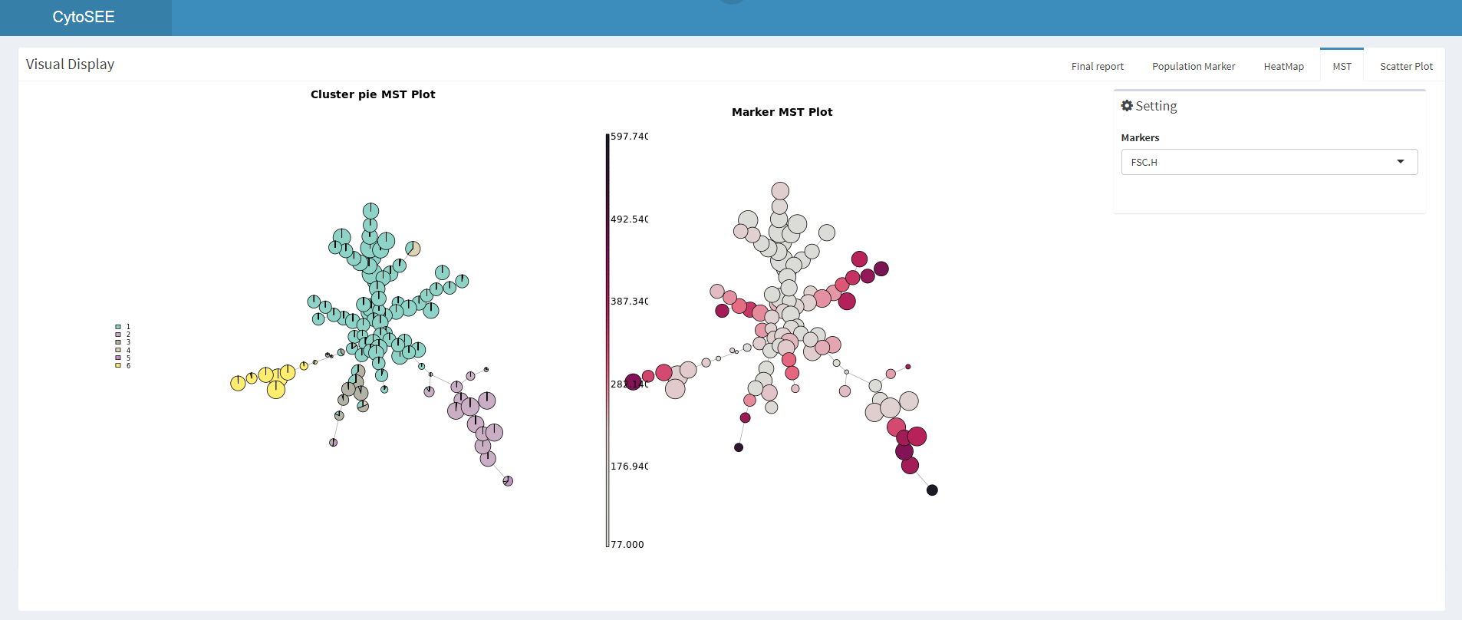
1
2
1
Minimum Spanning Tree Plot
2
Control panel – MST

Slide 13
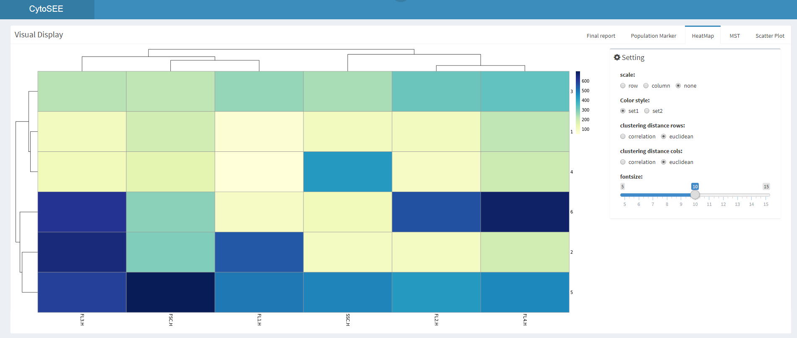
1
2
Heatmap plot
Control panel – Heatmap
1
2

Slide 14
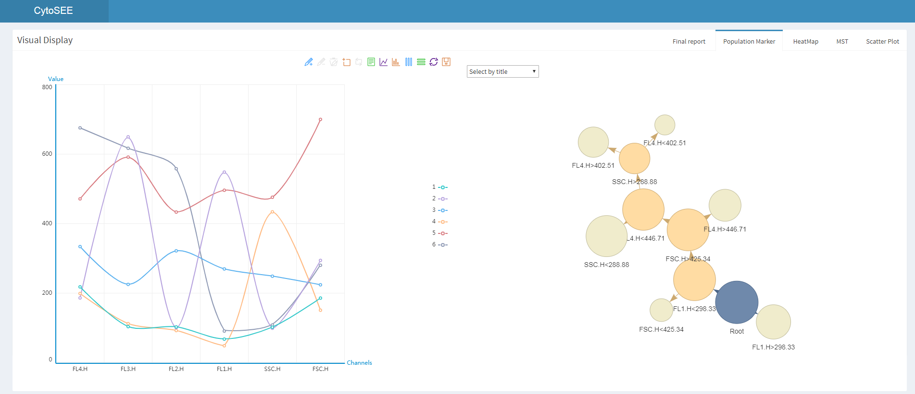
1
2
1
Population marker plot
Control panel – Population marker
2

Slide 15
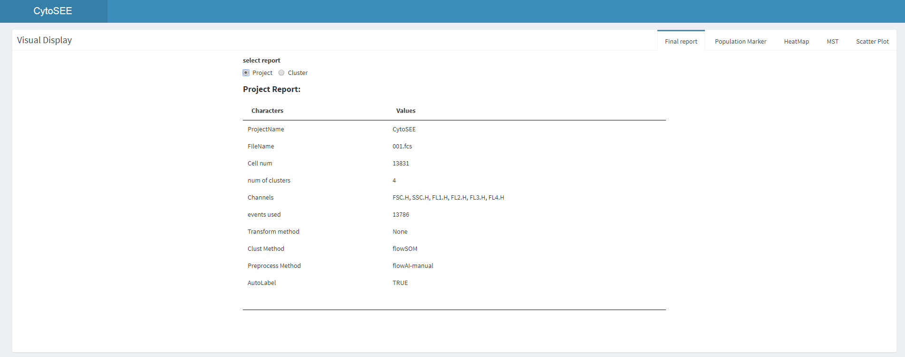
1
1
Project information report

Slide 16
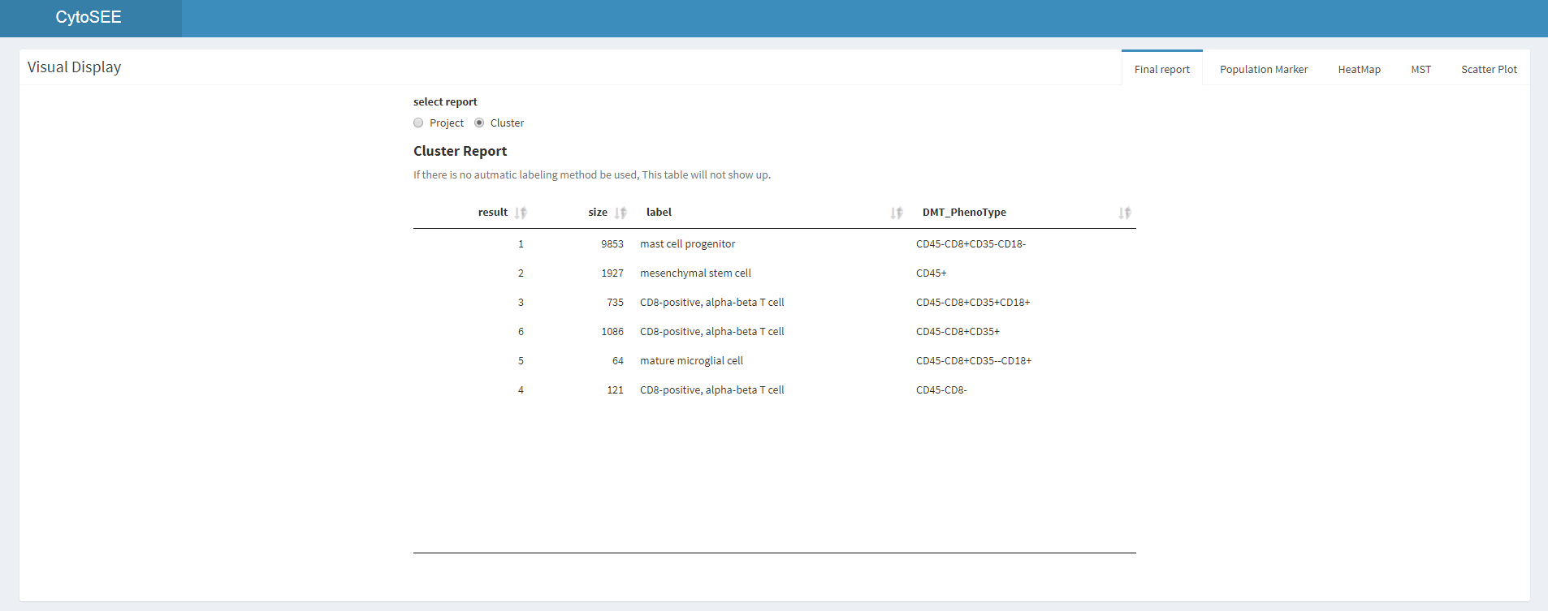
1
1
Cluster information report

Slide 17
2 Rdata display

Slide 18
1
2
1
Name the project, default is CytoSEE
2
Upload the .RData file

