Slide 1
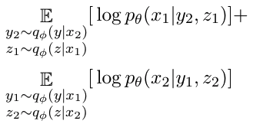

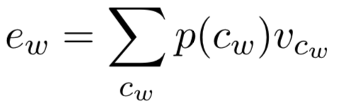





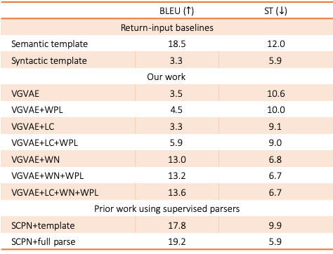









Controllable Paraphrase Generation with a Syntactic Exemplar
Mingda Chen, Qingming Tang, Sam Wiseman, Kevin Gimpel
Controllable Generation
Multi-Task Training
Experiment Results
Prior Work: controlled attributes with a finite set of values
Training uses paraphrase $x_{1}, x_{2}$
Word Position Loss
Data: 1300 human-annotated instances. (500 for Dev, 800 for Test)
Sentence
ParaNMT-50M: 50 million paraphrases
$$z_{1}$$
Evaluation metrics:
Semantic similarity: BLEU, ROUGE, METEOR.
Syntactic similarity: Syntactic tree edit distance (ST). Tree edit distance between constituency parse trees of two sentences.
New Sentence
Paraphrase reconstruction loss (PRL)
Shown in green lines ( )
$$x_{1}$$
$${ x}_{1}$$
Attribute
$$y_{1}$$
Our work: control the syntax of a generated sentence with a syntactic exemplar
$$y_{2}$$
 | BLEU ($↑$) | ST ($↓$)
Return-input baselines
Semantic template | 18.5 | 12.0
Syntactic template | 3.3 | 5.9
Our work
VGVAE | 3.5 | 10.6
VGVAE+WPL | 4.5 | 10.0
VGVAE+LC | 3.3 | 9.1
VGVAE+LC+WPL | 5.9 | 9.0
VGVAE+WN | 13.0 | 6.8
VGVAE+WN+WPL | 13.2 | 6.7
VGVAE+LC+WN+WPL | 13.6 | 6.7
Prior work using supervised parsers
SCPN+template | 17.8 | 9.9
SCPN+full parse | 19.2 | 5.9
Word position loss (WPL)
$$x_{2}$$
$${ x}_{2}$$
$$z_{2}$$
his teammates’ eyes got an ugly, hostile expression.
Word Position Loss
+
the smell of flowers was thick and sweet.
Better Learning of Syntax
=
the eyes of his teammate had turned ugly and hostile.
Latent Codes (LC) for Syntactic Encoder
vMF-Gaussian VAE
Inference model
$$z$$
$c_{w}$ is the latent code for word $w$, $v_{c_{w}}$is the vector for $c_{w}$ and $e_{w}$ is the resulting word embedding for word $w$.
Generative model
$$x$$
$$x$$
Word Noising (WN) via Part-of-Speech Tags
Semantic variable, vMF distribution
$$y$$
Syntactic variable, Gaussian distribution
Tag training set
Group the word types by tag
Randomly replace word tokens from the same group (syntactic input)
SCPN: Adversarial Example Generation with Syntactically Controlled Paraphrase Networks. (NAACL 2018)
Generated Sentences
Background
Gaussian distribution
vMF distribution
Semantic input | if i was there, i would kick that bastard in the ass.
Syntactic input | they would’ve delivered a verdict in your favor.
reference | i would’ve kicked that bastard out on his ass.
generation | she would’ve kicked the bastard on my ass.
Learned Word Clusters
Neural Architecture
12 | does must could shall do wo ’s did ai ’d ’ll should
451 | watching wearing carrying thrown refuse drew
11 | ?:*≫!;).”,’
18 | maybe they because if where but we when how
41279 | elvish festive freeway anteroom jennifer terrors
10 | well ⟨unk⟩ anyone okay now everybody someone
165 | supposedly basically essentially rarely officially
59 | using on by into as the with within under quite
Semantic input | don’t you think that’s a quite aggressive message?
Syntactic input | that’s worth something, ain’t it?
reference | that’s a pretty aggressive message, don’t you think?
generation | that’s impossible message, aren’t you?
Word averaging encoder
Bidirectional LSTM encoder
LSTM decoder
Semantic input | her yelling sounds sad.
Syntactic input | she looks beautiful. shining like a star.
reference | she sounds sad. yelling like that.
generation | she sounds sad. screaming like a scream.
See our prior work on learning disentangled sentence representations
A Multi-Task Approach for Disentangling Syntax and Semantics in Sentence Representations. (NAACL 2019)

