Slide 1

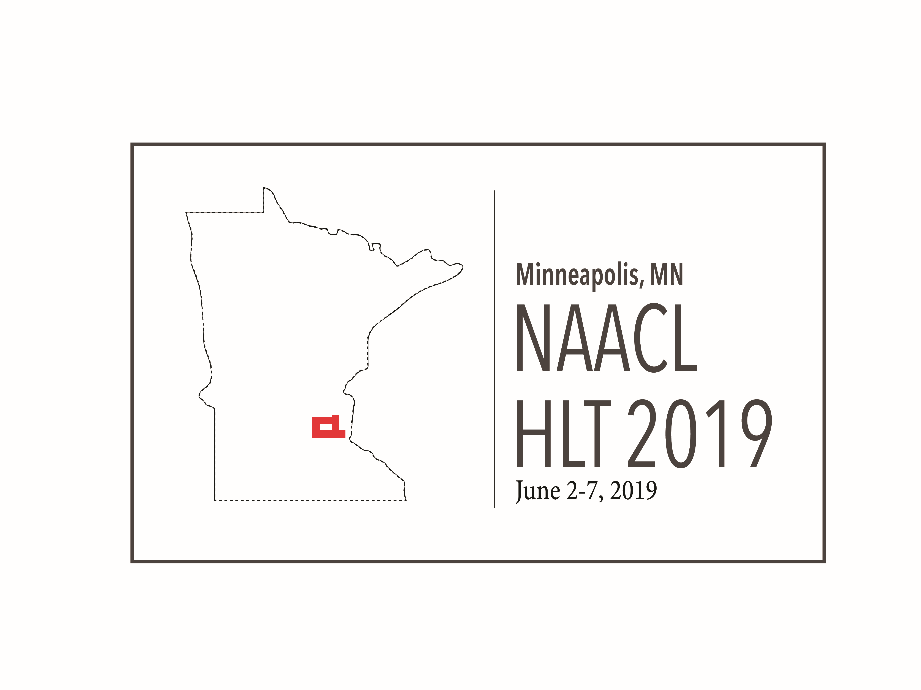
A Multi-Task Approach for Disentangling Syntax and Semantics in Sentence Representations
Mingda Chen, Qingming Tang, Sam Wiseman, Kevin Gimpel
Toyota Technological Institute at Chicago
Multi-Task Training
Experiment Results
Paraphrase Reconstruction Loss
Sentence
Semantic variable
Syntactic variable
Semantic tasks
Syntactic tasks
Maximal Disentanglement
Best Performance
Sentence
Nearest Neighbors
Discriminative Paraphrase Loss
Query
Semantically similar
Syntactically similar
starting
we’ve got to get a move on.
Word Position Loss
trying sharing chasing
you’ll have to get in there.
rising wake initial forward
come on, we got ta move.
Notes:
We propose a generative model that uses two latent variables, with one for semantic representations and the other for syntactic representations. We also propose several multitask losses, including ones that make use of aligned paraphrases and one that characterizes syntax as word ordering. Empirically, we show that the maximal disentanglement between semantic representations and syntactic representations can lead the best performance, and the nearest neighbors found by these two representations show that they capture desirable characteristics.

