Slide 1
5 ways to writter better Python
--Nian Ran

Slide 2
1. Check and print everything to make sure the code is exactly doing what you expect
2. Use a config file to store the configuration
3. Use a factory to create items
4. Recording the version of libraries installed
5. Remember to save or commit your code very frequently when working on a remote machine

Slide 3
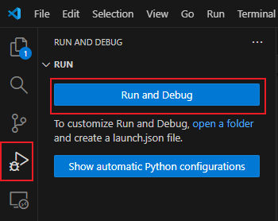
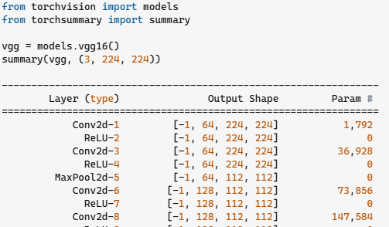

1. Check and print everything to make sure the code is exactly doing what you expect
- print, save logs to a file, using debugger, do a quick test in python file or notebook file, check the correctness when coding for a big project.

Slide 4
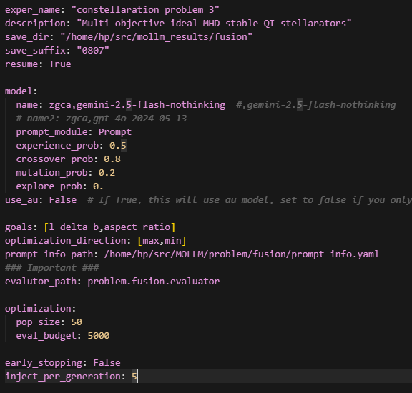
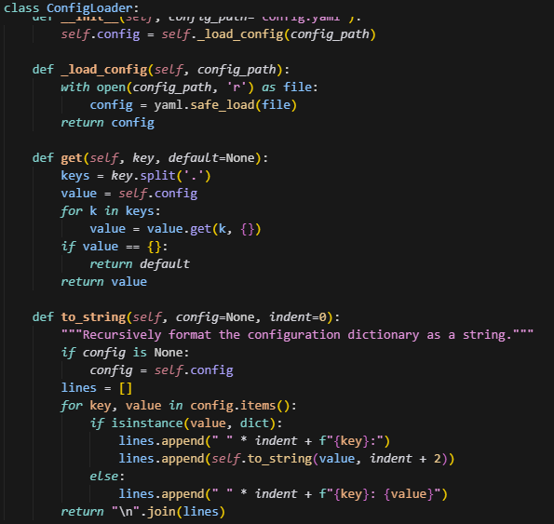
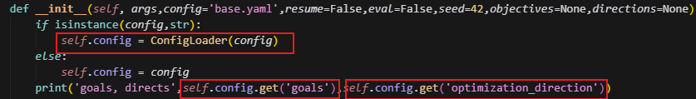
2. Use a config file to store the configuration
- A config file makes your easy to manage especailly when it grows large. Also good for experiments recordings, history recordings. .yaml, .json, .pkl etc.
get the parameters
yaml config file
a simple config loader

Slide 5
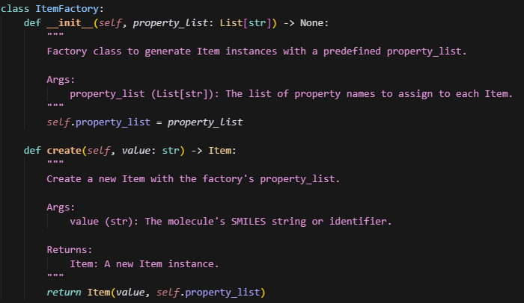
3. Use a factory to create items
- Particularly useful when you use an objective over multiple different files. The factory can store many attributes that are from different resources, and then you can create items with least information.

Slide 6
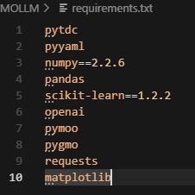
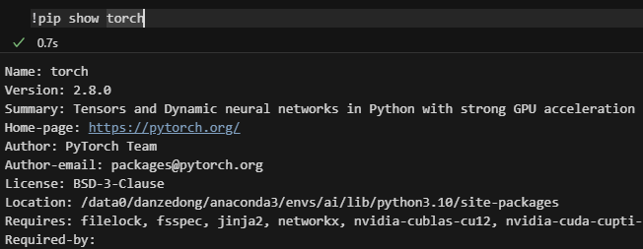
4. Recording the version of libraries installed
- A good habbit. The compatibility is fragile, when you install a new library, you may break the current dependence, careful with the installations and always maintain a good requirements.txt in case of any accidents in the environments.

Slide 7


5. Remember to save or commit your code very frequently when working on a remote machine
- Careful, remote machine can be down in anytime, make sure our work is always back up when working on a remote machine, use a cloud storage when training models instead of storing locally on the machine.
github to store code, cloud storage like Microsoft Blob, Wandb,

