Slide 1
5 Ways to Write Better Python
watching the Lyman break move through the LSST filters
Notes:
Running the code:
Cd /Users/user/Desktop/COMP64803-Responsible-Reproducible-AI/cohort-2026/Rosa_Roberts/lyman_break_demo
Rm –rf output
./build.sh
Docker ps
Docker images
Time ./run.sh

Slide 2
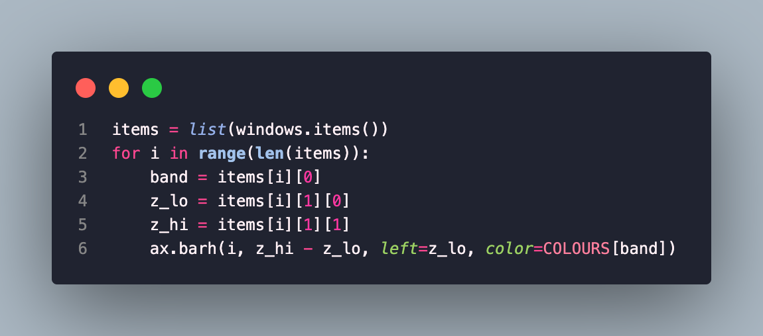
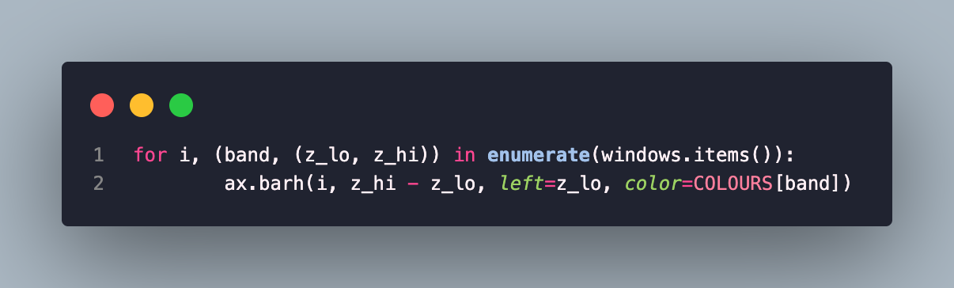
Item 6: Prefer Multiple Assignment Unpacking Over
Indexing
Notes:
To understand items[i][1][0] the reader has to work out the structure in their head, the unpacked version shows the structure in the loop itself and gives every value a name.
A lot of my data is nested, a dict of bands where each band has a tuple of 2 arrays, you don’t want to index and plot the wrong thing, unpacking names each piece at the start of the loop.
Unpacking lets the code show the shape of the data, instead of making the reader work it out from index numbers."

Slide 3
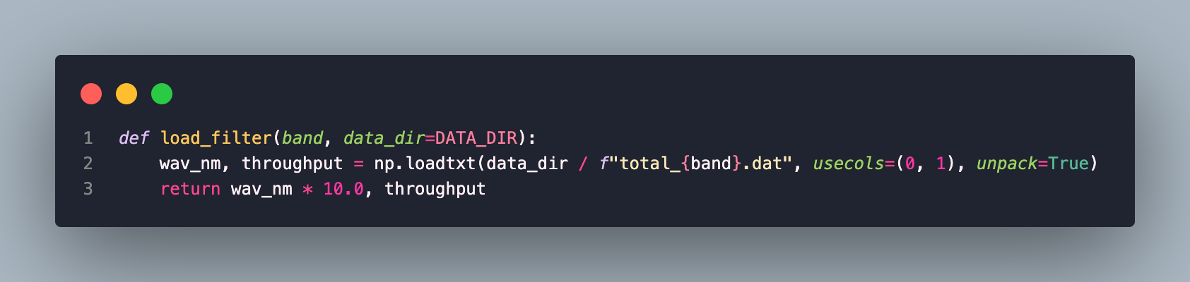
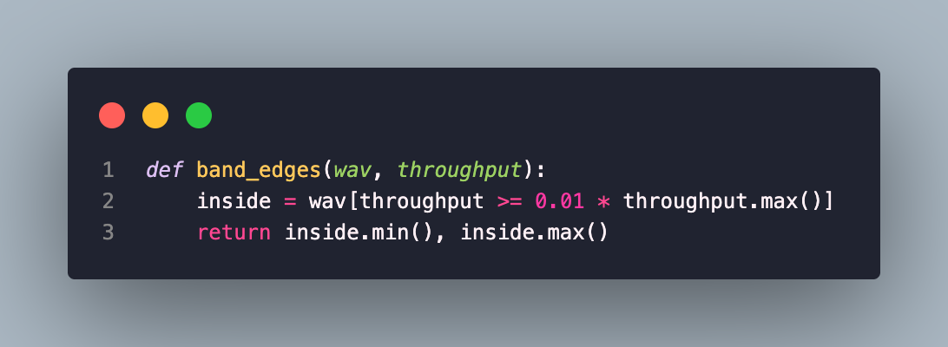
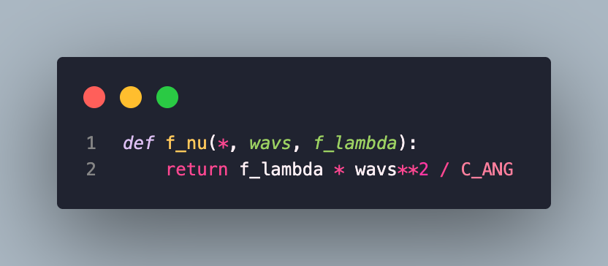
Item 5: Write Helper Functions Instead of Complex Expressions
Notes:
Once an expression gets hard to read it should become a named function. If repetition occurs then the fix only needs to occur in one plac

Slide 4
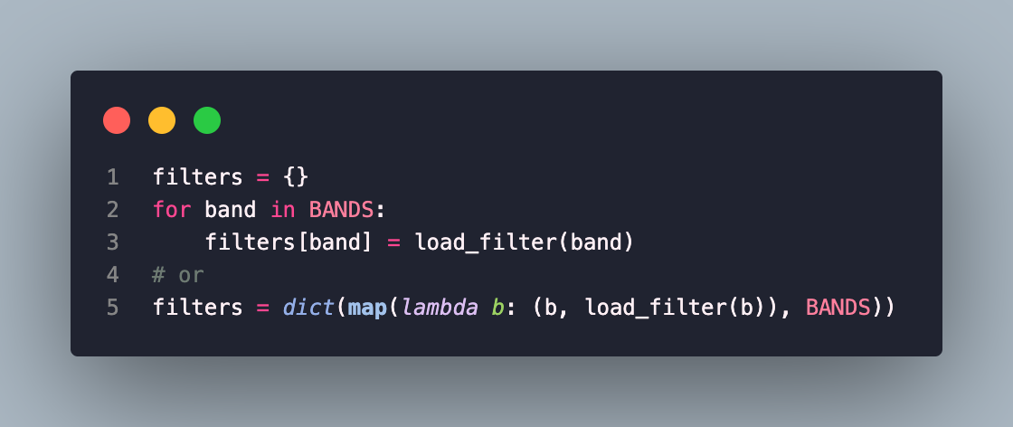
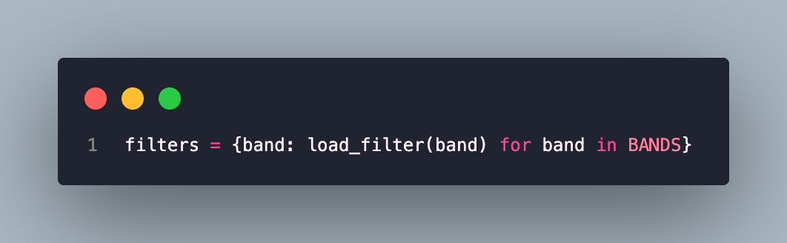
Item 27: Use Comprehensions Instead of map and filter
Notes:
Python provides compact syntax for deriving a new list from another sequence or iterable. Im showing dictionary comprehensions here that loops over each band so that each band becomes a key and the tuple returned by load_filter is its value of (wavelength, throughput).
Comprehensions are clearer than map and filter as they don’t require lambda expressions
I find this easier as its reads like a sentence: for each band, load its filter curve, easier to structure the data at hand
Filters is complete the moment it is created. In a loop there would be a point where it exists has half empty and later code could use it by mistake

Slide 5
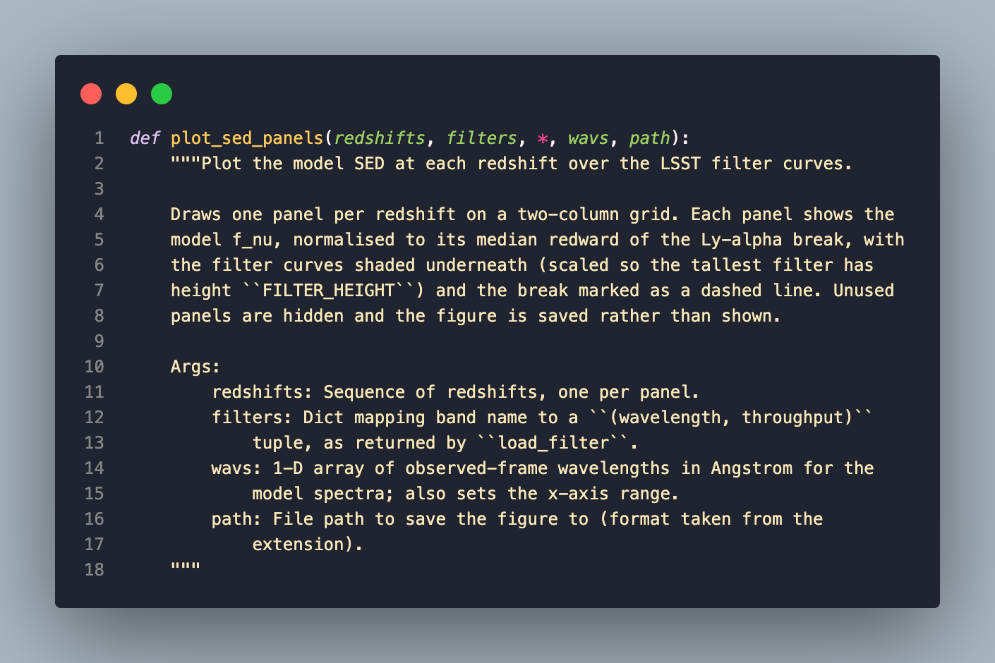
Item 84: Write Docstrings for Every Function,
Class, and Module
Notes:
Every module and function should have a docstring, it should give a summary, explain the arguments and return values with any error raised.
It helps here as most scientific code fails on units, the docstring tells us what units to work in and if they are converted.
Python can read the docstrings back to the user __doc__ and –help to print them, as argparse uses the module docstring as a description, comments cannot do that
A docstring is for anyone using the function, making development easier as the docstring should tell the user about the function’s operation

Slide 6
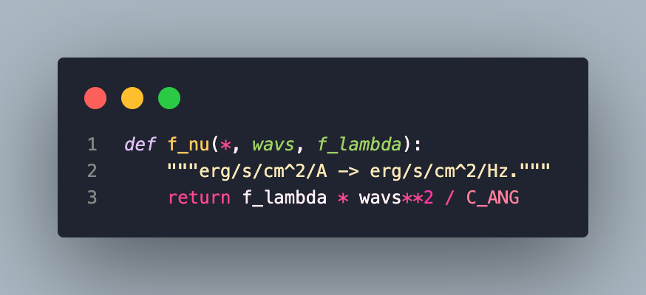
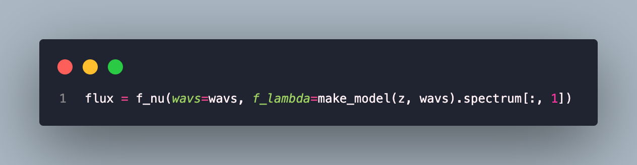
Item 25: Enforce Clarity with Keyword-Only and
Positional-Only Arguments
Notes:
Put a * in the function signature so the arguments after it must be passed by name. wavs and f_lambda are both numpy arrays of the same length, if you were to swap them, the positional arguments would let it run without error and silently return physically wrong results. The * raises a type error immediately and the call explains itself. F_lambda tells us the flux and the units, ensuring our units and axes are correct.
If two arguments could be swapped and still run, then name them.

