Slide 1
Five Ways to Write
Better Python
Oliwia Pedrycz

Slide 2
What will I talk about?
1
Use datetime instead of time for local clocks
2
Prefer enumerate() over range()
3
Avoid else blocks after for and while loops
4
Prefer raising exceptions to returning none
5
Prefer multiple assignment unpacking over indexing

Slide 3
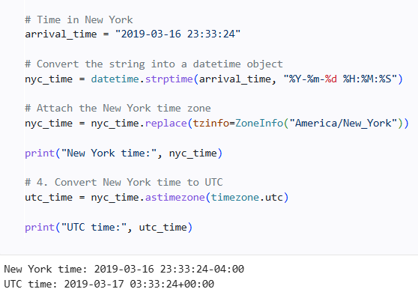
01 / FIVE PYTHON HABITS
Use datetime instead of time for local clocks
1
Use datetime for reliable time zone handling.
YOUR CODE SNIPET
2
Keep UTC as your shared time reference.
Paste your example here
3
Use named zones with ZoneInfo.
4
Convert zones with astimezone().
5
Convert to local time when showing users.
3 / 7

Slide 4
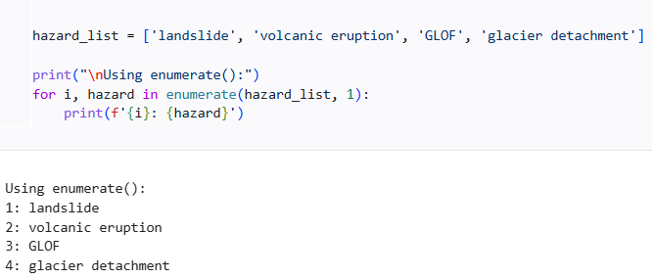
02 / FIVE PYTHON HABITS
Prefer enumerate() over range()
1
Get each item and its index together.
YOUR CODE SNIPPET
2
Skip range(), len(), and manual indexing.
Paste your example here
3
Reduce off-by-one mistakes.
4
Choose a starting count: enumerate(data, 1).
5
Use it with any iterable.
4 / 7

Slide 5
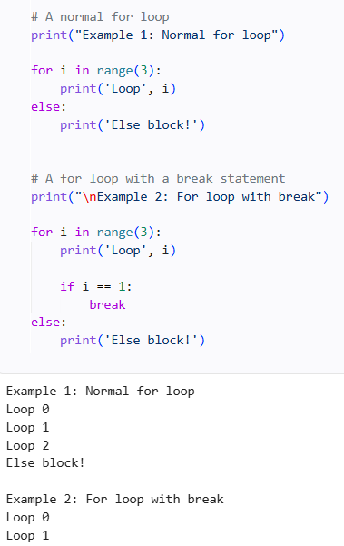
03 / FIVE PYTHON HABITS
Avoid else blocks after for and while loops
1
Loop else runs when a loop ends without break.
2
A break skips the else block.
3
Else also runs when the sequence is empty.
4
Use it to signal that a search found no match.
5
Choose it only when it makes the logic clearer.
5 / 7

Slide 6
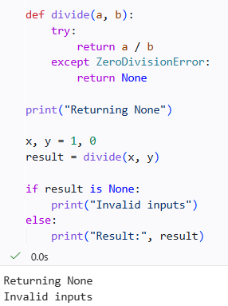
04 / FIVE PYTHON HABITS
Prefer raising exceptions to returning none
1
None can hide why an operation failed.
2
Callers may forget to check for None.
3
Raise an exception to make failure explicit.
4
Catch only errors you can handle.
5
Document expected errors and inputs.
6 / 7

Slide 7
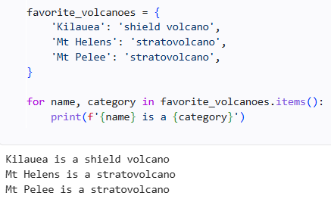
05 / FIVE PYTHON HABITS
Prefer multiple assignment unpacking over indexing
1
Assign several values in one clear step.
2
Use names instead of numeric positions.
Paste your example here
3
Unpack nested data when its structure is known.
4
Swap values without a temporary variable.
5
Unpack rows directly in a for loop.
7 / 7

Slide 8
5 Ways to Write
Better Python
Thank you

