Slide 1
Effective Python

Slide 2
Item 2: PEP 8 Style
Python Enhancement Proposal #8, is a style guide for how to format python code.
Using a consistent style makes code more approachable and easier to read.
Also sharing a common style eases collaboration with other developers on large projects.
Let’s look at some examples:

Slide 3
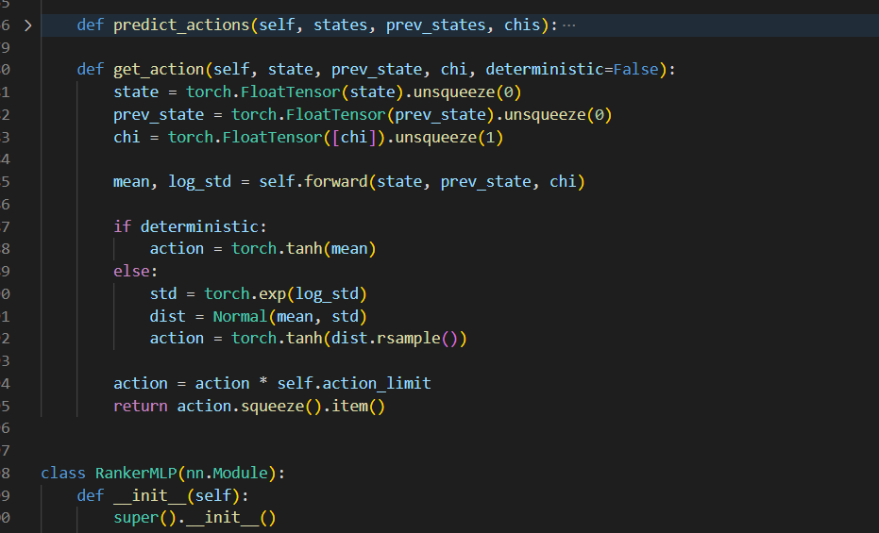
Item 2: PEP 8 Style – Whitespace
Separate class methods by one line.
Keep lines to <80 characters in length.
One space before and after “=“ in variable assignment.
Use four spaces instead of tabs (?)
Separate functions and classes by two lines.

Slide 4
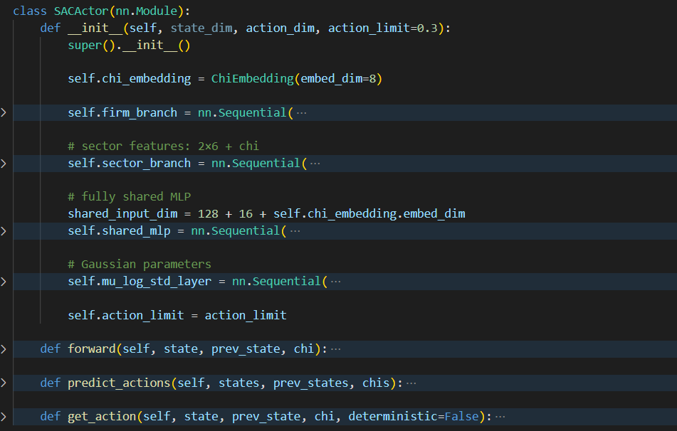
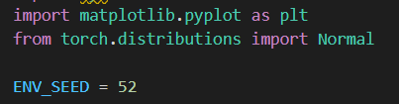
Item 2: PEP 8 Style – Naming
Functions, variables, attributes should be in lowercase_underscore format.
Classes should be in CapitalisedWord format.
Module-level constants in ALL_CAPS.

Slide 5
Item 6: Prefer Multiple Assignment Unpacking Over Indexing
The Python tuple type can be used to create immutable ordered sequences of values. Once created, it cannot be modified by assigning a new value to an index.
Unpacking lets you assign multiple values from a sequence in one step, instead of indexing manually. It makes code cleaner, more readable, and less error-prone.

Slide 6

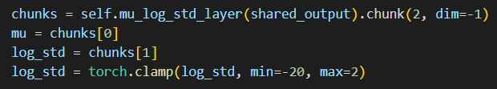
Item 6: Prefer Multiple Assignment Unpacking Over Indexing

Slide 7
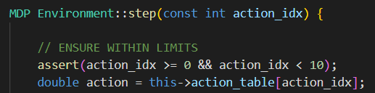
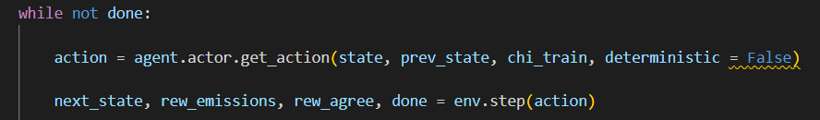
Item 6: Prefer Multiple Assignment Unpacking Over Indexing

Slide 8
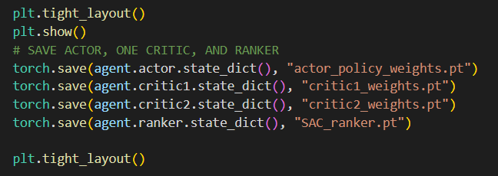
Item 65: Take Advantage of Each Block in try/except/else/finally
Python’s try statement actually has four parts:
try – code that might raise an exception.
except – what to do if an exception occurs.
else – runs only if no exception was raised in try.
finally – runs no matter what (success or failure), used for cleanup, closing files, releasing resources, etc.

Slide 9
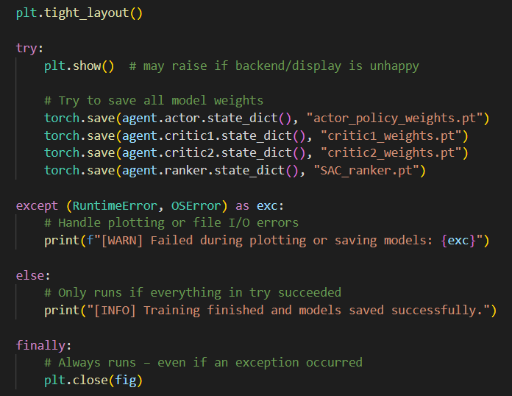
Item 65: Take Advantage of Each Block in try/except/else/finally

Slide 10
Item 8: Use zip to Process Iterators in Parallel
Often, we may find ourselves with many lists of related objects.
The zip function wraps two or more iterators, allowing us to iterate over two or more sequences at the same time, and avoid manual indexing.

Slide 11
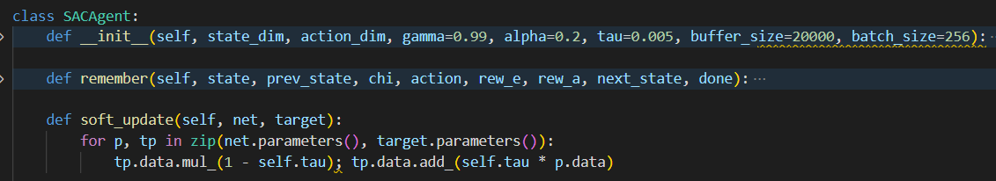
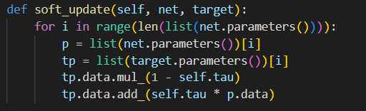
Item 8: Use zip to Process Iterators in Parallel

Slide 12
Item 5: Write Helper Functions Instead of Complex Expressions
Pythonic syntax makes it easy to write single-line expressions that implement a lot of logic.
These can become overly complicated and difficult to read.
We should make complex expressions into helper functions, especially if logic is repeated.

Slide 13
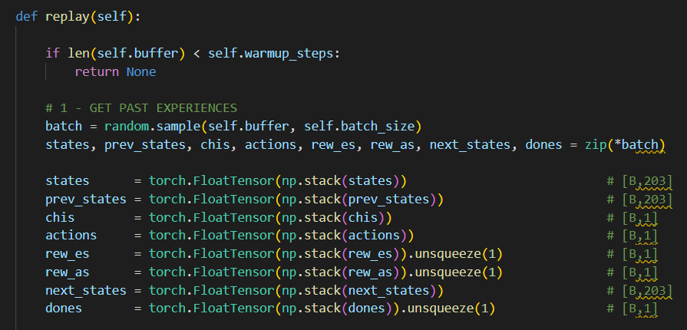
Item 5: Write Helper Functions Instead of Complex Expressions

Slide 14
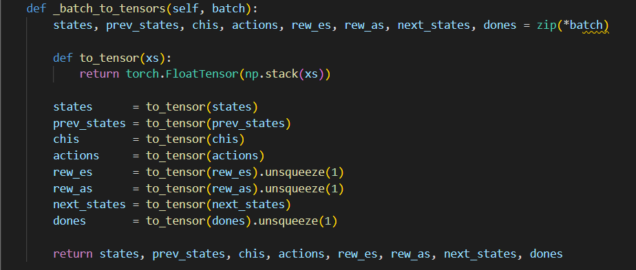
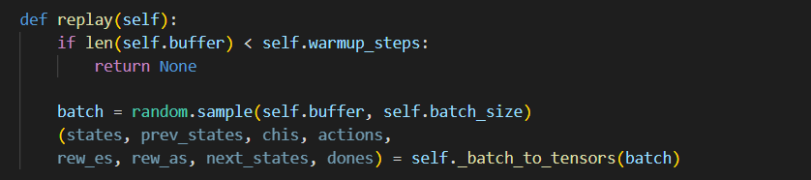
Item 5: Write Helper Functions Instead of Complex Expressions

Slide 15
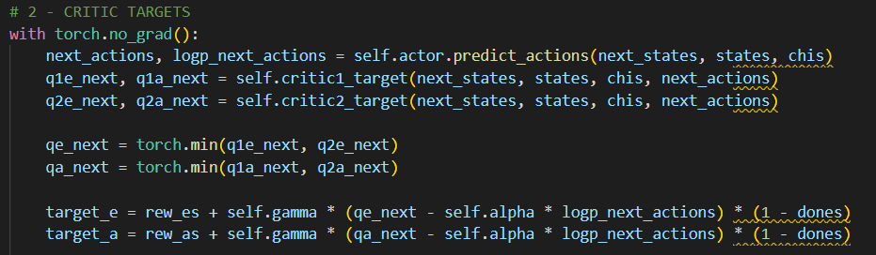
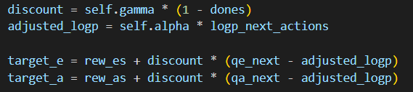
Item 5: Write Helper Functions Instead of Complex Expressions

