Slide 1
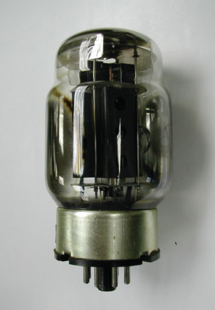
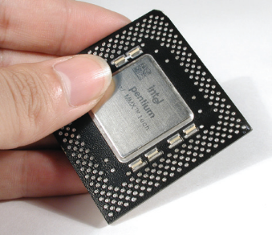
1st generation
1946~1959
vacuum tube 真空管
ENIAC
Second-generation computers Transistor period (1959~1963)
3rd generation computers The period of integrated circuits (1964~1970)
Fourth-generation computers Extra-large stacks Circuit period (1971~Present)

Slide 2
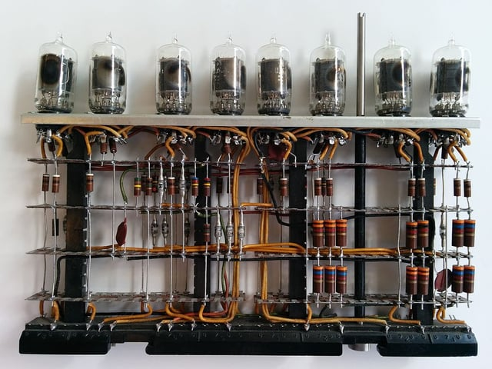
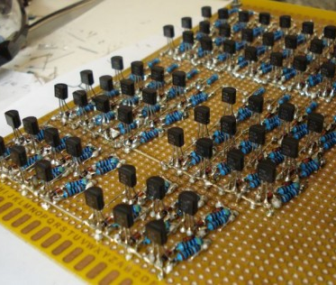
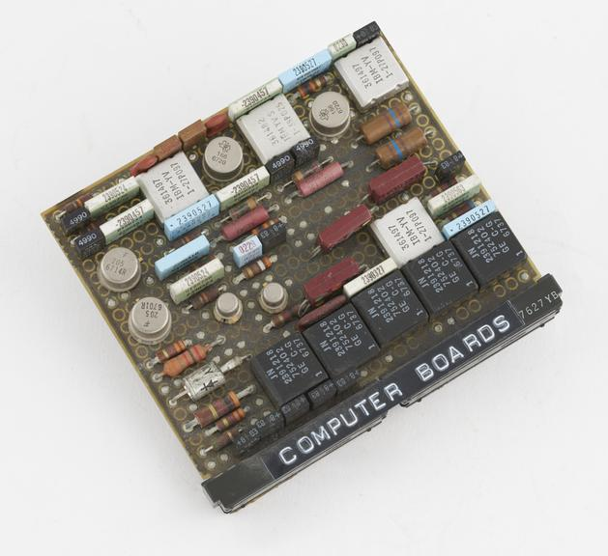
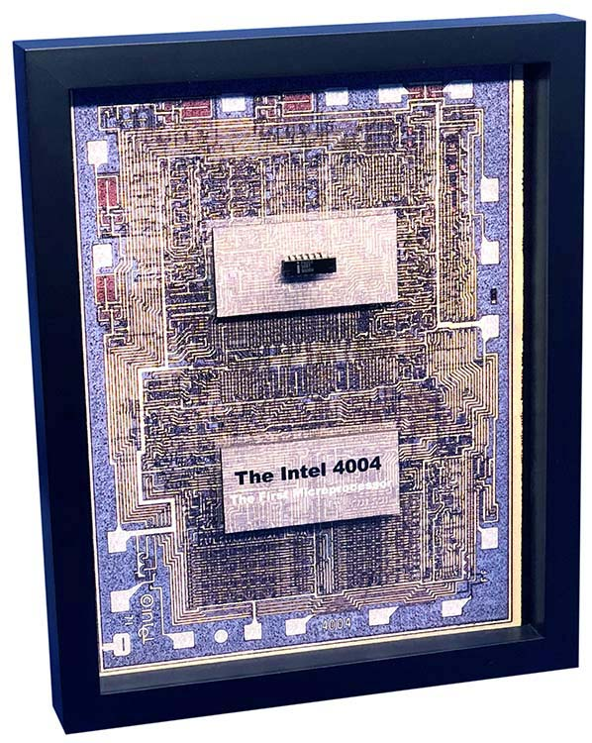
Computer
First Generation
Second Generation
Third Generation
1946~1959
Vacuum tube 真空管
ENIAC
Transistor 電晶體 Honeywell 400
1959~1964
1964~1970 Integrated circuits 積體電路 IBM 360
Fourth Generation
1971~Present VLSI 超大型積體電路
Intel 4004 micro processor

