Slide 1
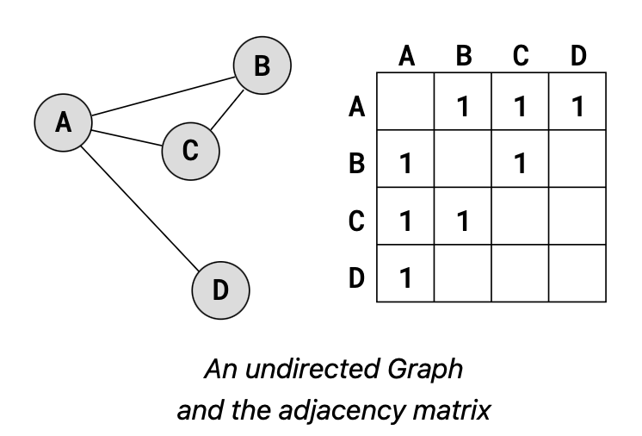
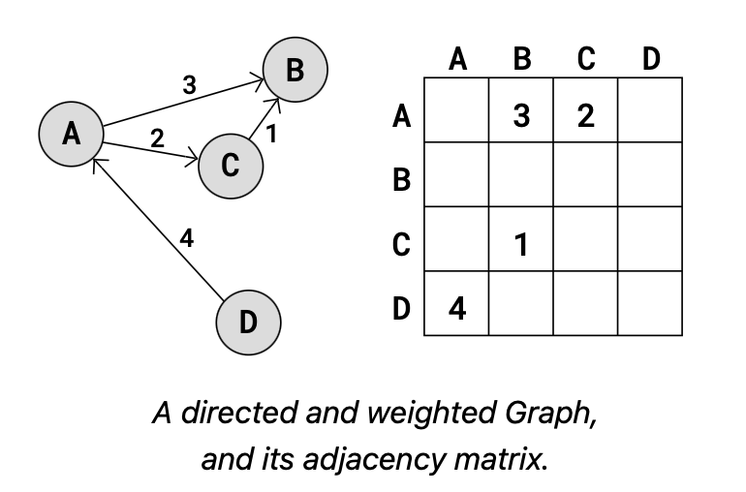

Slide 2
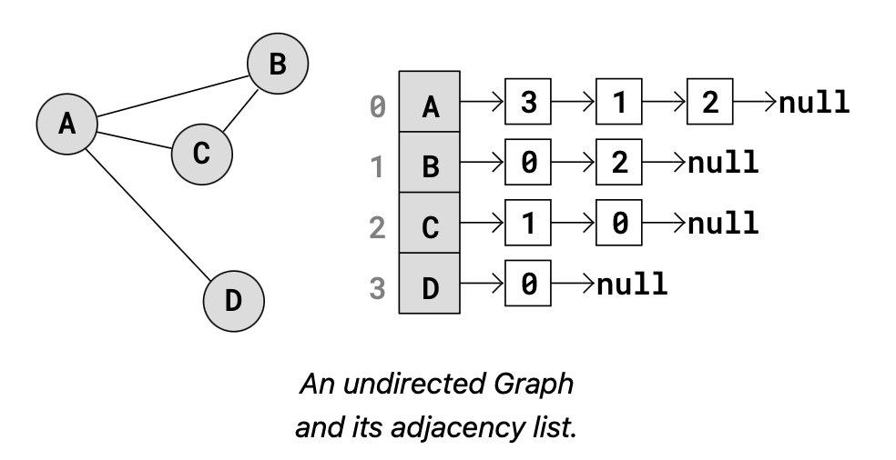
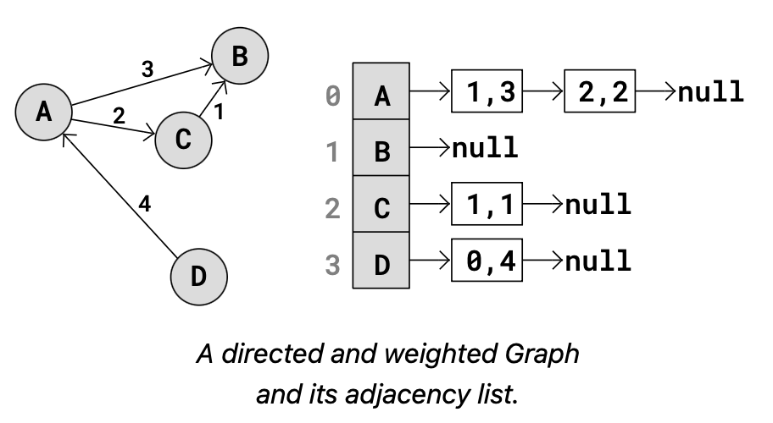

Slide 3
Vertex
Attribute
key
adjacency_list
has_edge_to()
outgoing_edges()
add_edge_to()
delete_edge_from()
Helper Methods
__init__()
__eq__()
__str__()
__repr__()

Slide 4
Graph
Attribute
vertex_number
edge_number
adj
read_file()
has_vertex()
has_edge()
get_vertices()
get_edges()
vertex_count()
edge_count()
insert_vertex()
delete_vertex()
insert_edge()
delete_edge()
Helper Methods
__init__()
__str__()
__repr__()
_get_vertex()

Slide 5
graph_bfs_traverse.txt
2
5
7 16
0 2
0 3
0 4
1 2
1 5
2 0
2 1
2 4
2 5
2 6
3 0
4 0
4 2
5 1
5 2
6 2
0
1
3
4
6

Slide 6
graph_dfs_traverse.txt
2
5
7 16
0 4
0 3
0 2
1 2
1 5
2 0
2 6
2 5
2 4
2 1
3 0
4 0
4 2
5 1
5 2
6 2
0
1
3
4
6

Slide 7
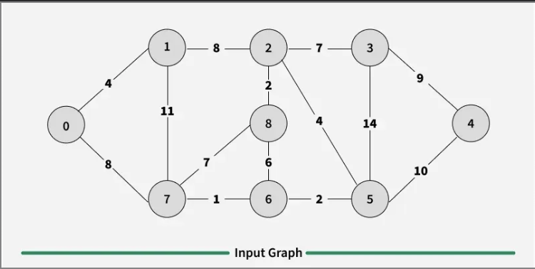
graph_mcst_kruskal.txt
9 28
0 1 4
0 7 8
1 0 4
1 7 11
1 2 8
2 1 8
2 8 2
2 5 4
2 3 7
3 2 7
3 5 14
3 4 9
4 3 9
4 5 10
5 6 2
5 2 4
5 3 14
5 4 10
6 7 1
6 8 6
6 5 2
7 0 8
7 1 11
7 8 7
7 6 1
8 7 7
8 2 2
8 6 6

