Slide 1
Queue
Attribute
- data
enqueue()
dequeue()
is_empty()
Helper Function
__init__()
__str__()
__repr__()
__len()__

Slide 2
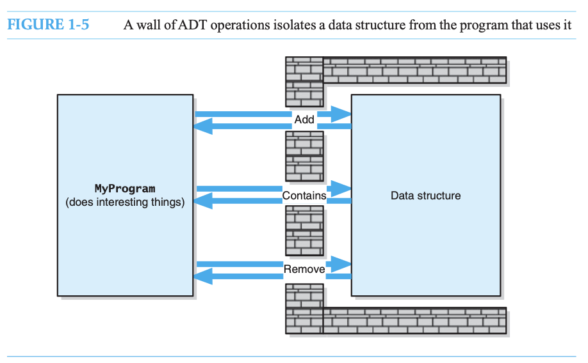
Carrano and Henry, 2016)

