Slide 1
Logical Data Structures
Logical Data Structures
Abstract Data Types (ADT)
Linear
Non-linear
Array
Linked List
Stack
Queue
Tree
Graph
Python
Built-in
Primitive
int
float
str
bool
Container
tuple
list
set
dict
Heap
Hash
A logical data structure defines how data elements are conceptually related and behave (like a Stack or Queue), focusing on attributes and behaviors.
It provides an abstract, platform-independent view, enabling flexible design and maintenance by separating what data is needed from how it's stored.

Slide 2
Physical Data Structures
Physical Data Structures
Linked Storage Structure
Singly Linked List
Doubly Linked List
Sequential Storage Structure
Compact Arrays
Referential Arrays
A physical data structure is the concrete, low-level implementation of a logical data structure, defining exactly how data is stored in computer memory or in disk.

Slide 3
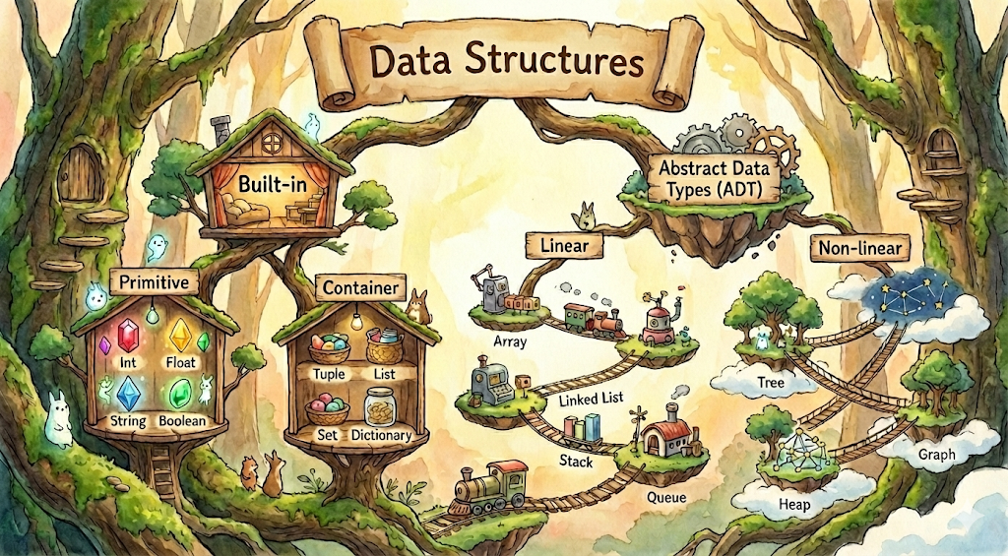
Data Structures

Slide 4
與資料結構最常見對應的演算法
Algorithms
Bound to Data Structures
Evaluating expressions
Queue
Parentheses checking
BFS
Array / List
(Search)
Linear Search
Binary Search
Array / List
(Sort)
Insertion Sort
Quick Sort
Bubble Sort
Stack
Merge Sort
Selection Sort
Hash Table
Tree
BST
Tree Traversal
Balanced Tree
Graph
BFS
DFS
Shortest Path (Dijkstra)
Heap Sort
Topological Sort
Minimum Spanning Tree
Frequency Counting
Two-sum
Deduplication
Heap
N-th max
Priority queue

Slide 5
演算法設計範式
Algorithmic Paradigms
Brute Force
Divide and Conquer
Greedy Algorithms
Dynamic Programming
Linear search
Permutation
Subset
Binary Search
Merge Sort
Quick Sort
Huffman Coding
Minimum Spanning Tree
Activity Selection
Fibonacci
Knapsack
LCS

