Slide 1
UnsortedStaticArray
Attribute
- typecode
- max_size
- size
- array
delete(idx)
insert(val)
find(val)
traverse()
Helper Function
__init__()
__len__()
__getitem__()
__setitem__()
__str__()
__repr__()

Slide 2
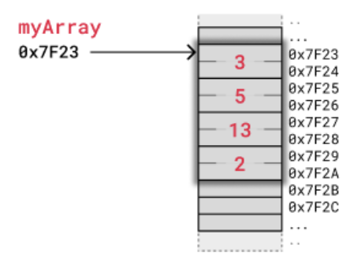
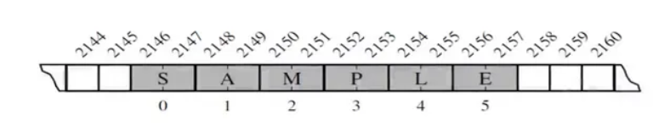
myString
2146

