Slide 1
Stack
Attribute
- data
push()
pop()
is_empty()
peek()
Helper Function
__init__()
__str__()
__repr__()
__len()__

Slide 2
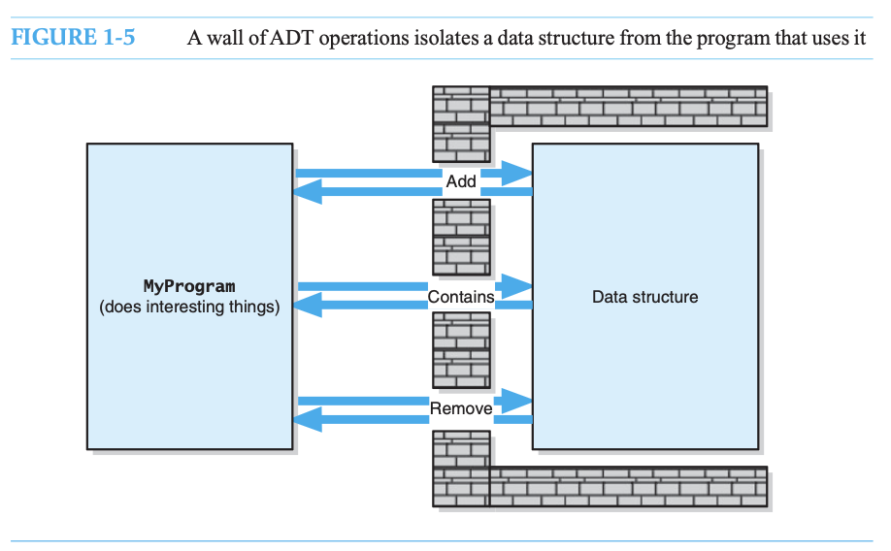
Carrano and Henry, 2016)

