Slide 1
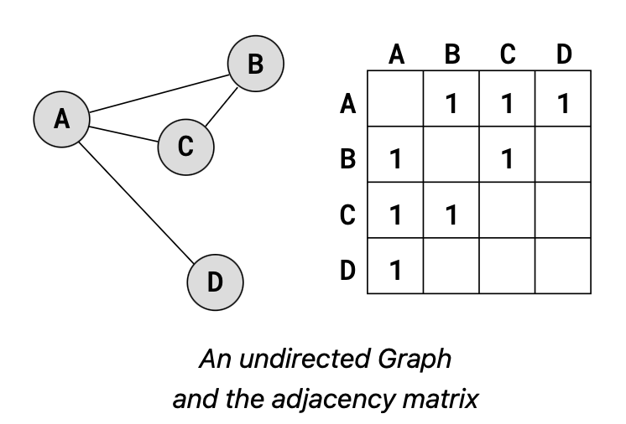
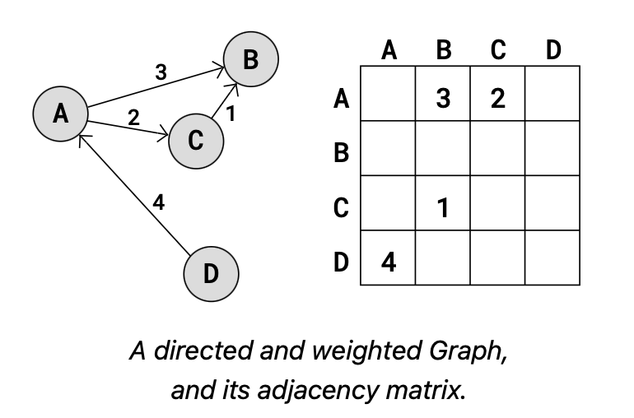

Slide 2
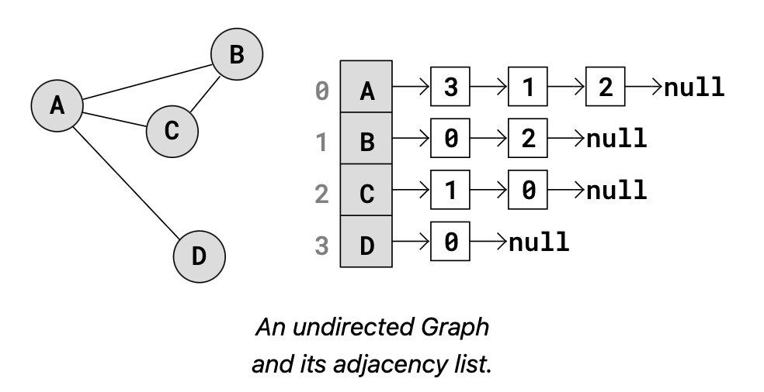
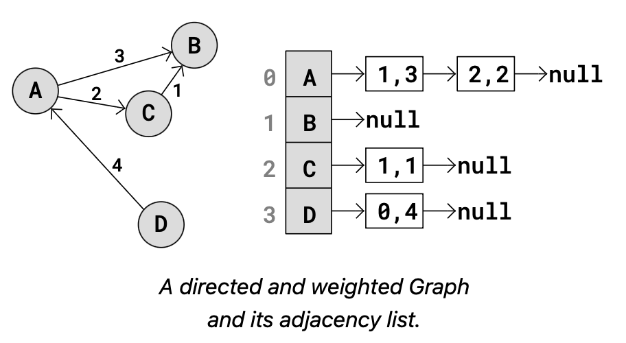

Slide 3
Vertex
Attribute
key
adjacency_list
has_edge_to()
outgoing_edges()
add_edge_to()
delete_edge_from()
Helper Methods
__init__()
__eq__()
__str__()
__repr__()

Slide 4
Graph
Attribute
vertex_number
edge_number
adj
read_file()
has_vertex()
has_edge()
get_vertices()
get_edges()
vertex_count()
edge_count()
bfs
dfs
insert_vertex()
delete_vertex()
insert_edge()
delete_edge()
Helper Methods
__init__()
__str__()
__repr__()
_get_vertex()

