Slide 1
BinaryTreeNode
Attribute
data
left
right
set_left()
set_right()
Helper Methods
__init__()
__str__()
__repr__()

Slide 2
traverse_preorder()
traverse_postorder()
traverse_inorder()
traverse_level_order()
is_empty()
search(value)
get_height()
.root()
BinaryTree
Attribute
- root
set_root()
Helper Methods
__init__()
__len__()
__str__()

Slide 3
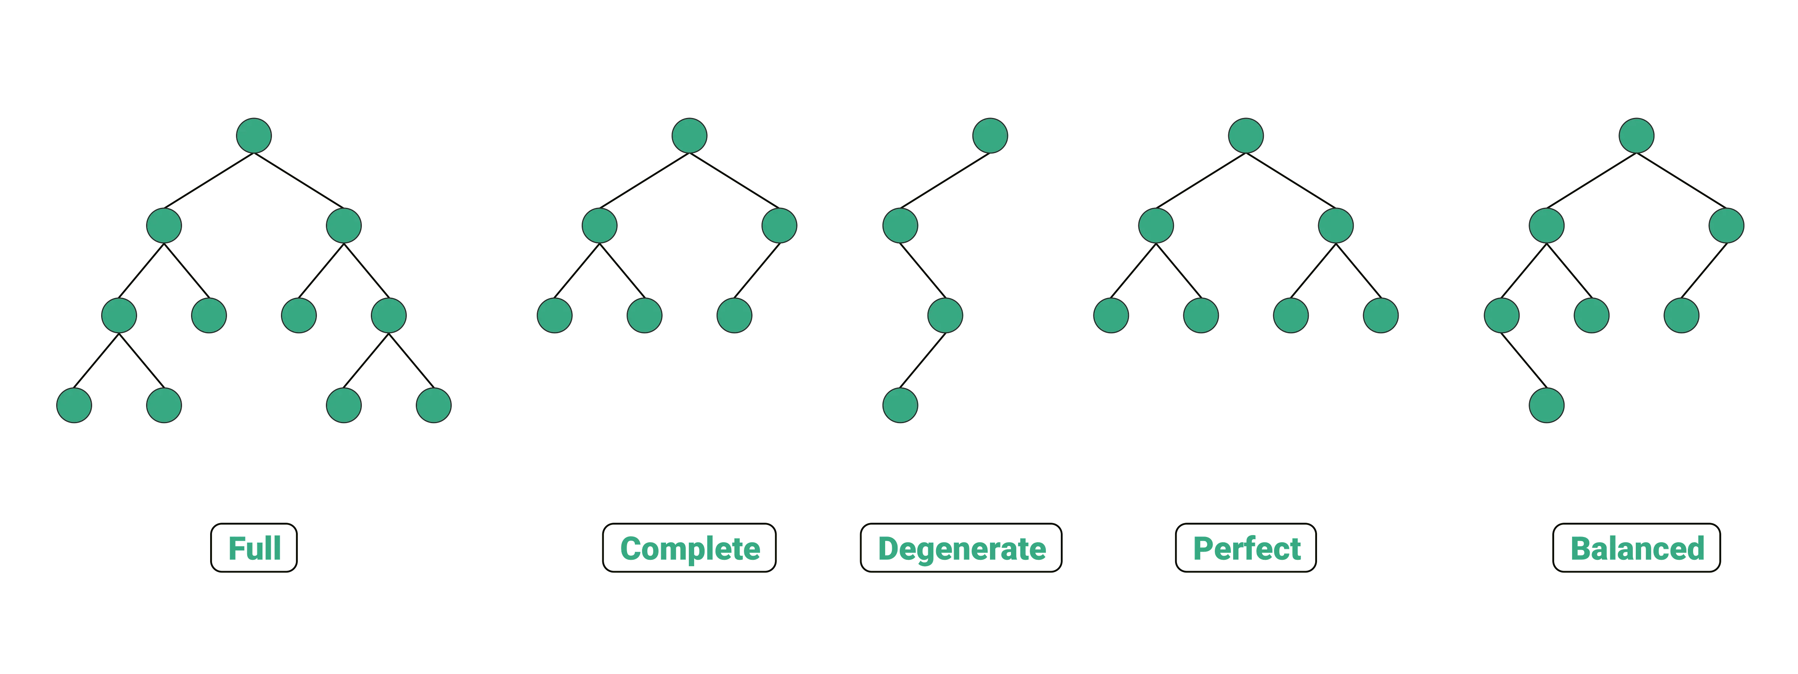

Slide 4
find_min_in_subtree
find_max_in_subtree
BSTNode
Attribute
data
left
right
.data
.left
.right
Helper Methods
__init__()
__str__()
__repr__()

Slide 5
insert()
delete()
BST
Attribute
root
contains()
Helper Methods
__init__()
__str__()
__len__()
_search()

Slide 6
if node.left() is None or node.right() is None (TRUE): to-be-deleted node has zero or one child
Pattern 1: (to-be-deleted) node has zero child, the node is root or a leaf
Delete root
Delete leaf
3
5
0
n
2
p
4
2
p
7
P = None
maybe = None
1
n
3
n
case1-1
P = Not None
maybe = None
P = Not None
maybe = None
case1-2
case1-3

Slide 7
if node.left() is None or node.right() is None (TRUE): to-be-deleted node has zero or one child
Pattern 2: (to-be-deleted) node has one child
5
p
3p
P = None
maybe = left/right child
root = maybe
P = None
maybe = left/right child
root = maybe
4
n
7
1
8n
3
n
2
maybe
P = NOT None
maybe = left child
P.left = maybe
P = NOT None
maybe = left child
P.right = maybe
3
n
5
maybe
1
3
4
6
case2-5
1
maybe
1
maybe
case2-3
Delete node only having right child
case2-1
2
7
p
3
p
case2-2
3n
9
1
5
n
5
maybe
P = NOT None
maybe = right child
P.left = maybe
P = NOT None
maybe = right child
P.right = maybe
8
maybe
4
6
6
9
case2-6
case2-4

Slide 8
if node.left() is None or node.right() is None (FALSE): to-be-deleted node has two children
Pattern 3A: (to-be-deleted) node has two children (P = None, N = root)
P = None
m.p = None
m = leaf
P = None
m.p = None
m = internal node
P = None
m.p = Not None
m = leaf
P = None
m.p = Not None
m = internal node
3
n
5
n
4
n
8
n
2
m
4
4
m
6
5
4
m.p
9
2
m.p
2
3
m
3
6
m
case3A-1
case3A-3
1
5
3
case3A-2
case3A-4

Slide 9
if node.left() is None or node.right() is None (FALSE): to-be-deleted node has two children
Pattern 3B: (to-be-deleted) node has two children (P = Not None)
P = Not None
m.p = None
m = internal node
P = Not None
m.p = Not None
m = leaf
P = Not None
m.p = Not None
m = internal node
P = Not None
m.p = None
m = leaf
6
p
8
p
4
p
6
p
7
5
n
9
2
n
5
4
n
3
n
7
3
m
5
2
m.p
6
1
m
3
1m.p
4
case3B-1
2
4
m
7
2m
5
1
case3B-2
case3B-3
3
case3B-4

Slide 10
Backup

Slide 11
Case 1
if node.left() is None or node.right() is None (TRUE)
Case 2
(to-be-deleted) node is root or a leaf
(to-be-deleted) node has one child
Delete root
Delete node only having left child
Delete node only having left child
n
p
p
maybe = None
P = None
n
n
maybe
maybe = left child
P is not None
maybe
maybe = left child
P is not None
Delete leaf
Delete node only having right child
Delete node only having right child
p
p
p
p
n
n
n
n
maybe = None
P is not None
maybe = None
P is not None
maybe
maybe = right child
P is not None
maybe
maybe = right child
P is not None

