Slide 1

BENV0091 Visualisation Competition Results
Patrick de Mars

Slide 2
Honourable Mentions

Slide 3
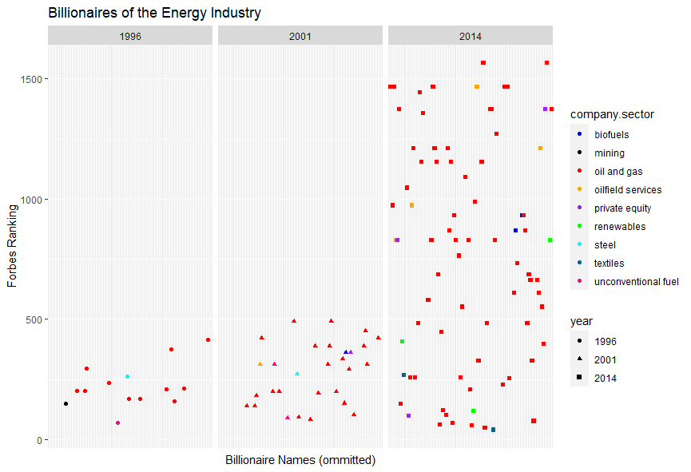
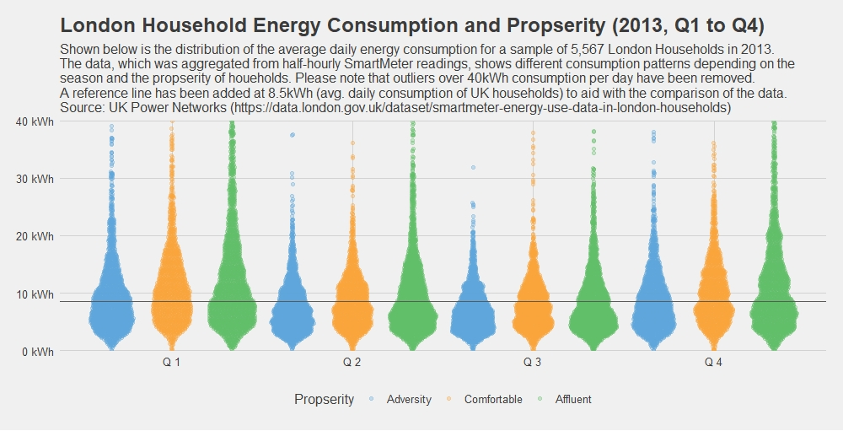
Jess Steinemann
Tosin Onaolapo

Slide 4
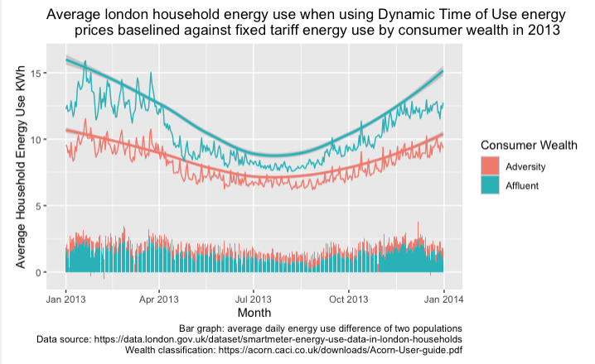
Javier Klatovsky
Peter Walsh

Slide 5
And The Winner Is

Slide 6
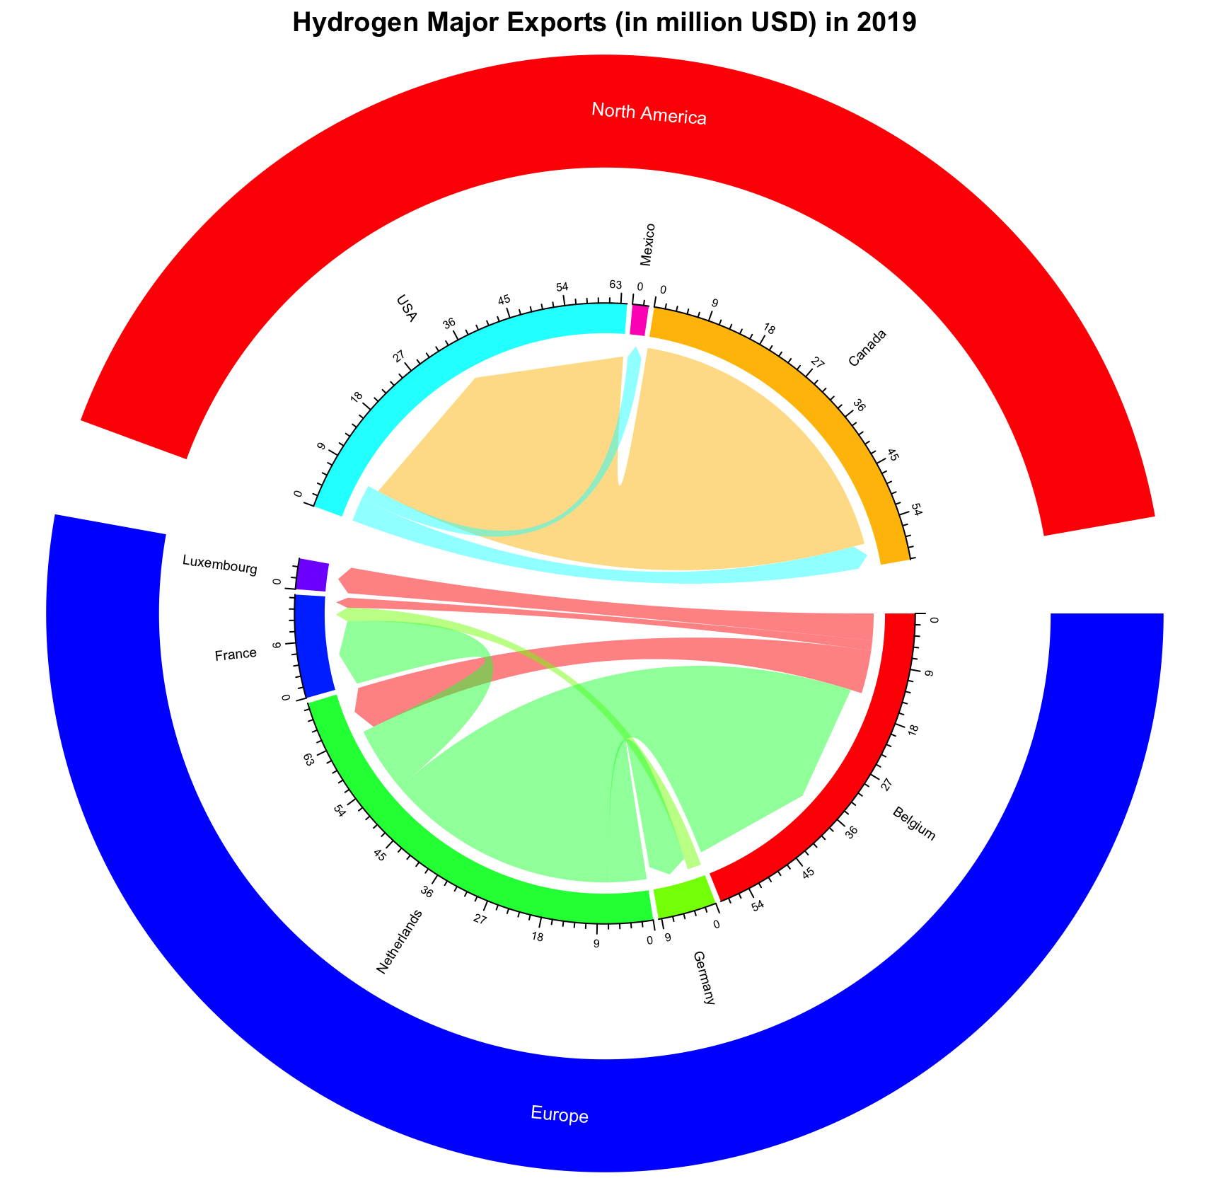
Alfian Rahman

Slide 7
Visualisation Competition: General Feedback
First and foremost: make sure it is clear what data the graph is displaying!
Use text (axis labels, title, subtitle)
geom_smooth() is not always interpretable
Save your image in an appropriate resolution and make sure the image is not cropped

