Slide 1
Parallelizing long-read de novo genome assemblers on mixed
architectures (CPU/GPU) with OpenACC and CUDA

Slide 2
Introduction
We have witnessed a dynamic evolution in NGS in the last decade. Sequencing can now be done in lesser time and cost much lesser than its precursor- Sanger sequencing.
However, its still a computational challenge to reconstruct the target sequence using only the information from the reads or pairs of reads (paired-end/mate-pair) sequencing protocol (de novo assembly) .
When doing de novo assembly, we make an assumption that the reads cover the examined part of the genome and are overlapping each other. By utilizing the information from the overlaps, the method can approximately reconstruct the genome sequence.

Slide 3
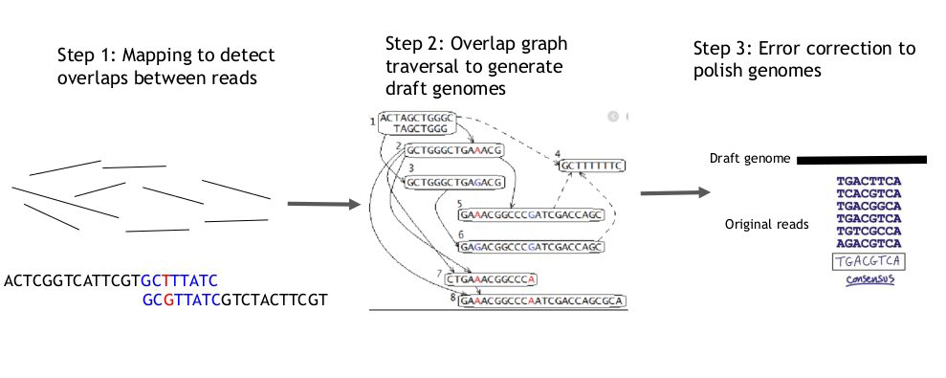
Long read de novo assembly

Slide 4
Assembly of sequences
De Bruijn Graph
Overlap-layout-consensus (OLC)

Slide 5
De Bruijn Graph
• It breaks reads into successive k-mers and the graph maps the k-mers.
• Each k-mer is a node and edges are drawn between each k-mer in a read.
• The k-mer size can only be determined by “trial and error”.
• A small value of K will create a complex graph but a large value of K may miss
small overlaps. A good starting point would be a k-mer size that is 2/3 the size of
the read
• Good for short reads or small genomes. With long reads and/or large genomes,
may require lots of RAM (e.g., ~0.5 TB for human)

Slide 6
Overlap-layout-consensus (OLC)
Each read is graphed as a node and the overlaps are represented as edges joining the two nodes involved.
The algorithm determines the best path through the graph.
This process is carried out multiple times and resulting sequences are combined to give the final consensus sequence that represents the genome.
OLC has a better overall performance and good for long reads.

Slide 7
Assembly of sequences
Hardware technologies like graphics processing units (GPUs) offer much more computational power than CPUs. To produce high quality results in a reasonable time, OLC approach can be used and parallelize its most time demanding steps on GPUs.
To focus our solution on producing high quality results in a reasonable time, we propose to use the OLC approach and parallelize its most time demanding steps on GPUs.

Slide 8
Graphical Processing Unit
GPUs were originally developed for gaming
Typical workload requires arithmetic operations on large amounts of data (objects, pixels, etc.) for rendering and shading.
Designed to be good in matrix operations.

Slide 9
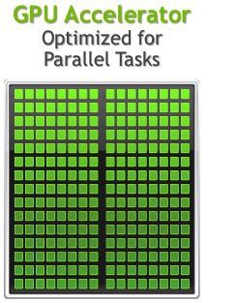
Graphical Processing Unit
GPU Strengths
High bandwidth CPU main memory
Significantly more compute resources
Latency tolerant via parallelism
High throughput
High performance/watt
GPU Weaknesses
Relatively low memory capacity
Low per-thread performance

Slide 10
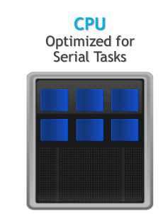
Central Processing Unit
CPU Strengths
Very large main memory
Very fast clock speeds
Latency optimized via large caches
Small number of threads can run very quickly
CPU Weaknesses
• Relatively low memory bandwidth
• Cache misses very costly
• Low performance/watt

Slide 11
Objectives
General objective
To develop an application that parallelize computer intensive step of long-read de novo genome on GPU.
Specific objective
To compare the efficiency of models used in GPU computing.
To compare the application with other long read de novo assemblers.

Slide 12
Justification
Given that the high computational capability of GPUs has not been fully utilized by existing genome assembly tools, it is crucial to develop a new GPU-based assembly framework that uses adequate techniques to scale up to the size of real-world human genomes without requiring large amounts of expensive computing resources.

Slide 13
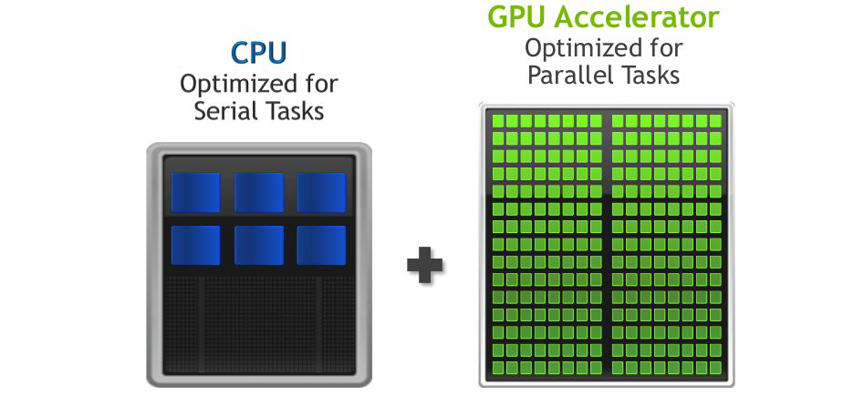
Methodology

Slide 14
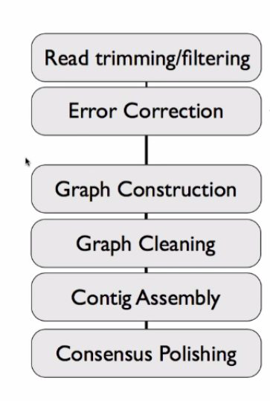
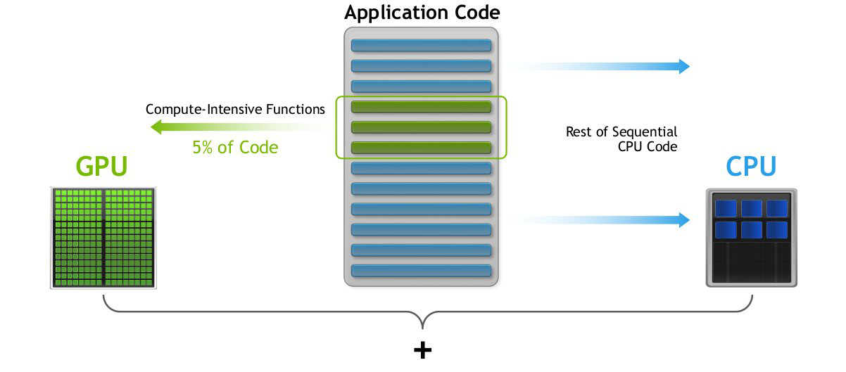
Methodology

Slide 15
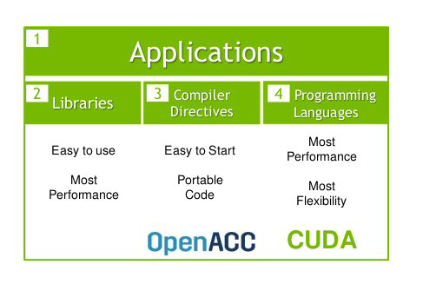
Methodology
OpenACC is easier to program than CUDA
However less efficient, so the program wont run as fast

Slide 16
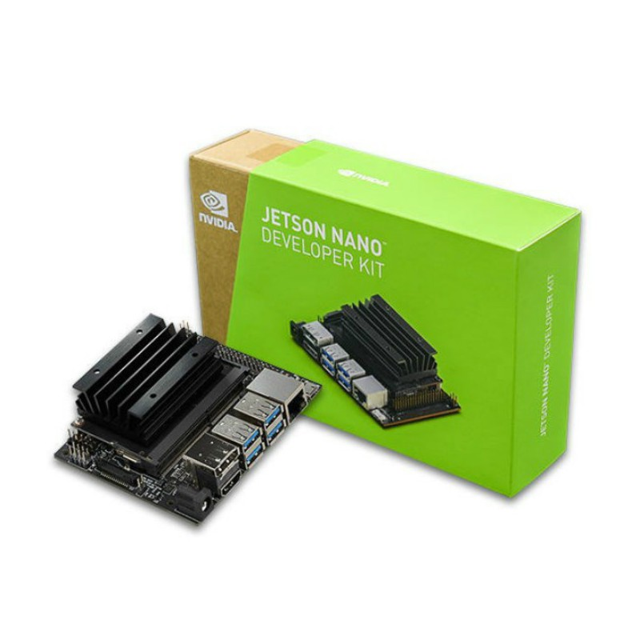
Methodology
GPU -128-core Maxwell
CPU -Quad-core ARM A57 @ 1.43 GHz
Memory -4GB 64-bit LPDDR4 25.6 GB/s

Slide 17
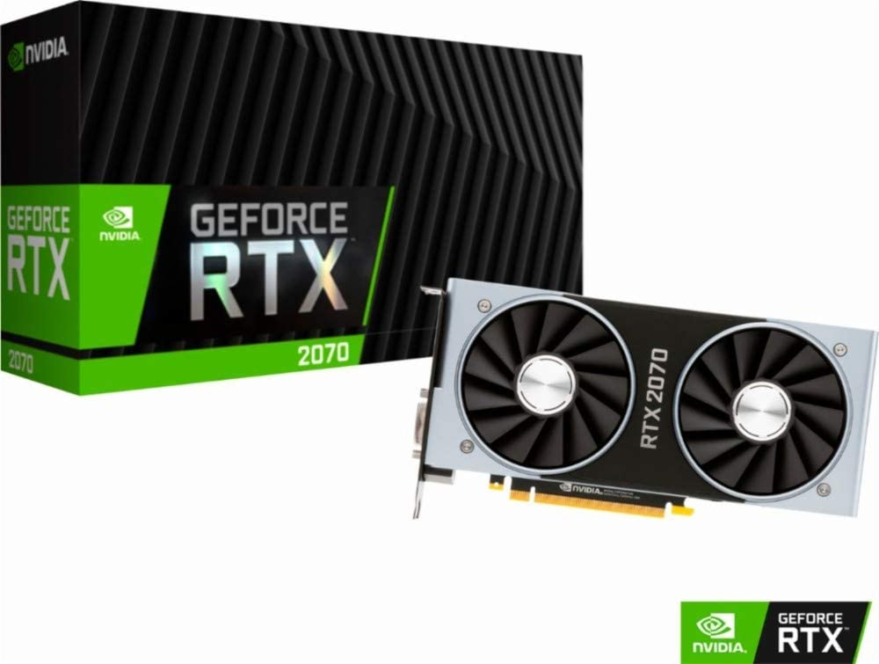
Methodology
NVIDIA CUDA Cores- 2560
Standard Memory- 8GB GDDR6
448 GB/s

Slide 18
Work plan

Slide 19
References
Ahmed N, Qiu TD, Bertels K, Al-Ars Z. GPU acceleration of Darwin read overlapper for de novo assembly of long DNA reads. BMC bioinformatics. 2020 Sep;21(13):1-7.
ClaraGenomicsAnalysis: A CUDA-based Software Development Kit (SDK) for GPU accelerated genome assembly and analysis, whose development is supported by NVIDIA.
https://github.com/clara-genomics/ClaraGenomicsAnalysis

Slide 20




Acknowlegment
Supervisor
Dr Jean-Baka

