Slide 1
Parallelizing long-read de novo genome assembly on mixed
architectures (CPU/GPU) with OpenACC and CUDA
Peter Muchina
Notes:
abcdeeff

Slide 2
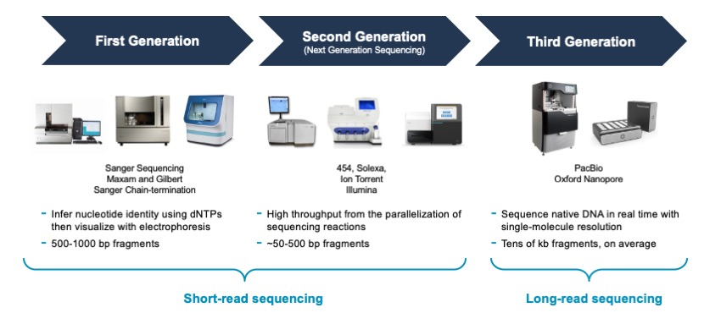
Introduction
We have witnessed a dynamic evolution in NGS in the last decade.
However, its still a computational challenge to do de novo assembly.
source: Pacbio
Notes:
Sequencing can now be done in lesser time and cost much lesser than its precursor- Sanger sequencing.
reconstruct the target sequence using only the information from the reads or pairs of reads sequencing protocol
When doing de novo assembly, we make an assumption that the reads cover the examined part of the genome and are overlapping each other. By utilizing the information from the overlaps, the method can approximately reconstruct the genome sequence.

Slide 3
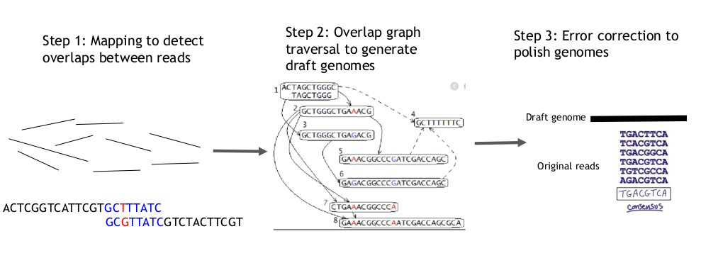
Long read de novo assembly
source: NVIDIA

Slide 4
Genome Assembly Algorithms
De Bruijn Graph
Overlap-layout-consensus (OLC)

Slide 5
De Bruijn Graph
• It breaks reads into successive k-mers and the graph maps the k-mers.
• The k-mer size can only be determined by “trial and error”.
• Good for short reads or small genomes. Long reads, may require lots of RAM (e.g., ~0.5 TB for human)
Notes:
Each k-mer is a node and edges are drawn between each k-mer in a read.
A small value of K will create a complex graph but a large value of K may miss
small overlaps. A good starting point would be a k-mer size that is 2/3 the size of
the read

Slide 6
Overlap-layout-consensus (OLC)
Each read is graphed as a node and the overlaps are represented as edges joining the two nodes involved.
The algorithm determines the best path through the graph.
OLC has a better overall performance and good for long reads.
Notes:
This process is carried out multiple times and resulting sequences are combined to give the final consensus sequence that represents the genome.

Slide 7
Our Focus
Hardware technologies like graphics processing units (GPUs) offer much more computational power than CPUs.
To focus our solution on producing high quality results in a reasonable time, we propose to use the OLC approach and parallelize its most time demanding steps on GPUs.
Notes:
To produce high quality results in a reasonable time, OLC approach can be used and parallelize its most time demanding steps on GPUs.

Slide 8
Graphical Processing Unit
GPUs were originally developed for gaming.
Typical workload requires arithmetic operations on large amounts of data (objects, pixels, etc.) for rendering and shading.
Designed to be good in matrix operations.

Slide 9
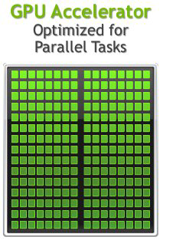
Graphical Processing Unit
GPU Strengths
High bandwidth main memory
Significantly more compute resources
Latency tolerant via parallelism
High throughput
High performance/watt
GPU Weaknesses
Relatively low memory capacity
Low per-thread performance
source: NVIDIA
Notes:
Memory bandwidth is the rate at which data can be read from or stored into a semiconductor memory by a processor.
expressed in units of bytes/second
is the time (the latency) between initiating a request for a byte or word in memory until it is retrieved by a processor.

Slide 10
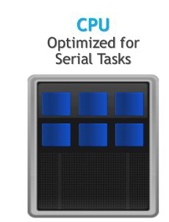
Central Processing Unit
CPU Strengths
Very large main memory
Very fast clock speeds
Latency optimized via large caches
CPU Weaknesses
• Relatively low memory bandwidth
• Cache misses very costly
• Low performance/watt
source: NVIDIA

Slide 11
Problem statement /Justification
Given that the high computational capability of GPUs has not been fully utilized by existing genome assembly tools, it is crucial to develop a new GPU-based assembly framework that uses adequate techniques to scale up to the size of real-world genomes without requiring large amounts of expensive computing resources.

Slide 12
Objectives
General objective
To develop an application that parallelizes computer intensive step of long-read de novo genome assembly on GPU.
Specific objective
To use openACC and CUDA GPU computing models to write the application.
To compare the efficiency of openACC and CUDA models.
To compare the application with other long read de novo assemblers.

Slide 13
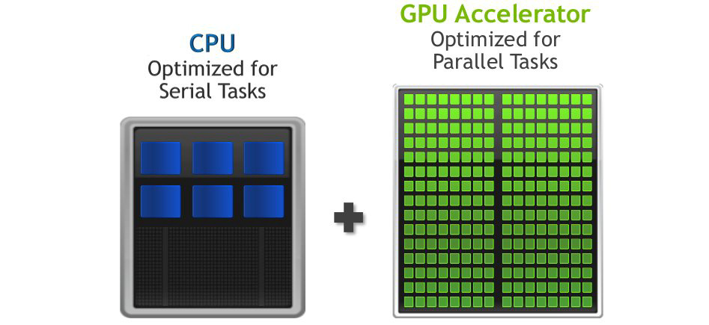
Methodology
source: NVIDIA

Slide 14
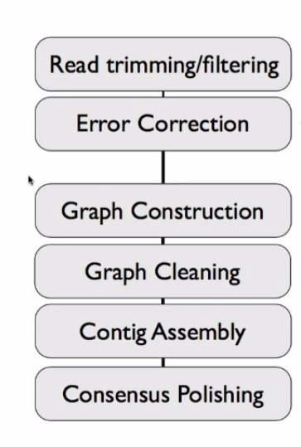
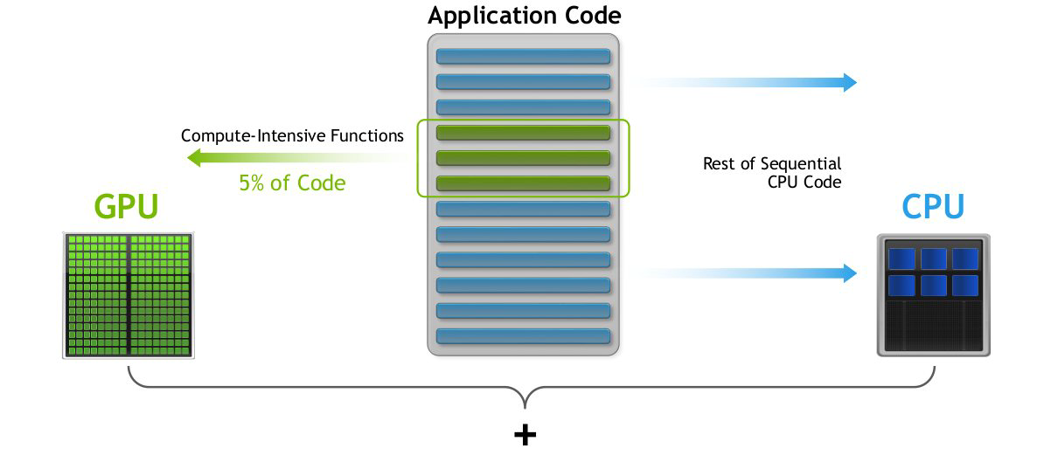
Methodology
source: NVIDIA

Slide 15
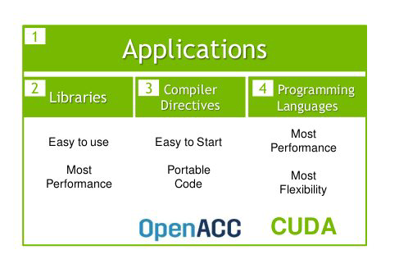
Methodology
OpenACC is easier to program than CUDA
However less efficient, so the program wont run as fast
source: NVIDIA

Slide 16
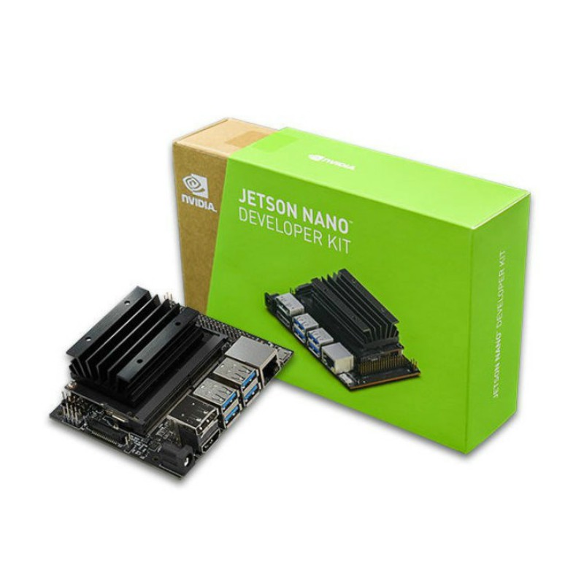
Methodology
GPU -128-core Maxwell
CPU -Quad-core ARM A57 @ 1.43 GHz
Memory -4GB 64-bit LPDDR4 25.6 GB/s
source: NVIDIA

Slide 17
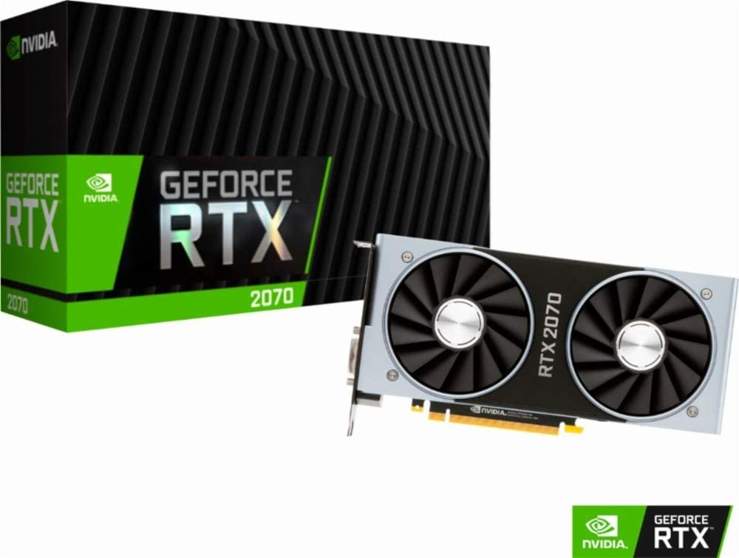
Methodology
2304 CUDA cores in the RTX2070
Standard Memory- 8GB GDDR6 448 GB/s
source: NVIDIA

Slide 18
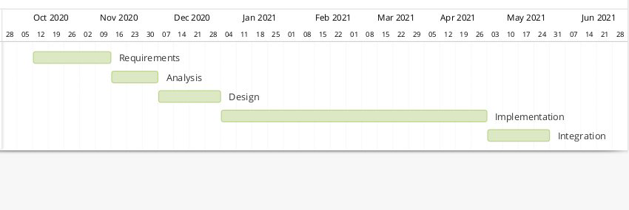
Work plan

Slide 19
References
Ahmed N, Qiu TD, Bertels K, Al-Ars Z. GPU acceleration of Darwin read overlapper for de novo assembly of long DNA reads. BMC bioinformatics. 2020 Sep;21(13):1-7.
ClaraGenomicsAnalysis: A CUDA-based Software Development Kit (SDK) for GPU accelerated genome assembly and analysis, whose development is supported by NVIDIA. https://github.com/clara-genomics/ClaraGenomicsAnalysis

Slide 20




Acknowlegment
Supervisor
Dr Jean-Baka

