Slide 1
GRASShopPER —An algorithm for de novo assembly based on GPU alignments

Slide 2
Introduction
We have witnessed a dynamic evolution in NGS in the last decade. Sequencing can now be done in lesser time and cost much lesser than its precursor- Sanger sequencing.
However, its still a computational challenge to reconstruct the target sequence using only the information from the reads or pairs of reads (paired-end/mate-pair) sequencing protocol (de novo assembly) .
When doing de novo assembly, we make an assumption that the reads cover the examined part of the genome and are overlapping each other. By utilizing the information from the overlaps, the method can approximately reconstruct the genome sequence.
Due to technological limitations, reads may fail to cover the whole target sequence. This results to independent sequences called contigs. Another major challenge is the repetitious fragments in the genome.

Slide 3
Introduction
Graph construction strategies include the de Bruijn graph approach (DBG) and the overlap-layout-consensus strategy (OLC). In DBG the occurrence of sequencing errors is inevitable, and the reconstruction problem becomes computationally harder. Only time- and memory efficient heuristic algorithms are capable of dealing with large input data sets within a reasonable time.
OLC deals with the sequencing errors by allowing overlaps between pairs of reads. This approach has an advantage over the DBG strategy in the context of quality, as DBG approach partly loses the information about read continuity after the decomposition to l-mers.
However, the quality improvement of OLC comes at the cost of memory consumption. OLC graphs need to store the information about overlaps, which is not necessary in DBG where l-mers themselves imply subsequent l-mers.

Slide 4
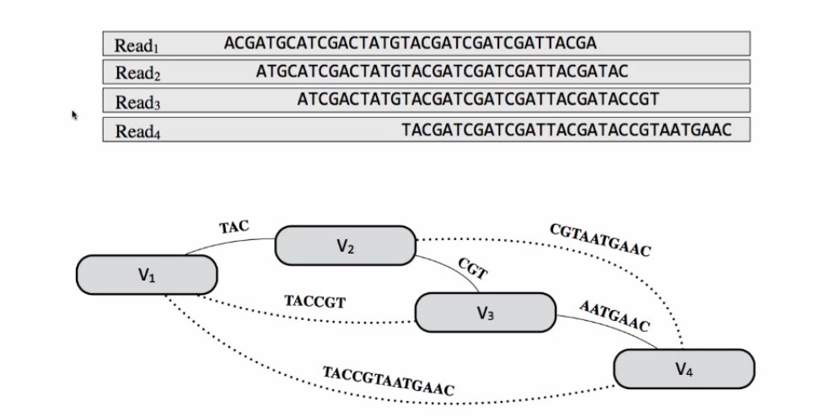
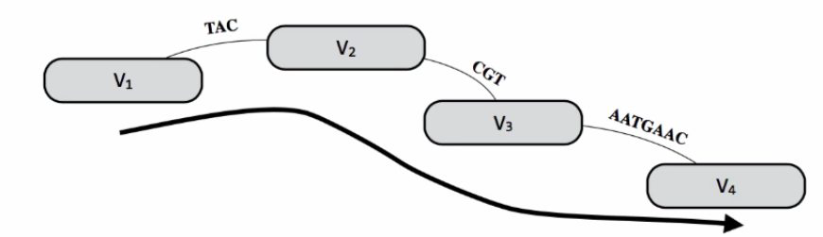

Slide 5
Introduction
Hardware technologies like graphics processing units (GPUs) offer much more computational power than CPUs. To produce high quality results in a reasonable time, OLC approach can be used and parallelize its most time demanding steps on GPUs.
A high performance module for overlap graph creation using graphics cards and a novel method for forks detection in the graph are the main features that differentiate GRASShopPER from other assemblers.

Slide 6
Algorithim Overview
GRASShopPER is composed of three main stages. First, an overlap graph is constructed from all high quality input reads including their reverse complementary counter-parts (they constitute vertices of the graph) .
Promising pairs (those pairs of reads that are likely to overlap) are calculated using a heuristic algorithim. Selection is based on the similarity of characteristics of corresponding k-mers. To confirm whether the promising pairs actually overlap, an exact algorithm for sequence alignment running on GPUs is executed.
Later, in the overlap graph, arcs are created only for those pairs of reads having the number of misaligned residues on the overlapping section below an adjustable threshold. The graph is expanded by several improvements toward finding further promising pairs.

Slide 7
Algorithim overview
The algorithm continues with a traversal method in order to find paths on the constructed graph. The algorithm detects forks along its way, and unambiguous paths are translated into contigs.
In the next step, the reads are mapped to contigs to find yet undetected forks by utilizing information from a wider context. This step allows reducing the misassembly rate and at the same time only slightly decreases the NG50 measure. At the end, the contigs are prepared for the scaffolding methods, which expect non-overlapping contigs.

Slide 8
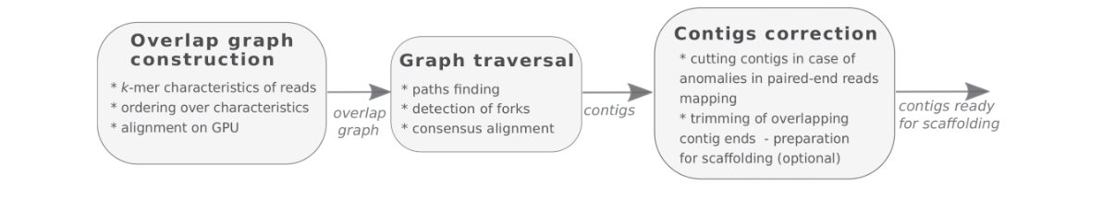
GRASShopPER assembler

Slide 9
Data sets for tests
GRASShopPER assembler was compared to other assemblers and to achieve unbiased comparison, tests were done on three data sets differing in read length, coverage depth, and genome repetitiveness.
These included: actinobacteria Candidatus Microthrix parvicella, nematode Caenorhabditis elegans strain N2, human chromosome 14.
All the data sets contain paired-end read libraries of small insert size. The data were preprocessed before the assembly process. Illumina specific adapters were clipped. Reads containing ‘N’ or not mapping to the reference genome were removed from the libraries.

Slide 10
Evaluation Metrics
The assemblies of the data sets were evaluated with the golden standard tool QUAST. QUAST comes with a set of well-established metrics for the assembly problem.
Important metrics are genome fraction, duplication ratio, NG50 and NGA50 metrics.

Slide 11
Test Environment
Poznan Supercomputing and Networking Center on a cluster named moss. Moss provides 6 highly specialized nodes for heterogeneous computing, each equipped with two general purpose graphics processing units (GPGPUs), between 256 and 512 GB RAM, and two CPUs.
Whenever possible, all the methods were run on one node with 16 cores.

Slide 12
Conclusion
From QUAST metrics, it was observed that GRASShopPER produced contigs that covered the largest part of the genomes (metric ‘genome fraction’) and usually had a few percent more coverage than other methods.
The largest difference was in chromosome 14, which had the lowest depth of coverage. Platanus obtained even 20% less of the genome fraction coverage than GRASShopPER.
GRASShopPER, SOAPdenovo2, and SGA, behave reasonably well for all considered statistics and for all tested data sets, providing high quality and long contigs that covered the largest part of the considered genomes.
Scaffolding used an external tool and in this GRASShopPER gave better results with the SOAPdenovo2 scaffolder. For the other data sets, with less depth of coverage, GRASShopPER worked best with SSPACE scaffolder

Slide 13
Conclusion
Although GRASShopPER is not the most efficient among the tested assemblers with respect to memory and time usage, it represents the overlap-layout-consensus strategy, which is considered to be more accurate.
It is especially noticeable in the graph construction step, where the method needs to remember reads on vertices and calculate the alignment of the pairs of reads to decide to what extent the reads overlap one another.
GRASShopPER does not lose the information about reads continuity caused by the decomposition into shorter k-mers, as entire reads are stored in the graph vertices.
OLC strategy is the future of the assembly of long read data sets produced by third generation sequencers.

