Slide 1
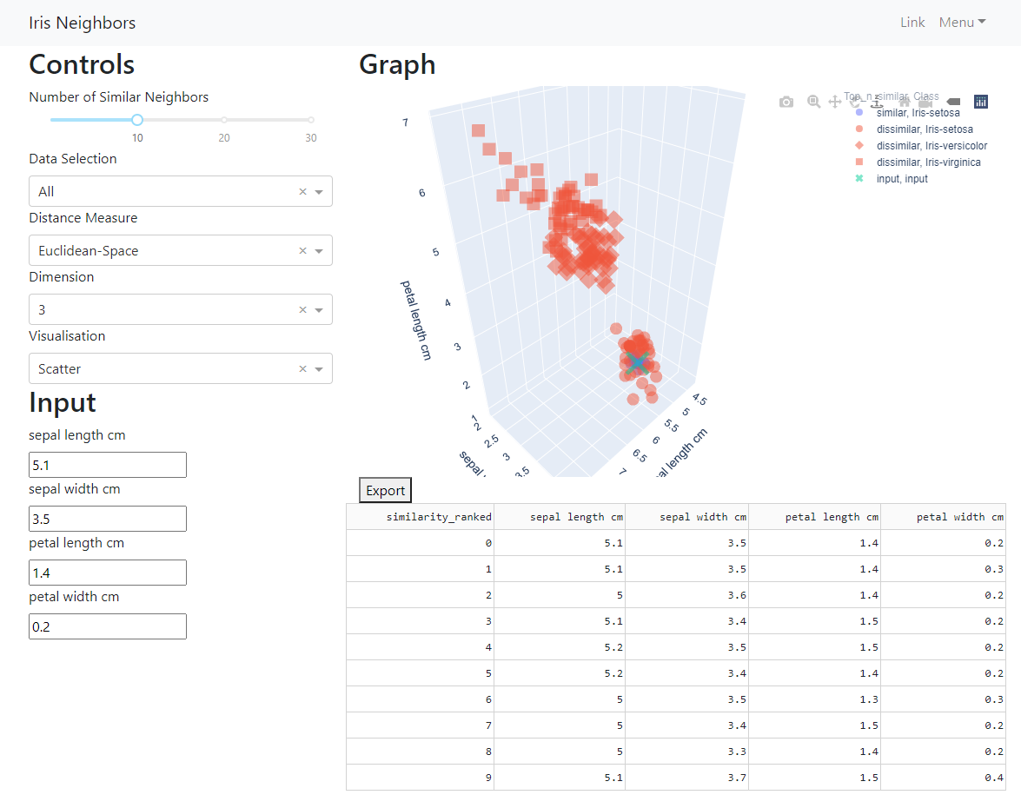
Data Science Test 1 - Iris neighbours
The Web app is deployed on and lived at GCP Cloud Run.
Local/deployment: GitHub or Docs/instruction.docs.

Slide 2
Controls on distance and visuals
GitHub link
Visualisation
Input for iris flower measurement
Retrieved records of most similar flowers

Slide 3
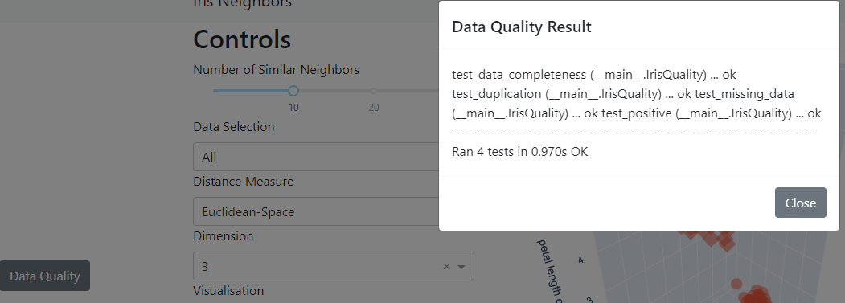
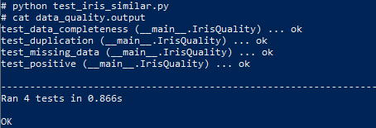
Data Quality check
The script will pull the data from the listed data source and examine if the characters are consistent with the records.
Extraction completeness
Check on the numbers of records and attributes.
Missing data/values check
Check for missing/empty records from the data source
Duplication check
Check for the number of duplicates (identical records of iris flower) within the data source.
Columns/check for negative values.
Check that all the recorded width and length are positive.
Web App
Trigger the Unit test manually (in dockerise environment)
The data quality check (unittest) are run on docker build with the results piped into data_quality.output

Slide 4
Data Pipeline (Approaches) The constructed options for Data Selection > Distance Measure > Output
Options
The default pipeline to identify similar flowers to input are:
(Data selection) Selecting the full iris data
(Distance Measure) Identifying flowers that are most similar to the new input iris in Euclidean space.
(Output) Depict the similar flowers in charts as well as the data in a table.
1. Data Selection
Sub Iris species
Full Iris
To select for relevant flowers species/all flowers
Versicolor, Sentosa, virginica
2. Distance Measure
Euclidean Distance
Standard Scalar
To calculate and identify the most similar flowers to the input
PCA Distance
3. Output
Parallel plots
Top N similar Table
To visualize the result
Scatter charts
Radviz

Slide 5
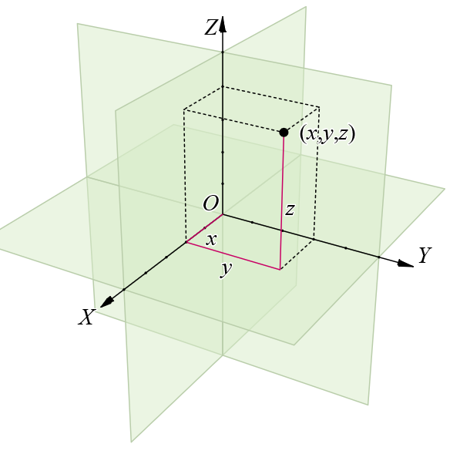
Findings 1 (Distance)
To identify similarity, we first need to construct a Mathematical quantity to identify the top 10 most similar iris flower to the input.
Implemented Metrics:
Distance between data points in Euclidean space Where all the iris features are considered with equal weighting.
Easier for interpretation
Distance between data points in PCA space Where all the iris flower features are the first standard scaled and phased into PCA space, from which the similarity is determined. Metrics/data situated in the abstract space of PCA coordinates

Slide 6
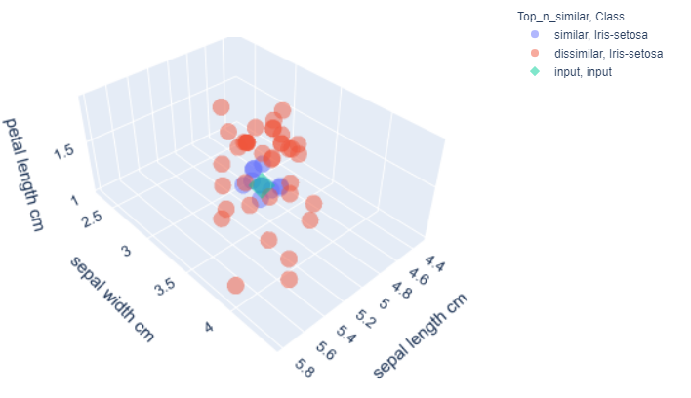
Findings 2 (Visual)
Visualising the result
Implemented Methods
Scatter Restricted to 2D, 3D features charts for similarity, plotting of all data points.
Parallel Able to depict a higher number of features for iris flowers at a glance
Radviz Able to depict a higher number of features for iris flowers at a glance
Due to the high correlation between iris flower’s petal length and petal width (see Appendix), we are able to illustrate the Euclidean distance chart on a 3D scatter plot without losing many details from data.

Slide 7
Expending iris solution
More dynamic options for Parallel/Radviz The dimension of visualization is kept in 2D/3D to ensure that Scatter plot charts work. On the other hand, Parallel coordinates/Radviz charts can visualize all the attributes in a single graph.
Python script/API deployment The tool in question isn’t well defined. It could have been something simple, such as a simple python script or perhaps a rest API deployment. For better ease of use, I decided to proceed with a simple web app.
Including more detail/information in the Web App More details/information can be included in the web app to enhance the ease of use/understanding of the charts within the app.

Slide 8
Resources & Link
GitHub Repo (where all the scripts for the web app, python, Dockerfile, Slides, Docs, and even instructions can be found)
Google Colab (used in the development of python scripts)
Deployed Web App (the web is deployed through via docker on GCP cloud run)

Slide 9
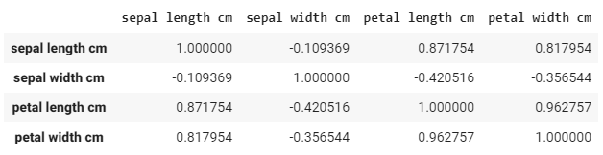
Appendix : Correlation
For 3d scatter plot (with Euclidean space), Due to the high correlation (>0.96) between petal length cm and petal width cm. I choose to illustrate only sepal length cm, septal width cm, and petal length cm.

