Slide 1
ComfortDelgro Zig Data Assignment
Develop a model to predict user churn
Identify insights and factors influencing churn and suggest possible initiatives or interventions to counter it.

Slide 2
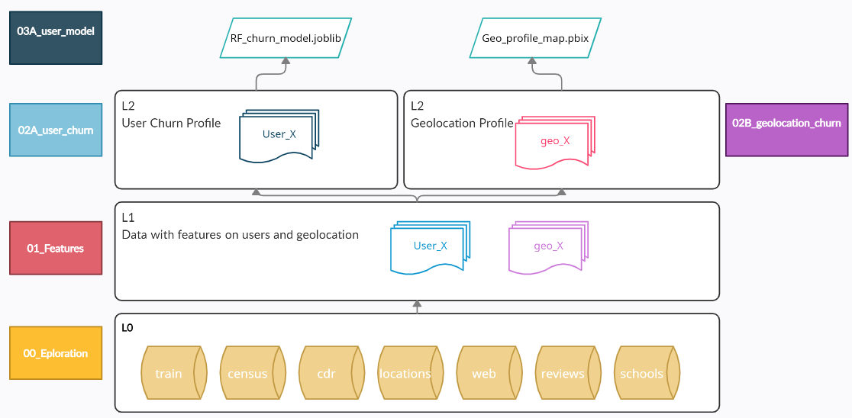
Pipeline & Notebooks Data flow
items | Description and Usage
00_exploration | Notebooks used for exploration on the raw data
01_features | Notebook for generating features on the respective raw data
02A_user_profile | Combining user profile data + modeling
02B_geolocation_profile | Combining geo profile data
03A_user_profile_model | Model for churn prediction

Slide 3


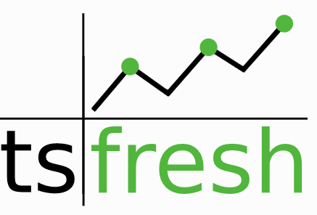
Features Generation of features via 01_features.ipynb
Nonstandard Libraries
School
Geo – school type and number per area
Train
Users – time features on contract, categories encoding
Geo – user data aggregated to planning area
Location
Users - visit sparse matrix
Geo – visits per planning area
Census
Geo – planning’s area income, pop, gini coef
Review (Time Series)
User reviews Sentimental over time Features
CDR (Times Series)
Web (Times Series)
User Voice Call Features
User Website Visits Features
User Data Usage Features
Used to construct Kdtree to assign the latitude, longitude data into nearest neighbor (planning area)
Sentimental Analysis on the user's reviews, which are then subsequently convert to scores and trends.
Automatically calculates a large number of time series characteristics and subsequently characteristic filtering base on target.

Slide 4
Features Select & Model Models via 02A_user_profile
Process
RF Model
Feature importance (nb splits)
Tuned RF Model
Permutation importance (Accuracy)
Interpretation
PDP (Partial Dependence plot)
Shap
Surrogate
Tree based models – random forest.
provide feature importance > permutation importance
can deal with correlated data
outliers resistant
class weight can be used for class imbalance
easy to setup
does not need additional scaling on features

Slide 5
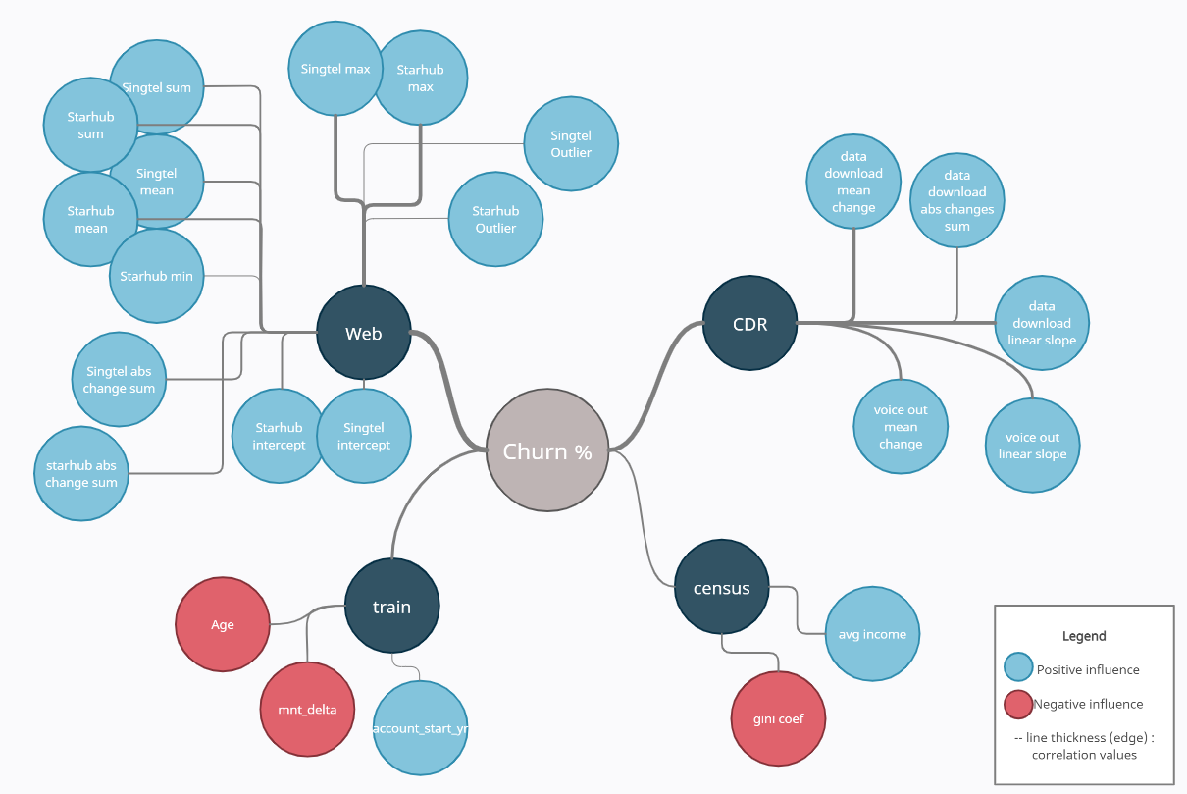
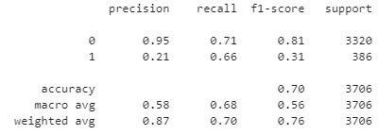
Model : RF model Visualization via 02A_user_profile
Metrics
Balanced accuracy (train) – 69.4%
Balanced accuracy (test) – 68.2%
Classification report
Features on user's profile
Grouped Metrics based on sources

Slide 6
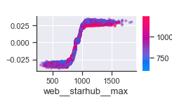
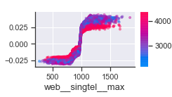
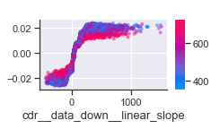
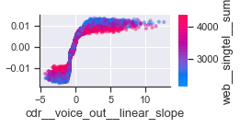
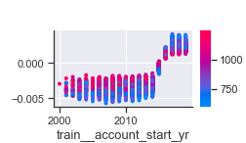
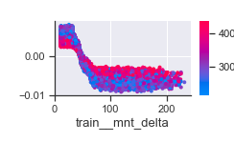
Model : Interpretations Shap & PDP - insights and factors influencing churn
Interventions
Where y axis is Shapley value (avg of marginal contributions across permutations) , x axis are the respective features values.
Likely users who are more value conscious
Increasing/heavy Data/Voice users
New customers who just signed up are more likely to churn (should also subject to contract)
Proactively offer them value packages.
Offer upgrade/ customized package (esp for users closing on their quota)
Offer better perks/incentives for 2 years contract/packaged (fibre).
Website
CDR
Train
Only snippets of the charts were taken (2 features per factor), I also removed the label for interaction term to keep the charts clean.

Slide 7
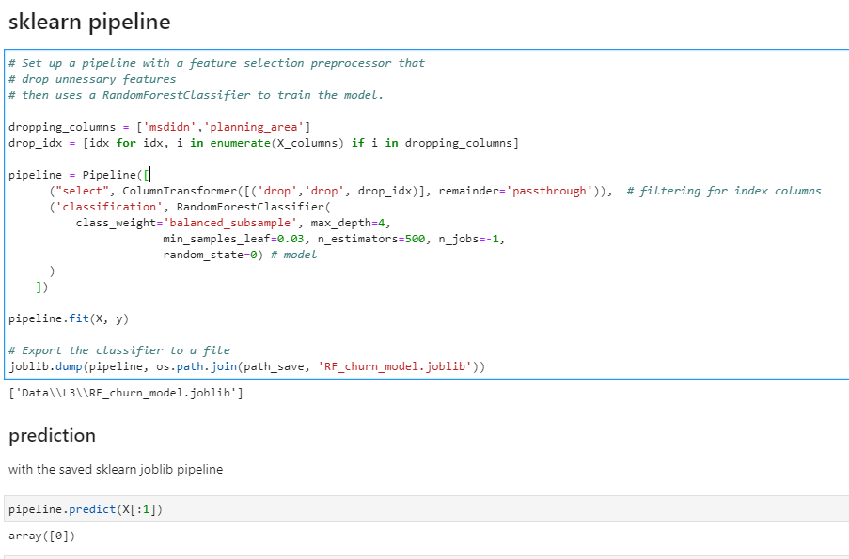
Model : Packaged – Codes within 03A_user_model
Sklearn pipeline
Model pre-processing (features selections, scaling, OHE, impute)
Prediction
Fitted and Exported to a artifact (joblib) for prediction.

Slide 8
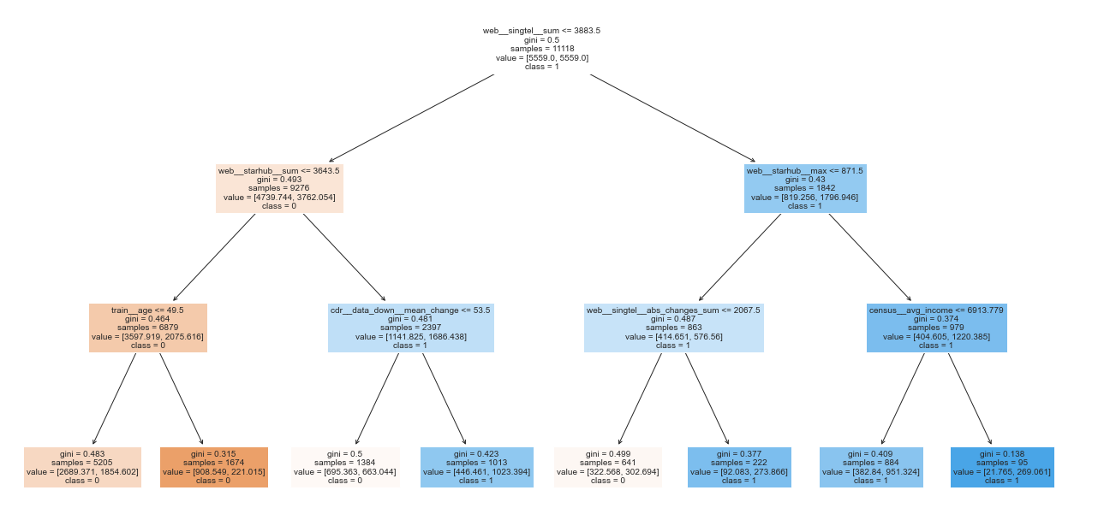
Surrogate Model: Decision Tree (simplified rules) - 02A_user_profile
Metrics
Balanced accuracy (train) – 64.2%
Balanced accuracy (test) – 60.3%

Slide 9
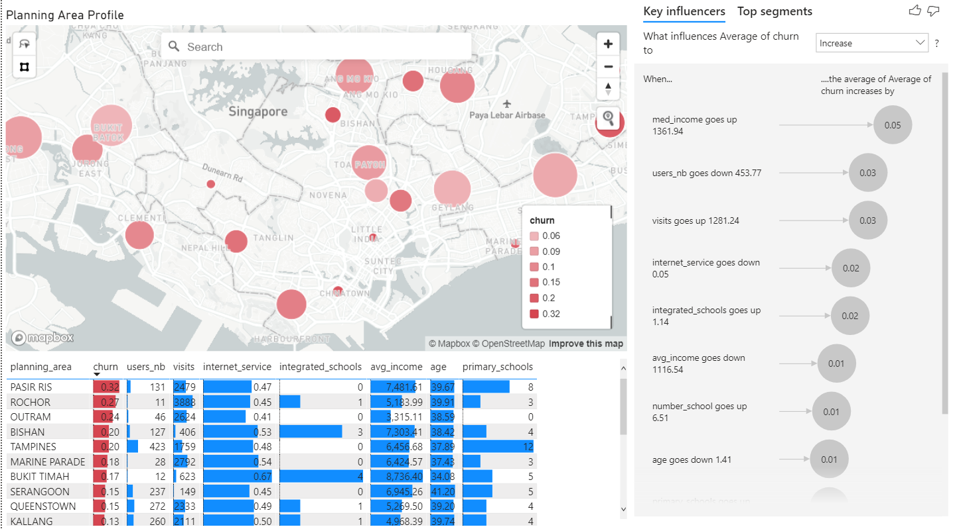
Geolocation profile PowerBI - too few points for models, will need finer granularity

