Slide 1
Final Project
Minghao Guo

Slide 2
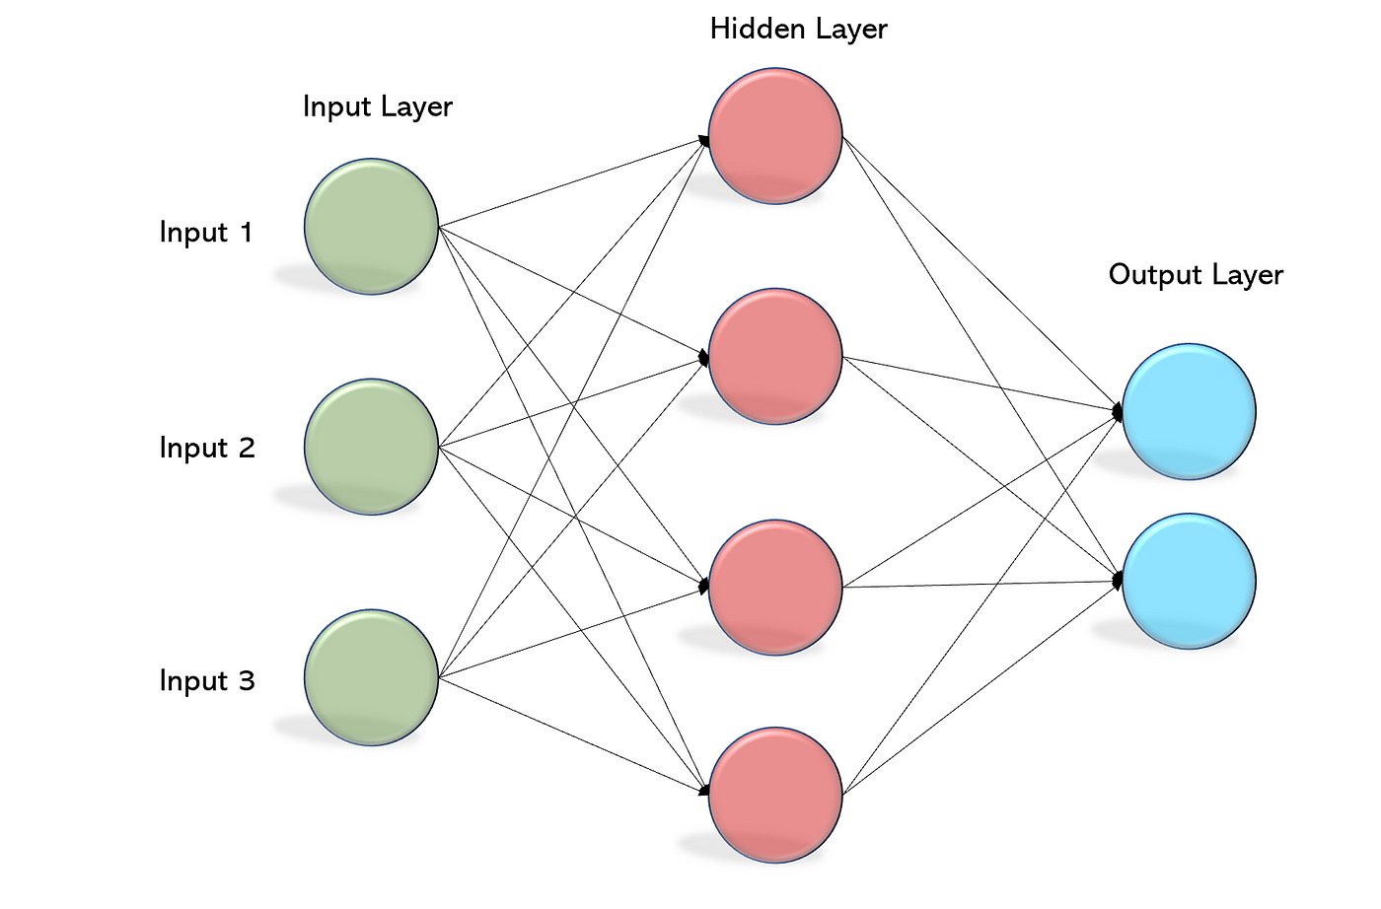
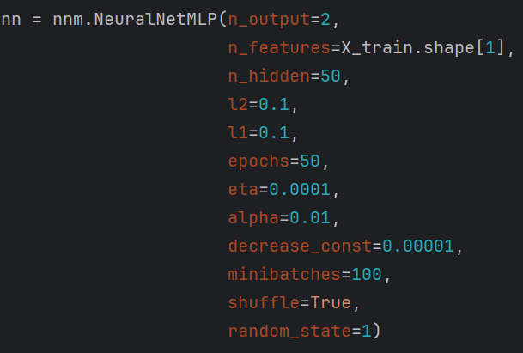
Multi-Layer Perception Neural Network
MLP model for binary classification
Architecture of the MLP model:
1. Input layer: number of neurons same as number of features
2. Hidden layer has 50 number of neurons
3. Output layer 2 neurons, one for each class
Regularization: l1, l2 = 0.1
Number of minibatches 100
Epochs 50
Learning rate: eta = 0.001, decrease by 0.00001

Slide 3
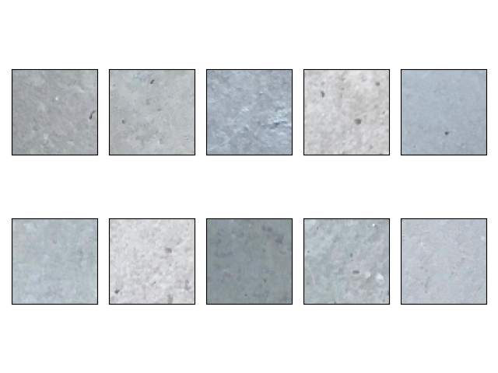
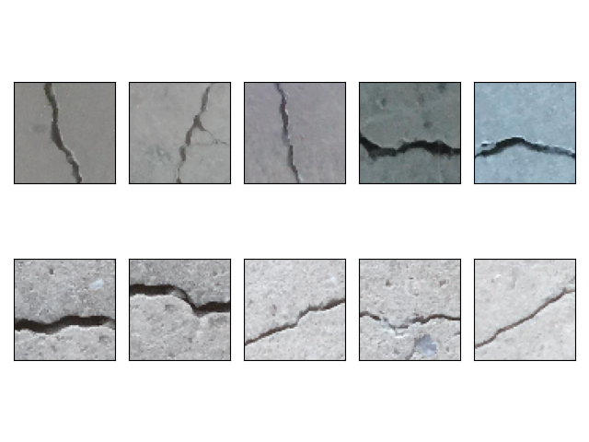
Multi-Layer Perception Neural Network
10 different images of crack and no-crack

Slide 4
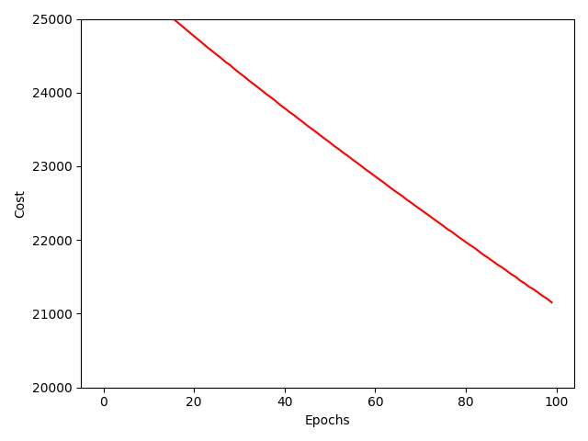
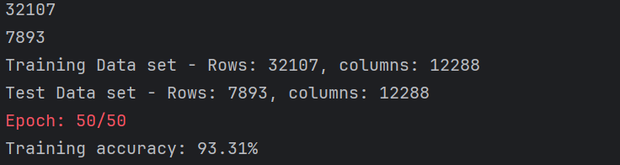
Multi-Layer Perception Neural Network
Plots the training cost over epochs to visualize the training progress
Accuracy: 93.31%

Slide 5
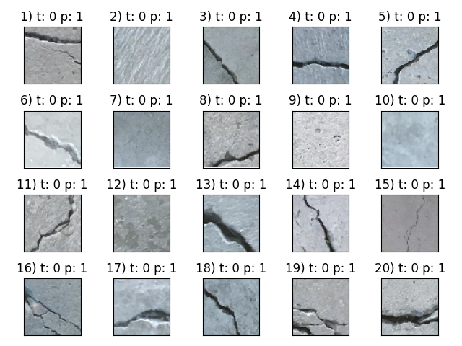
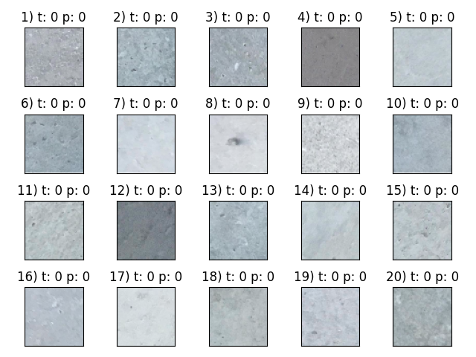
Multi-Layer Perception Neural Network
images of misclassified and correctly classified samples

Slide 6
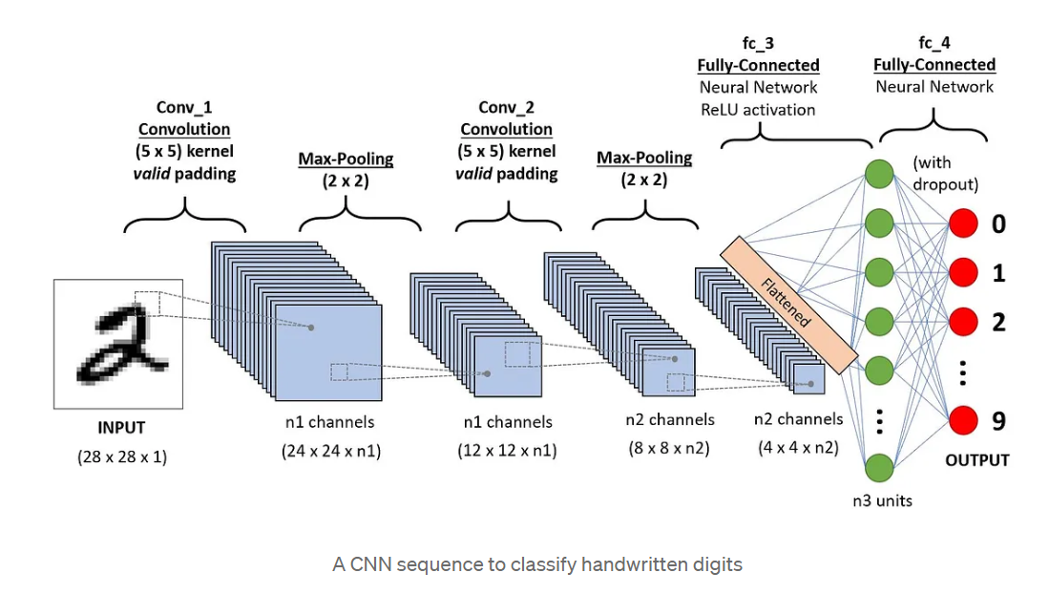
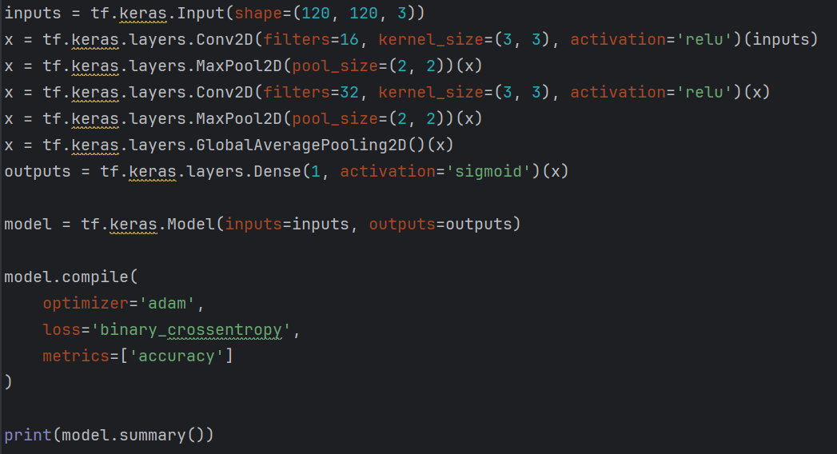
Convolutional Neural Network
Simple CNN model using Tensorflow and Keras
Architecture of the CNN model:
1. Input layer with a shape of (120, 120, 3) for images of size 120x120 pixels with 3 color channels.
2. Two convolutional layers with max-pooling layers.
3. A global average pooling layer to reduce spatial dimensions.
4. A dense output layer with a sigmoid activation function for binary classification.

Slide 7
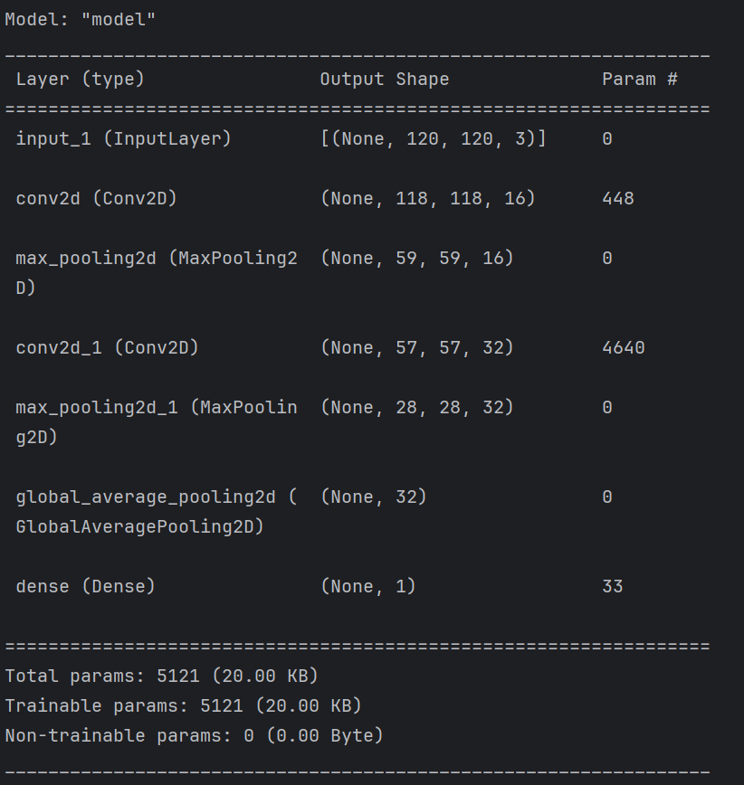
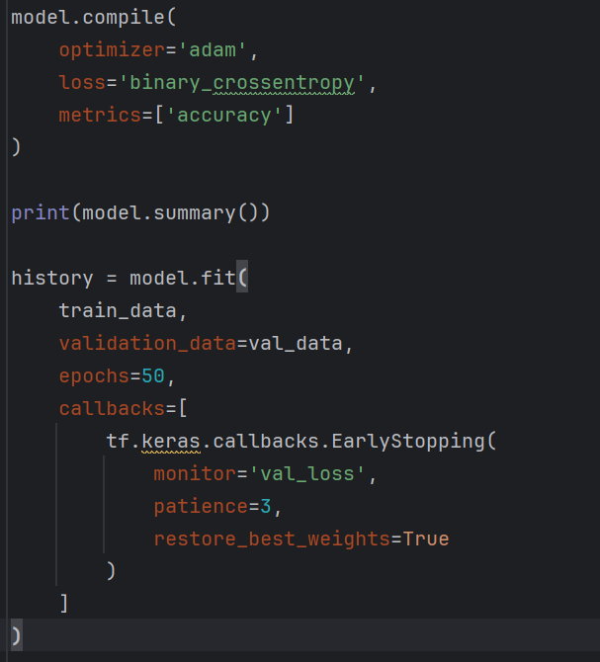
Convolutional Neural Network
Compile the model with binary cross-entropy loss and accuracy as the evaluation metric
Train the model using the fit method

Slide 8
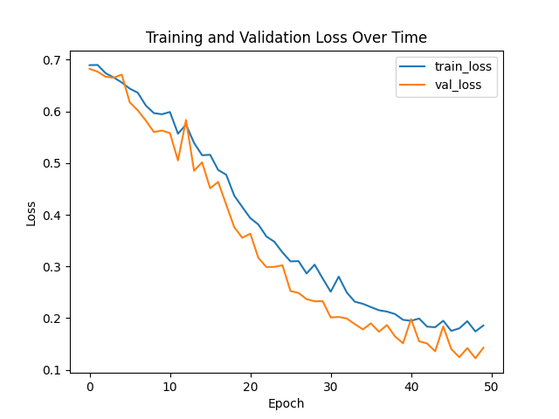
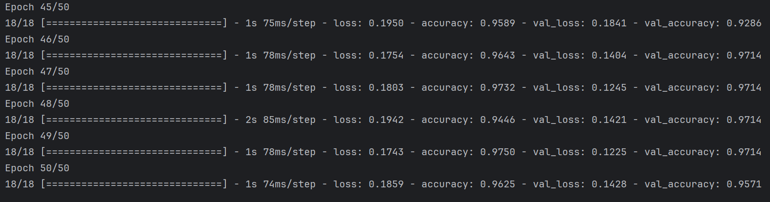
Convolutional Neural Network
Accuracy: 0.975
after 49 epochs

Slide 9
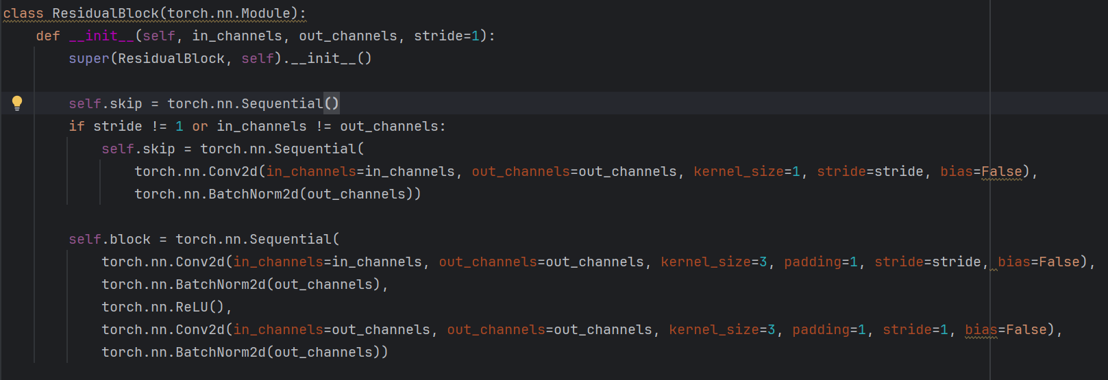
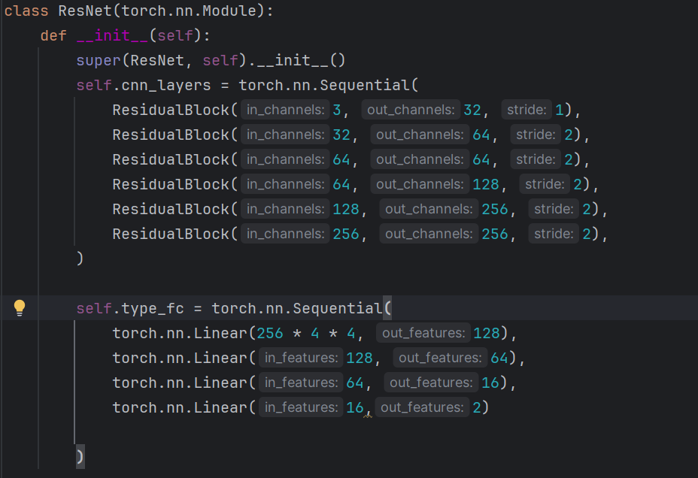
ResNet
Resnet model using PyTorch
Architecture of the Resnet model:
1. Series of convolution layers that consists of 6 ResidualBlock layers
2. Each ResidualBlock layer consists of two convolution layers, batch normalization layer and ReLU activation function
3. Followed by fully-connected layer for classification
4. Final fully-connected layer has 2 outputs for classification problem

Slide 10
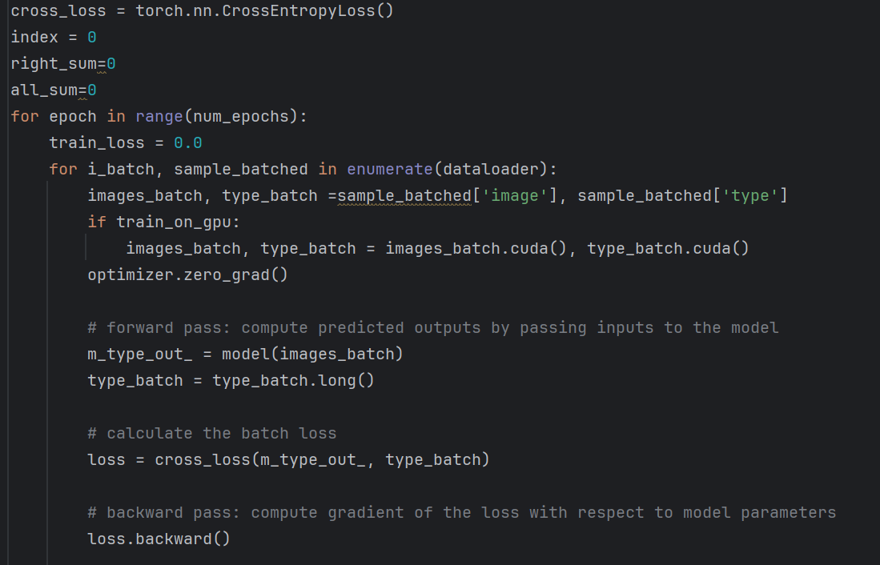
ResNet
Number of epochs: 15
Learning rate: 0.0001
Enter the training loop:
1. Iterate through the batches
2. Perform forward pass to get prediction
3. Calculate the batch loss using cross entropy loss
4. Perform a backward pass to compute gradients and update model parameters
5. Calculate accuracy

Slide 11
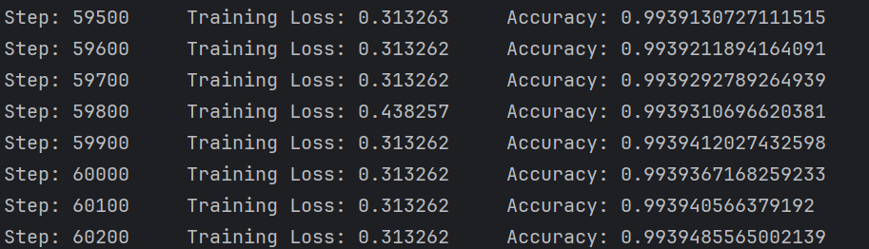
ResNet
Accuracy: 0.993

Slide 12
Comparison of the Models
MLP | CNN | ResNet
MLP is a basic feedforward neural network composed of multiple layers, including input, hidden, and output layers. | CNN is designed specifically for image-related tasks and excels at capturing spatial hierarchies and patterns in images. | ResNet is a specific type of CNN architecture designed to address the vanishing gradient problem during training very deep neural networks.
It is a fully connected network, meaning each neuron in one layer is connected to every neuron in the subsequent layer. | It consists of convolutional layers, pooling layers, and fully connected layers. | It introduces skip connections or residual blocks, where the output of one layer is added to the output of an earlier layer, allowing gradients to flow more effectively during backpropagation.
MLPs are suitable for tasks where the input data is represented as a flat vector (e.g., tabular data, text data) rather than structured data like images. | Convolutional layers use filters (kernels) to convolve over the input image, extracting features through convolution operations. | ResNet architectures can be exceptionally deep, with hundreds of layers, and still be trainable without vanishing gradient issues.
They lack the ability to capture spatial information present in images directly, making them less effective for image classification tasks. | Pooling layers reduce the spatial dimensions of the feature maps, helping to decrease computational complexity and prevent overfitting. | They have achieved state-of-the-art performance in various computer vision tasks, including image classification, object detection, and image segmentation.
Model | Accuracy
MLP | 0.933
CNN | 0.975
ResNet | 0.993

