Slide 1


ANZ Chengdu Data Science Competition
Team name：没事有我在
Pleader ：Gao Minghe

Slide 2
Team introduction and Member work
Sun Guangyu
（North China Electric Power University）
1
Data preprocessing, Feature construction and filtering, GBDT + LR model training and tuning parameters
Gao Minghe
（North China Electric Power University）
2
Data visualization analysis, Missing value handling, Data encoding, Neural network training, nn+xgboost model
Ma Qunfei
（North China Electric Power University）
3
GBDT model, lightGBM model and Xgboost model training and tuning parameters, Model integration

Slide 3
CONTENTS
01
04
Competition description
Feature selection
02
05
Model training and Evaluation
Data exploratory analysis
03
06
Data preprocessing and Feature engineering
Conclusion

Slide 4
01
Competition description

Slide 5

1.Competition description
the data provided is related to direct marketing campaigns of a banking institution,
the purpose is through data analyse and efficient model to predict whether the client will subscribe to a term deposit.

Slide 6
02
Data exploratory analysis

Slide 7
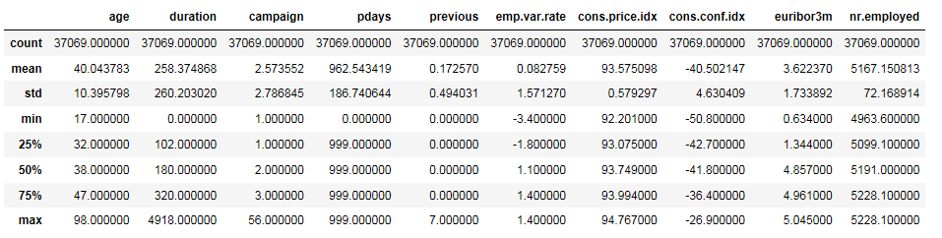
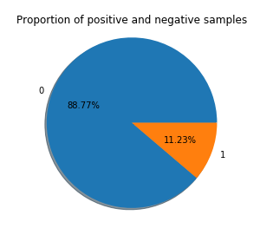
2.Data exploratory analysis
2.1 .Dataset information
The dataset include 10 numeric features and 10 category features,the follows are statistics about the dataset.
and the ratio of positive and negative samples is 1:8.

Slide 8
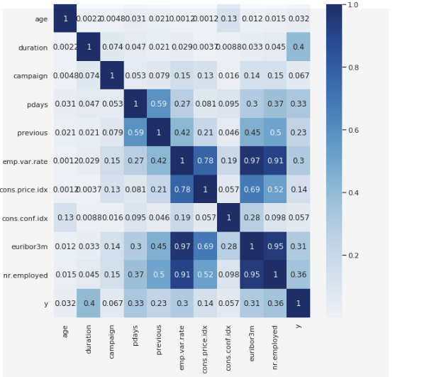
2.Data exploratory analysis
2.2 Characteristic analysis
Through the correlation analysis,found that features emp.var.rate, euribor3m and nr.employed and cons.prices.idx have a strong positive correlation.
It means that the employment variation rate will affect consumption-related indicators and employment.

Slide 9
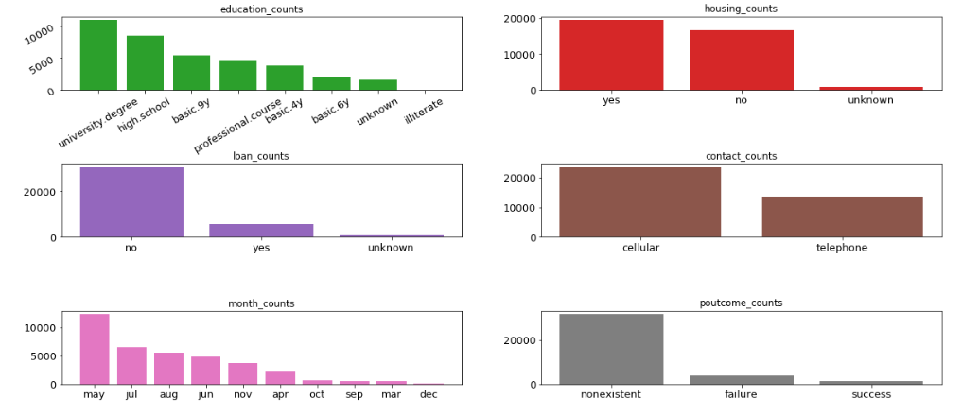
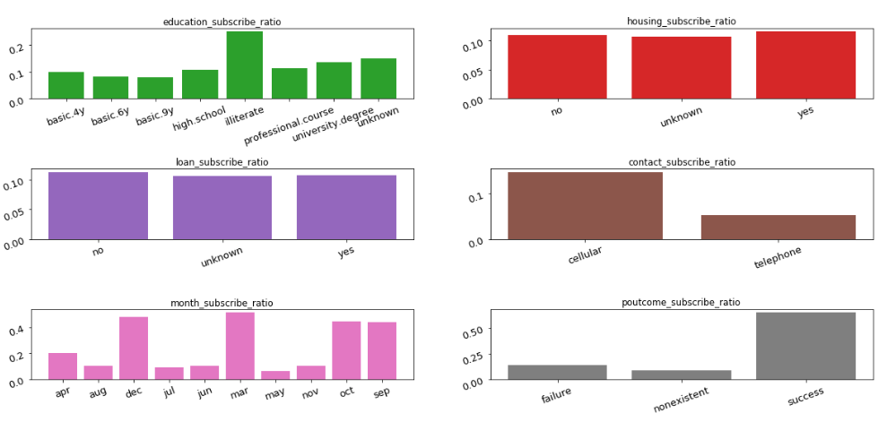
2.Data exploratory analysis
2.2.1 Categorical features analysis
We analyzed the counts of each feature category(Fig_1) and the subscription rate(Fig_2) of every feature.
such as, for the cantact type,we anaiyse that using cellular have a higher subscription probability .
Fig 1_categories_counts
Fig 2_subscription_rate

Slide 10
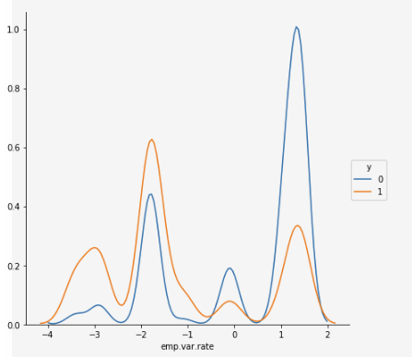
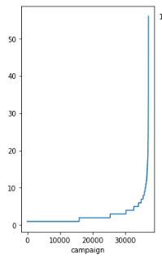
2.Data exploratory analysis
2.2.2 Numeric features analysis
We analyze the kde curve and sorting curve of each feature to further explore data distribution.

Slide 11
03
Data preprocessing and Feature engineering

Slide 12
3.Data preprocessing: feature coding
Ordinal Encoding
Features : month、day of week.
These features have the relationship of size between categories
Encoding
method
Features：job、marital、education、default、housing、 loan、contact、poutcome
These features are independent between categories
Binary
Encoding

Slide 13
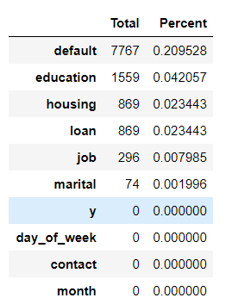
3.Data preprocessing: missing value
Padding methods
Features : ‘job’ ; ’marital’ mode padding
Categorical features
Features : other features The missing values as a category .

Slide 14
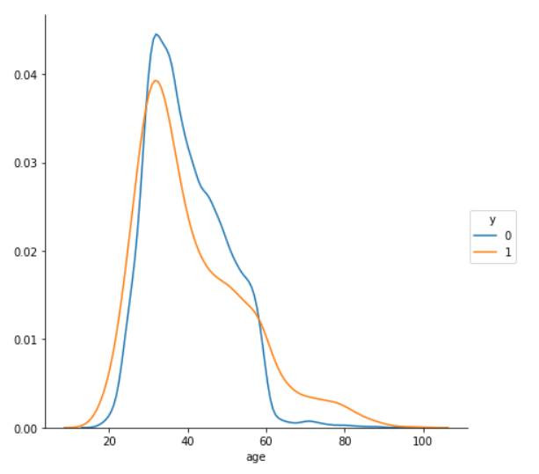
3.Feature engineering ：discrete feature
discret_age
discret_emp.var.rate
discret_ cons.price.idx
discret_ cons.conf.idx
discret_ euribor3m
discret_ nr.employed
discrete feature
0-29 → 1
the sample located between the
intersection of two curves has some similar characteristics
29-57 → 2
57- 100 → 3
Fig_ age_KDE curve

Slide 15

3.Feature engineering ：tricks
advantages
1.Reduce the interference of abnormal data,
2.Improve the robustness of model
3.Make more stable prediction.
Rank feature
advantages
Through the combination of features to form new features to improve the learning ability of model.
Combination feature
Mainly include:f1+f2、f1-f2、f1*f2、f1/f2、f1^2

Slide 16
04
Feature selection

Slide 17
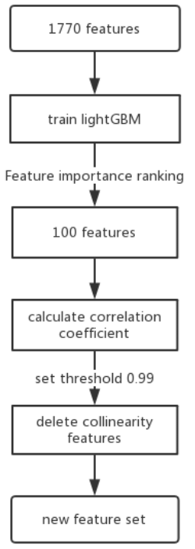
4. Feature selection
Choice important features
calculate feature importance according to the contribution of tree model construction。
computate contribution
+
delete collinearity features
Delete features by correlation coefficient
In view of the large number of collinearity features in cross-feature，we can calculate the Pearson correlation coefficient between each feature to delete collinearity features，When two features correlation coefficient is greater than 0.99, we think they are collinear，then remove one of them.

Slide 18
05
Model training and Evaluation

Slide 19
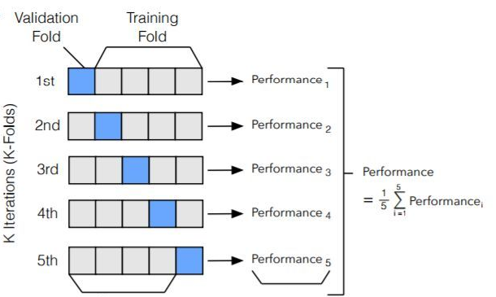
5.1 Model training method
Using 5-fold cross-validation to evaluate model.random select 80% data from dataset as training dataset,the remaining 20% as the test dataset.
At the same time, we also try to use 80% data as training dataset,10% data as validation dataset to guide training, and the remaining 10% as test dataset.the effect is slight improved.

Slide 20
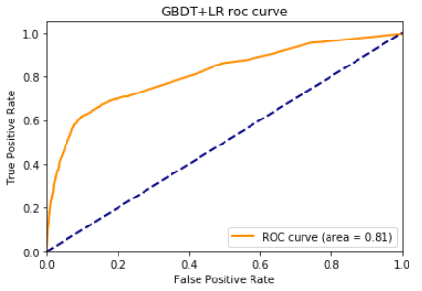
5.2 Model evaluation
Using AUC as evaluation indicator，compare to accuracy,AUC can reduce the interference caused by different test dataset.so as to describe the performance more objectively.
Especially for the unbalanced sample classification problem，the accuracy indicator will appear poor performance、high indicator value situation.however AUC value has a good synchronization relationship with the performance.

Slide 21
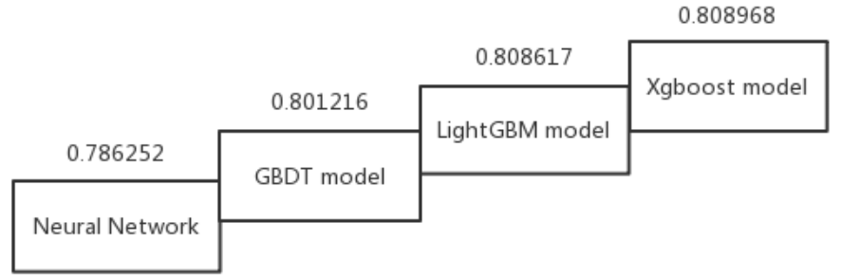
5.3 Model scheme - Single model
Neural Network:
Using Adam optimizer,Training a four-layer neural network, because of the data quantity problem, performance is poor.
LightGBM model:
Using Grid Search find optimal parameters，final 5-fold auc score is 0.808617
Xgboost model:
Using Grid Search find optimal parameters，final 5-fold auc score is 0.808968
GBDT model:
Using Grid Search find optimal parameters，final 5-fold auc score is 0.801216

Slide 22
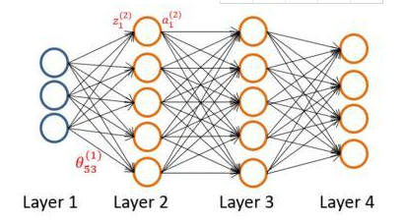
5.4 Modeling scheme- Combined model
nn+Xgboost model:
The neural network have strong feature combination and feature extraction ability, but it is easy to overfit. Therefore, the output of fixed hidden layer neurons can be extracted as the high-level feature, and the high-level feature can be used as the input of XGBoost model.
cv-score : 0.797872

Slide 23
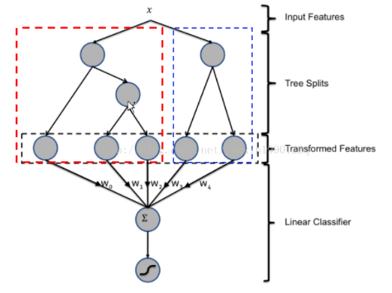
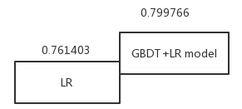
5.4 Modeling scheme- Combined model
LR is the most commonly used model in industry. It is easy to parallelize and is conducive to processing hundreds of millions of samples. However, LR model needs a lot of effective and strong features to have better model performance.
GBDT+LR model:
GBDT can find a variety of distinguishing features and feature combinations, and the leaves of the tree can be directly used as LR input features, saving the steps of manually searching for features and feature combinations.
Combined scheme can greatly improve LR score and has strong practical significance in industry.

Slide 24
5.5 The cv-score of different models
model | CV value
LightGBM | 0.808617
Xgboost | 0.808968
GBDT | 0.801216
Neural Network | 0.786252
GBDT+LR | 0.799766
nn+Xgboost | 0.797872
Linear weighted merge | 0.803847

Slide 25
06
Conclusion

Slide 26
6. Conclusion
1.EDA
Through Exploratory Data Analysis of data, we can know data distribution and characteristics.
2. Feature Engineering
By constructing combination, rank and discrete features, the interference of outliers can be reduced and the robustness of the model can be increased.
3. Feature selection
The LightGBM model was used to remove the low-importance features, and the collinearity features were also removed to ensure efficiency of the final feature set.
4. Cross validation and Model evaluation
Five-fold cross validation is adopted to ensure model stability. Consider the imbalance between positive and negative samples of data, so we choose the auc as model evaluation.
5. Simple and stable model
The feature dimension is only ninety-two, the single model + cross-validation fusion method ensures the simplicity, and GBDT+LR model ensures practicability.

Slide 27
THANK YOU FOR LISTENING

