Slide 1

Linux Cryptography overview and How-to’s using OpenSSL
In this session, we will cover cryptography basics and explore cryptographic functions, performance and examples using OpenSSL.
LAB: http://processors.wiki.ti.com/index.php/Sitara_Linux_Training:_Cryptography
July 2012

Slide 2
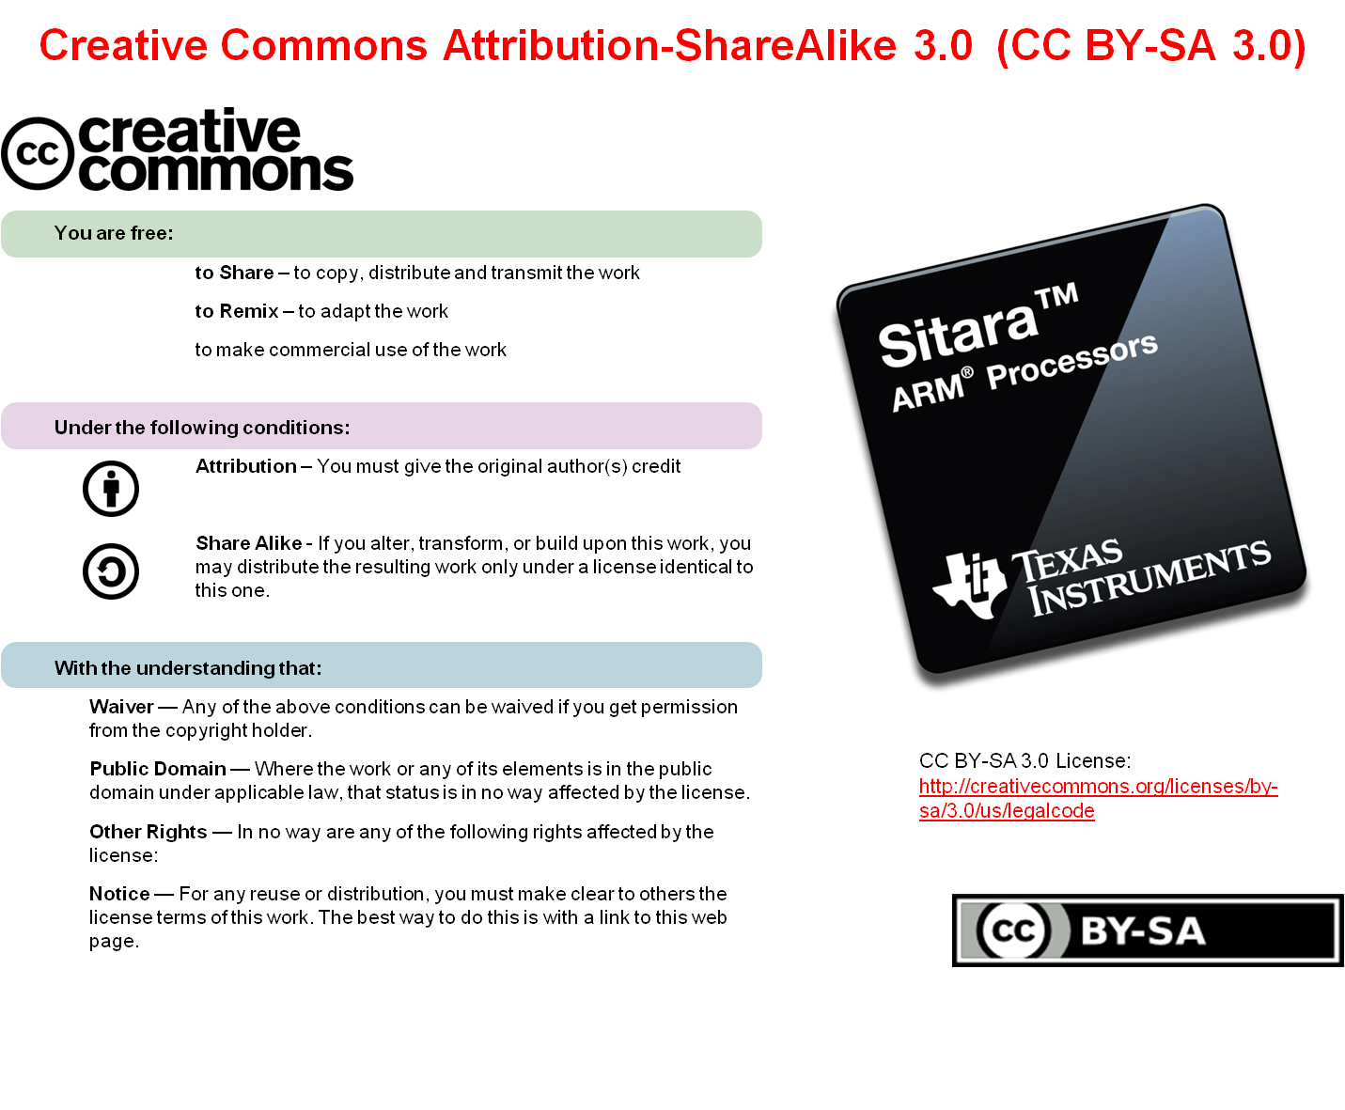

Slide 3
Agenda
Cryptography Is/Is NOT
Cryptography 101
Crypto Software Stack
Open Source Projects
  OpenSSL
  OpenSSH
  OpenSwan
Cryptographic Hardware Acceleration
Example Applications

Slide 4
Pre-work check list
Installed and configured VMWare Player v4 or later
Installed Ubuntu 10.04
Installed the latest Sitara Linux SDK and CCSv5
Within the Sitara Linux SDK, ran the setup.sh (to install required host packages)
Using a Sitara EVM, followed the QSG to connect ethernet, serial cables, SD card and 5V power
Booted the EVM and noticed the Matrix GUI application launcher on the LCD
Pulled the ipaddr of your EVM and ran remote Matrix using a web browser
Brought the USB to Serial cable you confirmed on your setup (preferable)

Slide 5
IS / IS NOT
Is
Is Not
All Sitara devices
Supported in all Sitara SDKs with Opens Source SW.
AES, DES, 3DES*, SHA1, SHA2, MD5, RNG* hardware accelerators in some GP devices
  AM35x
  AM37x
  AM335x*
Support for OpenSSL, OpenSSH, Openswan (IPSec)
High Security (HS) silicon support
Run-time Security
Notes:
The semantic difference between Cryptography and Security is important to understand.
To clarify, Cryptography is a tool that you use to build Secure Systems. In the same way that you can use mediocre crypto tools to build excellent security, you can use good crypto tools to build very poor security. As a tool, OpenSSL in used in many very good secure products.
Like the three little pigs all used the same tools, but two built houses of straw and twigs that were destroyed by the big bad wolf. One built a house of brick that withstood the wolf.

Slide 6
Cryptography 101
Definition – Practice and Study of Hiding Information (from Wikipedia)
  http://en.wikipedia.org/wiki/Cryptography
Goals
  Confidentiality
  Data Integrity
  Authentication
  Non-repudiation
Classic Cryptography
  Code Book
Modern Cryptography
  Public Algorithms
    Encrypt/Decrypt - DES, 3DES, AES
    Hash - SHA/MD5
  Key and Certificate Generation, Signing, Authentication
Notes:
Definition of cryptography is better understood from the viewpoint of the four basic goals of cryptography
Goals – Discussed further on next slides.
Confidentiality – Encrypting data in order to keep it secret. Done with Encryption algorithms (DES, 3DES, AES)
Data Integrity – Protecting data so that it not altered during transmission. Hash/Digest/Checksum (SHA, MD5)
Authentication – Creating assurance that data came from a trusted source. (MAC)
Non-repudiation – Creating assurance that an intended recipient actually received a sent message and an alleged sender is the actual sender of a received message. Digital Signing applications
Classic Cryptography
Example: Code book used to translate alphabetic characters.
Code Book – the algorithm itself (in this case the code book) is the secret and must be kept secret. Once it is broken or compromised it must be thrown out and a new code book must be developed.
Since the code book itself must be kept secret, it cannot be analyzed by independent experts. There is no way to know if the system is any good.
Modern cryptography
Public algorithms use complex mathematical processes (factoring large numbers, products of large prime numbers) to generate keys and perform encryption.
So the generated keys are the “secret” part of the system, not the algorithm.
Only the key needs to be kept secret. If the key is compromised, a new key can be generated, but the algorithm can be retained. In fact SSL web security relies on the fact that a new key is generated for every transaction.
They are not considered unbreakable, but rather impractical to break given current technological resources.
Since the algorithm is public it can be analyzed for performance. Modern algos are evaluated and scored by how long they are “good”. Currently DES is considered weak. 3DES is considered strong (20-30 years). AES is considered strong (50 years).
Definition: Certificate – a verified (and signed) public key. Example of a combination of crypto algorithms

Slide 7
Goal #1 – Confidentiality
Keep the meaning of a message private from unintended viewers in a communication channel
Accomplished with the use of Key Ciphers (symmetric or asymmetric)
Intended receiver does not know if the message is complete or altered
Using a Cipher on clear text produces cipher-text
Notes:
Although encryption hides the contents of a message, it may be possible to change an encrypted message without understanding it. (Some encryption algorithms, known as nonmalleable ones, prevent this, but others do not.)
Alterations could be done be accident in a poor communication channel or by an active attacker who does not care about the content but just wants to mess with the data.
The process of encryption is a mathematical method to scramble data using a secret key.
Malleability is a property of some cryptographic algorithms.^{[1]} An encryption algorithm is malleable if it is possible for an adversary to transform a ciphertext into another ciphertext which decrypts to a related plaintext.

Slide 8
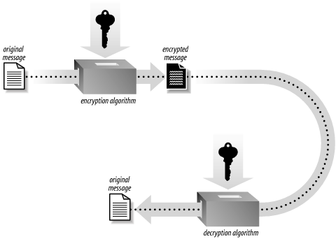
Modern Cryptography Topics
Symmetric Key Cryptography
Private Key
Sender
Insecure
Transmission
Medium
Private Key
Recipient
Notes:
Symmetric-key cryptography refers to encryption methods in which both the sender and receiver possess the same secret key.
Key and encryption can be generated using DES, 3DES, AES as well as others.
The term Symmetric refers to the fact that the same key is used on both end of the transaction.
The symmetric key must be thought of as a private key and can never be revealed to anyone.
This presents the problem of how to securely provide the key to another user. Another problem is that a unique key must be generated for each Sender/Receiver pair.
May be used in a private network where the initial transport of the key can be done securely.

Slide 9
Goal #2 – Data Integrity
Ensure that a message has not been altered or truncated during transmission
Only information channel errors considered, no active malicious participants
One-way Hash functions used to provide integrity
The output of a Hash function is a fixed length message digest
Notes:
Integrity
The sender and receiver of a message have a need for confidence that the message has not been altered during transmission. Although encryption hides the contents of a message, it may be possible to change an encrypted message without understanding it.
If a message is digitally signed, any change in the message after signature will invalidate the signature. Furthermore, there is no efficient way to modify a message and its signature to produce a new message with a valid signature, because this is still considered to be computationally infeasible by most cryptographic hash functions (see collision resistance).
http://en.wikipedia.org/wiki/Hash_function

Slide 10

Modern Cryptography Topics
Hash function
Original Message
Message Digest
Hash Algorithm
Notes:
Checksum is reversible so it is only good for detection of errors in the transmission channel as opposed to an active atacker.
Hash is a one-way algo and cannot be reversed like a checksum

Slide 11
Goal #3 - Authentication
Ensure that a message has not been altered or truncated during transmission (same as Data Integrity goal)
However, now it is assumed there are active malicious elements trying to subvert the message
Use of Message Authentication Functions (MAC) as a Digital Signature
The output of a MAC is a message tag
Notes:
Authentication
Although messages may often include information about the entity sending a message, that information may not be accurate. Digital signatures can be used to authenticate the source of messages. When ownership of a digital signature secret key is bound to a specific user, a valid signature shows that the message was sent by that user. The importance of high confidence in sender authenticity is especially obvious in a financial context. For example, suppose a bank's branch office sends instructions to the central office requesting a change in the balance of an account. If the central office is not convinced that such a message is truly sent from an authorized source, acting on such a request could be a grave mistake.
The problem then becomes how do you trust the sender. Trusted third party must provide the certificate.
http://en.wikipedia.org/wiki/Digital_signature

Slide 12
Goal #4 – Non-repudiation
Providing a binding transaction
Prevent any party involved in a transaction to refute that they took part in the transaction.
Public Key Digital Signatures
Asymmetric Public Key Algorithms
The output of a signature algorithm is a signature
Notes:
Non-repudiation
Non-repudiation, or more specifically non-repudiation of origin, is an important aspect of digital signatures. By this property an entity that has signed some information cannot at a later time deny having signed it. Similarly, access to the public key only does not enable a fraudulent party to fake a valid signature.
Need to have involvement of a trusted third party.
http://en.wikipedia.org/wiki/Non-repudiation

Slide 13
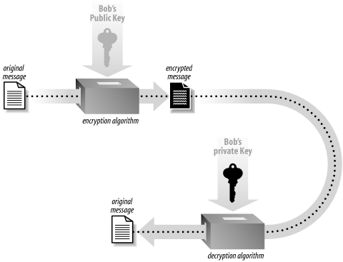
Modern Cryptography Topics
Asymmetric Key Cryptography - Encryption
Encrypted with Recipients Public Key
Sender
Insecure
Transmission
Medium
Decrypted with Recipients Private Key
Recipient
Notes:
Asymmetric cryptography
The encryption using a private key/public key pair ensures that the data can be encrypted by one key but can only be decrypted by the other key pair. The keys are mathematically related but one cannot be derived from the other. The trick in a key pair is to keep one key secret (the private key) and to distribute the other key (the public key) to everybody.
Anybody can send you a message encrypted with your public key, that only you will be able to decrypt with your private key. You are the only one to have the other key pair, right?
In the opposite , you can certify that a message is only coming from you, because you have encrypted it with your private key, and only the associated public key will decrypt it correctly. Beware, in this case the message is not secured you have only signed it. Everybody has the public key, remember!
Asymmetric (Public) Key Cryptography involves generating a pair of cryptographic keys where one key is private and must be kept secret. The other key is public and can be freely distributed.
The keys are mathematically related such that one can decrypt information that was encrypted with the other. However, it is not possible to re-create one key from the other.
The public key can be verified by a trusted third party to provide the end user some assurance that the key is from the intended owner.
There are two main uses of Asymmetric Key Cryptography: Encryption and Authentication
Public key encryption: a message encrypted with a recipient's public key cannot be decrypted by anyone except a possessor of the matching private key—presumably, this will be the owner of that key and the person associated with the public key used.

Slide 14
Modern Cryptography Topics
Asymmetric Key Cryptography – Authentication/Signing
Signed with Sender’s Private Key
Digital Signature
Sender
Insecure
Transmission
Medium
Hash algorithm
Verify with Sender’s Public Key
Verification
Recipient
Notes:
Public Key Authentication
A message signed with a sender's private key can be verified by anyone who has access to the sender's public key, thereby proving that the sender had access to the private key (and therefore is likely to be the person associated with the public key used), and the part of the message that has not been tampered with.
Encryption and Authentication can be combined with Public Key Cryptography where the sender encrypts a message with the recipients public key and then signs the encrypted message with their own private key. The recipient then authenticates the signature of the message with senders public key and decrypts the contents of the message with their own private key.
Certificate – a verified public key.
With the concept of keys comes the concept of verifying keys that are made public.
Certificate and key verification relies on the inclusion of a trusted third party to verify generated certificates. Verisign is the best known certificate authority (CA). But how do you trust Verisign. It is a classic chicken and egg issue.
This is the central problem with use of public-key cryptography. What is the confidence that a public key is correct, belongs to the person or entity claimed (i.e., is 'authentic'), and has not been tampered with or replaced by a malicious third party. The usual approach to this problem is to use a public-key infrastructure (PKI), in which one or more third parties, known as certificate authorities, certify ownership of key pairs.
Quote from Matt Blaze, “A commercial CA will protect you from anyone whose money it refuses to take,”. In early 2001, Verisign signed several keys purportedly from Microsoft Corporation, even though they turned out not to be.

Slide 15
Modern Cryptography Topics
Encryption/Decryption
  AES - http://en.wikipedia.org/wiki/Advanced_Encryption_Standard
  DES/3DES - http://en.wikipedia.org/wiki/Data_Encryption_Standard
Cryptographic Hash Functions
  Hash (also called Digest, Fingerprint or Checksum)
  SHA - http://en.wikipedia.org/wiki/Secure_Hash_Algorithm
  MD5 - http://en.wikipedia.org/wiki/MD5
Message Authentication Codes
  Keyed Hash
  HMAC – supported by OpenSSL
Digital Signatures
  Use of sender’s private key to encrypt.
  DSA – supported by OpenSSL
Notes:
Algorithms used for Encrytption: AES, DES/3DES
Algorithms used for data integrity and authentication.
Hash/Digest/Checksum/Fingerprint – All terms for the same thing
MD5 – weak hash
SHA - strong
Scenario: Software Package that is open source and therefore does not need encryption still needs a Checksum for Data integrity purposes.
Hash does not contain any data/message content.
Create fixed sized hash (ciphertext) that cannot be reversed (i.e. the original text cannot be generated from the hash).
Can be used as a traditional checksum
MAC is a hash that is signed with an Asymmetric key. An encrypted hash. So uses combination of encryption and hash.
Digital Signature involves encrypting a hash with your private key. The end user can hash the document themselves, then decrypt the signature and compare the hashes.
Or the message can be encrypted with a private key. Being able to decrypt the message with the public key constitutes proof that the message was originally encrypted by the sender. But how did you get the public key in the first place.
Scenario: Document that does not need to be encrypted still may need a digital signature to verify the ownership/source of the document.

Slide 16


OpenSSL Crypto SW Stack
App
Open SSL
  Standard API interface
  Implements crypto functions in SW
  Can use OCF when HW is available
OCF Driver (Open Source module)
  /dev/crypto created by OCF module
  Abstracts an API to higher level apps (OpenSSL)
Crypto accel module (TI)
  Low level device driver
TI H/W Crypto Accelerators *
  AES
  DES/3DES
  SHA1/MD5
  RNG
OpenSSL
/dev/crypto (OCF-Linux)
(Open Crypto Framework)
crypto accel module
H/W Crypto Accelerators
TI/Open Source SW
Customer SW
Notes:
Not all Sitara microprocessors provide accelerated crypto support
Those that do are provided with the crypto accelerator driver and OCF abstraction API to OpenSSL
With OCF in place, using OpenSSL automatically is provided with HW acceleration if it exists.

Slide 17
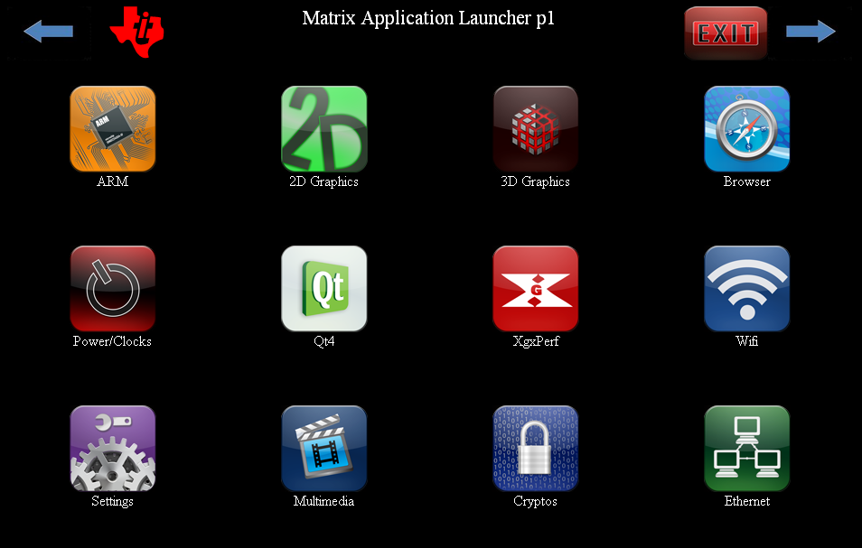
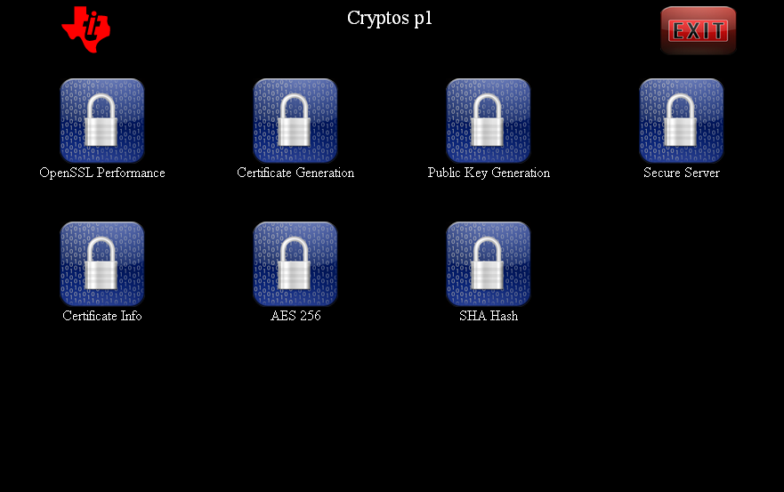
Cryptography

Slide 18
Example Apps
OpenSSL
  Command line application
  Crypto library can be called from C applications
Applications
  Performance
  Basic Encrypt/Decrypt
  Basic Hash
  Private Key/Certificate Generation
  Public Key Generation
  Extract/Verify certificate info
  Connect to Secure Server containing generated certificate
Notes:
Applications
- Performance – The OpenSSL “speed” tests provides statistics on the operation of each algorithm. Test is executed on each algo for a variety of data packets sizes.
- Basic Encrypt/Decrypt – Uses AES to encrypt a random data file. Then decrypts the file and compares it to the original.
- Private Key/Certificate Generation – This example performs a two step process of creating a private key and then a self-signed certificate with that key. This certificate is ready to be used on a secure web page server. The certificate will have contain the identification information that will be seen by a client web browser
- Public Key Generation – This will generate a public key based on the previously generated private key. This pair of keys make up the user’s asymmetric key pair.
- Extract/Verify Certificate info – read and verify information from a certificate.
- Secure Server – Start a Web page server which serves secure web pages (https) using an OpenSSL generated certificate.
- Sign Digest with a Private Key – First a Hash is performed on a document to create a Digest. The Digest is the encrypted with a private key. The result is digital signature used to verify the authenticity of the document.
- Verify Signed Digest – A Public key can be used by anyone to verify the authenticity of the digital signature.

Slide 19
Crypto User’s Guide
ARMCRYPTO (search part number “ARMCRYPTO” at www.ti.com)
  (http://www.ti.com/tool/armcrypto)
OpenSSL v1.0.0d
  Open Source project (http://www.openssl.org/)
OCF-Linux
  Open Source project (http://ocf-linux.sourceforge.net/)
ARM Crypto module (omap3_crypto module)
  TI internally developed
  External GForge project
  https://gforge.ti.com/gf/
Documentation
  http://processors.wiki.ti.com/index.php/Cryptography_Users_Guide
  http://processors.wiki.ti.com/index.php/Build_OpenSSL_for_Sitara
  http://processors.wiki.ti.com/index.php/Build_OCF_for_Sitara
  http://processors.wiki.ti.com/index.php/Build_Crypto_Module_for_Sitara
Notes:
TI must retain the SDK version on our own website for legal reasons.
The version of OpenSSL in the latest SDK is 1.0.0d.
The latest version can be obtained from the OpenSSL website.
From Wikipedia
OpenSSL is an open source implementation of the SSL and TLS protocols. The core library (written in the C programming language) implements the basic cryptographic functions and provides various utility functions. Wrappers allowing the use of the OpenSSL library in a variety of computer languages are available.
From http://ocf-linux.sourceforge.net/
OCF-Linux is a Linux port of the OpenBSD/FreeBSD Cryptographic Framework (OCF). This port aims to bring full asynchronous HW/SW crypto acceleration to the Linux kernel and applications running under Linux. It can accelerate DES, 3DES, AES, MD5, SHA, and Public Key operations and adds randomness to the kernels /dev/random by utilising the RNG hardware.
TI crypto module. Developed internally to connect OCF-Linux to HW accelerators.
External Wiki’s

Slide 20
Crypto User’s Guide
Command Line Interface to OpenSSL
  http://www.madboa.com/geek/openssl/
OpenSSL API for Applications in C
  http://www.openssl.org/docs/crypto/crypto.html
OpenSSL in other languages
  http://www.opensslbook.com/
  Java
  Perl
  Python
Notes:
The madboa page has excellent examples of how to use the command line version of OpenSSL to accomplish all high level crypto functions. This page is the basis for almost all of the examples contained in the SDK.
OpenSSL is actually a library that can be called from the C language. The complete API is documented at online at openssl.org.
Documentation for using OpenSSL with languages other than C is documented in:
Network Security with OpenSSL: Cryptography for Secure Communications by John Viega

Slide 21
LAB

Slide 22
Lab – Cryptography
In this lab exercise you will run the OpenSSL binary from a command line to…
Execute speed tests to analyze performance
Perform Basic Encryption/Decryption
Perform Basic Hash Functions
Generate Asymmetric Key Pair
Generate Web Certificate from Key Pair
Run Secure Web Server Using Web Certificate
http://processors.wiki.ti.com/index.php/Sitara_Linux_Training:_Cryptography
Notes:
Final Word
The client browser requests an https:// (secured) page.
The web server delivers its public key and certificate to the client browser.
The browser verifies that the certificate was issued by a trusted third party (in the real world someone like VeriSign), is still valid and is related to the site contacted. In the lab here of course the certificate is "self-signed" and therefore untrusted by the browser.
Some negotiation is done between the client and server to agree on the types and level of encryption capable on each end of the connection.
The browser then uses the public key, to encrypt a random symmetric encryption key and sends it to the server.
The web server decrypts the symmetric encryption key using its private key.
This symmetric key is now used to encrypt and decrypt all communications for the rest of the session.

Slide 23
THANK YOU!
For more Sitara Boot Camp sessions visit: www.ti.com/sitarabootcamp

