Slide 1

Linux Power Management Overview and Hands-on
In this session you will learn how to improve product power performance by minimizing power consumption and guaranteeing system performance. In addition, power management techniques enabled via the Linux SDK will be discussed.
LAB: http://processors.wiki.ti.com/index.php/Sitara_Linux_Training
July 2012

Slide 2
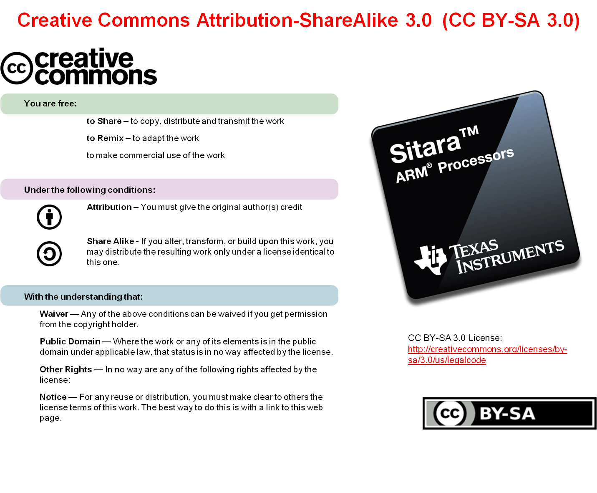

Slide 3
Agenda
What You Will Learn
Motivation for PM
Overview of Power Management Techniques
Understanding PM Features in the AMSDK
Hands-on Labs Throughout to Reinforce Learning
All of the above focused on AM335x.

Slide 4
Pre-work Check List
Installed and configured VMWare Player v4 or later
Installed Ubuntu 10.04
Installed the latest Sitara Linux SDK and CCSv5
Within the Sitara Linux SDK, ran the setup.sh (to install required host packages)
Using a Sitara EVM, followed the QSG to connect ethernet, serial cables, SD card and 5V power
Booted the EVM and noticed the Matrix GUI application launcher on the LCD
Pulled the ipaddr of your EVM and ran remote Matrix using a web browser
Brought the USB to Serial cable you confirmed on your setup (preferable)

Slide 5
What you will learn
GOAL: Improve product power performance
  Minimize power consumption
  Guarantee system performance
Motivation for power management techniques
Understand power management techniques of AM335x system
  DVFS: Dynamic Voltage and Frequency Scaling
  SmartReflex (aka AVS: Adaptive Voltage Scaling)
  Dynamic Power Switching (DPS)
    Implemented by Linux’s Runtime PM Framework
  Static Leakage Management (SLM)
    Device Idle and Standby modes
  Basic PM hardware architecture:
    Voltage domains, Power domains, Clock domains
(Hands on) Gain experience with AMSDK PM Features and Power Measurements
  Linux kernel configuration
  Use of PMDC for Power Measurements
  PM Software Interface (Command line and Matrix tools)
    Frequency selection (CPUFreq)
    Suspend/Resume
    CPU Idle

Slide 6
Why power management?
Competitive differentiator
Less heat dissipation
Smaller, sleeker products with smaller battery
Longer battery life
Better Features + Increased Usage = Increased Revenue
Quicker time-to-marked with advanced features
TI Customers
Smaller, sleeker products
Cooler device
More exciting, power hungry features like multimedia,
streaming video, etc.
Improved experience (longer battery life)
Lower cost
End Users

Slide 7
Power Management Principles
Power consumed is proportional to frequency and square of voltage.
  Small reductions in voltage can be very significant
  Applicable PM Techniques:
    Dynamic Voltage and Frequency Scaling (DVFS)
    SmartReflex (aka Adaptive Voltage Scaling or AVS)
Keeping devices powered on consumes a lot of power. Cut or reduce power to entire device or idle device portions.
  Applicable PM Techniques:
    Dynamic Power Switching (DPS)
      Turn off what you’re not using!
      At a granular, per-module level
      Called “Runtime PM” in Linux
    Static Leakage Management (SLM)
      System level idle and/or suspend

Slide 8
Power Management Principles (cont.)
3) For proper operation, you should run at one of the recommended operating voltage and frequency combinations (OPPs)
  Too low voltages can result in data propagation errors and system failure
  Too high voltages result in excessive power consumption
  Hardware timing closure results in a few PROVEN operating performance points (OPPs) which guarantee the system to work properly.

Slide 9
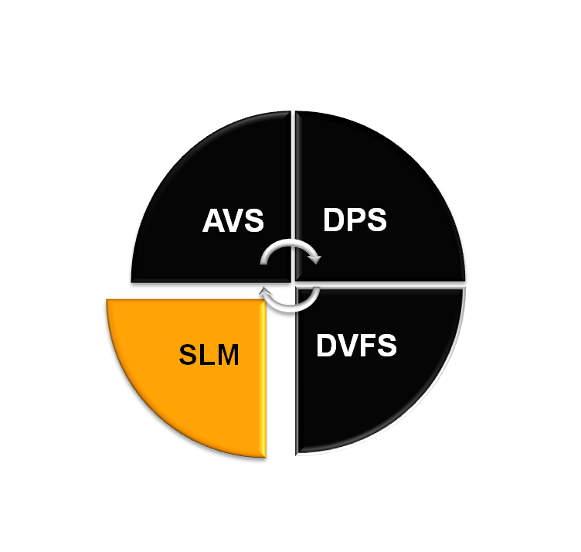






Power Management Techniques: Basics
PM Techniques can be categorized as “Active” or “Idle”:
Active PM Technique
Adaptive Voltage Scaling
Dynamic Power Switching
    Performed while device is on and in use. Involves all systems components: HW modules, device drivers, OS & apps.
    Techniques: AVS (SmartReflex), DPS & DVFS.
    Entire device is idled. Various idle states selected based on trade-off of power consumption and wakeup latency.
    Techniques: SLM
Idle PM Technique
Dynamic Voltage &
Frequency
Scaling
Static Leakage
Management
➔ Power Management is centralized and is handled by the PRCM (Power, Reset and Clock Management) module.

Slide 10
PM Architecture Basics
Devices are partitioned into the following architectural blocks:
Clock Domain:
  One or more modules fed with the same clock
  Clock has independent gating control
Power Domain:
  One or more modules fed with the same power rail
  Power rail controlled by independent power switches
Voltage Domain
  Group of modules supplied by the same voltage regulator (embedded or external)
  “VDDn” sometimes referred to in documentation as a “power rail”
Domains hierarchy is generally:
  Voltage domains contain one or more Power Domain
  Power domains contain one or more Clock Domain
Control of this infrastructure is done by the Power Reset and Clock Manager (PRCM), which is split in two entities:
  PRM: Handles voltage, power, reset, wake-up management, system clock source control and clock generation
  CM: Handles the clock generation, distribution and management
Voltage
Control
Voltage
Regulator
VDD
CLK
Clock
Domain 1
Clock
Domain 2
Power Domain
Voltage Domain VDD

Slide 11
AM335x Power Domains Overview
Refer to Ch. 8 of the TRM for more information:
Power Supply | Power Domain | Modules
VDD_CORE | PD_WKUP | PRCM, Control Module, GPIO0, DMTIMER0, DMTIMER1, UART0, I2C0, TSC, WDT1, SmartReflex, L4_WKUP, DDR_PHY
VDD_CORE | PD_PER | EMIF4, EDMA, GPMC, OCMC, PRUSS, LCD controller, CPSW, USB, MMC0..2, DMTIMER2..7, Uart1..5, SPI0..1, I2C1..2, DCAN0..1, McASP0..1,ePWM0..2, eCAP0..2, eQeP0..1,GPIO1..3,ELM
VDD_CORE | PD_GFX | SGX530
VDD_MPU | PD_MPU | CPU, L1, L2 of MPU
VDD_RTC | PD_RTC | RTC

Slide 12
Lab Break 1
Labs available at: http://processors.wiki.ti.com/index.php/Sitara_Linux_Training:_Power_Management
Lab 1: Kernel Configuration
  Learn the PM related kernel config options.
Lab 2: Using the PMDC
  Learn to make power measurements using the PMDC.

Slide 13

Dynamic Voltage and
Frequency Scaling (DVFS)
Active PM Technique
Technique used to scale operating frequency and voltage of hardware
Well-characterized Operating Performance Points (OPPs) defined for each device
  OPP specified as pair: (MPU FREQUENCY, VOLTAGE (for weak silicon))
    Indicates minimum voltage at which ALL devices can meet that frequency requirement
  For each OPP, software sends control signals to external regulators (DC/DC converters) to set the minimum voltage required.
  The OS monitors the workload and can dynamically adapt voltage/frequency when using certain governor policies (“ondemand”).
DVFS applicability:
  AM335x: VDD_MPU and VDD_CORE
Software Support:
  OPP can be statically selected by the user via Matrix, or at the Linux command line.
    Only if governor is “userspace”!
  The CPUFreq driver in Linux supports multiple “governors”.
    Governors implement different policies for dynamically managing OPP selection.
      “powersave” governor: selects the lowest possible frequency
      “performance” governor: selects the highest possible frequency.

Slide 14
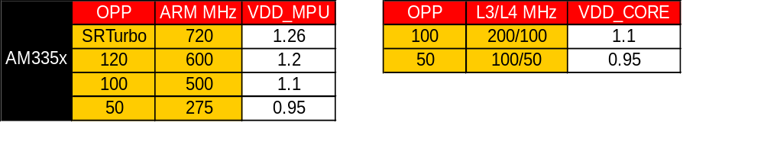
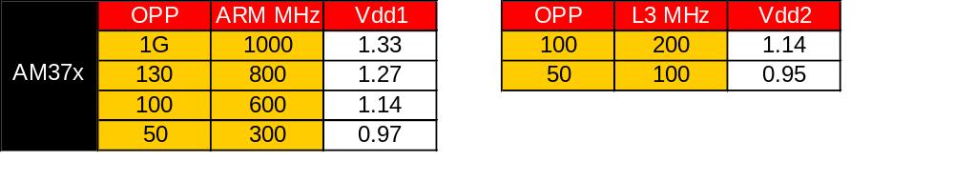

Dynamic Voltage and Frequency Scaling (DVFS)
These charts show the defined OPP’s for current devices:
Active PM Technique

Slide 15
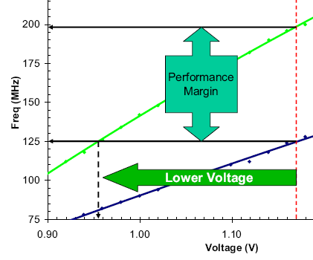
Adaptive Voltage Scaling
Active PM Technique
SmartReflex (trademark of Texas Instruments)
  Silicon manufacturing process yields a distribution of performance capability
  For a given frequency requirement:
    Hot/strong/fast devices can meet this at a lower voltage
    Cold/weak/slow devices needs higher voltage
  Simple system will set the higher voltage for operating all devices
  Smarter system will adapt operating voltage per device!
  Green line: “hot” device
  Blue line: “cold” device

Slide 16
SmartReflex Classes
Class-0: Manufacturing Test Calibration
  At manufacturing test, the device-optimized operating point voltages are permanently fused into each die. A one time optimization to account for process variations.
Class-1: Boot-Time Software Calibration
  At boot-up time, device-optimized operating point voltages of the die are determined during calibration. Optimization also accounts for process variations.
Class-2: Continuous Software Calibration (AM335x uses Class-2B)
  SmartReflex sub-chip does real-time voltage optimization via software loop
  Optimizes for process, temperature and silicon degradation effects
  Variants:
    Class-2A: Timer interrupt or other system event (e.g. frequency change) used to initiate interrogation of SmartReflex sub-chip
    Class-2B: SmartReflex sub-chip generates a host CPU interrupt when frequency is outside acceptable range
  Key: Software intervention required
Class-3 (AM37x): Continuous Hardware Calibration
  SmartReflex sub-chip has a dedicated hardware loop to dynamically optimize voltage for process, temperature and silicon degradation effects
  MPU intervention not required – SmartReflex sub-chip communicates any required voltage change directly to the PMIC via a hardware interface (e.g. i2c)
  Optimizes for process, temperature and silicon degradation effects
  Key: No Software intervention required
Class-4: Fully Integrated Solution
  Class 3 hardware control loop plus voltage regulator integrated on single die

Slide 17
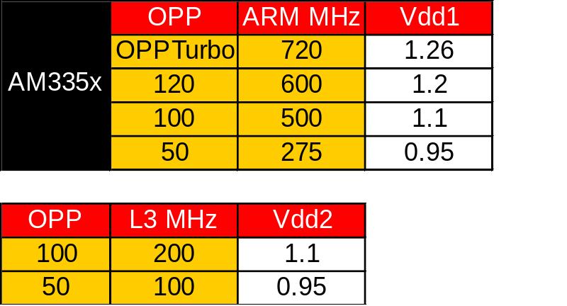
DVFS vs AVS
DVFS:
  Select OPP from available OPPs based on MIPS requirement in scenario
  Lower frequency requirement -> lower voltage
  All die treated the same for a particular application scenario
125
OPP1
Best case
100
Worst case
OPP2
OPP3
75
Performance
50
SmartReflex
SmartReflex
25
0.9
1
1.1
1.2
1.3
1.4
Voltage
AVS (SmartReflex)
  After selection of OPP, scale voltage based on device-specific properties (process capability, temperature)
  Faster (also stronger/warmer) process -> lower voltage
  Each die treated differently

Slide 18
Dynamic Power Switching
Active PM Technique
Allows certain modules to idle when not being used.
  Example use cases: during MP3 playback, we could idle CPSW (among others)
These modules operate in a high performance state to complete its tasks as fast as possible, then dynamically switch to a low-power state (“retention” or “off state”)
  Context save/restore may be necessary if memory is lost → additional overhead
  Acceptable wakeup latencies on the order of microseconds
Software support: In Linux, handled by the “Runtime PM” framework. This is driver-local suspend/resume, managed entirely by individual device drivers operation independently. Drivers can relinquish clocks, resulting in portions of the device in a “clock stop” state.
Without DPS
Overhead
With DPS
1
1
Normalized
Power
Power
0.1
Execution
Time
Execution
Time
1
2
3
4
1
2
3
4

Slide 19

Static Leakage Management
Idle PM Technique
Device switches into low-power system modes automatically or under user requests when no application is running
  Example: Media player shuts off display and enters standby after 10-seconds of on-time with no processing and no user input
  Typically whole device is in some sort of standby mode
  Acceptable latencies on the order of milliseconds. Deeper sleep state == longer wakeup latency.
Devices have multiple sleep states (or C-states)
  AM335x supports two C-states
    C1 – MPU WFI
    C2 – MPU WFI + DDR Self Refresh (lowest power)
Software support:
    CPUIdle algorithm automatically chooses from available sleep states based upon the inactivity period and current HW state. Useful for power savings during shorter periods of inactivity.
    Suspend/Resume support available for long inactivity periods (Deep sleep state)

Slide 20

DPS vs. SLM Review
DPS | SLM
Section of the device in low power mode | Entire device in low power mode (except WKUP domain)
Some parts of system stay active | Full system is inactive
Smaller transition latencies (us) | Larger transition latencies (ms)
Use case : Audio/video Playback - Some domains are going into an idle mode when not needed | Use case: OS idle: Drop into lower-power C-states Suspend-to-RAM: lowest power case
Active PM Technique
Idle PM Technique
Notes:
Suggestion: Convert into table format

Slide 21
Lab Break 2
Labs available at: http://processors.wiki.ti.com/index.php/Sitara_Linux_Training:_Power_Management
Lab 3: Dynamic Voltage and Frequency Scaling (cpufreq)
  Learn about frequency selection and cpufreq governors.
Lab 4: Suspend/Resume
  Learn how to manually suspend and resume the system.
Lab 5: CPU Idle
  Gain familiarity with the sysfs interface to CPU Idle information and the AM335x C-states

Slide 22
THANK YOU!
For more Sitara Boot Camp sessions visit: www.ti.com/sitarabootcamp

