Slide 1

U-Boot & Linux Kernel Board Port
In this session we will cover fundamentals necessary to port a TI Linux-based EVM platform to a custom target platform. We will introduce the necessary steps needed to port the following components: secondary program loader, u-boot and Linux kernel.
LAB: http://processors.wiki.ti.com/index.php/Sitara_Linux_Training
July 2012

Slide 2
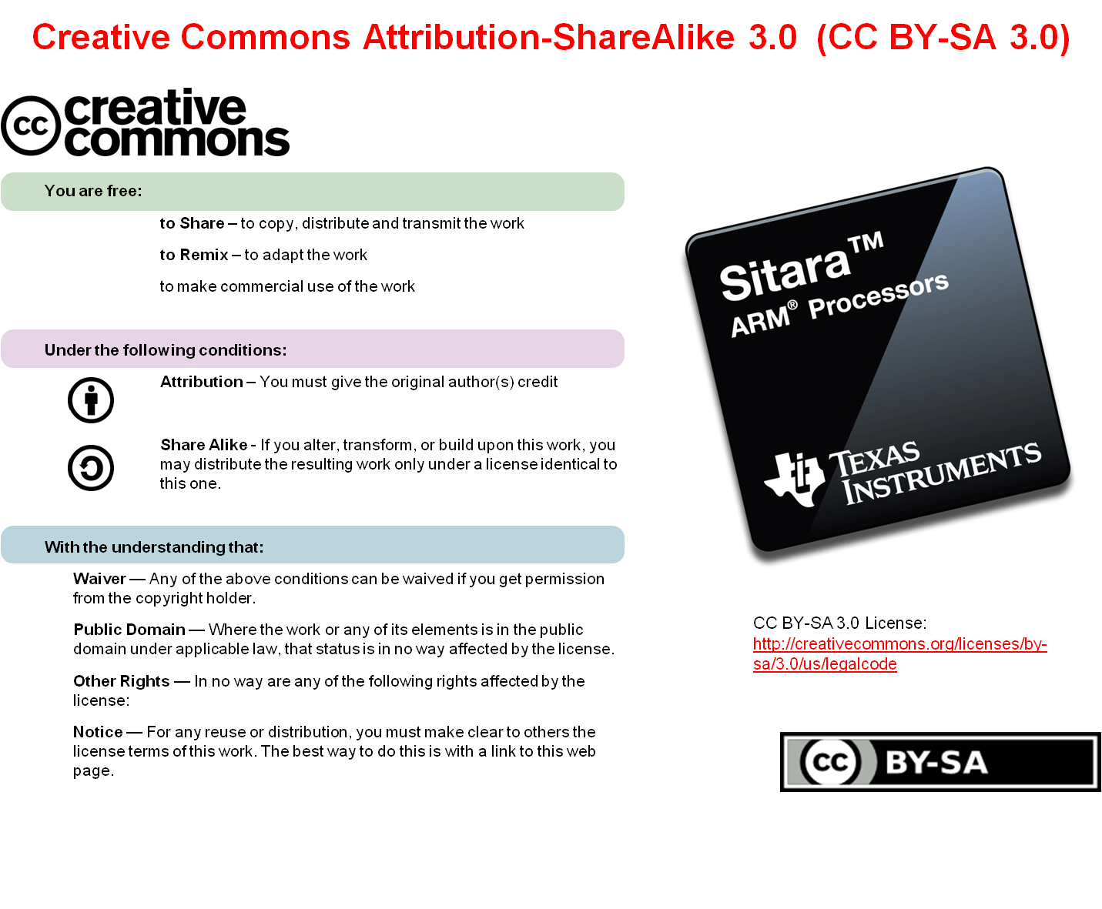

Slide 3
Pre-work Check List
Installed and configured VMWare Player v4 or later
Installed Ubuntu 10.04
Installed the latest Sitara Linux SDK and CCSv5
Within the Sitara Linux SDK, ran the setup.sh (to install required host packages)
Using a Sitara EVM, followed the QSG to connect ethernet, serial cables, SD card and 5V power
Booted the EVM and noticed the Matrix GUI application launcher on the LCD
Pulled the ipaddr of your EVM and ran remote Matrix using a web browser
Brought the USB to Serial cable you confirmed on your setup (preferable)

Slide 4
Agenda
Board Port Overview
Porting U-Boot to an AM335x Target
U-Boot Board Port Labs
Porting the Linux Kernel to a AM335x Target
Linux Kernel Board Port Labs

Slide 5
BOARD PORT OVERVIEW

Slide 6
Presentation Overview
Goal is to gain an understanding of the components of a board port for both U-Boot and Linux
The board or target portion is the last part of a three step method (Architecture/SOC/Target Board)
Explain how the SDK will support board ports going forward

Slide 7
Linux Board Background Assumptions
Already Familiar with :
  SPL/U-Boot/Linux (☺)
  SPL/U-Boot/Linux boot sequence
  U-Boot/Linux build process (kernel configuration)
  Minicom setup
  Root File Systems
Very limited time,
  Really only have time to show the tip of the iceberg, not going to all inclusive or discuss every facet of board porting, this is a starting place
  we’ll have to take extended question/answer after the class in the foyer or later over email. (or in the bar…. You buy ☺)
This information is good for today only……… always in flux…..
What’s presented here today may not be the only way of implementation
Standard disclaimer of “You can and should use what others have done as a method on what to do to move forward”

Slide 8
Things not covered today..
Not covering all of the board port steps
  Limited time today, so we will just be focusing on the code portion of the port
  Directory setup
  Machine ID discussion
  Makefile modifications
  Git Setup
  Other Processors

Slide 9
Linux Board Port Workshop Agenda
The Mission: “So…what’s a board port?”
Look at the System Block Diagram of the target board being used
Stages of a port
Pin Mux Utility Tool Overview
U-Boot Port
  source tree
  introduce the target board file
  Perform two labs that use an already ported example (the code added by with each lab will be discussed )
Linux Kernel Port
  source tree
  introduce the target board file
  Perform four labs that use an already ported example (the source additions for each lab will be discussed)

Slide 10
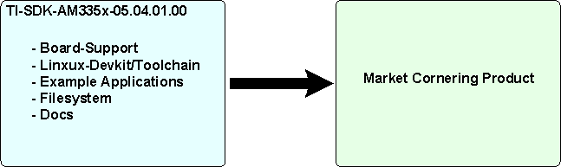
The Mission
“Good Morning … the AM335x has been chosen as the processor for your new exciting market cornering product. Your job (no choice but to accept it ☺) is to get U-Boot and the Linux kernel running on this new platform as soon as possible.
To accomplish this you will take the board design from your HW team and use the AM335x EVM and accompanying Sitara Linux SDK and port U-Boot and the Linux kernel to your new Hardware. “

Slide 11
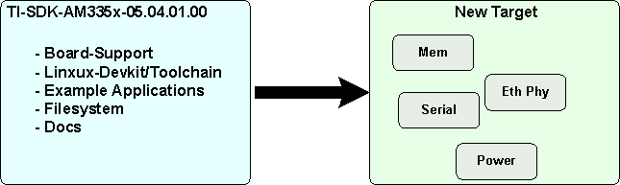
So….What’s a board port?
It is taking the Sitara Linux SDK that is working on a known platform and moving it to a new target platform that is based on the same TI AM335x processor

Slide 12
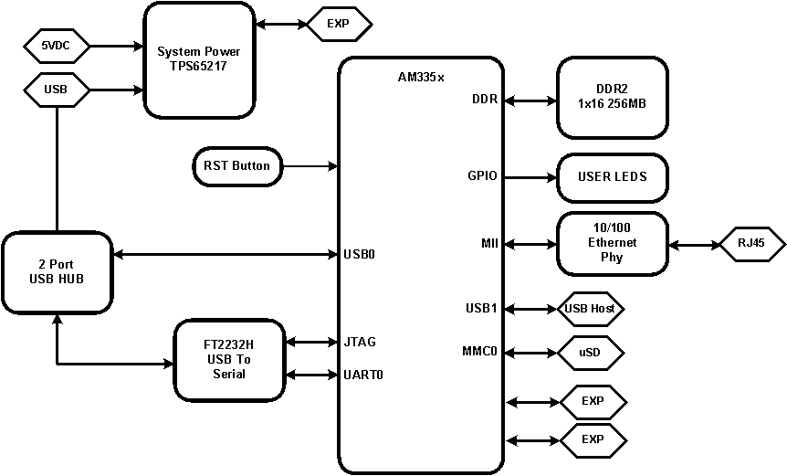
Target Board for this Exercise…. Beagle Bone

Slide 13
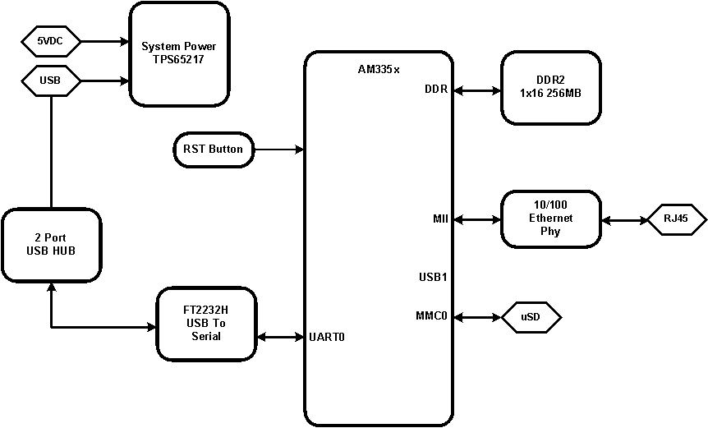
Target Board Port Configuration Example

Slide 14
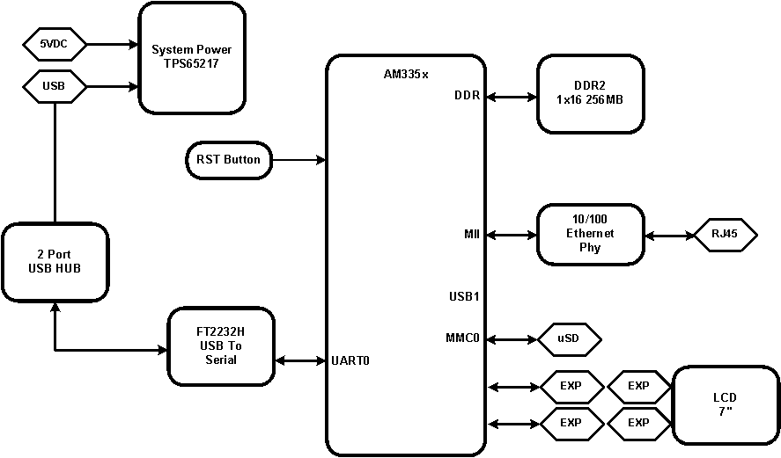
Will be adding an LCD to the system…..

Slide 15

Board Port…. Tip of the iceberg
Used to show the balance of work necessary
Notes:
Typically only 1/9th is above water….. The analogy here is that the board port person has to handle that 1/9th, the rest has been handled already by the Linux community. Have no idea if that ratio is accurate but used simply to illustrate the approach

Slide 16
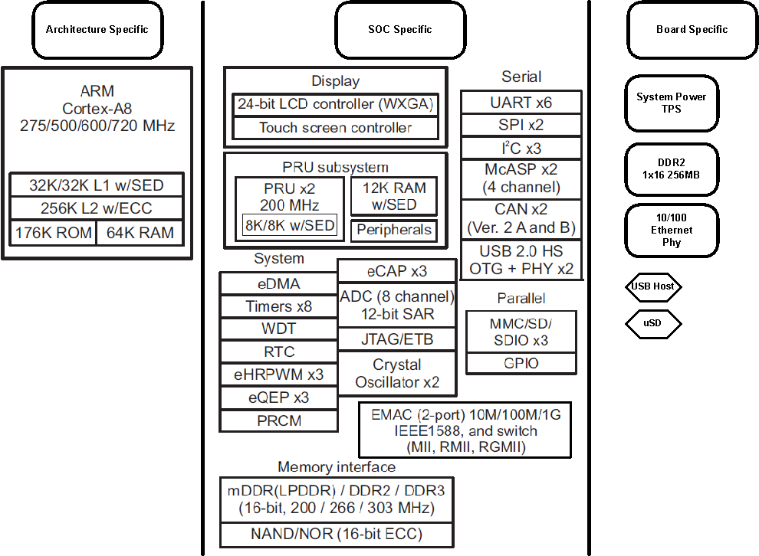
Architecture vs. SOC vs. Board Porting

Slide 17
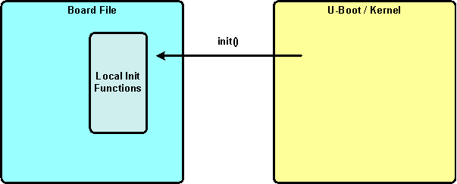
A Tale of Two Board Files
Both U-boot and Linux follow a similar board file abstraction approach
The Core Architecture is ported first
The SOC supporting functions are ported next
The last part to tie U-Boot/Kernel to the target is the Board file that defines “well known” initialization or entry functions that U-Boot and the Linux Kernel will call to handle “a priori” type board knowledge

Slide 18
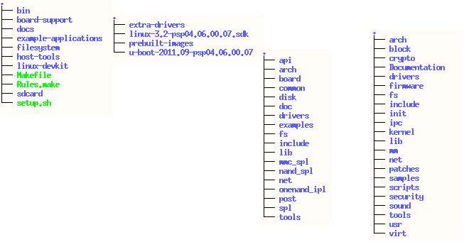
Where the U-boot and Kernel Sources are after TI-SDK-AM335x-05.04.01.00 installation
Both the U-Boot and the Linux Kernel Sources are found in the installed TI-SDK-AM335x-05.04.01.00 directory
ti-sdk-am335x-05.04.01.00/
ti-sdk-am335x-05.04.01.00/board-support/
ti-sdk-am335x-05.04.01.00/board-support/u-boot-2011.09-psp04.06.00.07/
ti-sdk-am335x-05.04.01.00/board-support/linux-3.2-psp04.06.00.07.sdk/
Later in the presentation you will see references to just the specific sub-tree that has the respective source such as U-Boot or Linux

Slide 19
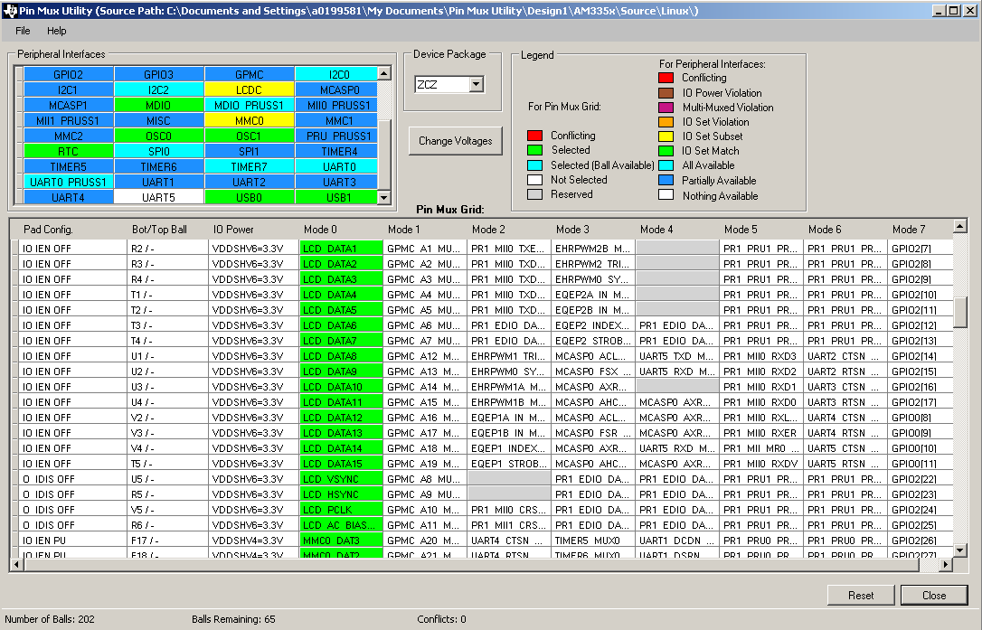
Pin Mux Utility
GPIO Signals are “muxed” with peripheral interfaces. These can be configured into one of several modes either supporting the peripheral or remaining in a GPIO mode.

Slide 20
Selecting a mode using Pin Mux Utility
Each Pin has a mode selection, using UART0 as an example here
UART0 RXD Mode 0 is selected and GPIO 1.9 is de-selected
UART0 RXD Mode 0 is selected and GPIO 1.9 is de-selected, notice Pad config changed too.
Utlitity helps find conflicts, two pins are simultaneously selected
Each Pin has a mode selection, using UART0 as an example here
Pin Mux Utility User Guide
http://processors.wiki.ti.com/index.php/Pin_Mux_Utility_for_ARM_MPU_Processors_v2

Slide 21
PORTING U-BOOT TO AN AM335X TARGET

Slide 22
U-Boot Port Agenda
What are the different stages of a Port
Introduce the board file, where it fits in the Port Picture, where it is in the source tree
What is the anatomy of the board file
Introduce the Board File Template that can be used to port u-boot
Labs Introduction

Slide 23
U-Boot Board Port Exercises and Source Links
Link to the U-Boot Labs
  http://processors.wiki.ti.com/index.php/Sitara_Linux_Training:_UBoot_Board_Port
Link to the U-Boot Template Source tree (clone this tree)
  git://gitorious.org/sitara-board-port/sitara-board-port-uboot.git
PSP U-boot Repo
  http://arago-project.org/git/projects/?p=u-boot-am33x.git;a=summary

Slide 24
SPL and U-Boot Builds
“Dude……. Where’s my X-Loader?”
  It has left the building…. Been replaced by SPL
The same code base is used to build U-Boot (u-boot.img) and the SPL (still called MLO). Since the same code base is used pre-processor flags are used to isolate the code between the two builds. For example, you do not want the DDR and MPU clock init code in both builds. Also of merit is that one build yields both images.
Below are examples of the pre-processor flags used:
#ifdef CONFIG_SPL_BUILD
#ifndef CONFIG_SPL_BUILD

Slide 25
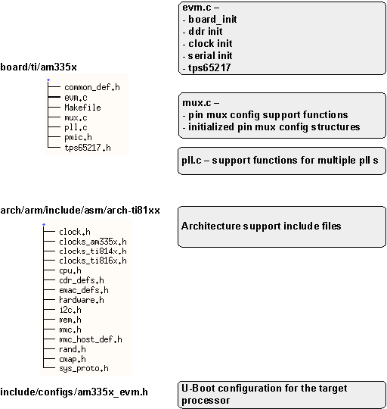
U-Boot Source Directory
Using the existing am335x source directory
The developer will be concentrating on one source directory and for the most part one include directory

Slide 26
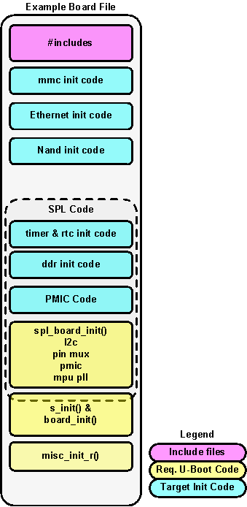
U-Boot Anatomy of a board File
Defines Required interface functions for SPL and U-Boot
One source file contains the code for both SPL and U-Boot and are separated by pre-processor flags
SPL handles the initialization of clocks, DDR, Serial Port and PMIC
Some functions are defined twice in both an SPL context and then again in a U-Boot context (s_init & board_init)
The board file is where the developer will spend most of their effort for a port

Slide 27
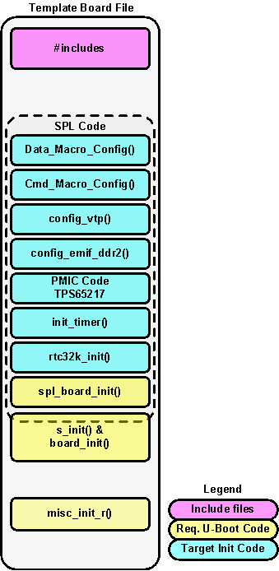
U-Boot/SPL Board Template File
The board file (evm.c) used here today is different from the one provided in the SDK
Contains the code for both SPL and U-Boot
This Board Template only enables MPU Clock, DDR and the Serial Port
It’s up to developer to decide how much functionality they choose to put into the board file and hence the u-boot.img. If the target board supports more peripherals but only one or two is needed to boot into the kernel why add that code?

Slide 28
U-BOOT BOARD PORT LABS

Slide 29
Board Port Labs
Lab 1
  Introduce the template board file and how SPL and u-boot.img are built
Lab 2
  Build on the template file demonstrating how to add the MMC and Ethernet peripherals
Notes:
All BP labs are:
Using the default configurations in the AM-SDK
Come from an external git tree that is public to use/clone/submit patches against
Using several tags in the git to demonstrate separate peripheral inclusion

Slide 30
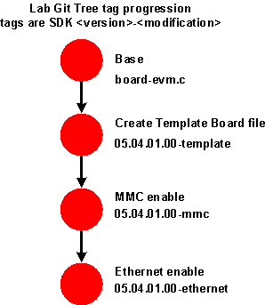
Board Port Source Tree being used
Currently Source is derived from AM-SDK-05.04.01.00, the Port Tree will follow or track each SDK release
A git tree has been setup for these labs on the host machines
Using existing board file name and build methods
Using the default U-Boot configuration supplied with the SDK
Notes:
What is being used for source code
Why the deletion of the original board file
Create the template file
Enable MMC
Enable Ethernet
LCD Enable

Slide 31
U-Boot Board Port Exercise 1 - Overview
Goal : Introduce workshop attendees to a board template file that can be used later for a U-Boot Board port
How this is Demonstrated
  Build both an SPL and u-boot.img using provided AM335x board template file, which has:
    Base processor configuration for u-boot, ddr, clocks and a serial console are initialized
What is being done:
  Examine the board file to see what is being initialized
Perform the Lab

Slide 32
SO… WHERE ARE THE DDR TIMINGS AND THE CLOCK SET?
First Burning Question:

Slide 33
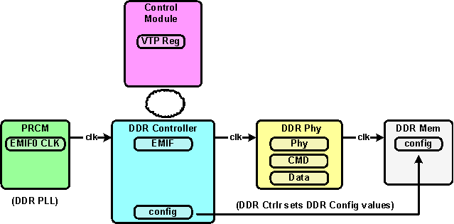
First Burning Question: So… where are the DDR timings and the clock set? DDR First
DDR Setup requires portions of 4 functional blocks to be setup. (Block Diagram)
EMIF , CMD, DATA and EMIF0 CLK are dependent on Memory selected

Slide 34
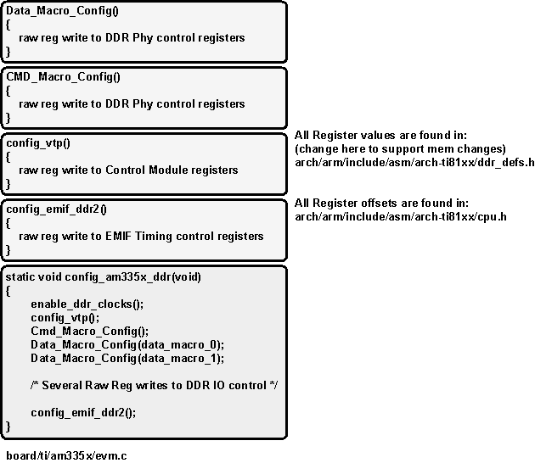
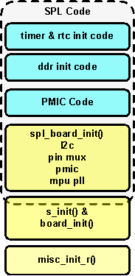
First Burning Question: So… where are the clock and DDR timings set? DDR First
The DDR is set up within the SPL context
enable_ddr_clocks in pll.c,
ddr_defs.h and cpu.h

Slide 35
Here is link to a Tool that can be used to generate necessary values to configure DDR
Spread Sheet Tool can be found here
  http://processors.wiki.ti.com/index.php/AM335x_EMIF_Configuration_tips

Slide 36
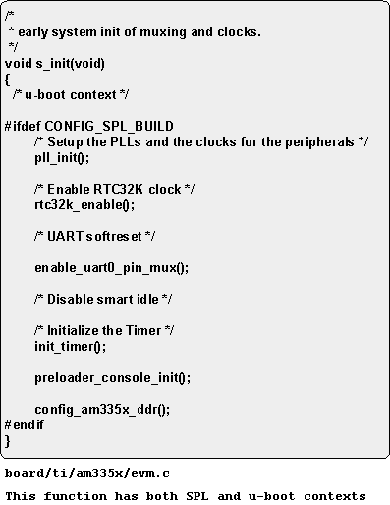
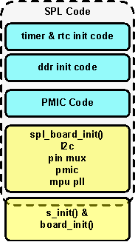
The SPL entry function
s_init is called from lowlevel_init.S to setup system PLL, RTC, UART, timer and finally configures DDR

Slide 37
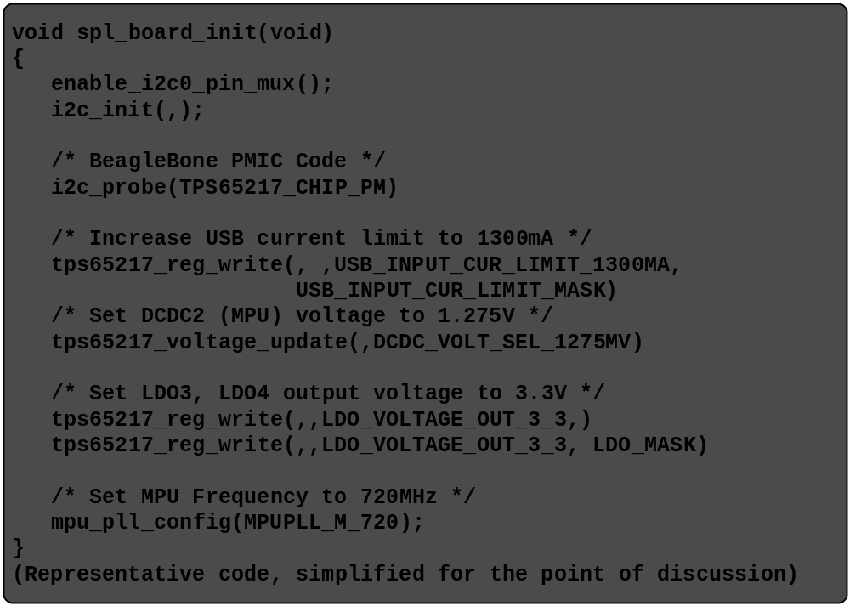
And now to Set the MPU Clock Rate….
SPL Context Function
Before setting the MPU PLL the voltage and current are increased using I2C commands to the tps65217.
Called from arch/arm/cpu/armv7/start.S
If you have a different PMIC you will most likely need a different code base than what is shown here

Slide 38
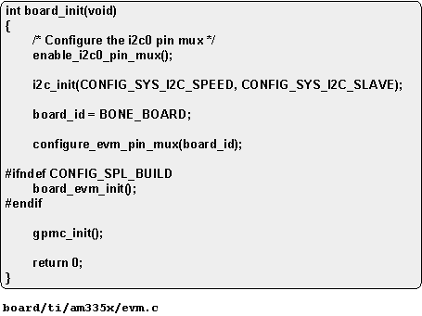
Board File Template for u-boot.img
Within the u-boot context this is the entry function
Same source file as used for SPL
Pin Mux config is setup for i2c, uart (already done in SPL) and

Slide 39
DO LAB 1……….

Slide 40
U-Boot Board Port Exercise 2 - Overview
Goal : Take the board template file (evm.c) and add both MMC and Ethernet support
How this is Demonstrated
  Using the supplied git tree checkout a Ethernet tagged branch, this has both the MMC and Ethernet support code. Build the kernel.
    This adds Pin Mux support for both Ethernet and MMC
    Adds the init functions for Ethernet and MMC.
What is being done:
  Examine the code changes necessary to implement Ethernet and MMC
Perform the Lab

Slide 41
Steps to adding MMC and Ethernet to the target board file
Review system info to see how peripheral is attached
Pin Mux
  Use the Pin Mux Utility to configure Pin Init data
  Create Device Init function
    If device is supported in U-Boot, set the desired include in include/configs
  Add Device Init Function to board file
Notes:
Start with Core Architecture/SOC/Target Board, peripheral support is already in the core and SOC port, just need to put that last definition to enable the peripheral

Slide 42
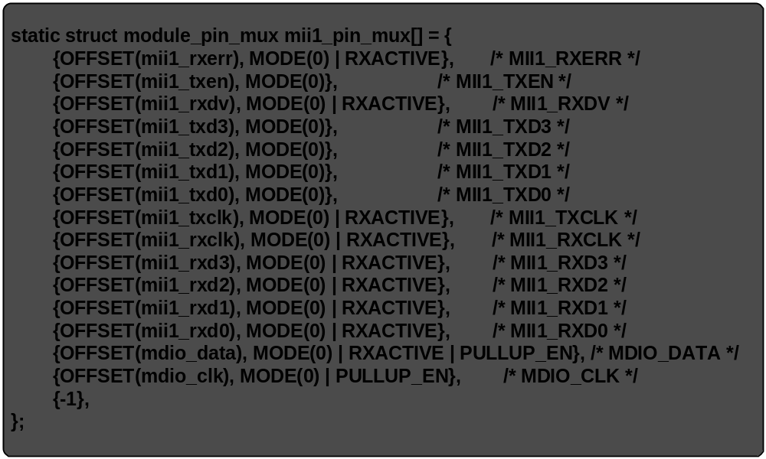
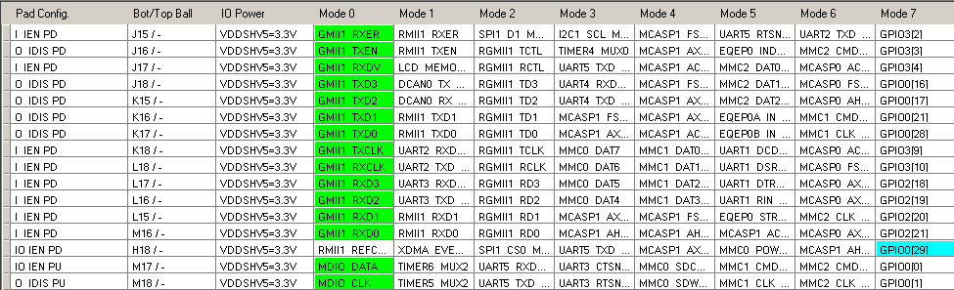
Pin Mux Utility
Pin Mux tool capture for MII interface
While the tool shows GMII this is the MII interface, doc bug in tool

Slide 43
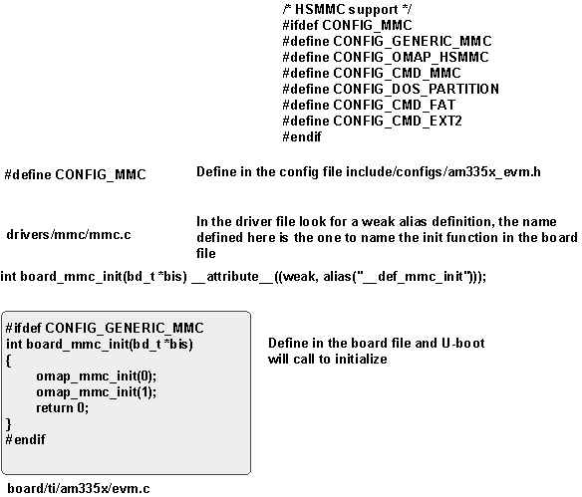
Adding MMC to the U-Boot Board file
Find the pre-processor flags in the am335x_evm.h config file that control inclusion of MMC
Use the name found for a weak alias to define in the board file
Create the init function in the board file

Slide 44
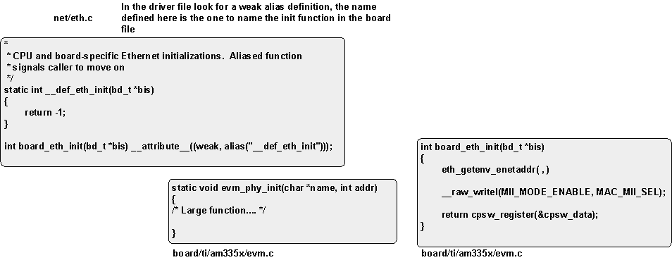
Adding Ethernet to the U-Boot Board File
Use the name found for a weak alias to define in the board file, in net/eth.c
Create the init functions in the board file
  2 functions are created one to init the phy (local) and the board_eth_init definition for u-boot network driver to call
There are additional supporting structures define in the board file

Slide 45

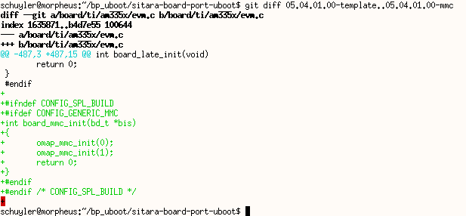
git diff – Code Difference between template and mmc commit
“git tag” is used to list tags on the git tree
“git diff” this is used to isolate code between git commits.
Do not be concerned about knowing git at this point, here we are using this for illustration purposes.

Slide 46
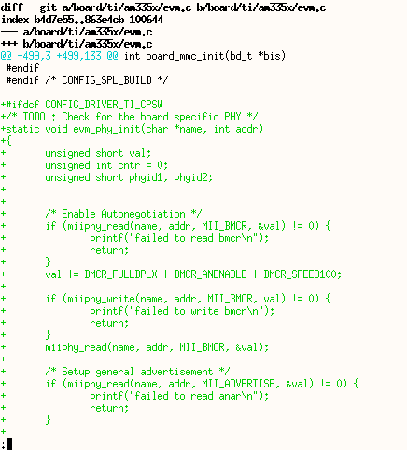
git diff – Code Difference between mmc and ethernet commit
“git diff” commands goes across several screens
Type “q” to quit command at any point
Note the plus sign on the edge of the diagram, code addition

Slide 47
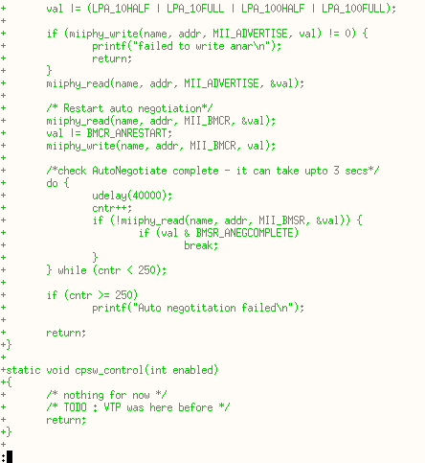
git diff – Code Difference between mmc and ethernet commit (cont)
Code continuation for Ethernet PHY setup
This code was extracted from Beagle Bone specific code from the SDK release.

Slide 48
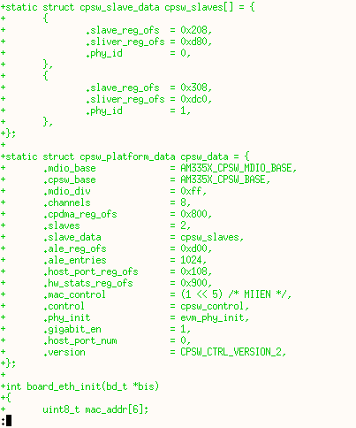
git diff – Code Difference between mmc and ethernet commit (cont)
Code continuation for Ethernet setup
This code was extracted from Beagle Bone specific code from the SDK release.

Slide 49
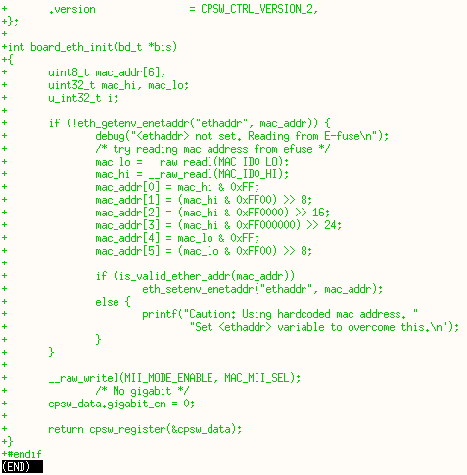
git diff – Code Difference between mmc and ethernet commit (cont)
Code continuation for Ethernet setup
This code was extracted from Beagle Bone specific code from the SDK release.
How is board_eth_init(..) called?

Slide 50
DO LAB 2……….

Slide 51
U-Boot Board Port Summary
Introduced a board port template file with a minimal feature set. Discussed the components in this file. This file could be used for actual board ports.
Performed two labs demonstrating the template file in action.

Slide 52
PORTING THE LINUX KERNEL TO AN AM335X TARGET

Slide 53
Linux Port Agenda
What are the different stages of a Port
Introduce the board file, where it fits in the Port Picture, where it is in the source tree
Discuss the OMAP2+ Machine Shared Common Code
Labs Introduction

Slide 54
Linux Board Port Exercises and Source Links
Link to the U-Boot Labs
  http://processors.wiki.ti.com/index.php/Sitara_Linux_Training:_Linux_Board_Port
Link to the Linux Template Source tree (clone this tree)
  git://gitorious.org/sitara-board-port/sitara-board-port-linux.git
PSP Linux Kernel Repo –
  http://arago-project.org/git/projects/?p=linux-am33x.git;a=summary

Slide 55
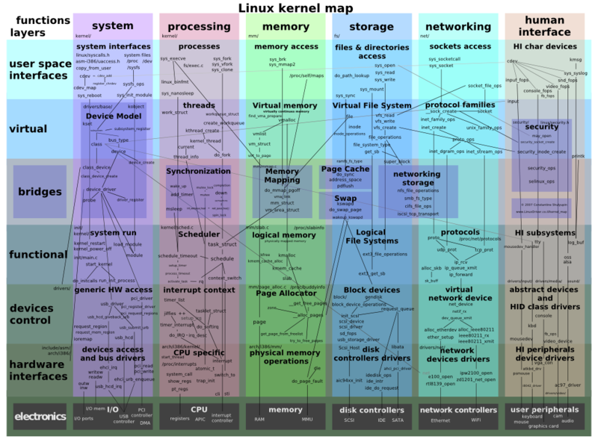
Linux Kernel Overview
(AHHHHH…. The Kernel…)
A very complex and overwhelming kernel block diagram, this is just to make you aware of what’s below the waterline…..
With a target port the architecture and SOC port has already been done. Therefore, the majority of this block diagram has been taken care of for the target port developer.
Source is:
http://en.wikipedia.org/wiki/File:Linux_kernel_map.png

Slide 56
Architecture vs. SOC vs. Board Porting
Board Developers only need to be looking at the last phase which is board porting, all the architecture and SOC port support has been done.

Slide 57
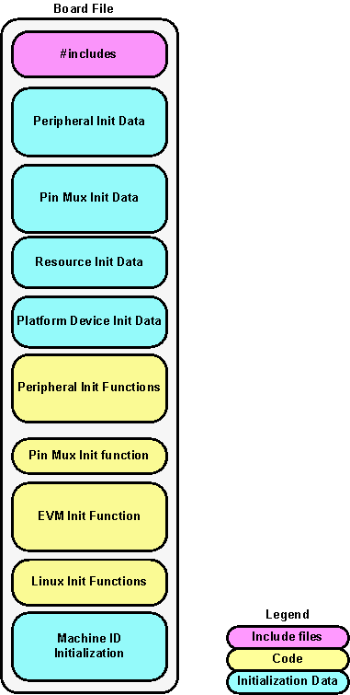
The Target Port Starts with a Board File
Defines the Machine Name
Declares Initialization Data for Peripherals being used
Declare Pin Mux initialization Data
Defines Initialization functions
Provides required Machine Initialization functions
Calls Common Initialization functions
Summary is that this file defines several required elements required to boot a Linux kernel, one of several bricks in the wall so to speak.
Notes:
Start with Core Architecture/SOC/Target Board, peripheral support is already in the core and SOC port, just need to put that last definition to enable the peripheral

Slide 58
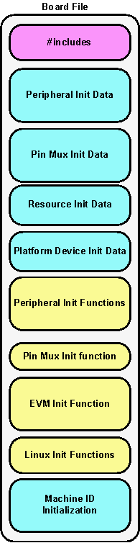
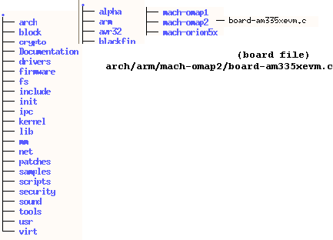
Linux Kernel Source Tree Overview
(Where is the Board file.)
The board file is located in a source directory called arch/arm/mach-omap2/ where all other board files are located of the same machine type.
Notes:
The board file is where the work starts for the target board developer
The developer will work out from this starting point to fill in the gaps
The developer will want to work out from the board file
The shared machine code is the first place that the developer works with, sometimes there is sufficient support in this interface, other times not

Slide 59
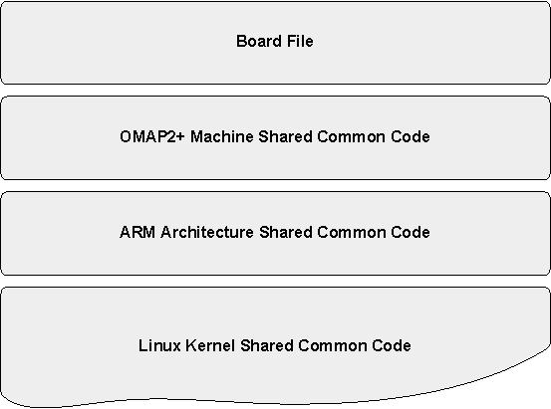
How the Board File fits in the stack
Board Developer will spend most of their time in the Board file.
The Board file makes use of the machine shared common code
The underlying port to the ARM Architecture Shared common code is already done and does not need to be looked at
Finally everything rests on the Linux Kernel Shared Common Code.
The lower in the stack you go the less direct interaction the board developer will or need to have.

Slide 60
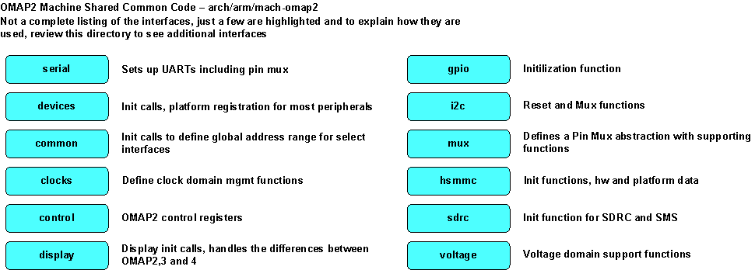
OMAP2+ Machine Shared Common Code
There are several board files in the mach-omap2 directory. These board files typical use the support functions defined within this directory. Below is a sampling of some of the supporting common code, not all are mentioned here.

Slide 61
OMAP2+ Machine Shared Common Code
Provided as means to provide a common interface to the SOC peripherals to reduce the time necessary to implement a board port
This interface is not always a clear dividing between maintainers and board developers.
This is not a documented interface and due to the changing nature of the Linux kernel will almost always be in flux. Maintainers in the end have the authority to accept reject code for their particular tree.

Slide 62
LINUX BOARD PORT LABS

Slide 63
Board Port Labs
Lab 1
  Introduce the template board file
Lab 2
  Build on the template file demonstrating how to add the MMC peripheral to provide a Root file system
Lab 3
  Build onto template file again this time adding Ethernet for network connectivity
Lab 4
  Demonstrate how to add an LCD panel to the board file
Notes:
All BP labs are:
Using the default configurations in the AM-SDK
Come from an external git tree that is public to use/clone/submit patches against
Using several tags in the git to demonstrate separate peripheral inclusion

Slide 64
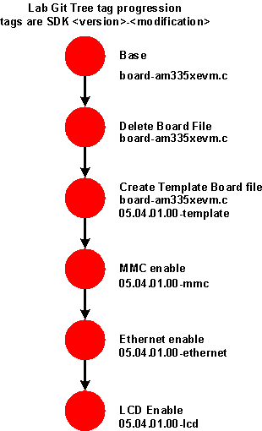
Board Port Source Tree being used
Currently Source is derived from AM-SDK-05.04.01.00, the Port Tree will follow or track each SDK release
A git tree has been setup for these labs on the host machines
Using existing board file name and build methods
Using the default kernel configuration supplied with the SDK
Notes:
What is being used for source code
Why the deletion of the original board file
Create the template file
Enable MMC
Enable Ethernet
LCD Enable

Slide 65
Linux Board Port Exercise 1 - Overview
Goal : Introduce workshop attendees to a board template file that can be used later for a Linux board port
How this is Demonstrated
  Build a kernel using provided AM335x board template file, which has:
    Base processor configuration for Linux, just serial console peripheral is initialized
    This board will not completely boot… no peripheral is defined for a Root File System
What is being done:
  Examine the board file to see what is being initialized
Perform the Lab

Slide 66
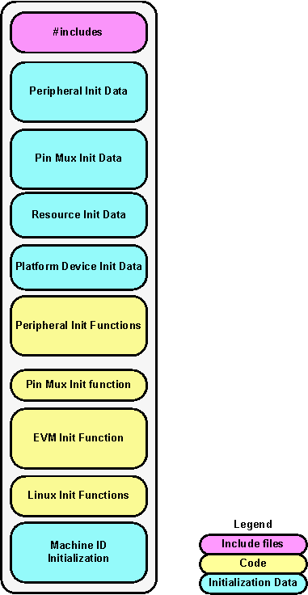
Template Board File Anatomy
Binds Linux to a particular target
Interfaces with the OMAP2+ Machine Shared Common Code.
Defines pin mux configuration
The file contains device initialization functions and data.
Defines the Machine ID and identifies to the Linux Kernel initialization functions
Notes:
Go over each block in the diagram
This template is an example, this works for OMAP class devices

Slide 67
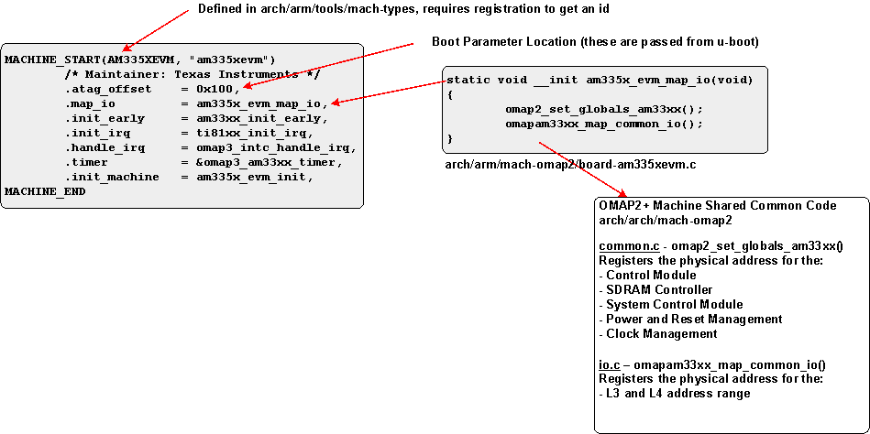
Template Board File Elements
MACHINE_START – Key Interface To Kernel
The Machine Start Macro is used to indentify initialization functions to the Linux kernel.
The am335x_evm_map_io is declared locally in the board file.
The am335x is define in the board file but calls common code to initialize the abstractions for the L3/L4 registers, this is existing code from the OMAP2+ Shared Common Code, no need to modify.

Slide 68
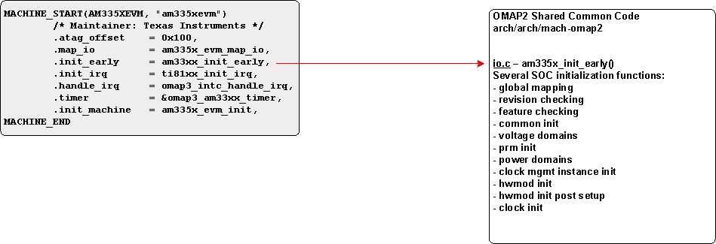
Template Board File Elements – (cont.)
MACHINE_START – Key Interface To Kernel
The am33xx_init_early is a function within the OMAP2+ Shared common code.
This is called directly from the common code without modification

Slide 69
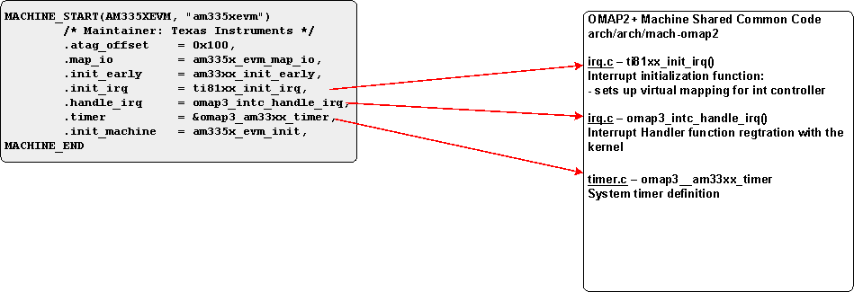
Board Template File Elements – (cont)
MACHINE_START – Key Interface To Kernel
All three of these functions defined come from the OMAP2+ Shared Common Code, none of these needed to be modified.

Slide 70
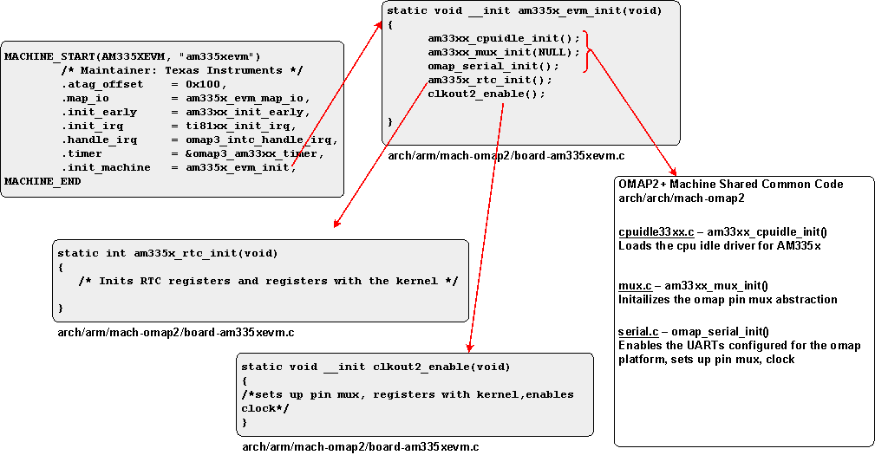
Template Board File Elements – (cont)
MACHINE_START – Key Interface To Kernel
The am335x_evm_init() is defined by the developer, but uses several functions from the OMAP2 Common Code without modification.

Slide 71
Question
Within the kernel source, where is the am335xevm board file located?
arch/arm/mach-omap2

Slide 72
DO LAB 1……….

Slide 73
Linux Board Port Exercise 2 - Overview
  Goal: Build on the template file demonstrating how to add the MMC peripheral to provide a Root file system
How this is demonstrated:
  Using the provided lab git tree branch that has the code additions necessary to enable MMC
  With MMC enabled the root file system can now be mounted
What is being done:
  Explaining the code addition components
Perform the Lab

Slide 74
Steps to adding an MMC interface to target board file
Review system info to see how peripheral is attached
Pin Mux
  Use the Pin Mux Utility to configure Pin Init data
Device/Platform Initialization data
  Some peripherals may not require init data
  Create Device Init function
  Add Device Init function to EVM Init Function
Notes:
Start with Core Architecture/SOC/Target Board, peripheral support is already in the core and SOC port, just need to put that last definition to enable the peripheral

Slide 75
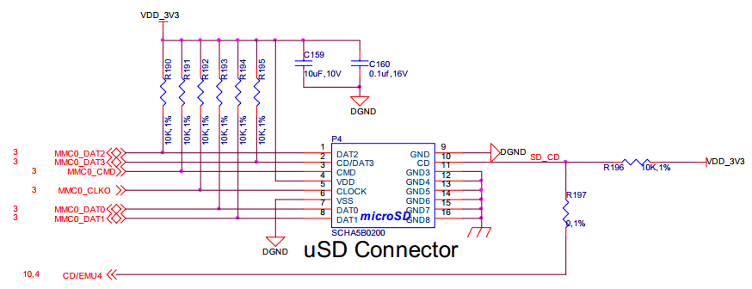
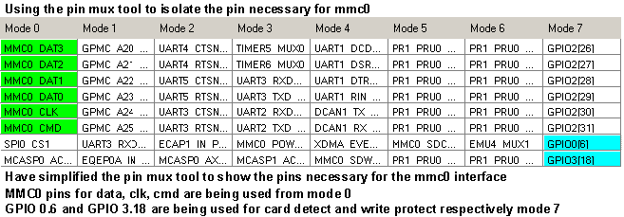
How is the peripheral attached? – Schematic to Pin Mux Utility
Beagle Bone Schematic
Pin Mux Tool Capture
Beagle Bone does not use the WP pin

Slide 76
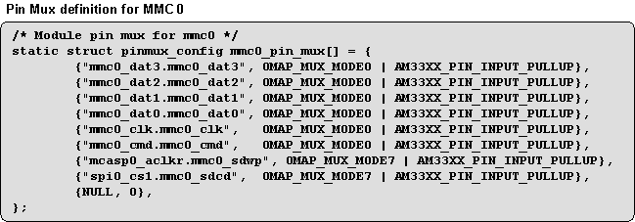

Lab 2 Board File Additions – Pin Mux Initialization Data
Capture from the Pin Mux tool, AM3358 ZCZ package
Use existing pinmux_config struct to create pin mux initialization data for mmc0
Number of pins has to match

Slide 77
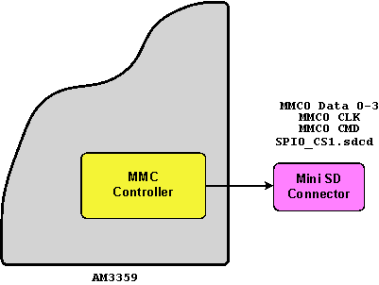
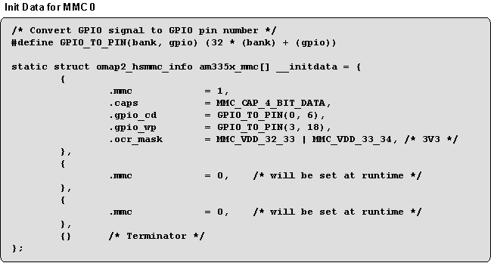
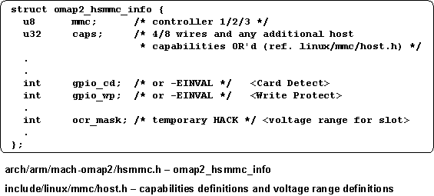
Lab 2 Board File Additions – MMC Device Initialization Data
MMC initialization structure to enable interface #1
This init data is from EVM, BB does not use WP signal
OMAP 2 mmc structure definition
Only the elements used are shown, several more

Slide 78
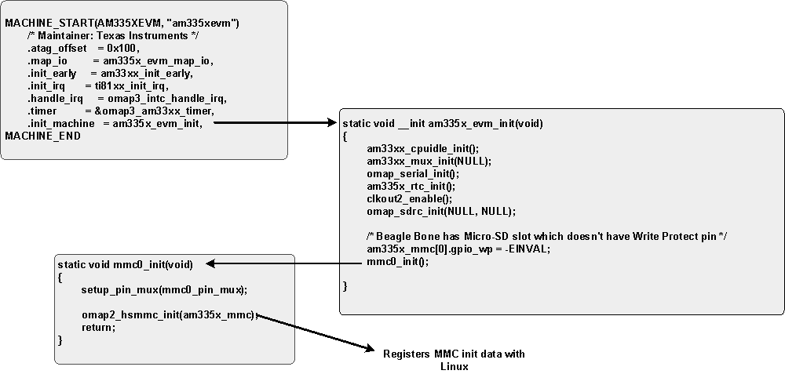
Initialization Function Call Sequence for MMC Enabling
This sequence of code is adding in the MMC initialization code to the template file.

Slide 79

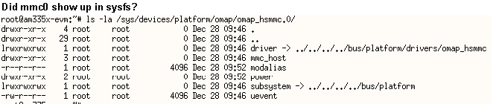

mmc0 initialization – did it work?
Notes:
These are just quick litmus tests of passing, does not imply fully functional or optimally setup, just that linux is able to mount a root file system on the mmc peripheral
Other than the obvious statement that the Root File System mounted
Review dmesg output
Looking at sys/fs
mount

Slide 80


git diff – Code Difference between template and mmc commit
Code for MMC setup
This code was extracted from Beagle Bone specific code from the SDK release.
git tag result for linux board port tree
git diff command for this commit

Slide 81

git diff – Code Difference between template and mmc commit (cont)
Code for MMC setup
Pin mux was started on previous page
This code was extracted from Beagle Bone specific code from the SDK release.

Slide 82

git diff – Code Difference between template and mmc commit (cont)
Code for MMC setup
Note this looks like a repeat from previous page, only these lines are different…
How is mmc0_init() called?
This code was extracted from Beagle Bone specific code from the SDK release.
use “q” to quit

Slide 83
DO LAB 2……….

Slide 84
Lab 2 Summary
Added code to the board port template file to handle pin mux, MMC controller initialization and evm initialization function.
All changes happened within the board file

Slide 85
Linux Board Port Exercise 3 - Overview
Goal: Build onto the template file again adding Ethernet for Network connectivity
How this is demonstrated:
  Using the lab git tree branch with the code additions necessary to enable Ethernet
  With Ethernet enabled Remote Matrix will be brought up on the browser on the Host machine
What is being done:
  Explaining the code addition components (in multiple files this time)
Perform the Lab

Slide 86
Steps to adding Ethernet to target board file
Review system info to see how peripheral is attached
Pin Mux
  Use the Pin Mux Utility to configure Pin Init data
Device/Platform Initialization data
  None required for this integration
  Create Device Init function
    Additional Init code required outside the board file
  Add Device Init Function to EVM Init Function
Notes:
Start with Core Architecture/SOC/Target Board, peripheral support is already in the core and SOC port, just need to put that last definition to enable the peripheral

Slide 87

MII Ethernet connection
Captured from Beagle Bone SRM
Please use RMII for MII here in this example, doc bug….
MII Interface signals that need to be indentified to the driver

Slide 88


Pin Mux Utility and pinmux config struct
Pin Mux tool capture for MII interface
While the tool shows GMII this is the MII interface, doc bug in tool
This demonstrates how the Pin Mux utility can assist in filling out the pinmux_config structure

Slide 89

devices.c - code addition outside of board file
Reason - This is code added to devices.c to supplement existing am33x_cpsw_init, does not require eeprom support.
Reads the MAC IDs
Sets the PHY type
Registers MDIO
Register CPSW with Linux kernel
Notes:
Added init function to handle non TI based target boards, this is just an example (there is a mistake in the code……)
Does not expect an eeprom to contain mac,

Slide 90


Ethernet Device Init and EVM Init functions
The MII init function – call pin mux setup.
The EVM init function – calls mii1_init and the cpsw init function.
Notes:
Blocks of code added to support Ethernet
pin mux
Initialization function call, fairly strait forward
EVM Initi function
Still additional changes needed
-

Slide 91



Ethernet Initialization – Did it work?

Slide 92
DO LAB 3……….

Slide 93
Lab 3 summary
Followed the steps of system attach review, pin mux config, device init to evm init
Had to add additional code outside the board file to support initializing the cpsw for a generic case

Slide 94
Linux Board Port Exercise 4 - Overview
Goal: Build onto the template file again adding support for an LCD panel
How this is demonstrated:
  Using the lab git tree tagged branch with code additions necessary to enable an LCD Panel
What is being done:
  Explaining the code addition components (multiple files this time)
Perform the Lab

Slide 95
Steps to adding an LCD Panel to target board file
Review the system
  3 interfaces used: PWM (backlight), LCD, Touch Screen
Pin Mux
  Use the Pin Mux Utility to configure Pin Init data
Device/Platform Initialization data?
  Backlight , LCD and Touch screen all have initialization data
  Create Device Init function initializes all 3 components
  Add Device init to board_init
Notes:
Start with Core Architecture/SOC/Target Board, peripheral support is already in the core and SOC port, just need to put that last definition to enable the peripheral

Slide 96

LCD Panel Functional Components
LCD is the same 7” panel currently found on the EVM
The respective controllers require data initialization

Slide 97


LCD Panel Pin Mux Initialization
Pin Mux Tool capture for the LCD Panel
Notes:
Notice the difference between the LCD data lines in the Pin Utility and the Pin Mux Config structure. This is due to Pin Utility has no means to know what kind of Panel is attached, this one is output only.

Slide 98


LCD Touch Screen Pin Mux Initialization
Pin Mux Capture of Pins used for Touch Screen
4 Wire Resistive touch
2 Wire for Voltage reference
Pin connections are determined by schematic reference
Notes:
Notice that these pins do not have any other mux mode options

Slide 99

LCD Back Light Pin Mux Initialization
Just a single pin used for the backlight.
This is a pwm signal that is used to control brightness

Slide 100

Add LCD Panel – Data Initialization
This configures the registers in the LCD Controller.
The datasheet for LCD will provide information (to name a few)
  BPP
  Clock polarity
  Data Format
  DMA

Slide 101

LCD Panel Initialization data used by the LCDC
LCD Panel interfacing numbers have to be added in the da8xx-fb.c if they are not alreay defined.
These numbers are derived from the datasheet for the panel (to name a few)
  Screen resolution
  Timings
  Pixel Clock and Polarity

Slide 102



Backlight Initialization Data
PWM is used to control the LCD Panel Brightness

Slide 103


LCD Init Function
The steps are:
  Pin mux setup
  Assign a GPIO to support VDD_en to the LCD
    Refer to schematic on which to use
  Define PLL value for the pixel clock
  Register with the kernel

Slide 104



LCD Clocking Layout

Slide 105


Touch Screen and Backlight Init Functions
These init functions call the pin mux config function with the earlier defined initialized structures

Slide 106

LCD Init Sequence in the EVM Init function
Calling three functions, initialization of
  Backlight
  LCD
  touchscreen

Slide 107
DO LAB 4……….

Slide 108
Summary Lab 4
LCD required 3 functions to be configured, Backlight, Touch Screen and LCDC
  required device initialization data
  required init functions
  required pin mux configurations
Made additions to the board file and the frame buffer support file

Slide 109

So…. does it work yet? Works Enough!

Slide 110
THANK YOU!
For more Sitara Boot Camp sessions visit: www.ti.com/sitarabootcamp

