Slide 1
U-Boot and Linux Kernel Debug using CCSv5
In this session we will cover fundamentals necessary to use CCSv5 and a JTAG to debug a TI SDK-based U-Boot and Linux kernel on an EVM platform.
LAB: http://processors.wiki.ti.com/index.php/Sitara_Linux_Training
July 2012

Slide 2
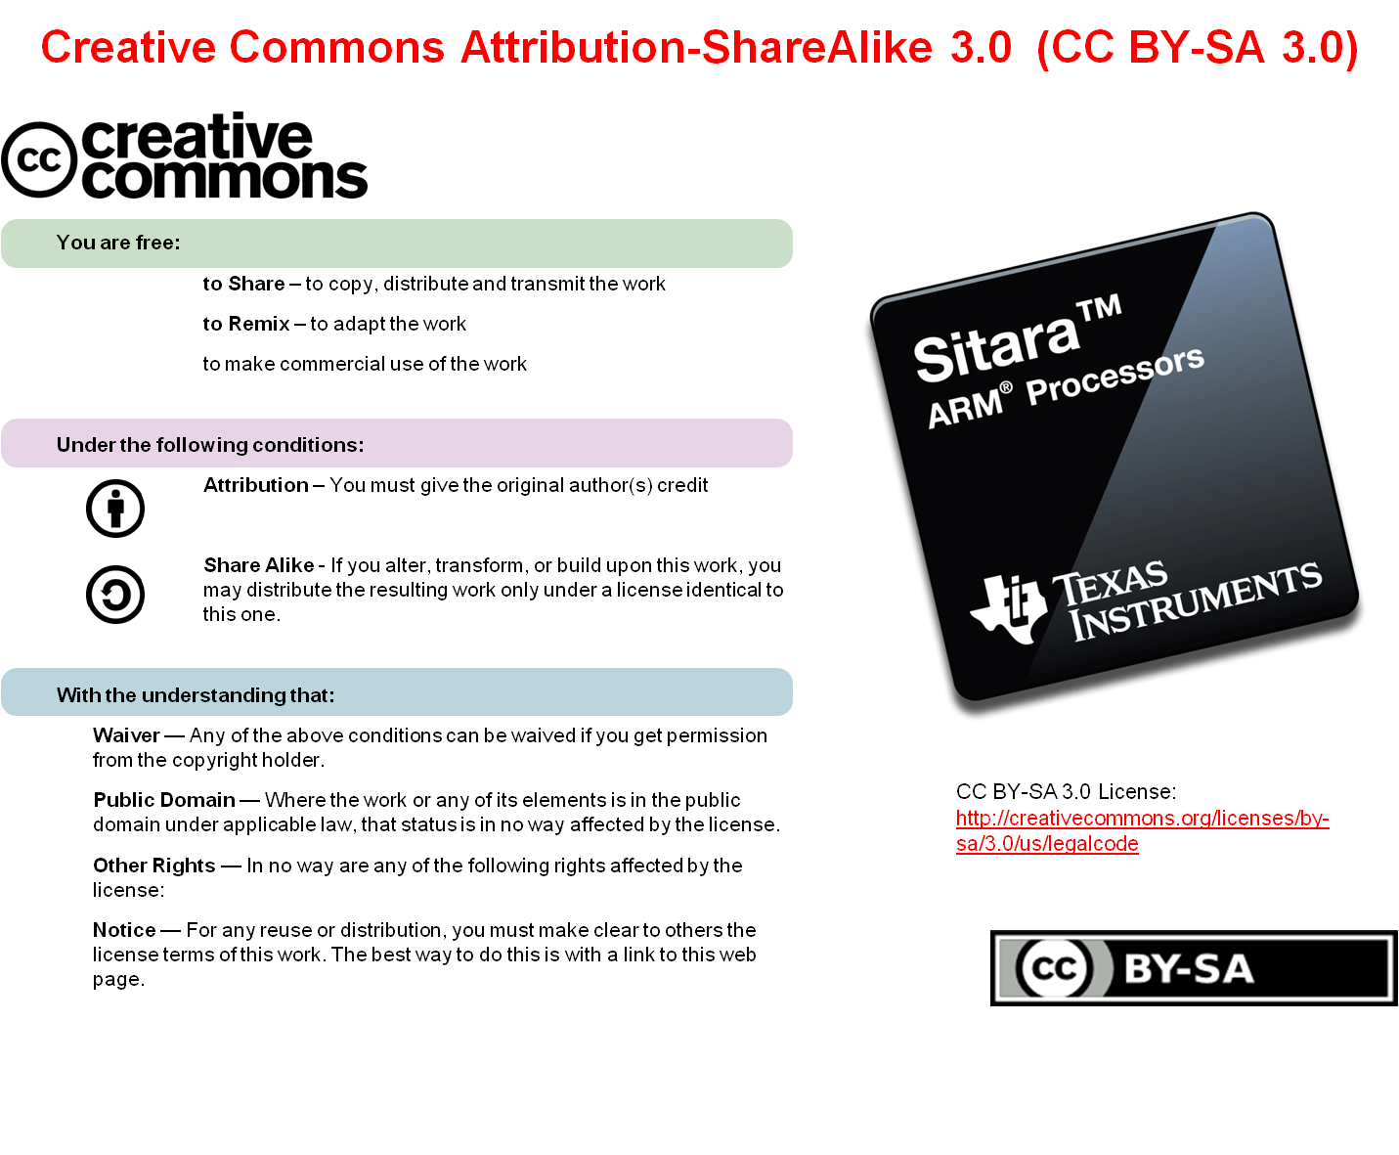

Slide 3
Pre-work Check List
Installed and configured VMWare Player v4 or later
Installed Ubuntu 10.04
Installed the latest Sitara Linux SDK and CCSv5
Within the Sitara Linux SDK, ran the setup.sh (to install required host packages)
Using a Sitara EVM, followed the QSG to connect ethernet, serial cables, SD card and 5V power
Booted the EVM and noticed the Matrix GUI application launcher on the LCD
Pulled the ipaddr of your EVM and ran remote Matrix using a web browser
Brought the USB to Serial cable you confirmed on your setup (preferable)

Slide 4
Agenda
Sitara Linux SDK Development Components
Example Development Environment
U-Boot Debug Overview
U-Boot Debug Lab
Kernel Debug Overview
Kernel Debug Lab

Slide 5
Background for this Workshop
Understand the SPL/U-Boot/Kernel boot process
Knowledge of the Sitara Linux SDK and that it contains a cross compiler for the target device, CCSv5.1 and the source code for SPL/U-Boot/Kernel
Have run the setup scripts in the Sitara Linux SDK to configure the target to boot the Linux kernel from tftp.
Some knowledge of CCSv5
Techniques presented here are not the only way to do things.

Slide 6
SITARA LINUX SDK COMPONENTS

Slide 7
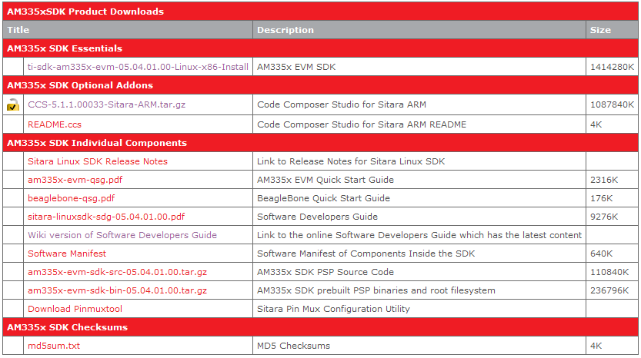
Where to get the Sitara SDK w/ CCS
SDK Installer
CCSv5 Installer
The list of available Sitara Linux SDKs can be found at: http://www.ti.com/tool/linuxezsdk-sitara

Slide 8
CCS Installation – Key things to know..
JTAG use requires a License
  The XDS100v2 can be used without a license
  You can use a free 90 day evaluation license for all other emulators
To get JTAG support the CCS installer needs to be run in root mode using “sudo”

Slide 9
EXAMPLE DEVELOPMENT ENVIRONMENT

Slide 10
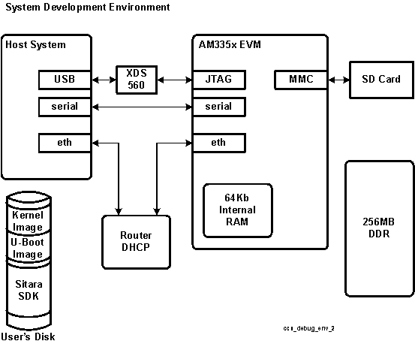
Example AM335x EVM Debug Environment
Ubuntu 10.04 LTS
Sitara Linux SDK
CCSv5.1
XDS560v2 USB JTAG
Serial Console
Ethernet
SD Card
  MLO/U-Boot Pre-builts
  Root File System installed

Slide 11
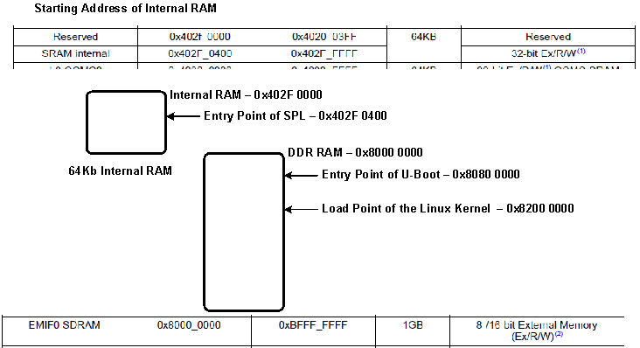
AM335x Image Load Addresses
These addresses are related to the AM335x, other processors will have different addresses, please refer to respective TRMs. The Addresses here are pulled from the AM335x TRM.

Slide 12
U-BOOT DEBUG OVERVIEW

Slide 13
U-Boot Debug Overview
Familiarize yourself with the u-boot load address. This can be found in the configuration file (i.e. include/configs/am335x_evm.h) and look for the following variables:
  For SPL - CONFIG_SPL_TEXT_BASE
  For U-boot - CONFIG_SYS_TEXT_BASE
Define a CCS project and point to the source tree within the SDK
  This will take a couple minutes since CCS will index the u-boot source tree
Create a target configuration (can specify a gel file)
Power on the EVM with no SD card installed
Launch the target configuration
From CCS connect to the Target, this suspends the target

Slide 14
U-Boot Debug Overview - Cont.
Switch from THUMB2 to ARM mode
Load the SPL image
  Load the binary (bin) image if you are not debugging the SPL on the persistent storage
  If using persistent storage you do not need to load anything
Load the U-Boot information
  Load the ELF image if you are not debugging the u-boot on the persistent storage (i.e. SD card or NAND)
  Load the symbols only if you are using the u-boot from the persistent storage
Navigate Source Code and set desired HW Break Point

Slide 15
U-Boot Debug Overview - Cont.
Depending on how code was loaded:
  Start target execution from the U-boot load address if your loaded the ELF image
  Perform system reset from CCS if you loaded the symbold for u-boot in the persistent storage
These steps will be performed in the Debug Lab and will emphasize that how U-Boot is loaded matters (i.e. whether in SPL context or not)

Slide 16
U-BOOT DEBUG LAB

Slide 17
U-Boot Debug Lab Overview
Have to build U-Boot to get an binary SPL and ELF U-Boot image to work with
Load the SPL which has some knowledge that is needed beforehand
Halt the SPL to allow loading U-Boot
Load the U-Boot ELF image
Open the source browser and set a HW break point
Run the U-Boot binary and you will hit the HW break point

Slide 18
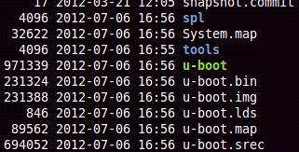
U-Boot Build (Refresher)
To get an image with Debug Information in it you have to build U-Boot, which is already configured to build with Debug information in it.
Start with clean configuration
Configure for EVM
Build for EVM
U-Boot ELF Image

Slide 19
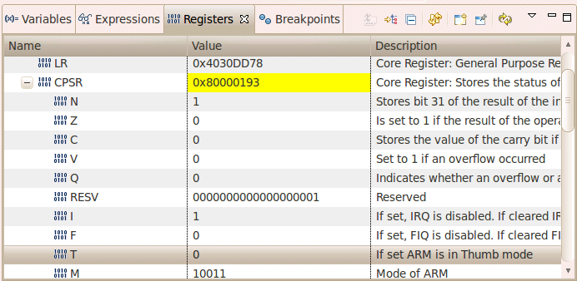
Changing from Thumb2 to ARM Mode
ROM Code runs in Thumb2 mode, after loading the SPL binary image and the PC is set to the entry point of SPL, the processor must be set to ARM mode. The reason this has to be done is the ROM code is not being used to jump from ROM to SPL and therefore the BX instruction that the ROM uses to jump to SPL and change the execution mode is not being used.

Slide 20
KERNEL DEBUG OVERVIEW

Slide 21
Linux Kernel Debug Steps using CCS
Define a CCS project and point to the source tree within the SDK
  This will take several minutes since CCS will index the kernel source tree
Create a target configuration
Power on the EVM with an SD card installed that contains MLO and U-Boot, press any key to stop the auto-boot into Linux
Launch the target configuration
From CCS connect to the Target, this suspends the target
Build the Linux kernel to generate the images needed (vmlinux and uImage)
Copy the arch/arm/boot/uImage image to the tftpboot directory

Slide 22
Linux Kernel Debug Steps using CCS (cont)
Load the vmlinux symbols (no code), and now navigate kernel source and set desired HW Break Point
From CCS resume target execution
From the serial console type “boot” to tftp the kernel image and start execution.
The breakpoint will now be hit if it was set on code that will be executed
This will be performed in the Lab accompanying this lecture.

Slide 23
What expected in a Linux Kernel Debug
The board developer typically wants to:
  Look at code they modified such as the board file
  Halt the system and examine system registers
    Will need to be aware of Virtual to Physical addressing requirements
The board developer will not typically be looking at core kernel functions such as the scheduler
  Kernel Optimization will make single stepping hard to follow, kernel is built with O2.
  Many of the core functions make heavy use of inline functions which are not handled well by CCS

Slide 24
KERNEL DEBUG LAB

Slide 25
Linux Debug Lab Overview
The Kernel has to be configured and then built to generate the debug images
Hardware Breakpoints will be used to stop the kernel during the boot
While stopped a couple of locations will be examined using the memory browser
Single stepping will also be performed so the optimization affects can be witnessed.

Slide 26
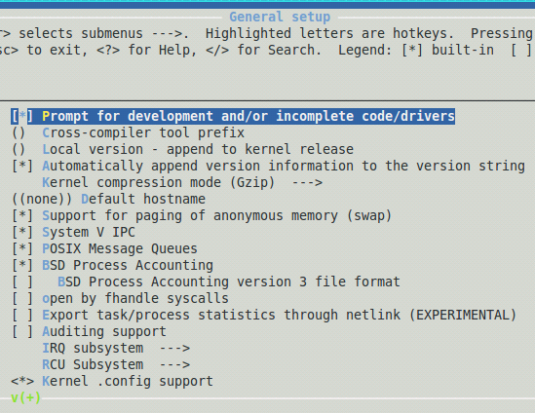
Kernel Build
Under General Setup in the Kernel Config
Select Prompt for development and/or incomplete code/drivers

Slide 27
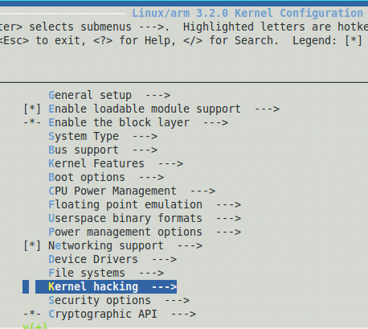
Kernel Debug Configuration
Start a Kernel configuration session, here starting with a default configuration
Locate the Kernel Hacking entry in the configuration menu
Note: Use the cursor keys to navigate and the space bar to select the desired kernel option.

Slide 28
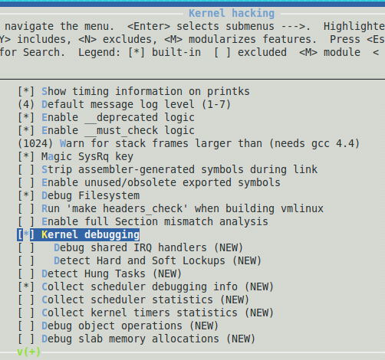
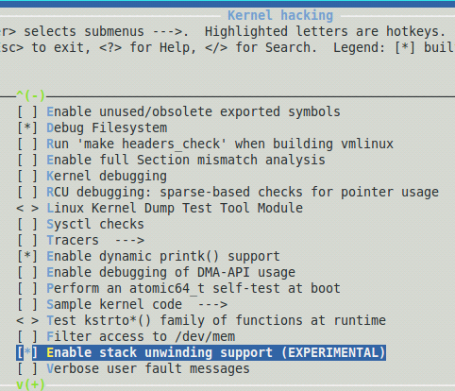
Kernel Debug Configuration (cont)
Under Kernel Hacking enable “Kernel Debugging”
Also under Kernel Hacking enable “Enable stack unwinding support”

Slide 29
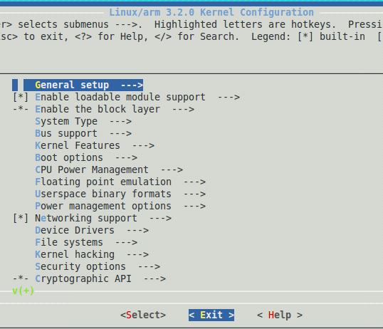
Kernel Debug Configuration (cont) and Build
Be sure to save your configuration, you will be prompted to do so.
Build the kernel with the following line:
Since Debug information is being compiled this build will take considerable time.

Slide 30

THANK YOU!
For more Sitara Boot Camp sessions visit: www.ti.com/sitarabootcamp

