Slide 1
Mid-Term Project Status LIQUID: 2-D FLUID DYNAMIC SIMULATOR
TEAM PRYMM
Pavan Kumar Gade, Radhika Panchal, Yashraj Sinha, Minghua Liu and Manoj Mathe

Slide 2
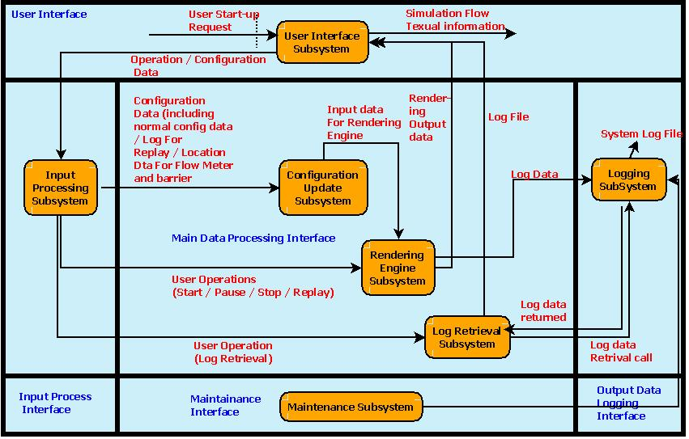
Architecture Diagram

Slide 3
Current Status of each component
Components | Percentage Completion
User Interface Subsystem | 90
Input Processing | 70
Configuration Update Subsystem | 70
Rendering Engine Subsystem | 50
Log Retrieval subsystem and Logging Subsystem | 10
Maintenance | 0

Slide 4
Current status of project task
User Interface subsystem
GUI design : 90 %
Configuration Settings: 90%
Rendering Engine subsystem
Calculation of fluid Particles : 50%
Pipe settings and Initial force influence : 20%
Log subsystem
Write log : 10% - GUI for writing log implemented
Retrieve log : 10% - GUI for retrieve log implemented
Maintenance
Log size monitoring : 0%
Installable Feature
Make application installable on MS Windows platform : 0%
Documentation
User Manual, Programmer guide : 0%

Slide 5
Technical and Scheduling area of concern
Technical areas of concern
None
Scheduling areas of concern
In time implementation with correct calculations to simulate flow of fluid from all four directions.

Slide 6
Remaining Task Schedule
User Interface - Add flow meter
(Radhika Panchal :17th to 25th November 2015)
Log - Write break point , flow meter and configuration in log file
(Pavan Kumar Gade and Manoj Mathe: 17th to 29th November 2015)
Log - Retrieve log file and perform configuration settings accordingly
(Pavan Kumar Gade and Manoj Mathe:17th to 29th November 2015)
Maintenance – Tracking size of log file
(Minghua Liu : 03rd to 5th December 2015)
Rendering - Fluid flow from all directions of container and impact of adding pipe at entry and exit path
(Yashraj Sinha : 17th to 29th November 2015)
Installable feature : Make the application installable on MS Windows.
(Minghua Liu : 05th to 09th December 2015)
Documentation – Preparation of User guide, Installation guide and Programmer guide
(Team PRYMM from 11th to 13th December 2015)
Integration and System Test : After every feature integration and before major milestones.
(Yashraj Sinha and Minghua Liu

Slide 7
Thank You

