Slide 1
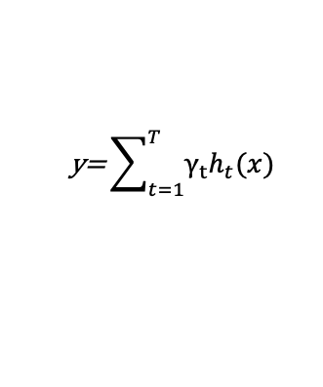




Input
Feature Selection
Ensemble learning framework
Output
Gene feature
CatBoost Models
pathogenic
TR locus
Gene1
5’UTR
exon
…
A
T
T
A
T
T
…
Gene2
A
T
T
A
T
T
…
3’UTR
Intron
$$\text{y}\text{=}\sum_{t=1}^{T}{γ_{t}h_{t}(x)}$$
exon
C
G
G
C
G
G
…
Sequence feature
$$y_{i1}$$
$$y_{i2}$$
…
$$y_{in}$$
Stacking
A
G
A
G
A
G
…
flanking
A
T
T
A
T
T
…
T
C
C
T
T
C
…
$$y=Meta(y_{1},y_{2},…,y_{n})$$
Ref
…
G
C
G
C
…
A
C
A
C
…
TR
G
C
C
…
Logistic Regression
benign

