Slide 1
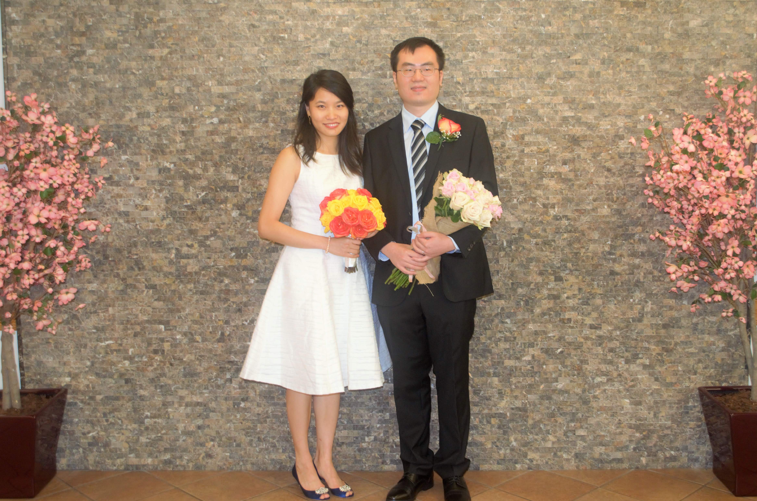
test
Edit from laptiop

Slide 2
dfds

