Slide 1


aNMM: Ranking Short Answer Texts with Attention-Based Neural Matching Model
Liu Yang¹, Qingyao Ai¹, Jiafeng Guo², W. Bruce Croft¹
¹Center for Intelligent Information Retrieval, University of Massachusetts Amherst
²Institute of Computing Technology, Chinese Academy of Sciences

Slide 2
Outline
Motivation
Related Works
Learning to rank for QA
Deep learning for QA
Attention-based Neural Matching Model
Experiments
Data Set and Experiment Settings
Model Learning Results
Experimental Results for Ranking Answers
Conclusions and Future Work

Slide 3
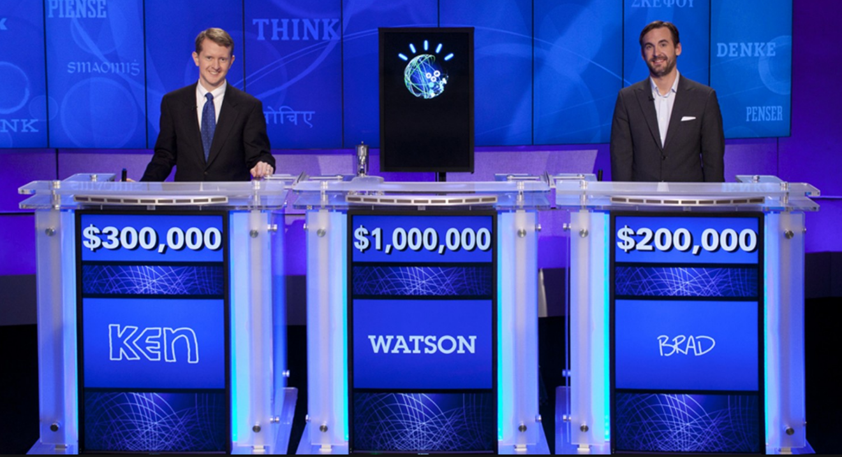



Motivation
Question answering plays a central role in many popular mobile search systems and intelligent assistant systems
Google Assistant, Microsoft Cortana, Microsoft Xiaoice, IBM Watson, etc.
Users are more likely to expect direct answers instead of a rank list of documents from search results
Retrieve finer grained text units such as passages or sentences as answers for Web queries or questions
Notes:
As the increasing popularity of mobile search systems and intelligent assistant systems such as Google Now and Microsoft Cortana, search engine users are more likely to expect direct answers instead of a rank list from search results.
Thus retrieving finer grained text units such as passages or sentences as answers for Web queries or questions is becoming increasingly important.

Slide 4
Learning to Rank for QA
Many previous QA systems used a learning to rank approach
Encode question/answers with complex linguistic features including lexical, syntactic and semantic features
E.g. Surdeanu et al. [1,2] investigated a wide range of feature types for learning to rank answers
Problems with learning to rank approaches
Reply on feature engineering, which is time consuming and requires domain dependent expertise
Need additional NLP parsers or external knowledge sources
may not be available for some languages
[1] M. Surdeanu, M. Ciaramita, and H. Zaragoza. Learning to rank answers on large online QA collections. In ACL 2008.
[2] M. Surdeanu, M. Ciaramita, and H. Zaragoza. Learning to rank answers to non-factoid questions from web collections. Comput. Linguist., 2011.

Slide 5
Deep Learning for QA
Recently researchers have been studying deep learning approaches to learn semantic match between questions and answers
Convolutional Neural Networks (CNN) [3, 4, 5]
Long Short-Term Memory (LSTM) networks [6]
Benefit of not requiring hand-crafted linguistic features and external resources except pre-trained word embedding
Some of them [5] achieve state-of-the-art performance for answer sentence selection task benchmarked by the TREC QA Data
[3] L. Yu, K. M. Hermann, P. Blunsom, and S. Pulman. Deep Learning for Answer Sentence Selection. In NIPS Deep Learning Workshop, 2014.
[4] X. Qiu and X. Huang. Convolutional neural tensor network architecture for community-based question answering.In IJCAI 2015.
[5] A. Severyn and A. Moschitti. Learning to rank short text pairs with convolutional deep neural networks. In SIGIR 2015.
[6] D. Wang and E. Nyberg. A long short-term memory model for answer sentence selection in question answering. In ACL 2015.

Slide 6

Deep Learning for QA
Problems with current deep learning architectures for answer sentence selection
The proposed models, either based on CNN or LSTM, need to be combined with additional features such as word overlap features [3,5] and BM25 [6] to perform well
Without combining additional features, the performance of their model is significantly worse
Comparing with the results from the state-of-the-art methods using linguistic feature engineering [7]
Research question:
Could we build deep learning models that can achieve comparable or even better performance without combining additional features than methods using feature engineering ?
[7] W.-t. Yih, M.-W. Chang, C. Meek, and A. Pastusiak. Question answering using enhanced lexical semantic models. In ACL 2013.
Notes:
The proposed models, either based on CNN or LSTM, need to be combined with additional features such as word overlap features [3,5] and BM25 [6] to perform well

Slide 7
Observations From the Current Deep Learning Architectures for Ranking Answers
Architectures not specifically designed for question/answer matching
CNN
Uses position-shared weights with local perceptive filters to learn spatial regularities as in many CV tasks
Such spatial regularities may not exist in the semantic matching between questions and answers
Complex linguistic property of natural languages
LSTM
View the question/answer matching problem in a sequential way
No direct interactions between question and answer terms
Can not capture sufficiently detailed matching signals
Our solution
Introduce a novel value-shared weighting scheme in deep neural networks
Learn value regularities rather than spatial regularities
Notes:
Important similarity signals between question and answer terms could appear in any position due to the complex linguistic property of natural languages

Slide 8
Observations From the Current Deep Learning Architectures for Ranking Answers
Lack of modeling question focus
Understanding the focus of questions which are important terms is helpful for ranking answers correctly
E.g. Where was the first burger king restaurant opened ?
Most existing text matching deep learning models do not explicitly model question focus
Our solution
Incorporate attention scheme over question terms
Introduce attention mechanisms with a gating function
Explicitly discriminate the question term importance
Notes:
Most existing text matching deep learning models do not explicitly model question focus
CNNs treat all the question terms are equally important when matching to answer terms
LSTMs usually model question terms closer to the end to be more important
Why LSTMs usually model question terms closer to the end to be more important?
In a hypothetical RNN that doesn't use LSTM, say our hidden unit at time t gets 1/2 of its value from the hidden unit at time t-1, and 1/2 from the current input. Then the influence of an input on hidden units decays exponentially over time since it keeps getting halved. Now say we have a single input at the beginning, the hidden unit gets its value from that, and we fully block all future inputs. Then the influence of that first input doesn't decay at all, since it isn't getting halved at each time step.

Slide 9
Outline
Motivation
Related Works
Learning to rank for QA
Deep learning for QA
Attention-based Neural Matching Model
Experiments
Data Set and Experiment Settings
Model Learning Results
Experimental Results for Ranking Answers
Conclusions and Future Work

Slide 10

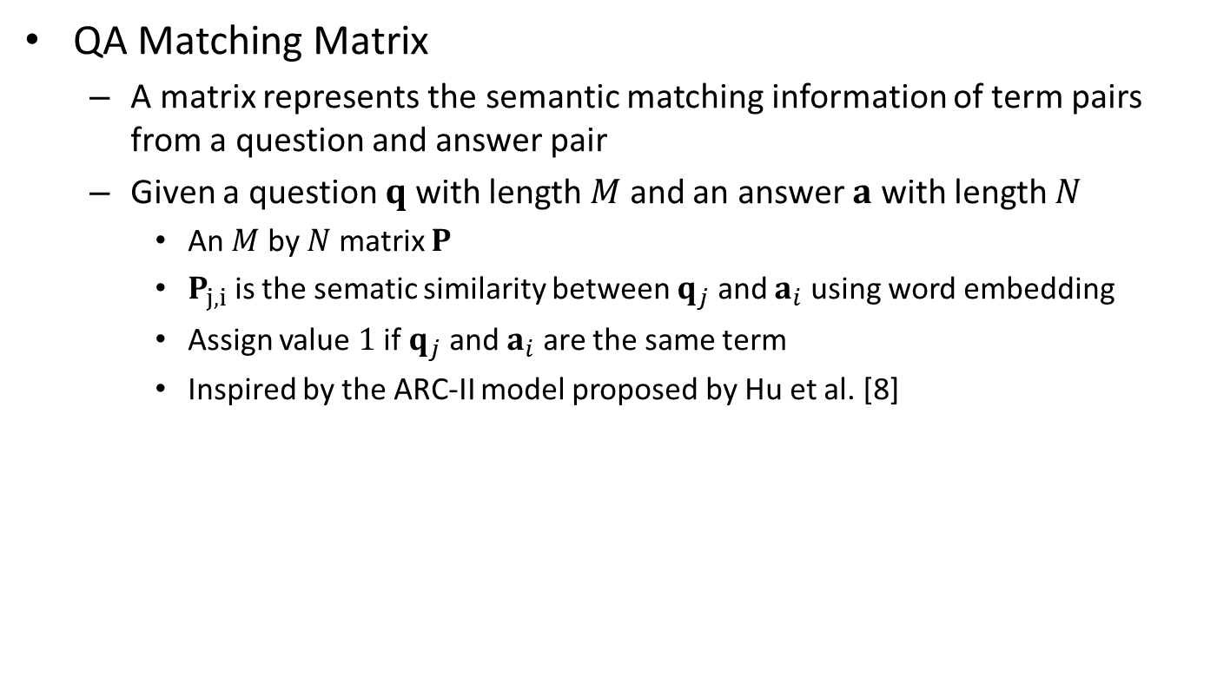


QA Matching Matrix
QA Matching Matrix
A matrix represents the semantic matching information of term pairs from a question and answer pair
Given a question $q$ with length $M$ and an answer $a$ with length $N$
An $M$ by $N$ matrix $P$
$P_{j,i}$ is the sematic similarity between $q_{j}$ and $a_{i}$ using word embedding
Assign value $1$ if $q_{j}$ and $a_{i}$ are the same term
Inspired by the ARC-II model proposed by Hu et al. [8]
$$a_{1}a_{2}a_{3}a_{4}a_{5}a_{6}a_{7}a_{8}$$
A
$$q_{1}$$
$$q_{2}$$
$$q_{3}$$
$$q_{4}$$
$$q_{5}$$
$$q_{6}$$
$$q_{7}$$
$$q_{8}$$
X
$$q_{1}q_{2}q_{3}q_{4}q_{5}q_{6}q_{7}q_{8}$$
Q
[8] B. Hu, Z. Lu, H. Li, and Q. Chen. Convolutional neural network architectures for matching natural language sentences. In NIPS 2014.

Slide 11













Attention-based Neural Matching Model
Weight for 1 Bin Node 1
…
Weight for [0.5, 1) Bin Node 1
…
Weight for [0, 0.5) Bin Node 1
Weight for 1 Bin Node 2
Weight for [0.5, 1) Bin Node 2
1
0.3
0.8
0.4
0.9
1
1
0.6
Weight for [0, 0.5) Bin Node 2
$$a_{1}a_{2}a_{3}a_{4}a_{5}a_{6}a_{7}a_{8}$$
Zoom In
$$q_{1}$$
$$a_{1}a_{2}a_{3}a_{4}a_{5}a_{6}a_{7}a_{8}$$
A
$$q_{1}$$
$$q_{2}$$
$$q_{3}$$
$$q_{4}$$
$$q_{5}$$
$$q_{6}$$
$$q_{7}$$
$$q_{8}$$
$$q_{2}$$
$$y$$
X
…
…
$$q_{1}q_{2}q_{3}q_{4}q_{5}q_{6}q_{7}q_{8}$$
Q
$$q_{8}$$
Word Embedding
QA Matching Matrix
Value-shard Weight
Question Attention Network
$$x_{jk}$$
$${\{w}_{kt}\}$$
$$s_{t}$$
$${\{r}_{t}\}$$
$$h_{j}$$
$${\{v}_{p}\}$$
$τ:$ softmax gate function
$δ$: sigmoid function
Neural network architecture with value-shared weights
$$y=∑_{j=1}^{M}τ\left(v⋅q_{j}\right)⋅δ(∑_{t=0}^{T}r_{t}⋅δ\left(∑_{k=0}^{K}w_{kt}x_{jk}\right))$$
Notes:
Give a overview of the architectures firstly
Our method contains three steps as follows:
1. We construct QA matching matrix for each question and answer pair with pre-trained word embedding.
2. We then employ a deep neural network with value-shared weighting scheme in the first layer, and fully connected layers in the rest to learn hierarchical abstraction of the semantic matching between question and answer terms.
3. Finally, we employ a question attention network to learn question term importance and produce the final ranking score.

Slide 12
Value-shared Weighting
1
0.3
0.8
0.4
0.9
1
1
0.6
0.7
Position-shared Weight (CNN )
Weight for 1 Bin Node 1
Weight for [0.5, 1) Bin Node 1
Weight for [0, 0.5) Bin Node 1
Weight for 1 Bin Node 2
1
0.3
0.8
0.4
0.9
1
1
0.6
0.7
Weight for [0.5, 1) Bin Node 2
Weight for [0, 0.5) Bin Node 2
Value-shared Weight (aNMM)
In CNN, the weight associated with a node only depends on its position as specified by the filters
In aNMM, the weight associated with a node depends on its value
$τ:$ softmax gate function
$δ$: sigmoid function
Neural network architecture with value-shared weights
$$y=∑_{j=1}^{M}τ\left(v⋅q_{j}\right)⋅δ(∑_{t=0}^{T}r_{t}⋅δ\left(∑_{k=0}^{K}w_{kt}x_{jk}\right))$$

Slide 13
Question Attention Network
Weight for 1 Bin Node 1
…
Weight for [0.5, 1) Bin Node 1
…
Weight for [0, 0.5) Bin Node 1
Weight for 1 Bin Node 2
Weight for [0.5, 1) Bin Node 2
1
0.3
0.8
0.4
0.9
1
1
0.6
Weight for [0, 0.5) Bin Node 2
$$a_{1}a_{2}a_{3}a_{4}a_{5}a_{6}a_{7}a_{8}$$
Zoom In
$$q_{1}$$
$$a_{1}a_{2}a_{3}a_{4}a_{5}a_{6}a_{7}a_{8}$$
A
$$q_{1}$$
$$q_{2}$$
$$q_{3}$$
$$q_{4}$$
$$q_{5}$$
$$q_{6}$$
$$q_{7}$$
$$q_{8}$$
$$q_{2}$$
$$y$$
X
…
…
$$q_{1}q_{2}q_{3}q_{4}q_{5}q_{6}q_{7}q_{8}$$
Q
$$q_{8}$$
Word Embedding
QA Matching Matrix
Value-shard Weight
Question Attention Network
$$x_{jk}$$
$${\{w}_{kt}\}$$
$$s_{t}$$
$${\{r}_{t}\}$$
$$h_{j}$$
$${\{v}_{p}\}$$
Neural network architecture with attention schemes
$τ:$ softmax gate function
$δ$: sigmoid function
$$y=∑_{j=1}^{M}τ\left(v⋅q_{j}\right)⋅δ(∑_{t=0}^{T}r_{t}⋅δ\left(∑_{k=0}^{K}w_{kt}x_{jk}\right))$$

Slide 14
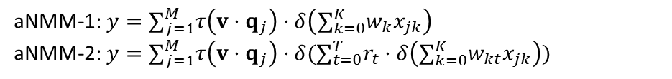
Two Variations: aNMM-1 and aNMM-2
Weight for 1 Bin Node 1
…
Weight for [0.5, 1) Bin Node 1
…
Weight for [0, 0.5) Bin Node 1
Weight for 1 Bin Node 2
Weight for [0.5, 1) Bin Node 2
1
0.3
0.8
0.4
0.9
1
1
0.6
Weight for [0, 0.5) Bin Node 2
$$a_{1}a_{2}a_{3}a_{4}a_{5}a_{6}a_{7}a_{8}$$
Zoom In
$$q_{1}$$
$$a_{1}a_{2}a_{3}a_{4}a_{5}a_{6}a_{7}a_{8}$$
A
$$q_{1}$$
$$q_{2}$$
$$q_{3}$$
$$q_{4}$$
$$q_{5}$$
$$q_{6}$$
$$q_{7}$$
$$q_{8}$$
$$q_{2}$$
$$y$$
X
…
…
$$q_{1}q_{2}q_{3}q_{4}q_{5}q_{6}q_{7}q_{8}$$
Q
$$q_{8}$$
Word Embedding
QA Matching Matrix
Value-shard Weight
Question Attention Network
$$x_{jk}$$
$${\{w}_{kt}\}$$
$$s_{t}$$
$${\{r}_{t}\}$$
$$h_{j}$$
$${\{v}_{p}\}$$
Two variations
aNMM-1: basic architecture
aNMM-2: Extension with multiple sets of value-share weights
aNMM-1: $y=∑_{j=1}^{M}τ\left(v⋅q_{j}\right)⋅δ\left(∑_{k=0}^{K}w_{k}x_{jk}\right)$
aNMM-2: $y=∑_{j=1}^{M}τ\left(v⋅q_{j}\right)⋅δ(∑_{t=0}^{T}r_{t}⋅δ\left(∑_{k=0}^{K}w_{kt}x_{jk}\right))$

Slide 15
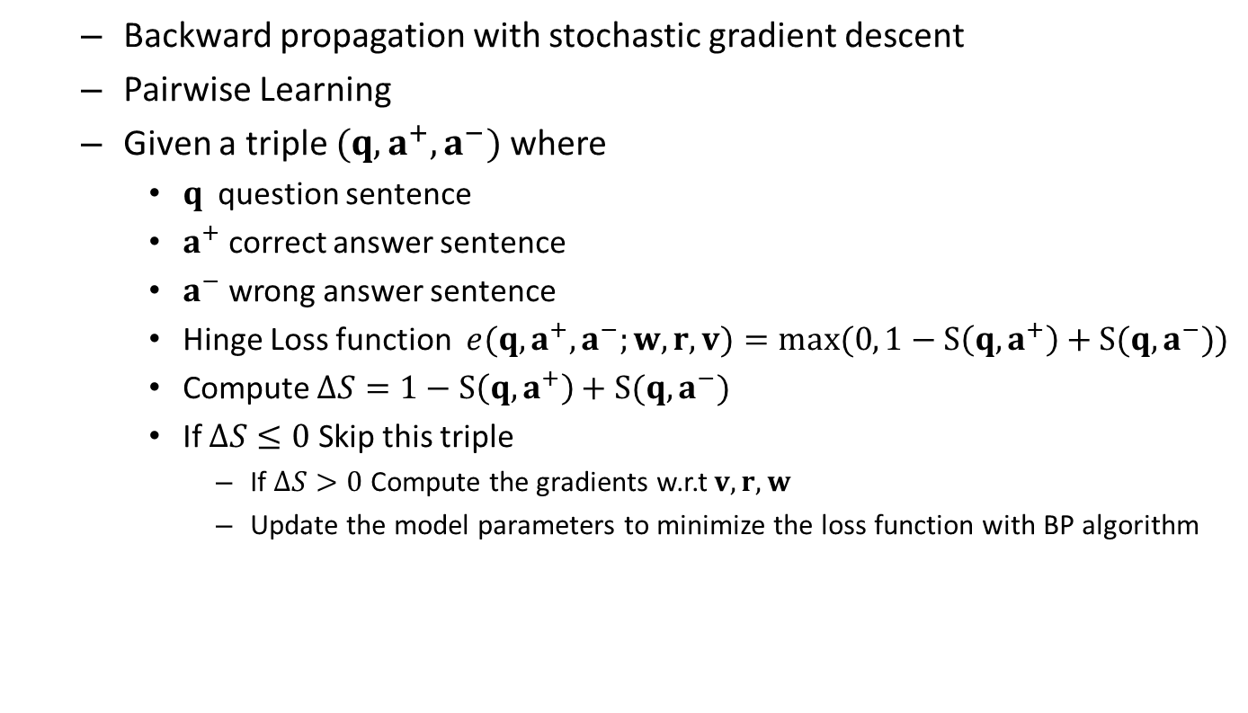
Back Propagation for Model Training
Backward propagation with stochastic gradient descent
Pairwise Learning
Given a triple $(q,a^{+},a^{−})$ where
$q$question sentence
$a^{+}$ correct answer sentence
$a^{−}$ wrong answer sentence
Hinge Loss function $e(q,a^{+},a^{−};w,r, v)=max(0, 1−S\left(q,a^{+}\right)+S(q,a^{−}))$
Compute $ΔS=1−S\left(q,a^{+}\right)+S(q,a^{−})$
If $ΔS≤0$ Skip this triple
If $ΔS>0$ Compute the gradients w.r.t $v,r,w$
Update the model parameters to minimize the loss function with BP algorithm

Slide 16
Outline
Motivation
Related Works
Learning to rank for QA
Deep learning for QA
Attention-based Neural Matching Model
Experiments
Data Set and Experiment Settings
Model Learning Results
Experimental Results for Ranking Answers
Conclusions and Future Work

Slide 17
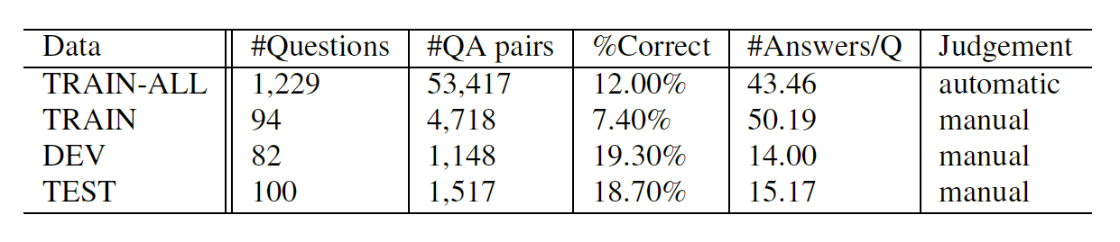
Experimental Data and Settings
TREC QA data set from TREC QA track 8-13
One of the most widely used benchmarks for answer sentence selection/ranking
Contains a set of factoid questions with candidate answers which are limited to a single sentence
Judgements in TRAIN and TRAIN-ALL
Word embedding: pre-trained with English Wikipedia dump with the Word2Vec tool by Mikolov et. al [9, 10]
Statistics of the TREC QA data set
[9] https://code.google.com/archive/p/word2vec/
[10] Tomas Mikolov, Ilya Sutskever, Kai Chen, Greg Corrado, and Jeffrey Dean. Distributed Representations of Words and Phrases and their Compositionality. In NIPS 2013.

Slide 18
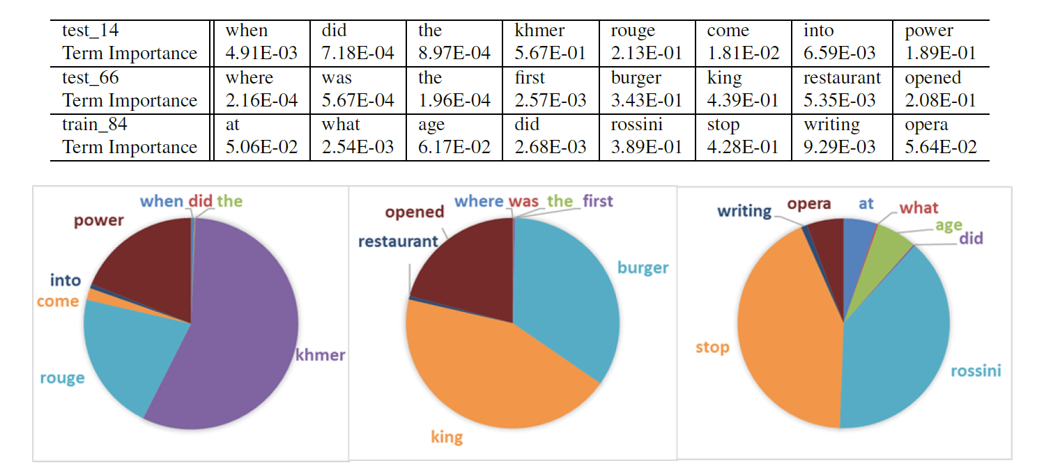
Model Learning Results
Visualization of learned question term importance

Slide 19
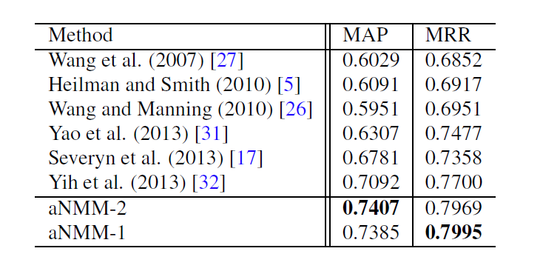
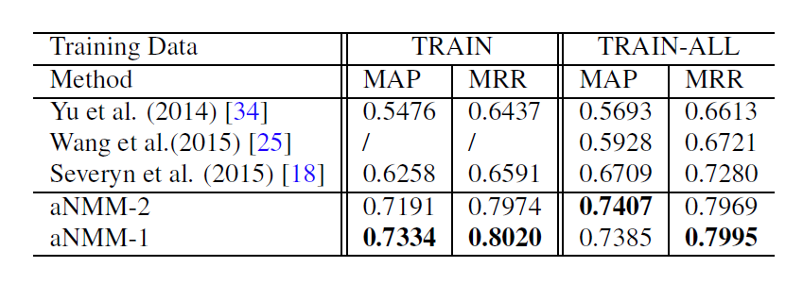
Experimental Results
Learning without combining additional features
Compare with methods using feature engineering (on TRAIN-ALL)
Compare with deep learning methods
Achieve better performance comparing with other methods using feature engineering
Show significant improvements comparing with previous deep learning methods
Results of aNMM-1 and aNMM-2 are very close
aNMM-1 could be trained with higher efficiency

Slide 20
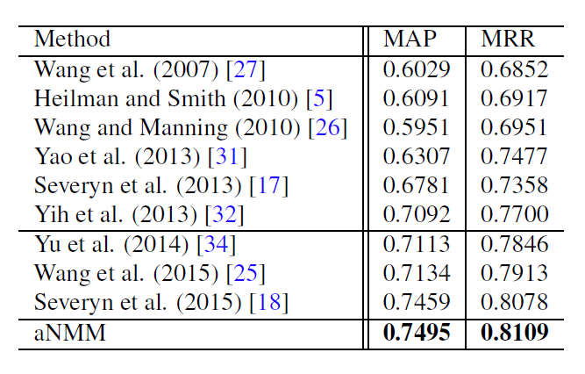
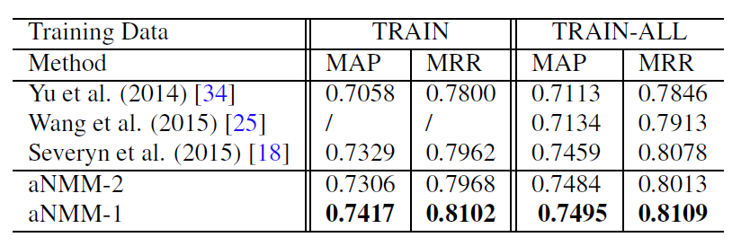
Experimental Results
Learning with combining additional features
Overview of previously published results on TREC QA data
(the best setting of each model trained on TRAIN-ALL)
Compare with deep learning methods
Severyn et al. (SIGIR 2015) is the state-of-the-art result
Combine the score of aNMM-1/aNMM-2 with QL score
With the combined feature, both aNMM-1 and aNMM-2 have better performances
aNMM-1 also outperforms CDNN by Severyn et al. ([5] in SIGIR 2015) which is the current state-of-the-art method

Slide 21
Outline
Motivation
Related Works
Learning to rank for QA
Deep learning for QA
Attention-based Neural Matching Model
Experiments
Data Set and Experiment Settings
Model Learning Results
Experimental Results for Ranking Answers
Conclusions and Future Work

Slide 22
Conclusions and Future Work
Propose an attention based neural matching model for ranking short answer text
Adopt value-shared weighting scheme instead of position-shared weighting scheme for combining matching signals
Incorporate question term importance learning using a question attention network
Perform a thorough experimental study with TREC QA data and show promising results
Without combining additional features
Outperform previous deep learning methods and feature engineering methods with large gains
With one simple additional feature
Outperform the state-of-the-art method

Slide 23
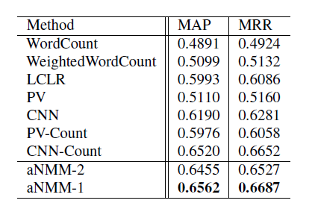
Conclusions and Future Work
Additional results on Microsoft Research WikiQA data [11]
Double confirms the advantages of the attention based neural matching models for ranking answer sentences.
Future work
Extend our work to include non-factoid question answering data sets
Yahoo CQA /Stack Overflow/ WebAP
Interactive QA & Natural language dialogue for FAQ search
[11] Yi Yang, Wen-tau Yih and Christopher Meek. WikiQA: A Challenge Dataset for Open-Domain Question Answering, In EMNLP’15.

Slide 24
Thank You Q&A Email: lyang@cs.umass.edu https://sites.google.com/site/lyangwww/

