Slide 1



Modeling User Interests for Zero-query Ranking
Liu Yang, Qi Guo, Yang Song, Sha Meng, Milad Shokouhi, Kieran McDonald,
and W. Bruce Croft
Center for Intelligent Information Retrieval, University of Massachusetts Amherst
Microsoft Bing, Microsoft Research Redmond
Microsoft Research Cambridge
Notes:
Hi all, thanks for your time, and hope you can enjoy my talk. I’m Liu Yang who is a PhD student from UMass Amherst and this work was done with my mentors during my summer internship in Microsoft Research and Bing last year. The title of this paper is “Modeling User Interests for Zero-query Ranking”.

Slide 2

Roadmap
Motivation
Method Overview
Mining User Interests From Logs
Ranking Feature Extraction
Experiments
Conclusion and Future Work

Slide 3
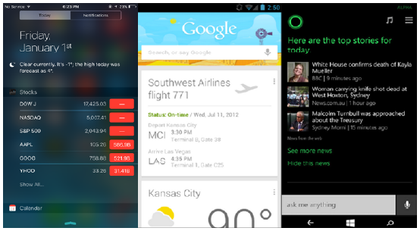
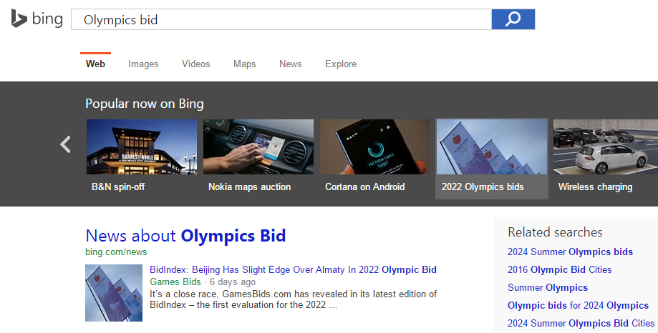
Proactive Search
Popular proactive search systems among mobile Internet users, e.g., Microsoft Cortana, Apple Siri and Google Now
Actively push information cards to users on mobile devices
Notes:
The recent boom of mobile internet has seen the emergence of proactive search systems
like Google Now, Apple Siri and Microsoft Cortana. Unlike traditional reactive
Web search systems where the search engines return results in response to queries issued
by users, proactive search systems actively push information cards to users on mobile
devices based on the context such as time, location, environment (e.g., weather),
and user interests. Information cards are concise and informative snippets commonly
shown in many intelligent personal assistant systems. Figure 1 shows examples of
proactive information cards presented in Apple Siri (stocks), Google Now (flight and
weather) and Microsoft Cortana (news). There are no explicit queries for these returned
information cards which are triggered by some particular context.

Slide 4
User Modeling in Proactive Search
Why Proactive
Overcome physical limitation of mobile devices
Enhance Users’ ability to interact with the system
Proactively push content to users
Improve user engagement
Respond with information appropriate to the current context without a query
Zero-query Ranking
Absence of query information
User modeling plays a critical role in understanding user information needs
Notes:
The need for these proactive search systems increases in mobile environments,
where the users’ ability to interact with the system is hampered by the physical limitations of the devices[2].
Thus future information retrieval systems must infer user information
needs and respond with information appropriate to the current context without
the user having to enter a query. User modeling plays a critical role for understanding
user information needs in the absence of query information.

Slide 5
User Modeling in Proactive Search
Many previous research are about user modeling and personalization for reactive Web search systems
Little is known about how to model user interests in proactive systems
The closest research (Shokouhi and Guo, SIGIR15) aimed to understand the connections between reactive searching behavior and user interaction with the proactive systems
Notes:
Despite the abundance of research about user modeling and personalization for reactive
Web search systems [1,4,19], little is known about how to model user interests
to improve the effectiveness of the proactive systems. The closest research to our paper
is the recent work by Shokouhi and Guo [15] , where the authors looked at the usage
patterns of proactive systems and aimed to understand the connections between reactive
searching behavior and user interaction with the proactive systems.

Slide 6
User Modeling in Proactive Search
Explore a broader variety of ways and data sources in modeling user interests
Coarser-level of card types
Finer-grained modeling of entities
Variety of demographics
Compare with a baseline that is similar to Carre model (Shokouhi and Guo, SIGIR15)
Entity semantic similarity features
Word embedding
Entity taxonomy in knowledge base
Notes:
In this paper, we explore a broader variety of ways and data sources in modeling user
interests and compare the proposed method with a baseline that is similar and comparable
to the Carre model presented in [15] for the application of improving ranking of
information cards of the proactive systems. Our explorations include modeling at the
coarser-level of card types, to finer-grained modeling of entities, and the capturing of
variations lie in the variety of demographics. We develop entity based representations
for user interests and card topics. Entities are extracted from user search/browse logs
across multiple commercial platforms and devices to represent user interests. For card
topics, entities are extracted from the associated URLs. To reduce the feature sparsity
problem, we propose entity semantic similarity features based on word embedding and
an entity taxonomy in knowledge base

Slide 7
Roadmap
Motivation
Method Overview
Mining User Interests From Logs
Ranking Feature Extraction
Experiments
Conclusion and Future Work

Slide 8




Method Overview
Search Logs
Entity based User Interests
Internet Browser Logs
Trigger Context
User Modeling
Card Type based Implicit Feedback
Ranked
Cards
Web Portal Browse Logs
Learning Model
Voice Assistant Logs
User Demographics
Weather, Finance, News, Calendar, Places, Event, Sports, Flight, Traffic, Fitness, Package Tracking …
Information Cards
Card Features
Notes:
We propose a framework for proactive ranking referred to as UMPRanker (User
Modeling based Proactive Ranker). Firstly we mine user interests from multiple user
logs. Each user is distinguished by a unique and anonymized identifier which is commonly
used in these platforms. The information collected from these different platforms
forms the basis of our user modeling. Then we derive multiple user interest features
including entity based user interests, card type based implicit feedback and user demographics
based on the collected information. Information cards are generated from multiple
pre-defined information sources and templates including weather, finance, news,
calendar, places, event, sports, flight, traffic, fitness, etc. We also extract card features
from the associated URLs and card types. Given user features and card features, we can
train a learning to rank model. Given a trigger context like particular time, location or
event, information cards are ranked by the model and pushed to the user’s device.

Slide 9
Roadmap
Motivation
Method Overview
Mining User Interests From Logs
Ranking Feature Extraction
Experiments
Conclusion and Future Work

Slide 10
Mining User Interests From Logs
Mine user interests from the textual content that users engaged with
Issued queries
Satisfactory(SAT) clicked documents
Browsed documents
Clicks and viewports on a personal assistant
Notes:
We can derive user interests from the short text that users specified and the textual
content that users engaged with during their historical activity. Specifically, the information
sources of user interests we consider include the following user behavior in
logs:
1. Issued queries from the search behavior.
2. Satisfactory(SAT) clicked documents from the search behavior.
3. Browsed documents on an Internet browser and a Web portal.
4. Clicks and viewports on a personal assistant.

Slide 11
Mining User Interests From Logs
Logs we collected are from “opt-in” users only
Entity based user interest representation
Represent information card topics based on card URLs
Link with entities in a large scale knowledge base
Notes:
Users decide whether the services could collect their behavior data
Note that users have the right to choose whether they would like the services to collect
their behavior data. The logs we collected are from “opt-in” users only. To represent
user interests, we extract entities from the text content specified by user behaviors. We
can also represent information card topics by entities exacted from card URLs. Entities
in user profiles and cards are linked with entities in a large scale knowledge base to get
a richer representation of user interests.

Slide 12
Roadmap
Motivation
Method Overview
Mining User Interests From Logs
Ranking Feature Extraction
Experiments
Conclusion and Future Work

Slide 13
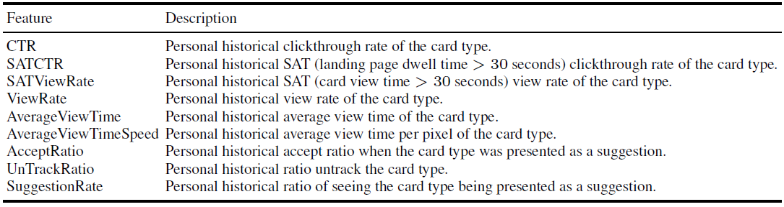
Ranking Feature Extraction
Card Type based Implicit Feedback Features (IF)
Capture individual user preferences of particular card type based on the statistics of the historical interactions
For each <user, card type> pair, features extracted include historical clickthrough rate(CTR), SAT CTR, view rate, SAT view rate, etc.
Notes:
This feature group is based on statistics of user interactive history with different card
types like average view time of each card type, accept ratio of each card type, etc. This
group of features aims at capturing individual user preferences of particular card type,
for example, news, based on the statistics of the historical interactions. Specifically,
for each <user, card type> pair, features extracted include historical clickthrough rate
(CTR), SAT CTR (i.e., clicks with more than 30 seconds dwell time on landing pages),
SAT view rate (i.e., card views with more than 30 seconds), hybrid SAT rate (i.e., rate
of either a SAT click or a SAT view), view rate, average view time, average view speed,
accept ratio of the card suggestions, untrack ratio of the card type, ratio of the cards
being a suggestion. The details of these features are explained in Table 1.

Slide 14
Ranking Feature Extraction
Entity based User Interests Features (EF)
Represent user interests by entities extracted from user behavior
Represent card topics with entities for cards with URLs
Measure the similarity between user entity sets and card entity sets
Exact Match
Similarity based on entity id matching by Jaccard Index/ raw match count
Term Match
Similarity between two entity name term sets by cosine similarity
Language Model
Query Likelihood Language Model
Word Embedding
Entity Taxonomy in Knowledge Base
Notes:
As described in Section 4, we can represent user interests by entities extracted from
user behavior across multiple services and devices. For cards with URLs, we can also
represent card topics with entities. So the next problem is how to measure the similarity
between user entity sets and card entity sets. We consider features including
exact match, term match, language models, word embedding and entity taxonomy in
the knowledge base. In the following parts, we let Ui and Cj denote the entity set of the
i-th user and the j-th card.

Slide 15
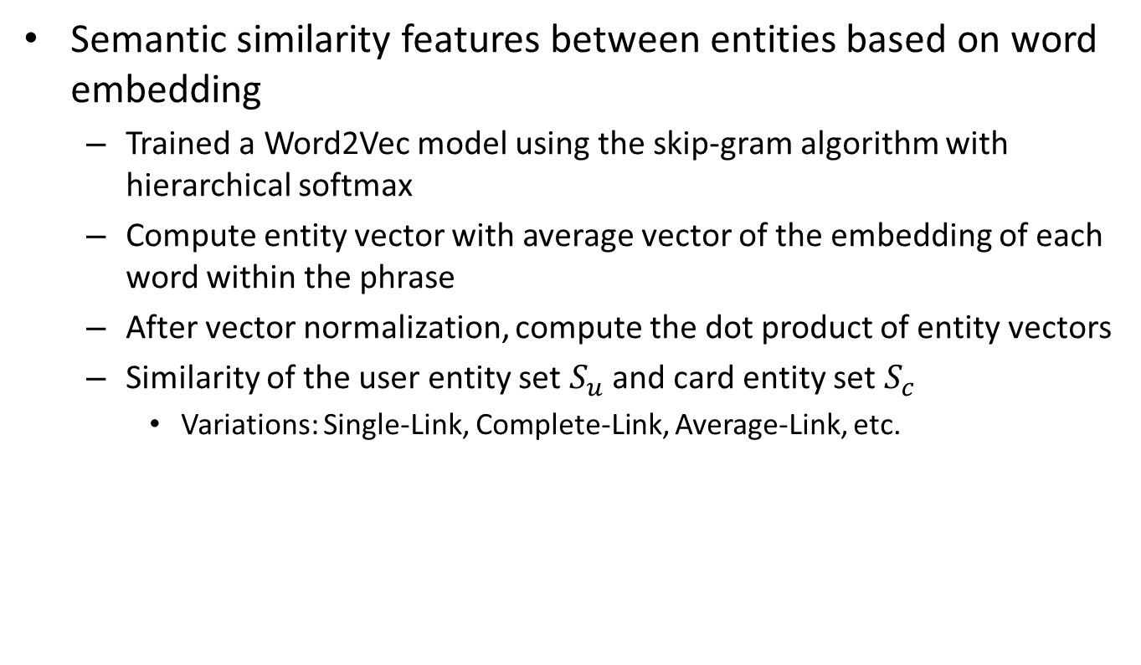
Word Embedding
Semantic similarity features between entities based on word embedding
Trained a Word2Vec model using the skip-gram algorithm with hierarchical softmax
Compute entity vector with average vector of the embedding of each word within the phrase
After vector normalization, compute the dot product of entity vectors
Similarity of the user entity set $S_{u}$ and card entity set $S_{c}$
Variations: Single-Link, Complete-Link, Average-Link, etc.
Notes:
Word Embedding. We extract semantic similarity features between entities based
on word embeddings. Word embeddings [11,12] are continuous vector representations
of words learned from very large data sets based on neural networks. The learned
word vectors can capture the semantic similarity between words. In our experiment,
we trained a Word2Vec model using the skip-gram algorithm with hierarchical softmax
[12]. The training data was from the Wikipedia English dump obtained on June
6th, 2015. Our model outputs vectors of size 200. The total number of distinct words
is 1; 425; 833. We then estimate entity vectors based on word vectors. For entities that
are phrases, we compute the average vector of embedding of words within the entity
phrase. After vector normalization, we use the dot product of entity vectors to measure
entity similarity. To define features for the similarity of Ui and Cj , we consider feature
variations inspired by hierarchical clustering algorithms as shown in table 2.

Slide 16
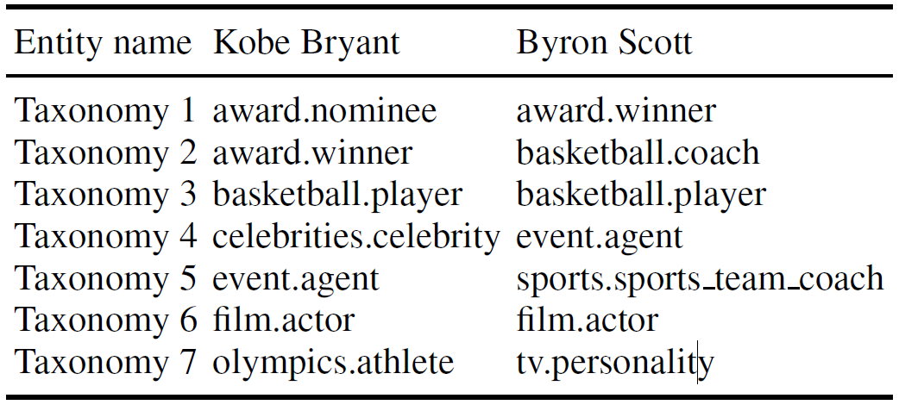
Entity Taxonomy
Measure entity similarity by entity taxonomy
Link entities in the user interest profile with entities in a large scale knowledge base
Two entities without any common terms could have similarities if they share some common entity types
Measure the similarity of two entities based on the Jaccard index of the two corresponding type sets
Notes:
Another way to extract semantic similarity
features between entities is measuring the similarity of entity taxonomy [10]. As presented
in Section 4, we link entities in the user interest profile with entities in a large
scale knowledge base. From the knowledge base, we can extract the entity taxonomy
which is the entity type information. Two entities without any common terms could
have similarities if they share some common entity types.

Slide 17
User Demographics Features(UD)
User interests are partly influenced by their demographic information, e.g., age and gender
Extract features related to user demographic information
Compute user demographics features in matched version
The user and users who clicked the card urls
Notes:
Part of user interests are influenced by their demographic information such as age
and gender. The tastes of teenagers and adults are different. Men and women also have
different preferences for information cards. Motivated by this intuition, we also extract
features related to user demographic information. In addition to the raw user demographics
features, we also add user demographics features in a matched version. We
compute the matched features of the user demographics features between the user and
users who clicked the card URLs. To achieve this, we need to compute the average age
and average gender value for users that clicked on each card. The gender value is between
1 (male) and 2 (female), where the more the value is approaching 1, the more men
clicked the URLs in the corresponding card. Based on this, we compute the differences
between user demographic features. We distinguish zero distance with null cases by
adding an offset to zero distance when we compute the matched version feature values.
The details of these features are explained in the Table 4.

Slide 18
Roadmap
Motivation
Method Overview
Mining User Interests From Logs
Ranking Feature Extraction
Experiments
Conclusion and Future Work

Slide 19
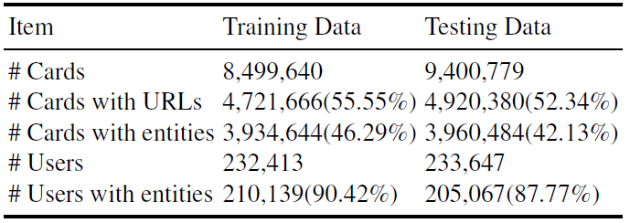
Experiments
Experiment Settings
Use real data from a commercial intelligent personal assistant
Training data: 20150318 to 20150324 (One Week)
Testing data: 20150325 to 20150331 (One Week)
User profile entity data: 20140318 to 20150317 (One Year)
Notes:
We use real data from a commercial intelligent personal assistant for the experiments.
The training data is from one week between March 18th, 2015 and March 24th,
2015. The testing data is from one week between March 25th, 2015 and March 31st,
2015. The statistics of card impressions and users are shown in Table 5.
The user profiles represented by entities are built from multiple logs presented in
Section 4. The time window from user profile is from March 18th, 2014 to March 17th,
2015. So there is no overlap time between the user profiles and training/testing data.

Slide 20
Experiments
Metrics
Most proactive impressions have only one card with a positive relevance label
Pick mean reciprocal rank(MRR) and NDCG@1 as the evaluation metric
Relevance Labels Generation
Use the SAT-Hybrid method to generate the relevance labels
Considers all cards with a SAT-Click or a SAT-View as relevant cards
Notes:
SAT-Click: For each card in proactive impressions, we consider clicked cards with $≥30s$ dwell time as relevant and other cards as non-relevant
SAT-View: Cards with viewport duration $≥10s$ are labeled as relevant and the others are non-relevant
Since most proactive impressions have only one card with a positive relevance label,
we pick mean reciprocal rank(MRR) and NDCG@1 as the evaluation metric.
Following previous research in reactive search personalization [3,6] and proactive
information card ranking[15], we use the SAT-Hybrid method to generate the relevance
labels in our experiments. This method considers all cards with a SAT-Click or a SATView
as relevant cards. The definition of SAT-Click and SAT-View are as following.
SAT-Click: For each card in proactive impressions, we consider clicked cards with
30s dwell time as relevant and other cards as non-relevant. This is a commonly used
strategy for generating relevance labels in reactive search systems.
SAT-View: Some types of cards do not require a click to satisfy users’ information
needs. For instance, users could scan the weather and temperature information on the
cards without any clicking behavior. Stock cards could also tell users the real-time stock
price of a company directly in the card content. Cards with viewport duration 10s are
labeled as relevant and the others are non-relevant.

Slide 21
Experiments
Learning Model
LambdaMART
Based on gradient boosted regression trees
One of the most effective models for the ranking task
Commonly used in previous research on personalized ranking
Comparison of Different Rankers
Baseline ranker: a production ranker shipped to a commercial personal assistant system
Only report the relative gains and losses of other rankers against this production ranker to respect the proprietary nature of this ranker
Notes:
We choose LambdaMART [20] as our learning model to rerank cards based on
features extracted in Section 5. LambdaMART is an extension of LambdaRank [5]. This
learning to rank method based on gradient boosted regression trees is one of the most
effective models for the ranking task. It won Track 1 of the 2010 Yahoo! Learning to
Rank Challenge and was commonly used in previous research on personalized ranking
We compare the performance of different rankers. The baseline ranker is a production
ranker which has been shipped to a commercial personal assistant system. This
production ranker includes features that statically rank the different information cards
based on their relative importance, and dynamic features that adjust their relevance
scores based on the contextual information and the card content. This ranker is similar
and comparable to the Carre model as described in [15]. We only report the relative
gains and losses of other rankers against this production ranker to respect the proprietary
nature of this ranker

Slide 22
Experiments
Comparison of Different Rankers
UMPRanker-I (IF)
UMPRanker-IE (IF + EF)
UMPRanker-IEU (IF + EF+ UD)
Notes:
The rankers which are compared with the baseline ranker
include the following:
– UMPRanker-I(IF): The ranker from adding IF features on top of the features being
used in the production ranker.
– UMPRanker-IE (IF + EF): The ranker from adding IF and EF features on top of the
features being used in the production ranker.
– UMPRanker-IEU(IF + EF+ UD): The ranker from adding IF, EF and UD features
on top of the features being used in the production ranker.

Slide 23
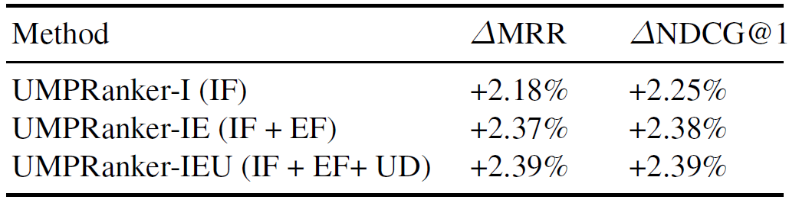
Experiments
Relative improvements against the baseline ranker in capturing user interests
With the IF features, significant improvements of 2.18% in MRR and 2.25% in NDCG@1
Adding EF features, significant larger gains of 2.37% in MRR and 2.38% in NDCG@1, demonstrating the substantial additional values in the entity-level modeling
With the UD features added, 2.39% for both MRR and NDCG@1
Notes:
Table 6 summarizes the relative improvements of the different rankers against the
baseline ranker. Starting from the base set of features used in the baseline model, we
gradually add the three feature groups introduced in Section 5, namely, IF, EF and
UD. IF is the feature group of directly modeling user historical interactions with the
proactive cards, which is a coarser-level modeling, based on the card type, while EF is
the finer-grained modeling at the level of entities. UD is the group of demographical
features, which can be seen as a multiplier/conditioner on top of the first two feature
groups for additional gains.
As we can see, with the IF features, we were able to capture the user interests
nicely, resulting in significant improvements of 2.18% in MRR and 2.25% in NDCG@1
compared to the strong baseline ranker that was shipped to production, which is very
substantial. On top of the baseline features and IF features, adding EF features, we
were able to see significant larger gains of 2.37% in MRR and 2.38% in NDCG@1,
demonstrating the substantial additional values in the entity-level modeling. Finally,
with the UD features added, we were able to see additional statistically significant gains,
even though to a lesser extent, making the total improvements of MRR to NDCG@1
both to 2.39%.

Slide 24
Experiments
Feature Importance Analysis
Features | Feature Group | Feature Importance
ViewRate | IF | 1.0000
KBTaxonomyLevel1Weighted | EF | 0.9053
CTR | IF | 0.8593
AverageViewTime | IF | 0.7482
LMScore | EF | 0.6788
CardAvgAge | UD | 0.1026
SATCTR | IF | 0.0705
TMWeighted | EF | 0.0628
GenderAbsDistance | UD | 0.0486
Notes:
Note that there is a typo in the paper where there shouldn’t have 2 ViewRate in the paper
Next we perform feature importance analysis. By analyzing the relative importance,
we can gain insights into the importance of each feature for the proactive ranking
task. LambdaMART enables us to report the relative feature importance of each
feature. Table 7 shows the top 10 features ordered by feature importance among IF,
EF and UD feature groups. Half of the most important 10 features come from the
IF feature group. 3 features come from the EF feature group and the rest are from
the UD feature group. Features with the highest feature importance are V iewRate,
KBTaxonomyLevel1Weighted, CTR, AverageV iewTime and LMScore. Features
like V iewRate, CTR, AverageV iewTime can capture users’ preferences on
different card types based on user historical interaction with the intelligent assistant
system. Entity based features like KBTaxonomyLevel1Weighted and LMScore
are useful for improving proactive ranking through modeling user interests with user
engaged textual content with term matching and semantic features. UD features, as
shown in Table 7, are not as important as IF and EF features. However, they can still
contribute to a better proactive ranking by capturing user preferences with user demographics
information.

Slide 25
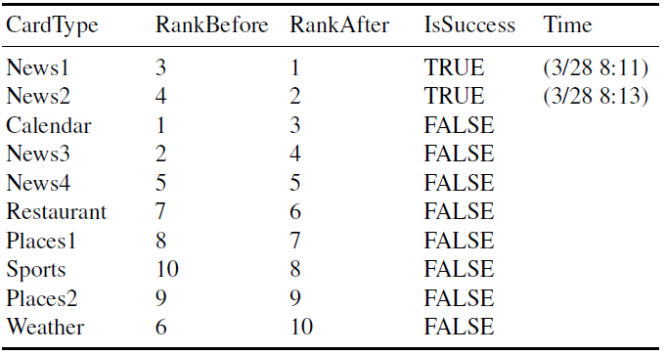
Experiments
Case Studies of Re-ranking
Notes:
To better understand the improvements in ranking enabled through our UMPRanker,
we conduct case studies to look into the changes in the re-rankings of the proactive
cards. From the examples, we find that the UMPRanker is able to identify the individual
card types that each user prefers and rank them higher for the user (e.g., for users
who like restaurant cards, the cards are promoted higher), thanks to the IF features; and
provide customized ranking for different demographics, thanks to UD features (e.g.,
promoting sports cards for male users). And finally, we also observe the proposed EF
features allow finer-grained improvements to adapt the ranking according to the user
interests at the entity-level. Table 8 provides an example of this. As we can see, two
News cards were promoted (i.e., News1 from 3rd to 1st, News2 from 4th to 2nd), while
one News card (i.e., News3 from 2nd to 4th) was demoted. A closer look at the data
reveals that the two promoted news cards are of higher weights learned in the EF representations
of the user interests due to higher historical engagements with the entities
(embedded in the news articles of News1 and News2) for the user, showing the ben
efits of finer-grained modeling such as EF on top of the coarser-grained user interests
modeling at the card type level through IF.

Slide 26
Roadmap
Motivation
Method Overview
Mining User Interests From Logs
Ranking Feature Extraction
Experiments
Conclusion and Future Work

Slide 27
Conclusion and Future Work
Conclusion
First in-depth study on modeling user interests for improving the ranking of proactive search systems
Conduct in-depth feature analysis
Perform a experimental evaluation of the proposed methods
Our method significantly outperforms a strong baseline ranker deployed in the production system
Future Work
Study different strategies, such as collaborative filtering, to further address the feature sparsity in entity-level modeling
Contextualize the user interest modeling on factors such as time and location
Notes:
In this paper, we explore a variety of ways to model user interests, with the focus
on improving the ranking of information cards for proactive systems such as Google
Now and Microsoft Cortana. We propose a learning to rank framework and encode the
various models as features, which include coarser-grained modeling of card type preferences
directly mined from the historical interactions, finer-grained modeling of entity
preferences, and features that capture the variations among demographics. Experiments
performed with large-scale logs from a commercial proactive search system show that
our method significantly outperforms a strong baseline method deployed in production,
and show that the fine-grained modeling at the entity-level and demographics enable
additional improvements on top of the coarser-grained card-type level modeling. In the
future, we plan to experiment with different strategies, such as collaborative filtering, to
further address the feature sparsity in entity-level modeling and contextualize the user
interest modeling on factors such as time and location.

Slide 28
Thank You Q&A Email: lyang@cs.umass.edu https://sites.google.com/site/lyangwww/

