Slide 1




Beyond Factoid QA: Effective Methods for Non-factoid Answer Sentence Retrieval
Liu Yang, Qingyao Ai, Damiano Spina, Ruey-Cheng Chen, Liang Pang,
W. Bruce Croft, Jiafeng Guo, and Falk Scholer
Center for Intelligent Information Retrieval, University of Massachusetts Amherst
RMIT University
Institute of Computing Technology, Chinese Academy of Sciences
Notes:
Hi all, thanks for your time, and hope you can enjoy my talk. I’m Liu Yang who is a PhD student from UMass Amherst and this work was done with my collaborators in UMass, RMIT and ICT-CAS.
The title of this paper is “Beyond Factoid QA: Effective Methods for Non-factoid Answer Sentence Retrieval”.

Slide 2
Roadmap
Motivation
Related Work
Task Definition and Data
Our Method
Baseline Experiments
Capturing Semantics and Context
Experiments
Conclusion and Future Work
Notes:
This is the outline of my presentation. Firstly I will describe the motivation of this work, then I will introduce the related work. After giving the task definition and data, I will introduce our method and experiment. Finally, I will conclude our work.

Slide 3


Motivation
Provide answers in finer grained text units, rather than to simply rank lists of documents in response to Web queries
Save the users’ efforts in fulfilling their information needs
Improve the user experience in applications where the output bandwidth is limited, such as mobile Web search and spoken search
Notes:
A central topic in developing intelligent search systems is to provide answers in finer-grained text units, rather than to simply rank lists of documents in response to Web queries.
Here I showed an example, where the query is “How to apply visa to US”. We can see Google directly return the answers instead of multiple blue links, which is more user friendly.
This can not only save the users’ efforts in fulfilling their information needs,
but also will improve the user experience in applications where the output bandwidth is limited, such as
mobile Web search and spoken search.

Slide 4
Motivation
Finding answers for Non-factoid questions
Factoid questions v.s. Non-factoid questions
How many people live in US
How to apply visa to US
Factoid question answering
Significant progress has been made in TREC QA track
Non-factoid question answering
Remains a critical challenge in QA
Notes:
The problem we want to study is finding answers for non-factoid questions. Factoid questions like “How many people live in US” can be answered by a short fact in noun phrases or numbers , whereas non-factoid questions like “How to apply visa to US” requires longer sentences or passages as the answer. For factoid question answering, significant progress has been made in TREC QA track. But non-factoid question answering remains a critical challenge in QA.

Slide 5
Answer Sentence Retrieval
Passages as Answers v.s. Sentences as Answers
Passage-level answer retrieval can be difficult due to both the vague definition of a passage and evaluation methods
A more natural and direct approach: retrieve sentences that are part of answers
Sentences are basic expression units in most if not all natural languages, and are easier to define and evaluate compared with passages
To facilitate research on this task, we have created a benchmark data set referred as WebAP using a Web collection (TREC GOV2)
Notes:
In this work, we study answer sentence retrieval instead of answer passage retrieval for the following reasons:
Passage-level answer retrieval can be difficult due to both the vague definition of a passage and evaluation methods
A more natural and direct approach: retrieve sentences that are part of answers
Sentences are basic expression units in most if not all natural languages, and are easier to define and evaluate compared with passages
To facilitate research on this task, we have created a benchmark data set referred as WebAP using a Web collection (TREC GOV2)

Slide 6
First Attempt: Apply Existing Methods
Factoid QA methods
A state-of the art method based on convolutional neural network(CNN)
Sentence selection methods
A machine learning method using six text matching features
Both methods just generate inferior results compared with traditional retrieval models like LM
Confirms the need of studying more effective methods / features for answer sentence retrieval for non-factoid Web queries
Notes:
Our first attempt is to apply existing methods including factoid QA method and sentence selection methods. However, both methods just generate inferior results compared with traditional retrieval models like LM. This confirms the need of studying more effective methods / features for answer sentence retrieval for non-factoid Web queries.

Slide 7
Two Key Observations
Observation 1 from WebAP data: vocabulary mismatch
Q: What are the goals and political views of the Green Party?
A: The need for fairness for people and local communities in developing economic opportunities, instead of continually favoring big corporations and other concentrations of wealth and power… (Labeled as “Excellent”)
Nearly no term match in such examples
Due to the shorter length of sentences compared with documents, the problem of vocabulary-mismatch may be even more severe
Need more features to capture the semantic relations
Introduce semantic features
Notes:
We got two key observations from the WebAP data.
The first observation is vocabulary mismatch. We can take a look at this example. There is nearly no term match in such examples. Thus we can find that due to the shorter length of sentences compared with documents, the problem of vocabulary-mismatch may be even more severe. Thus we need more features to capture the semantic relations between query and answer sentences. So we consider to introduce sematic features.

Slide 8
Two Key Observations
Observation 2 from WebAP data
Non-factoid questions usually require multiple sentences as answers
These answer sentences do not scatter in documents but often form small clusters
Thus the context of a sentence may be an important clue for identifying answer sentences
Introduce context features
Notes:
The second observation is that non-factoid questions usually require multiple sentences as answers, and these answer
sentences do not scatter in documents but often form small clusters. Thus the context of a sentence may be an important clue for identifying answer sentences.
So we consider to introduce context features

Slide 9
Roadmap
Motivation
Related Work
Task Definition and Data
Our Method
Baseline Experiments
Capturing Semantics and Context
Experiments
Conclusion and Future Work

Slide 10
Related Work
Related Research
Answer passage retrieval
Answer retrieval with translation models
Answer ranking in community question answering (CQA) sites
Answer retrieval for factoid questions
Differences between our work and research in TREC QA track / answer retrieval in CQA
Focus on answer finding for non-factoid questions
Find answers from general Web documents, not limited to CQA answer posts
Answers could be longer than factoid QA and the search space is much larger than CQA answer posts
Notes:
Our work is related to several research areas, including answer passage retrieval, answer
retrieval with translation models, answer ranking in community question answering
(CQA) sites and answer retrieval for factoid questions.
The differences between our work and research in TREC QA track / answer retrieval in CQA
Focus on answer finding for non-factoid questions
Find answers from general Web documents, not limited to CQA answer posts
Answers could be longer than factoid QA and the search space is much larger than CQA answer posts

Slide 11
Roadmap
Motivation
Related Work
Task Definition and Data
Our Method
Baseline Experiments
Capturing Semantics and Context
Experiments
Conclusion and Future Work

Slide 12

Task Definition
A set of non-factoid questions $\{Q_{1},Q_{2},…,Q_{n}\}$and Web documents $\{D_{1}, D_{2},…,D_{m}\}$ that may contain answers
Our task is to learn a ranking model $R$ to rank the sentences in the Web documents to find sentences that are part of answers
Notes:
We now give a formal definition of our task.
Given a set of non-factoid questions $\{Q_{1},Q_{2},…,Q_{n}\}$and Web documents $\{D_{1}, D_{2},…,D_{m}\}$ that may contain answers
Our task is to learn a ranking model $R$ to rank the sentences in the Web documents to find sentences that are part of answers
The ranker is trained based on available features $F_{s}$and labels $L_{s}$ to optimize a metric $E$ over the sentence rank list

Slide 13
Data
WebAP: A test collection of questions and multi-sentence (passage) answers based on the TREC GOV2 queries and documents
Passages were marked with labels “Perfect”, “Excellent”, “Good”, “Fair”.
To obtain the annotation for our answer sentence retrieval task, we let sentences in answer passages inherit the label of the passage
Notes:
We use WebAP for our experiments. It is created using TREC GOV2 queries and documents and passages were marked with labels “Perfect”, “Excellent”, “Good”, “Fair”. To obtain the annotation for our answer sentence retrieval task, we let sentences in answer passages inherit the label of the passage.
A test collection of questions and multi-sentence (passage) answers has been created
based on the TREC GOV2 queries and documents.1 GOV2 is the test collection used
for the TREC Terabyte Track and crawled from .gov sites in early 2004. It contains 25
million documents. The annotated GOV2 data set was produced by the following process
[9, 10]. For each TREC topic that was likely to have passage-level answers (82 in total),
the top 50 documents were retrieved using a state-of-the-art retrieval model [7, 11]. From
the retrieved documents, documents identified as relevant in the TREC judgments were
annotated for answer passages. Passages were marked with labels “Perfect”, “Excellent”,
“Good”, “Fair”. The annotators found 8027 answer passages to 82 TREC queries, which is
97 passages per query on average. Among the annotated passages, which exclude passages
without annotations and are treated as negative instances, 43% are perfect answers, 44%
are excellent, 10% are good and the rest are fair answers.

Slide 14
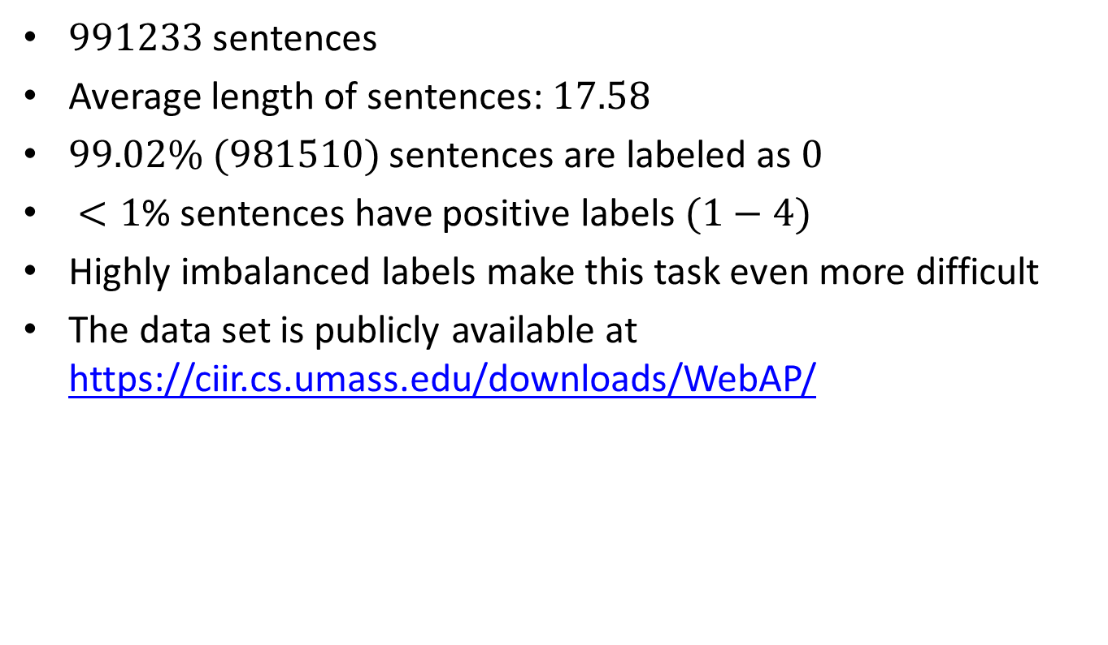
Data
$991233$ sentences
Average length of sentences: $17.58$
$99.02\% (981510)$sentences are labeled as $0$
$<1$% sentences have positive labels $(1−4)$
Highly imbalanced labels make this task even more difficult
The data set is publicly available at https://ciir.cs.umass.edu/downloads/WebAP/
Notes:
Here shows some statistics of our data. There are $991233$ sentences in our data and the average length of sentences is 17.58. More than 99% sentences are labeled as 0. Less than 1% sentences have positive labels. Highly imbalanced labels make this task even more difficult. We released the data set on this website.
To obtain the annotation for our answer sentence retrieval task, we let sentences in
answer passages inherit the label of the passage. Then we map “Perfect”, “Excellent”,
“Good”, “Fair” to 4 1 and assign 0 for all the other sentences. Note that there are some
duplicate sentences in the previously annotated passage data set. Judgments over these
duplicates are not entirely consistent. We fix this problem by a majority vote and break
ties by favoring more relevant labels. The data after label inheritance and inconsistent
judgment fixing is named WebAP data. There are 991233 sentences in the data set and
the average length of sentences is 17:58. After label propagation from passage level to
sentence level, 99:02% (981510) sentences are labeled as 0 and less than 1% sentences
have positive labels (149 sentences are labeled as 1; 783 sentences are labeled as 2; 4283
sentences are labeled as 3; 4508 sentences are labeled as 4.) . Highly imbalanced labels
make this task even more difficult.

Slide 15
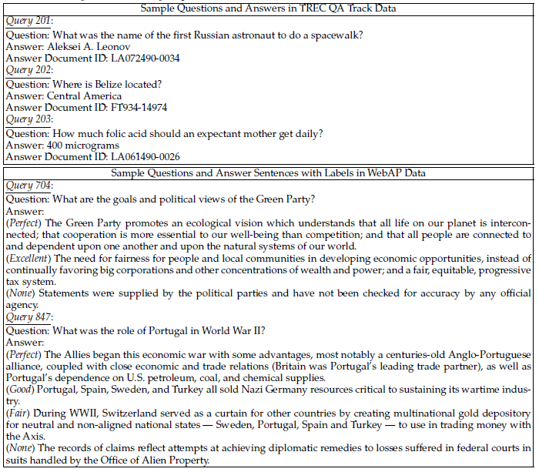
Data
Notes:
To better understand our task and data, we show a comparison of sample questions
and answers in TREC QA Track data and WebAP data in this figure.
We can clearly see the difference is that answers in TREC QA Track data are mostly short phrases like entities
and numbers, whereas answers in WebAP data are longer sentences.

Slide 16
Roadmap
Motivation
Related Work
Task Definition and Data
Our Method
Baseline Experiments
Capturing Semantics and Context
Experiments
Conclusion and Future Work

Slide 17
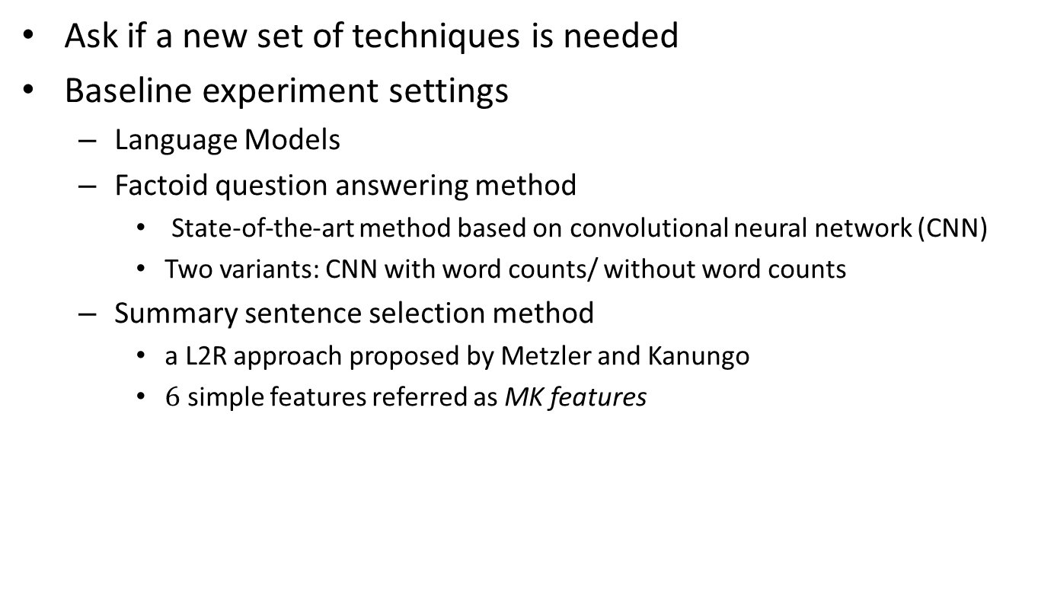
Baseline Experiments
Ask if a new set of techniques is needed
Baseline experiment settings
Language Models
Factoid question answering method
State-of-the-art method based on convolutional neural network (CNN)
Two variants: CNN with word counts/ without word counts
Summary sentence selection method
a L2R approach proposed by Metzler and Kanungo
$6$ simple features referred as MK features
Notes:
Firstly we ask if a new set of techniques is really needed. Thus we set up a baseline experiment, where we consider some representative existing methods including
Language Models
Factoid question answering method
State-of-the-art method based on convolutional neural network (CNN)
Two variants: CNN with word counts/ without word counts
Summary sentence selection method
a L2R approach proposed by Metzler and Kanungo, which uses $6$ simple features referred as MK features
a new set of techniques is needed. We address this question using a baseline experiment,
in which we use some techniques that should be reasonable for retrieving non-factoid
answers, and compare these techniques with a factoid question answering method.
We set up this experiment by including the following three classes of techniques:
1. Retrieval functions. In this experiment, we considered query likelihood language
model with Dirichlet smoothing (LM).
2. Factoid question answering method. In this experiment, we use a more recent approach
based on convolutional neural network (CNN) [22], whose performance is
current on par with the best results on TREC QA Track data. This is a supervised
method and needs to be trained with pre-defined word embeddings. Two variants are
tested here, which are CNN with word count features and CNN without word count
features.
3. Summary sentence selection method. In this experiment, we test a L2R approach
proposed by Metzler and Kanungo [13], which uses 6 simple features referred as MK
features as described in x5 to address the lexical matching between the query and
sentences. As suggested in the original paper, we use the MART ranking algorithm to
combine these features.

Slide 18
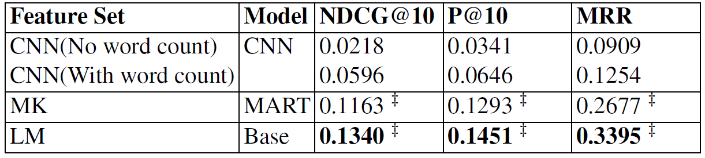
Baseline Experiments
MK Features
Exact Match
Term Overlap
Synonyms Overlap
Language Model
Sentence Length
Sentence Location
Baseline Experiment Results
Notes:
MK features include exact match, term overlap, synonyms overlap, language model, sentence length and sentence location. From the results shown in this table, we can see that CNN based method perform poorly on this task. MART with MK features performs better than CNN based method. LM performs the best among the three methods.
This result shows that automatically learned word features (as in CNN) and simple combined text matching features (as in MK) may not be sufficient for our task, suggesting that a new set of techniques is needed for non-factoid answer sentence retrieval.

Slide 19
Roadmap
Motivation
Related Work
Task Definition and Data
Our Method
Baseline Experiments
Capturing Semantics and Context
Experiments
Conclusion and Future Work

Slide 20
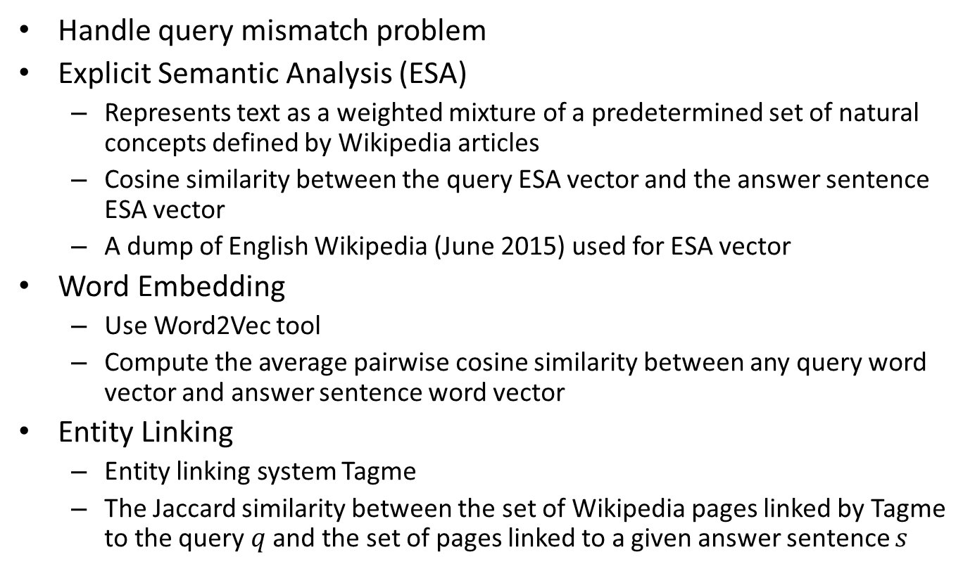
Semantic Features
Handle query mismatch problem
Explicit Semantic Analysis (ESA)
Represents text as a weighted mixture of a predetermined set of natural concepts defined by Wikipedia articles
Cosine similarity between the query ESA vector and the answer sentence ESA vector
A dump of English Wikipedia (June 2015) used for ESA vector
Word Embedding
Use Word2Vec tool
Compute the average pairwise cosine similarity between any query word vector and answer sentence word vector
Entity Linking
Entity linking system Tagme
The Jaccard similarity between the set of Wikipedia pages linked by Tagme to the query $q$ and the set of pages linked to a given answer sentence $s$
Notes:
Semantic features contain three categories:
Explicit Semantic Analysis (ESA)
Represents text as a weighted mixture of a predetermined set of natural concepts defined by Wikipedia articles
Cosine similarity between the query ESA vector and the answer sentence ESA vector
A dump of English Wikipedia (June 2015) used for ESA vector
Word Embedding
Use Word2Vec tool
Compute the average pairwise cosine similarity between any query word vector and answer sentence word vector
Entity Linking
Entity linking system Tagme
The Jaccard similarity between the set of Wikipedia pages linked by Tagme to the query $q$ and the set of pages linked to a given answer sentence $s$
ESA. Explicit Semantic Analysis (ESA) [6] is a method that represents text as a
weighted mixture of a predetermined set of natural concepts defined by Wikipedia articles
which can be easily explained. Semantic relatedness is computed as the cosine similarity
between the query ESA vector and the sentence ESA vector. A recent dump of English
Wikipedia (June 2015) is used to generate ESA representations for queries and sentences.
WordEmbedding. Word embeddings are continuous vector representations of words
learned from large amount of text data using neural networks. Words with similar meanings
are also in close distances in this vector space. Mikolov et al. [14] introduced the
Skip-gram model as an efficient method for learning high quality vector representations of
words from large amounts of unstructured text data. The implementation of the continuous
bag-of-words and skip-gram architectures for computing vector representations of words
is released as an open-source project Word2Vec.3 We compute this feature as the average
pairwise cosine similarity between any query-word vector and any sentence-word vector
following previous work [2].
EntityLinking. Linking short texts to a knowledge base to obtain the most related concepts
gives an informative semantic representation that can be used to represent queries and
sentences. We generate such a representation through an entity linking system Tagme [4],
which is able to efficiently augment a plain text with pertinent hyperlinks to Wikipedia
pages. On top of this, we produce the following semantic feature: the Jaccard similarity
between the set of Wikipedia pages linked by Tagme to the query q and the set of pages
linked to a given sentence s (Eq. 2):
ESA takes advantages of human labeled concepts fromWikipedia and explicitly presents
topical differences between queries and sentences; WordEmbedding captures word semantics
from unstructured text data based on the hypothesis that words with similar meanings
should appear in similar lingual contexts; and EntityLinking converts sentences to
entity space where different words for the same entity, and different entities with similar
Wikipedia pages are assigned with high similarity scores. Combined together, these semantic
features compensate MK features and alleviate problems like query mismatching
through the introduction of a semantic similarity score

Slide 21
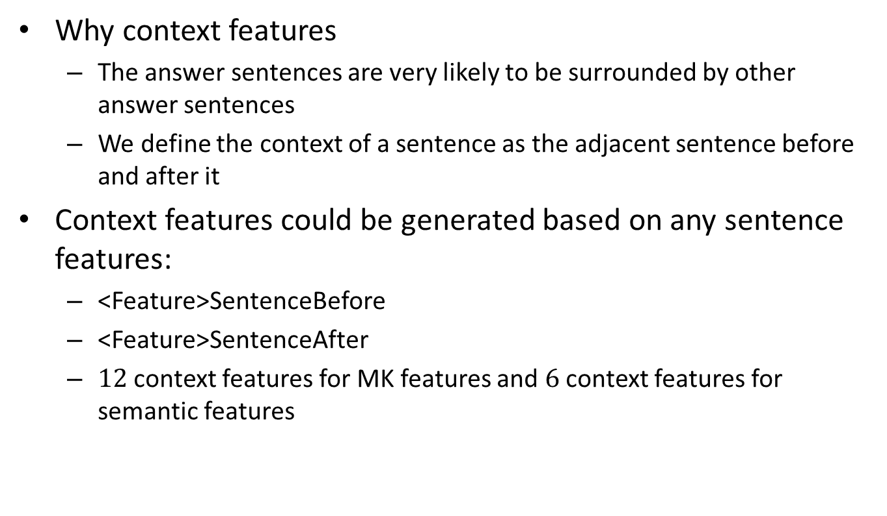
Context Features
Why context features
The answer sentences are very likely to be surrounded by other answer sentences
We define the context of a sentence as the adjacent sentence before and after it
Context features could be generated based on any sentence features:
<Feature>SentenceBefore
<Feature>SentenceAfter
$12$ context features for MK features and $6$ context features for semantic features
Notes:
The reason why we want to consider context feature is that the answer sentences are very likely to be surrounded by other answer sentences
We define the context of a sentence as the adjacent sentence before and after it.
They include features in the following two types:
– <Feature>SentenceBefore: MK features and semantic features of the sentence before
the candidate sentence.
– <Feature>SentenceAfter: MK features and semantic features of the sentence after
the candidate sentence.
There are 12 context features for MK features and 6 context features for semantic features.

Slide 22
Learning Models
With the computed features, we carry out sentence re-ranking with L2R methods using the following models
MART
LambdaMART
Coordinate Ascent (CA)
Notes:
Learning Models
With the computed features, we carry out sentence re-ranking with L2R methods using
the following models:
– MART Multiple Additive Regression Trees [5], also known as gradient boosted regression
trees, produces a prediction model in the form of an ensemble of weak prediction
models.
– LambdaMART [19] combines the strengths of MART and LambdaRank which has
been shown to be empirically optimal for a widely used information retrieval measure.
It uses the LambdaRank gradients when training each tree, which could deal with
highly non-smooth IR metrics such as DCG and NDCG.
– Coordinate Ascent (CA) [12] is a list-wise linear feature-based model for information
retrieval which uses coordinate ascent to optimize the model’s parameters. It optimizes
the objective by iteratively updating each dimension while holding other dimensions
fixed.

Slide 23
Roadmap
Motivation
Related Work
Task Definition and Data
Our Method
Baseline Experiments
Capturing Semantics and Context
Experiments
Conclusion and Future Work

Slide 24
Experiments
Experiment Settings
Use WebAP dataset as the benchmark
Partition data by queries and conducting 5-fold cross validation
SummaryRank for feature extraction
RankLib to implement MART and CA
jforests to implement LambdaMART
Metrics: NDCG@10, P@10 and MRR, focusing on the accuracy of top ranked answer sentences in the results
Notes:
Use WebAP dataset as the benchmark
Partition data by queries and conducting 5-fold cross validation
SummaryRank for feature extraction
RankLib to implement MART and CA
jforests to implement LambdaMART
Metrics: NDCG@10, P@10 and MRR, focusing on the accuracy of top ranked answer sentences in the results
we use the aforementioned WebAP dataset as the benchmark. We
follow the LETOR experiment protocol, partitioning data by queries and conducting 5-
fold cross validation throughout. We use our own package SummaryRank4 for feature
extraction. We use RankLib5 to implement MART and CA, and use jforests6 to implement
LambdaMART. For each experimental run, we optimize the hyperparameters using
cross validation and report the best performance. 7 For evaluation, we compute a variety
of metrics including NDCG@10, P@10 and MRR, focusing on the accuracy of top ranked
answer sentences in the results.

Slide 25
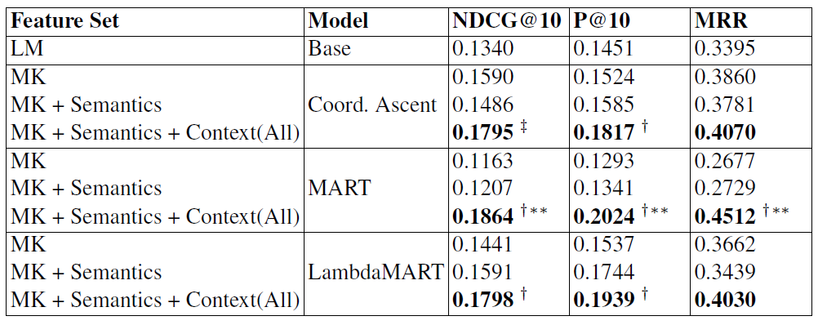
Overall Analysis of Results
For feature set comparison, the results are quite consistent across the three different learning models where the combination of MK, semantic features, and context features achieve the best results for all three learning model settings
Notes:
Table 3 shows the evaluation results for non-factoid answer sentence retrieval using
different feature sets and learning models. We summarize our observations as follows: (1)
For feature set comparison, the results are quite consistent across the three different learning
models where the combination of MK, semantic features, and context features achieve
the best results for all three learning model settings. For MRR, this combination achieves
5:4% gain using CA, 68:55% gain using MART, and 10:05% gain using LambdaMART
over the MK feature set. Similar gains are also observed under other metrics. In terms of
relative feature importance, context features achieve larger gain compared to semantic features
although adding both of them can improve the performance of the basic MK feature
set. (2) For the learning model comparison, MART achieves the best performance with
MK + Semantics + Context(All) features, with statistically significant differences with respect
to both LM and MK(MART), which shows the effectiveness of MART for combining
different features to learn a ranking model for non-factoid answer sentence retrieval.

Slide 26
Overall Analysis of Results
For learning model comparison, MART achieves the best performance with MK + Semantics + Context(All) features
Notes:
Table 3 shows the evaluation results for non-factoid answer sentence retrieval using
different feature sets and learning models. We summarize our observations as follows: (1)
For feature set comparison, the results are quite consistent across the three different learning
models where the combination of MK, semantic features, and context features achieve
the best results for all three learning model settings. For MRR, this combination achieves
5:4% gain using CA, 68:55% gain using MART, and 10:05% gain using LambdaMART
over the MK feature set. Similar gains are also observed under other metrics. In terms of
relative feature importance, context features achieve larger gain compared to semantic features
although adding both of them can improve the performance of the basic MK feature
set. (2) For the learning model comparison, MART achieves the best performance with
MK + Semantics + Context(All) features, with statistically significant differences with respect
to both LM and MK(MART), which shows the effectiveness of MART for combining
different features to learn a ranking model for non-factoid answer sentence retrieval.

Slide 27
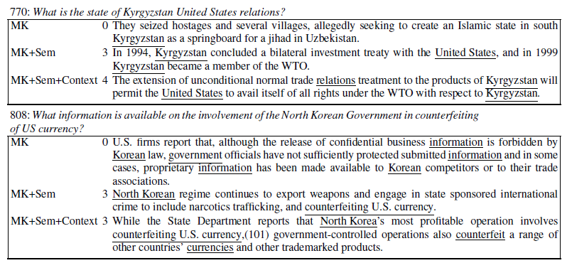
Examples of Top Ranked Sentences
Notes:
We further show some examples and analysis of top-1 ranked sentences by different
methods in Table 4. In general, the top-1 ranked sentences by MK + Semantics + Context(
All) are better than the other two methods. Although there are lexical matches for
top-1 sentences retrieved by all methods, sentences with lexical matches may be not answer
sentences of high quality. For example, for query 808, MK features will be confused
on “Korean”, “North Korean” and “South Korean” appearing frequently in sentences since
there is a common term among them. Semantic features play an important role here to alleviate
this problem. Semantic features such as EntityLinking can differentiate “Korean”
with “North Korean” by linking them to different Wikipedia pages.
Context features have the potential to guide the ranker in the right direction since
correct non-factoid answer sentences are usually surrounded by other similar non-factoid
answer or relevant sentences. Query 816 in Table 4 gives one example for their effects.
Without context features, LambdaMART with MK+Semantics features retrieved a nonrelevant
sentence as the top-1 result. The retrieved sentence may seem relevant itself (as it
indeed mentions USAID’s efforts to support biodiversity), but if we pull out its context….

Slide 28
Roadmap
Motivation
Related Work
Task Definition and Data
Our Method
Baseline Experiments
Capturing Semantics and Context
Experiments
Conclusion and Future Work

Slide 29
Conclusion and Future Work
Conclusion
Formally introduced the answer sentence retrieval task for non-factoid Web queries
Compared learning to rank methods with baseline methods including language models and a CNN based method
Both semantic and context features are useful for non-factoid answer sentences retrieval
Data and code publicly available to further research
Future Work
Investigate more features such as syntactic features and readability features
Learning an effective representation of answer sentences for information retrieval
Notes:
For the conclusion, we formally introduced the answer sentence retrieval task for non-factoid Web queries
Investigated a framework based on learning to rank methods
Compared learning to rank methods with baseline methods including language models and a CNN based method
Both semantic and context features are useful for non-factoid answer sentences retrieval
Provides a good basis for non-factoid answer sentence retrieval
Future Work
Investigate more features such as syntactic features and readability features
Learning an effective representation of answer sentences for information retrieval

Slide 30
Thank You Q&A Data :https://ciir.cs.umass.edu/downloads/WebAP/ Code: http://rmit-ir.github.io/SummaryRank/ Email: lyang@cs.umass.edu https://sites.google.com/site/lyangwww/

