Slide 1

CD Project: M3
Info on
Group Project for CD
(Final Poster)
LeongHW
(Summer 2018)

Slide 2
Project Milestones (2018)
Team Project: (Milestones)
M1: Project proposal [23-July]
M2: Interim Poster Report [26-July]
M3: Poster Showcase [01-Aug]

Slide 3
Milestone M3: Final Poster…
Final Poster – of your project.
Expectations:
  Completed your project
  Poster highlights key things you have done.
  Have used more than one CD algorithms
  Have done some comparison
  Have analyzed the computed communities
  Have found some nice observations

Slide 4
Preparing your Final Poster…
Put in Project-ID & Group Number
  Somewhere near the top left corner.
Revise from your Interim Poster

Slide 5
Submitting your Final Poster
Call your poster G03-Final-Poster.pptx
Create pdf version G03-Final-Poster.pdf
Submit both files to:
IVLE > Project > Group 03 > Files
Deadline: 31-July, Tue, 11:59am
Any extra details goes to separate ppt file.

Slide 6


Slide 7

CD News (Summer 2018)
About M3:
Poster Presentation

Slide 8
Poster Presentation…
Presentation: Wednesday, 01-Aug-2018
  @COM1, Level 2
  9:00am—02:00pm
Putting up your Posters
  Come BEFORE 8:30am
  Put up your posters…

Slide 9
Poster Session:
Part A: Evaluation by Tutors/Profs
  We do poster evaluation (20min each gp)
Part B: Explaining to Others
  Other particpants/professors may visit
  May ask you about your posters
Best Poster competition:
  https://steps.comp.nus.edu.sg/
  3 Best wins $2000

Slide 11
Tips on Poster
Short points
  NOT long sentences.
  Look at your sentences, read it many times,
  Keep only IMPORTANT words
Think about telling a story
  Not long paragraphs..

Slide 13
Presentation Tips
Before presentation:
  Come early, set up poster
  Have laptop ON with your backup ppt
During presentation
  INTRODUCTION
  BODY (work done)
  KEY FINDINGS
  ANY SURPRISES?

Slide 14
Presentation Tips: (details)
INTRODUCTION
  Introduce yourselves
  Run through outline of the project
BODY (work done)
  Focus on big picture (not the details)
  Explain the main steps
  Don’t explain “standard” algs/methods
  Explain any changes you made

Slide 15
Presentation Tips: (details-2)
KEY FINDINGS
  What are the key findings of project
  Explain the findings
  Don’t just say, GIVE EVIDENCES
ANY SURPRISES?
  Any surprising findings
  Any unexpected work you needed to do?

Slide 16
How to perfect your presentations
practice,
Practice,
PRACTICE

Slide 17
For project evaluation…
For evaluation by tutors/prof.
Talk about Team Work, Task allocation
What have you learned?
NOT compulsory to put into poster.

Slide 18
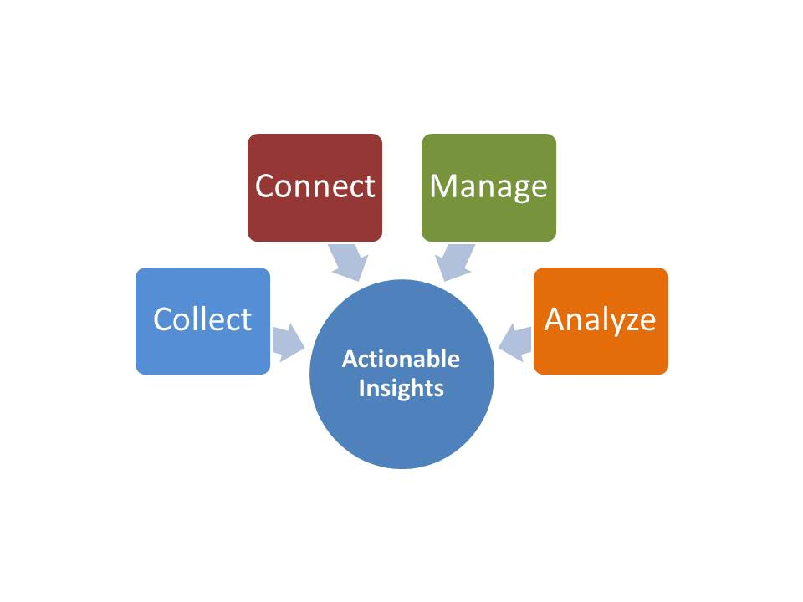
Did you find some…

Slide 19
Thank you!

