Slide 1

CS5234 Lecture 3 -- (28-Aug-12)
“Priority Queues & LEDA”
Lecture Topics and Readings
  Priority Queues (Heaps) [CLRS]-C6
  Binomial Heaps [CLRS]-C19
  LEDA: Library of [LEDA-notes]
  Efficient Data Structures & Algorithms
Effective Use of
Efficient Data Structures and Algorithms

Slide 2
Recall different PQ impl…
Time Bounds for different PQ implementations
  n is the number of items in the PQ
Data Str | INSERT | MIN | D-MIN | D-KEY | DELETE | MELD
Binary H | O(lg n) | O(1) | O(lg n) | O(lg n) | O(lg n)
Leftist H | O(lg n) | O(1) | O(lg n) |  |  | O(lg n)
Binomial H | O(lg n) | O(lg n) | O(lg n) | O(lg n) | O(lg n) | O(lg n)
Fibonacci | O(1) | O(1) | O(lg n) | O(1) | O(lg n) | O(1)
Skew H | O(1) | O(1) | O(lg n) | O(lg n) | O(lg n) | O(1)
Relaxed H | O(1) | O(lg n) | O(lg n) | O(1) | O(lg n) | O(lg n)

Slide 3
Binomial Trees
Recursive definition:
B_{k}
B₀
B_{k}
B_{k−1}
B_{k−1}
B₂
B₁
B₀
B_{k−1}
Some examples:
B₀
B₁
B₂
B₃
B₄

Slide 4
Properties of Binomial Trees
For a Binomial Tree B_{k} (of order k)
  there are 2^{k} nodes,
  the height of the tree is k,
  root has degree k and
  deleting the root gives binomial trees B₀, B₁, …, B_{k−1}
Proof: (DIY, by induction)
depth
0
1
2
3
4
B₀
B₁
B₂
B₃
B₄

Slide 5
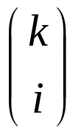
Defining Property of Binomial Trees
There are exactly nodes at depth i,
(0 ≤ i ≤ k)
depth
Nodes
0
1
1
4
2
6
3
4
B₄
4
1

Slide 6
Binomial Heap (Vuillemin, 1978)
A sequence of binomial trees that satisfy
  binomial heap property (each tree B_{k} is a min-heap)
  0 or 1 binomial tree B_{k} of order k,
There are at most ⎣lg n⎦ + 1 binomial trees.
Eg: A binomial heap H with n = 11 nodes.
head[H]
18
3
6
37
29
10
44
11 = (1011)₂
48
31
17
50
B₀
B₁
B₃
Notes:
sequence -> ordered

Slide 7
Representing Binomial Heaps (1)
Each node x stores
  key[x]
  degree[x]
  p[x]
  child[x]
  sibling[x]
(3 pointers per node)
parent
key
10
1
degree
sibling
child

Slide 8
Representing Binomial Heap (2)
head[H]
18
3
6
37
29
10
44
48
31
17
50
head[H]
18
0
3
1
6
3
37
0
29
2
10
1
44
0
Each node x has
p[x]
child[x]
sibling[x]
degree[x], key[x]
48
1
31
0
17
0
50
2
Notes:
sequence -> ordered

Slide 9
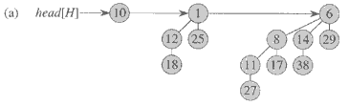
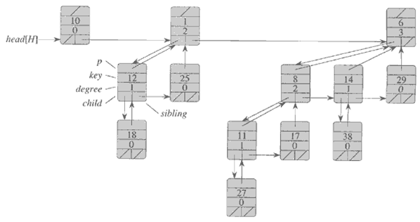
From the textbook [CLRS]
The Binomial Heap:
It’s actual implementation

Slide 10
Operations on a Binomial Heap
MAKE-BINOMIAL-HEAP(H)
  Allocate object H, make head[H] = NIL. Θ(1).
BINOMIAL-HEAP-MINIMUM(H)
  Search the root list for minimum. O(lg n).
head[H]
18
3
6
37
29
10
44
48
31
17
50
B₀
B₁
B₃

Slide 11
Linking Step: Fundamental Op
BINOMIAL-LINK (y, z)
y
z
Linking step
z
B_{k−1}
B_{k−1}
B_{k−1}
y
B_{k−1}
Assume z ≤ y
BINOMIAL-LINK (y, z) ⊳ Assume z ≤ y
  p[y] ← z
  sibling[y] ← child[z]
  child[z] ← y
  degree[z] ← degree[z] + 1
Constant time O(1)

Slide 12
Binomial Heap Union
6
3
18
8
29
10
44
37
30
23
22
48
31
17
15
7
12
45
32
24
50
+
55
28
33
25
41
1
1
1
1
0
0
1
1
19 + 7 = 26
+
0
0
1
1
1
1
1
0
1
0
Notes:
amusing to consider "multiplying" binomial heaps or other arithmetic ops. Any uses???

Slide 13
Binomial Heap Union
6
3
18
8
29
10
44
37
30
23
22
48
31
17
15
7
12
45
32
24
50
+
55
28
33
25
41

Slide 14
Binomial Heap Union
12
18
6
3
18
8
29
10
44
37
30
23
22
48
31
17
15
7
12
45
32
24
50
+
55
28
33
25
41

Slide 15
3
12
7
37
18
25
6
3
18
8
29
10
44
37
30
23
22
48
31
17
15
7
12
45
32
24
50
+
55
28
33
25
41
12
18

Slide 16
3
3
12
15
7
37
7
37
18
28
33
25
25
41
6
3
18
8
29
10
44
37
30
23
22
48
31
17
15
7
12
45
32
24
50
+
55
28
33
25
41
12
18

Slide 17
3
3
12
15
7
37
7
37
18
28
33
25
25
41
6
3
18
8
29
10
44
37
30
23
22
48
31
17
15
7
12
45
32
24
50
+
55
28
33
25
41
3
12
15
7
37
18
28
33
25
41

Slide 18
3
3
12
15
7
37
7
37
18
28
33
25
25
41
6
3
18
8
29
10
44
37
30
23
22
48
31
17
15
7
12
45
32
24
50
+
55
28
33
25
41
6
3
12
8
29
10
44
15
7
37
18
30
23
22
48
31
17
28
33
25
45
32
24
50
41
55

Slide 19
Binomial Heap Union
MAKE-BINOMIAL-HEAP-UNION (H₁, H₂) :
  Create a heap H that is the union of two heaps H₁ and H₂
  Analogous to binary addition of n₁ and n₂
Running time.: O(log n) [n = n₁ + n₂]
  Prop to # of trees in root lists ≤ 2( ⎣log₂ n⎦ + 1).
1
1
1
1
0
0
1
1
19 + 7 = 26
+
0
0
1
1
1
1
1
0
1
0

Slide 20
More Operations (1)
BINOMIAL-HEAP-INSERT(H, x)
  Create a one-item (x) binomial heap H₁ and then union H and H₁. O(lg n).
BINOMIAL-HEAP-EXTRACT-MIN(H)
  Find minimum, remove root, then union. O(lg n).
head[H]
18
3
6
37
29
10
44
48
31
17
50
B₀
B₁
B₃

Slide 21
More Operations (2)
BINOMIAL-HEAP-DECREASE (H, x, k)
BINOMIAL-HEAP-DELETE (H, x)
DIY -- Read up [CLRS]-C19
head[H]
18
3
6
37
29
10
44
48
31
17
50
B₀
B₁
B₃

Slide 22
Binomial Heaps (Summary)
MINIMUM(H) O(lg n)
UNION(H₁, H₂) O(lg n)
INSERT(H, x) O(lg n)
EXTRACT-MIN(H) O(lg n)
DECREASE-KEY (H, x, k) O(lg n)
DELETE (H, x) O(lg n)

Slide 23

Thank you.

