Slide 1
From MLP to CNN A brief introduction
Ng Yen Kaow

Slide 2
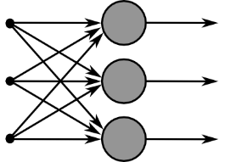
Before deep learning
1958
1960
1961
1964
1965
1969
1969
1970
1974
1980
1982
1989
Perceptron (+ training rule)
Single-layer NN
ADALINE training rule
Two-layer perceptron
MADALINE
Kernel perceptron
GMDH (8 layers used in 1971)
Criticism of single-layer NN
Various forms of backpropagation (BP)
Discussed in “Deep learning in neural networks: An overview”
2014 Schmidhuber
Neocognitron (Hubel-Wiesel’s model)
Recurrent neural network
Handwritten ZIP code recognition (BP)
Universal Approximation Theorem
Rosenblatt
Widrow and Hoff
Gamba
Widrow
Aizerman et al.
Ivakhnenko
Minsky and Papert
Bryson and Ho
Linnainmaa
Werbos
Fukushima
Hopfield
LeCun et al.
Cybenko

Slide 3
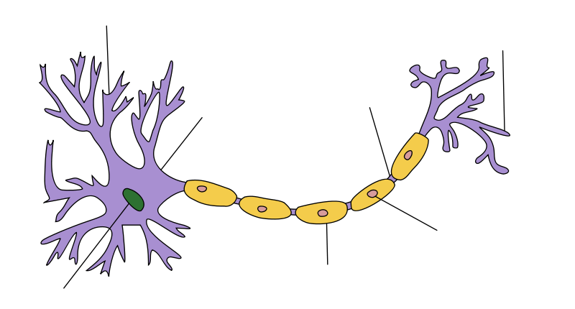
Idea for artificial neural network
A biological neuron
Dendrites – receive signal
Nucleus – process
Axon – send signal out
Dendrite
Axon
Terminal
Node of
Ranvier
Soma
Axon
Shawann cell
Myelin sheath
Nucleus

Slide 4
Artificial neuron
Input (Dendrites)
Summation and Activation (Nucleus)
Output (Axon)
Idea: Network many of these together to form an artificial neural network (McCulloch and Pitts, 1943)
Summing
Junction
x₁
θ₁
Input
Signals
θ₂
u
Ф
x₂
Ф
y
∑
∑
Output
…
x_{n}
θ_{n}
Activation
Function
Synaptic
Weights

Slide 5
Perceptron
Rosenblatt (1958)
Computation:
Input values are (positive or negative) real numbers, but output value is binary (0 or 1)
u = θ₁ x₁ + θ₂ x₂ + θ₃ x₃ =
y = Φ(u),
x₁
θ₁
θ₂
u
Ф
x₂
Ф
y
∑
∑
x₃
θ₃

Slide 6
Perceptron geometrical meaning
θ₁x + θ ₂y = b is a line equation – it’s
y = (θ₁/θ₂) x + b/θ₂
⇒
In the case of 2 elements
f(x)=1 if (x, y) lies on one side of a line,
f(x)=0 if (x, y) lies on the other side

Slide 7
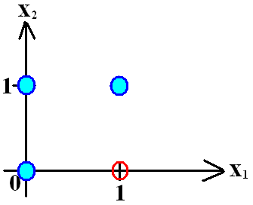
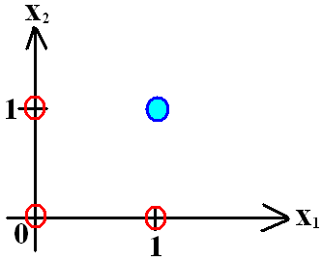
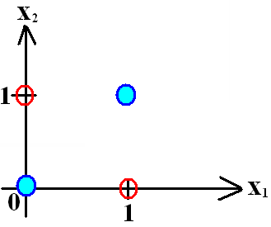
Perceptron geometrical meaning
A perceptron is a linear classifier
The perceptron cannot solve non-linearly separable cases
This is called a hyperplane
θ₁
θ₁
θ₁
θ₂
θ₂
θ₂

Slide 8
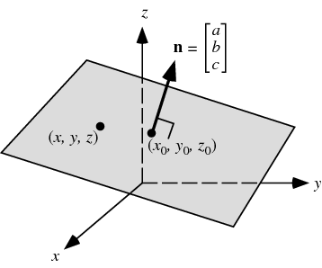
Perceptron geometrical meaning
A hyperplane in 2D is a line
A hyperplane in 3D is a plane
This extends to any number of dimensions

Slide 9
Training the perceptron
Given 2 sets of points that are linearly separable, how do we automatically find a hyperplane which separates the two sets?
Yes, this can be done
Perceptron training rule

Slide 10
Perceptron training
For each input example: update each weight w_{i} as follows
t = target output on given example
y = perceptron output on given example
η = learning rate
The resultant updating process
If t = y ⇒ no change to θ_{i}
If t > y ⇒ (t − y)>0 ⇒ θ_{i} increased (⇒ y increased)
If t < y ⇒ (t − y)<0 ⇒ θ_{i} decreased (⇒ y decreased)
(Rosenblatt 1958)

Slide 11
Perceptron learner
The hypothesis space of the perceptron learner is the set of all possible perceptrons
Each perceptron specifies a hyperplane
A point X in n-D
Machine Learner
Train with examples
Perform tasks or make predictions
(Hypothesis space = perceptrons = hyperplanes)
Classify x according to which side of the hyperplane point X lies in

Slide 12
Problem with perceptron learners
When the examples are linearly separable (can be separated using a hyperplane), the perceptron can be trained with the perceptron training rule
The perceptron learner cannot work on non-linearly separable points
In fact, when the examples are not linearly separable, the perceptron training rule will never stop

Slide 13
Multilayer perceptron (MLP)
Use multiple layers of perceptrons, constructed as a directed network that is fully connected from one layer to the next
Can have any number of perceptrons in each layer, and any number of layers
Ф no longer restricted to binary 1-0 output
Hidden layers
Input layer
Output layer

Slide 14
MLP activation functions
Except for the input layer, nonlinear activation functions are typically used in the MLP
Most commonly, the sigmoid function (next slide)
If only linear activation functions are used, then any number of layers can be reduced to a simple input-output model (later)
The name “perceptron” in MLP is historical, and sometimes misleading

Slide 15
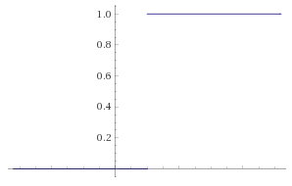
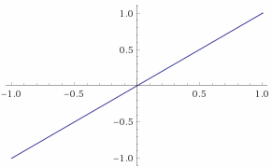
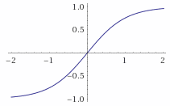
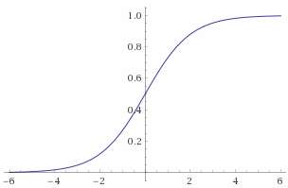
MLP activation functions
Φ(u)
Perceptron
Non-threshold activation functions
Linear Hyperbolic
Sigmoidal / logistic
u
b
Φ(u)
u
Φ(u)
Φ(u)
u
u

Slide 16
Forward activation
Output of each layer is given as input to the next layer
Similar to the perceptron’s learning method
Output y is compared to the desired output
The error is used to correct the network’s weights
Hidden layers
Input layer
Output layer

Slide 17
Weight correction rule
Suppose the cost function is
How to minimize J?
Find turning point (that is, find θ where )
Used for Simple Linear Regression
Not quite possible here
Use Newton-Raphson
Use Gradient Descent

Slide 18
Weight correction rule
Suppose the cost function is
Use Gradient Descent
Use this rule at every layer (chain rule)
Define a modified error δ_{k} (denoted Δ_{k} in Russell-Norvig) for node k
This gives the weight update/correction rule
, where
at an output node k
at a hidden node k,
δ_{i}
θ_{ij}
δ_{j}
i
j
i’s output is o_{i} (for output node) or y_{i} (for hidden node)

Slide 19
Backward propagation
Correct each node according to its contribution to the error
This is indicated by its gradient
Correction is performed first on the weights to the last layer, then the second last layer, and so on, until the first layer
Hence the name backward propagation of error, or simply backpropagation
Problems to struggle with in practice
Convergence
Optimality

Slide 20
Why we need non-linear activation
If only linear activation functions, Φ(u)=u, are used, then any number of layers can be reduced to a simple input-output model
Input layer
Hidden layers
Output layer

Slide 21
Other cost function
An equally effective cost function is
see https://see.stanford.edu/materials/aimlcs229/cs229-notes1.pdf
In the mean time, ask yourself what does the MLP learn:
Function?
Probability distribution?
Actual perceptron output
Over examples
Over output perceptrons
Expected perceptron output
Similar cost used in logistic regression… for good reasons

Slide 22
Why does MLP work?
While a perceptron works as a linear classifier, an MLP can be used to approximate any real function (non-linear regression), according to the following result
Universal Approximation Theorem
(Cybenko 1989)
The standard multilayer feed-forward network with a single hidden layer that contains finite number of hidden neurons, and with arbitrary activation function are universal approximators on a compact subset of R^{n}

Slide 23
Reasons for non-deep MLP
Chain rule ⇒ diminishing gradient in backpropagation
slow update
Gradient diminishes

Slide 24
Reasons for non-deep MLP
Single hidden layer MLP suffices (Cybenko 89)
Hidden layer
Output layer
Input layer
…..
…..
…..

Slide 25
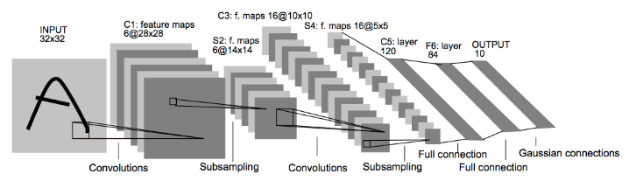
From MLP to Deep Learning
Early attempts at deeper NN train one level at a time
In 1989, LeCun’s AT&T handwritten zip code recognizer
Trained entirely using backpropagation
3 hidden layers
By 1998, most of the major components (except ReLU) of convolutional neural networks have been established
Convolutional layer
Pooling (or subsampling) layer
Backpropagation
In 2006, Hinton rebranded NN “deep learning” (DL)
In 2011, ReLU introduced to solve vanishing gradient (“Deep Sparse Rectifier Neural Networks”, 2011 Glorot et al.)
LeNet-5

Slide 26
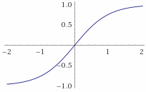
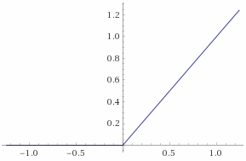
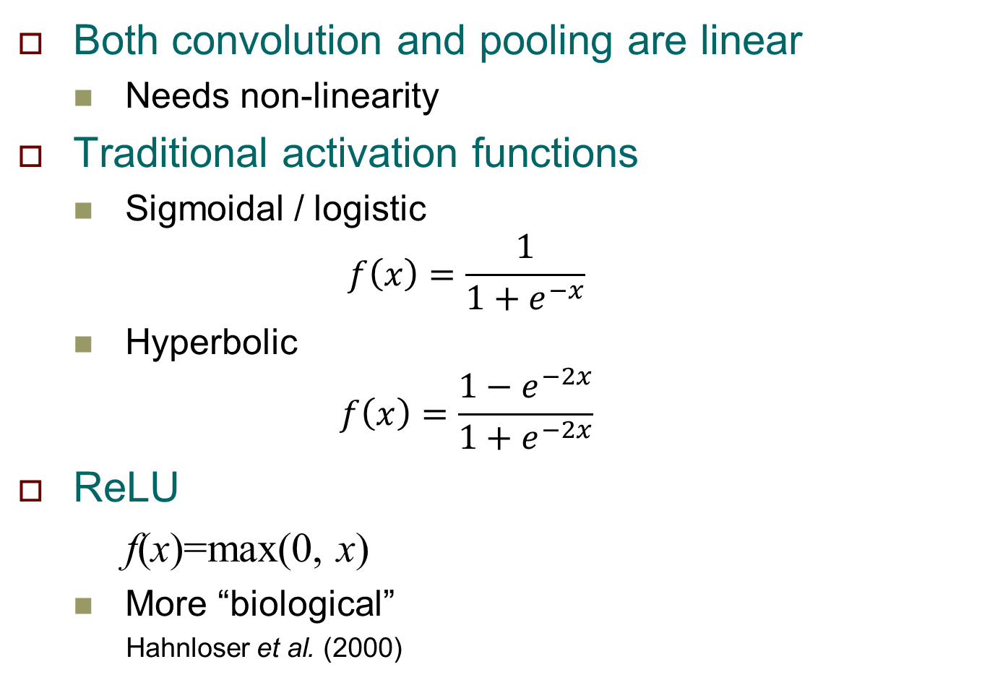
Rectified linear unit (ReLU)
Both convolution and pooling are linear
Needs non-linearity
Traditional activation functions
Sigmoidal / logistic
$$f\left(x\right)=\frac{1}{1+e^{−x}}$$
Hyperbolic
$$f\left(x\right)=\frac{{1−e}^{−2x}}{1+e^{−2x}}$$
ReLU
f(x)=max(0, x)
More “biological”
Hahnloser et al. (2000)
f(x)
x
x
x

Slide 27
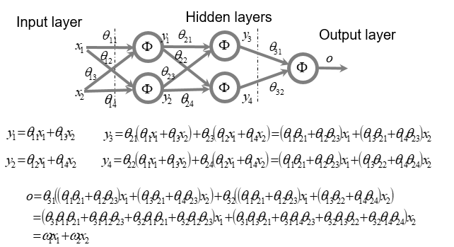
Rectified linear unit (ReLU)
Recall our earlier problem with linear function
Will ReLU give the same problem?

Slide 28
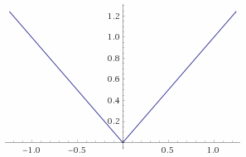
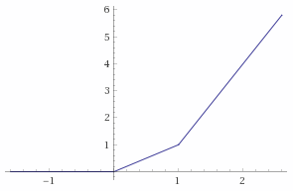

Rectified linear unit (ReLU)
Linear combination of ReLU functions can assume very diverse shapes
$\max\left(0,x\right)+\max\left(0,−x\right)$ $\max\left(0,x\right)+\max\left(0,2x−2\right)$
plot(Piecewise[{{0,x<0},{x,x>0}}] +Piecewise[{{0,2x-2<0},{2x-2,2x-2>0}}]) from x=-1 to 2
Try in http://www.wolframalpha.com/

Slide 29
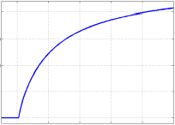
Rectified linear unit (ReLU)
What about this function?

Slide 30
Rectified linear unit (ReLU)
Pros
Solves vanishing gradient problem
Extremely easy to compute (good for GPU)
Similar result to Cybenko’s (“Understanding Deep Neural Networks With Rectified Linear Units”, 2018 Arora et al.)
Cons
Non-differentiable at zero
Unbounded
Dying ReLU problem

Slide 31
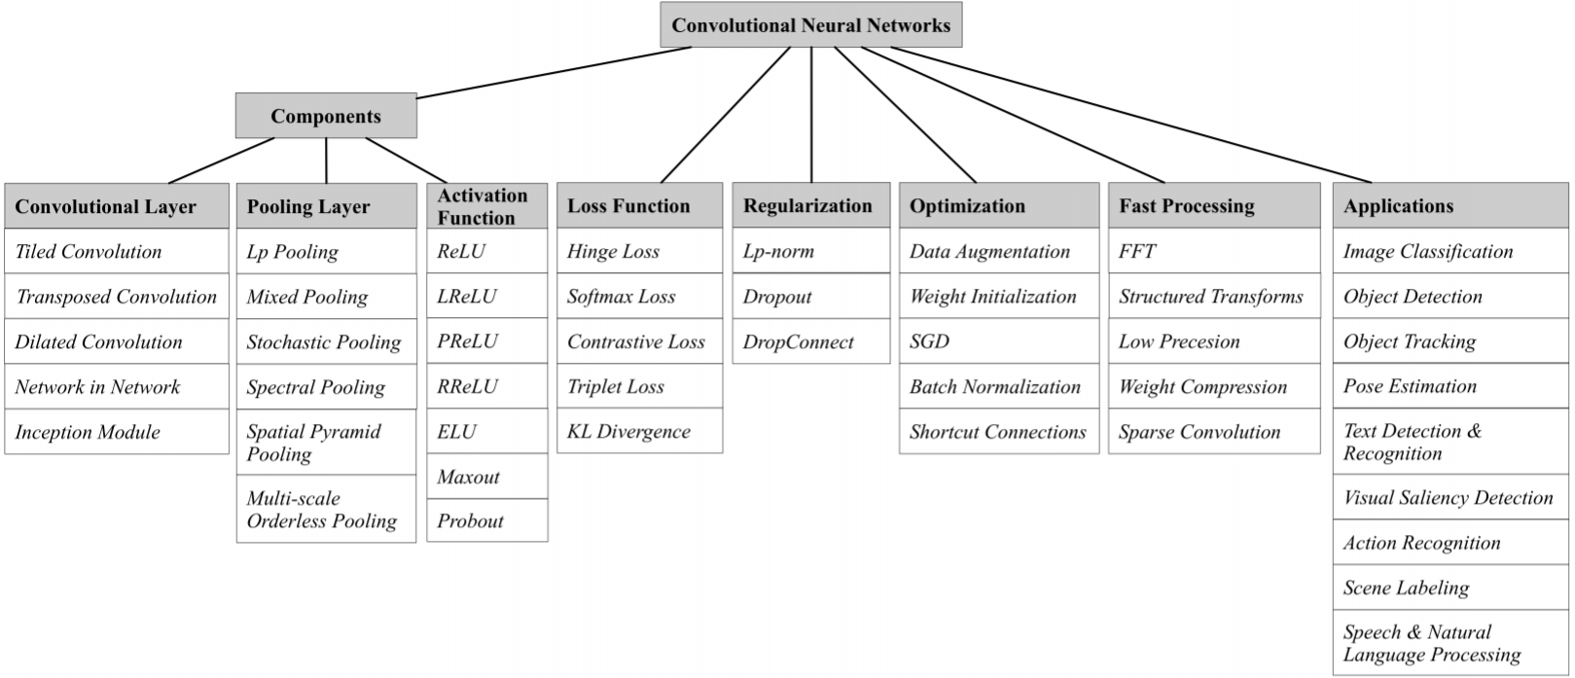
CNN components
“Recent Advances in Convolutional Neural Networks”, 2015 Gu et al.

Slide 32
Why does CNN work
Possibility 1: Cybenko theorem
A model that is sufficiently complex may be able to “memorize” every detail in the images in the training set
Overfitting the data
Possibility 2: Mimics human vision
The interlacing conv and pooling layers, as well as the ReLU function is modeled from human vision

Slide 33
DL Frameworks
Library functions to DL components
Backpropagation gradient computation
GPU-support
Popular frameworks
Theano family
Theano (U of Montreal)
TensorFlow (Google)
Torch family
Torch (NYU)
PyTorch (Facebook)
Caffe family
Caffe (UC Berkeley)
Caffe2 (Facebook)
CNTK (Microsoft)
MXNet (Amazon)
Wrapper
keras (works with Theano, TensorFlow, CNTK)

Slide 34
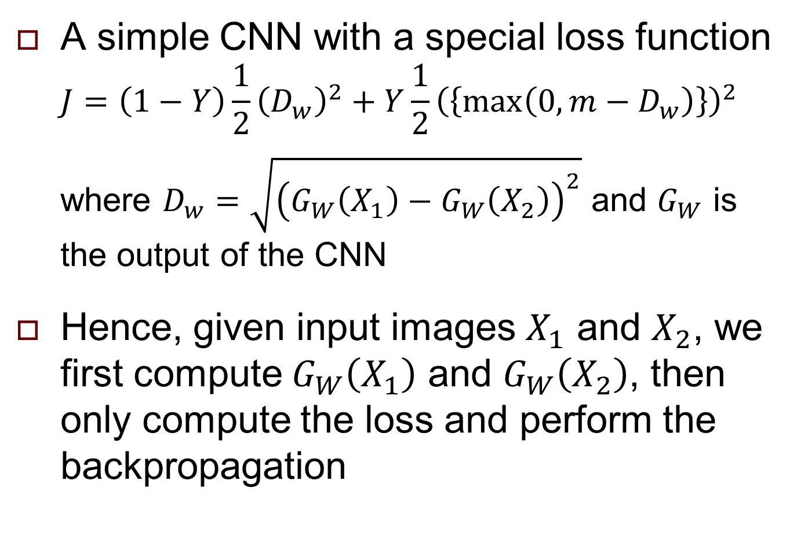
Siamese Network
A simple CNN with a special loss function
$$J=\left(1−Y\right)\frac{1}{2}{\left(D_{w}\right)}^{2}+Y\frac{1}{2}{\left(\left\{max⁡\left(0,m−D_{w}\right)\right\}\right)}^{2}$$
where $D_{w}=\sqrt{{\left(G_{W}\left(X_{1}\right)−G_{W}\left(X_{2}\right)\right)}^{2}}$ and $G_{W}$ is the output of the CNN
Hence, given input images $X_{1}$ and $X_{2}$, we first compute $G_{W}\left(X_{1}\right)$ and $G_{W}\left(X_{2}\right)$, then only compute the loss and perform the backpropagation

